Slide 1
Python
solar_cell_uniformiPy
Patrice Bras
Solid State Electronics

Slide 2
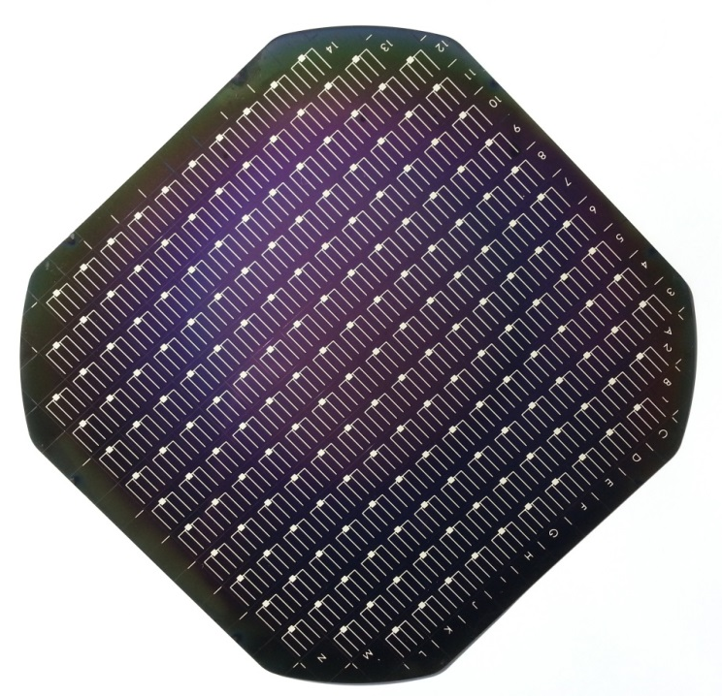
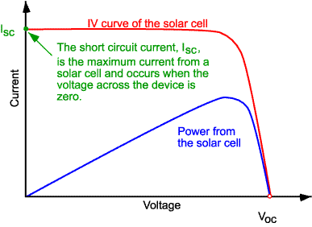
A little bit of background on solar cells
Main parameters
Voc : open circuit voltage
Isc : short circuit current
FF : fill factor
Eta : efficiency
Current-voltage curve of a solar cell
A full size solar cell divided into 184 small cells

Slide 3

solar_cell_uniformiPy

Slide 4
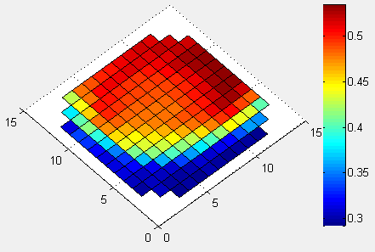
Expected output

