Slide 1


Change the Geomagnetic Field Simulator from .exe to .py File
Backward simulation. initial v_dir is theta = 90, phi = 0
As we see, without too much difference, it speeds up like 5~6 times!
Now every single muon shooting takes at most 4 seconds
This one uses new .py generator
This one uses the .exe file

Slide 2
II. run the backward simulation to get all the data points
including 5 cos theta levels, each one has 20 initial phi data, each of which is composed by 5x5x5 initial points where a 4 muon bundle is shoot.
So by choosing one cos theta level, we have 20 phi evenly displaced from 0 to 2pi, and at each phi 4x5x5x5 = 500 muons are shoot as as a whole muon packet

Slide 3
III. Correction
The result of last part is corrected by removing the final step error.
Then all the related info are extracted.
including: theta, phi, zenith ang, azimuth ang, energy for each muon in a 500 muon packet
Here are some analysis for the result in this part

Slide 4
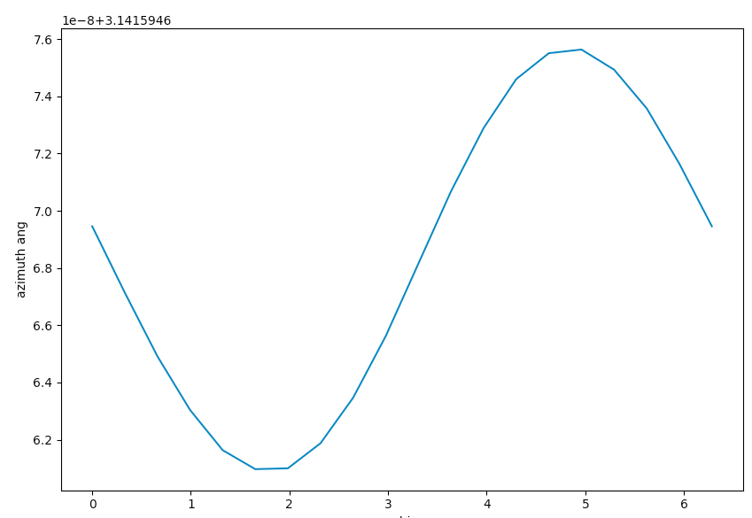
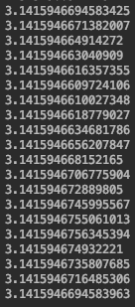
plot for averaged azimuth ang and numerical result (averaged for each muon packet)
phi

Slide 5
Azimuth angle is defined to be the angle with respect to the longitude.
It can be shown using a picture why the azimuth angles are all around pi
But we can still see periodic variation with respect to phi

Slide 6
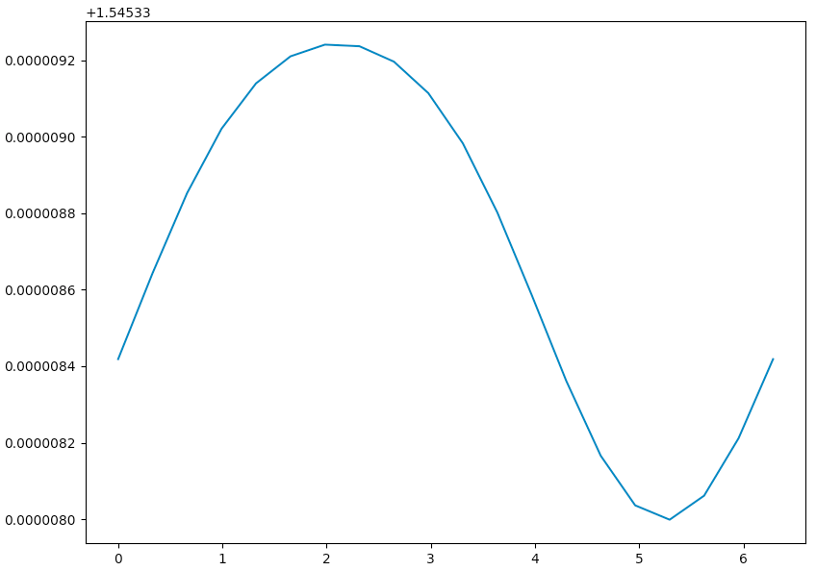
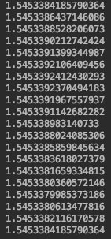
Plot for zenith ang and numerical result
zenith ang
phi

Slide 7
As we see in the flux mapping, the zenith ang is larger at phi = 0 – pi, so muons are likely to get deflected more downward. (Since azimuth ang is around pi here)
For phi = pi – 2pi the zenith ang is smaller, so the muons are not so much likely to get deflected more upward than as phi = 0 - pi
It corresponds to the flux asymmetry we see.

Slide 8
IV. Random Generator
So now we have all 5 parameters for every muon, now we build the random generator to get a random parameter set (theta, phi, zenith, azimuth, E) from one 500 muon packet (which are all muons with similar initial direction but different initial position).
For theta, phi, azimuth we just get the max and min value from all the parameters of this 500 muon packet, then generate a random value in between
(should we use random cos theta? or it does now matter?)
For zenith and E some extra operations need to be done.

Slide 9
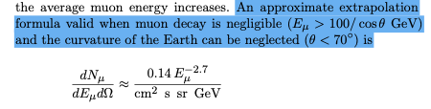


Since the spectrum of zenith and E is:
One thing we can do is to get a 2D list of (E, cos_zenith), then reshape it to 1D list
Then use this method to get a value
The problem is: list of E is too long! from 10^21 to 10^40 for theta = 90. Now this factor list is too long to be stored and generated quickly
(For depth 1500m, dis is around 138km, depth 2500m, dis is around 178km so huge energy difference according to E = A e^{a*dis})

Slide 10
Method to solve this: Separation of variable
Since the equation of (E, cos_zenith) is E^-3.7 and sec_zenith scale, and according to the zenith list we know that zenith angles are all around 1.545, we assume that most of the influence come from the E part
So we use C * E^-3.7 * sec_theta to separate the variable. Since C is a constant and does not matter in a normalized factor in np.random.choice(list, p=factor), we can just use E^-3.7 and sec_theta
So we deal with E part first, however the problem of too long E still exists
Solution:
Now use a multistep method: First divide E (which ranges from 10^21 to 10^40) evenly into 1000 parts, then do an integration of E^-3.7 for each part, the result for each part is used as a factor list
Then perform np.random.choice to select one result in this list
repeat for 20 times, we get (1000)^20 accuracy, enough!

Slide 11
Then we use the selected E to get a zenith:
So now we get both E and zenith

Slide 12
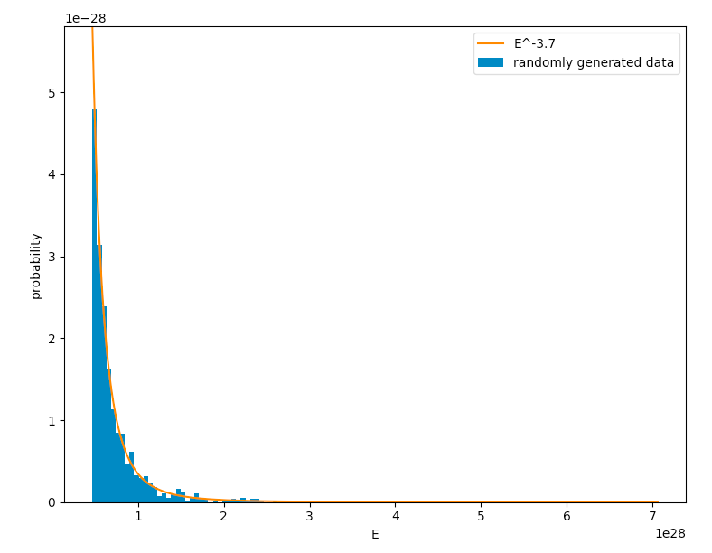
Test for E:
As we see the randomly generated 5000 data points, after normalization, match the E^-3.7 result (also normalized)

Slide 13
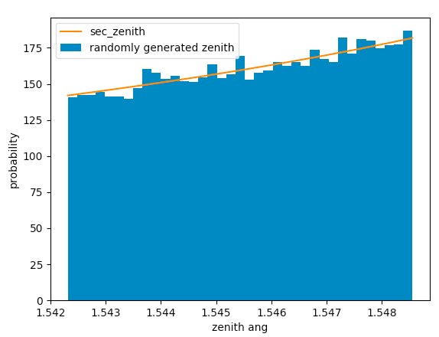
test for zenith ang
Randomly generate 50000 values using the previous procedure, and the result is normalized and compared with the sec function in this range

Slide 14
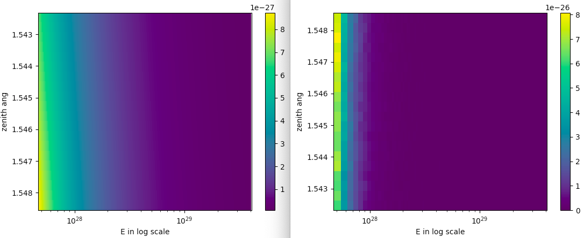
Comparison using 2D plot
using separation of variable described above to get 50000 (E, zenith pairs)
using full function
As we see the scale of color bar are not exactly the same. The reason is that the full function is now the idealized E^-3.7 * sec zenith , which is the one used on left. However both patterns are similar

Slide 15
V. Forward Simulation
Now we have the random generator which gives us parameters: (theta, phi, zenith, azimuth, E)
With this pair as the starting point, the differences between forward and backward simulation is that 1. the -1 multiplied to the geomagnetic field is removed, to make the direction of deflection correct. 2. The energy is decreased now in each iteration
Also some changes are added at the end of each iteration:
Now the trajectory between pre_pos (the position this muon takes at the beginning of this iteration round) and pos (the position this muon takes at the end of this iteration round) is divided by 100 points
For each point, its position is check in such a away that if it lies within the range of detector, which is centered at (0, 0, 6369000) with side length 1km, the counter n gets increased by 1 and simulation stops. N also + 1
Or if the energy drops below 1GeV, the simulation stops with only N + 1 (a miss)
So we get number of hits n vs number of total muons N

Slide 16
test of forward simulation:
The basic idea is that given an initial velocity and E to backward simulation, we can get the final (theta, phi, zenith, azimuth, E). Then we use it to run the forward simulation and see if it can get a reach (which is should get)
Then we change the (theta, phi, zenith, azimuth, E) slightly, see if we get a miss ending somewhere around.
Then we increase the B field to see if a smaller change could get a miss

Slide 17
test1:
Run the backward simulation with
initial v = [-1, 0, 0]
E = 1GeV
pos = [400, 400, 6369400]
so it represents a muon we received from positive x dir
the result is final_v = [-9.99999904e-01 4.32077163e-04 -7.13014482e-05]
E = 2.3146460908525178e+32
pos = [1.42324601e+05 3.39000474e+02 6.36941007e+06]
The use this as input to run the forward simulator, we get a hit firstly at:
pos = [4.99836095e+02 3.99984463e+02 6.36940001e+06]
E = 25135611224.19789 = 25GeV
and min distance between initial pos and this final pos is 0.004029486481588753 m

Slide 18
test2:
the result is final_v = [-9.99999904e-01 4.32077163e-04 -7.13014482e-05]
E = 2.3146460908525178e+32
pos = [1.42324601e+05 3.39000474e+02 6.36941007e+06]
But instead of using this, we change it slightly into
v = [-9.99999904e-01 12.32077163e-04 -7.13014482e-05]
E = 2.3146460908525178e+32
pos = [1.42324601e+05 3.39000474e+02 6.36941007e+06]
The use this as input to run the forward simulator, we get a miss:
and min distance between initial pos and this final pos is 113.53941602874501 m

Slide 19
test3:
use the same input, but
B = B_z * 10000 so only z direction with increased magnitude
the result is final_v = [ 0.38089862 -0.92461681 0.]
E = 4.164216943694575e+32
pos = [ -56292.52123554 131208.9777008 6369400]
The use this as input to run the forward simulator, we get a hit firstly at:
pos = [-4.98855811e+02 2.67160698e+02 6.36940000e+06]
E = 303990432522.9729 = 30GeV
and min distance between initial pos and this final pos is 0.5017834737643417 m

Slide 20
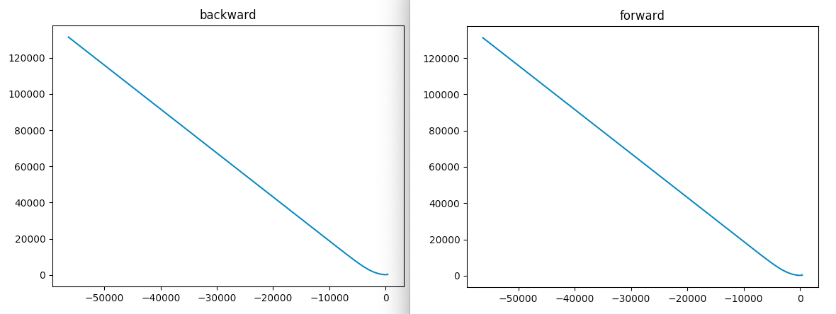
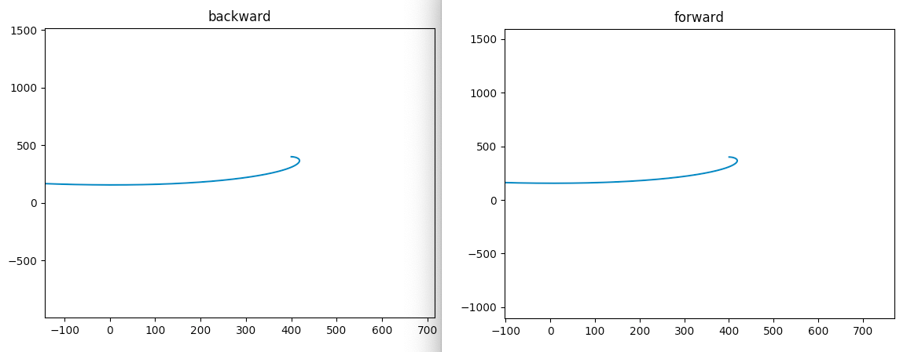
trajectory plot
general
zoom in

Slide 21
test4:
use the same input, but
B = B_z * 10000 so only z direction with increased magnitude
the result is final_v = [ 0.38089862 -0.92461681 0.]
E = 4.164216943694575e+32
pos = [ -56292.52123554 131208.9777008 6369400]
But instead of using this, we change it slightly into
the result is final_v = [ 0.39089862 -0.92461681 0.]
E = 4.164216943694575e+32
pos = [ -56292.52123554 131208.9777008 6369400]
The use this as input to run the forward simulator, we get a miss:
and min distance between initial pos and this final pos is 472.867785267966 m

Slide 22
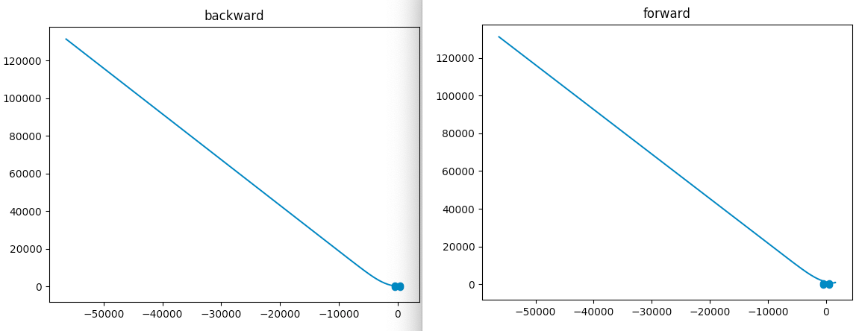
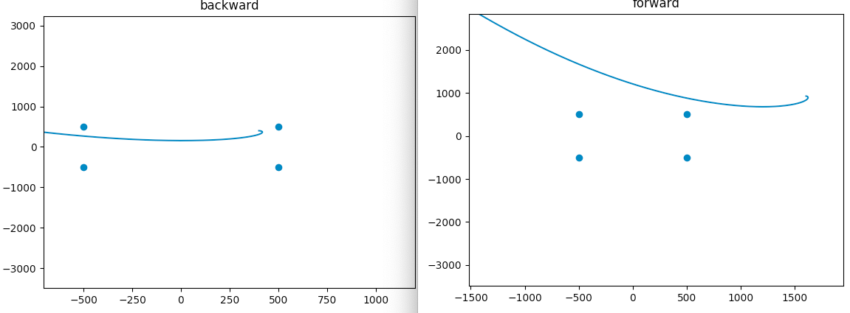
trajectory comparsion

Slide 23
VI. Error Analysis
We want to get the ratio r = #hit/N, representing the probability that a randomly generated muon can reach the detector.
So each muon can either hit with P = r or miss with P = 1-r, which is a binominal distribution, when N is large it becomes a gaussian.
So the statistical uncertainty of #hit is sqrt(N * r)
So the r we get has uncertainty:
sqrt(N * r * (1-r)) / N = sqrt(r * (1-r) / N)
We can use this to calculate the N we need to limit the statistical error

Slide 24
For cos_theta = 0, we expect asymmetry to be around 20%
After some test run, the r = #hit / N is roughly 0.011
So the 20% asymmetry causes a fluctuation around 0.009 to 0.012
So we need to limit the statistical uncertainty to 0.0001 scale
So:
r = 0.011
sqrt(r * (1-r) / N) = 0.0001
We get roughly N = 1087900
#hit = 12000
is needed to satisfy the statistical need
However, shooting 1000000 muons in each 6 phi dir we pick takes 277 days on a single cpu

Slide 25
VII. Current Result
According to PART II
Firstly, the backward simulation is run so that we have one muon packet for each of cos_theta, phi pair.
Now we pick cos_theta = 0, and select num 3, 6, 9, 12, 15, 18 out of 20 phi values we run backward simulation on.
For these 6 muon packets, we run forward simulation to get r = #hit/N
Currently:

Slide 26
Current result:
 | 3 | 6 | 9 | 12 | 15 | 18
run1 | 17939 | 16889 | 17999 | 17921 | 17419 | 16606
run2 | 18515 | 18647 | 16826 | 18849 | 17406 | 18544
run3 | 20997 | 17290 | 16994 | 19369 | 17333 | 19476
run4 | 18503 | 16694 | 17824 | 16216 | 19394 | 18246
run5 | 19757 | 19139 | 15209 | 19174 | 17107 | 16937
run6 | 20328 | 19139 | 16710 | 18379 | 17041 | 15120
run7 | 17397 | 20360 | 16641 | 17125 | 19068 | 17505
Num of hit | 1400 | 1400 | 1400 | 1400 | 1400 | 1400
N_sum | 133436 | 128158 | 118203 | 127033 | 124723 | 122434
r | 1.05% | 1.09% | 1.18% | 1.1% | 1.12% | 1.14%
extend of asymmetry is 6%, not the expected 20%!

Slide 27
With current 1400 hits, N roughly 125000, and r roughly 0.011, we can estimate the error in r to be:
err = sqrt(r * (1 - r) / N) = 0.0003, acceptable but still relatively large
The result is not very satisfying, we do not see the expected asymmetry
Possible reason:
The phi I pick does not include minimum or maximum, so we do not have enough points to show the asymmetry.
Or
The error is still to large

Slide 28
VIII. A*Omega issue
we have agreed that we should use r = #hit/N * A * Omega
However for every muon packet which contains 125 * 4 muons, its hard to decide the precise area A bounded by the outer most muons. Instead I tried a naïve way by get the largest theta & phi and smallest theta & phi, then use the 4 coordinates obtained from their combination to calculate the area.
Same procedure to get the solid angle
However the result is strange.

Slide 29
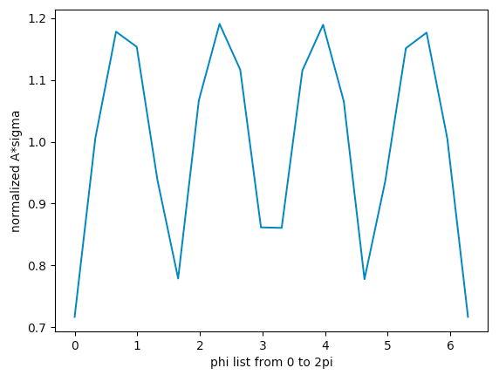
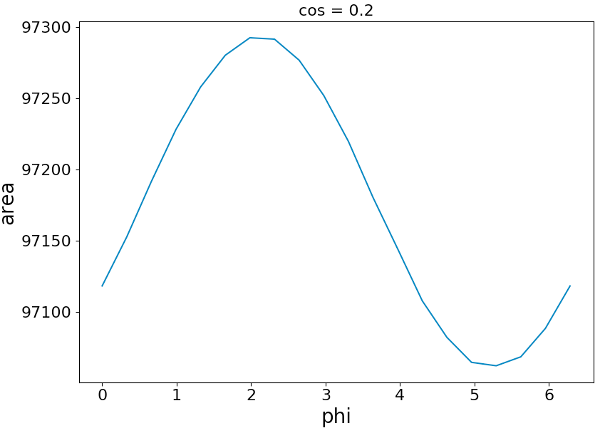
result:
This is the old plot from last presentation
It is the area A bounded by a 4 muon bundle located at center of detector
This plot is the A*Omega plot using the method mentioned before
A here is the A bounded by 500 muon packet, with min&max theta and min&max phi

Slide 30
As we can see, if we consider a 4-muon bundle starting from the same initial location, the asymmetry is only 1%.
If we consider 125 4-muon bundles as a packet, then the asymmetry is 30%
The reason can be seen from the pattern of the plot:
As we see, all maximum values come from phi values which
correspond to corner of icecube detector
all min values come from phi values which
correspond to side of icecube detector

Slide 31
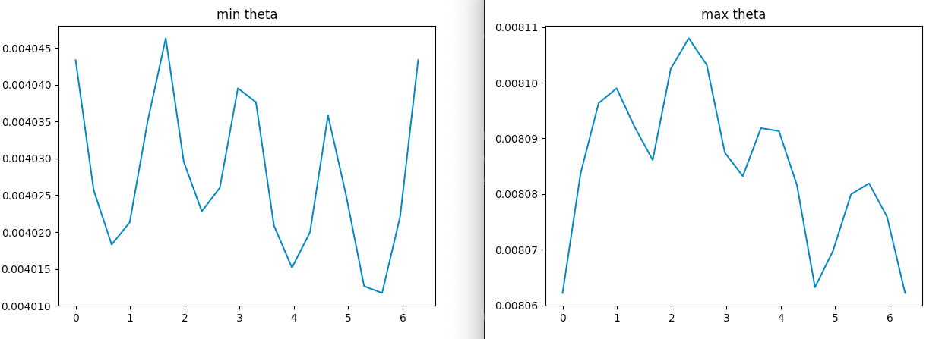
The reason is that at since IceCube is a cube, at 4 sides of the detector, the min theta is larger, and the max theta is smaller. At 4 corners of the detector, the min theta is smaller, and the max theta is larger. So the area we calculated in this way has much more asymmetry.
However if we consider only one initial position with a 4 muon bundle, this issue will not appear, as we see in previous figure on the right
(Can be clearer shown using a picture)
s c s c s c s c s
s c s c s c s c s

Slide 32
Question:
This asymmetry we get in A*Omega seems to dominate over anything else, should we deal with it, or it is what we expect?
How to overcome the issue that the statistical accuracy requires too much time?
Now every backward simulation use 10 GeV as starting energy should we include more energy range, maybe 1 GeV?
If so, will the ending condition of forward simulation also be changed to match?

