Slide 1

TCP-HyStart: A Modified TCP Slow Start
CSE322 NS2 Project
HAZ Sameen Shahgir
1805053

Slide 2
Acknowledgements
Ha, Sangtae, and Injong Rhee. "Taming the elephants: New TCP slow start." Computer Networks 55.9 (2011): 2092-2110.

Slide 3
Standard Slow Start in TCP
Standard TCP doubles the congestion window (cwnd) for every round-trip time (RTT) during slow start
The exponential growth of cwnd results in burst packet losses.
Since the cwnd overshoots the path capacity an amount as large as the entire bandwidth-delay product (BDP), in large BDP networks, this overshoot causes strong disruption in the networks.

Slide 4
Hybrid Start (HyStart)
The algorithm does not change the doubling of cwnd during slow start
Based on clues from ACK spacing and round-trip delays it heuristically finds safe exit points
Safe Exit Points: when to finish slow start and move to congestion avoidance before cwnd overshoots.
When packet losses occur during slow start, HyStart behaves in the same way as the original slow start protocol.

Slide 5
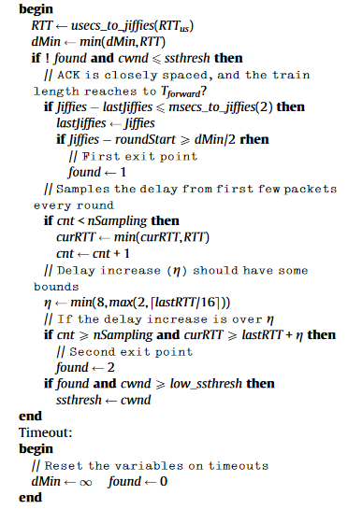
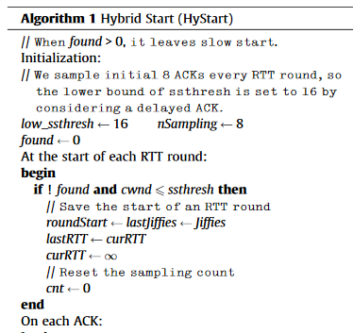

Slide 6
HyStart Algorithm
If a rapid succession of ACK from receiver is detected
hystart_ack_train = true
Start sampling RTT up to a certain HYSTART_MIN_SAMPLES
if sampled RTT > THRESHOLD
hystart_delay = true
If (hystart_ack_train|| hystart_delay)
cwnd_upperbound = curr_cwnd

