Slide 1

Efficient and parallel Kohn-Sham DFT developments for large molecular systems
Simen Reine
CTCC Centre for Theoretical and Computation Chemistry, University of Oslo,
Hamn i Senja, 13 July 2012

Slide 2
Outline
Kohn-Sham DFT
Linear-scaling DFT
Density-fitting approximation
Parallelization strategy
Parallel distributed approach
Current status
Future Developments

Slide 3
Kohn-Sham DFT
In density-functional theory (DFT) the wave function Ψ(x₁,…,x_{N}) is replaced by the much simpler electron density ρ(r)
The universal density functional F[ρ] is unknown
In Kohn-Sham DFT the density is represented by a single Slater determinant Ψ_{KS}=|φ₁,…,φ_{N}| - reintroduce MOs φ_{i}(r)
For pure DFT there is no orbital dependent exchange (μ=0)

Slide 4
Kohn-Sham DFT
LCAO and AO density matrix
Iterative SCF energy optimization procedure
Kohn-Sham matrix
Four bottlenecks: Coulomb (J), exchange (K), exchange-correlation (XC), wave-function optimization (RH/DIIS, ARH)

Slide 5
Linear scaling DFT
Cauchy-Schwartz screening M. Häser and R. Ahlrichs, J. Comp. Chem. 10, 104 (1989)
LinK for exchange C. Ochsenfeld, C. A. White and M. Head-Gordon, J. Chem. Phys. 109, 1663 (1998)
FMM for Coulomb C. A. White, B. G. Johnson, P. M. W. Gill and M. Head-Gordon, Chem. Phys. Lett. 230, 8 (1994)
XC by atomic grids - linear scaling in nature A. D. Becke, J. Chem. Phys. 88, 2547 (1988), J. M. Perez-Jorda, W. Jang, Chem. Phys. Lett. 241 (1995) 469, O. Treutler, R. Ahlrichs, J. Chem. Phys. 102, 346 (1995)
Wave-function optimization - linear scaling for sparse matrices P. Sałek, et. al, J. Chem. Phys. 126, 114110 (2007)

Slide 6
Density fitting
Coulomb J. L. Whitten, J. Chem. Phys. 58, 4496 (1973), E. J. Baerends, D. E. Ellis and P. Ros, Chem. Phys. 2, 41 (1973), B. I. Dunlap, J. W. D. Connolly and J. R. Sabin, J. Chem. Phys. 71, 4993 (1979)
Speed-up factor 3-60 for systems up to 10 000 basis functions!
Exchange F. Weigend, Phys. Chem. Chem. Phys. 4, 4285 (2002), R. Polly, H.-J. Werner, F. R. Manby and P. J. Knowles, Mol. Phys. 102, 2311 (2004)
Speed-up factors 2-40 up to 1000 basis functions – scaling wall!

Slide 7
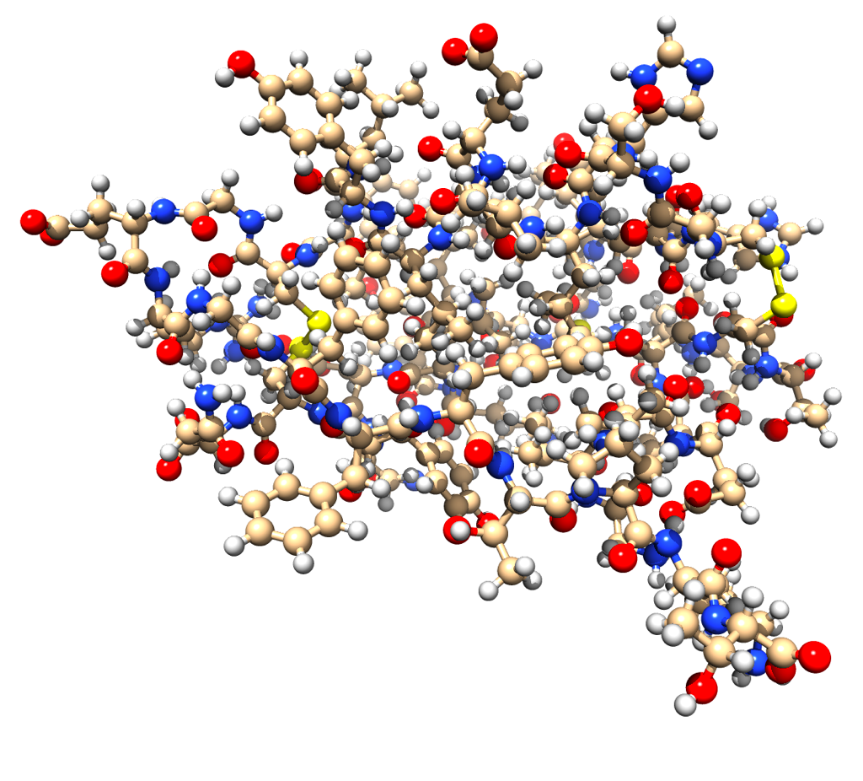
A Routine Calculation
An insulin monomer containing 787 atoms on a single node (12 threads)
BLYP/cc-pVDZ(Ahlrichs-Coulomb-Fit)
787 Atoms
7604 Basis functions
20750 Aux Basis functions
Average wall time for
KS matrix build = 9 min 39s
1 Full Matrix = 0.46 GB
Peak Memory usage
57 Full Matrices = 26.37 GB

Slide 8
A Routine Calculation
An insulin monomer containing 787 atoms on a single node (12 threads)
CAMB3LYP/cc-pVDZ(Ahlrichs-Coulomb-Fit)
787 Atoms
7604 Basis functions
20750 Aux Basis functions
Average wall time for
KS matrix build = 4 hours 44 min
LinK 4 hours 34 min
xc 5 min 55 sec
df-J 3 min 43 sec
(reg-J 2 hours 39 min)

Slide 9
Larger calculations!
HF/cc-pVTZ
787 Atoms
17522 Basis functions
1 Full Matrix = 2.46 GB
44 Full Matrices = 107.51 GB
Average wall time for
Fock matrix build takes 74 hours
Coulomb 22 hours
exchange 52 hours
Speed for Exchange Matrix!
Memory Requirements!

Slide 10
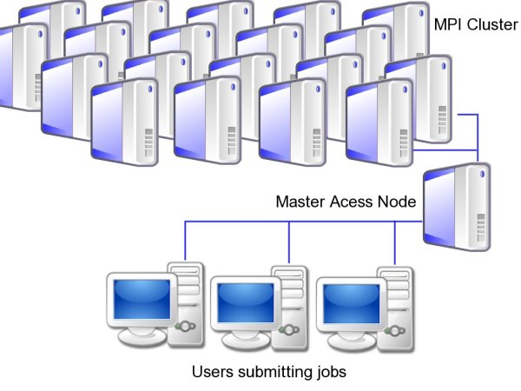
Parallelization

Slide 11
MPI strategy
Matrix Operations – libraries
  PBLAS, SCALAPACK
Integral evaluation – specialized framework
Task manager based on a priori time estimate

Slide 12
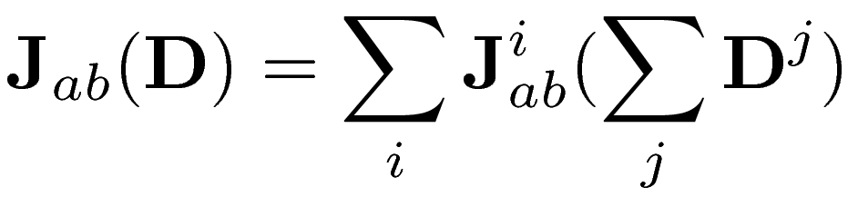

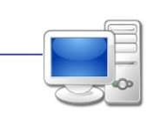
Parallel distributed SCF
D =
J1( ) =
J1( ) =
J1( ) =
J1( ) =
J1 =
+
+
+
=

Slide 13
Parallel distributed SCF
D =
J1( ) =
J1( ) =
J1( ) =
J1( ) =
J2( ) =
J2( ) =
J2( ) =
J2( ) =
J3( ) =
J3( ) =
J3( ) =
J3( ) =
J4( ) =
J4( ) =
J4( ) =
J4( ) =
J1 =
+
+
+
=
J2 =
+
+
+
=
J3 =
+
+
+
=
J4 =
+
+
+
=
J =

Slide 14
Parallel distributed SCF
D =
F =
Matrix multiplication: SCALAPACK and PBLAS
Uses 2d-cyclic parallel distributed matrices
Cannot be used efficiently for integral evaluation
Need proper interfacing!

Slide 15
A Routine Calculation
An insulin monomer containing 787 atoms – parallel run
BLYP/cc-pVDZ
787 Atoms
7604 Basis functions
Wall time 32 cores
SCF 3 hours 55 min
regJ 3 hours 46 min
xc 2 min 50 sec
dens 6 min 43 sec
Wall time 1024 cores
SCF iteration 12 min 23 sec
regJ 9 min 59 sec
xc 12 sec
dens 2 min 11 sec
Speed up factor 19 (ideal 32)

Slide 16
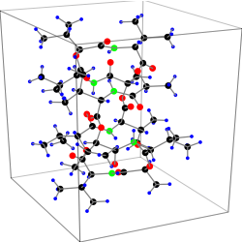
Dynamics
Valinomycine, AIMD dynamics
BLYP/6-31G**(df-def2)
168 Atoms
1542 Basis functions
Parallel run 64 cores
Time step 2 min 4 sec
Energy 1 min 46 sec
Forces 16 sec

Slide 17
Feature of LSDALTON2011
Started in 2006 by Poul Jørgensen and Trygve Helgaker
Goal: To treat Large Molecular Systems
Efficient and linear-scaling HF and DFT code (OpenMP parallel) Restricted and unrestricted
No Point Group symmetry
Efficient linear scaling methodology (memory and computations)
Flexible (dynamic memory allocation)
Modern Modular code (no common blocks)
Fortran 90
Released 2011

Slide 18
Feature of LSDALTON2011
Robust and efficient wave-function optimization procedures (Trilevel, ARH)
Efficient and linear-scaling integral code
Quasi-Newton based methods for geometry optimizations
Electric properties
  Excitation energies, Polarizabilities and first hyperpolarizabilities, Damped and un-damped two-photon absorption, Permanent dipole moment of ground and excited states, Regular and excited state gradients, Second hyperpolarizabilities (HF only)

Slide 19
Development Version: LSDALTON
Local Molecular Orbitals
Divide-Expand-Consolidate CC (MP2,CCSD)
MP2-F12, CCSD-F12
Magnetic Properties (MCD, NMR shielding)
Improved Integral Code
Hybrid MPI/OpenMP parallelism
PBLAS/ScaLapack
PBC code
Dynamics
Cmake build system
PointCharges – ChemShell (QM/MM)
Ghost Orbitals – BSSE – counterpoise correction

Slide 20
Future Development
Fast Exchange (PARI, ADMM, COSX)
Improved MPI
Divide-Expand-Consolidate (DEC) CC
Higher order derivatives
Point-group symmetry
OpenRSP

Slide 21
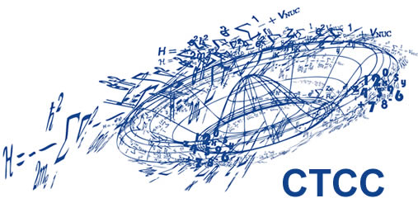
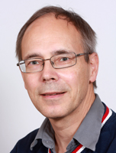




Acknowledgments
Trygve Helgaker
Thomas Kjærgaard
Patrick Merlot
Johannes Rekkedal
Vladimir Rybkin
Erik Tellgren
Vebjørn Bakken
Branislav Jansik
And you for your attention!
Notes:
For you attention and patience

