Slide 1
CST8917 Final Assignment
Expense Approval
Workflow
Durable Functions vs Logic Apps + Service Bus
Dharti Patel • April 21, 2026

Slide 2
Agenda
01
Business problem & workflow rules
02
Two architectures side-by-side
03
Live demo: test scenarios & evidence
04
Comparison across 6 dimensions
05
Recommendation & lessons learned
CST8917 Final • Dharti Patel
2 / 15

Slide 3
Business Rules
The same workflow, implemented two ways
Input Fields
Decision Flow
employee_name
employee_email
amount (number)
category (travel, meals, supplies,
equipment, software, other)
description
manager_email
Validate input
Amount < $100 → auto-approve
Amount ≥ $100 → manager approves/rejects
No response in window → escalate
Invalid input → reject
Notify employee via email
CST8917 Final • Dharti Patel
3 / 15

Slide 4
Version A
Durable Functions
HTTP Client
(Starts orchestration)
Key Characteristics
✓
Code-first
Orchestrator Function
(Stateful, checkpointed)
Python orchestrator + activity functions
✓
Stateful
Activity: Validate
State checkpointed to Azure Storage
Activity: Send Approval Email
✓
Native human-in-loop
task_any([event, timer]) is built-in
wait_for_external_event OR timer (task_any)
✓
Testable
Activity: Notify Employee
Unit-test activities + mock orchestrator context
CST8917 Final • Dharti Patel
4 / 15

Slide 5
Version B
Logic Apps + Service Bus
Service Bus Queue
expense-requests
Logic App (Consumption)
cst8917-expense-logic
Azure Function
validate
Service Bus Topic • expense-outcomes
approved
rejected
escalated
SqlFilter: outcome = 'approved'
SqlFilter: outcome = 'rejected'
SqlFilter: outcome = 'escalated'
Message publishes to topic with custom property `outcome`; SQL filters route to the matching subscription.
CST8917 Final • Dharti Patel
5 / 15

Slide 6
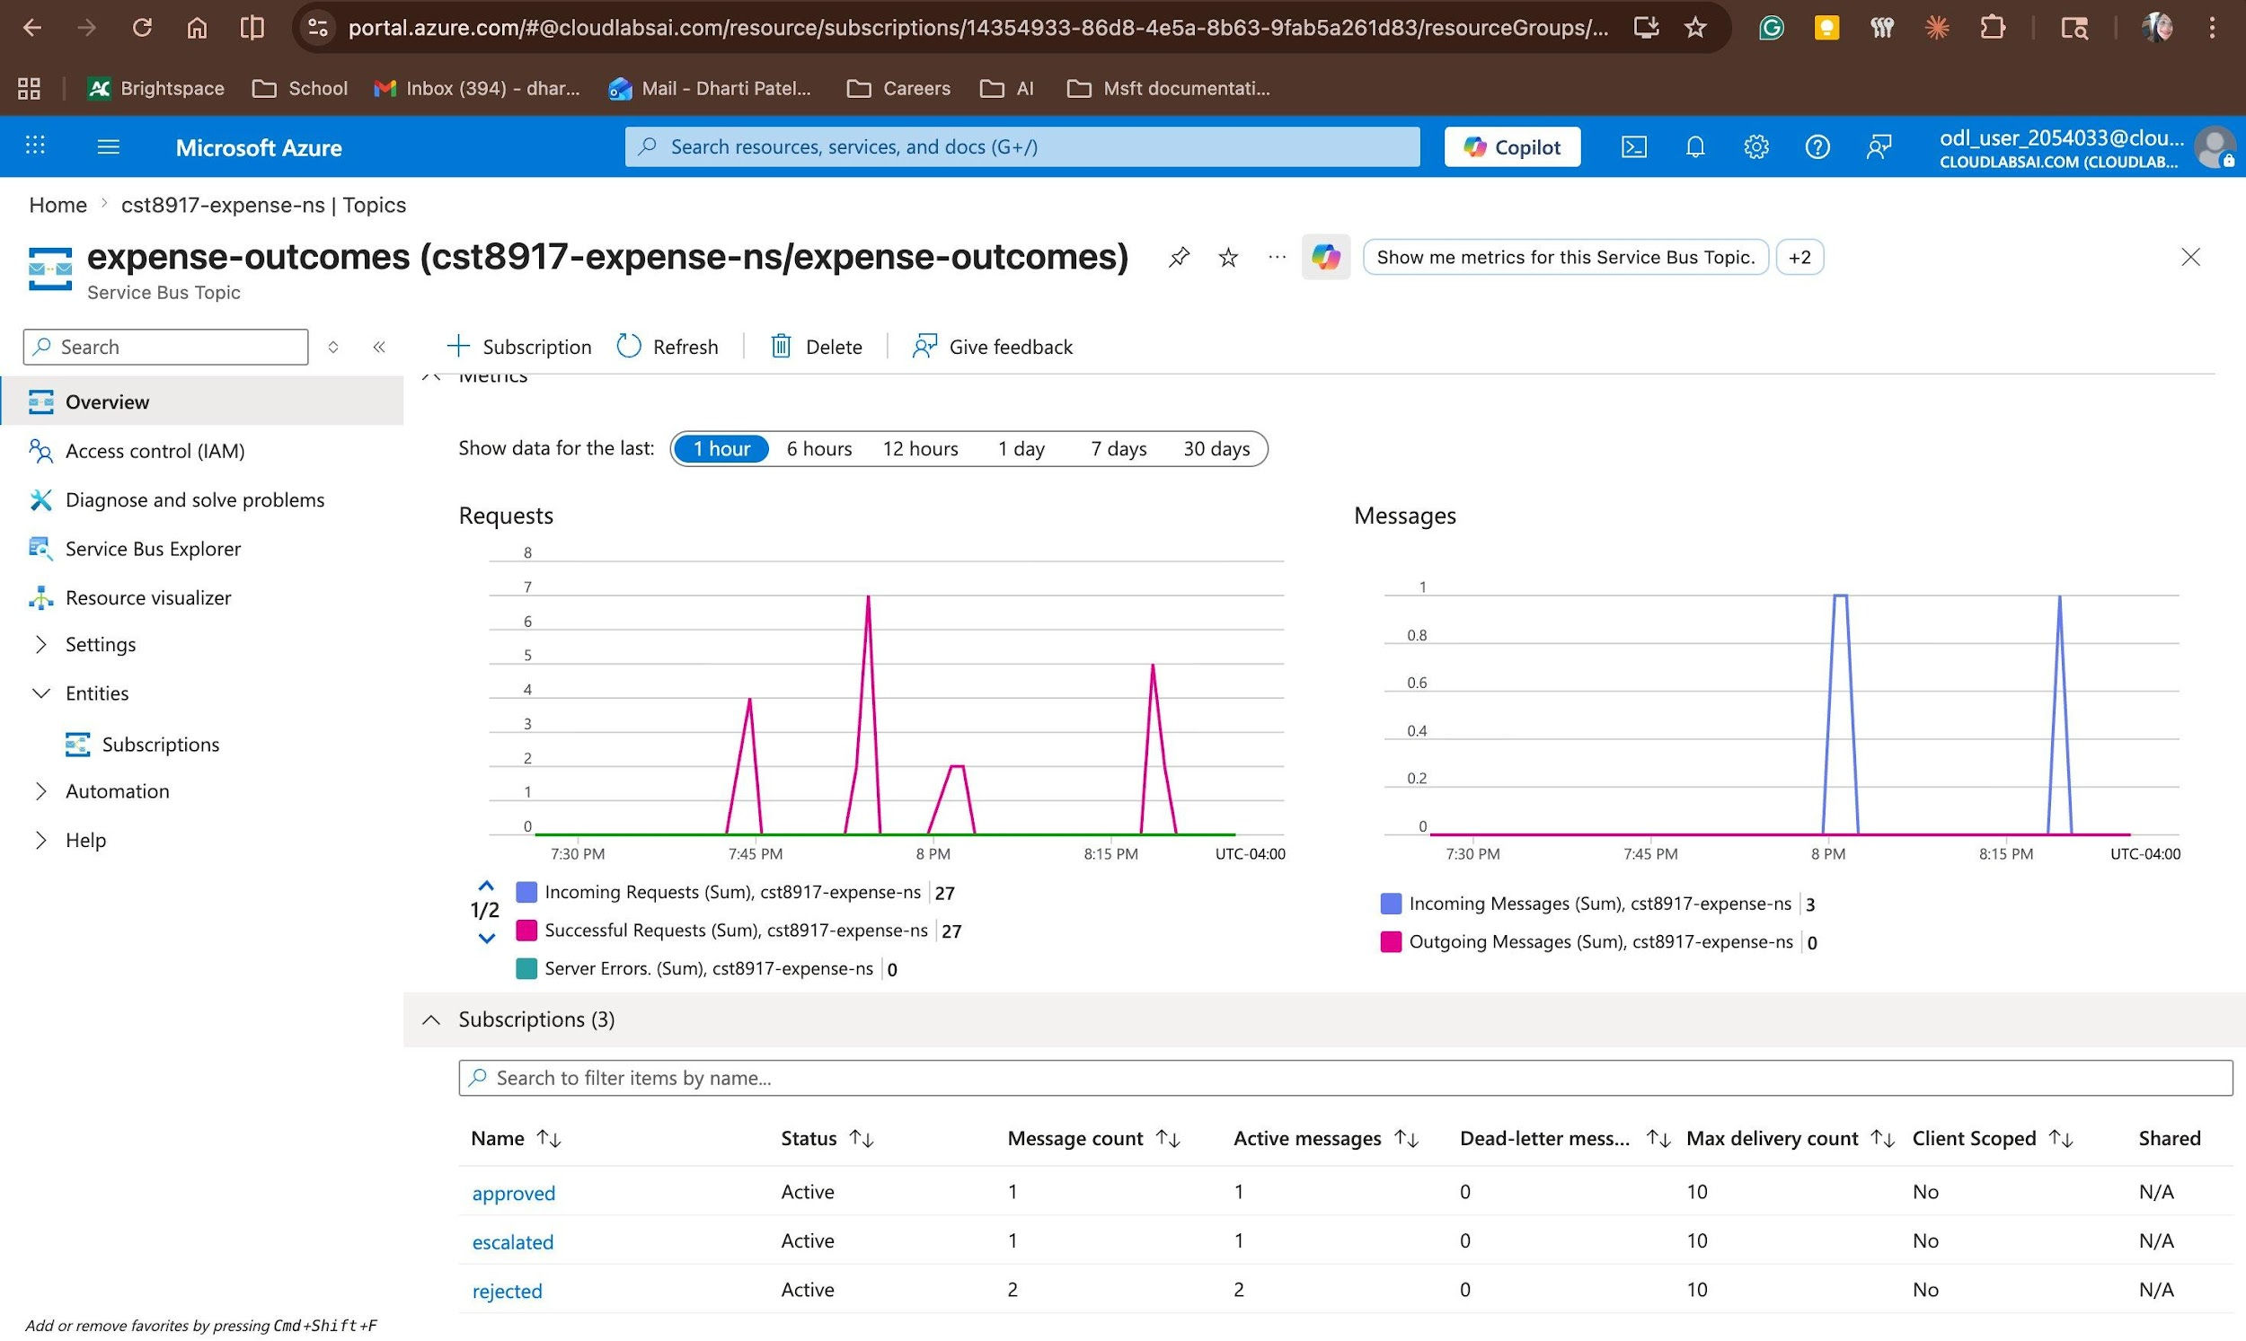
Live Demo • End-to-End Evidence
6 scenarios tested on Version B — topic routing verified across all three outcome paths
Scenarios
✓ Auto-approve (< $100)
✓ Manager approves ($250)
✓ Manager rejects ($500)
◐ Escalation ($150)
✓ Missing fields
✓ Invalid category
◐ Partial — see Lessons Learned
expense-outcomes • all 3 subscriptions populated
CST8917 Final • Dharti Patel
6 / 15

Slide 7
1 • Development Experience
Durable Functions
Logic Apps
Slower to start
Environment setup, programming model conceptually.
Real productivity once scaffolded
IntelliSense, debugger, stack traces, Python idioms.
Faster initial cost of entry
Drag-and-drop skeleton before writing expressions.
Productivity evaporates with complexity
Expressions have no type checking, no autocomplete, no inline docs.
CST8917 Final • Dharti Patel
7 / 15

Slide 8
2 • Testability
Durable Functions wins decisively
Activity functions = plain Python, unit-testable with pytest. Orchestrator testable with DurableOrchestrationContext mock.
Logic Apps has no local unit test story
No local-first development for Consumption-tier workflows
Only way to verify a branch: send a real message and inspect run history
During debugging, could not easily isolate whether failure was in Parse_JSON, the Azure Function, or topic publish
All three ran together inside a single cloud execution
CST8917 Final • Dharti Patel
8 / 15

Slide 9
3 • Error Handling
A real bug I hit — and what each platform would have done with it
The bug
@result('Manager_Approval_Scope', 'Succeeded')[0]['status']
Empty array access when scope times out → runtime error → whole run fails opaquely
Durable Functions would have…
Logic Apps surfaced…
Caught it at authoring time
IndexError on empty list is a Python stack trace, not a workflow-level mystery failure.
Wrapped in try/except
Compensation logic runs as normal Python.
A generic red X
"ActionFailed. No dependent actions succeeded" — on the parent action, not the real culprit.
No retry option that fits
Built-in retry policy doesn't help a logic bug.
CST8917 Final • Dharti Patel
9 / 15

Slide 10
4 • Human Interaction Pattern
Where the two platforms diverge most sharply
Durable Functions
Logic Apps
approval = context.wait_for_external
_event("ManagerDecision")
timer = context.create_timer(deadline)
winner = yield context.task_any(
[approval, timer]
)
ApiConnectionWebhook + @listCallbackUrl()
Works for the happy path, but:
• Callback URLs expire when the run completes
• Clicking old email → "workflow not in Running state"
• Empty result() array trap on timeout
Real user-facing failure mode, not just a dev headache.
One expression. State checkpointed. Events correlated by instance ID.
Architecturally immune to expired-callback bugs.
CST8917 Final • Dharti Patel
10 / 15

Slide 11
5 • Observability
Logic Apps wins the demo
Durable wins the forensics
Visual workflow diagram with green/red checkmarks
Inputs + outputs for every action
One-click App Insights integration
But…
The red X on Check_Valid was two levels ABOVE where the actual bug lived.
Queryable orchestration state
Instance + history tables as structured data
Replay any instance from any checkpoint
Structured logs via App Insights
Trade-off
Requires more setup — enable App Insights, learn the query surface.
CST8917 Final • Dharti Patel
11 / 15

Slide 12
6 • Cost
Estimates using Azure Pricing Calculator; ~75% auto-approved, 25% manager-approved
Scenario | Durable Functions | Logic Apps + Service Bus
100 expenses / day | ~$2 / month | ~$8–12 / month
10,000 expenses / day | ~$40 / month | ~$600–900 / month
Why the gap widens at scale
Logic Apps bills per action execution.
One expense = 10–15 actions inside the workflow; per-action cost accumulates fast.
Durable Functions bills per execution and GB-seconds.
Idle orchestration waits (24-hour approval window) cost nothing — the orchestrator is dehydrated.
CST8917 Final • Dharti Patel
12 / 15

Slide 13
Recommendation
For production: Durable Functions
Human-approval is the core of this workflow. Durable Functions models it natively via wait_for_external_event + timer-in-task-any — eliminating three classes of bugs I hit in Version B.
Logic Apps wins when:
Implementing team is non-developer (business analysts, ops)
Workflow is genuinely low-volume (< 50/day)
Integration with many SaaS systems (Salesforce, ServiceNow, SAP) matters more than programmability
CST8917 Final • Dharti Patel
13 / 15

Slide 14
Lessons Learned
Real bugs, real diagnoses, real fixes
01
Base64 on ContentData
Sending JSON strings to a topic fails silently until you wrap in @base64(string(…)). No error — just no messages. Taught me to always verify via topic metrics.
02
Peek-lock polling concurrency
30-second polling on a non-empty queue spawns competing runs. "Losing" runs fail on lock tokens. Run history inflates with apparent failures that aren't real.
03
Empty array in result() on timeout
@result('Scope', 'Succeeded')[0]['status'] errors out when filter returns []. Fix: @length(…) > 0 first. A try/except in Python catches this at runtime — Logic Apps does not.
CST8917 Final • Dharti Patel
14 / 15

Slide 15
Thank you
Questions?
Dharti Patel
CST8917 — April 21, 2026

