Slide 1

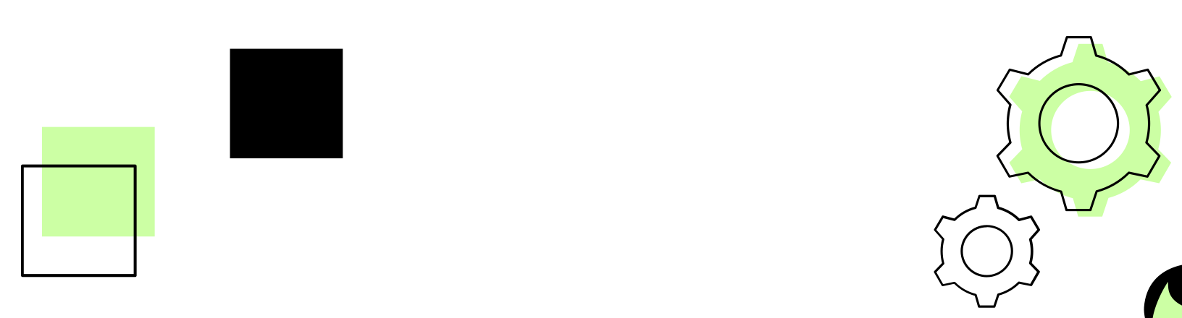

ML 24/25–09 Semantic Analysis Of Textual Data
Presented By : triVision
Presented To : Prof. Damir Dobric/Andreas Peach
SUBJECT: Software Engineering

Slide 2


01
Introduction
TABLE OF
CONTENTS
02
Data Processing
03
Embedding Generation
04
Similarity Calculation
05
Sample Results
06
Conclusion

Slide 3





Team Members
Saquib Attar
1567041
saquib.attar@stud.fra-uas.de
Muhammad Ahsan Ijaz
1566312
muhammad.ijaz@stud.fra-uas.de
Aman Basha Patel
1565430
aman.patel@stud.fra-uas.de

Slide 4

01
INTRODUCTION

Slide 5


What is Semantic Similarity Analysis
Definition
Semantic similarity analysis measures the closeness of textual data based on meaning rather than keywords. It leverages NLP techniques like embeddings and cosine similarity to capture contextual relationships between words, sentences, or documents.

Slide 6
Introduction
With the rise of textual data, semantic similarity analysis helps in document comparison, recommendations, and anomaly detection. While traditional keyword-based methods fall short, modern embedding techniques improve representation but often lack scalability.
This work presents a modular framework integrating data extraction, embedding generation, and cosine similarity for efficient text comparisons. Its scalable and automated design supports applications like document clustering, recommendations, and anomaly detection.

Slide 7




PROJECT WORKFLOW
Data Extraction
Embedding generation
Cosine Similarity
Result
Data processing and cleaning from input documents.
Generation of Embeddings using OpenAI
Calculating Similarity between generated embeddings of both documents.
.csv file with similarity

Slide 8
02
DATA PROCESSING

Slide 9

What is Data Extraction?
Data extraction is the process of retrieving data from various sources and converting it into a usuable format
It involves using specific techniques for structured (e.g., CSV,JSON) or unstructured (e.g., PDFs,DOCX) data to prepare it for analysis.
Unstructured Data Extraction:(PDF,DOCX)
Structured Data Extraction:(JSON,CSV,XML)

Slide 10


Data Extraction Process
Step 1: Preprocessing
Extract data from various formats (e.g., JSON, CSV, TXT, XML, PDF, DOCX, HTML).
Each file type routed to its specific extraction method (e.g., Extractdatafromtext, ExtractdatafromJson)
Handles structured and unstructured data formats.
01

Slide 11

Data Extraction Process
Step 2: Data Cleaning(CleanData())
Removes unnecessary whitespace and symbols.
Segments content into sentences using punctuation delimiters.
Converts text to lowercase for consistency and strips non-alphanumeric characters.
02

Slide 12
Data Extraction Process
Step 3: Data OUTPUT
SaveDataToJSON() method oversees that the extracted and cleaned data is serialized and saved into a structured format.
03
Ensures output directories are created if missing
This data is ready for further processing i.e., the next step embedding.

Slide 13

03
Embeddings Generation

Slide 14

What are Embeddings?
Embeddings are numerical vector representation of textual data
They capture semantic relationship beyond keywords matching.
Types of Embeddings:
Static embeddings: (Word2vec, GloVe)- Word fixed representation.
Contextual Embeddings: (BERT, GPT)- Dynamic based on context.

Slide 15
Embedding Generation Process
Step 1: JSON File Input
Read textual data from JSON file using ReadJsonFileAsync method.
Process JSON as a whole document for embedding generation using method ProcessWholeJson and user also have the option to process JSON word by word or phrase by phrase
01

Slide 16
Embedding Generation Process
Step 2: Embeddings
Embedding Generation is handled using two key methods.
GenerateAndSaveEmbeddingsAsync 2. GenerateChunkedEmbeddingAsync
02
Reads text from JSON files.
Call’s Open AI’s embedding API ( API key stored in environment variable).
Implements batch processing to improve efficiency.
Periodically saves progress to disk (checkpoint system).
Splits documents exceeding token limits (e.g., 8,000 tokens)
Processes each chunk separately while maintaining vector consistency
Averages embeddings of all chunks to form a unified representation

Slide 17

Embedding Generation Process
Step 3: SAVING OUTPUT
ProcessJsonFileAsync method orchestrates the entire pipeline, handling data extraction, embedding generation, and CSV output. It ensures seamless processing by managing configuration settings, error handling, and batch execution.
03
Word-by-word/Phrase-by-phrase embedding: Each word/phrase has its own vector, enabling fine-grained similarity analysis.
Full document embedding: A single vector represents the entire document, suited for document-level comparisons.

Slide 18


04
COSINE SIMILARITY

Slide 19

What is Cosine Similarity?
Cosine Similarity is a metric used to measure how similar two documents are, based on their vector representations. It calculates the cosine of the angle between two vectors in a multi-dimensional space.
A.B → Dot product of vectors A and B.
||A|| → Magnitude (length) of vector A.
||B|| → Magnitude (length) of vector B.
The range of cosine similarity metric is between 0 and 1.
1 → Documents are identical.
0 → Documents doesn’t have similarity.

Slide 20
Cosine Similarity Workflow
Step 1: Read vector embeddings from CSV files using ReadVectorsFromCsv() method.
→ Load the document data from CSV.
→ Extract text content and vector values.
→ Stores them in dictionary for easy access.
Step 2: Normalize Vector using NormalizeVector() method.
→ Ensures every vector have magnitude of 1.
→ Prevents different document length from affecting similarity calculation.
01

Slide 21
Cosine Similarity Workflow
Step 3: Compute Cosine Similarity using CosineSimilarityCalculation() method.
→ Uses the dot product and magnitudes of the vector for calculation.
→ Output a score between 0 (no similarity) and 1 (identical).
Step 4: Save Results to CSV using SaveOutputToCsv() method.
→ Stores similarity scores for analysis and reporting.
02

Slide 22
05
SAMPLE RESULTS

Slide 23
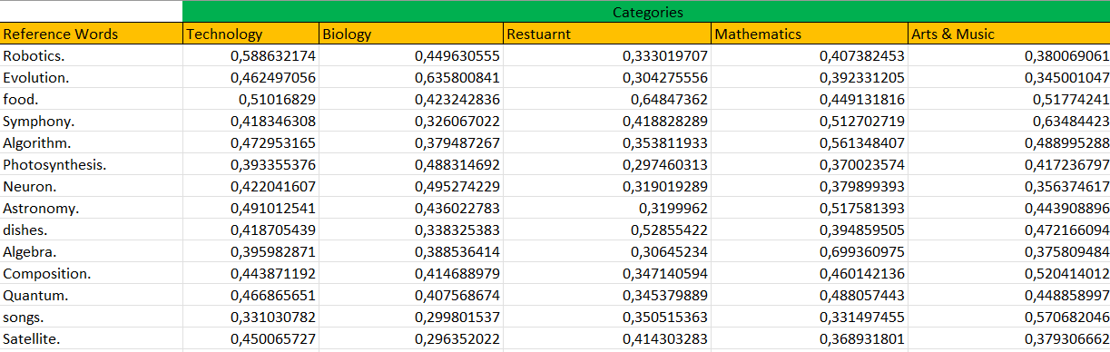
SAMPLE RESULT 1: Semantic Analysis Between Reference Words and Categories
Following embeddings were generated using text-embedding-3-small model.

Slide 24
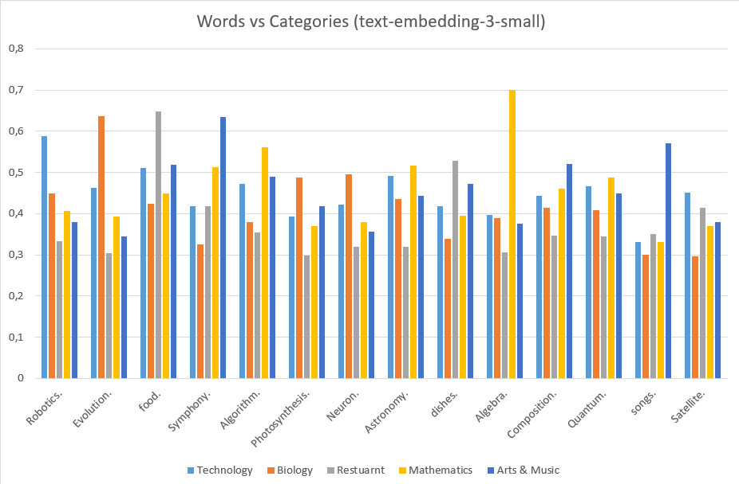
Semantic Analysis Between Reference Words and Categories
Bar graph shows the similarity between different words and recpective categories.

Slide 25
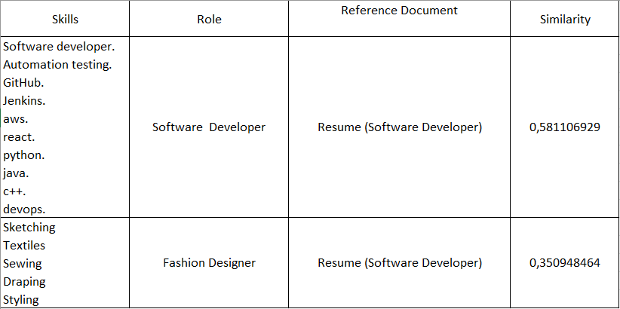
SAMPLE RESULT 2: Semantic Analysis Between Job Skills and Reference Resumes
Following embeddings were generated using text-embedding-3-large model.

Slide 26
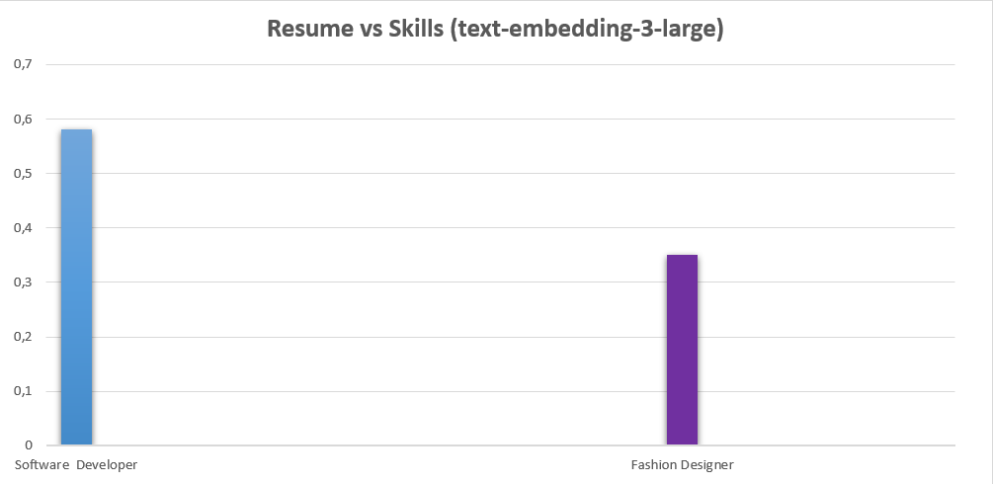
Semantic Analysis Between Different Job Skills and Reference Resume
Visualization of the experiment shows similarity according job role skills and resumes.

Slide 27
CONLUSION
This project presents a scalable and modular framework for semantic similarity analysis, integrating data extraction, embedding generation, and similarity computation. By leveraging advanced embedding techniques and cosine similarity, the system enables efficient and precise text comparisons. The framework is designed for automation and scalability, making it applicable to document clustering, recommendation systems, and anomaly detection.

Slide 28

Project Timeline
 | December 2024 |  | January 2025 |  | February 2025 |  | March 2025
Documentation & Submission
Improvements
Unit Testing
Development
Design
Analysis
Planning & Research

Slide 29
THANK YOU
Team: triVision

