Slide 1
PS4 - Secure Internet Messaging Service
Ankit Patel
Student of MS In IoT Student
Electrical and Computer Engineering
Northeastern University, United States

Slide 2
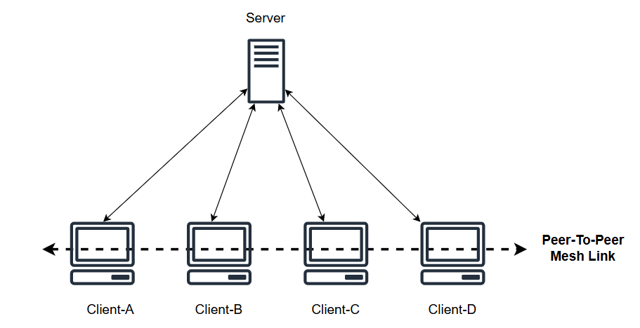
Architecture Hybrid (server-assisted peer-to-peer).
Components:
Clients (Users' Devices/WorkStation)
Server
Assists in discovery and authentication
Holds usernames, ip, port, ephemeral pub key, hash of weak password (W{g^a mod p})
Communication:
Server used for initial discovery and authentication only.
Post-authentication, direct client-to-client messaging.
Assumptions
Client does not store any key or password
Pub keys can be exchanged with certificates for future implementation.
Server stores derived weak password in W{g^b mode p} format
W is derived form password using PKBDF2
Client derive W on every login and sends W{g^a mode p}
to server for session key generation.
All Users are preregistered with server
Server stores username and ephemeral public keys
of clients that client send while login time mutual authentication
Server stores IP and Port after login and successful authentication with client
Server and client forgets temporary/ephemeral keys at the end of session

Slide 3
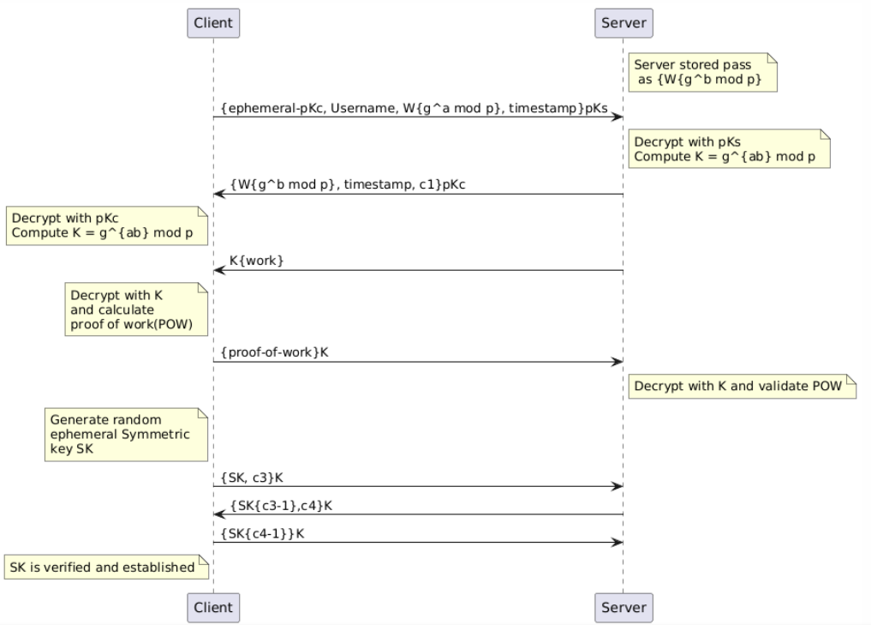
Auth & Key Management
Client
User logins with Username and weak password.
Client derives W hash using PKBDF2 from password and salt (makes bruteforce harder).
Client generates ephemeral pub/private kyes for the current session.
Client sends {pKcx,Username,other-login-info}pKs to server while login with mutual authentication, pKs and pKc are public key of server and client. (this can be authenticated using certificates)
pKs provides end point hiding
W{g^b mode p} stored in server and W{g^a mod p} created at the time of login provides protection against weak password
Server
Server has its private key protected using strong password.
Server stores public key, IP, Port against username.
Server and client exchanges DH keys with W{g^a mod p} and W{g^b mod p} encrypted using each others pub key.
K = g^ab mod p (Provides PFS)
Server sends {work challenge}K to client
Client send proof-of-wok, this handles DOS
Server generates sym key and IV for efficient encryption and exchanges them with a client using challenge response encrypted with key K.
AES-256-GCM sym key will provide integrity and authenticity and confidentiality

Slide 4
Discussion on Choices & Service Provided
Authentication: Mutual between client and server using passwords and public keys, DH exchange, proof of work, challenge-response and child session key exchange.
Provides mutual authentication
DH key exchange provides Perfect forward secrecy
Proof-of-work provides protection against Denial of service attack
Pub/private key exchange hides endpoints
Confidentiality: End-to-end encryption using ephemeral pub/private key, DH exchange and symmetric key.
Integrity: Signed messages to verify authenticity and integrity.
using AES-256-GCM mode.
Additional Services:
Perfect Forward Secrecy through is guaranteed through per session random ephemeral key generation and usage.
Protection against weak passwords using server-side rate limiting and salted hash storage.
Proof of wok for protection against DOS
endpoint Identity hiding using 2048 bit pub/private key encryption and secured session key establishment.
Security for weak password, as password is not stored either at client or server
Salt and password is used to generate W using PKBDF2
Server stores W{g^b mod p} and client generates W{g^a mod p} on every login session.

Slide 5
Client Server Authentication

Slide 6
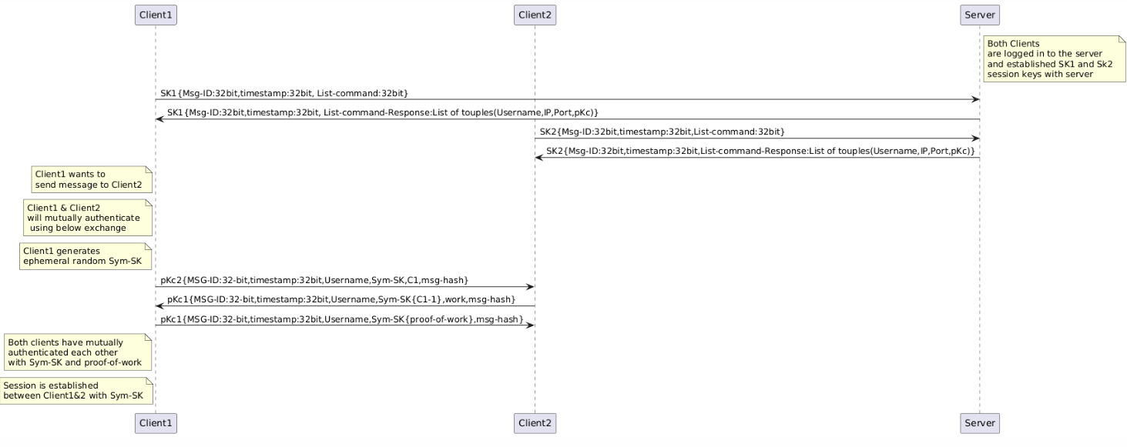
Client-Client Authentication & Session

Slide 7
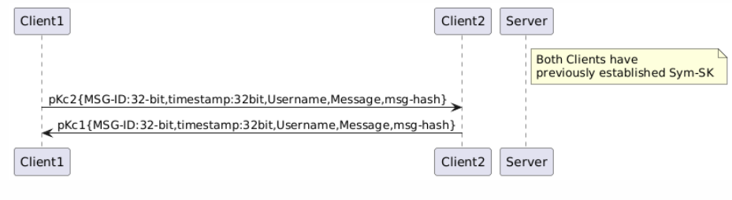
Client-Client Messaging

Slide 8
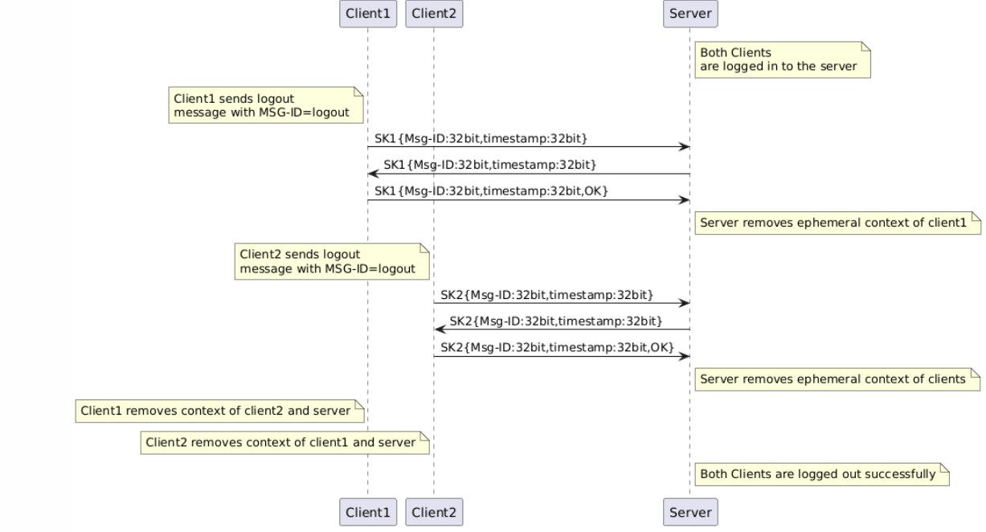
Logout

Slide 9
Thank You!!

