Slide 1

My Introduction
NAME:-Patel Charvi .A.
Enrollment no:-24C15045
Course:-Diploma IT
Semister:-3rd
^{Section:-B}

Slide 2
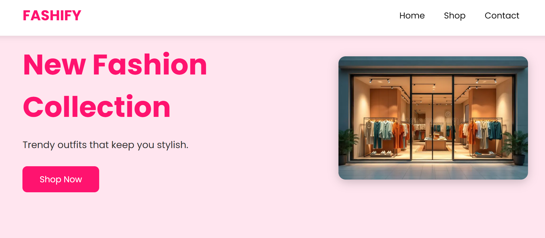
Fashify – Fashion Website
A Modern & Aesthetic Fashion Catalog Website

Slide 3
Introduction
Fashify is a modern fashion website designed to display seasonal clothing collections.
The website showcases outfits for Summer, Winter, Spring, and Marriage seasons.
It focuses on pastel colors, curved cards, and clean aesthetic design.
Each product includes an image, name, description, and price.
The project is made up from HTML, CSS, and JavaScript.

Slide 4
Purpose
To provide users with an easy and attractive platform to browse fashion items.
To display clothing collections based on different seasons.
To help customers quickly find outfits suitable for weather and occasions.
To showcase products with clear images, prices, and descriptions.

Slide 5
Benefits
Displays products clearly with images, names, and prices.
Offers a smooth, user-friendly interface for all age groups.
Works perfectly on phones, tablets, and desktops.
Helps boutique owners showcase their fashion catalog online.
Saves time by presenting all products neatly in one place.

Slide 6
Who can Use
Anyone interested in buying trendy and seasonal fashion items.
Boutique owners or small businesses who want ideas for styling and product display.
Fashion lovers looking for inspiration or outfit ideas.
Online shoppers who want a clean and easy shopping experience.

Slide 7
Thank you

