Slide 1
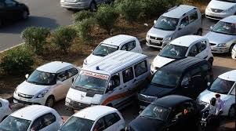
Traffic Clearance For Emergency Vehicles Through AI
Created by: Patel Devanshu
Branch: Cyber Security
Batch: 12
Subject: ESFP
PID: 780

Slide 2
Challenges Faced By Industries
Vehicular traffic is endlessly increasing everywhere in the world and can cause terrible traffic congestion at intersections.
Most of the traffic lights today feature a fixed green light sequence, therefore the green light sequence is determined without taking the presence of the emergency vehicles into account.
An increased volume of vehicles not only increases the response times of emergency vehicles, but it also increases the chances for them being involved in accidents.
The emergency vehicle entering an intersection at a high speed on a red light poses danger to traffic on roads and can cause accidents.
Emergency vehicles such as ambulances, police cars, fire trucks, stuck in a traffic jam and delayed in reaching their destination can lead to loss of property and valuable lives.

Slide 3
Solution for the challenges
There is a need for smart traffic management systems based on priority and traffic density to improve the transportation efficiency and response times of emergency services.
RFID tags have been used to identify the presence of emergency vehicles and the inductive loop method is used to count vehicles, widely used traffic detection methods, include video-based detection, microwave detection, radar detection, ultrasonic detection, etc.
An RFID-Radio Frequency Identification and GPS-based automatic lane clearance system for ambulances should be proposed.
The main function of this TAG is to send signal and in return the Emergency vehicle(EMVs) will response and presence of it can be known.

Slide 4
.
The signal which is sent by the control unit will be received by a TAG in the traffic control unit. On reception of this signal, microcontroller will switch the traffic signal from normal mode to blue mode. Duration of blue mode is about 30 seconds which is sufficient for ambulance to cross the traffic signal. After 30 seconds blue mode is switched to normal mode.
The traffic light sequence is interrupted with the approaching emergency vehicle and thereby its waiting time at the intersection is reduced.
The proposed system alert's the drivers of normal vehicles and pedestrians about approaching emergency vehicle.
The controller measures the frequencies of siren signals and computes the average of measured frequencies.
The frequency measuring controller sends the alert signal to the traffic signal controller(TSC).
The data collection module gathers the data from all the RSU’s and forwards it to Traffic Signal Control Module (TSCM).
The Traffic Signal Control Module(TSCM) will take change Traffic signal accordingly.

Slide 5
Advantages
The smart way of controlling traffic light timing during a peak hours and also to provide smooth flow for the ambulance and other emergency vehicles to reach the hospital in time.
Thus it will reduces accidents, mortality rate and traffic congestion.

Slide 6
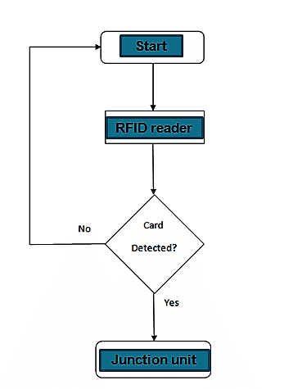
Flowchart

Slide 7
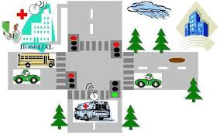
.
Notes:
s

Slide 8
References
https://www.slideshare.net/journalijrtem/traffic-and-admission-clearance-for-patient-on-ambulance?next_slideshow=99847758
https://www.ncbi.nlm.nih.gov/pmc/articles/PMC5134551/
Notes:
a

