Slide 1
Welcome to
X-$ender
Transfer Smarter

Slide 2
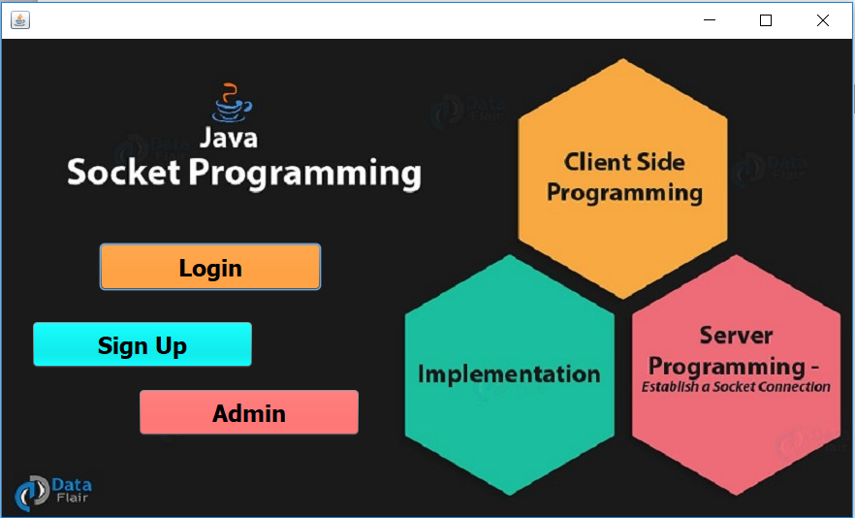
Select your pathway….

Slide 3
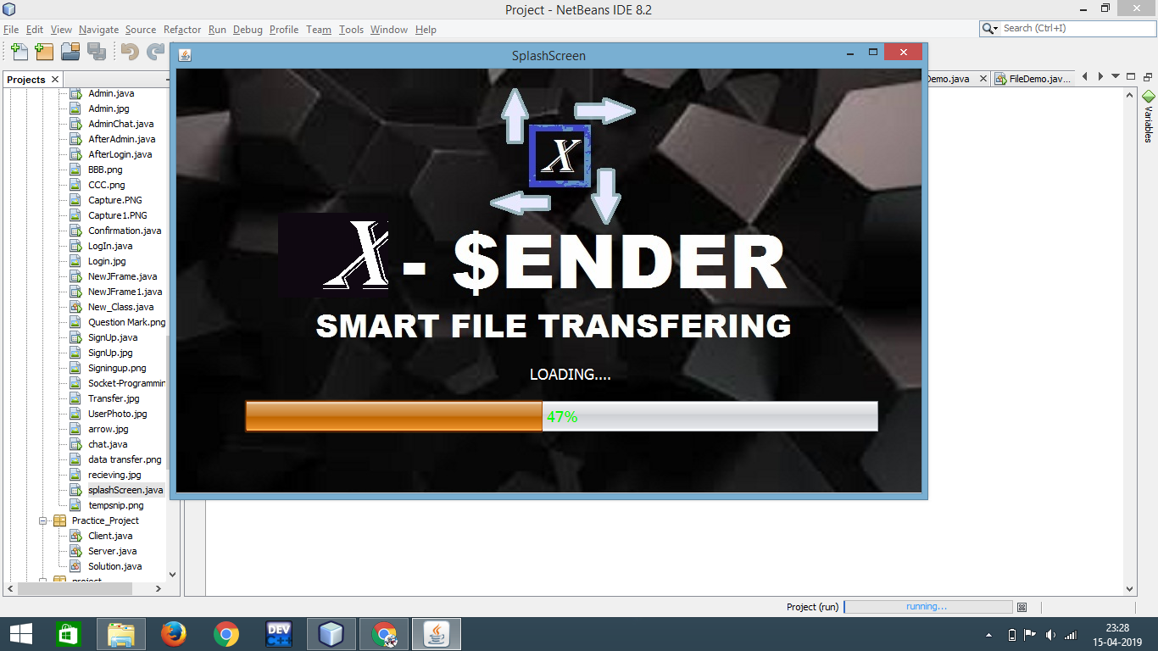
Just- Send it …

Slide 4
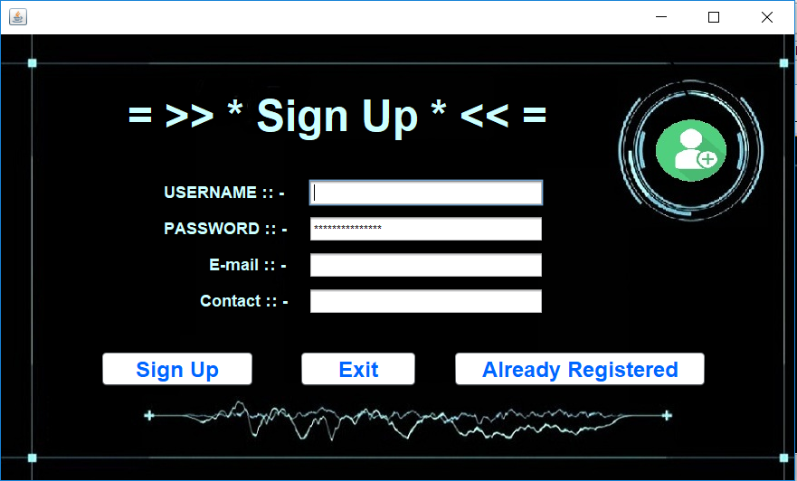
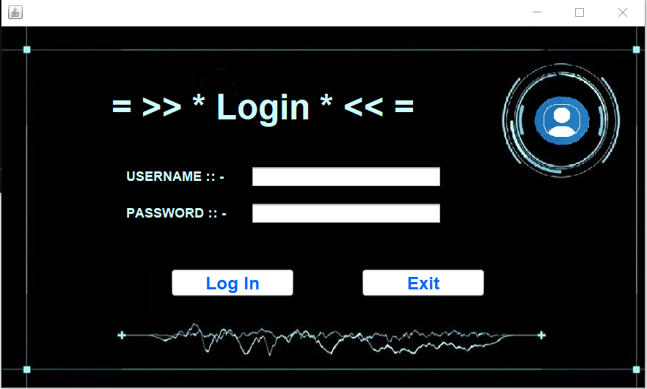
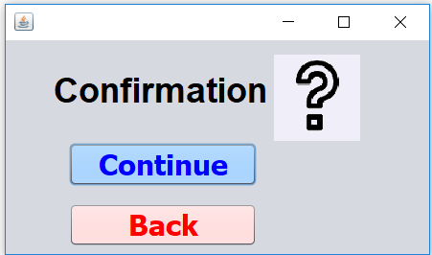
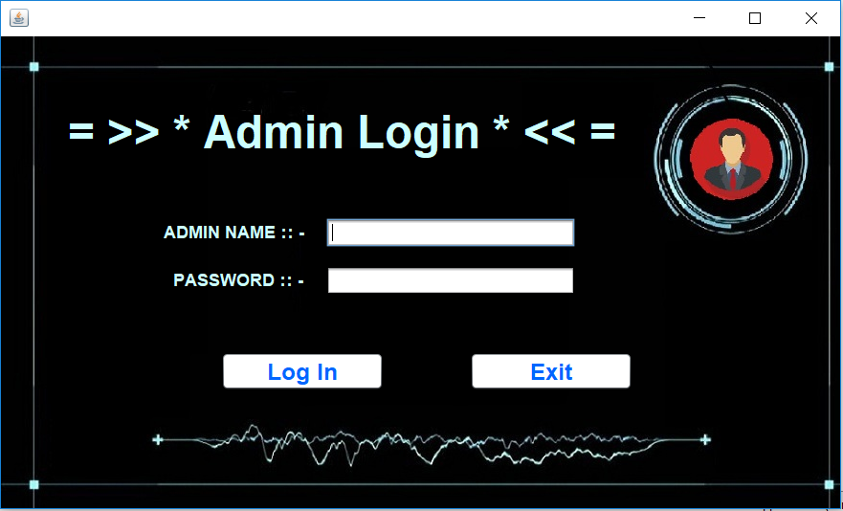
E
N
T
E
R
To
A
P
P

Slide 5
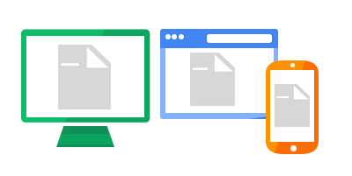
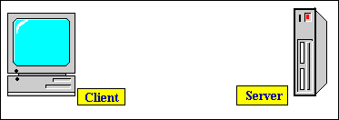
File Transferring
Connect to our server to access
Smart transferring experience
Working ::

Slide 6
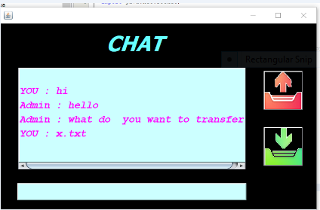
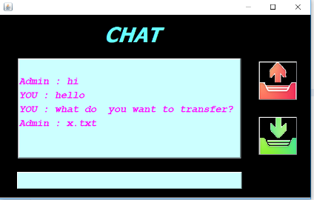
Experience a smart chatting during your transfer
Multi-functionality of Send/Receive can be allowed through X-$ENDER .
InterConnection between two desktops can be established via Socket Programming.

