Slide 1
Billy
Group No. 1
Team Member:
Abhishek Choksi(201906100110032)
Meet Patel(201906100110015)
Guide:
MS. JIGNA SOLANKY

Slide 2
Introduction
In earlier days, all restaurants can use manual ways to store their data and records so maintaining a large amount of data was difficult.
They need full function software to maintain their day-to-day life transaction, order, cash transaction, and customer feedback. Because of large data, they need some features or systems which can maintain and stores the data or records accurately.
The Billy reduces the manual works and improves the efficiency of the store.
To remove all the disadvantages of conventional methods, a system is proposed which is an Billy.

Slide 3
Objective
To reduce the cost of the business operation.
To improve the customer service.
To simplify the workflow.
To save the environment.
This will be adding on benefit for the customers as it will save their time, plus it adds on for the owner also.

Slide 4
Product Scope
The user first registration into the system and then the customer can buy food from the Billy. The system will deliver food only to Bardoli city.
The scope of this system is confined to one city and involves multiple customers and partners.
This system is a multi-restaurants system, allowing customers to buy and browse items from various restaurants.

Slide 5
Hardware Interface/Hardware Specification
CPU: | Intel Core Pentium
HDD Space: | 120 GB HDD
RAM: | 4 GB RAM
Software Interface/Software Specification
Operating System: | Multi-Platform (Window, IOS, Linux, Web Server)
Front-end Technology: | React JS, Flutter, HTML, CSS, Bootstrap, JavaScript, jQuery
Back-end Technology: | Node JS, Express JS, MongoDB
Other Tool: | Visual Studio Code, MongoDB Compass, Postman, Android Studio, Android Virtual Device, XCode, IOS Simulator

Slide 6
Functional Requirement
Manage User Login
Manage Cuisines
Manage Restaurant
Manage Category
Manage Added On
Manage Add Extra
Manage Item
Manage Variant
Manage Banner
Manage Customer
Manage Wishlist

Slide 7
Functional Requirement
Manage Cart
Billing Address management
Manage Customer Order Management
Manage Delivery Boy
Report management
Manage Get Touch (Help)
Manage Setting (Partner Setting)
Manage Question
Manage Complain
Manage Referral Amount

Slide 8
Non-Functional Requirement
RN | Description | Comments
NFR1 | This system has one feature called email verification. The user's entered email id is also verified by the system. | Security
NFR2 | This system prevents spam user attacks and automated software (bots) by using ReCAPTCHA. | Security
NFR3 | The architecture of our system is based on a typical MVC model. | Security
NFR4 | This system is SEO-friendly means that we apply the on-page SEO in this system. | Efficiency
NFR5 | To send coupon codes to users the system provides the facility of sending bulk emails. | Efficiency
NFR6 | The system has feature translator users can change the system language according to their regional. | Usability
NFR7 | The system is provided with a mechanism to verify the owner of certain JSON data using JWT token authentication. | Security

Slide 9
Use case Diagram
Use case Diagram – Admin
Use case Diagram – Partner
Use case Diagram – Customer
Use case Diagram - Delivery Boy

Slide 10
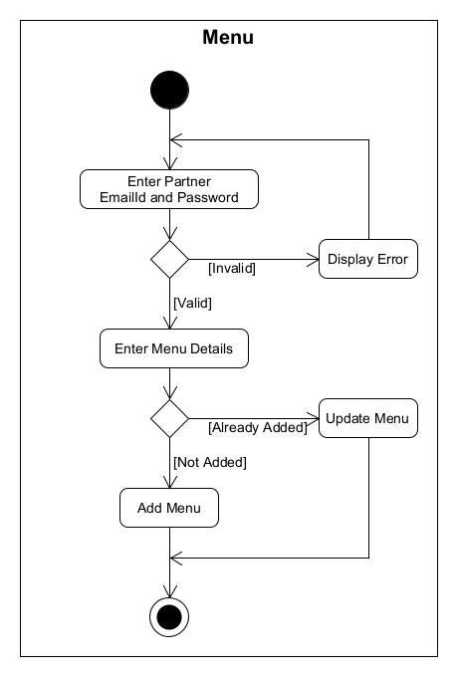
Activity Diagram
Activity Diagram for Manage Menu

Slide 11
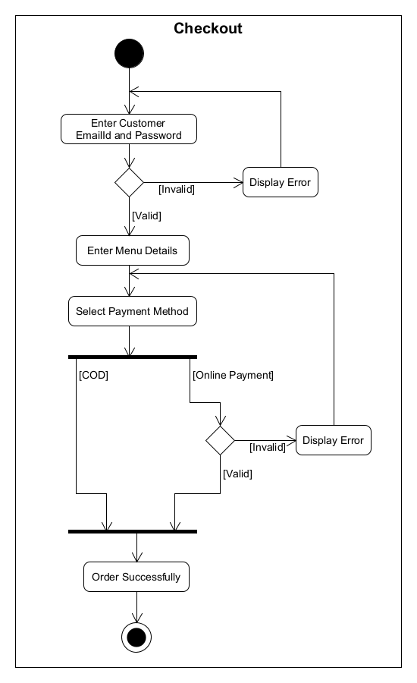
Activity Diagram
Activity Diagram for Checkout

Slide 12
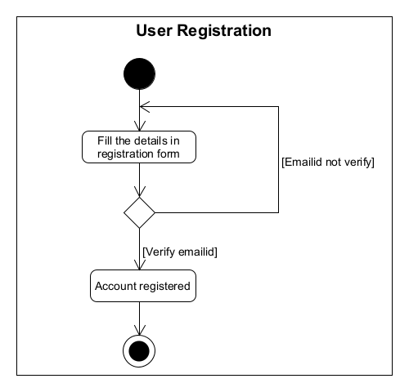
Activity Diagram
Activity Diagram for User Registration

Slide 13
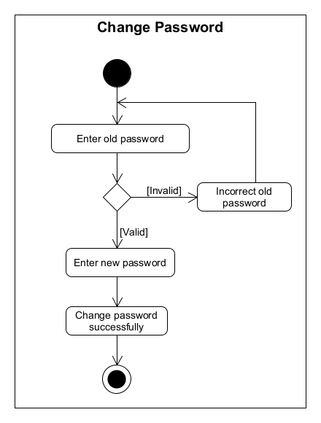
Activity Diagram
Activity Diagram for Change Password

Slide 14
Database Design
Database Schema
Admin Table
admin (ID[PK], Name, Username, Password, Email, createdAt, updatedAt)
FD: ID-> {Name, Username, Password, Email, createdAt, updatedAt}
Cuisines Table
cuisines (ID[PK], Name, Image, Description, Banner, Status, createdAt, updatedAt)
FD: ID-> {Name, Image, Description, Banner, Status, createdAt, updatedAt}

Slide 15
Database Design
Restaurant Table
restaurant (ID[PK], Restaurant Name, Restaurant Image, Restaurant Address, Restaurant City, Restaurant Contact No., Owner Name, Owner Contact No., Owner Email ID, Owner Password, Reset Password Token, Restaurant Documents, Restaurant Timing, cuisines [FK], Status, createdAt, updatedAt)
FD: ID-> {Restaurant Name, Restaurant Image, Restaurant Address, Restaurant City, Restaurant Contact No., Owner Name, Owner Contact No., Owner Email ID, Owner Password, Reset Password Token, Restaurant Documents, Restaurant Timing, cuisines [FK], Status, createdAt, updatedAt}
FD: Documents-> {GST Certificate, FSSAI Certificate, Sample Bill, Sample Menu, Owner PAN Card}
FD: Restaurant Timing-> {Monday, Tuesday, Wednesday, Thursday, Friday, Saturday, Sunday}

Slide 16
Database Design
Added-On Table
addedon (ID[PK], restaurant [FK], Name, Type, Price, Additional Price, Final Price, Approval Status, Status, createdAt, updatedAt)
FD: ID-> {restaurant [FK], Name, Type, Price, Additional Price, Final Price, Approval Status, Status, createdAt, updatedAt}
Add Extra Table
addextra (ID[PK], restaurant [FK], Name, Type, Price, Additional Price, Final Price, Approval Status, Status, createdAt, updatedAt)
FD: ID-> {restaurant [FK], Name, Type, Price, Additional Price, Final Price, Approval Status, Status, createdAt, updatedAt}

Slide 17
Database Design
Category Table
category (ID[PK], restaurant [FK], Name, Approval Status, Status, createdAt, updatedAt)
FD: ID-> {restaurant [FK], Name, Approval Status, Status, createdAt, updatedAt}
Item Added-On Table
itemaddedon (ID[PK], title, Customer Selection, addedon [FK], createdAt, updatedAt)
FD: ID-> {title, Customer Selection, addedon [FK], createdAt, updatedAt}
Item Add Extra Table
itemaddextra (ID[PK], title, Customer Selection, addextra [FK], createdAt, updatedAt)
FD: ID-> {title, Customer Selection, addextra [FK], createdAt, updatedAt}

Slide 18
Database Design
Variant Table
variant (ID[PK], Name, UOM, Price, Sales Price, Approval Status, Status, createdAt, updatedAt)
FD:ID -> {Name, UOM, Price, Sales Price, Approval Status, Status, createdAt, updatedAt}
Item Table
item (ID[PK], restaurant [FK], category [FK], variant [FK], Name, Type, Description, itemaddedon [FK], itemaddextra [FK], Image, Approval Status, Status, createdAt, updatedAt)
FD: ID-> {restaurant [FK], category [FK], variant [FK], Name, Type, Description, itemaddedon [FK], itemaddextra [FK], Image, Approval Status, Status, createdAt, updatedAt}

Slide 19
Database Design
Banner Table
banner (ID[PK], restaurant [FK], Name, Image, Approval Status, Status, createdAt, updatedAt)
FD: ID-> {restaurant [FK], Name, Image, Approval Status, Status, createdAt, updatedAt}
Delivery Boy Table
deliveryboy (ID[PK], Name, Mobile, Password, Status, createdAt, updatedAt)
FD: ID-> {Name, Mobile, Password, Status, createdAt, updatedAt}
Coupon Code Table
couponcode (ID[PK], Coupon code, Coupon type, Coupon value, Cart min value, Expired on, Status, createdAt, updatedAt)
FD: ID-> {Coupon code, Coupon type, Coupon value, Cart min value, Expired on, Status, createdAt, updatedAt}

Slide 20
Database Design
Billing Address Table
billingaddress (ID[PK], Title, Address, Country, State, City, Pin Code, createdAt, updatedAt)
FD: ID-> {Title, Address, Country, State, City, Pin Code, createdAt, updatedAt}
Customer Table
customer (ID[PK], Name, Email ID, Password, Contact No., Billing Address [FK], OTP, Hash, Referral Code, From Referral Code, Status, createdAt, updatedAt)
FD: ID-> {Name, Email ID, Password, Contact No., Billing Address [FK], OTP, Hash, Referral Code, From Referral Code, Status, createdAt, updatedAt}

Slide 21
Database Design
Wishlist Table
wishlist (ID[PK], customer [FK], item [FK], addedon [FK], addextra [FK], createdAt, updatedAt)
FD: ID-> {customer [FK], item [FK], createdAt, updatedAt}
Cart Table
cart (ID[PK], customer [FK], item [FK], addedon [FK], addextra [FK], Qty, Price, createdAt, updatedAt)
FD: ID-> {customer [FK], item [FK], addedon [FK], addextra [FK], Qty, Price, createdAt, updatedAt}

Slide 22
Database Design
Order Master
Order (ID[PK], customer [FK], Billing Address [FK], Price, Coupon Code [FK], Total Price, Delivery Boy [FK], Payment Status, Payment Type, Payment ID, Order Status, Cancel By, Cancel At, Delivered On, Refund Status, createdAt, updatedAt)
FD: ID-> {customer [FK], Billing Address [FK], Price, Coupon Code [FK], Total Price, Delivery Boy [FK], Payment Status, Payment Type, Payment ID, Order Status, Cancel By, Cancel At, Delivered On, Refund Status, createdAt, updatedAt}

Slide 23
Database Design
Order Detail Table
Order (ID[PK], Order Master [FK], item [FK], Qty, variant [FK], addedon [FK], addextra [FK], createdAt, updatedAt)
FD: ID-> {Order Master [FK], item [FK], Qty, variant [FK], addedon [FK], addextra [FK], createdAt, updatedAt}
Get Touch Table
gettouch (ID [PK], restaurant [FK], Subject, Message, Status, createdAt, updatedAt)
FD: ID-> {restaurant [FK], Subject, Message, Status, createdAt, updatedAt}

Slide 24
Database Design
Setting Table (For Partner)
setting (ID [PK], restaurant [FK], Cart Min Price, Cart Min Price Message, Delivery charge, GST, createdAt, updatedAt)
FD: ID-> {restaurant [FK], Cart Min Price, Cart Min Price Message, Delivery charge, GST, createdAt, updatedAt}
Question Table
Question (ID[PK], Question, createdAt, updatedAt)
FD: ID-> {question, createdAt, updatedAt}

Slide 25
Database Design
Complain Table
complain (ID[PK], customer [FK], order [FK], question [FK], Message, Status, createdAt, updatedAt,)
FD: ID-> {customer [FK], order [FK], question [FK], Message, Status, createdAt, updatedAt}
Referral Amount Table
referral (ID[PK], Referral Amount, createdAt, updatedAt)
FD: ID-> {Referral Amount, createdAt, updatedAt)

Slide 26
Database Design
Review Table
review (ID[PK], customer [FK], order [FK], item [FK], ratting, comment, createdAt, updatedAt)
FD: ID-> {customer [FK], order [FK], item [FK], ratting, comment, createdAt, updatedAt}
Wallet Table
wallet (ID[PK], customer [FK], amount, message, type, payment id, createdAt, updatedAt)
FD: ID-> {customer [FK], amount, message, type, payment id, createdAt, updatedAt}

Slide 27
Future Enhancement
This module can be modified if the future according to the need of the organization.
For future enhancement, we try to track the customer order and the customer's live location is automated fetch by using an AI system.
And also, we will try to use the QR Code for the coupon code. So, the customer easily scanned the coupon code.
Conclusion
A billy is proposed, useful in small family-run restaurants. This also helps restaurant owners to develop healthy customer relationships by providing reasonably good service.

Slide 28
Bibliography
Website Referred:
o Order food online from India's best food delivery service. Order from restaurants near you (swiggy.com)
Stack Overflow - Where Developers Learn, Share, & Build Careers
La Pino'z Pizza
Flutter Dev Document
Pub Dev (Flutter Packages)
Website referred:
Register on Swiggy || Add restaurant || रेस्टोरेंट SWIGGY पे कैसे लाये || Hindi || March 2021
How to Edit Menu on Swiggy|Add items,Change Price,Add items Photo,Delete items|Step-By-Step|Swiggy
How To Order Food From Swiggy App | Swiggy App Se Khana Order Kaise Karen | GagTech
React and node js project in Hindi (MERN stack)
Getting Started with MERN Stack Application

