Slide 1


Text summarization
Mentor : Mr. Narendra kumar
Intern: Patel Hetu
B.Tech 3rd year(ICT)
Group-1
Date : 3-7-2024

Slide 2
Introduction
Definition of Text Summarization:
"Text summarization is the process of creating a concise and coherent version of a longer text document.“
Importance:
"Summarization helps quickly understand large volumes of information.“
Applications:
"Used in news articles, research papers, legal documents, customer feedback, and social media."
Used datasets:
CNN/daily mails
Samsum

Slide 3
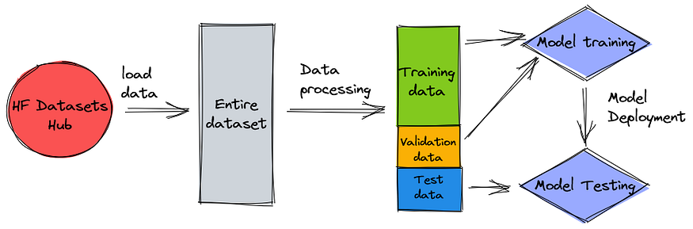
Intended plan:

Slide 4
Techniques and Algorithms
Basic Techniques:
Frequency-based methods: Select sentences based on word frequency.
TF-IDF: Measures the importance of words in a document relative to a corpus.
Sentence scoring and ranking: Ranks sentences based on various metrics.
Advanced Algorithms:
LexRank and TextRank: Graph-based algorithms that rank sentences based on their importance.
Latent Semantic Analysis (LSA): Uses singular value decomposition to identify important concepts.
Neural Networks and Deep Learning:
RNNs: Sequence processing neural networks.
LSTMs: Advanced RNNs capable of learning long-term dependencies.
Attention Mechanisms: Enhance the focus on relevant parts of the input.
Transformer Models:
BERT: A model that understands context in both directions.
GPT: A generative model for producing coherent text.
T5: A model that treats all tasks as text-to-text transformations.

Slide 5
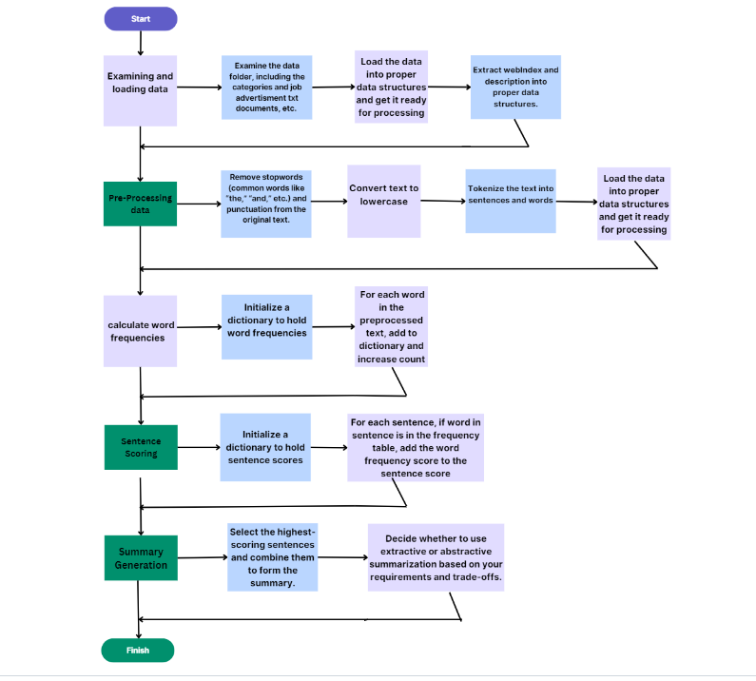
Work flow:

Slide 6
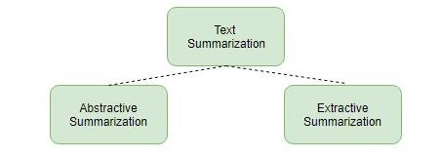
Types of Text Summarization
Extractive Summarization:
Extractive summarization selects key sentences, phrases, or sections directly from the source text.
It often uses methods like frequency-based selection and TF-IDF.
Pros: Simple and quick.
Cons: May lack coherence and context.
Abstractive Summarization:
Abstractive summarization generates new sentences that convey the main ideas of the source text.
It involves complex techniques like neural networks and transformer models.
Pros: Can produce more coherent and human-like summaries.
Cons: More computationally intensive and may introduce inaccuracies.

Slide 7
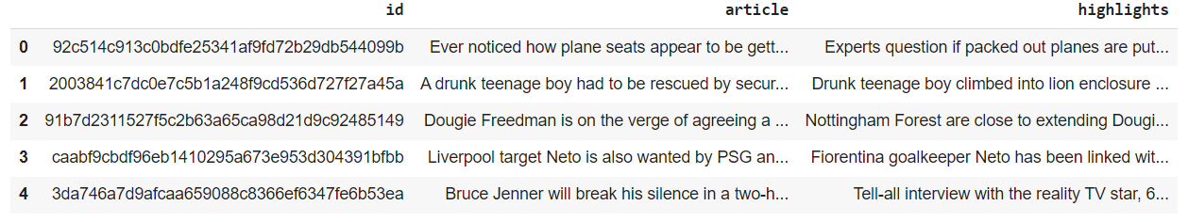
Dataset proposal:
Merged dataset from
CNN/Daily mails
Samsum

Slide 8
Extractive Summarization
Definition:
"Extractive summarization involves selecting and concatenating the most important sentences from the source text.“
Methods:
"Frequency-based selection, TF-IDF.“
Pros and Cons:
"Pros: Simple and quick."
"Cons: May lack coherence and context."

Slide 9
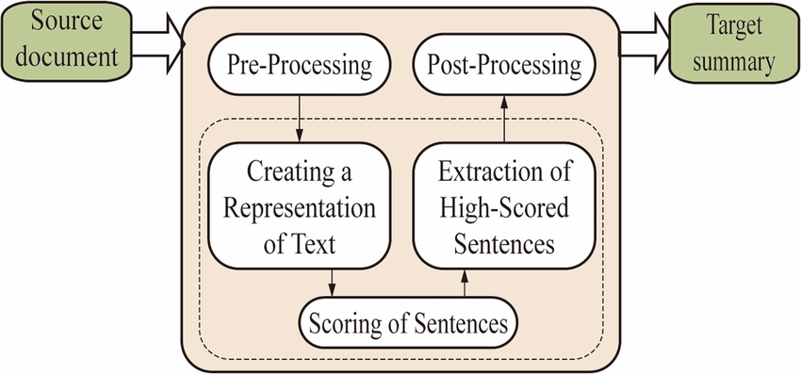
Architecture of the extractive text summarization system:

Slide 10
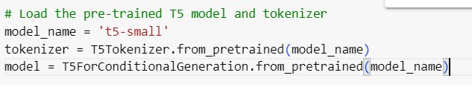
Rouge score
'rouge1': AggregateScore(low=Score(precision=0.75, recall=0.6, fmeasure=0.6666666666666665), mid=Score(precision=0.75, recall=0.6, fmeasure=0.6666666666666665), high=Score(precision=0.75, recall=0.6, fmeasure=0.6666666666666665)), 'rouge2': AggregateScore(low=Score(precision=0.3333333333333333, recall=0.25, fmeasure=0.28571428571428575), mid=Score(precision=0.3333333333333333, recall=0.25, fmeasure=0.28571428571428575), high=Score(precision=0.3333333333333333, recall=0.25, fmeasure=0.28571428571428575)), 'rougeL': AggregateScore(low=Score(precision=0.75, recall=0.6, fmeasure=0.6666666666666665), mid=Score(precision=0.75, recall=0.6, fmeasure=0.6666666666666665), high=Score(precision=0.75, recall=0.6, fmeasure=0.6666666666666665)), 'rougeLsum': AggregateScore(low=Score(precision=0.75, recall=0.6, fmeasure=0.6666666666666665), mid=Score(precision=0.75, recall=0.6, fmeasure=0.6666666666666665), high=Score(precision=0.75, recall=0.6, fmeasure=0.6666666666666665))

Slide 11
Abstractive Summarization
Definition:
"Abstractive summarization generates new sentences to represent the core ideas of the text."
Techniques:
"Uses neural networks and transformer models."
Pros and Cons:
"Pros: More coherent and human-like summaries."
"Cons: Computationally intensive and may introduce inaccuracies."

Slide 12
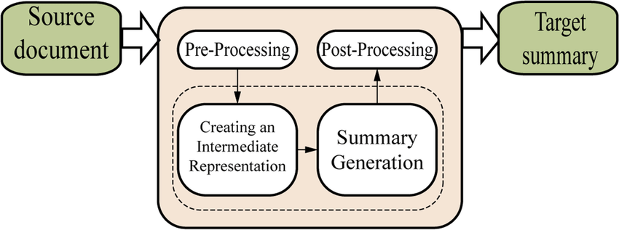
Architecture of the abstractive text summarization system:

Slide 13
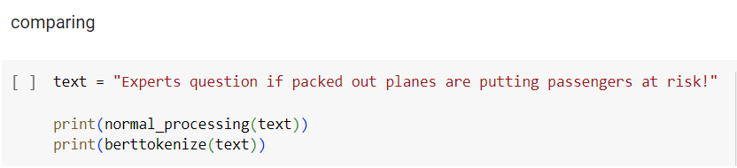
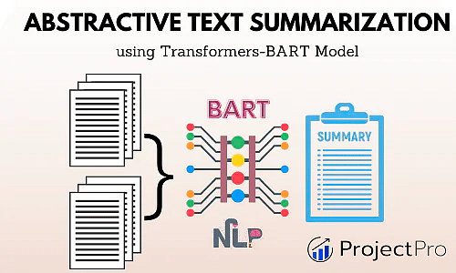
COMPARING MODELS
OUTPUT:
Normal processing Experts question if packed out planes are putting passengers at risk! ['expert', 'question', 'pack', 'plane', 'put', 'passeng', 'risk'] {'input_ids': [101, 8519, 3160, 2065, 8966, 2041, 9738, 2024, 5128, 5467, 2012, 3891, 999, 102], 'token_type_ids': [0, 0, 0, 0, 0, 0, 0, 0, 0, 0, 0, 0, 0, 0], 'attention_mask': [1, 1, 1, 1, 1, 1, 1, 1, 1, 1, 1, 1, 1, 1]}

Slide 14
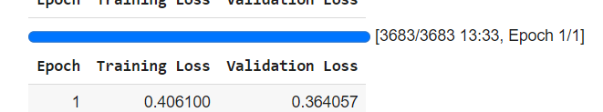
model training :
TrainOutput(global_step=3683, training_loss=0.5255669773256134, metrics={'train_runtime': 814.185, 'train_samples_per_second': 18.094, 'train_steps_per_second': 4.524, 'total_flos': 1993855419285504.0, 'train_loss': 0.5255669773256134, 'epoch': 1.0})

Slide 15
Evaluate the Model(model validation)
Evaluate the model using the ROUGE metric.
ROUGE-1 (R1): ROUGE-1 measures the overlap of unigram (single word) tokens between the generated summary and the reference (gold-standard) summary. It calculates the precision, recall, and F1 score of unigrams.
ROUGE-2 (R2): ROUGE-2 measures the overlap of bigram (two-word sequences) tokens between the generated summary and the reference summary. Similar to ROUGE-1, it calculates precision, recall, and F1 score of bigrams.
ROUGE-L (RL): ROUGE-L measures the longest common subsequence (LCS) between the generated summary and the reference summary. It calculates precision, recall, and F1 score based on the length of the LCS.
ROUGE-W (RW): ROUGE-W (sometimes referred to as ROUGE-Lsum) measures the weighted LCS between the generated summary and the reference summary. It assigns more weight to longer matches in the LCS.

Slide 16
Rouge score:
rouge1: Score(precision=0.767627392778128, recall=0.22941014983341268, fmeasure=0.33640983854210316)
rouge2: Score(precision=0.41012512677602814, recall=0.11619754543090752, fmeasure=0.17460415842663637)
rougeL: Score(precision=0.5740780603041631, recall=0.19681507337121906, fmeasure=0.28288022661661905)
rougeLsum: Score(precision=0.7189119882750398, recall=0.21573804703761962, fmeasure=0.3182781398546788)
https://github.com/Patelhlt/text-summarizer/blob/main/Interface.ipynb
Fine-tuned-Abstractive:
https://drive.google.com/drive/folders/1w2cE6bqU-YomgUloOUafl7zOatt287OY?usp=sharing

Slide 17
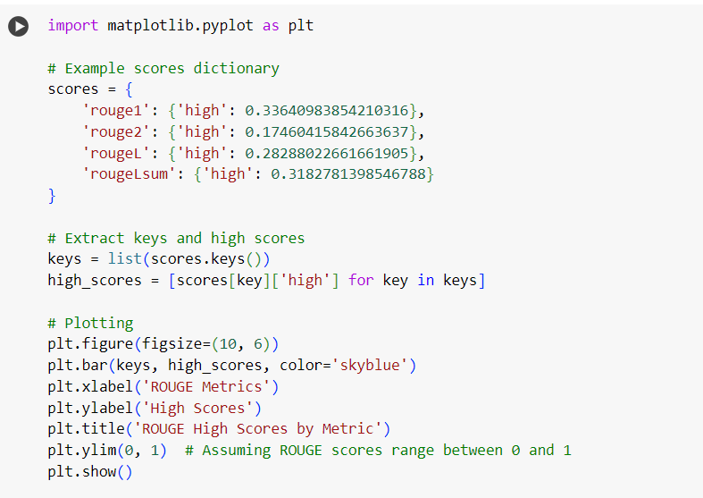
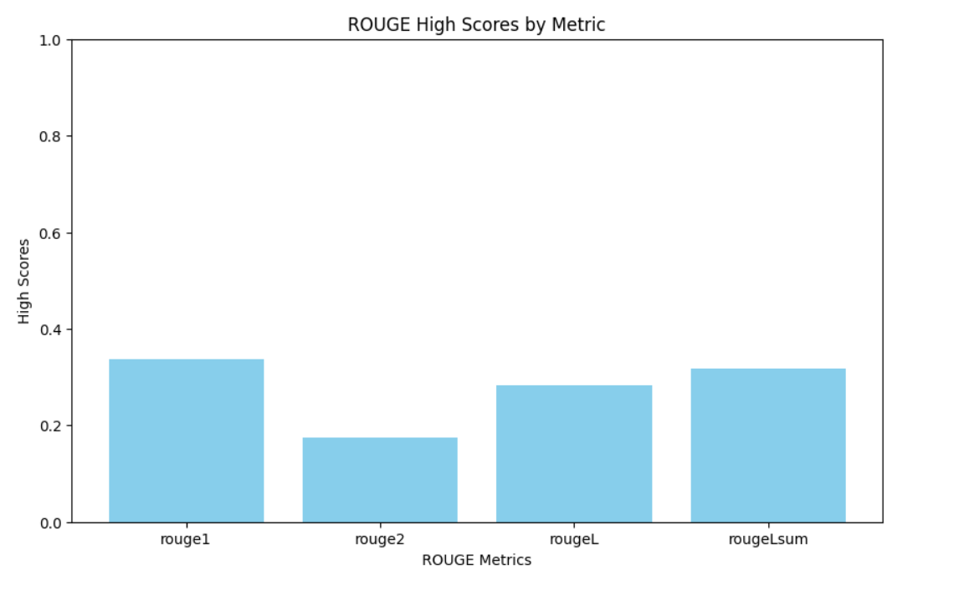
Plotting :

Slide 18
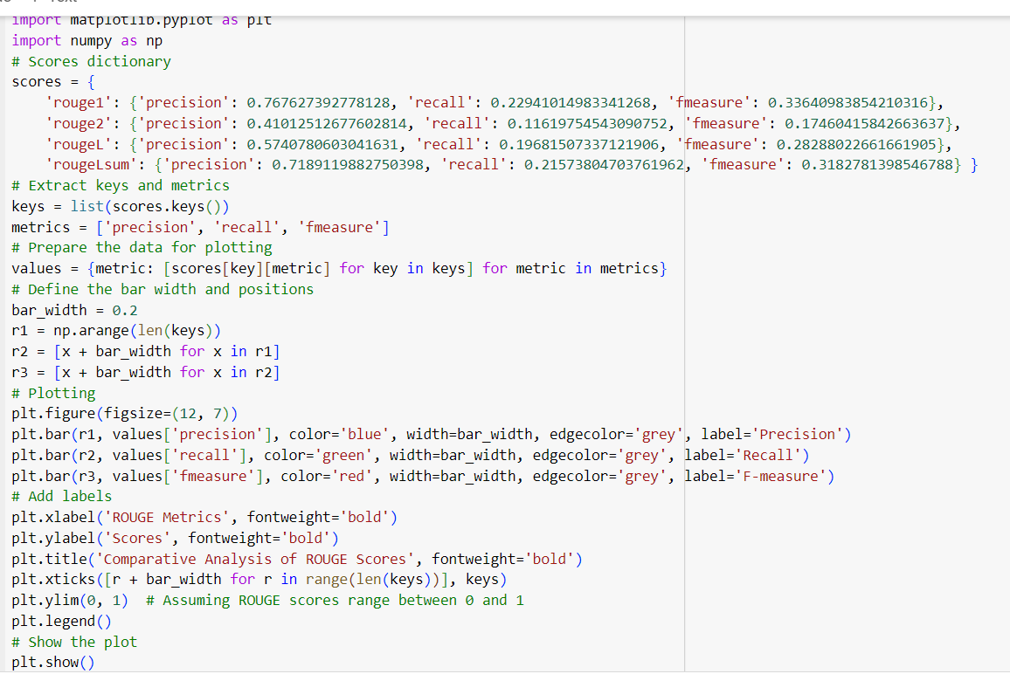
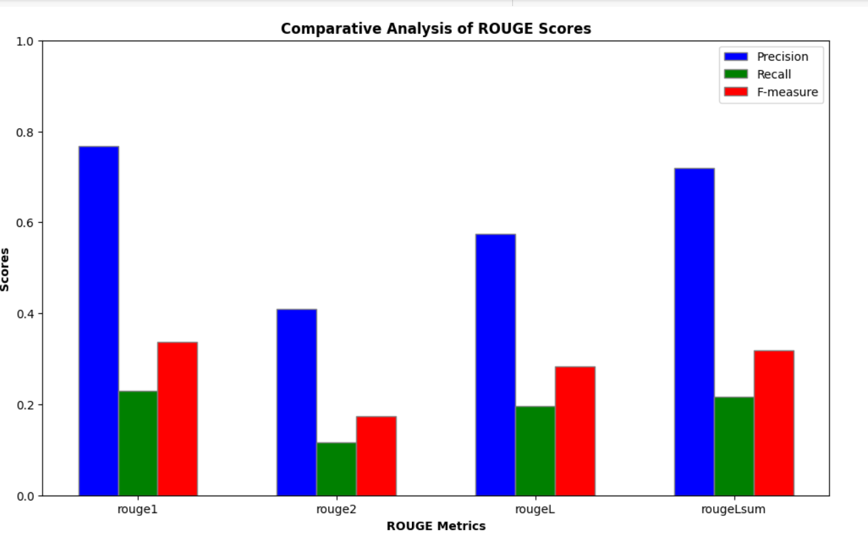
Comparative analysis:

Slide 19
Interface :
Components of a Text Summarization Interface
Input Field:
Text Box: A large text box where users can paste or type the text they want to summarize.
File Upload: Option to upload text files (e.g., .txt, .docx, .pdf) for summarization.
Summarization Options:
Type of Summarization: Choose between extractive (selects important sentences from the original text) and abstractive (generates new sentences that convey the main ideas) summarization.
Summary Length: Slider or input box to specify the desired length or percentage of the summary.
Output Display:
Summary Box: A text box or display area where the summarized text is shown.
Download Option: Button to download the summary as a text file.
Additional Features:
Language Selection: Option to select the language for summarization.
Adjustable Parameters: Advanced settings for adjusting parameters like temperature, beam size, or max tokens for abstractive models.
User Feedback:
Edit and Improve: Option for users to manually edit the generated summary.
Feedback Form: Collect user feedback to improve the summarization model.
Design Considerations
User Experience (UX):
Simplicity: Keep the interface clean and intuitive.
Responsiveness: Ensure the interface works well on various devices, including desktops, tablets, and smartphones.
Performance:
Speed: The summarization process should be fast to enhance user satisfaction.
Scalability: The system should handle multiple requests efficiently.
Accuracy and Quality:
Model Selection: Use state-of-the-art models for better summarization quality.
Continuous Improvement: Regularly update the models based on user feedback and advancements in NLP.
Security and Privacy:
Data Privacy: Ensure that user data is not stored or misused.
Secure Uploads: Implement secure file handling practices.

Slide 20


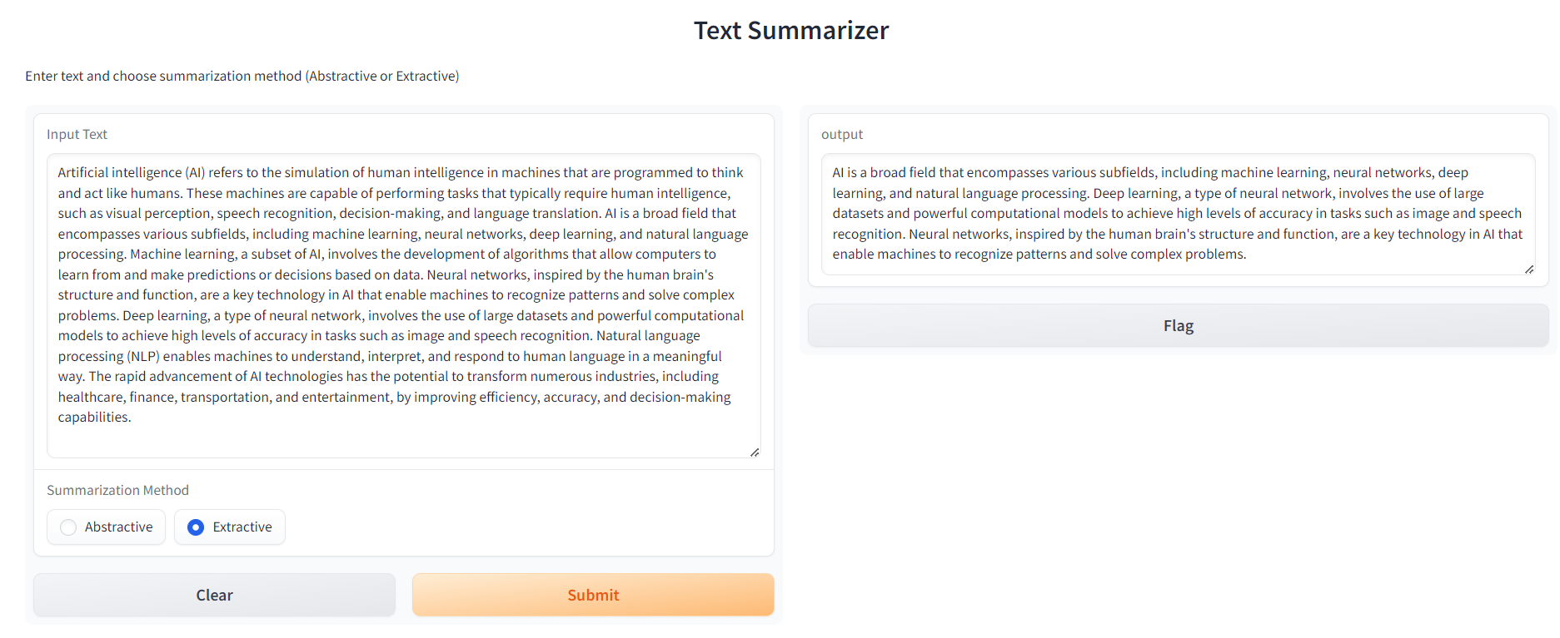
Testing interface using gradio:
fig: abstractive model
fig: extractive model
https://drive.google.com/drive/folders/1w2cE6bqUYomgUloOUafl7zOatt287OY?usp=sharing

Slide 21
deployment part:

Slide 22


popular platforms
1. Hugging Face Spaces
About: Hugging Face Spaces is a hosted platform that allows you to deploy machine learning models and applications. It's especially well-suited for models developed with popular frameworks like Gradio, Streamlit, and others. Spaces provide easy integration, seamless deployment, and a community-driven ecosystem.
Pros:
Easy to use and integrate with Hugging Face models.
Free tier available.
Supports Gradio and other web app frameworks.
No need for server management.
Cons:
Limited compute resources in the free tier.
May require knowledge of Hugging Face ecosystem.
Website: Hugging Face Spaces
2. Heroku
About: Heroku is a cloud platform as a service (PaaS) that enables developers to build, run, and operate applications entirely in the cloud. It supports multiple programming languages and frameworks, including Python and Gradio.
Pros:
Easy deployment with Git.
Free tier available with limitations.
Supports a wide range of programming languages and frameworks.
Cons:
Limited free tier with dyno sleeping and restricted resources.
May require additional setup for machine learning models.
Website: Heroku

Slide 23


Popular platforms
3. Google Cloud Platform (GCP)
About: Google Cloud Platform (GCP) provides a suite of cloud computing services that run on the same infrastructure that Google uses internally. It offers various services for deploying machine learning models, including AI Platform, App Engine, and Cloud Run.
Pros:
Robust and scalable infrastructure.
Wide range of services tailored for machine learning and AI.
Integration with other Google services.
Cons:
Steeper learning curve compared to other options.
Costs can accumulate quickly without proper management.
Website: Google Cloud Platform
4. Amazon Web Services (AWS)
About: AWS is a comprehensive and widely adopted cloud platform offering over 200 fully featured services from data centers globally. For machine learning deployments, AWS provides services like SageMaker, Lambda, and EC2.
Pros:
Highly scalable and reliable.
Comprehensive suite of tools and services.
Strong community and support.
Cons:
Can be complex to navigate and set up.
Costs can be high, especially for large-scale deployments.
Website: Amazon Web Services

Slide 24
Tools and Libraries
Spacy:
"A fast and efficient NLP library."
"Useful for preprocessing and entity recognition, aiding summarization tasks."
Gensim:(optional)
"A robust library for topic modeling and document similarity analysis."
"Implements algorithms like TextRank and LSA for summarization."
Hugging Face Transformers:
"A library offering pre-trained transformer models.“
"Enables easy implementation of state-of-the-art summarization models.

Slide 25
Case Studies and Examples
Real-world Applications:
"Summarizing news articles for concise updates."
"Condensing research papers for quick review."
"Creating summaries of legal documents."
Detailed Examples:
"Input texts and their summaries."
"Comparison between extractive and abstractive methods."
"Code snippets demonstrating the use of various tools and libraries."

Slide 26
Challenges and Future Directions
Current Limitations:
"Difficulty in understanding context and maintaining coherence."
"Handling diverse and large datasets."
"Issues with factual accuracy and grammar in abstractive summarization."
Future Trends:
"Improvements in deep learning and transformer models."
"Integration with other AI technologies like chatbots."
"Development of better evaluation metrics for summarization quality."

Slide 27
Conclusion and references
Summary:
"Text summarization is a crucial tool for managing information overload."
"Both extractive and abstractive methods have their uses and challenges."
"Ongoing research is vital for improving summarization techniques.“
References:
"List of academic papers, books, articles, and online resources cited.“
“Kaggle”
ChatGPT, perplexity.ai etc…

