Slide 1


FACULTY OF ENGINEERING & TECHNOLOGY
File Conversion
Major Preject Revivew-I
B.Tech (CE-SE) Sem-VIII
At
Department of Computer Engineering
Sankalchand Patel College of Engineering, Visnagar
Presented By
Patel Keyur Nareshbhai (2021095900024201)
Patel Tanish Pravinbhai (2021095900024197)
Patel Pranav Baldevbhai (2021095900023453)
Darbar Ranjit Abhesinh (2021095900023677)
Guided By
Prof. Vivek Shah

Slide 2
Outline
Objective
Introduction
Functionality
Integration and Automation
Hardware & Software Requirement
Security and Privacy
Design Diagrams
Snapshot
References

Slide 3
Objective:
The objective is to provide a user-friendly tool that efficiently converts various formats into another formats (PDF, images, video, DOCX), ensuring content integrity and accessibility. This tool aims to enhance versatility, streamline workflows, and support diverse presentation needs across different platforms and devices.

Slide 4
Introduction
Streamlined File Conversion
Our powerful file conversion tool makes it easy to quickly transform your documents, images, and media files into the desired format with just a few clicks.
User-Friendly Interface
Designed with simplicity in mind, our intuitive interface guides you through the conversion process, allowing even non-technical users to convert files with ease.
Extensive File Support
Our tool supports a wide array of file types, ensuring that you can convert virtually any document, image, or media file to the format you need.

Slide 5
Functionality
Batch Processing
Seamless
Conversion
Quality Preservation
Compatibility Across Devices
Our tool effortlessly converts a wide range of file formats, from documents and spreadsheets to images and media files, with just a few clicks.
Convert multiple files at once, saving you time and streamlining your workflow.
Our advanced algorithms ensure that your files maintain their original quality and formatting during the conversion process.
The converted files are compatible with a wide range of devices and platforms, making it easy to share and access your content.

Slide 6




Integration and Automation
Seamless Integration
1
Connect with your favorite apps and tools
2
Automated Workflows
Streamline your file conversion process
3
API Access
Integrate our tool into your custom applications

Slide 7
Hardware & Software Requirement
  Software Requirement :-
    Operating Systems: Windows.
    Backend Language: JS, Node Js, Express Js
    Frontend Language: React Js, Tailwind css.
    Database: MongoDB.
    IDE: Vs Code

Slide 8
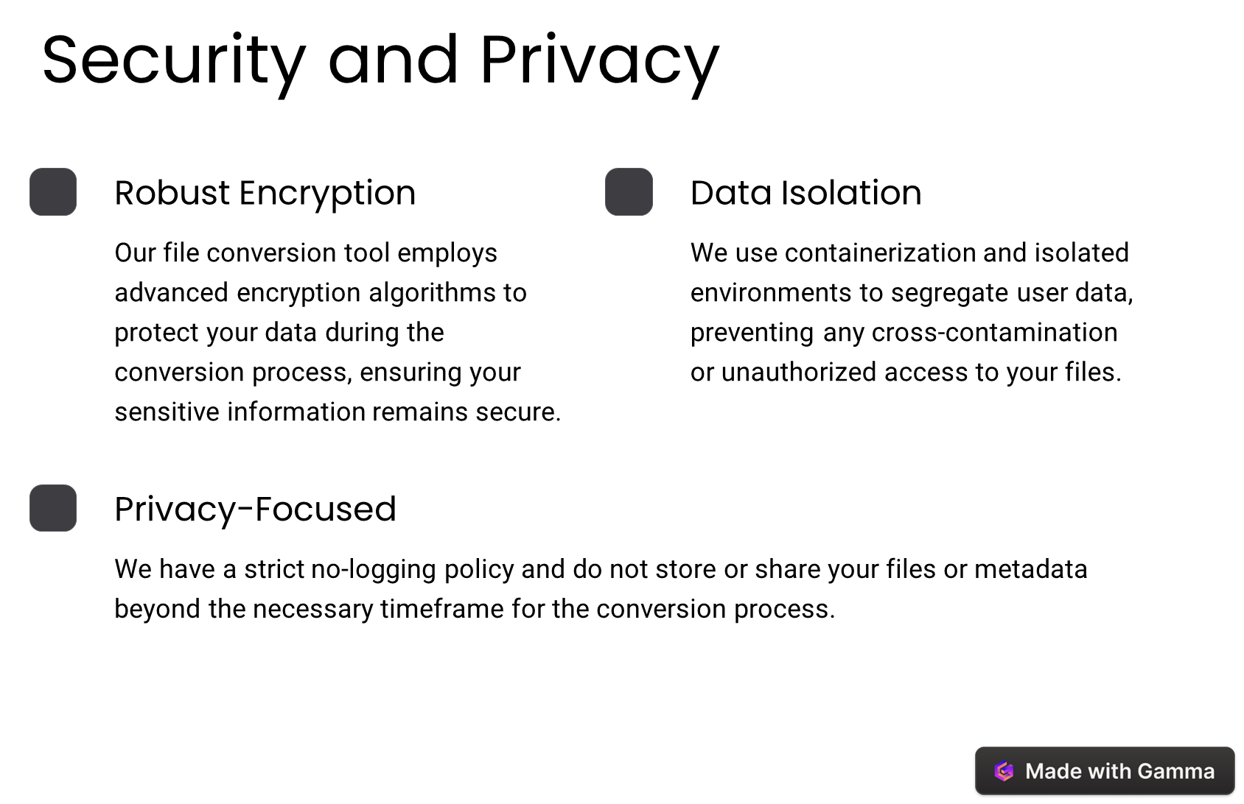

Slide 9
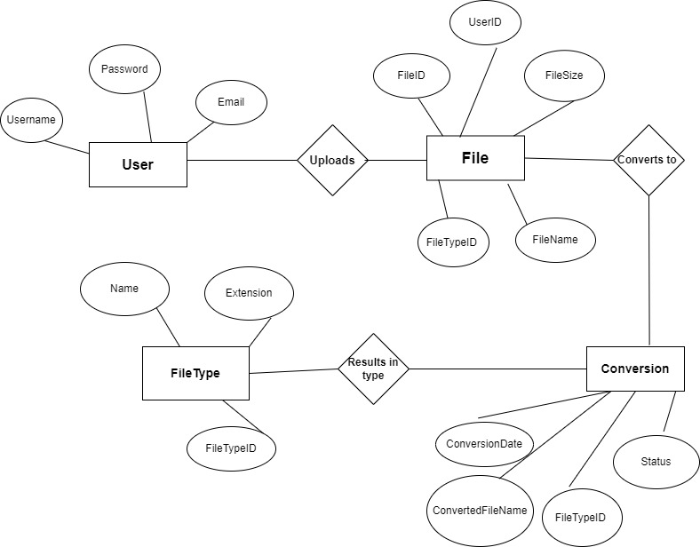
Design Diagram

Slide 10
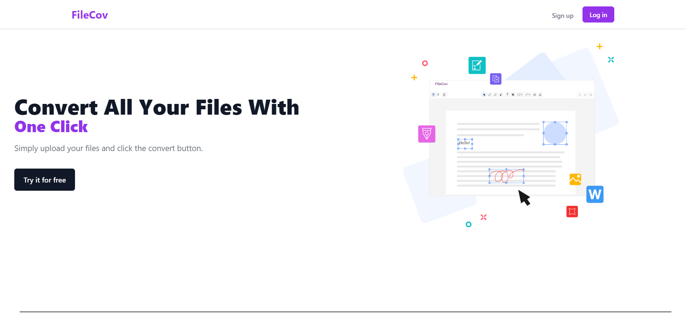

Slide 11
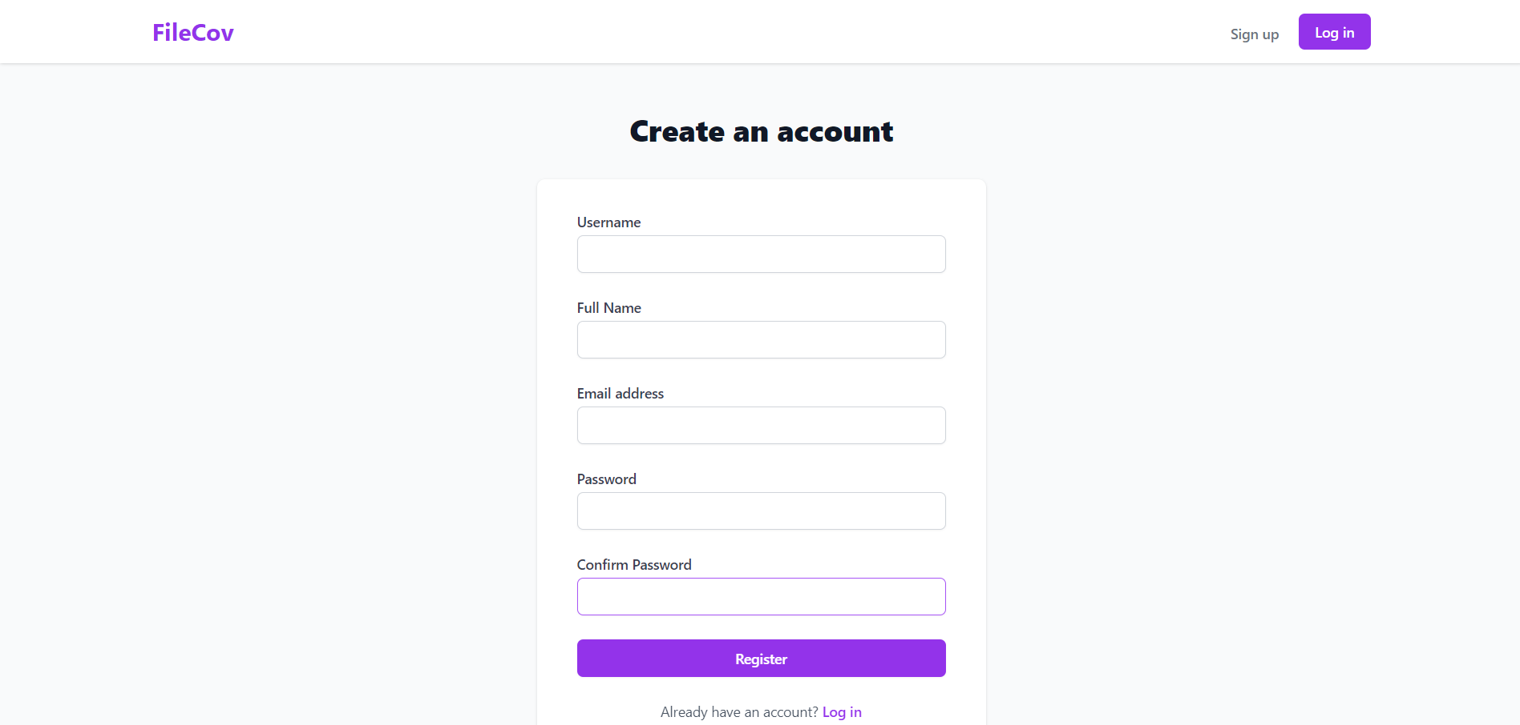

Slide 12
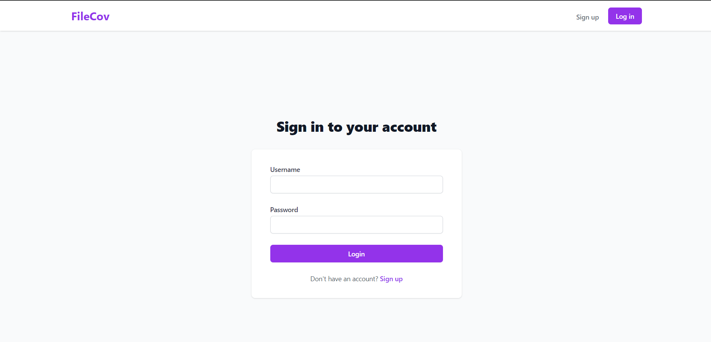

Slide 13
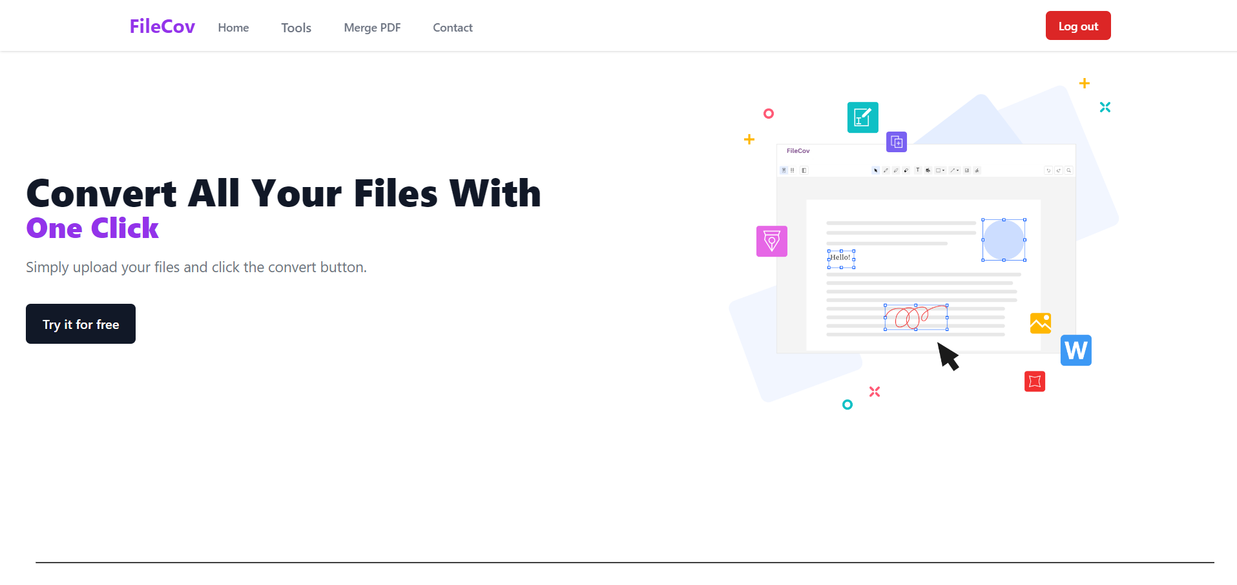

Slide 14
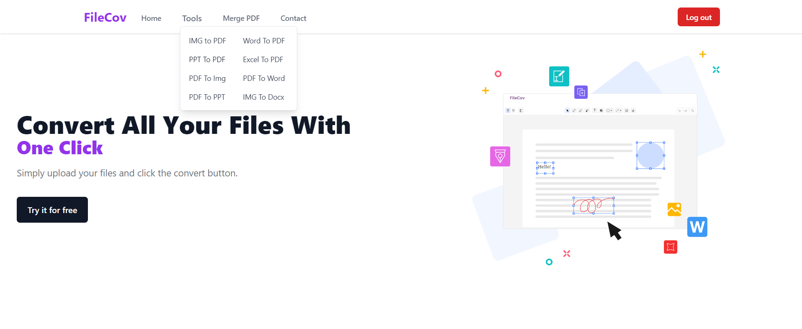

Slide 15
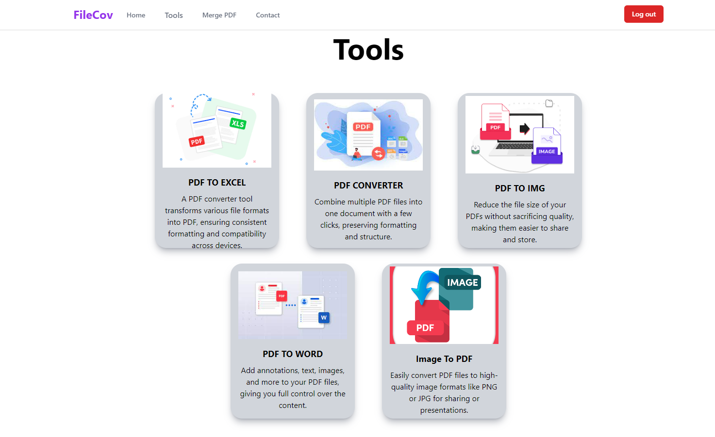

Slide 16
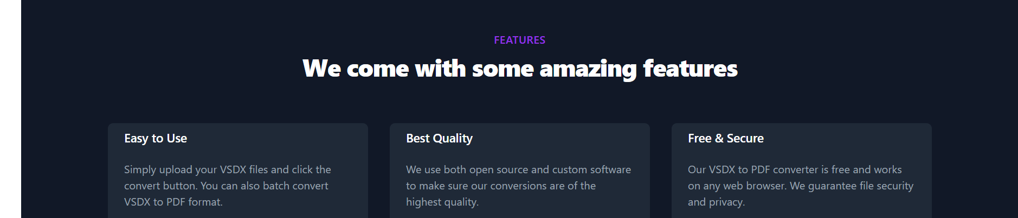
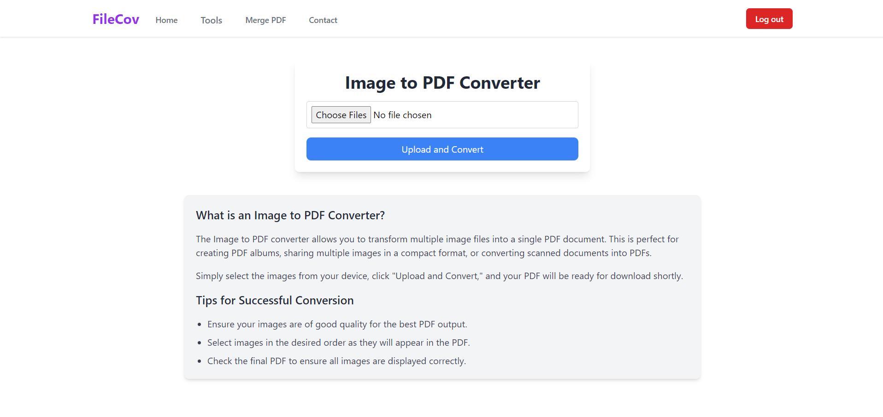

Slide 17
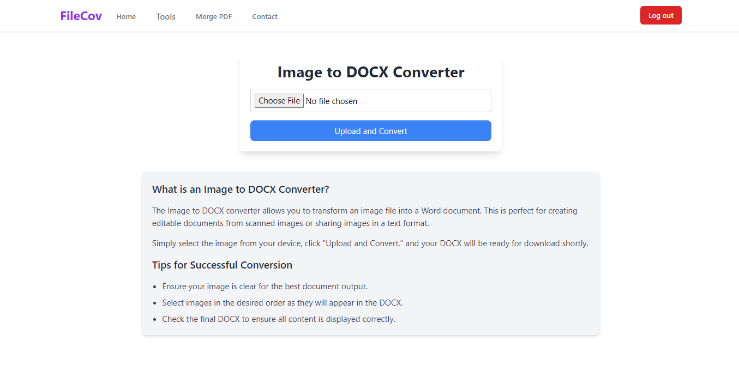

Slide 18
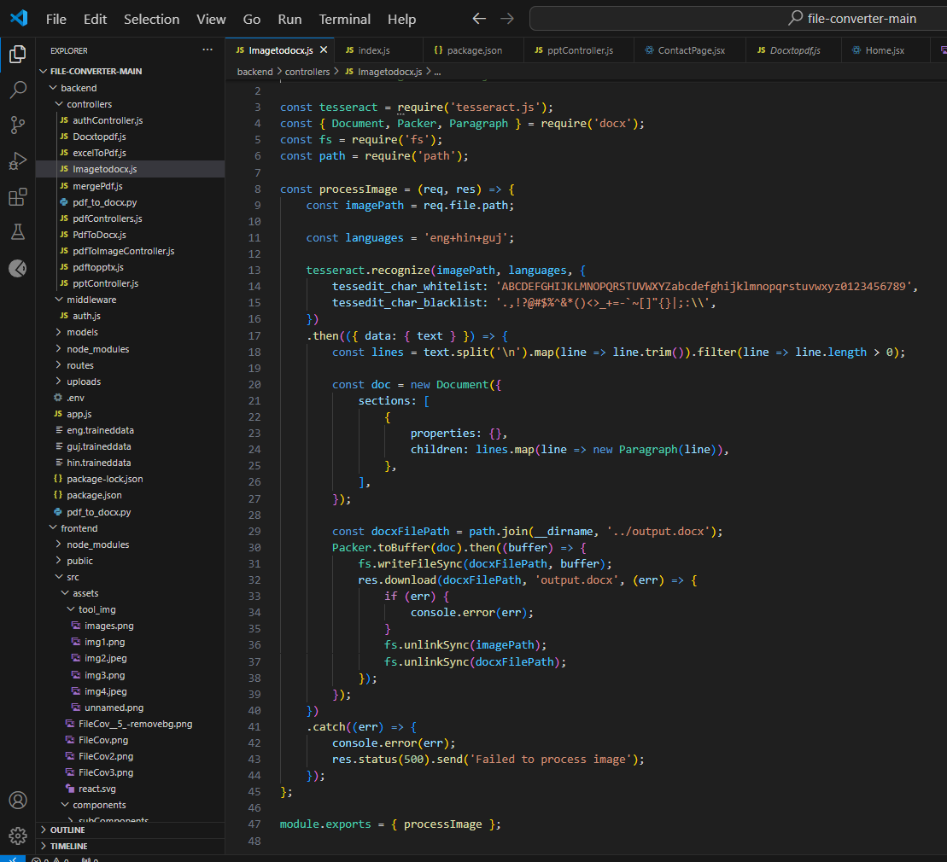

Slide 19
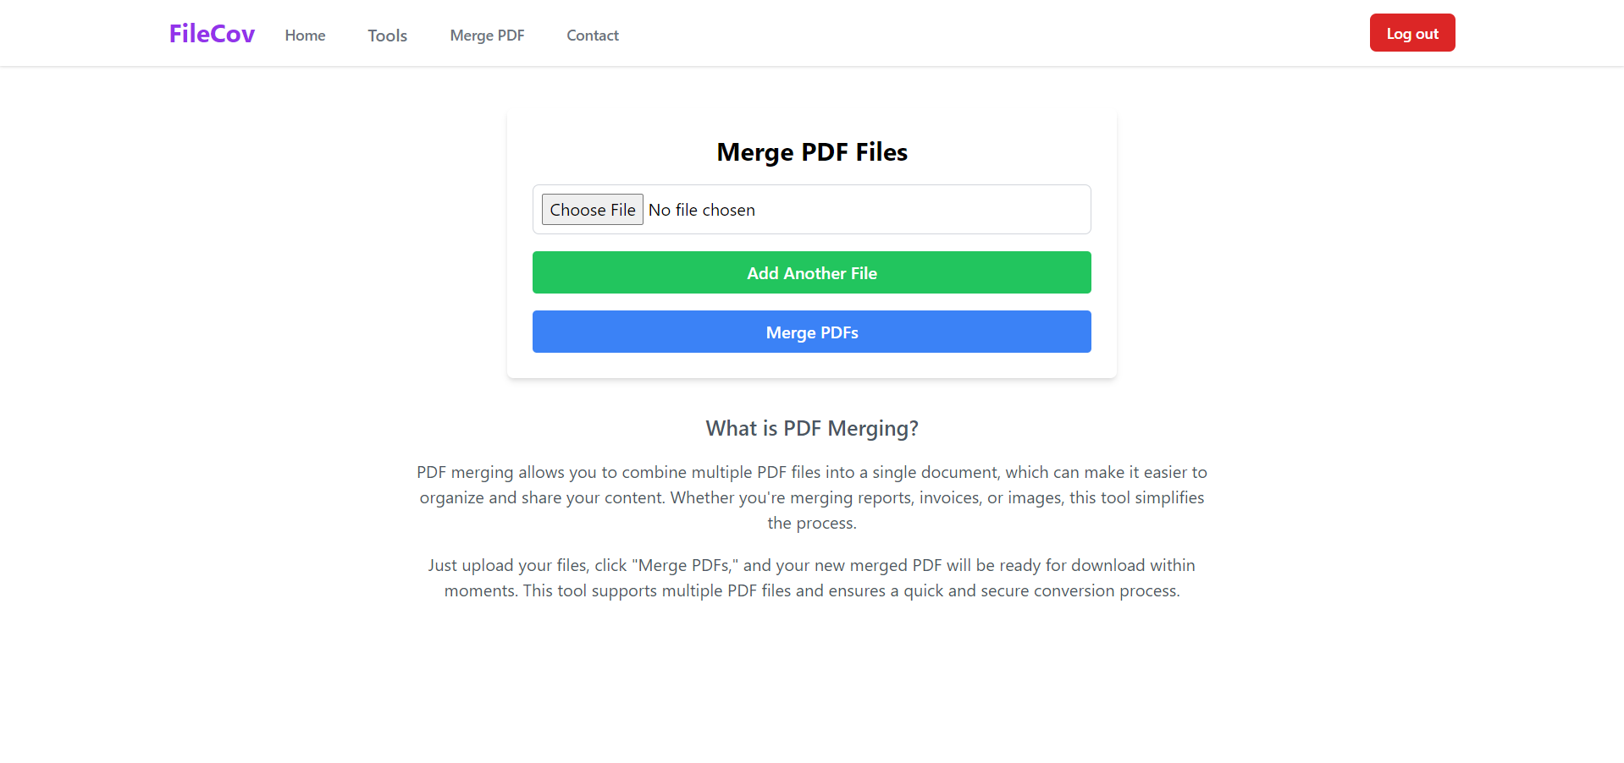

Slide 20
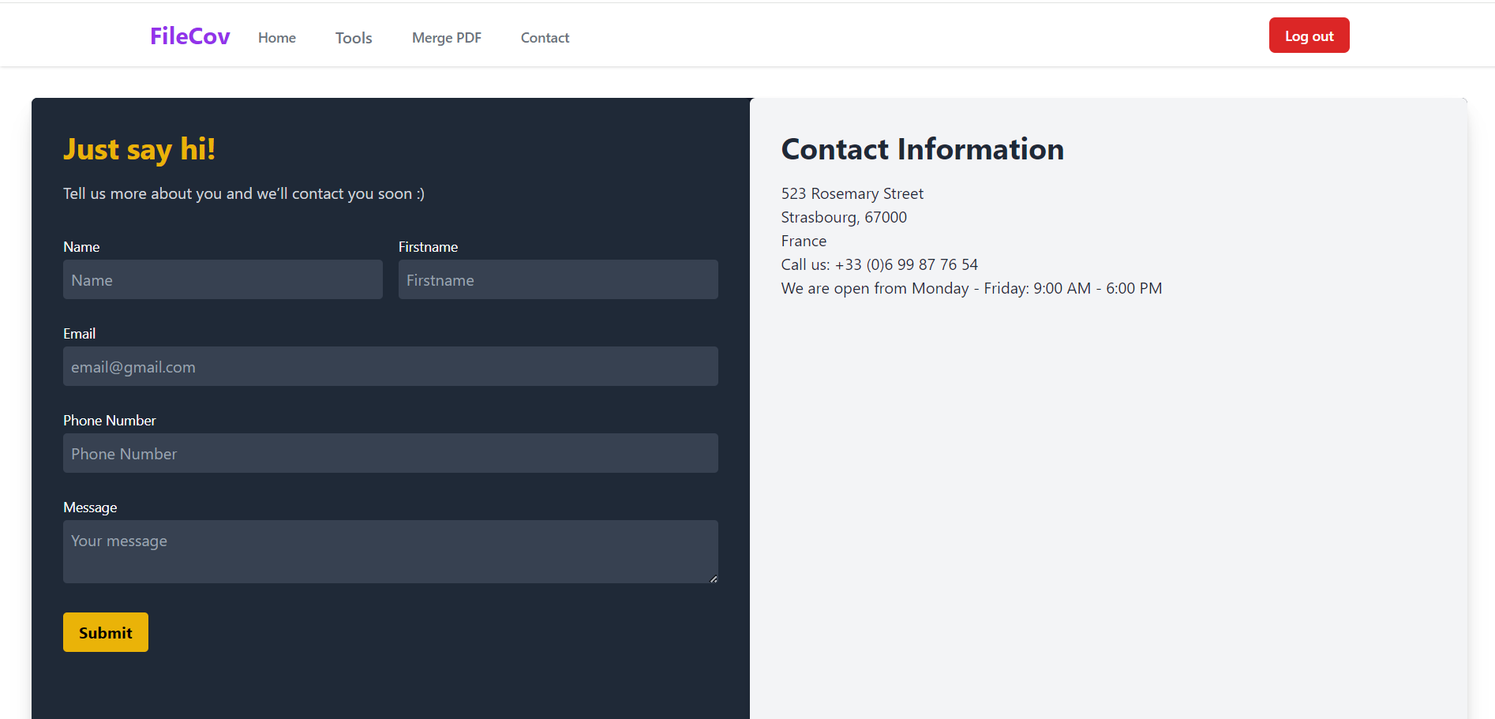

Slide 21
References
Convertio: A popular online converter with a wide range of supported formats, including documents, images, audio, video, and ebooks.
[Convertio]
Zamzar: Another well-known online converter offering various file types and some advanced features like batch conversions.
[Zamzar]
CloudConvert: Offers a robust set of conversion options, including cloud storage integration and document editing tools (paid plans).
[CloudConvert]

Slide 22


-------------------------------------------------------------------------------------------------------------------------

