Slide 1

IBM BOB 2.0 HACKATHON 2026
CODEPILOT
AI-Assisted Developer Workflow
with IBM Bob 2.0
From bug report to verified fix.
BUG → INVESTIGATE → FIX → TEST → VERIFY
TEAM CODEPILOT
Patel Princekumar · Rudra Patel · Abhishek Chikhaliya

Slide 2
PROBLEM
02
Debugging Is Not Just Fixing One Line
BUG REPORT
ENDPOINT
SERVICE
REPOSITORY
ROOT CAUSE
FIX
TEST
VERIFY
Repository-scale debugging requires connecting information across multiple layers.
Src/api/tasks.py
→ src/services/task_service.py
→ src/repositories/task_repository.py
→ tests/test_tasks.py
When a bug crosses multiple layers, developers spend time understanding the codebase before they can confidently fix the issue.

Slide 3
SOLUTION · HUMAN IN THE LOOP
03
CodePilot Turns Debugging Into a Structured Workflow
BUG REPORT
INVESTIGATE
Understand repository behavior
REPOSITORY ANALYSIS
ROOT CAUSE
FIX
Trace and correct root causes
MINIMAL FIX
REGRESSION TESTS
VERIFY
Run regression and full-suite validation
FULL SUITE
VERIFICATION
IBM Bob 2.0 → DEVELOPMENT AGENT CodePilot → DEVELOPER WORKFLOW TaskFlow API → TARGET CODEBASE

Slide 4
DEVELOPMENT EVIDENCE
04
IBM Bob 2.0 Is Part of the Development Process
ISSUE
REPO ANALYSIS
INVESTIGATION
ROOT CAUSE
IMPLEMENTATION
REGRESSION
VERIFY
BOB SESSION 01
01_progress_investigation.png
BOB SESSION 02
02_progress_fix_verification.png
BOB SESSION 03
03_status_investigation.png
BOB SESSION 04
03_assignee_investigation.png
BOB SESSION 05
04_regression_tests.png
Bob was used during development—not embedded inside Streamlit.
IBM Bob 2.0 investigated repository behavior, traced root causes, implemented fixes, reviewed regression scenarios and validated the resulting test suite.

Slide 5
SYSTEM ARCHITECTURE
05
From Developer Report to Verified Change
DEVELOPER BUG REPORT
DATASET · data/bug_reports.json
CODEPILOT · Investigate / Fix / Test
TASKFLOW API · FastAPI
CODEBASE · Models / Repositories / Services / API
TEST SUITE · pytest
VERIFICATION · 41 PASSED / 0 FAILED
PYTHON FASTAPI PYDANTIC PYTEST STREAMLIT IBM BOB 2.0

Slide 6
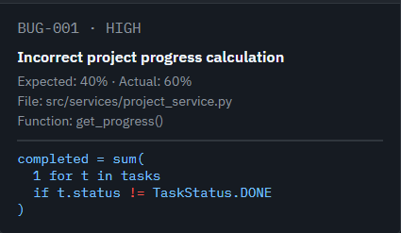
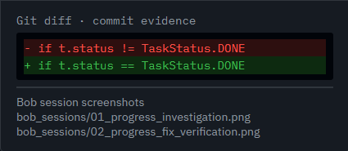


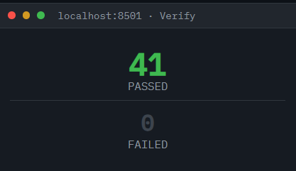
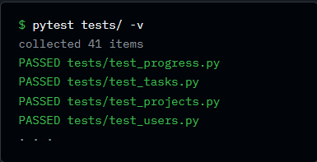
LIVE PROTOTYPE
06
The Working Prototype
VERIFY
41 passed / 0 failed

Slide 7
REAL DEBUGGING EXAMPLE
07
Example: Incorrect Project Progress
BUG
ROOT CAUSE
FIX
5 total tasks, 2 completed
Expected: 40%
Actual: 60%
completed = sum(
1 for t in tasks
if t.status != TaskStatus.DONE
)
completed = sum(
1 for t in tasks
if t.status == TaskStatus.DONE
)
VERIFICATION 41 TESTS · 41 PASSED · 0 FAILED

Slide 8
REGRESSION TESTING
08
The Fix Was Not Enough — We Tested the Workflow
BEFORE · 31 TESTS
EXPANSION · +10
FINAL · 41 TESTS
RESULT · 41 PASSED / 0 FAILED
COVERAGE ADDED
status blocked · status done · missing task handling
assignment handling · status/assignee preservation
project filtering · status filtering · assignee filtering · combined filters
$ pytest tests/ -v
================ test session starts ================
collected 41 items
.........................................
41 passed, 0 failed, 80 warnings
Warnings are existing datetime deprecation warnings, not test failures.

Slide 9
SYNTHETIC · TEAM-CREATED
09
A Structured Bug-Report Dataset
data/
├── bug_reports.json
└── README.md
{
"bug_id": "BUG-001",
"affected_file": “src/services/project_service.py",
"affected_function": “get_progress()",
"severity": “high",
"status": “fixed"
}
BUG-001 Incorrect project progress calculation
BUG-002 Task status update not persisting
BUG-003 Task filter arguments swapped
FIELDS bug_id · title · description · expected_behavior · actual_behavior · affected_area · affected_file · affected_function · severity · status
All records are synthetic and team-created. No personal, confidential, client, social-media or private data is used.

Slide 10
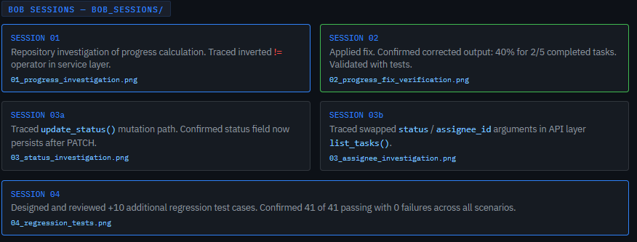
TRACEABILITY & REPRODUCIBILITY
10
Every Development Step Leaves Evidence
BUG REPORT
AFFECTED FILE
BOB SESSION
GIT CHANGE
REGRESSION TEST
VERIFICATION
CodePilot makes debugging inspectable and reproducible—not an unexplained final answer.

Slide 11
MEASURED ON THE CURRENT PROTOTYPE
11
What We Demonstrated
3
10
41
41/41
0
DEBUGGING SCENARIOS
ADDITIONAL REGRESSION TESTS
TOTAL TESTS
PASSING
FAILED
CodePilot connects repository investigation, implementation, regression testing and verification into one developer workflow.
Prototype measurements are based on the current TaskFlow API test suite.

Slide 12
ORIGINALITY & VALUE
12
Why CodePilot?
STRUCTURED
EVIDENCE-DRIVEN
VERIFICATION-FIRST
Turns an unstructured bug report into a traceable workflow.
Connects investigation, source changes, Bob sessions and tests.
Does not stop at a fix; it validates the resulting code.
FUTURE SCOPE · POTENTIAL, NOT IMPLEMENTED
Larger repositories · Additional debugging patterns · Automated code review
Test-generation workflows · Maintenance and release workflows

Slide 13
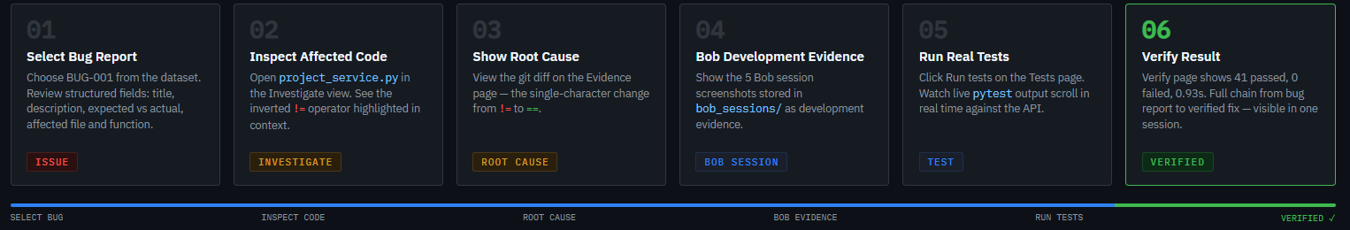
ACTUAL PROTOTYPE · TASKFLOW API
13
Live Demo
Demo uses the actual CodePilot prototype and TaskFlow API.
streamlit run app.py → select → inspect → test → verify

Slide 14
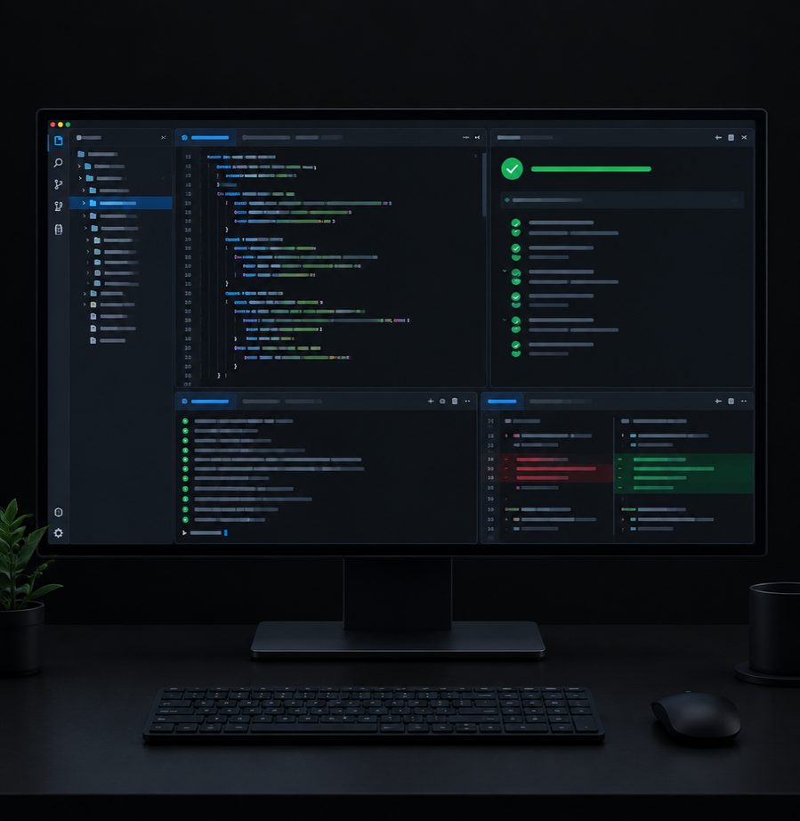
FROM BUG REPORT TO VERIFIED FIX
CODEPILOT
AI-Assisted Developer Workflow with IBM Bob 2.0
Investigate. Fix. Test. Verify.
TEAM CODEPILOT
Patel Princekumar · Rudra Patel · Abhishek Chikhaliya
IBM Bob 2.0 Hackathon 2026

