Slide 1
SmartRoute AI
Port
Congestion
Shipment
Risk
Weather
Alert
Supply Chain Disruption Assistant & Fleet Utilisation Optimizer
Vessel
Failure
IBM Bob AI Innovation Hackathon 2026
Team PI-NANT
Kashyap Nasit | Patel Princekumar | Patel Rudrakumar
Notes:
Opening slide. Team PI-NANT presenting SmartRoute AI for the IBM Bob AI Innovation Hackathon 2026. This is an AI-powered supply chain control tower.

Slide 2
The Problem
2
Supply chains are complex, disruptions are constant, and manual response is too slow.
Port Congestion
Port congestion can block shipping lanes and delay deliveries.
Extreme Weather
Cyclones and storms force route diversions adding days and cost.
Vessel Failures
Vessel failures can strand cargo and cause significant delays.
Cold-Chain Risk
Temperature excursions can damage pharmaceutical and perishable cargo.
Fleet Under-Utilisation
Vessels sit idle while disrupted routes have no available cover.
Manual Response
Rerouting across carrier portals takes hours — often too late.
Notes:
Six problem dimensions that SmartRoute AI addresses. No numerical claims — all statements are qualitative and supportable from the project documentation.

Slide 3
Our Solution
3
Risk Scoring
0-100 with CRITICAL/HIGH/
MEDIUM/LOW classification
Route Recommendation
Alternatives with delay
and cost estimates
SmartRoute AI
Disruption Detection
Port, weather, strike
and vessel events
Fleet Optimisation
Vehicle availability,
utilisation metrics
Cold-Chain Monitor
Excursion detection,
temperature risk scoring
AI Explanations
IBM watsonx.ai
Granite 13B Instruct
One dashboard. Every affected shipment surfaced, scored, and routed — automatically.
Notes:
SmartRoute AI centralises six capabilities that currently require separate tools: disruption detection, risk scoring, route recommendation, fleet utilisation, cold-chain monitoring, and AI-generated explanations. All driven by IBM watsonx.ai and accessible via IBM Bob MCP tools.

Slide 4
How It Works
4
1
Shipment Data
Loaded from JSON records — origin, destination, carrier, ETA, cargo type
5
Fleet Optimizer
Checks vehicle availability, capacity, reefer slots, and idle status
2
Disruption Detection
Matches active port/weather/strike/vessel events to each shipment
6
Cold Chain Monitor
Analyses temperature log readings against safe range, scores excursion severity
or
3
Risk Engine
5-factor scoring: disruption severity, delay, deadline, priority, cold-chain
7
watsonx.ai / Mock AI
Builds structured prompt from risk context, calls Granite 13B, returns explanation
4
Route Advisor
Filters alternative routes that avoid active disruptions and match cargo type
8
Actionable Output
Dashboard shows: risk score, disruptions, alternative routes, vehicle, AI advice
Notes:
The eight-step pipeline. Steps 1-4 run left column (data → detection → scoring → routing). Steps 5-8 run right column (fleet → cold-chain → AI → output). Everything feeds into the Streamlit dashboard or is accessible via the IBM Bob MCP server.

Slide 5
System Architecture
5
INTERFACE LAYER
Streamlit Dashboard
src/app.py
5 pages
IBM Bob MCP Server
src/mcp_server.py
7 tools
IBM Bob CLI
(natural language
interface)
CORE ENGINE (src/core/)
Disruption
Detector
Risk
Engine
Route
Advisor
Fleet
Optimizer
Cold Chain
Monitor
watsonx
Client
DATA LAYER (src/data/)
IBM watsonx.ai
Granite 13B Instruct
(or mock fallback)
shipments.json | disruptions.json | vehicles.json | temperature_readings.json
Notes:
Three-layer architecture. Interface: Streamlit (human) and MCP Server (IBM Bob). Core: six Python modules in src/core/. Data: four JSON files — no database required. watsonx.ai sits alongside the core engine and is called only for AI explanations; a mock fallback ensures the app runs without credentials.

Slide 6
Key Features
6
Shipment Risk Analysis
5-factor score 0-100. Classification: CRITICAL / HIGH / MEDIUM / LOW with per-factor breakdown.
Disruption Detection
5 matching rules: explicit link, route, carrier, port, vessel. Active and monitoring events.
Route Recommendation
Alternatives filtered by disruption avoidance and cargo type. Shows extra days and cost.
Vehicle Recommendation
Filters by availability, TEU, weight, reefer slots. Ranks by best fit for cargo type.
Cold-Chain Monitor
Temperature excursion detection with NORMAL / WARNING / CRITICAL severity and 0-100 risk score.
IBM Bob MCP Server
7 tools: get_shipment_risk, recommend_route, recommend_vehicle, get_fleet_status, get_temperature_alerts, explain_shipment.
Notes:
Eight implemented features across the three parts. All features are backed by real Python code and tested with 191 pytest tests. The MCP server exposes 7 tools that IBM Bob can call in natural language.

Slide 7
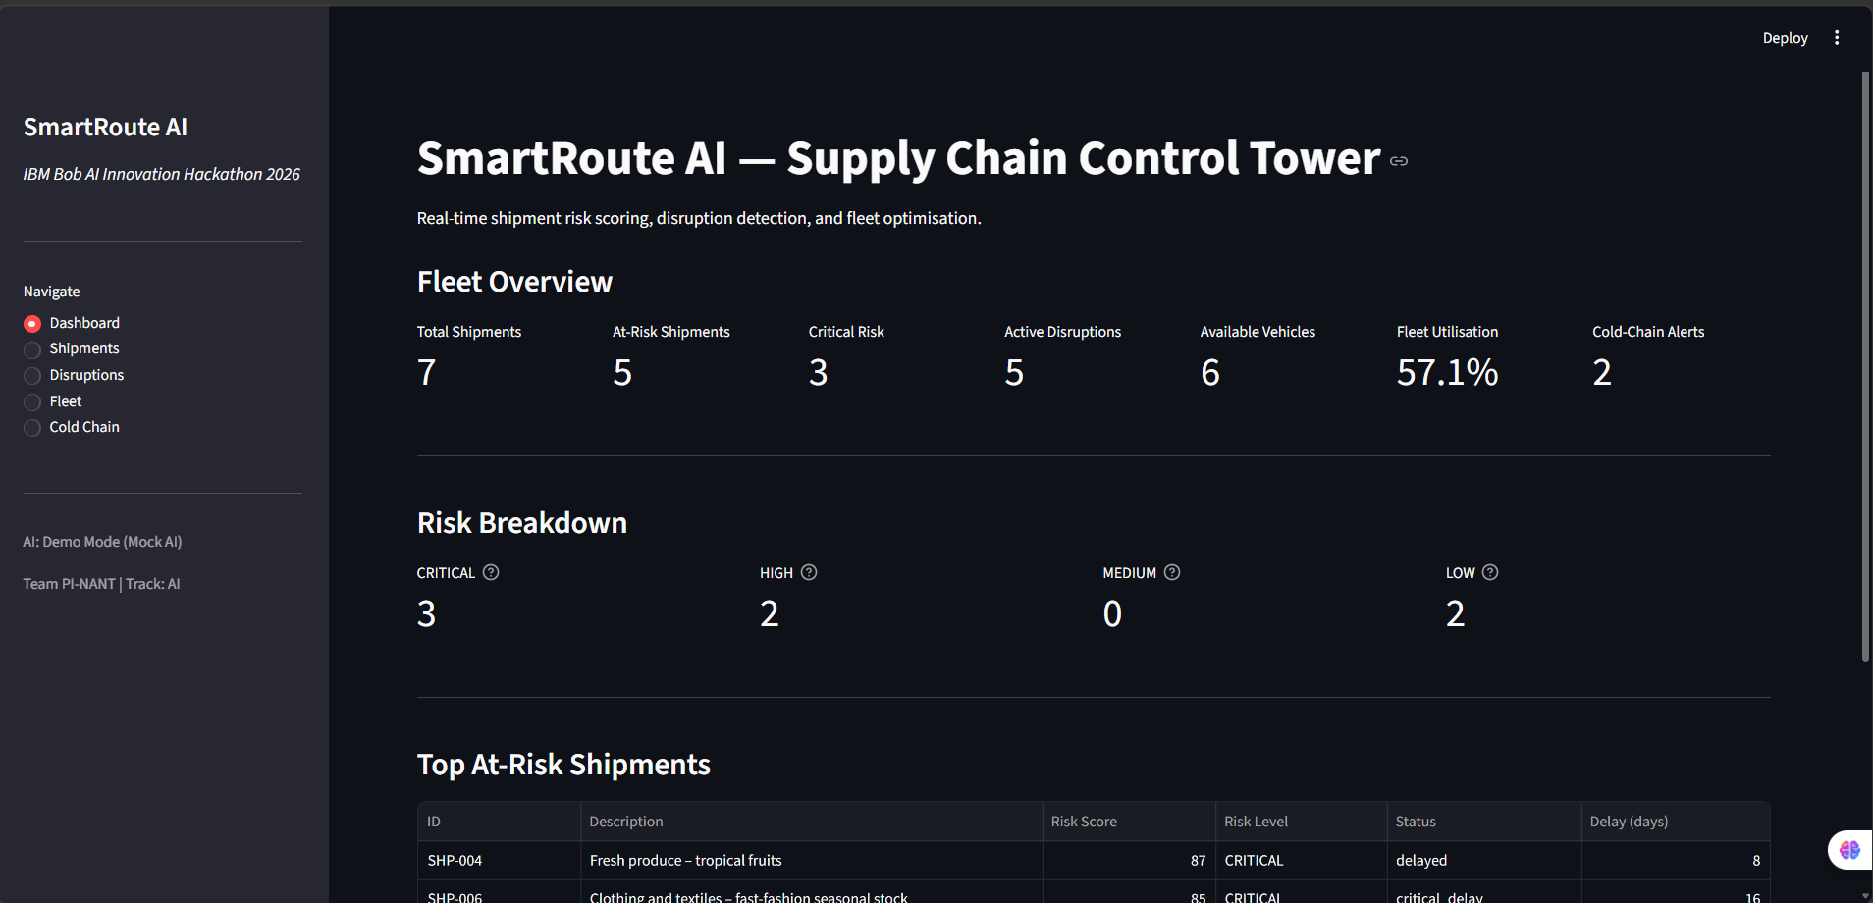
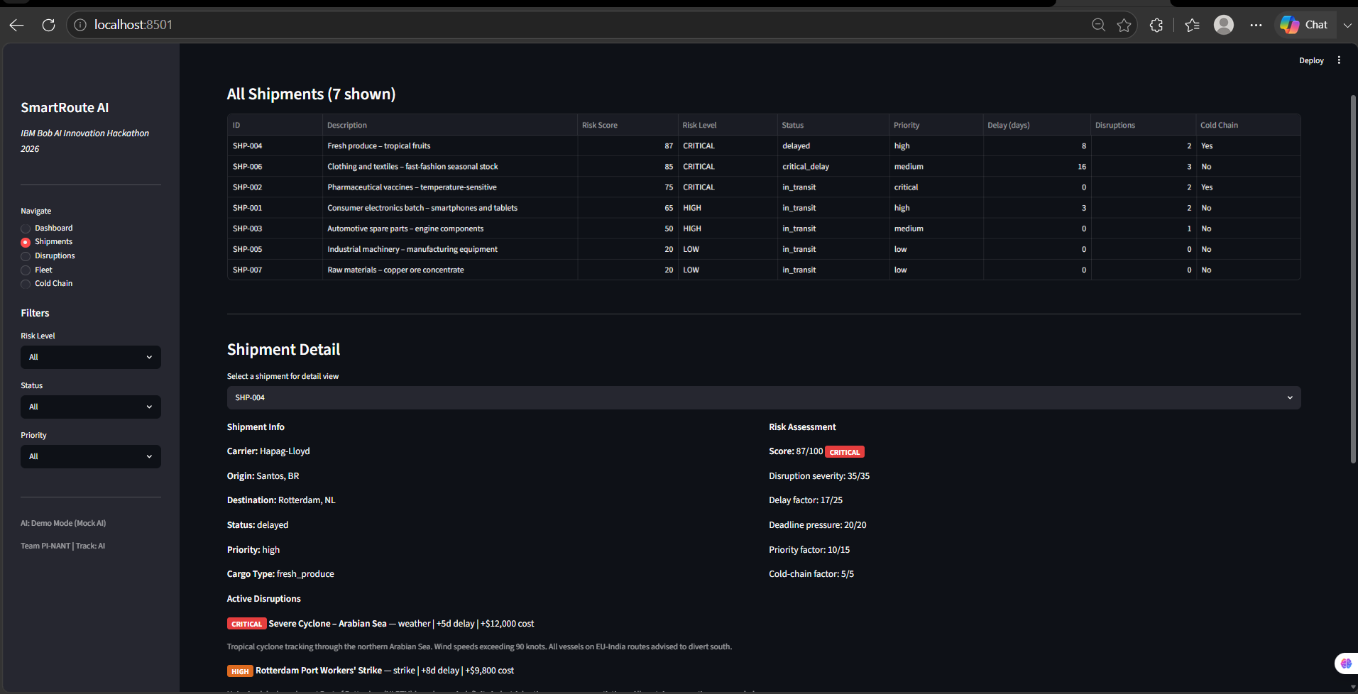
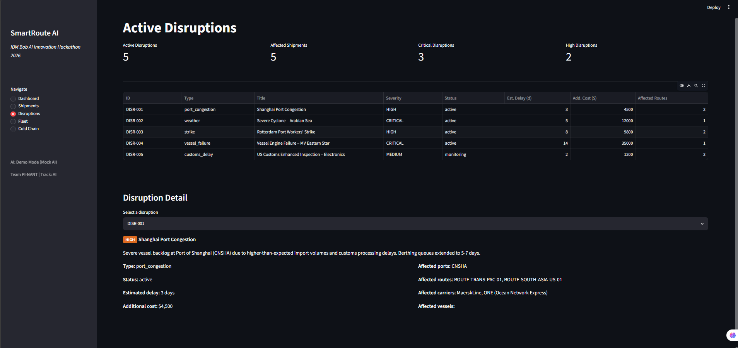
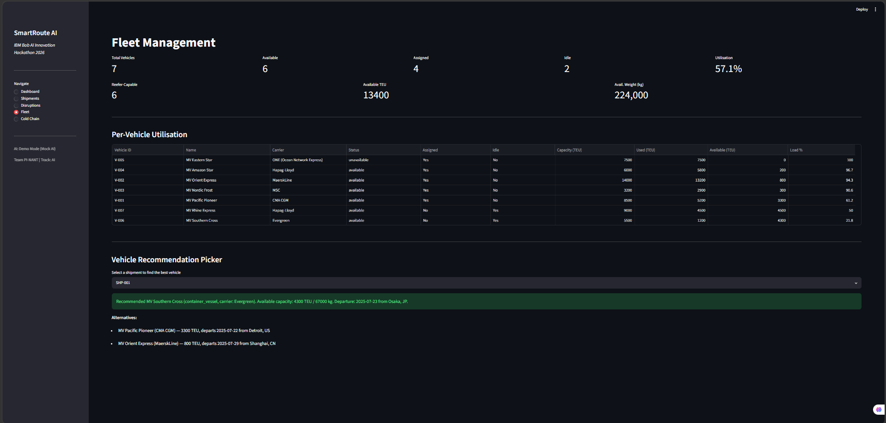
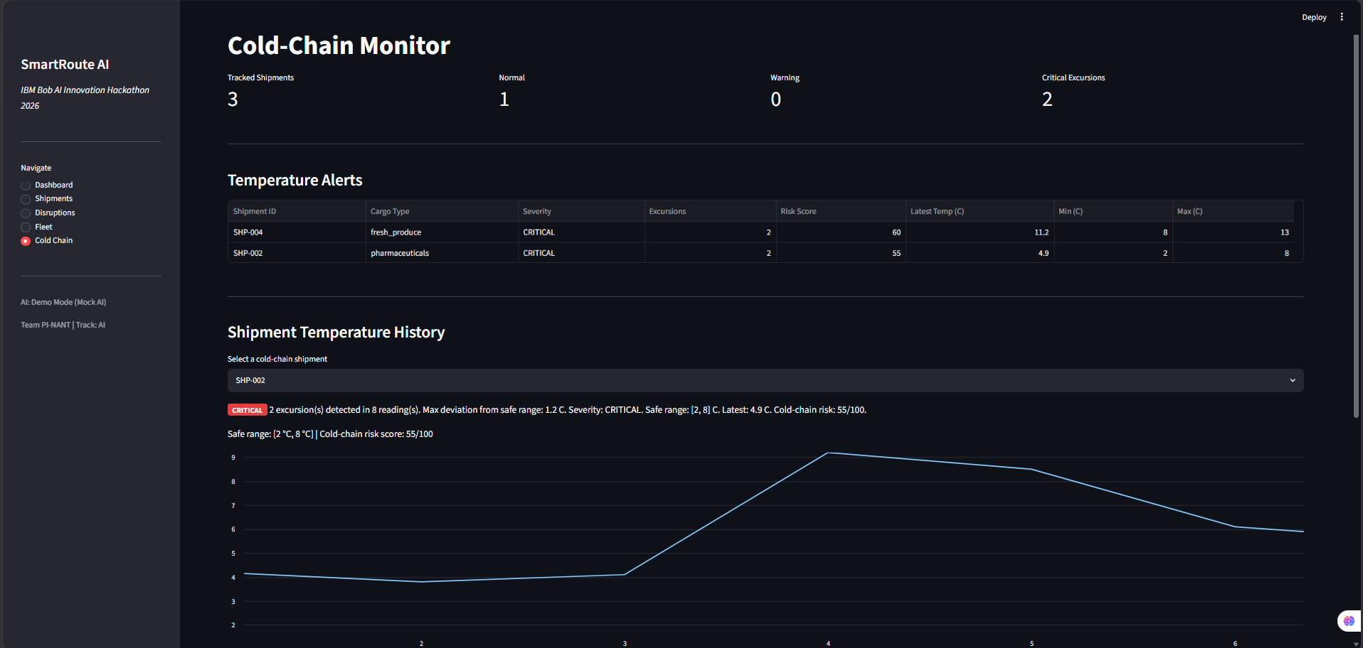
The Application
7
Dashboard — KPI cards and at-risk shipments
Shipment Analysis — risk, disruptions, routes, vehicle, AI explanation
Disruption Center
Fleet Utilisation
Cold Chain Monitor
Notes:
Five screenshots from the running application. All data is from the pre-populated mock JSON files. No credentials needed to run in demo mode.

Slide 8
IBM Bob + watsonx.ai Integration
8
IBM Bob — AI Development & SDLC Partner
Planning
Problem framing
and architecture design
Coding
Code generation
for all 3 parts
Refinement
Docs, tests
and MCP interaction
->
->
Testing
191 pytest tests
all passing
Review & Debug
Code review
and debugging
IBM watsonx.ai — AI Explanation Runtime
Generates plain-English shipment risk explanations
Granite 13B Instruct model integration
Used when WATSONX_API_KEY, WATSONX_PROJECT_ID and WATSONX_URL are configured.
Mock fallback included — application runs fully without credentials.
IBM Bob does NOT perform watsonx.ai inference.
watsonx.ai is called directly by src/core/watsonx_client.py.
MCP Server — 7 Tools
Exposes SmartRoute AI to IBM Bob for natural-language queries
get_shipment_risk | recommend_route | recommend_vehicle
get_fleet_status | get_temperature_alerts
explain_shipment | get_shipment_disruptions
Notes:
Key distinction: IBM Bob is the AI development and SDLC partner and the MCP interaction layer. watsonx.ai is the AI inference runtime for explanations. IBM Bob does NOT call watsonx.ai directly — it calls our MCP tool explain_shipment, which calls watsonx_client.py, which calls the watsonx.ai API (or mock fallback). Two clearly separated roles.

Slide 9
Impact & Innovation
9
Expected benefits — not measured production metrics. These are the intended outcomes of the system.
Faster Disruption Response
Affected shipments are surfaced automatically rather than discovered during manual portal checks.
Confident Route Decisions
Alternatives are pre-filtered by disruption avoidance, cargo type, and real vehicle availability.
Improved Fleet Utilisation
Idle vessels are identified and can be matched to shipments that need rerouting cover.
Earlier Cold-Chain Alerts
Temperature excursions are classified before delivery, enabling cargo recovery decisions.
What makes this different
Single Python codebase — no database, no external map APIs, no broker services. Runs locally with one command. IBM Bob MCP integration means a logistics coordinator can query the entire supply-chain engine in natural language without opening the dashboard.
Notes:
Expected benefits, not measured metrics. The innovation is simplicity: the entire system runs with pip install and one command. The IBM Bob MCP integration is load-bearing — it's not a name-drop; every tool calls the real project functions.

Slide 10
Demo & Conclusion
10
Live Demo Flow
Key Takeaways
Dashboard
→ Select Shipment
→ Risk Analysis
→ Disruption
→ Route / Vehicle Recommendation
→ Cold Chain
→ AI Explanation
End-to-end visibility
All affected shipments surfaced and scored automatically
AI-powered risk scoring
5-factor engine, 0–100 scale, CRITICAL / HIGH / MEDIUM / LOW
Cold-chain compliance
Excursion detection protects pharmaceutical and perishable cargo
Fleet optimisation
Idle vehicles identified and matched to rerouting needs
IBM Bob + watsonx.ai
Bob = SDLC partner & MCP layer · watsonx.ai = AI runtime
GitHub: github.com/Patelprincekumar2007/sample_repo_for_ibm Deployment: NOT DEPLOYED
Team PI-NANT · Kashyap Nasit · Patel Princekumar · Patel Rudrakumar · IBM Bob AI Innovation Hackathon 2026
Notes:
Demo script: 1) Home Dashboard — risk gauge, KPI tiles, disruption count. 2) Select SHP-002 — carrier, route, cargo type, ETA. 3) Risk Analysis — HIGH score with per-factor breakdown showing cold-chain + disruption contributions. 4) Disruption — CRITICAL severity filter, SHP-002 affected badge. 5) Route/Vehicle Recommendation — ranked alternatives, best-fit vehicle matched to cargo. 6) Cold Chain — CRITICAL excursion alert on SHP-002, temperature deviation. 7) AI Explanation — IBM Bob calls the explain_shipment MCP tool; watsonx.ai (NOT Bob itself) returns a plain-English risk summary. Key clarification for judges: IBM Bob is the SDLC partner and MCP interaction layer. watsonx.ai is the separate AI inference runtime.

