Slide 1
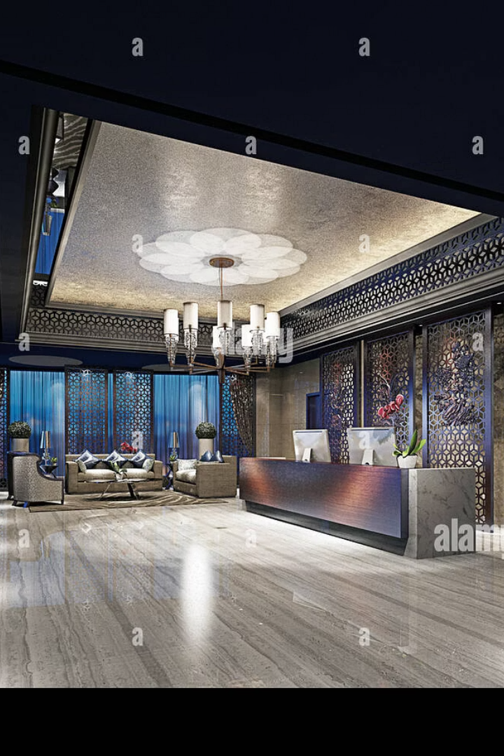
Hotel Management System:
Automate hotel operations using Java to enhance efficiency and accuracy.
Core functions include booking, check-in/out, billing, and availability tracking.
K. Himakar Reddy - AP22110011215
M. Lohith - AP22110011229
B. Sai Ganesh - AP22110011320
Ishraful Ansari - AP22110011525
Sandesh Patel - AP22110011637
Yadav Sarbesh - AP22110011510

Slide 2

Project Objective: Streamlining Hotel Operations
Comprehensive Java-based System
Efficiency Focus
Simplifies booking, check-in/out, and billing.
Automates core hotel services seamlessly.
Accuracy Enhancement
Improves data reliability and service quality.

Slide 3
Key Features: Core Functionality
Room Reservation & Cancellation
Customer Check-in & Check-out
Real-time Room Availability
Bill Generation & Payment Tracking
Admin Dashboard
User-friendly GUI

Slide 4
System Architecture: High-Level Design
Presentation Layer
Business Logic Layer
Data Layer
Java Swing GUI for user interaction.
Handles core application processes.
Manages database interactions and storage.

Slide 5
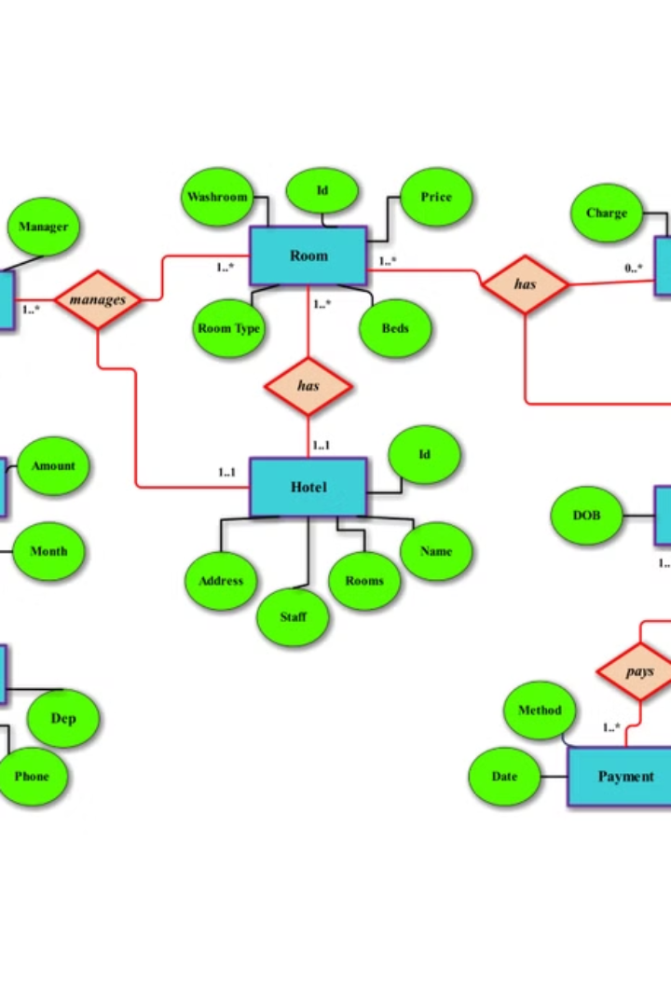
Database Design: Data Management
MySQL Database
Key Tables
Stores all hotel-related data securely.
Rooms, Customers, Reservations, Bills, Users.
Relationships
ER diagram illustrates data connections.

Slide 6
User Interface: Intuitive Design
Room Availability
Admin Dashboard
Booking Module
Check-in/Check-out Module
Displays real-time room status and bookings.
Manage rooms, customers, and generate reports.
Streamlined reservation process for users.
Simplifies guest handling efficiently.

Slide 7

Implementation Details: Java Code
Technologies Used
Code Structure
Java Swing, JDBC, MySQL Connector for connectivity.
Organized in packages and classes for clarity.
Sample Code
Showcases key functionalities and modular design.

Slide 8
Testing and Validation: Ensuring Quality
Unit Testing
Integration Testing
User Acceptance Testing
JUnit to validate individual components.
Ensures smooth module interactions.
Gathers feedback for refinement.

Slide 9
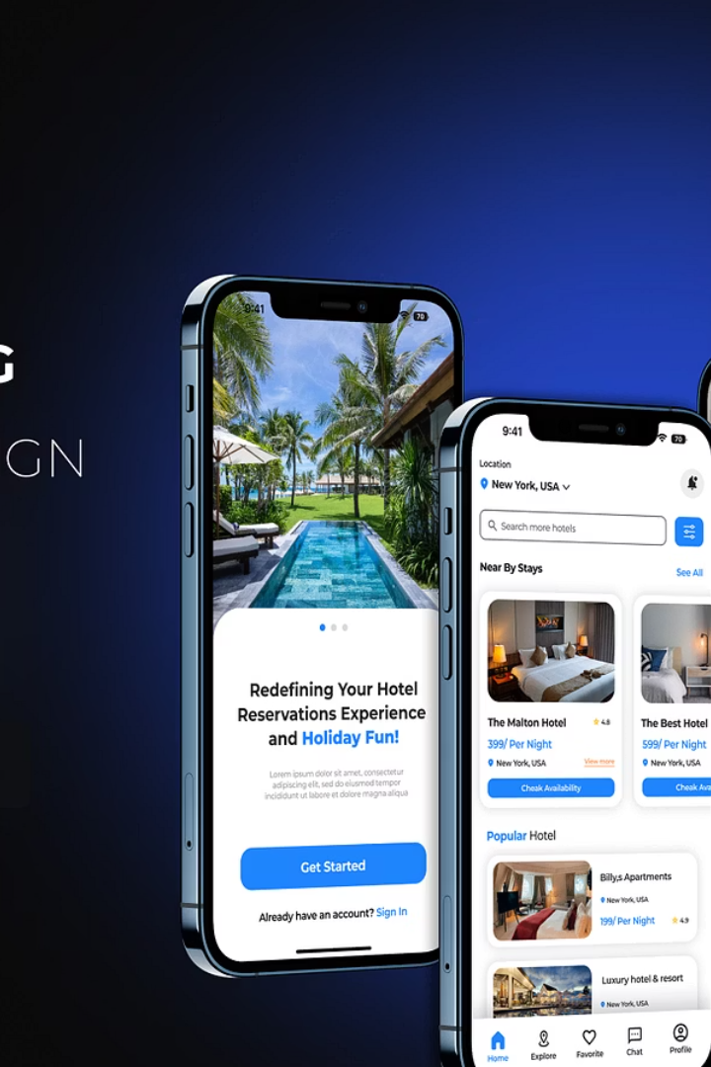




Future Enhancements: Expanding Capabilities
Online Payment Gateway
Secure digital transactions for convenience.
Cloud Deployment
Access system from anywhere with ease.
Mobile Application
Customer-friendly interface for bookings on-the-go.
Analytics Dashboard
Advanced reporting for data-driven decisions.

Slide 10
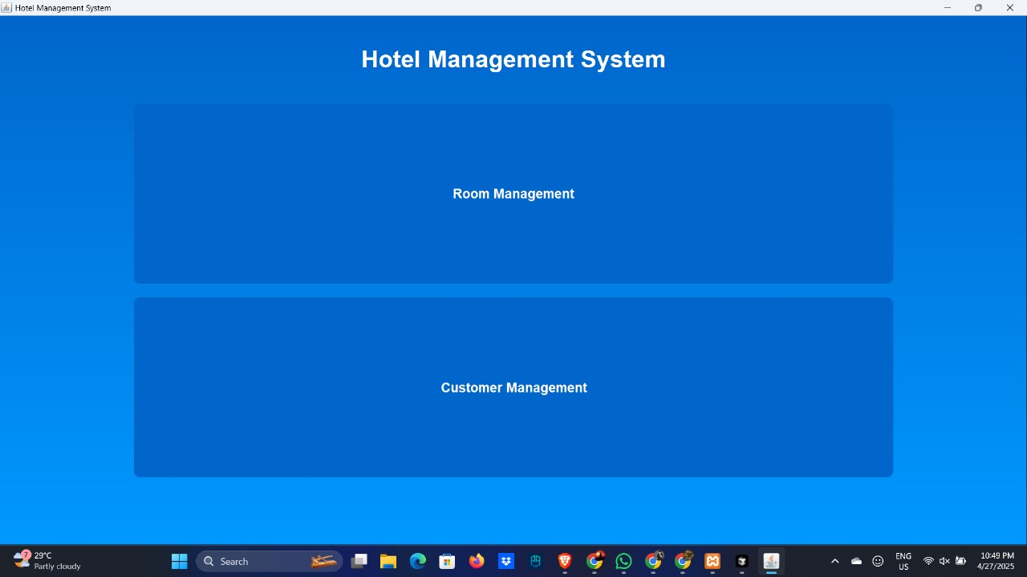
User Interfaces

Slide 11
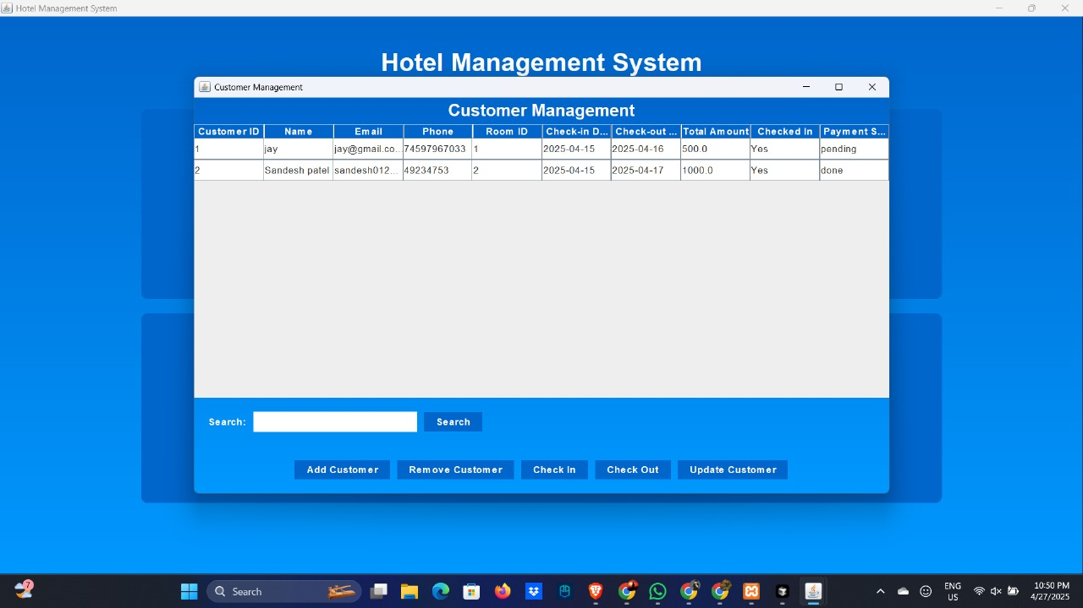
User Interfaces

Slide 12
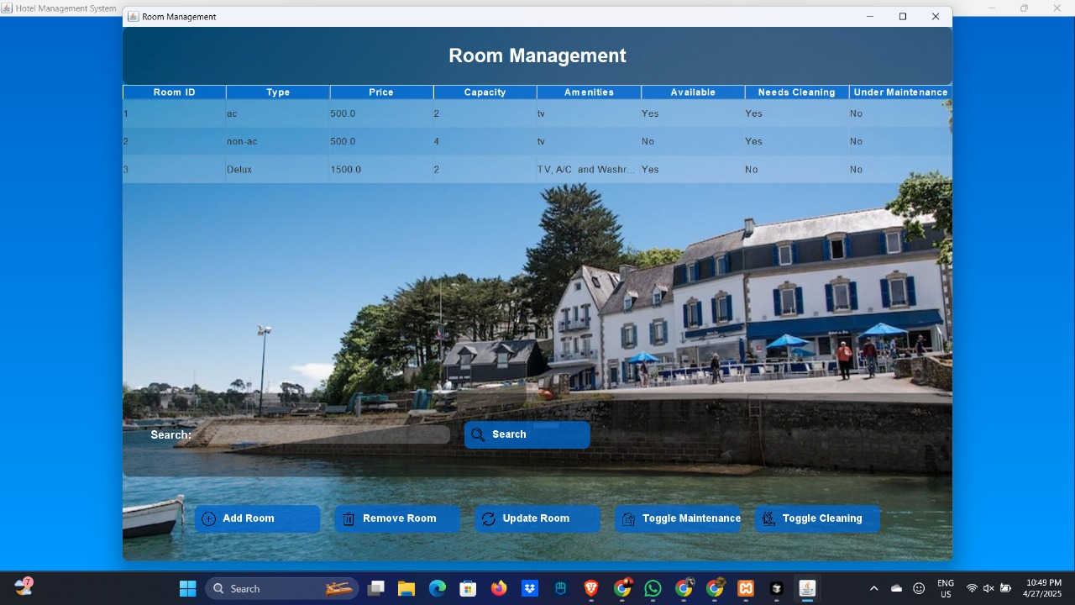
User Interfaces

Slide 13

Conclusion: Efficiency and Accuracy
Streamlined Operations
Customer Satisfaction
Reduces errors and manual workload substantially.
Fast, accurate service improves guest experience.
Scalable System Design
Supports future growth and feature additions.

