Slide 1


Kadi Sarva Vishwavidyalaya
N.P. College Of Computer Studies and Management, Kadi
BCA SEMESTER – IV
Subject Name : Project Work - IV
Subject Code : SEC204-2C
SUBJECT TYPE - SEC
Application Development
Group No : PW-IV_C14

Slide 2
Table of Contents
Specification | Slide No.
Group Details | 3
Project Title | 4
Task 1 : 1.1. Program Definition / Code / Diagram | 5,6
1.2. Output / Explanation | 7
Task 2 : 2.1. Program Definition / Code / Diagram | 8
2.2. Output / Explanation | 9
Task 3 : 3.1. Program Definition / Code / Diagram | 10
3.2. Output / Explanation | 11
Task 4 : 4.1. Program Definition / Code / Diagram | 12
4.2. Output / Explanation | 13
Task 5 : 5.1. Program Definition / Code / Diagram | 14
5.2. Output / Explanation | 15

Slide 3
Group Details
Group No. : PW-IV_ C14
S. NO | STUDENT NAME | ENROLLMENT NUMBER | ROLL NUMBER | EXAM NUMBER
1 | DARJI KARAN RAJESHBHAI | 24BCA24036 | 194 | 4194
2 | PATEL HARSH MAHENDRABHAI | 24BCA24120 | 156 | 4156
3 | PATEL SHUBHAM DINESHKUMAR | 24BCA24164 | 161 | 4161
4 | RAVAL JAYESH SURESHBHAI | 24BCA24195 | 167 | 4167.

Slide 4
PORJECT TITLE
Application Development

Slide 5
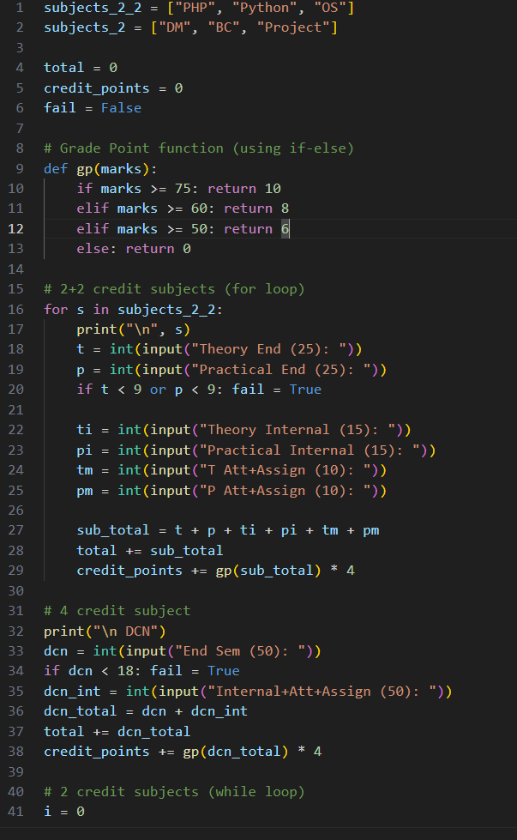
TASK1 CODE1.1

Slide 6
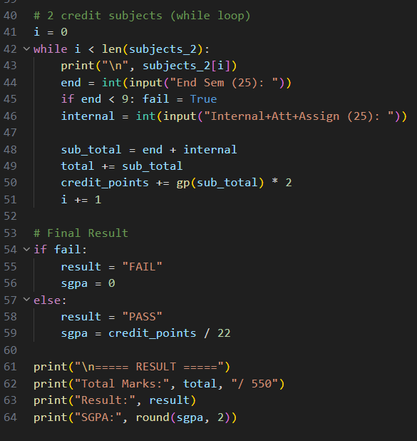

Slide 7
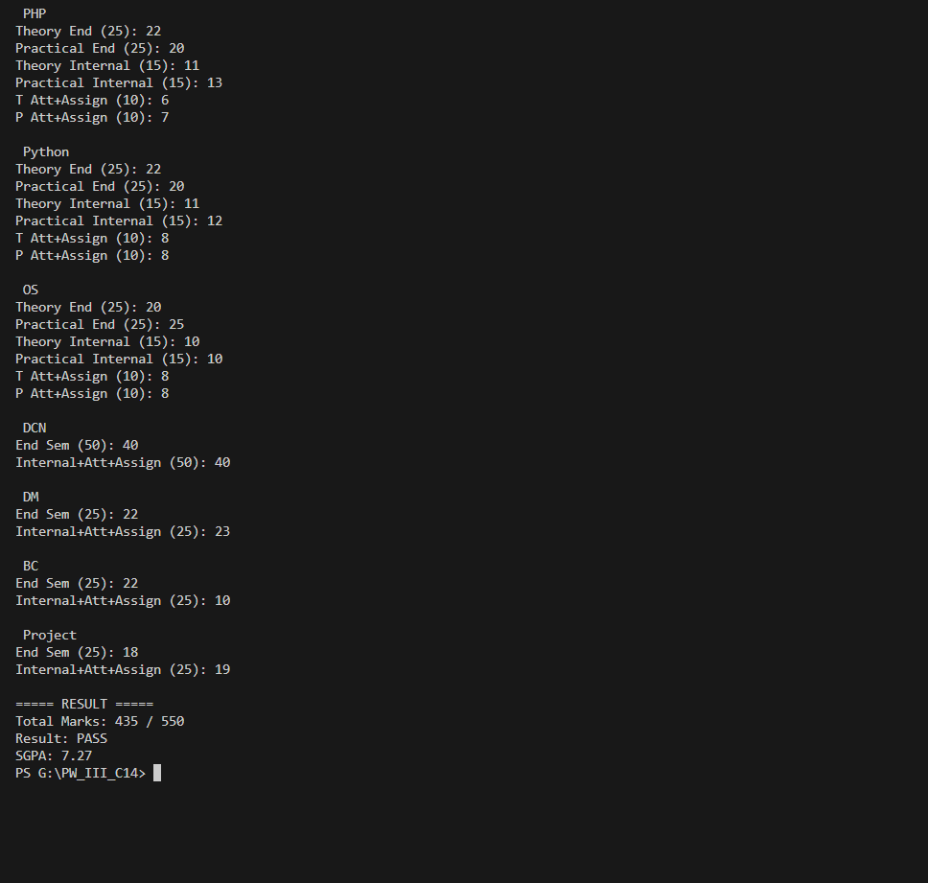
1.2. Output

Slide 8
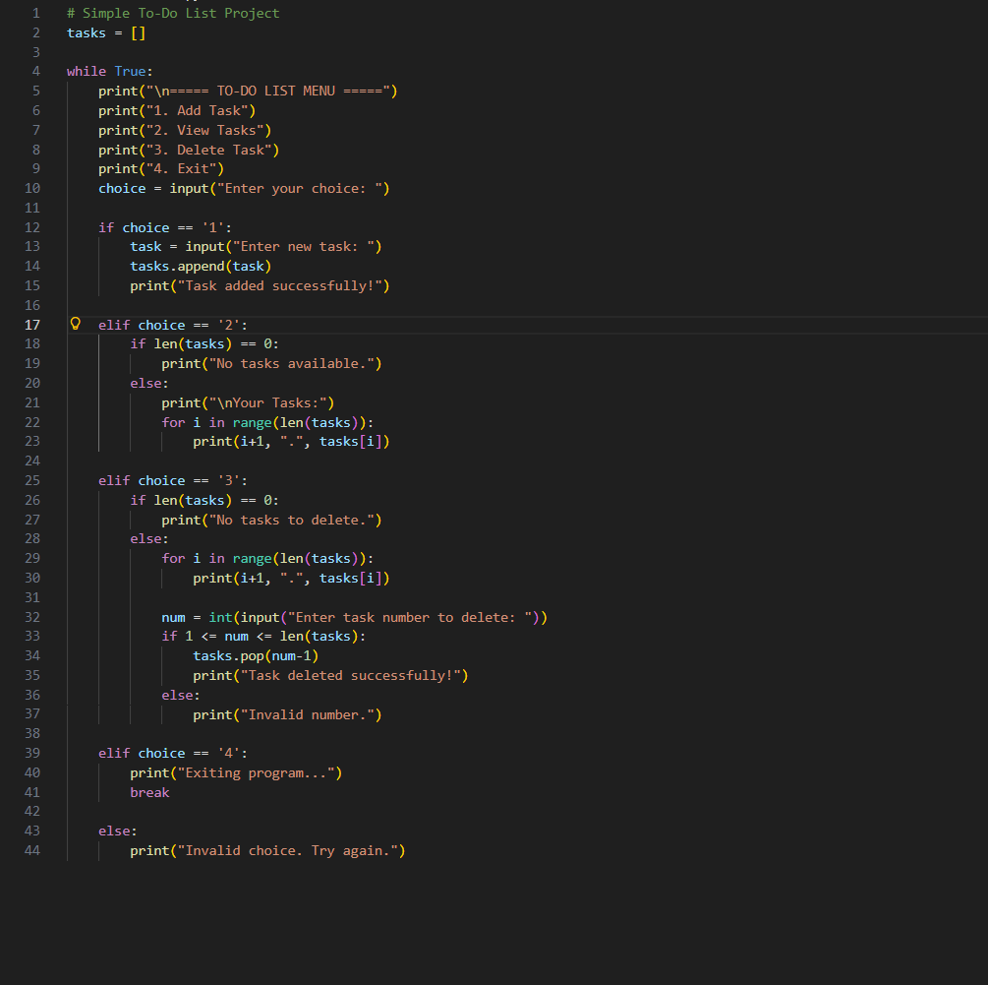
TASK2 CODE2.1

Slide 9
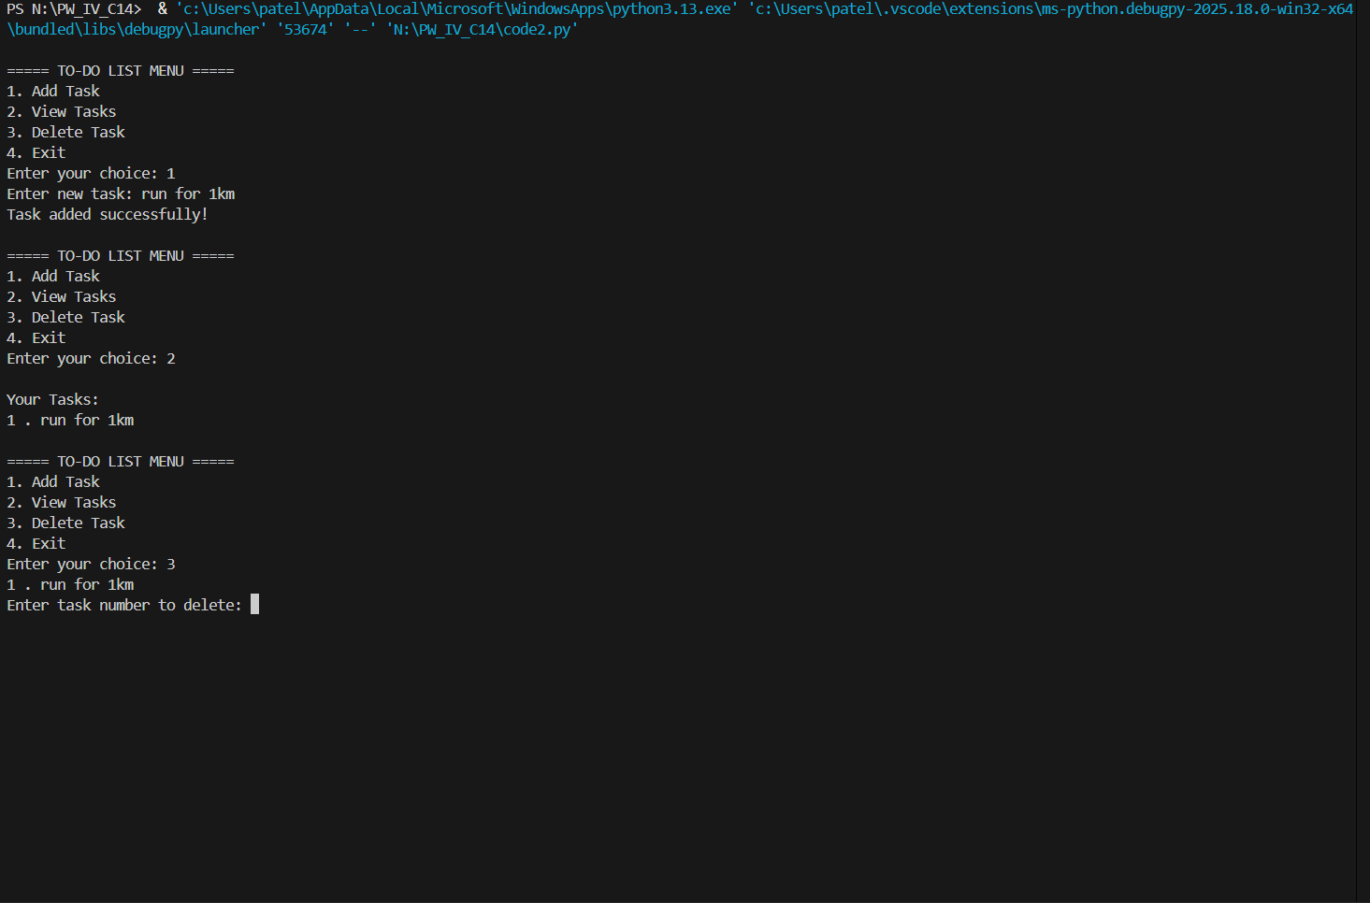
2.2. Output

Slide 10
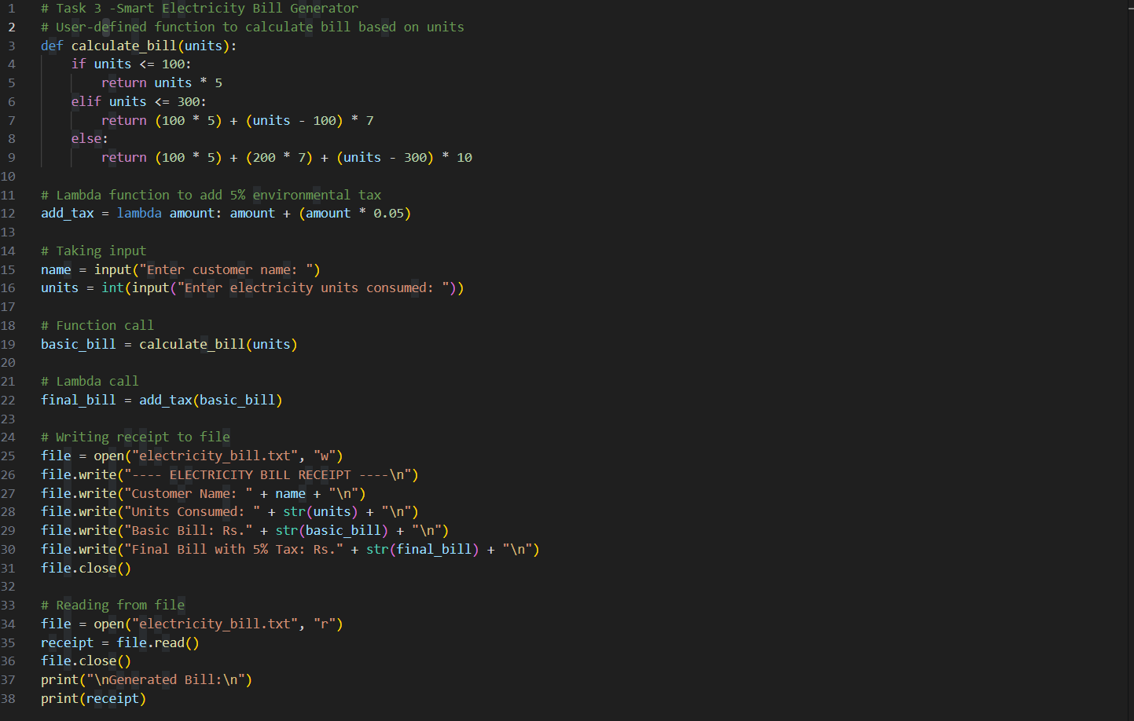
TASK3 CODE3.1

Slide 11

3.2. Output

Slide 12

TASK4 CODE4.1

Slide 13

4.2. Output

Slide 14
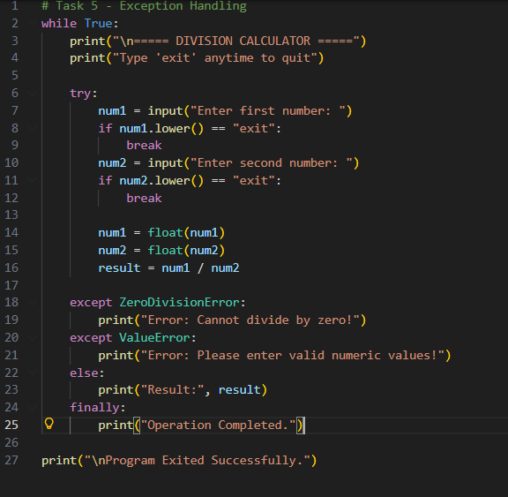
TASK5 CODE5.1

Slide 15
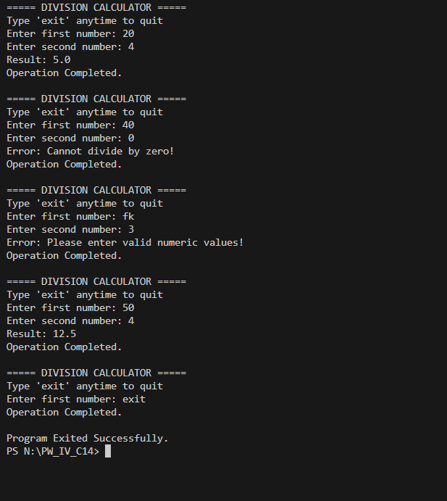
5.2. Output

