Slide 1
traffic simulation and prediction
---by Median MINDS

Slide 2
introduction
Traffic Congestion leading to slower speeds, longer travel times
Prolonged delays are caused by traffic congestion at peak hours in large cities.
Impact: Resident’s general quality of life and economic productivity were both negatively impacted.
Goal: Using time series forecasting to creative ways to reduce traffic jams and enhance urban mobility.

Slide 3
Methodology
Data Acquisition & Cleaning
Data Preparation for modeling
Model Training & Evaluation
Data Visualization

Slide 4
Data Acquisition
Chicago Traffic Tracker - Historical Congestion
Time Period: January 2018 to Current
Data Availability: Historical estimated congestion for 29 traffic regions
Data Collection: Continuous monitoring and analysis of GPS traces from CTA buses

Slide 5
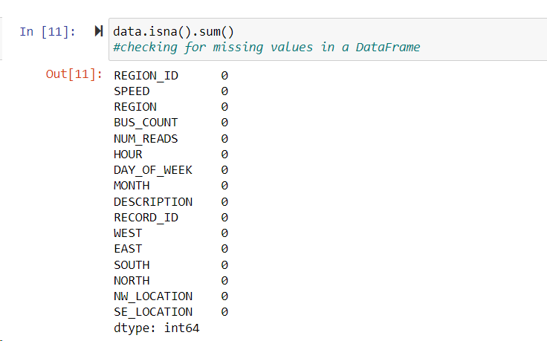
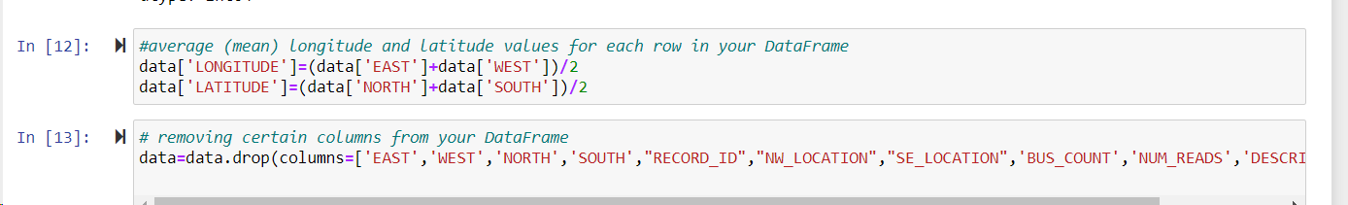
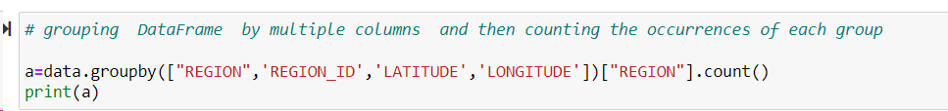
Data Cleaning

Slide 6
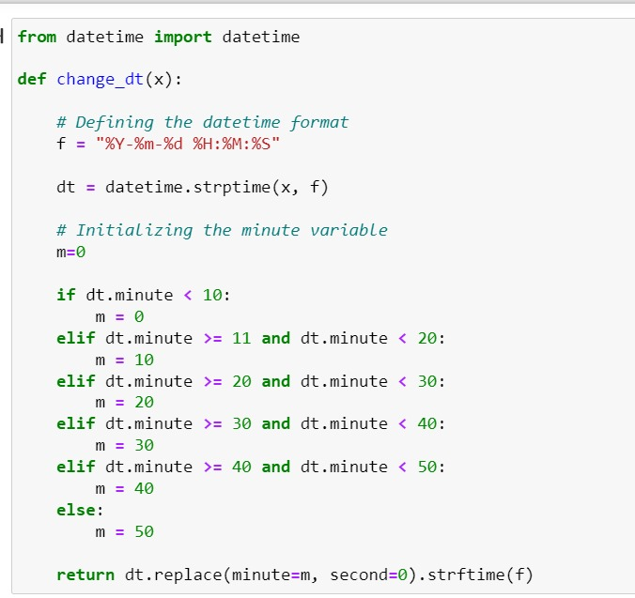
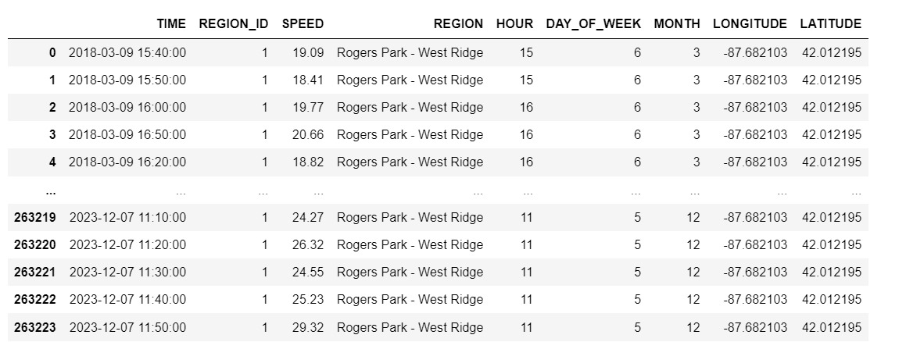
Data Preparation for modeling

Slide 7
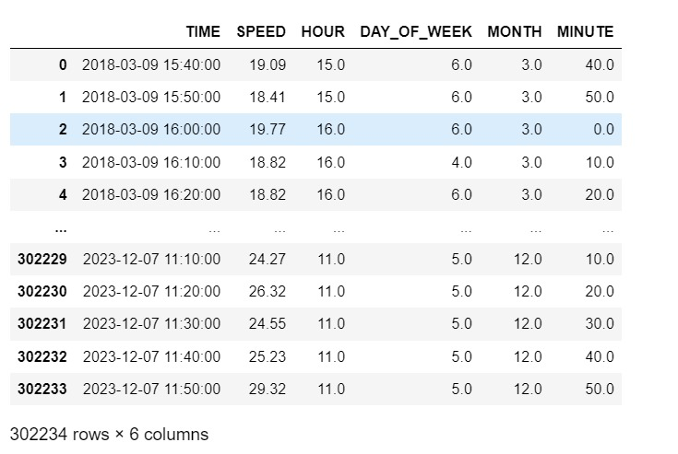
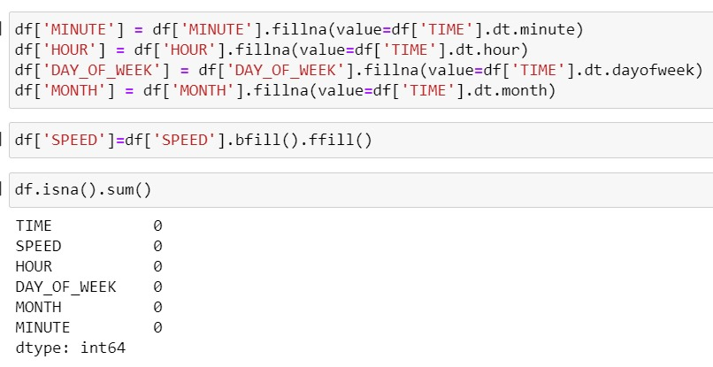
Data Preparation for modeling

Slide 8
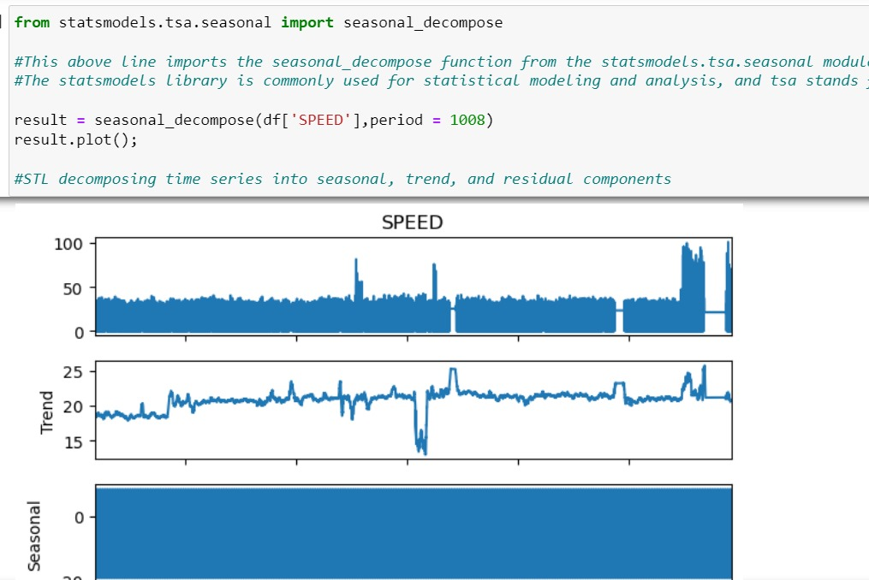
Model Training & Evaluation

Slide 9
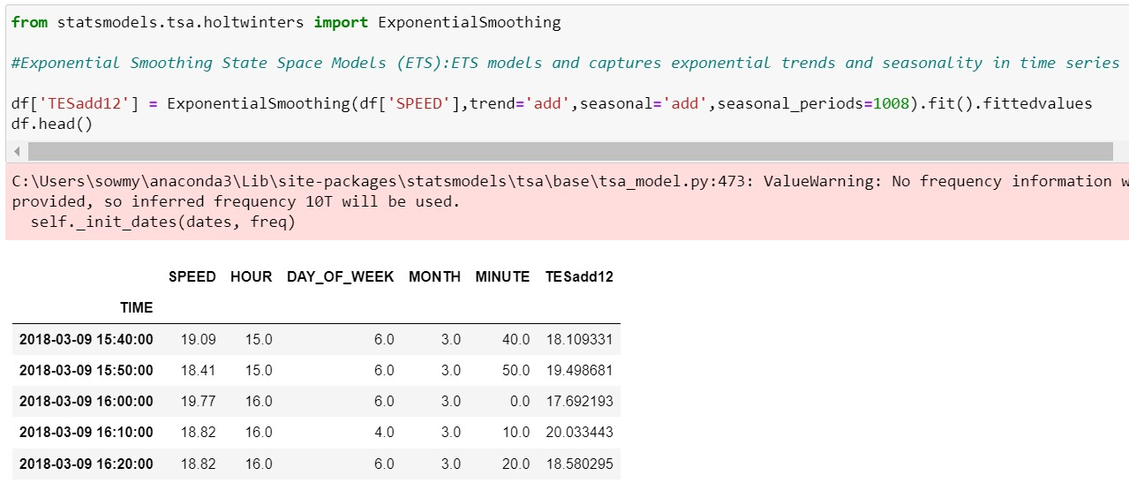
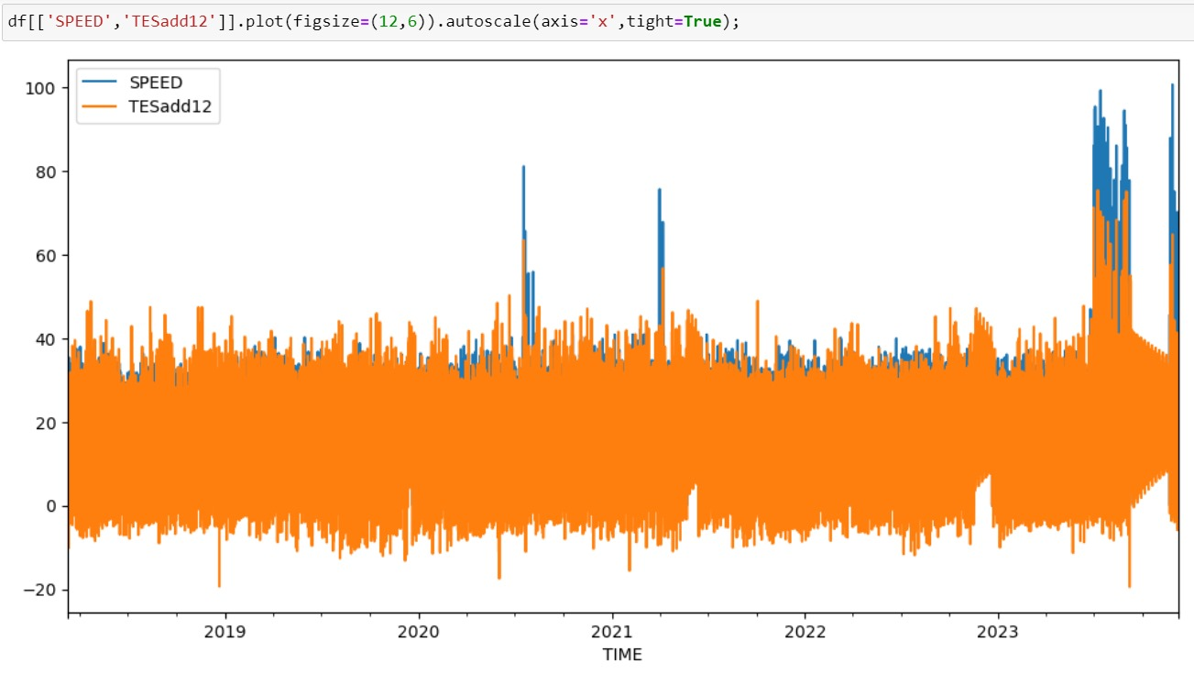
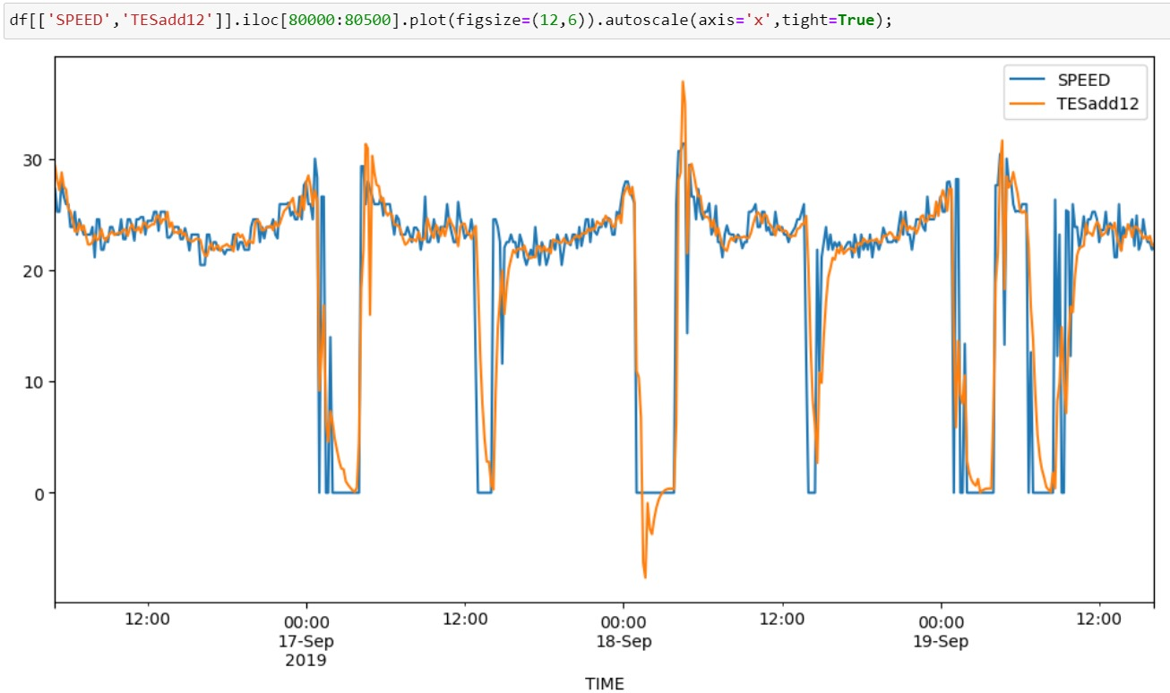
Model Training & Evaluation

Slide 10
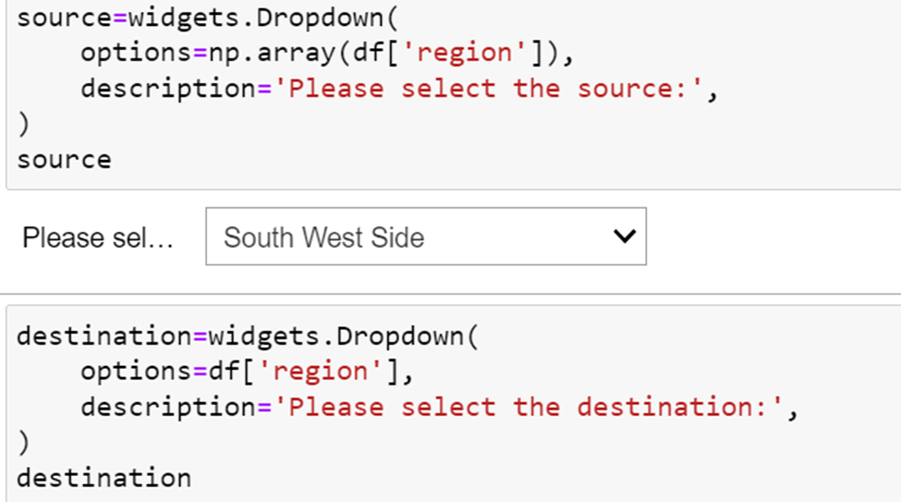
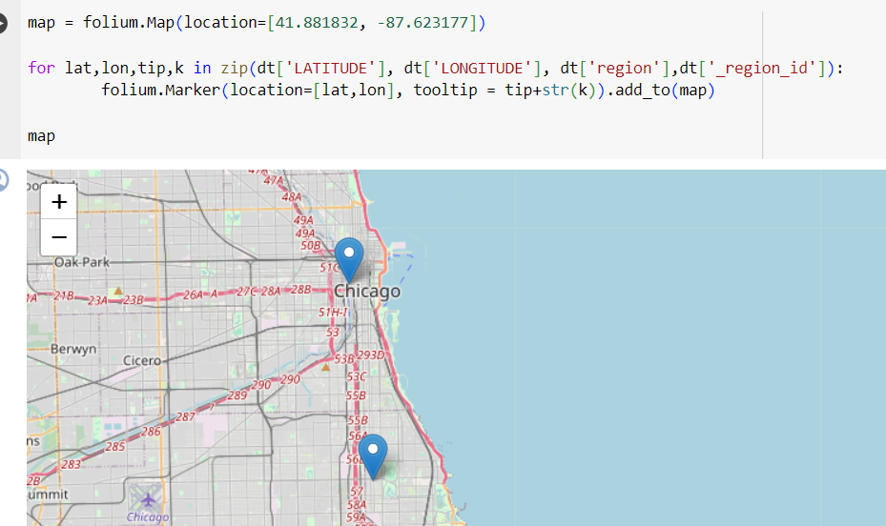
Data Visualization
Source and Destination Pointing

Slide 11
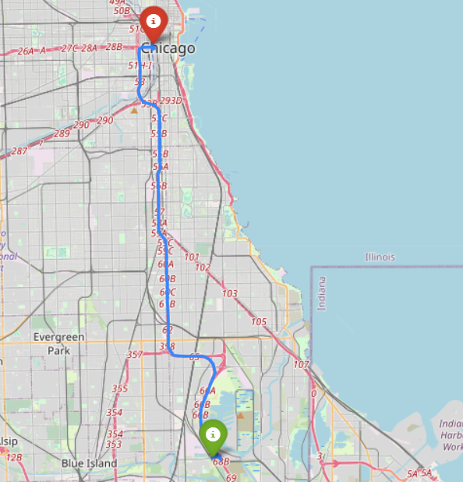
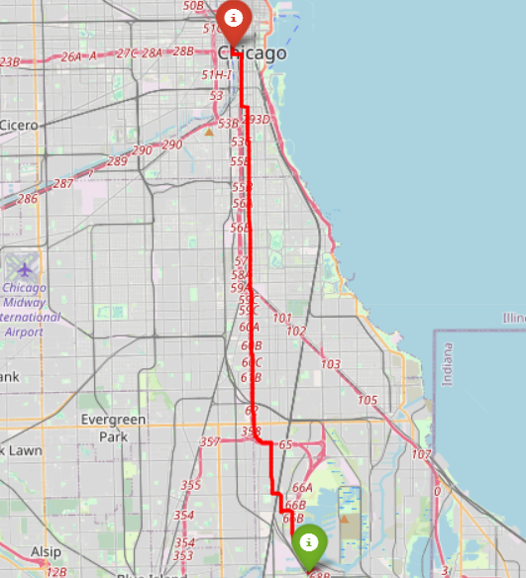
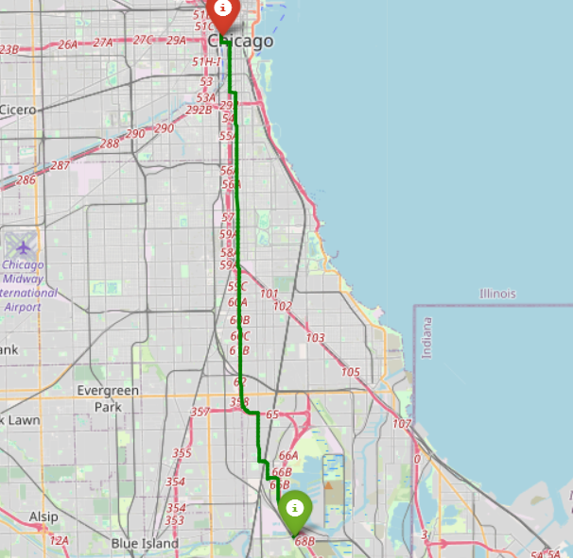
Data Visualization
Shortest Path Alternative Path1 Alternative Path2

Slide 12
CHALLENGES
Large Data volume and Processing
Data is not at regular intervals of time.
We encountered some accuracy problems with simple and double exponential smoothing when constructing the model using exponential smoothing.

Slide 13
Contribution
Data Acquisition & Cleaning - Sri Sindhu Mallela
Data Preparation for modeling - Sowmya Patlolla
Model Training & Evaluation - Vasanthi Yandrapalli
Data Visualization - Sridevi Konda

Slide 14
THANK YOU

