Slide 1
Tourist-Behaviour-Analysis
Analysis and Prediction of future tourism demands
Presented By:

Slide 2
Table of Contents
Introduction
Methodology
Implementation
Results
Contribution

Slide 3
Introduction
Problem
The tourism sector is quite dynamic and is impacted by a number of variables, including seasonality, the state of the economy, and cultural events.
Effective tourism planning, resource allocation, and marketing strategies depend on an understanding of visitor behavior patterns and the ability to anticipate future trends in visitor arrivals. This project's goal is to evaluate a dataset of visitor arrivals in order to pinpoint important trends, seasonal patterns, and variables affecting visitor behavior.
The project's objectives are to analyze the tourist behavior, to identify tourists’ interests and most visited locations and accordingly, and to predict future tourism demands by using the regression models that can precisely forecast visitor arrivals based on historical data.

Slide 4
Introduction
Solution
The Tourist-activity-Analysis project is an in-depth study that uses big data analytics to explore and identify patterns and trends in tourist activity.
This project uses big data analytics to evaluate vast amounts of data from many sources, including social media platforms, online travel firms, booking systems, and tourist surveys.
By analysing massive volumes of data, this initiative aims to give tourism stakeholders with actionable insights to improve tourist experiences, optimize tourism offers, and boost destination competitiveness.
The regression models used in the python for the big data can be used to analyse the data, and the time seies modelling can generate the future predictions for the each month.

Slide 5
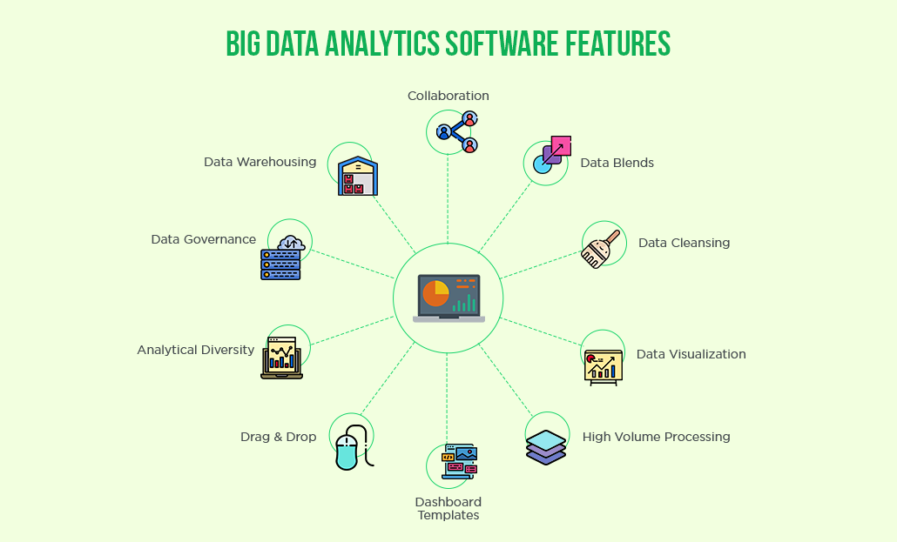
Features and solutions offered by Big data

Slide 6
Methodology
To extract insights from huge data and analyse tourist behaviour, the Tourist-Behaviour-Analysis project adopts a rigorous and methodical methodology. The methodology utilized in this project is outlined in the following steps:
Data Collection: The first stage is to collect information from a variety of sources, such as social media platforms, online travel companies, booking systems, and visitor surveys.
Refinement of the dataset: Once acquired, data is used to set geographical coordinates in order to extract data from a certain region which can be used for further processing or analysing the trends and for estimation.
Processing of textual metadata: The input data is used to remove extraneous characters and stop words, as well as to stem words into their root form. The output data is then used to generate the geo clustering data.
Clustering of geographical data: The output data generated by the textual metadata processing is fed as an input to this notebook.
The HDBSCAN algorithm is used in the notebook to group popular sites together.

Slide 7
Prediction of regional trends: Next the pre-processed data is used as a tool for estimating the trend of visitor arrivals in a specific region for a specific location.
Time Series Modelling: We used the Time series modelling that analyses the seasonal trend of visitor arrivals in a specific region and estimated the future patterns based photoon the past analysis.
Metadata of geo tagged photos
Textual Metadata Textual Refined Support Interested
Processing Metadata Photo Tags Threshold Tags
Geographical Geographical Density Based Clusters Denoting Exemplar
Data Clustering Data Clustering Tourists Spot of cluster
Trend Temporal Regression Estimate
Estimation Info Function Trend
Time Series Estimated Linear Regression Predictions Plotting
Modelling Data (Model Prediction) Against Actual Tourists

Slide 8
Implementation
There are Five major process to complete in order to get the complete analysis and future predictions:
Refinement of Raw Dataset
Textual metadata processing
Geographical data clustering
Prediction of regional trends
Time Series Modelling

Slide 9
Refinement of Raw dataset
The dataset which we utilized in this project is a subset of the YFCC dataset available at (http://webscope.sandbox.yahoo.com).
The dataset contains millions of records for the various regions for various countries. These records are refined to get the dataset for the particular region or country.
For obtaining the dataset for a particular region we mention regions by Setting their respective geographical coordinates in the notebook script.

Slide 10
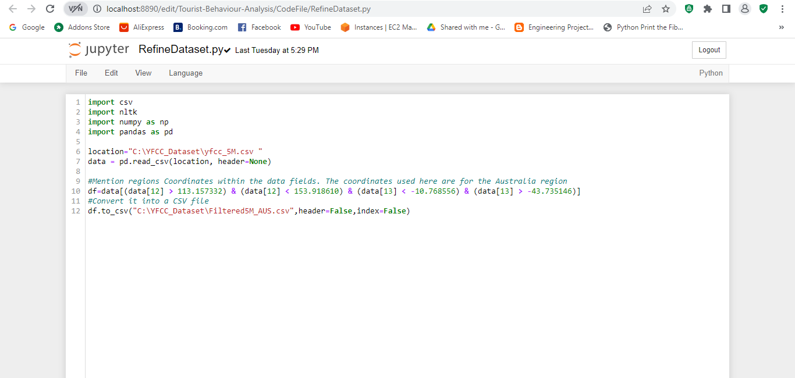
The figure above shows the script to generate the data for a particular region.
The data obtained is stored in a separate folder which will be used for the further processing

Slide 11
Textual metadata processing
The refined dataset is used as an input to Textual metadata processing which is a crucial step in analyzing and extracting meaningful information from text data.
Tokenization
Tokenization involves breaking down the text into individual words or tokens.
Stop Word Removal
Stop words are commonly used words that do not carry significant meaning and can be removed from the text.
Removing stop words helps reduce noise and focus on more meaningful terms.
Lemmatization and Stemming
Lemmatization and stemming are techniques used to reduce words to their base or root form.
Lemmatization considers the word's context and transforms it to a meaningful base form.

Slide 12
Geographical Data Clustering
Geographical data clustering is a technique used to group similar data points based on their geographic attributes.
It helps in discovering spatial patterns, identifying clusters or regions with similar characteristics, and gaining insights from spatial data.
The output data from the textual metadata processing is fed as in input to the geographical data clustering.
The clustering algorithms we applied to geographical data, is HDBSCAN.
Through this algorithm we partitioned the data points into clusters based on proximity or density criteria.
Two graph before clustering and after clustering displaying the clustering process was obtained as an output of this process.

Slide 13
Prediction of regional trends
Next we used the Trend estimation which is helpful in analyzing time series data, such as tourist arrivals over different time periods.
We used different Regression techniques, including linear regression, ridge regression, and lasso regression, to estimate trends and make predictions.
The particular region dataset is fed as an input to this step in order to predict the number of tourists in a specific region, particularly.
By considering different polynomial degrees and regularization techniques, we obtained more accurate trend estimates and make informed predictions.
The mean absolute error is also calculated to assess the accuracy of the predictions.

Slide 14
Time Series Modelling
Next and final we will use the Time series modeling which is a statistical technique used to analyze and forecast data that varies over time.
Using the time series modelling we constructed a time series data by counting the number of tourists on a monthly basis.
The data which was refined in the first step is fed as an input to analyze and forecast the tourists on a monthly basis.
Trend Analysis for Each Month:
To analyze the trend for each month, linear regression with polynomial features is applied.
For each month, a scatter plot is created with the tourist count for each year.
A polynomial regression model is fitted to the data to estimate the trend line.
The model predictions are plotted against the actual tourist counts to visualize the trend.

Slide 15
Results/Outcomes
The overall project depicted the use of large amount of tourists data for multiple regions across multiple countries.
The data was cleaned, analyzed, forecasted and used many components to generate some of the meaningful insights.
Refinement of Data: In this initial step the data was refined to small chunks based on particular region or country.
Textual Metadata Processing: In this step we cleaned the data to remove the stop words, tokenization to make the data more meaningful for further processing in order to get the good insights.

Slide 16
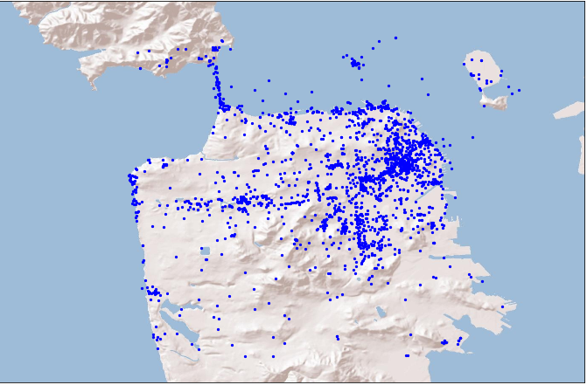
Results/Outcomes
Geographical Data Clustering : This step generates the Geographical clustering stage output. After running the notebook depicting the code to generate the geographical data clustering, we get the image representing the clusters.
Below are the Images depicting cluster formation.
Before Cluster Formation:

Slide 17
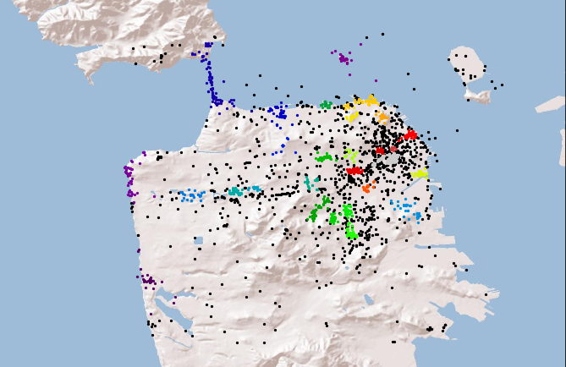
After Cluster formation:
It represents the clusters identified by the HDBSCAN algorithm. Each cluster is assigned a different colour. The data points belonging to each cluster are plotted using the corresponding colour

Slide 18
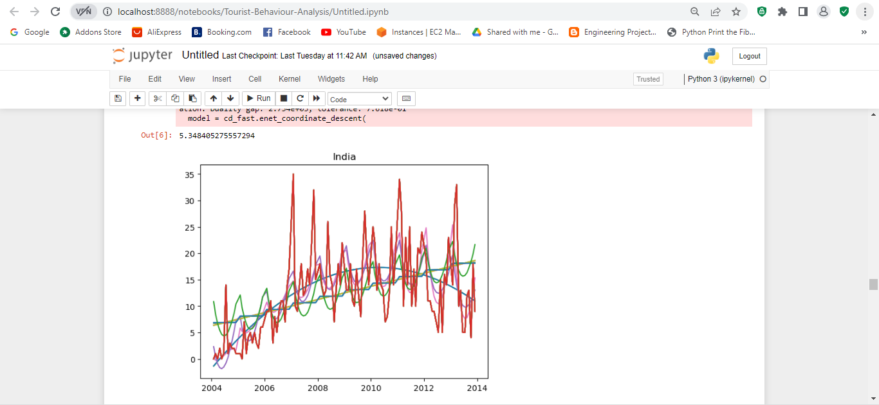
Results/Outcomes
Trend Estimation: This steps generated the graph depicting the predicted values (Y_pred) and the actual number of tourists (Ct) which vary over time for particular country.
The below graph predicts the number of tourists in a specific region, particularly in India. The mean absolute error is also calculated to assess the accuracy of the predictions.

Slide 19
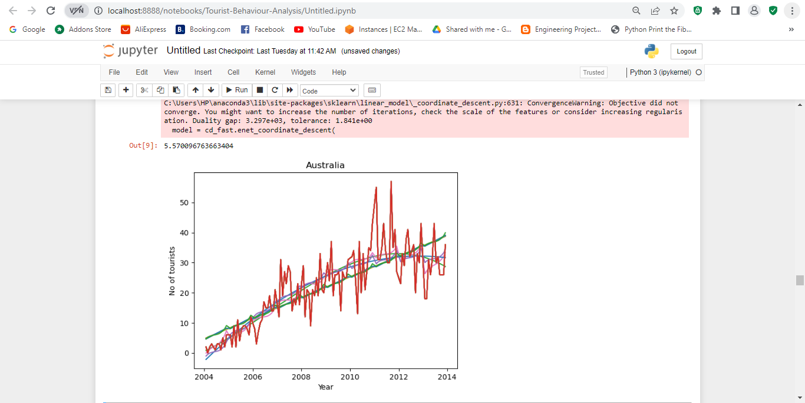
The below image predicts the number of tourists in a specific region, particularly in Australia.
The mean absolute error is also calculated to assess the accuracy of the predictions.
Blue: Linear regression with polynomial degree 1.
Orange: Polynomial regression with polynomial degree 3.

Slide 20
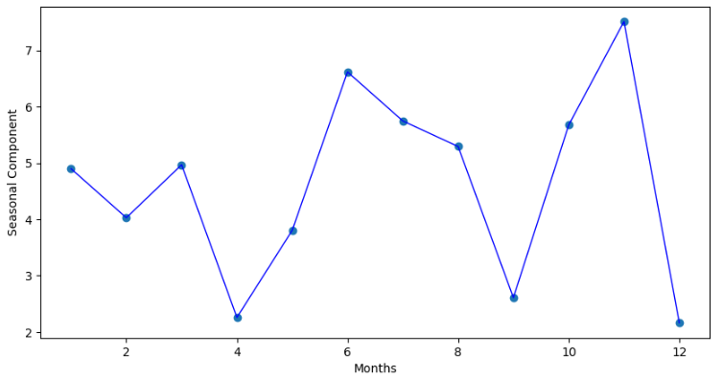
Results/Outcomes
Time Series Modelling: In this final part we applied the time series modelling on the data to provides the region's seasonal trend analysis. It consists of multiple Graphs as described below:
Time Series Component
The graph below shows the average absolute difference between the actual count of tourists and the predicted count based on the regression models. The y-axis represents the seasonal component, which indicates the deviation of the actual count from the predicted trend.

Slide 21
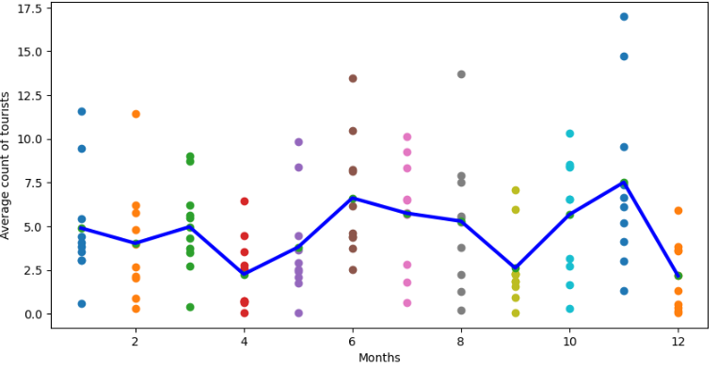
Time Series Output
The final graph combines both the average count of tourists and the seasonal component in a single plot. The blue line represents the average count of tourists for each month, while the scatter points represent the seasonal component for each month.

Slide 22
Contribution

Slide 23
Thank you

