Slide 1
Group 3
EECE 5552: Assistive Robotics
Project Proposal
BrailleSense: Real-Time Digital Text to Braille Converter
Roman Iles
Maxwell Hasenauer
Tirth Patel
Venkata Subhash Jahnav Lanka
Notes:
Braille literacy is critical for the independence and education of visually impaired individuals. However, many current solutions for converting digital text to Braille are expensive and inaccessible to those in need. The goal of this project, “BrailleSense,” is to create an affordable and portable device that converts text into Braille in real time. The device will provide a practical and accessible solution for visually impaired individuals, allowing them to read any form of text content on the go

Slide 2
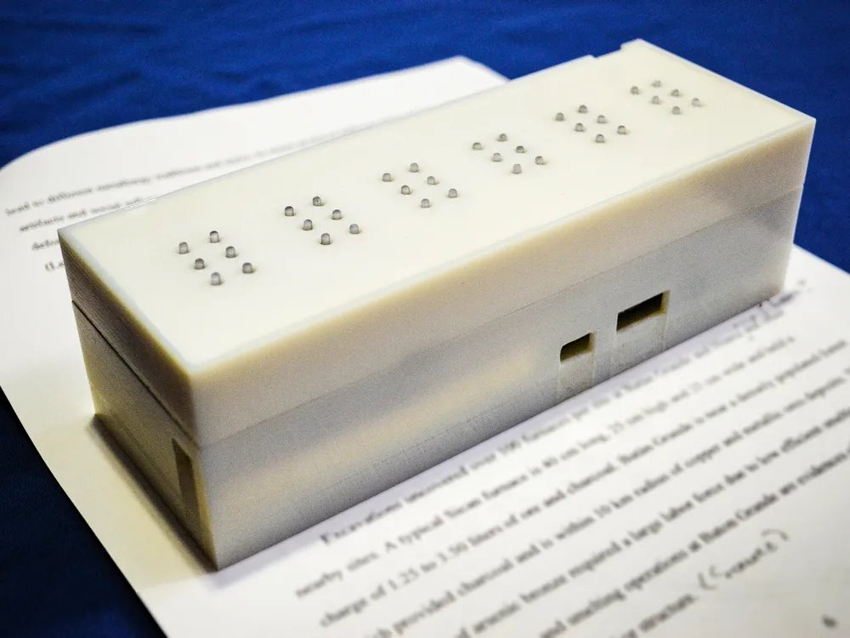
Objectives
Target Audience: Visually Impaired
Design a device that converts any text source (flat surfaces) into Braille in real-time.
Current devices exist, but are bulky
A typical Braille reader reads with their fingertips, is a bulky device really a solution?
Features:
Real-Time conversion
Portability
User-friendly Interface
Image credit : https://www.smithsonianmag.com/innovation/device-translates-text-braille-real-time-180963171/
Notes:
. According to the World Health Organization (WHO), over 285 million people worldwide are visually impaired, and many rely on Braille for reading and writing. Current refreshable Braille displays, which can convert text to tactile Braille characters, are prohibitively expensive for many users, with prices often exceeding thousands of dollars. Furthermore, these devices tend to be bulky and limited in functionality, restricting their usage in real-life scenarios like reading from mobile devices or computer screens. This project seeks to provide some remedy to the lack of access to devices that also translate physical texts - like those in books or on signs - into Braille.
Objectives:
Real-Time Text Conversion: Conversion of digital text from various sources (smartphones, computers, tablets) to Braille instantly.
Portability: Compact design that allows for ease of transportation and usability on the go.
Affordability: Using low-cost materials and open-source software to ensure accessibility for the masses.
User-Friendly Interface: Simple operation allowing visually impaired individuals to interact easily with digital content.

Slide 3
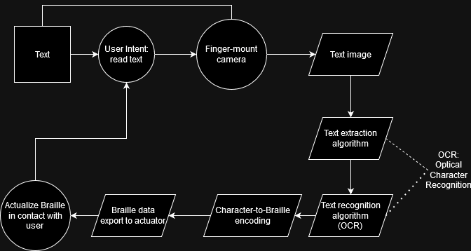
Process
Implement a pre-trained OCR
Character recognition is a common ML algorithm
The OCR extracts characters and inputs to a Braille encoding algorithm
Think an ASCII-to-Braille mapping
This Braille encoding will be exported to the actuator for interaction with the user
Notes:
3 Deliverables
A functional prototype that can at least take in images and extract characters – either by fully ingesting a word and separating out that word into characters or processing into characters directly through the use of some stochastic algorithm (or other method that is less computationally impactful, but most probably through a computer vision based ML algorithm), and then output some Braille-encoded character to a skin-contact actuator in a dynamic manner.
Individual deliverables:
Text ingestion
Camera → OCR Algorithm
low resolution camera (low enough to accurately read a printed word, but not too high to significantly increase processing power/camera quality requirements)
The algorithm first extracts the text from the image.
The algorithm identifies what the text contains and outputs a letter or number (or punctuation).
Text processing algorithm
A CNN or similar extracts and identifies characters with high accuracy
Trained on some external dataset of letters.
This dataset should be printed letters, however there is potential in also training the algorithm on some handwritten characters.
Processing
Processing can probably be done through an Arduino or some other prebuilt circuit with ad-hoc programming.
The processor does not need to have high computational power to process only letters, even when running an OCR-trained algorithm
If the computer has some low-power GPU or vector core, processing becomes less of an issue.
Buses do not necessarily need to be high-speed or throughput, they just need to be fast enough to input some analyzable file from the camera as well as output either a single character or character array to the actuator.
Actuator
The actuator should receive some packet of Braille data and output a physical change in the device that allows the user to feel/read the letters output by the algorithm

Slide 4
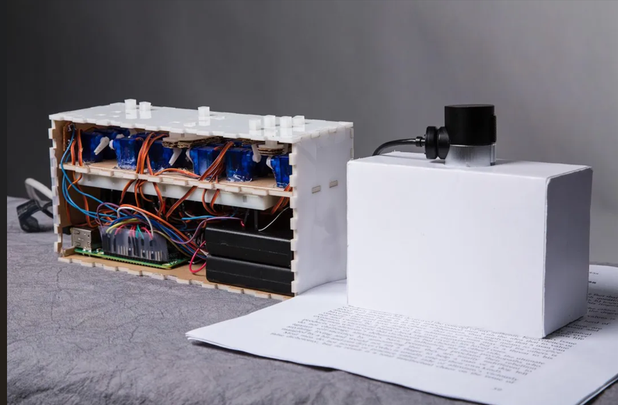
Equipment
Text Input Source
Any physical representation of text
A full test suite should include several different surface types with printed text
Processing Unit
Braille Display
Housing components
Arduino, Raspberry Pi, or a low-power microcontroller for handling the OCR and Braille conversion.
Multiple 3 by 2 shaped grids
Actuation for each grid point
Piezoelectric actuators
Image credit : https://www.smithsonianmag.com/innovation/device-translates-text-braille-real-time-180963171/

Slide 5
Milestones
Week 1-2: Buidling hardware schematic and Bill of materials
Week 3-4: Building Basic software that converts text into Braille and hardware prototype setup
Week 5-6: Delivering a working prototype and feedback for initial testing
Week 7-8: Delivering a refined and user-friendly version of BrailleSense
Week 8-9: Comprehensive Project report and output video
Week 9-10: Final Presentation
Notes:
5 Plan of Action
Week 1- 2: Hardware Design and Procurement (10/15/2024 - 10/22/2024)
Deliverable: Hardware schematic, BOM (Bill of materials)
Week 3-4: Software and Prototyping (10/23/2024 - 10/29/2024)
Deliverable: Basic software that converts text into Braille and hardware prototype setup
Week 5-6: Testing and Refining Prototype (10/30/2024 - 11/6/2024)
Deliverable: Working prototype and feedback for initial testing
Week 7-8: User Testing and Optimization (11/7/2024 - 11/14/2024)
Deliverable: Refined and user-friendly version of BrailleSense
Week 8-9: Final Touches and Documentation (11/15/2024 - 11/22/2024)
Deliverable: Comprehensive project report and video
Week 9-10: Presentation (11/23/2024 - 12/6/2024)
All members present the project and submit the final report, working prototype, detailed documentation, challenges and outcomes, final project video

Slide 6
Thank you!
Questions?

