Slide 1
SLIDE 1 • PROJECT OVERVIEW
MetaMind AI: Smart Cognitive Learning Co-Pilot
Bridging the gap between asking a doubt and truly mastering the concept
1. INTRODUCTION
What is MetaMind AI?
• A personal AI tutor that helps computer science and engineering students master tough concepts.
• Instead of just handing over direct answers, it diagnoses why a student is stuck and helps them fix their foundational gap.
• Designed for college students, self-learners, and interview candidates who need real retention.
2. THE PROBLEM
False Feeling of Mastery
• Standard AI chatbots (like ChatGPT) dump complete answers right away, encouraging passive copy-pasting.
• Students think they understand a topic until exam day because nobody tested their hidden misconceptions.
• No confidence tracking: Students don't know if they are truly ready or just guessing.
• Important explanations and formulas get lost in long chat history with no quick revision notes.
3. PROPOSED SOLUTION
The Closed-Loop Tutor
• Cognitive Diagnostic: Pinpoints the student's exact misconception and confirms what they got right.
• Step-by-Step Breakdown: Explains complex ideas in simple plain English with minimal diagrams.
• Live Confidence Meter: Starts at 50%, updates to 92% (Mastery) after answering a quick check question.
• 1-Click Study Guide: Automatically compiles printable A4 revision sheets with key formulas and tips.

Slide 2
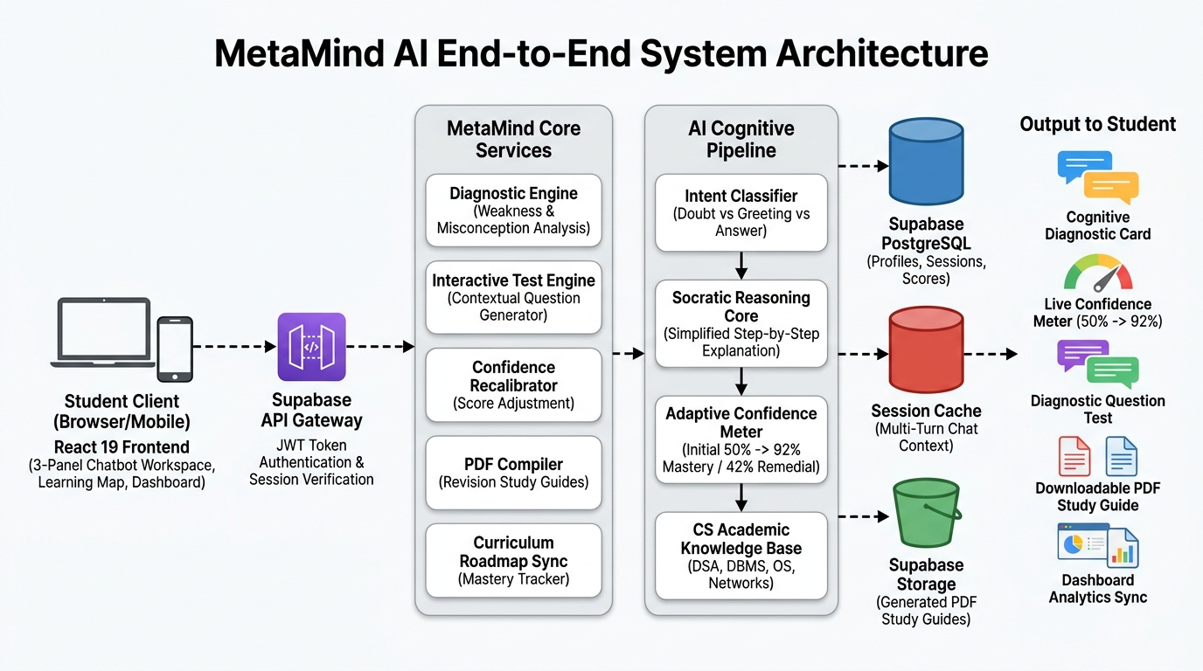
SLIDE 2 • TECHNICAL APPROACH
System Architecture: How the Platform Works
Clean direct pipeline from student input to AI reasoning, database, and instant output
ARCHITECTURAL LAYERS
1. Student Client (Frontend)
React 19 + TypeScript + Vite. Features a 3-panel workspace, learning roadmaps, and analytics dashboard.
2. Supabase API Gateway & Auth
Verifies student logins, protects data, and manages database sessions securely.
3. Core Diagnostic Engine
Splits the student's doubt into understood strengths vs hidden conceptual errors.
4. Socratic AI Pipeline
Delivers simplified explanations, tests with 1 QuickCheck question, and recalculates confidence.
5. Database & Storage
Supabase PostgreSQL saves chat history and scores; Storage bucket stores downloadable PDF guides.

Slide 3
SLIDE 3 • MARKET COMPARISON
How MetaMind AI Compares to Existing Tools
Why our closed-loop diagnostic approach produces real mastery instead of memorization
Key Capability
Traditional Courses
(YouTube / Udemy)
Standard AI Chatbots
(ChatGPT / Claude)
MetaMind AI
(Our Solution)
Finding Student's Exact Mistake
❌ One-size-fits-all videos
Cannot diagnose student flaws
❌ Dumps complete answers
Ignores underlying confusion
✅ Pinpoints exact misconception
Explains root cause first
Live Confidence Measurement
❌ No confidence tracking
Only static quiz scores
❌ Zero confidence metrics
Chatbot doesn't track certainty
✅ Dynamic Confidence Meter
Recalibrates from 50% to 92%
Active Concept Verification
❌ Passive watching
Easy to zone out
❌ Gives direct code solutions
Encourages lazy copying
✅ 1-Click QuickCheck Question
Verifies understanding on the spot
Instant Revision Notes
❌ Must take manual notes
Slow and unstructured
❌ Important tips get lost
in long chat history
✅ 1-Click Printable PDF Guide
Formulas, rules & exam traps ready
Structured Learning Roadmap
❌ Rigid video playlists
Hard to jump to weaknesses
❌ Disconnected single chats
No roadmap or progress graph
✅ Visual Concept Roadmaps
Tracks prerequisites across subjects

Slide 4
SLIDE 4 • USER FLOW & FEATURES
MetaMind AI: Step-by-Step Student Learning Journey
6-stage closed-loop cognitive flow from initial doubt to verified 92% mastery
STEP 01
DOUBT INPUT
Student Query
▸ Student enters 3-Panel Chatbot Workspace
▸ Chooses tutor persona & asks technical doubt
▸ Intent filter verifies conceptual query
STEP 02
DIAGNOSTIC
Cognitive Scan
▸ Analyzes root misconception vs strength
▸ Renders live Diagnostic Card in panel
▸ Initializes Confidence Meter at 50%
STEP 03
EXPLANATION
Socratic Core
▸ Step-by-step intuitive breakdown
▸ Uses plain English & minimal code
▸ Highlights core rules & visual invariants
STEP 04
QUICKCHECK
Active Recall
▸ AI serves 1 targeted verification question
▸ Tests identified boundary edge case
▸ Single-click interactive answer pills
STEP 05
RECALIBRATE
Confidence Loop
▸ Correct: Meter jumps to 92% (Mastery)
▸ Wrong: Score adjusts to 42% with hints
▸ Immediate real-time active feedback
STEP 06
PDF & SYNC
Revision & Store
▸ 1-Click printable A4 Study Guide PDF
▸ Persists verified score in Supabase
▸ Updates Learning Map & Dashboard
→
→
→
→
→

Slide 5
SLIDE 5 • LOOKING FORWARD
Future Scope & Platform Roadmap
Taking MetaMind AI from a smart hackathon tool to an essential student companion
NEAR TERM
Phase 1: Multi-Modal Inputs
• Handwritten Math & Code OCR: Snap a picture of your notebook or whiteboard; AI diagnoses syntax and mathematical errors.
• Error Screenshot Analysis: Paste compiler errors or terminal tracebacks directly to get step-by-step debug assistance.
• Voice-Guided Tutoring: Speak your doubts naturally and listen to intuitive audio explanations on mobile.
MID TERM
Phase 2: IDE & Tool Integration
• VS Code Extension: Diagnostic tutoring right inside your code editor while working on college projects.
• Collaborative Study Rooms: Peer study mode where AI acts as a friendly arbitrator and discussion moderator.
• Memory Decay Reminders: Spaced repetition alerts that remind you to review concepts right before you forget them.
LONG TERM
Phase 3: University & Ecosystem Scale
• College LMS Integration: Connect directly with Canvas, Blackboard, or Moodle so professors see aggregate student confusion spots.
• Autonomous Subject Specialists: Multi-agent system tailored to specific curriculums (GATE, GRE, Technical Interviews).
• Global Knowledge Graph: Crowdsourced concept maps contributed by top educators worldwide.

Slide 6
SLIDE 6 • CONCLUSION
Summary & Project Impact
Transforming how students learn, retain, and succeed in technical education
KEY TAKEAWAYS
Why MetaMind AI Matters
End the 'Illusion of Knowing': Students no longer just copy answers—they understand the core principles and fix their misconceptions.
Instant Verification: The dynamic confidence meter and 1-question QuickCheck ensure immediate active recall.
No More Lost Notes: Downloadable A4 study guides turn everyday doubt sessions into structured revision sheets.
Production-Ready Stack: Built with React 19, Vite, Tailwind CSS, and Supabase for high performance and reliability.
THANK YOU!
MetaMind AI — Empowering Every Learner
🌐 Live Web Demo Running locally at: http://localhost:5173
📂 Source Code: Fully structured React 19 + Supabase project
🧠 Curated Knowledge Base: 11+ CS & Engineering Topics
❓ Questions & Answers: We are excited to hear your feedback!

