Slide 1

Paisa
TITLE
A comprehensive AI-powered finance platform for personal finance management.

Slide 2

Introduction
Paisa is a modern, full-stack, AI-powered finance platform designed to simplify and enhance personal financial management.
Built using cutting-edge technologies like Next.js, Prisma, Clerk, and Google Gemini AI, the application delivers an intelligent, secure, and responsive user experience.
With powerful tools for budgeting, transaction tracking, and personalized financial insights, Paisa empowers users to make smarter money decisions—driven by real-time AI recommendations and a sleek, user-friendly interface.

Slide 3
Main Purpose
Paisa is built to help people manage their money better, without stress or confusion.
The main goal is to give users a single, smart platform where they can track spending, set budgets, manage accounts, and get helpful advice — all in one place.
Here’s what makes Paisa special:
    Everything in One Place: No need for multiple apps — view your income, expenses, and savings all in one dashboard.
    Smart AI Suggestions: Paisa uses AI to understand how you spend and gives personal tips to help you save more or cut back where needed.
    Easy to Use: The app is designed to be clean, modern, and simple — so anyone can use it, even without financial knowledge.
    Helpful Insights: Instead of showing just numbers, Paisa explains what they mean and how you can improve your finances.

Slide 4
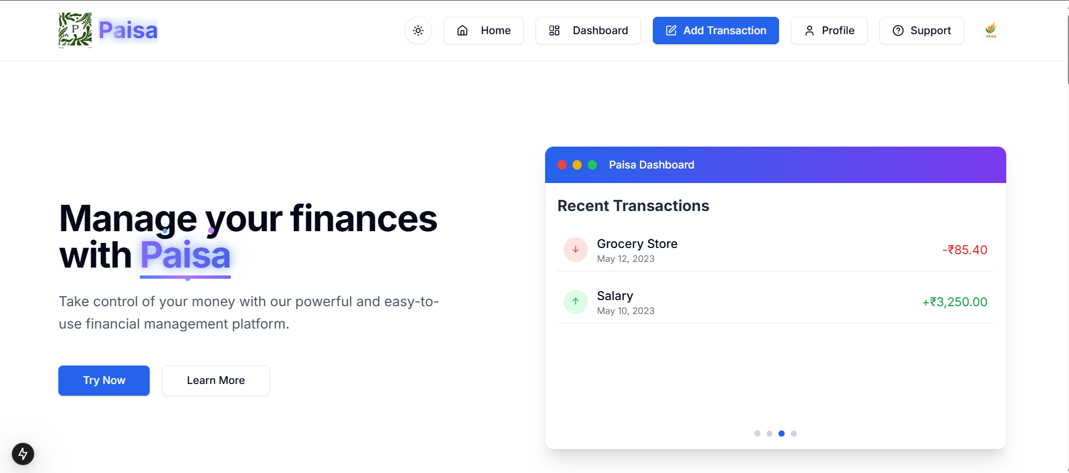
User Interface
+91 620 421 838

Slide 5
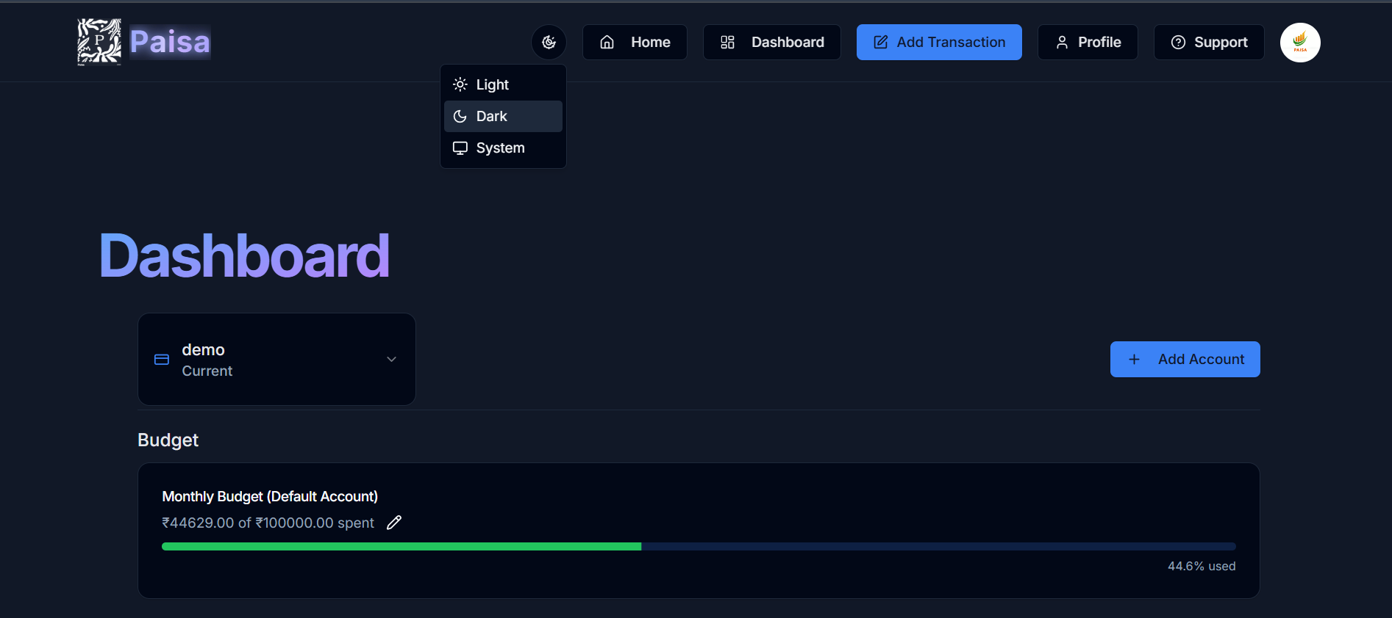
User Interface
+91 620 421 838

Slide 6
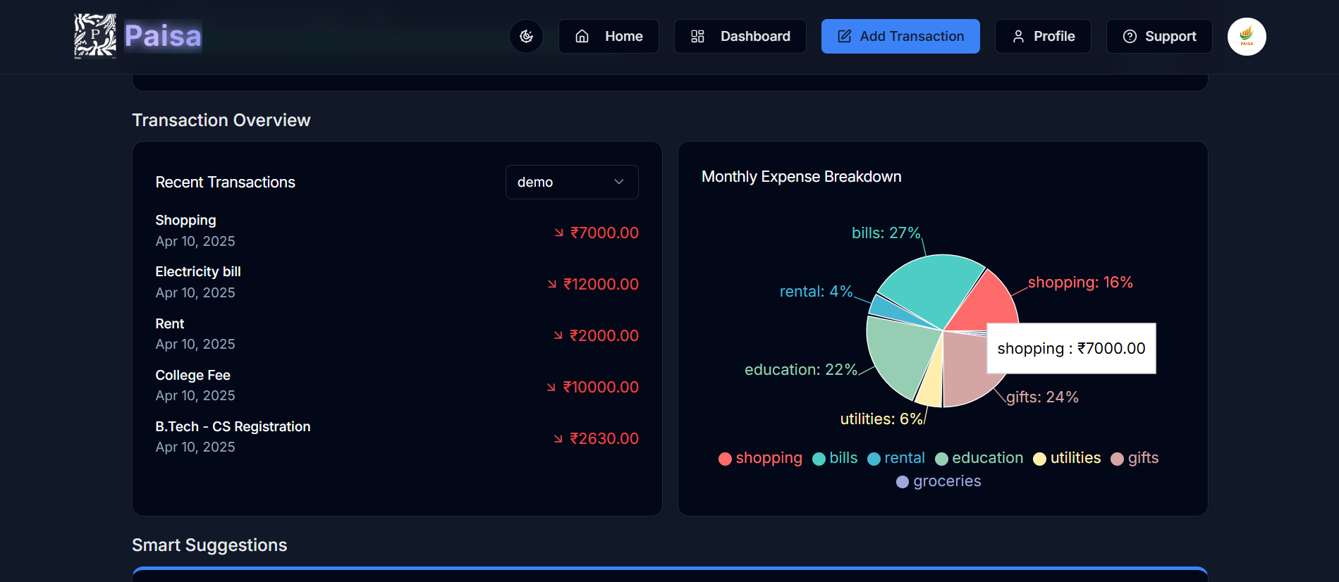
User Interface
+91 620 421 838

Slide 7

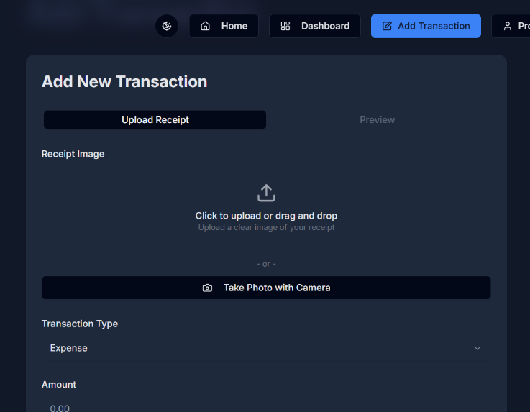

User Interface
+91 620 421 838

Slide 8
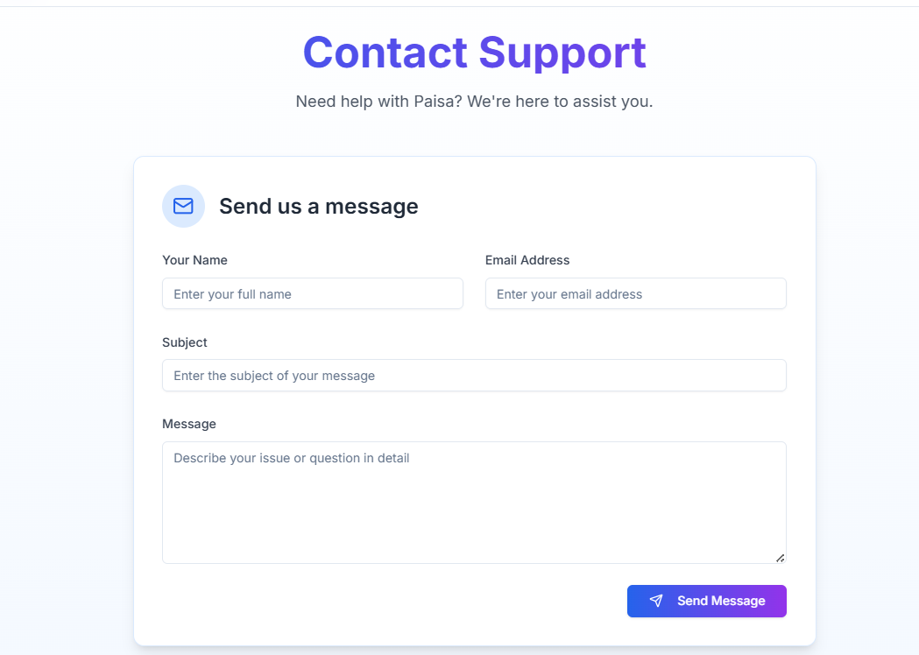
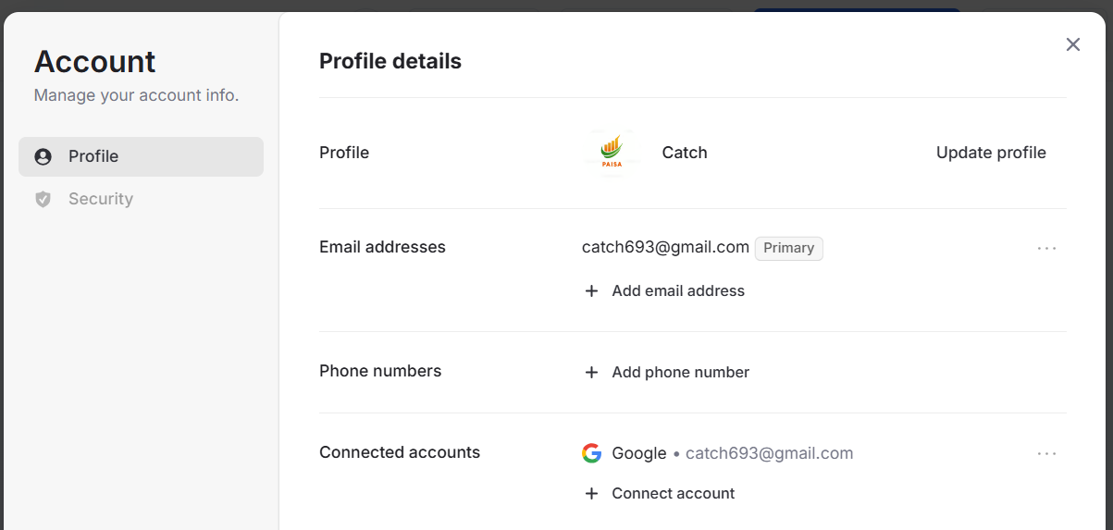
User Interface
+91 620 421 838

Slide 9
01
Core Technologies

Slide 10



Frontend stack
The frontend of Paisa is powered by Next.js 15, which allows for server-side rendering and fast performance. It utilizes React 19 for building interactive user interfaces, and Tailwind CSS for responsive design and styling. UI components are integrated to provide a modern look and feel.

Slide 11


Backend infrastructure
Paisa's backend is built using Next.js API routes.
For seamless database management with PostgreSQL.
This robust architecture ensures secure data handling and efficient query execution.
Additionally, integration with Google Gemini AI enhances the platform's capabilities in providing personalized financial recommendations.

Slide 12


AI integration
Paisa utilizes Google Gemini AI to enhance user experience by providing tailored financial recommendations.
This integration allows the platform to analyze user spending patterns and generate actionable insights.
Users benefit from three tiers of recommendations: quick wins for immediate savings, monthly plans for medium-term financial goals, and long-term strategies for significant financial planning.
The AI also calculates potential savings impact on monthly and annual budgets, helping users make informed financial decisions.

Slide 13
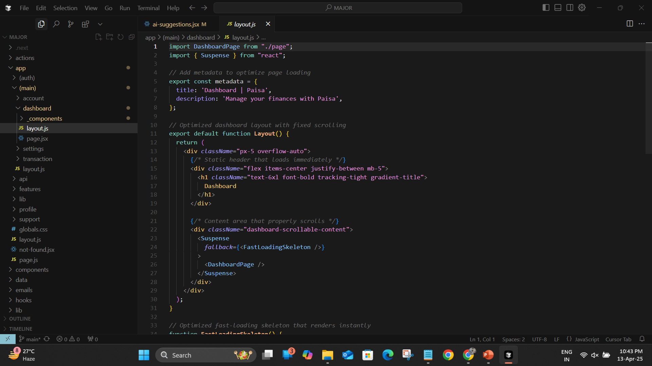

Slide 14
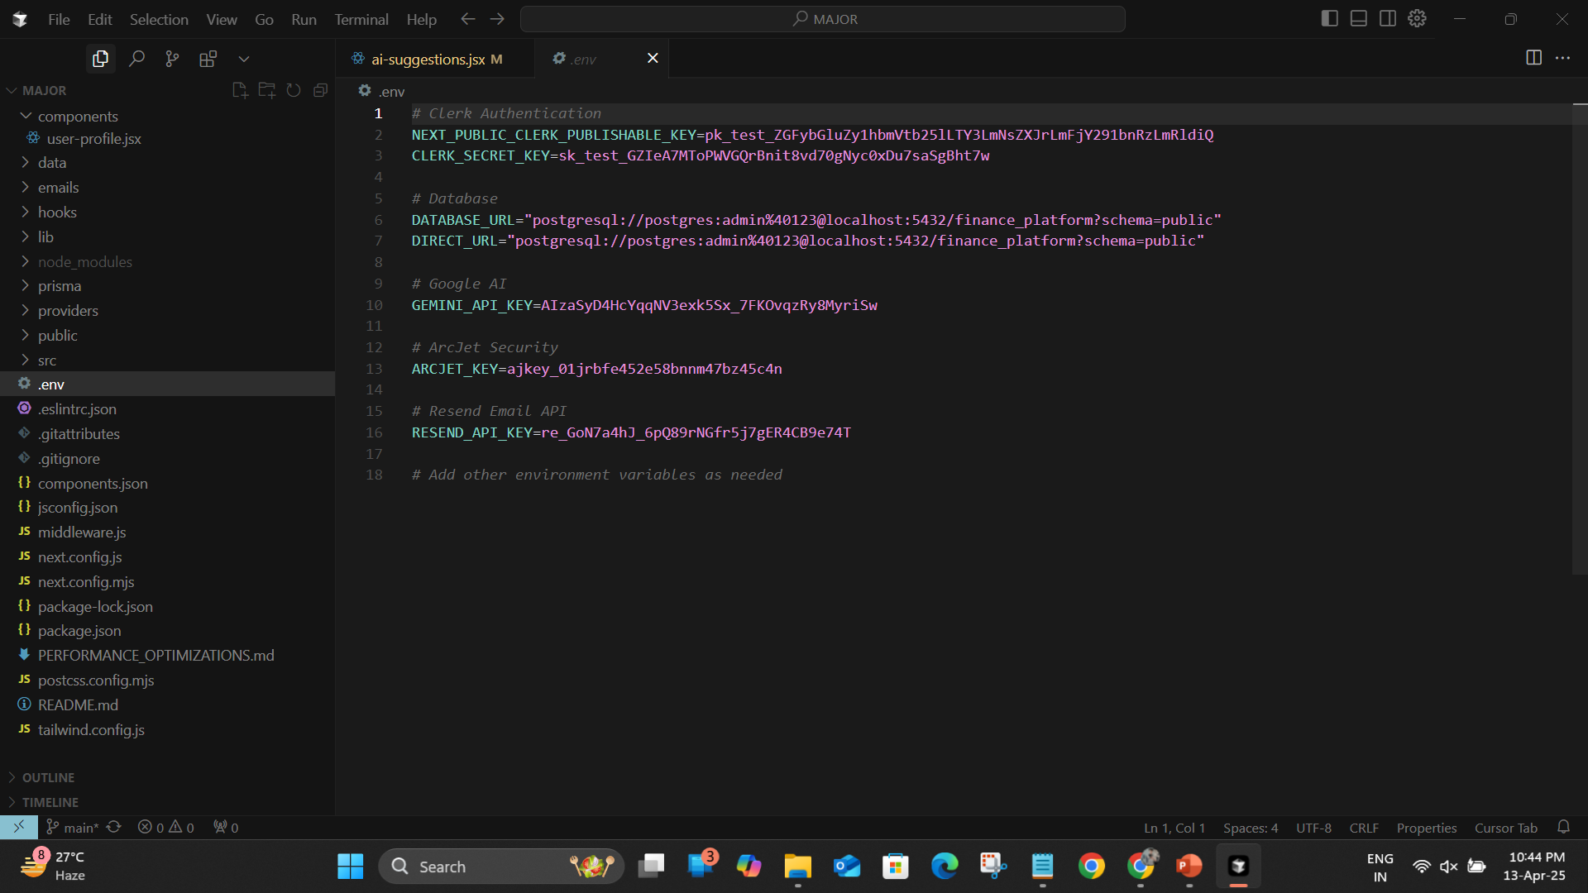

Slide 15
02
Key Features

Slide 16

User authentication
Paisa prioritizes user security with a two step authentication system powered by Clerk. It enables secure sign-up and sign-in processes, ensuring that user data is protected. The platform includes a comprehensive onboarding flow to guide new users through the setup process and offers features such as profile management to enhance the user experience.

Slide 17

Budgeting tools
The budgeting tools in Paisa empower users to create and track monthly budgets effectively.
Users can set budget categories with specified spending limits, and the platform provides real-time monitoring of budget utilization.
This ensures that users remain informed about their spending habits and can adjust their financial plans accordingly.

Slide 18

AI-powered insights
Paisa offers AI-powered insights that help users make smarter financial decisions. By analyzing user transactions, the platform provides personalized recommendations for saving and investing. Users receive insights on spending trends, along with forecasts for potential savings from adhering to recommended financial practices. This feature aims to enhance users' financial literacy and encourage better money management.

Slide 19
Future Enhancements
Mobile app integration
Goal tracking
Investment portfolio
Tax planning
Expense forecasting
Financial product marketplace

Slide 20

Conclusions
In summary, Paisa stands out as an innovative finance platform by combining advanced technology with user-centric features. Its core technologies and key features, such as AI integration, user authentication, comprehensive budgeting tools, and personalized insights, position it as a leading tool for personal finance management. By leveraging AI, Paisa not only simplifies financial planning but also empowers users to achieve their financial goals.

Slide 21
Thank you!
Do you have any questions?
+91 620 421 838

