Slide 1


Sex Difference in Allele Frequency (sdMAF) in UK Biobank
Zeya Chen
Paterson-Sun Lab
20th Jan 2023

Slide 2
Structure
Background
Sex chromosome
Data & Methods
Genotyping Array
Whole Exome Sequencing
Results

Slide 3
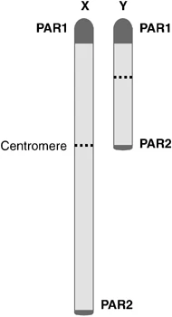
X-chromosome 155Mb
Y-chromosome 62Mb
Crossovers only in PAR during male meiosis
X-chromosome nucleotide diversity¹:
population bottleneck
sex-biased demographics events
De novo mutation rates
Flaquer, A., Rappold, G., Wienker, T. et al. The human pseudoautosomal regions: a review for genetic epidemiologists. Eur J Hum Genet 16, 771–779 (2008). https://doi.org/10.1038/ejhg.2008.63
1.Gottipati S, Arbiza L, Siepel A, et al. Analyses of X-linked and autosomal genetic variation in population-scale whole genome sequencing. Nature Genetics 2011;43(8):741–743.

Slide 4
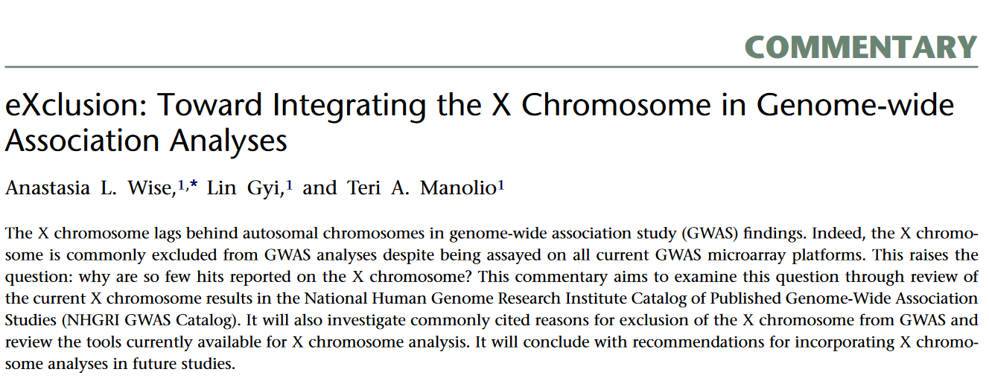
AJHG 2013
X chr commonly excluded from GWAS
2010-2011: only 33% GWAS reported X chr results
Few genome-wide significant associations
cf. chr 7 (similar length): 120 associations
X chr: 15 associations
25% of X and 3% of Y as of 2021

Slide 5
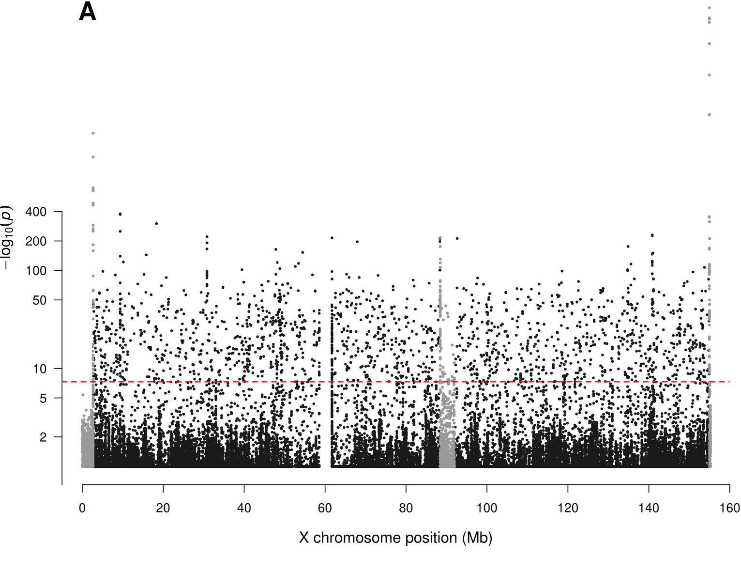
Published work
PAR2
PAR1
XTR/PAR3
Wang Z, Sun L, Paterson AD (2022) Major sex differences in allele frequencies for X chromosomal variants in both the 1000 Genomes Project and gnomAD. PLoS Genet 18(5): e1010231. https://doi.org/10.1371/journal.pgen.1010231

Slide 6
UK Biobank Genomics
White British ~ 400k Participants
DNA from Blood
Affymetrix UKBB Axiom Array Genotype Calls (Field ID: 22418)
710k biallelic SNPs
Regeneron Whole Exome Sequence (WES) (Field ID:23159)
2.3M biallelic SNPs

Slide 7




Wang Z, Sun L, Paterson AD (2022) Major sex differences in allele frequencies for X chromosomal variants in both the 1000 Genomes Project and gnomAD. PLoS Genet 18(5): e1010231. https://doi.org/10.1371/journal.pgen.1010231
Method
Departure from HWE

Slide 8
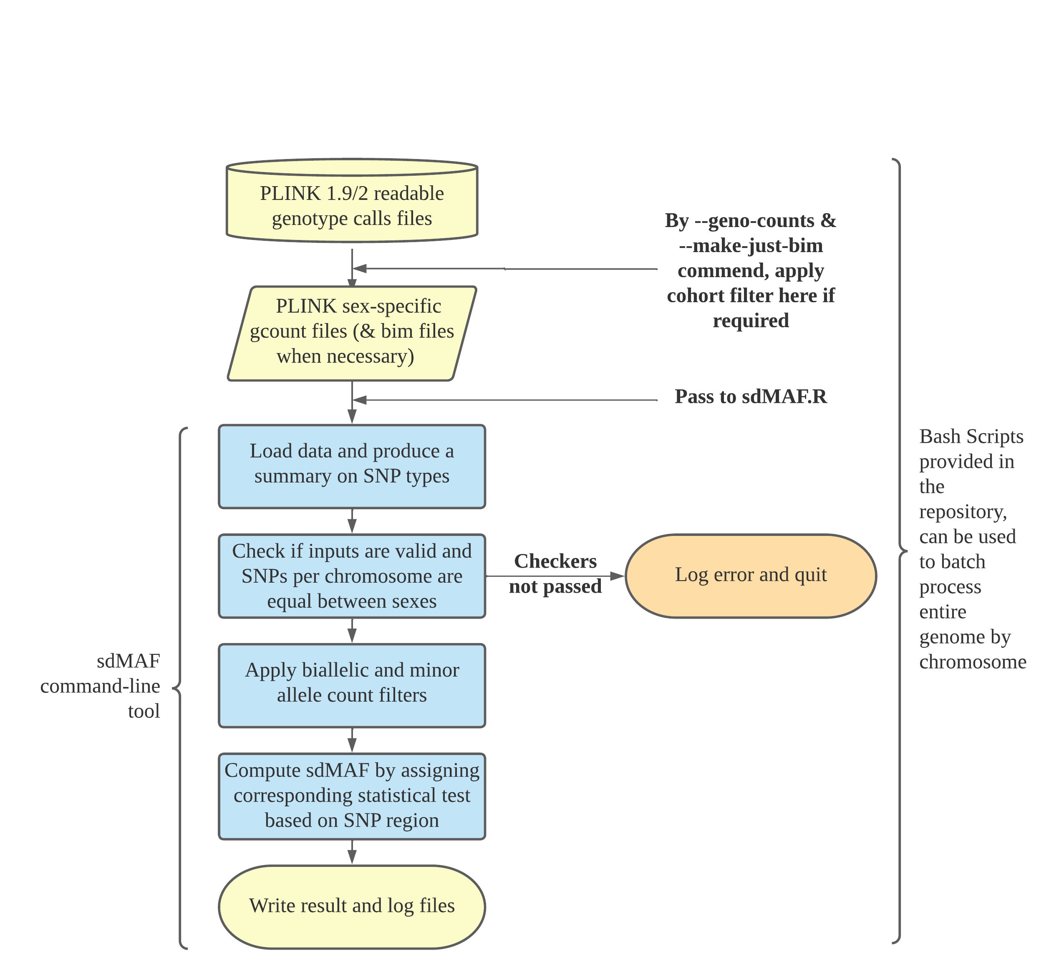
Software Tools

Slide 9
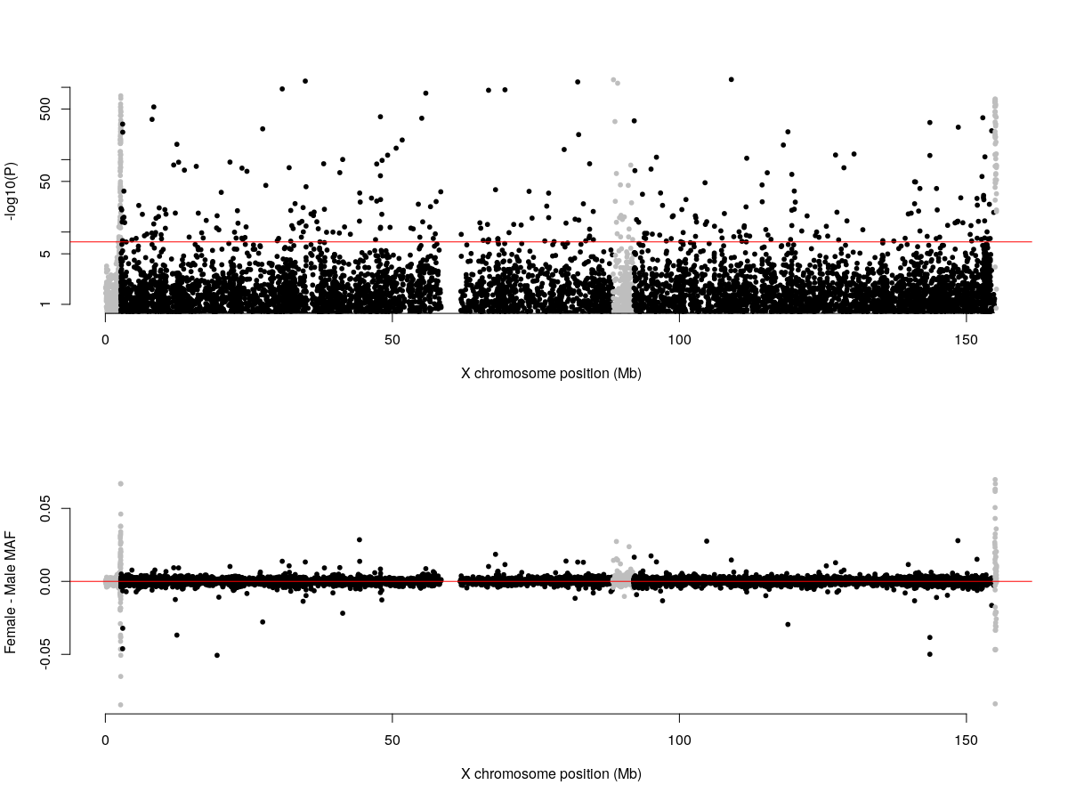
Genotyping Array X chr
PAR1
XTR/PAR3
PAR2

Slide 10
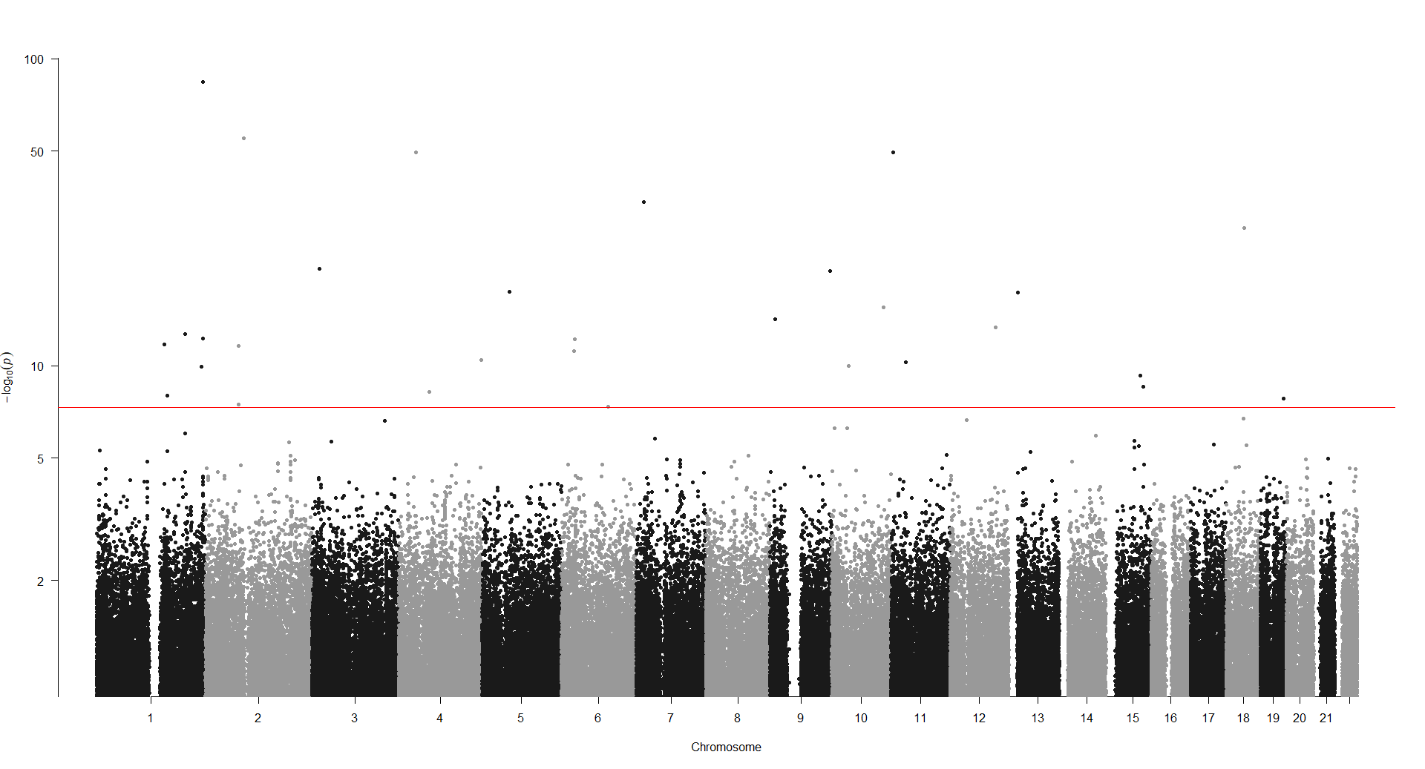
Genotyping Array Autosomes

Slide 11
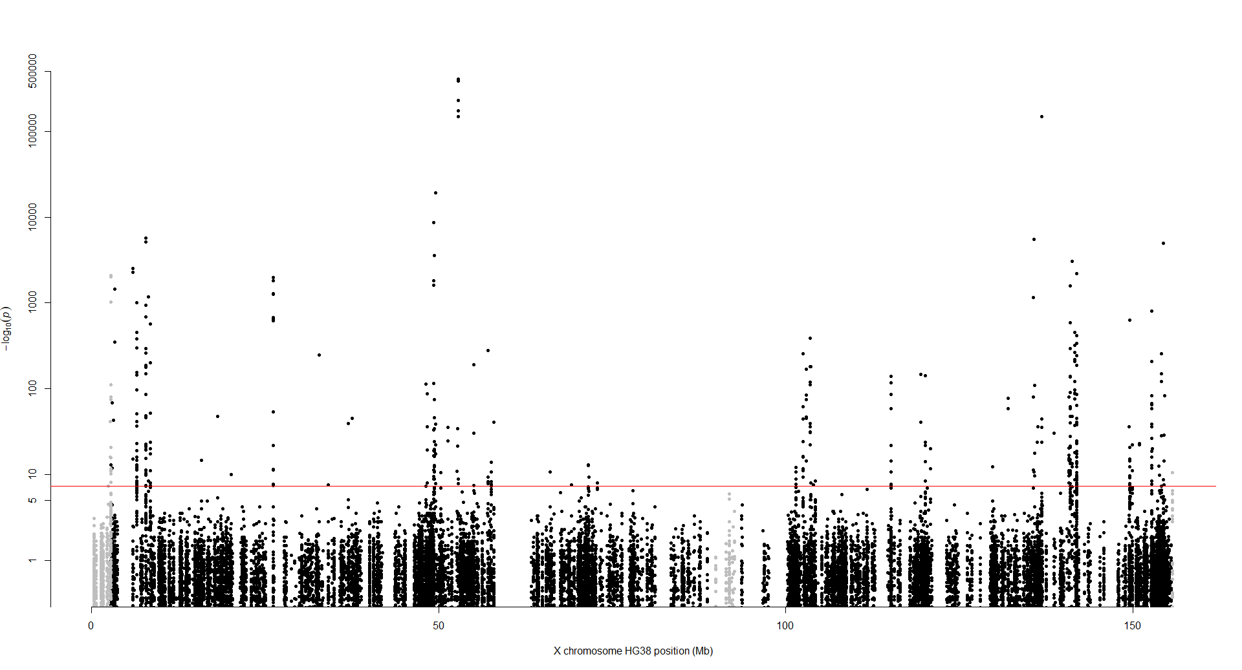
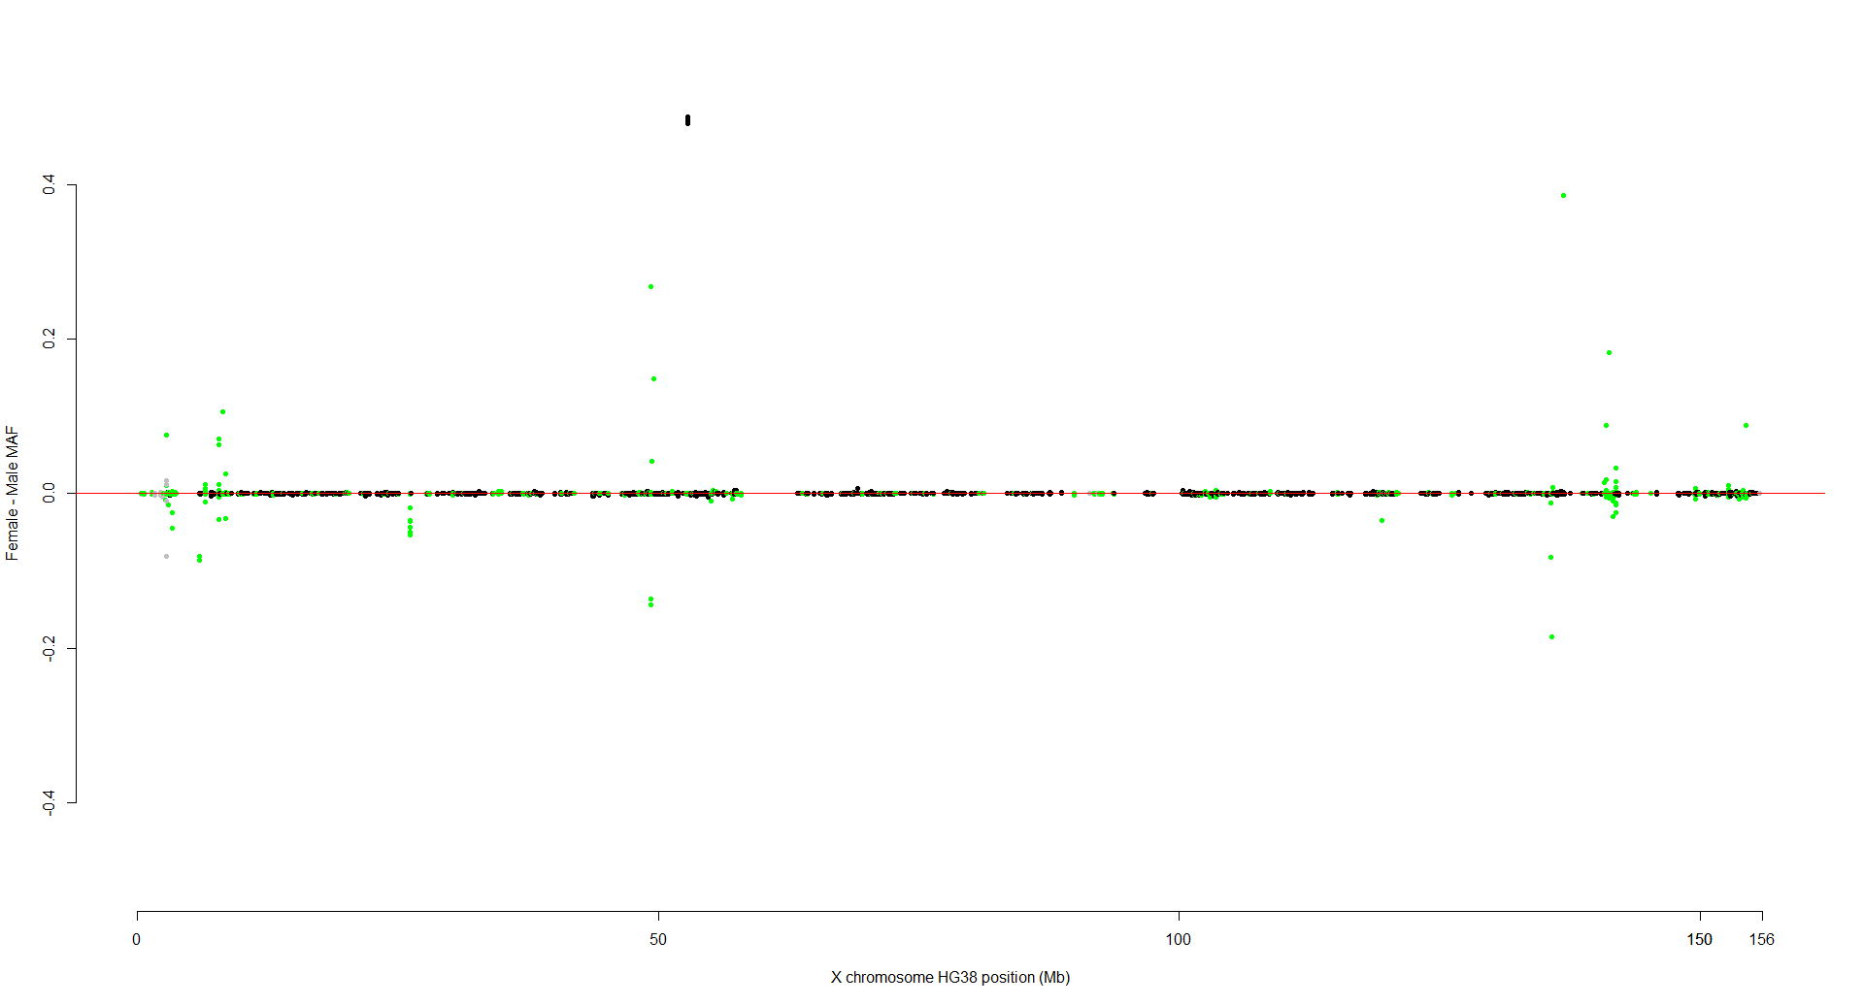
WES X chr
PAR1
PAR2
XTR/PAR3
Zook, J.. et al. Extensive sequencing of seven human genomes to characterize benchmark reference materials. Sci Data 3, 160025 (2016). https://doi.org/10.1038/sdata.2016.25

Slide 12
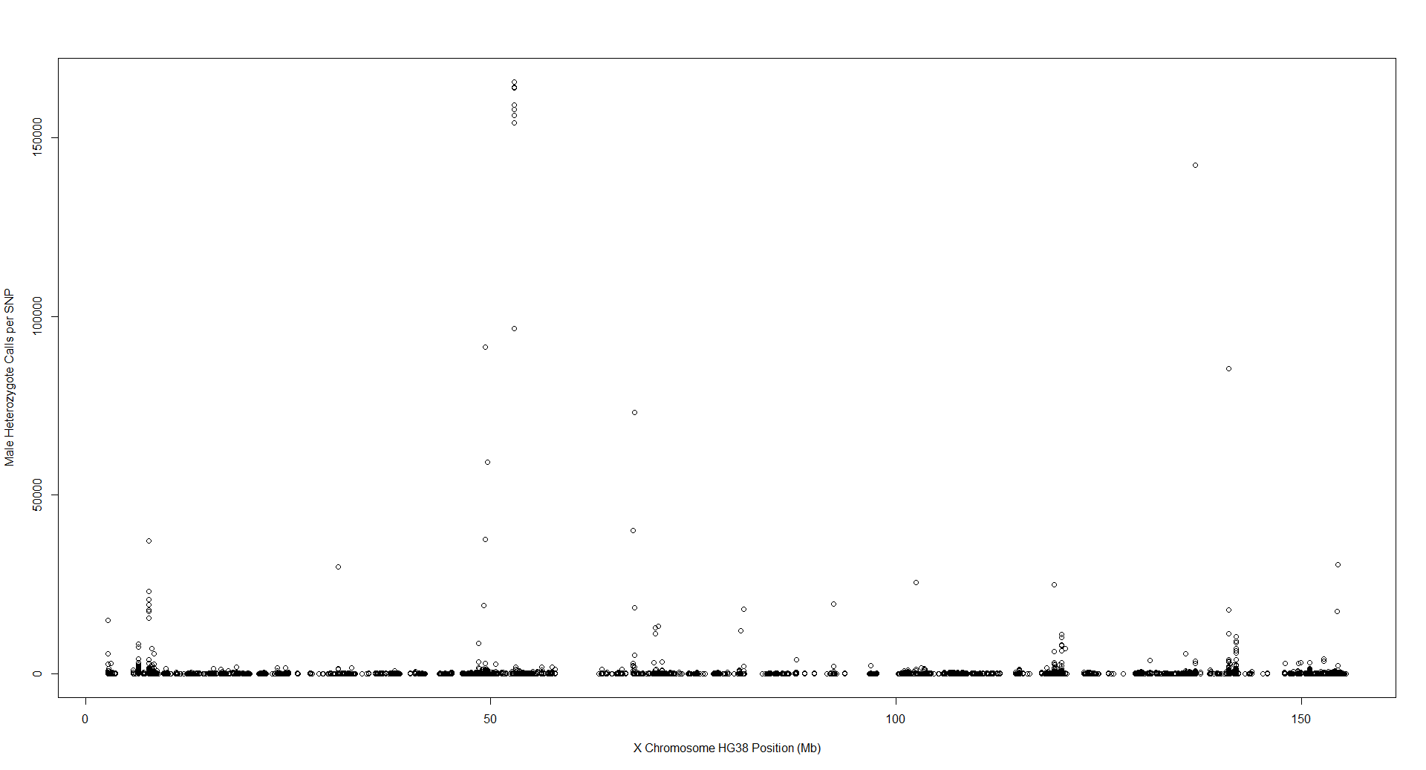
WES X chr Male Heterozygote Calls

Slide 13
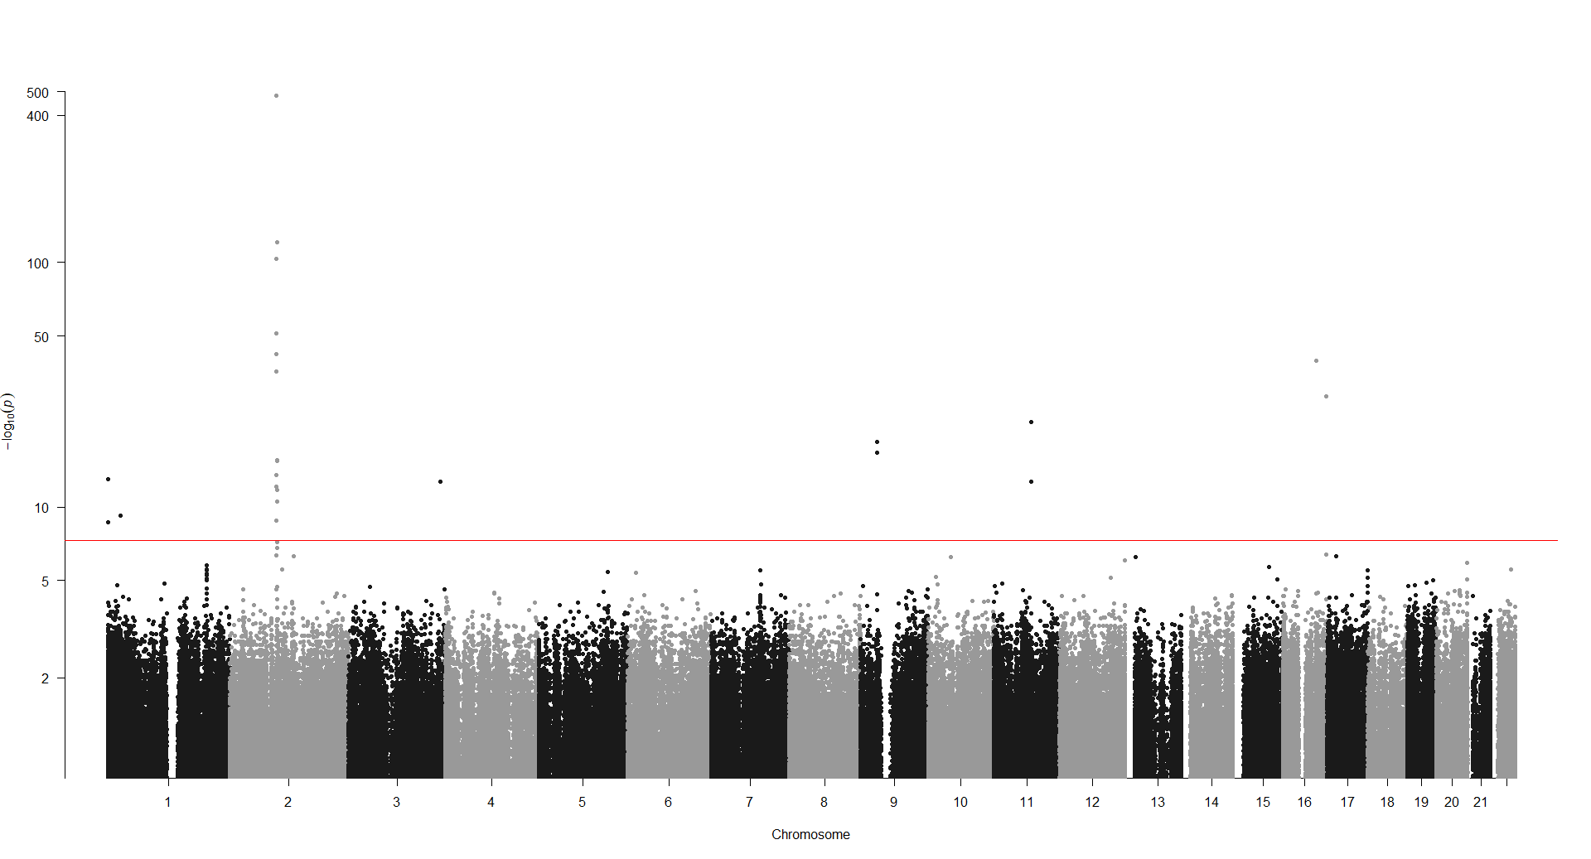
WES Autosomes

Slide 14
Conclusion
Sex Differences in observed in both WES and array
Potential technical artifacts from WES result

Slide 15
Limitations
Selection bias due to participation rate​
Restricted to White British
UKBB Whole Genome Sequencing ​

Slide 16
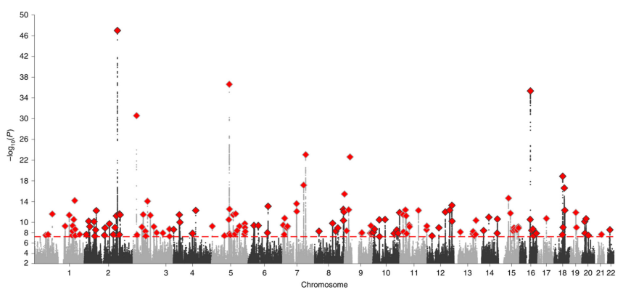
Discussion
23andMe sex GWAS did not analyze X chr²
2. Pirastu, N. et al. Genetic analyses identify widespread sex-differential participation bias. Nat Genet 53, 663–671 (2021). https://doi.org/10.1038/s41588-021-00846-7

Slide 17
Discussion
Include sex as a covariate in the GWAS to avoid false positive/negative effect
Sex difference in missingness suggesting missingness is not random

Slide 18
Acknowledgement
UK Biobank participants, UK Biobank research group
Zhong Wang for sharing pipeline
Dr. Delnaz Roshandel, Dr. Lei Sun and Dr. Andrew Paterson for mentoring

