Slide 1

PRIMACY
GUI for Massively Multiplexed Pathogen Detection Optimization
By Turan Naimey, Austin Kelly, Alex Lacy and Chance Nelson
Mentor: Isaac Shaffer
Team
PathLab

Slide 2

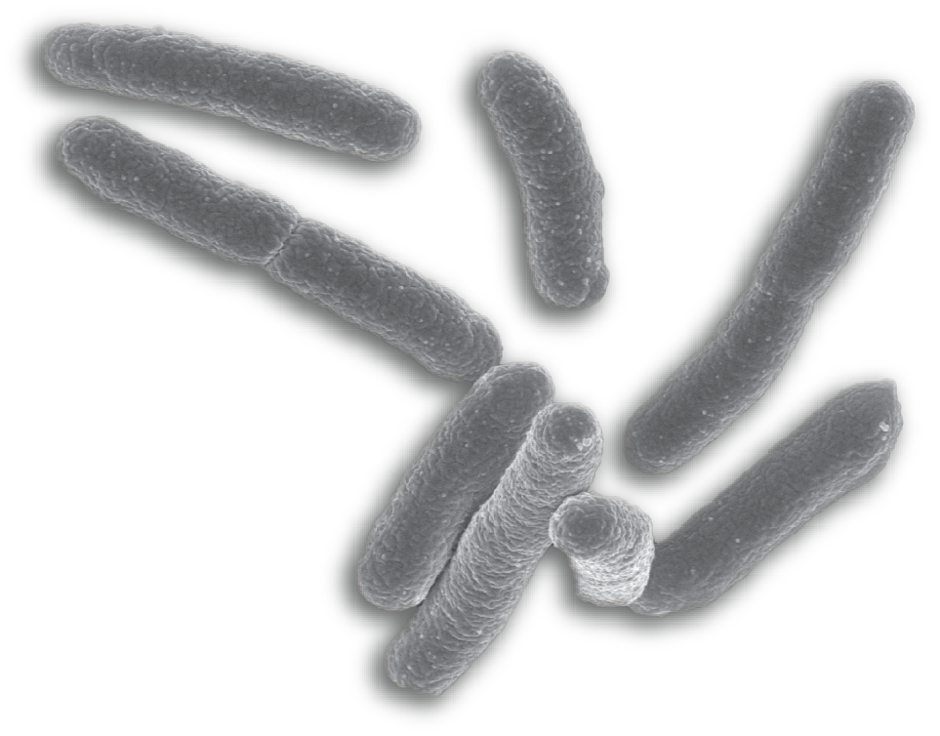
Background
E. Coli Outbreak Germany 2011
3500 cases of infection
51 deaths
Spanish Cucumbers
Failure to detect the right strain
Notes:
Turan
Go back in time to 2011 Germany where an E.Coli outbreak caused massive panice and led to 51 deaths and hundreds of hospitalizations
Talk about the problem of why it took the scientific community to find out which strand caused the outbreak
Phenotypic testing --->>>>> Genomic tests

Slide 3
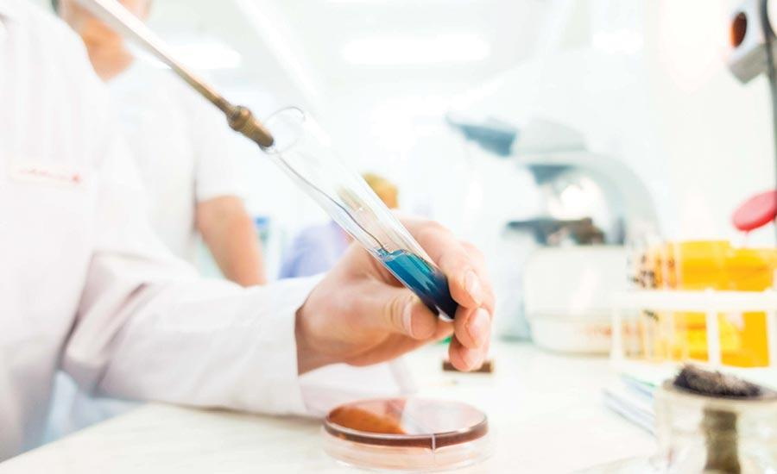

Multiplexed Genomics Testing
Pathogen screening panel
Diagnostic Tests
Optimization of Tests
Efficient Identification of different Pathogen strains
Notes:
Turan
Advances in DNA sequencing technology have made it possible for scientists all over the world to sequence complete microbial genomes rapidly and efficiently.

Slide 4
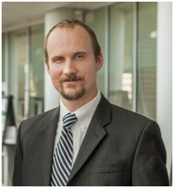
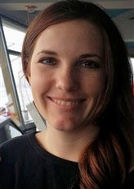
Our Client: Fofanov Lab
Bioinformatics
Epidemiology
Detection
Tracking
Primacy - Pathogen identification optimisation tool
Viacheslav Fofanov, Ph.D.
Tara Furstenau, Ph.D.
Notes:
http://www.fofanovlab.us/

Slide 5
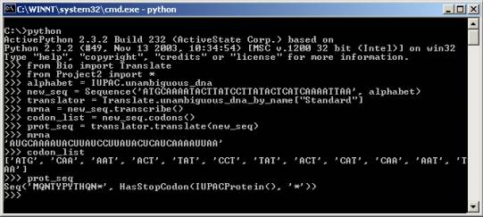
Primacy - The Pipeline
Simplifies designing tests
4 Module Pipeline
Python Based CLI (Command Line Interface)
Inexpensive
Notes:
Alex
Edit: change to ‘identifies more effective primers quicker and cheaper’
Makes pathogen identification easier
Allows researchers to create more comprehensive test panels and monitor interactions between tests

Slide 6
The Problem
End-user biologist are not all CLI experts
CLI based tools limit the number of users
Perception that CLI tools are only for competent programmers/users
Intimidating interface for starters
Existing tools are expensive
Notes:
Alex
Cost, accessibility

Slide 7
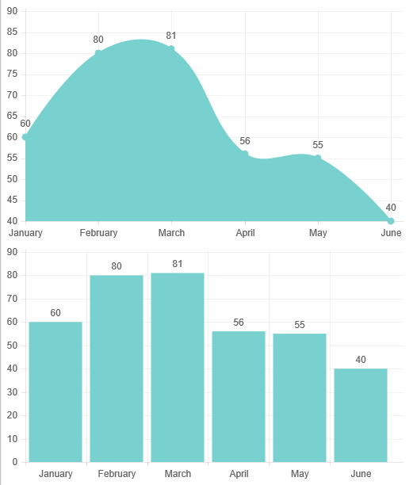
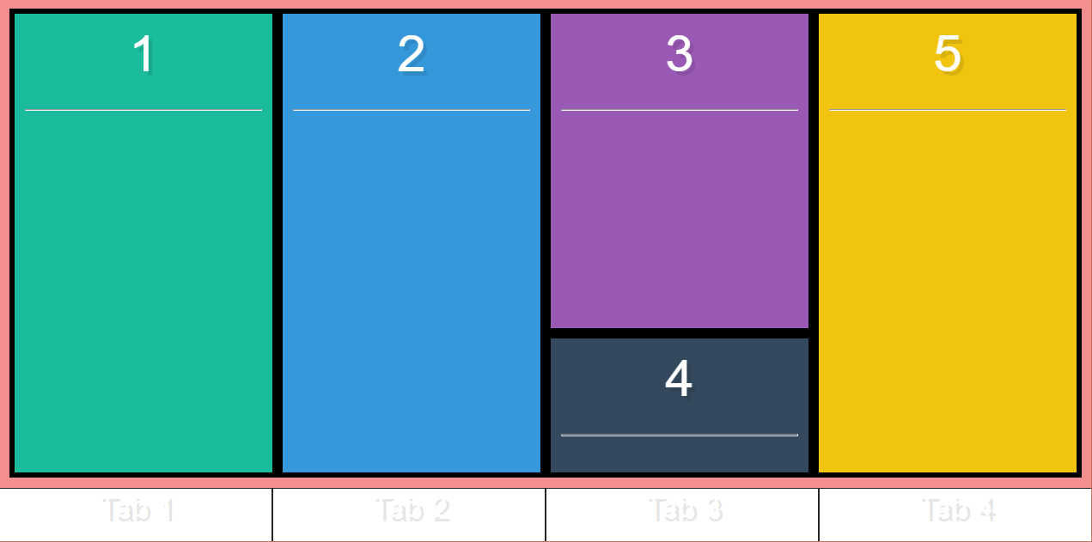
Solution: GUI
Chart.JS example
Technologies
Electron
Flexbox
Chart.JS
Primacy Window
Electron and Flexbox example
Notes:
Add chart.ja example

Slide 8

Domain Requirements
Uses Primacy
Biologist-friendly
Communicates with Primacy pipeline
Configurable
Input Checking
Notes:
Austin
Begin by discussing how we got we these requirements
Discuss domain level specific requirements

Slide 9
Functional Requirements
Non-Functional Requirements
Pipeline Traversal
Error Correction
Maintainable/Expandable
Performance Requirement
Input Validation Time Frame
Ease of Use
Learnable in X hours
UI Aesthetic Quality
Notes:
Dont reiterate, maintainaanility?
Low overhead - If it runs primacy, it runs our GUI

Slide 10
Environmental Constraints
GUI must run on Windows and MacOS operating systems
GUI must be packaged with the Primacy Pipeline
GUI communicates with the pipeline using JSON strings
Notes:
(Chance)
Environmental Constraints
• Describe context your software must live in

Slide 11
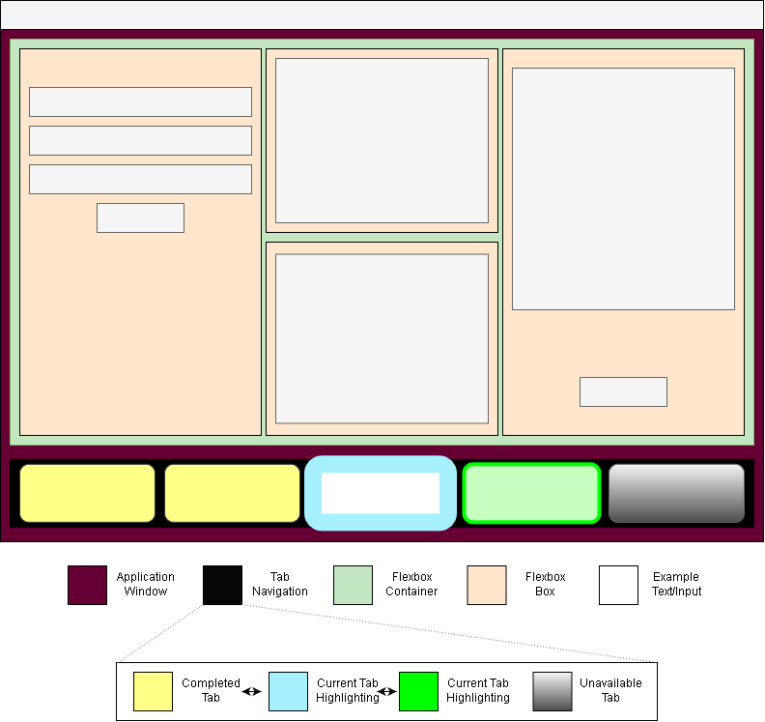
Deep Dive: Pipeline Traversal
Pipeline Traversal
Electron
API
JSON
Tabs
User Guidance
Highlighting
User Feedback
Notes:
We containerized our environment using flexbox because it allows seamless scalability for window sizing. This means boxes within our program can scale to fit or rearrange themselves so they are all easily viewable

Slide 12
Risks and Feasibility
Domain Requirements: Medium Risk
Feature Creep
Technical Requirements: Low Risk
Performance Requirements: Medium Risk
Validation Time Frame
Notes:
Domain Requirements: FEATURE CREEP! Medium Risk, but we have mitigating factors

Slide 13
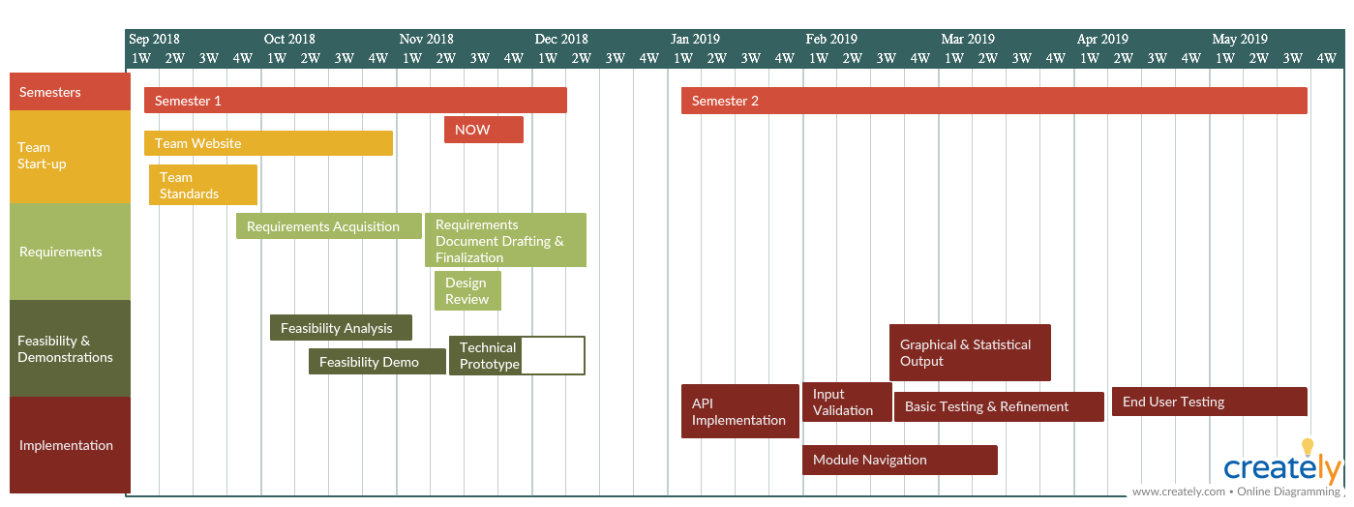
Schedule
Notes:
Alex

Slide 14
Conclusion
This GUI will allow researchers to use the Primacy tool without worrying about learning a new interface
Using web-based technologies allow flexibility and adding new features seamless
Some risks, which we are confident we can mitigate.
Prototyping right now, development soon to begin.
Notes:
Turan

