Slide 1

MaPPFinder 2.0

Slide 2
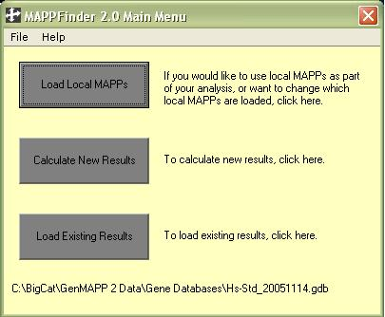
Main menu screen

Slide 3
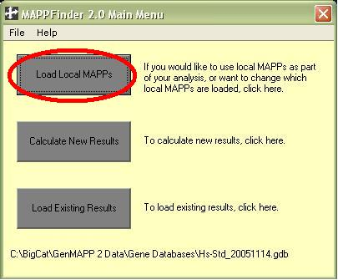
First option: Load Local MaPPs

Slide 4
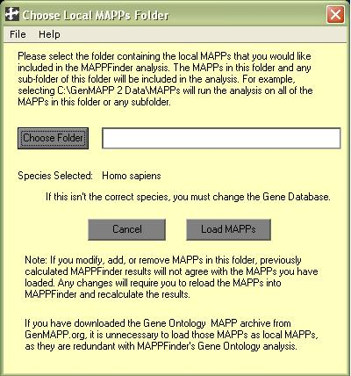
Load Local MaPPs

Slide 5
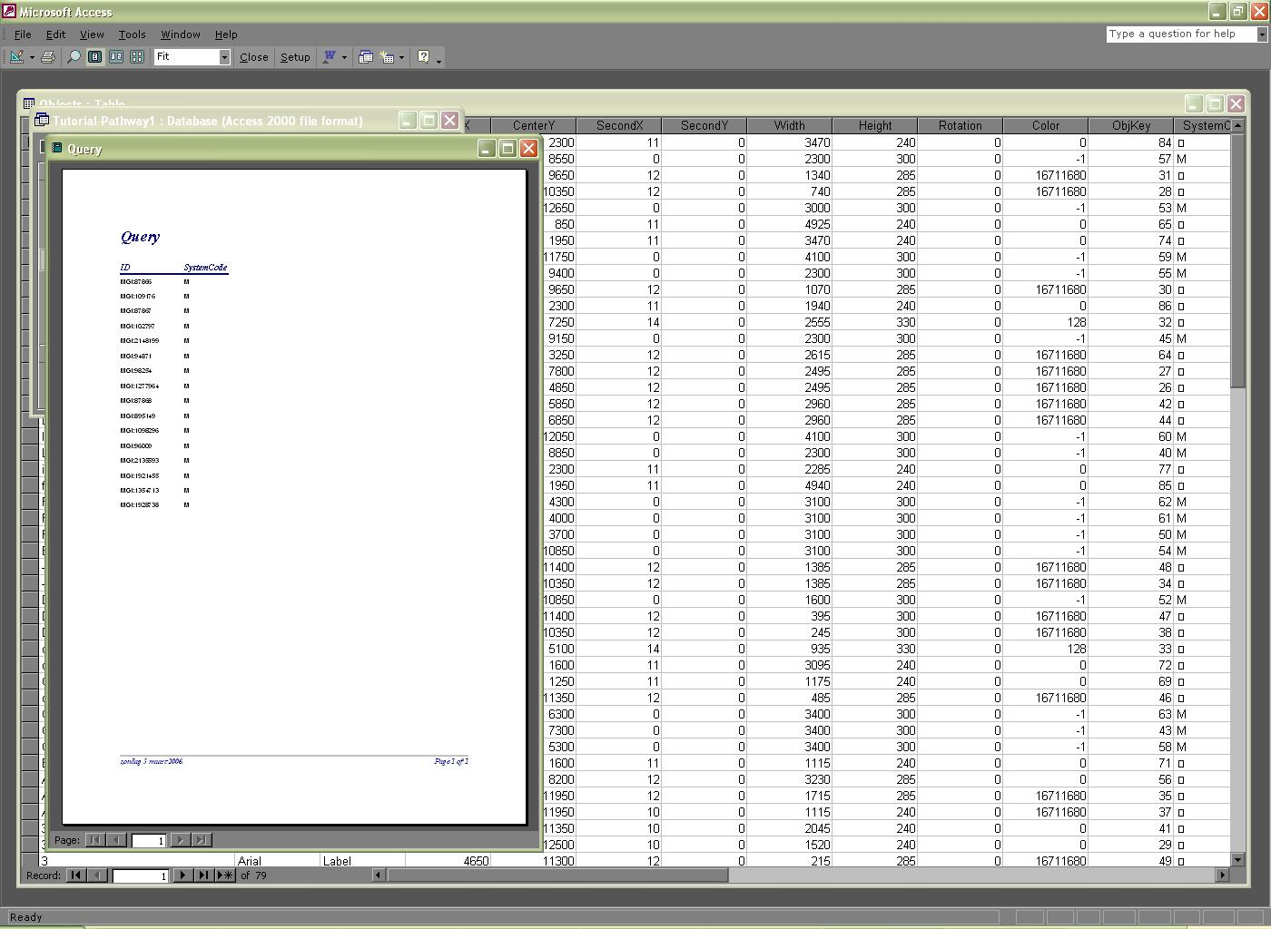
SQL
Select DISTINCT ID, SystemCode FROM [Objects] Where Type = 'Gene'
Notes:
In database MAPP

Slide 6

Function getPrimary
Two columns are parameters for function
Target: determine if the id given in the parameters is a primary or secundary id or should be left alone

Slide 7
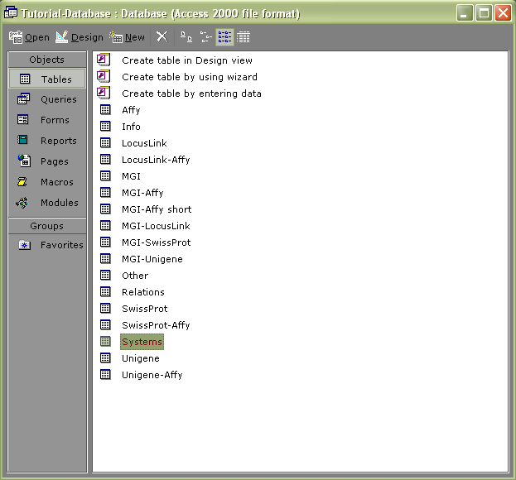
Primary ID
Database dbMaPPFinder
has table
Systems

Slide 8
Primary ID
All columns selected that meet function parameters
Saved in variable rsSystems
Is rsSystems empty?
  YES: id = primary id

Slide 9
Primary ID
  NO: selection in table based on columns Date and Systemcode
  Criteria:
  Date is not empty or
  Systemcode is “O”
  Meets criteria: Table exists within database
  Result: supportedSystem = true

Slide 10
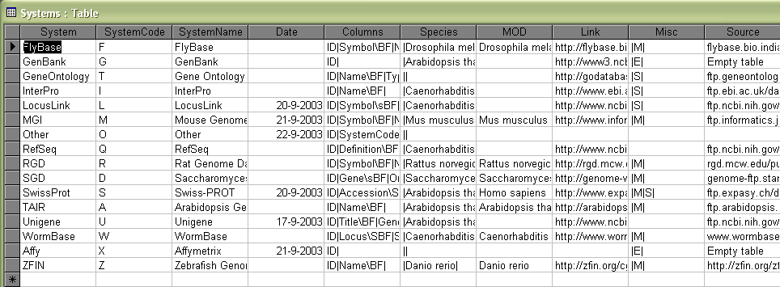

Slide 11
Primary ID
If supportedSystem = true
New connection database:
Select all columns where ID = idIn from table srSystems!system
Save in variable rsSystem

Slide 12
Primary ID
Is rsSystem an empty list?
NO: idIn = getPrimary
ID of gen is found originating directly from table of value from column System.
(SwissProt)

Slide 13
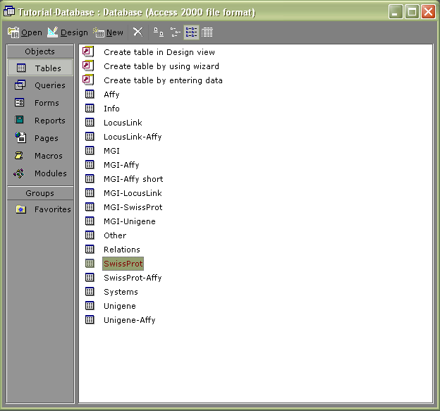

Slide 14
Secundary ID
YES: ID isn’t directly from table
Result: ID isn’t a Primary ID
Is it a Secundary ID?

Slide 15
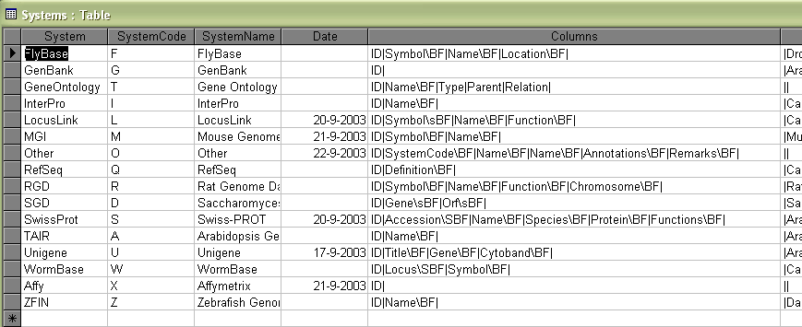
Secundary ID
The column “Columns” of the table Systems holds a String

Slide 16
Secundary ID
String is searched for “\”
If \ is found and no primary id was found in preceding method:
search in the same String for “|” (pipe) with startingposition position of “\” working backwards

Slide 17
Secundary ID
If character after \ is “S” (not case sensitive) then the name of a column from the System table is retracted and given to variable column (i.e. Accession)
When character after \ is also “S” (case sensitive) then variable sql gets value

Slide 18
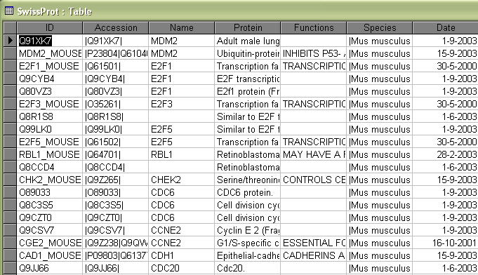

Slide 19
Secundary ID
Search Accession for value LIKE idIn,
get ID from adjacent column and give to variable sql
If “s” then value in earlier table System must be exactly idIn and returned to variable sql

Slide 20
Secundary ID
sql = statement
sql is executed on database dbMaPPFinder
Result is saved in rsSystem

Slide 21
Secundary ID
Is rsSystem an empty list?
NO: found = true (found primary id)
getPrimary= rsSystem
YES: search for next slash

Slide 22
Id should be left alone
supportedSystem = False
“Columns” has been completely searched but nothing has been found

Slide 23
Function addMAPPgene
getPrimary id is added to MAPPGenes collection
addMAPPgene = true
In original function AddMapp if-statement executed
Row added to table GenetoMAPP with values id, systemcode from rsGenes and name of MAPP.
Notes:
tekst en moet dus eerst nog omgezet worden in sql (“TextToSql”).
Dit alles gebeurt binnen de database dbLocalMAPPs

Slide 24
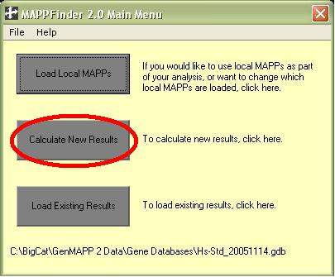
Second Option: Calculate New Results

Slide 25
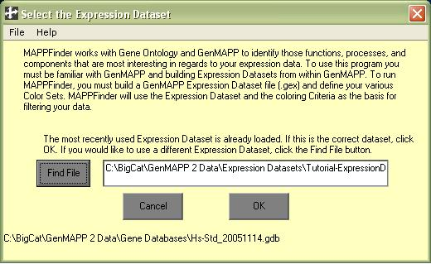
Input screen

Slide 26
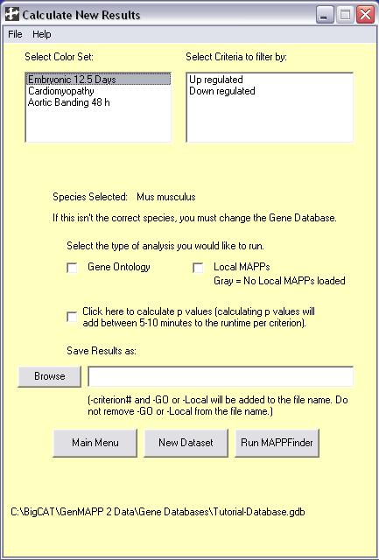
Criteria

Slide 27
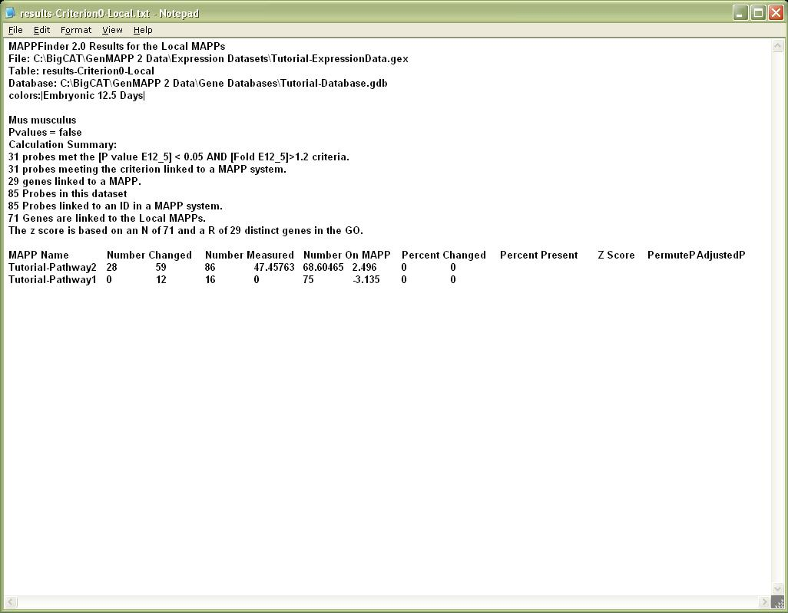
Text File

Slide 28
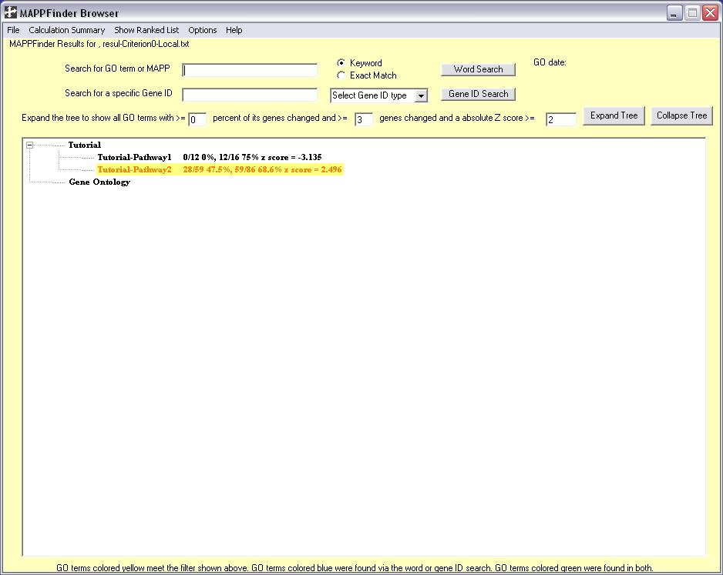
MaPPFinder Browser

Slide 29
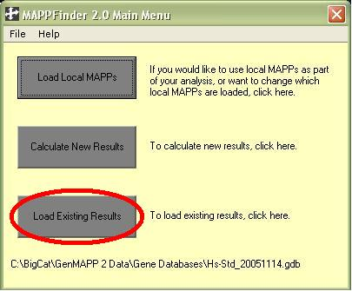
Third option: Load Existing Results

Slide 30
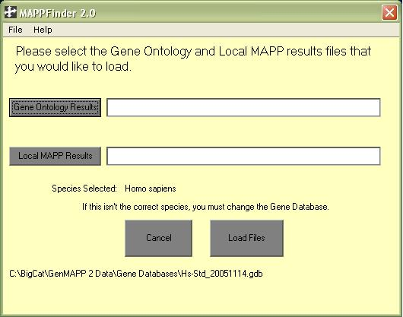
Load Files

Slide 31
MaPPFinder Browser

Slide 32

Questions?

