Slide 1
Wine Quality Classification Using Weka
Darshan Pathak

Slide 2
01
Classification

Slide 3
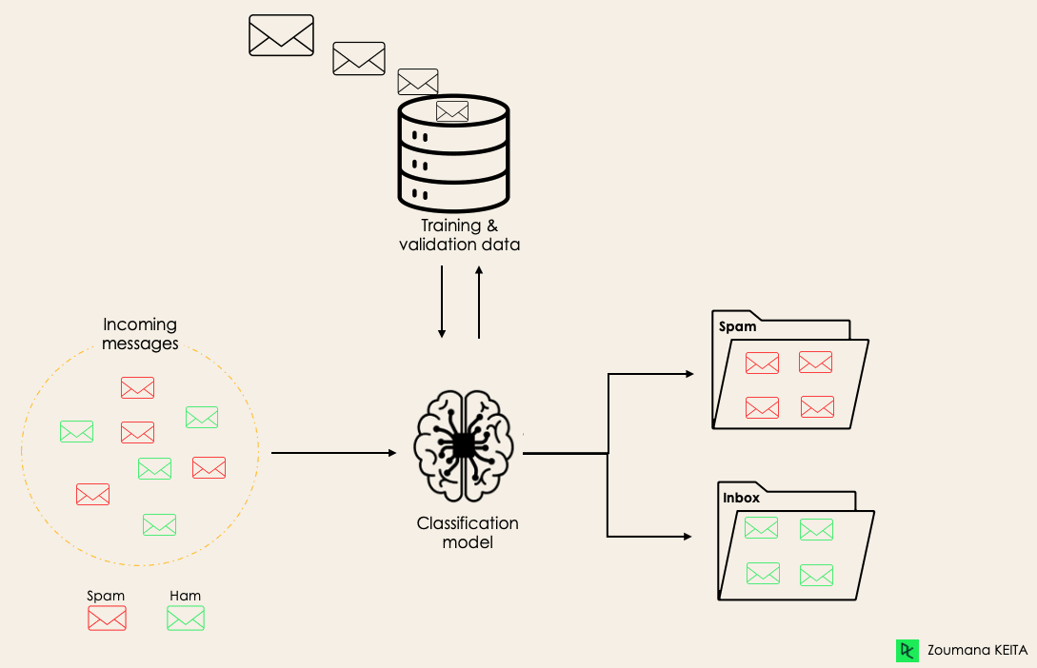
What is Classification
Classification in Machine Learning aims to determine which category an observation by understanding the relationship between the dependent and independent variables.
Classification algorithm can learn to predict whether a given email is spam or not span

Slide 4
Working of Classification Algorithms
Classification algorithms sort data into predefined categories based on patterns they learn from labeled examples. They use features (data attributes) to create a model during training, and then apply this model to predict the classes of new, unseen data.

Slide 5
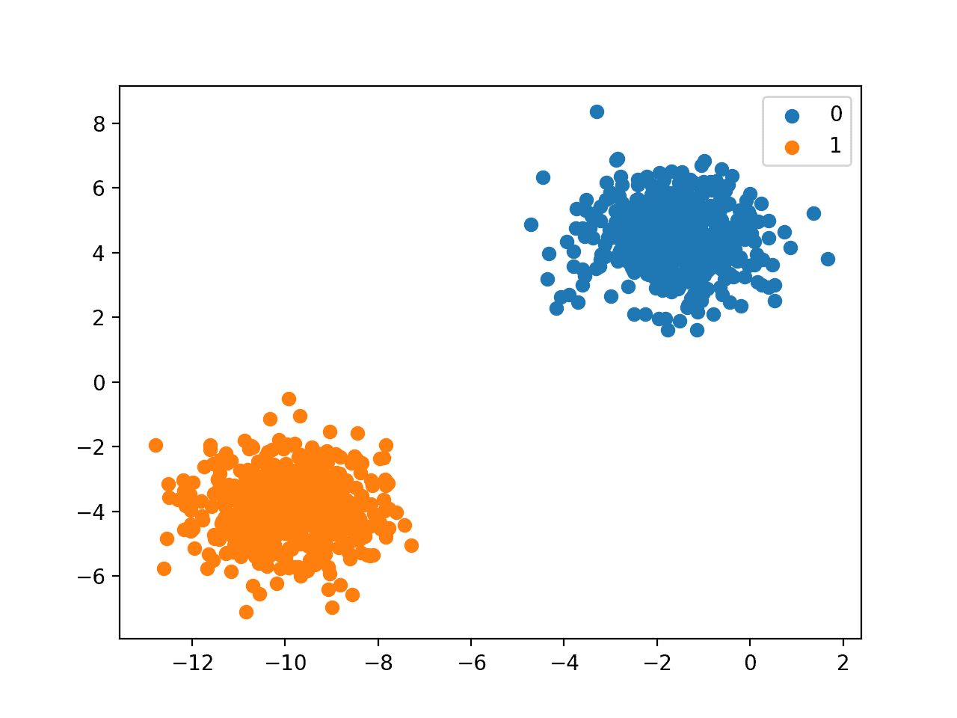
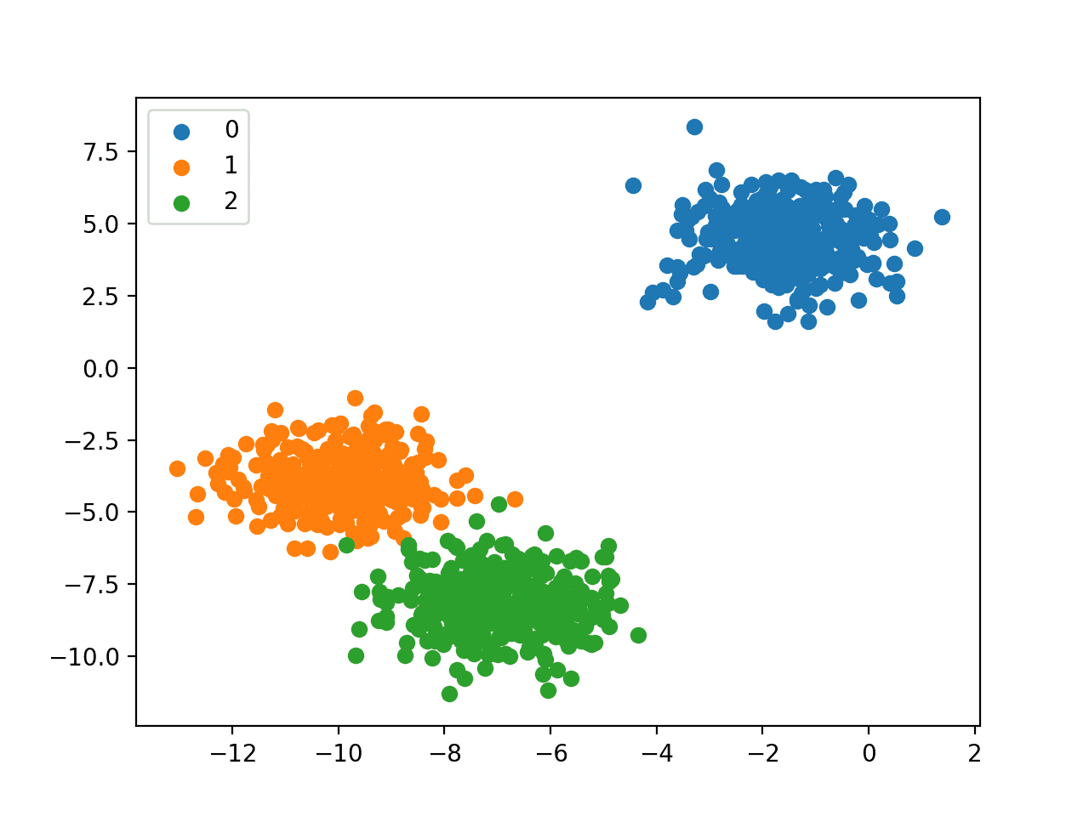
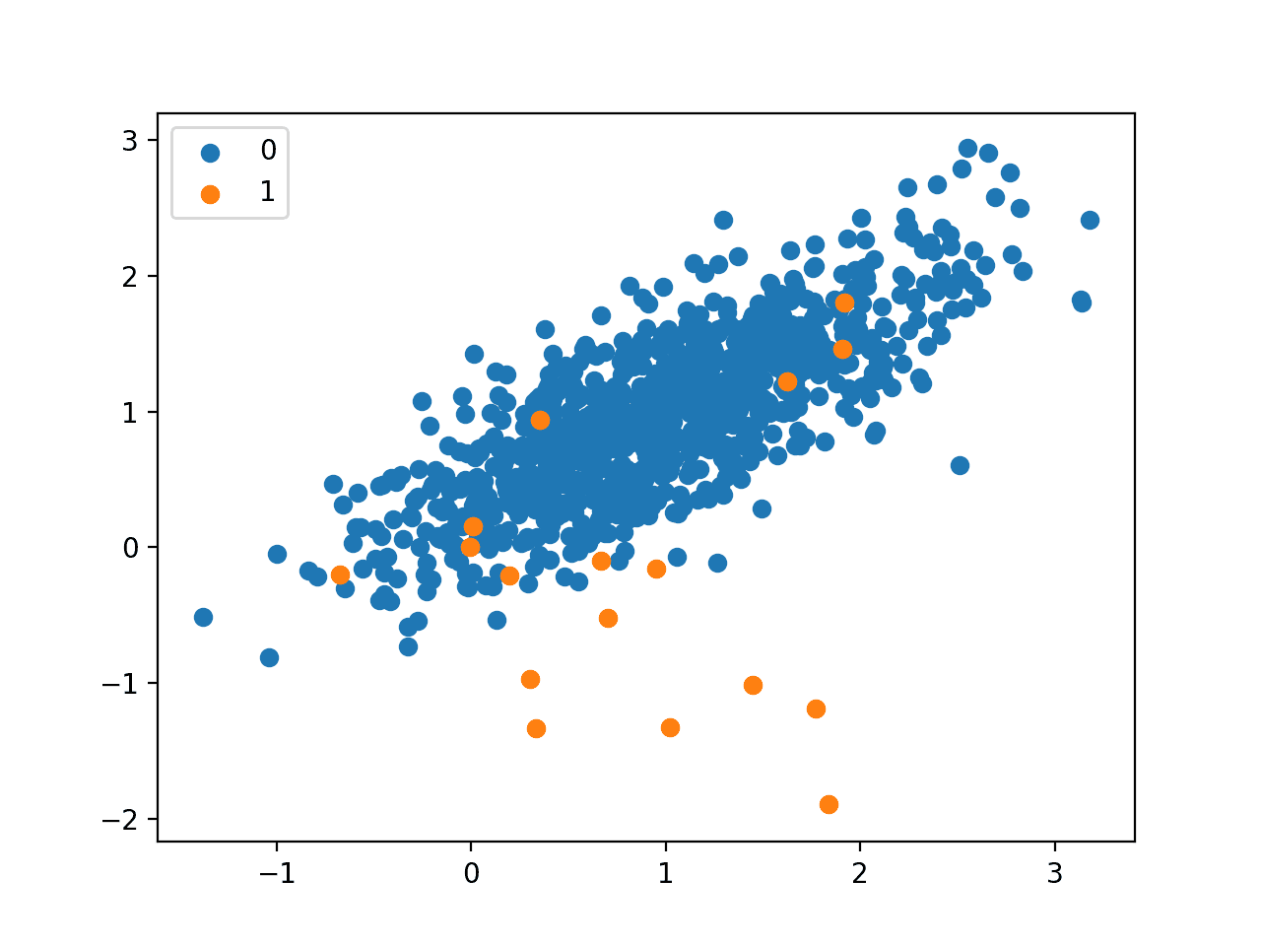
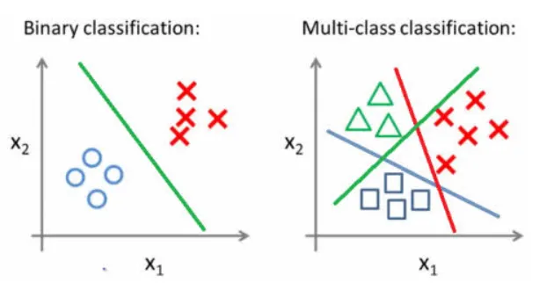
Types of Classification
Binary Classification
Multi-Class Classification
Multi-Label Classification
Imbalanced Classification

Slide 6
02
Case Study

Slide 7
Let’s learn with help of
Wine Quality Case Study
Using Weka Software

Slide 8
What is WEKA Software
Waikato Environment for Knowledge Analysis
Collection of machine learning algorithms and data processing tools implemented in Java
Used for the process of experimental data mining
Preparation of input data
Statistical evaluation of learning schemes
Visualization of input data and the result

Slide 9
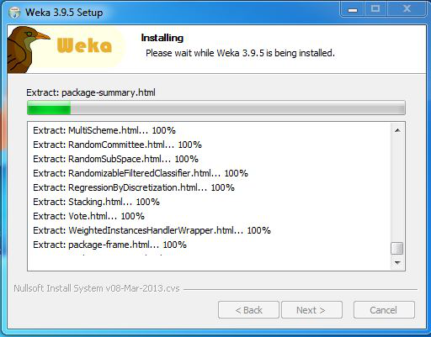
1. Install Weka

Slide 10
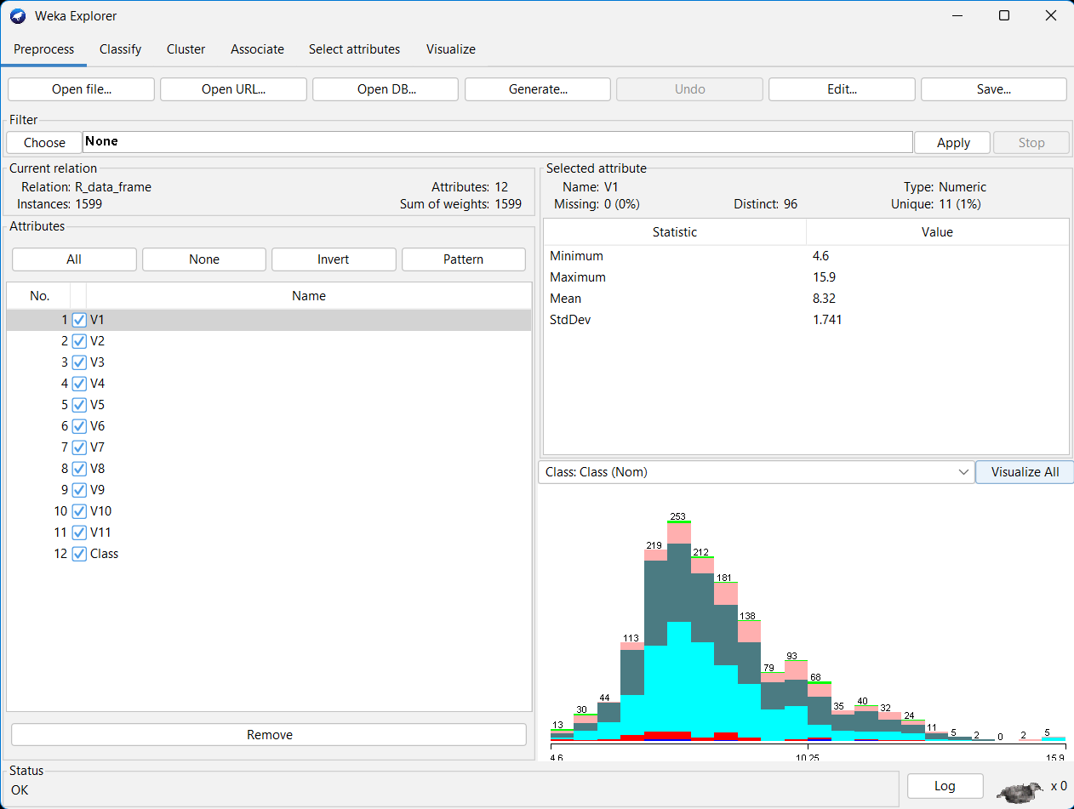
2. Load Data

Slide 11
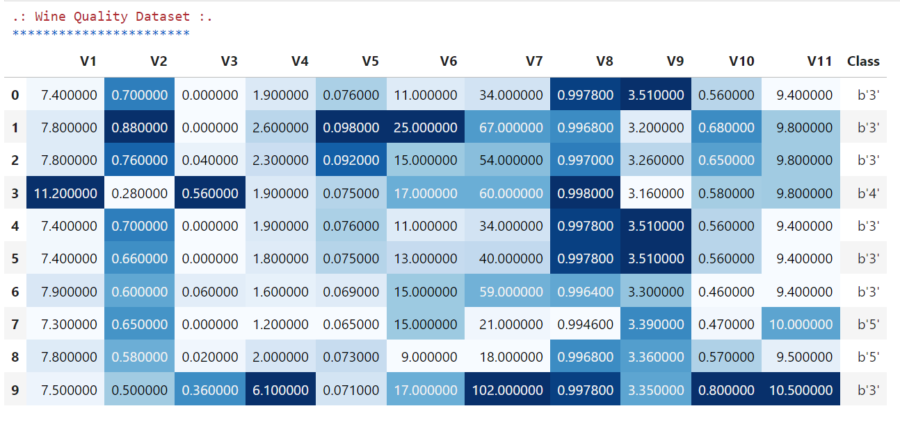
Wine Quality Dataset

Slide 12
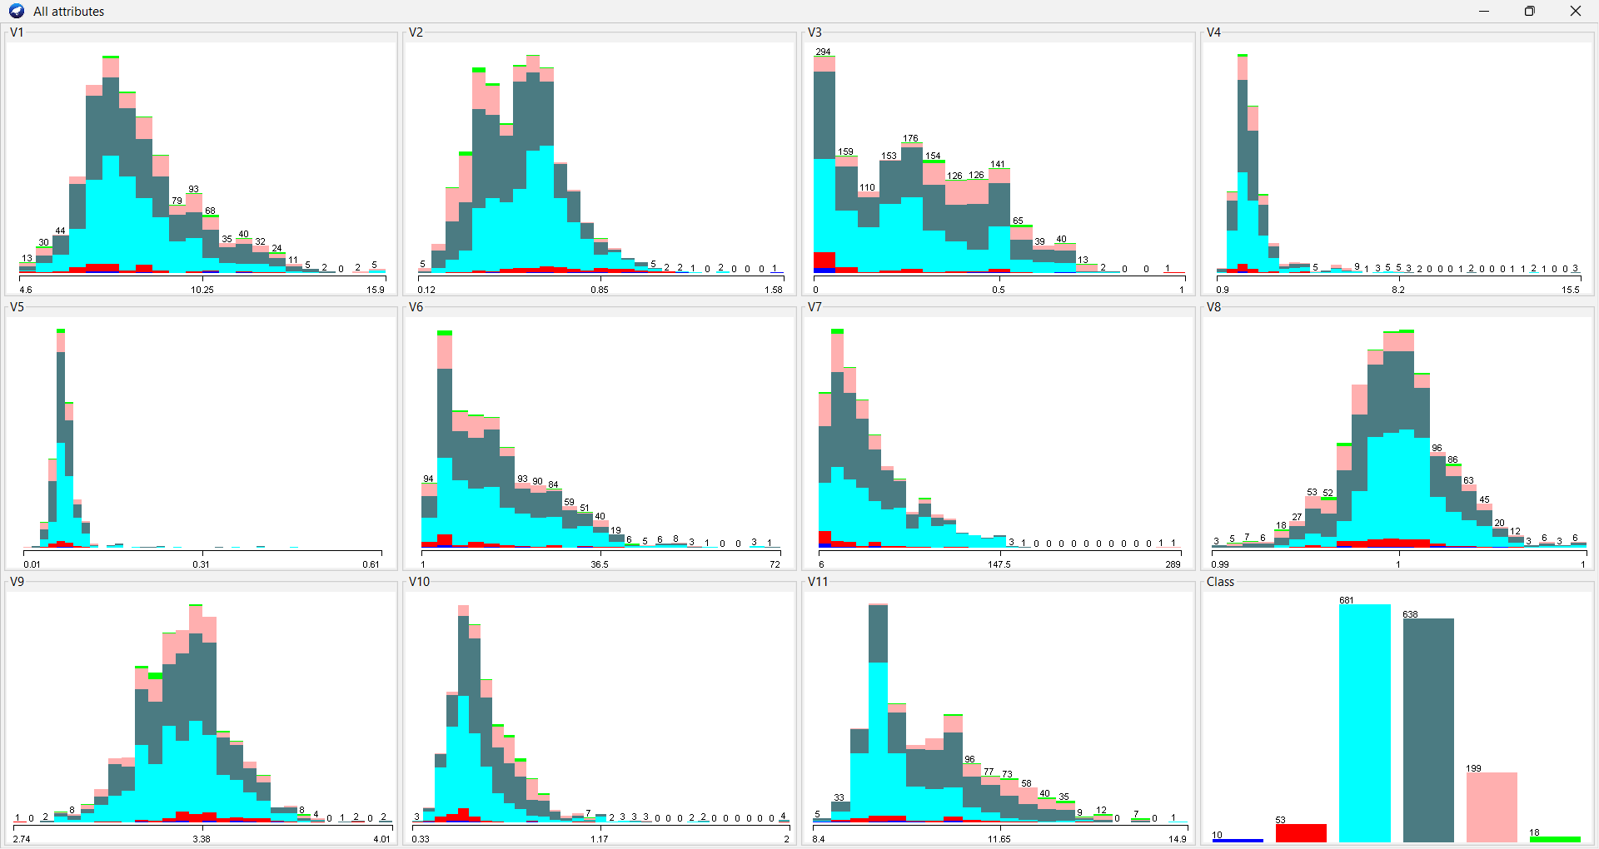
3. Visualize

Slide 13
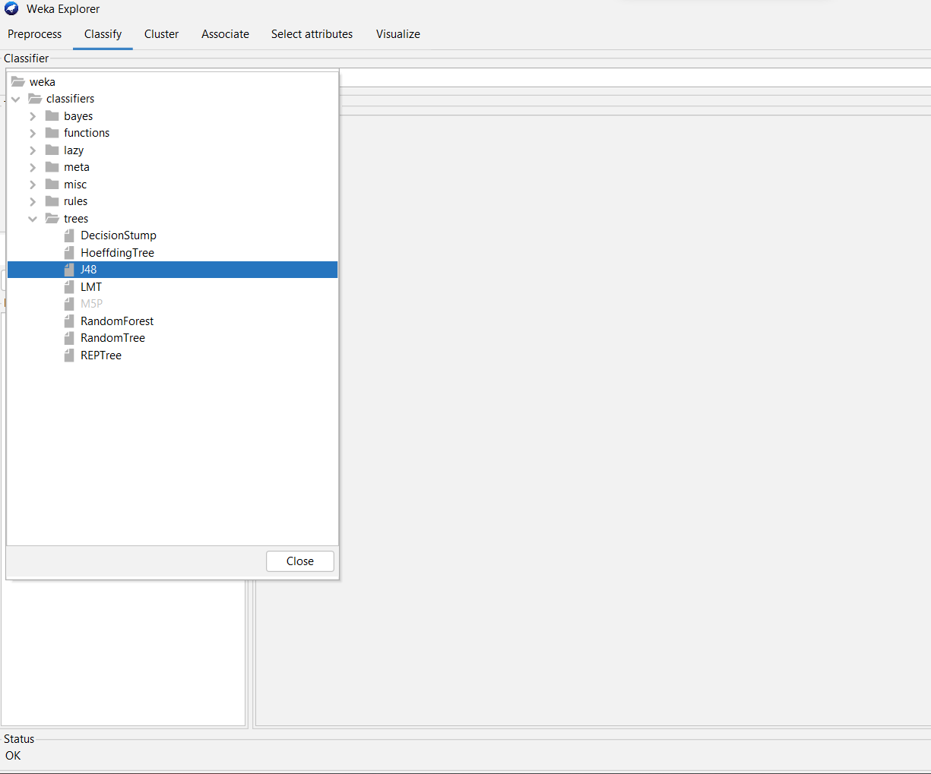
4. Select J48 Classifier

Slide 14
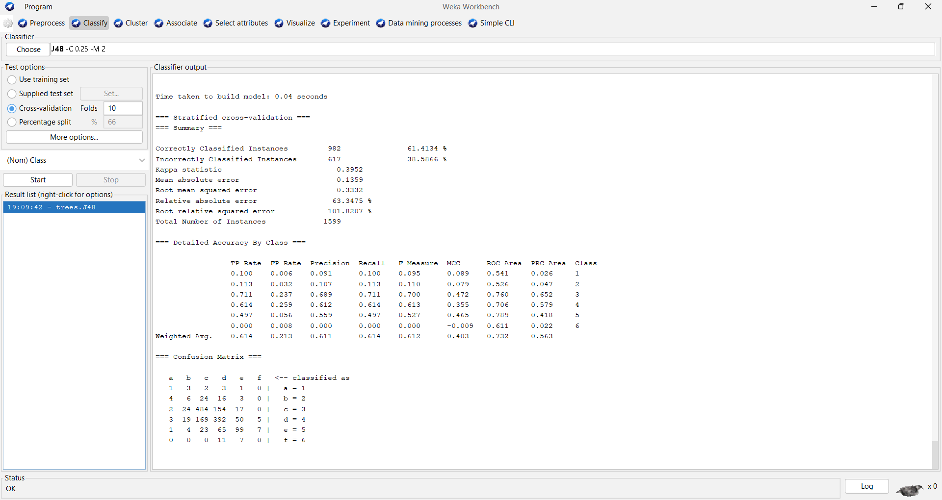
5. Evaluate Result

Slide 15
Summary
Classification
Kappa statistic | 0.3952
Mean absolute error | 0.1359
Root mean squared error | 0.3332
Relative absolute error | 63.3475 %
Root relative squared error | 101.8207 %
Total Number of Instances | 1599
Corretly Classified
61.4%
Classifier - J48
982 Instances
Decision tree classifier
Recursively splits based on attribute
Select features to create decision nodes and branches.
Emphasizes information gain.
Effective for categorical data.
Incorrectly Classified
38.5%
617 Instances

Slide 16
TP Rate
Proportion of actual positive instances correctly identified.
FP Rate
Proportion of actual negative instances incorrectly classified as positive.
Precision
The accuracy of positive predictions, representing the ratio of true positives to the total predicted positives.
Recall
The model's ability to correctly identify all actual positive instances.
Evaluation Metrics
F-Measure
Combines precision and recall into a single metric, balancing both aspects of classification performance.
MCC
Matthews Correlation Coefficient considers true & false +tives/-tives to assess classification quality
ROC Area
Measures the model's ability to distinguish between classes
PRC Area
Quantifies the model's precision-recall trade-off

Slide 17
Detailed Accuracy By Class
TP Rate | FP Rate | Precision | Recall | F-Measure | MCC | ROC Area | PRC Area | Class
0.1 | 0.006 | 0.091 | 0.1 | 0.095 | 0.089 | 0.541 | 0.026 | 1
0.113 | 0.032 | 0.107 | 0.113 | 0.11 | 0.079 | 0.526 | 0.047 | 2
0.711 | 0.237 | 0.689 | 0.711 | 0.7 | 0.472 | 0.76 | 0.652 | 3
0.614 | 0.259 | 0.612 | 0.614 | 0.613 | 0.355 | 0.706 | 0.579 | 4
0.497 | 0.056 | 0.559 | 0.497 | 0.527 | 0.465 | 0.789 | 0.418 | 5
0 | 0.008 | 0 | 0 | 0 | -0.009 | 0.611 | 0.022 | 6
0.614 | 0.213 | 0.611 | 0.614 | 0.612 | 0.403 | 0.732 | 0.563 | Weighted Avg.

Slide 18
Confusion Matrix
 | a | b | c | d | e | f
a | 1 | 3 | 2 | 3 | 1 | 0 | a = 1
b | 4 | 6 | 24 | 16 | 3 | 0 | b = 2
c | 2 | 24 | 484 | 154 | 17 | 0 | c = 3
d | 3 | 19 | 169 | 392 | 50 | 5 | d = 4
e | 1 | 4 | 23 | 65 | 99 | 7 | e = 5
f | 0 | 0 | 0 | 11 | 7 | 0 | f = 6
A confusion matrix is a compact table summarizing the performance of a classification model, detailing true positive, true negative, false positive, and false negative predictions for each class, aiding in model evaluation and error analysis.

Slide 19
03
Conclusion

Slide 20
This presentation on wine quality classification using the J48 algorithm in Weka highlights the significance of classification in machine learning, specifically exploring the Weka software and its application to the Wine Quality dataset. The detailed accuracy metrics and confusion matrix provide valuable insights into model performance, aiding in informed decision-making using classification in Data Mining

Slide 21
Thank You

