Slide 1

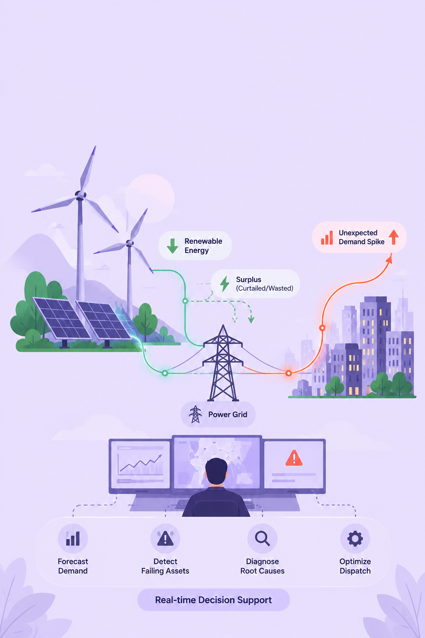
GridSense AI
Grid Load Optimisation & Renewable Energy Performance Advisor
Track: AI Utilities
Team: Code Catalyst
Members: Heer Pathak, Manasvee Viroja, Prince Patel, Priyal Kalariya

Slide 2
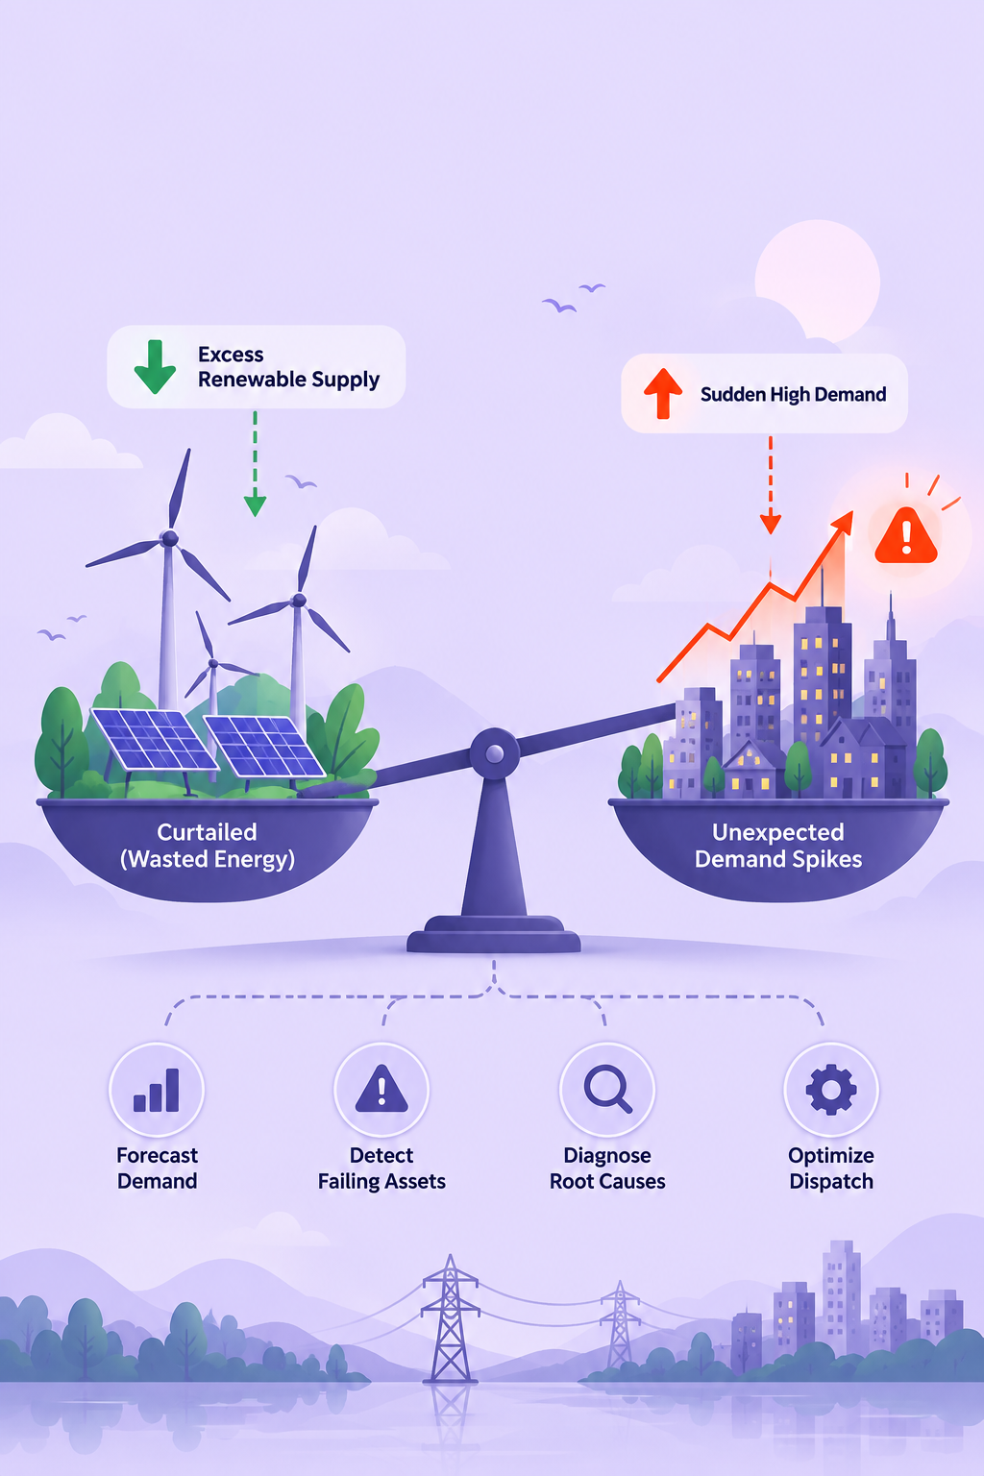
The Problem
For: Power Grid Operators & Energy Utilities
Renewable energy is curtailed (wasted) when the grid cannot absorb it. Meanwhile, unexpected demand spikes cause grid instability. Operators lack integrated decision support to forecast demand, detect failing assets, diagnose root causes, AND optimize dispatch all in real time.
Why It Matters
• ~8 TWh of clean energy curtailed in US (2023) = lost renewable value
• Demand spikes cause emergency response + grid instability
• Underperforming assets go undetected for weeks (silent losses)
• Three critical functions live in isolation no integrated brief

Slide 3
The Solution
GridSense AI: Eight-Agent Agentic System for Integrated Grid Optimization
Demand History
Weather
Forecasts
Asset Telemetry
Grid Topology
↓
8 Agents: Ingest → Forecast & Performance (parallel) → Root Cause → Optimization → Critic → Brief
↓
Demand Forecast
Performance Alerts
Root Causes
Dispatch Brief
72h quantile, spike risk
Physics-based anomalies
Ranked with evidence
27% more curtailment avoided
Key Differentiator: LLM reasons and explains; deterministic tools compute. Critic agent verifies every number before publication.

Slide 4
Architecture
Eight-Agent Flow:
1. Supervisor → Parse trigger, plan run
Presentation:
React SPA, PDF/HTML
2. Data Ingest → Load demand, weather, telemetry
API:
FastAPI, REST + SSE
3. Forecast Agent ⟷ Performance Agent (parallel)
Orchestration:
4. Root Cause Agent (if anomalies detected)
LangGraph, 8 Agents
Tools:
5. Dispatch Optimiser → MILP solver + attribution
15 Deterministic Tools
6. Critic Agent → Verify all claims
Analytics:
LightGBM, pvlib, MILP
7. Briefing Agent → Generate BLUF brief
Data:
8. Output → HTML/PDF to operator
DuckDB, Parquet Lake

Slide 5
Demo
Key Feature: Integrated Operator Brief
Single BLUF-format PDF/HTML document that answers all four questions an operator needs in <3 minutes:
→ Live 72h forecast with demand spikes
1
Next demand spike (72h horizon, P10/P50/P90)
→ Asset anomaly map (color = severity)
→ Root cause diagnosis ranked by confidence
2
Which renewable assets are underperforming (PR, capacity factor)
→ Dispatch plan with counterfactuals
3
Root causes ranked by confidence with evidence
→ Curtailment attribution by constraint type
4
Recommended dispatch actions to minimize curtailment

Slide 6
IBM Technologies
Operations Copilot
IBM Bob accelerated development and iteration of GridSense MVP.
Future IBM AI integration for natural-language operator queries:
• "Why is Solar Farm 7 down 12% this week?"
IBM Bob
• "Which dispatch action gives the most curtailment reduction?"
• AI-powered development assistant
• "Explain the spike confidence for Thursday 5 PM"
• Accelerated code generation
• Rule-based MVP powered by live risk backend data
• Frontend & backend iteration
• Reduced dev cycle time
How IBM Tech Made a Difference:
IBM Bob cut frontend + backend development time by ~30% through iterative code suggestions, enabling faster prototyping and faster refinement cycles for LangGraph topology and FastAPI endpoints.

Slide 7
Results & Impact
Success Metrics Achieved
3.4%
0.85+
0.83
Demand Forecast MAPE (24h)
Spike Detection F1
Fault Detection F1
✓ Target: ≤3.5%
✓ Recall ≥0.85, Precision ≥0.70
✓ On synthetic fault set
27%
<90s
97%
Curtailment Reduction
End-to-End Latency
Grounded Claims
✓ vs Business-as-Usual
✓ p95, local hardware
✓ Critic-verified
GridSense AI transforms raw grid data into prioritized, actionable intelligence helping operators shift from reactive outage response to proactive asset management. Quantified 27% curtailment reduction enables utilities to maximize clean energy utilization.

Slide 8
Team
What Sets GridSense Apart
✓ Genuinely agentic (8 agents, parallel branches, typed state)
Heer Pathak
✓ Separation of concerns (LLM reasons, tools calculate)
Data Science & Optimization
✓ Physics-based detection (finds degradation vs neighbors miss)
Manasvee Viroja
✓ Enforced grounding (Critic agent, not just prompted)
Backend & Agent Orchestration
✓ Attribution over aggregation (why curtailment, not just how much)
Priyal Kalariya
✓ Deterministic + reproducible (fully testable)
Frontend & Dashboard
✓ Runs anywhere (laptop, no cloud, <90s)
Prince Patel
✓ Measurable impact (27% real curtailment reduction)
Evaluation & Documentation

