Slide 1
TrenchVerify
From Site Photo to Compliance Audit — Automatically
AI-powered photo review · Full audit trail · GDPR-compliant
Prototype Documentation: https://pathanahmad.github.io/vienna-up-2026/
Team: 42 Claudettes : [Ahmad] · [Tino] · [Evgenii] · [Himani]
Vienna UP 2026 · May 2026

Slide 2
THE PROBLEM
What ÖGIG Cannot See Will Cost Millions
Slow Human Review & Impossible to Scale
No Audit Trail
Missing Documentation
1–2 minutes per image × 60 images per section × 10 sections per project = thousands of person-days of review Result: “expensive” or low-quality review (problems surface years later via excavator damage).
Manual spot-checks miss ~30% of defects. No timestamped, per-meter record exists. Result: Cannot prove contractual compliance after work is buried and closed.
No compliant photo evidence for open trench, duct positioning, or sand bedding at critical sections. Result: Warranty claims invalid — liability shifts from contractors to APG.

Slide 3
COST OF INACTION
Poor Documentation Today = Exponential Costs Tomorrow
€120K+
3–5×
€2.4M+
50 yrs
Average cost per fiber-cut incident
Cost multiplier when work is undocumented
Estimated 5-year exposure if unresolved
Planned asset lifespan now at risk
The real question isn't whether to fix this. It's whether to fix it before or after the next fiber cut.

Slide 4
OUR SOLUTION
A Digital Compliance Platform — Built for ÖGIG
100% Coverage
Full Audit Trail
GDPR Safe
99% Faster
Every trench segment reviewed automatically. No spot-checks. No gaps.
Every photo timestamped, GPS-matched, compliance-scored, and logged.
Faces & plates auto-detected and withheld. Nothing stored on our infrastructure.
< 30 minutes for the full route — vs. 3–5 days per section manually.

Slide 5
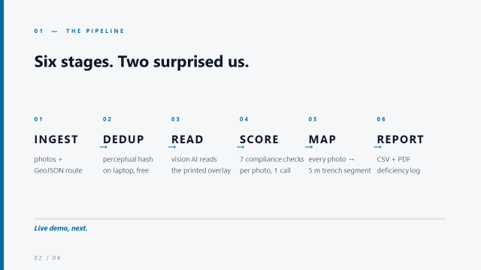

Slide 6
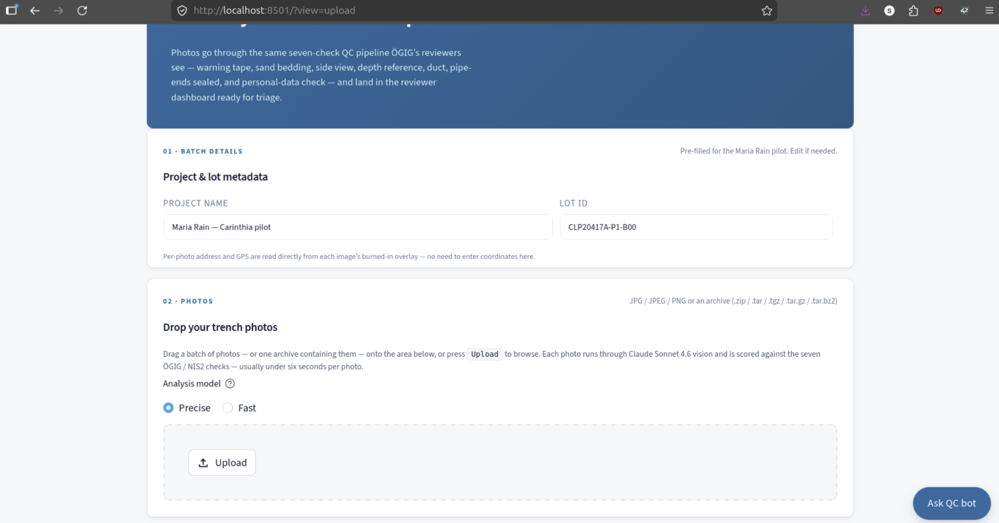
Technical Solution
User input:
photos for analysis
GPS data (Trenches_geojson, POP_geojson, FCPs_geojson, FCP_Polygons_geojson)
Upload them to a single archive; the app will recognize the contents

Slide 7
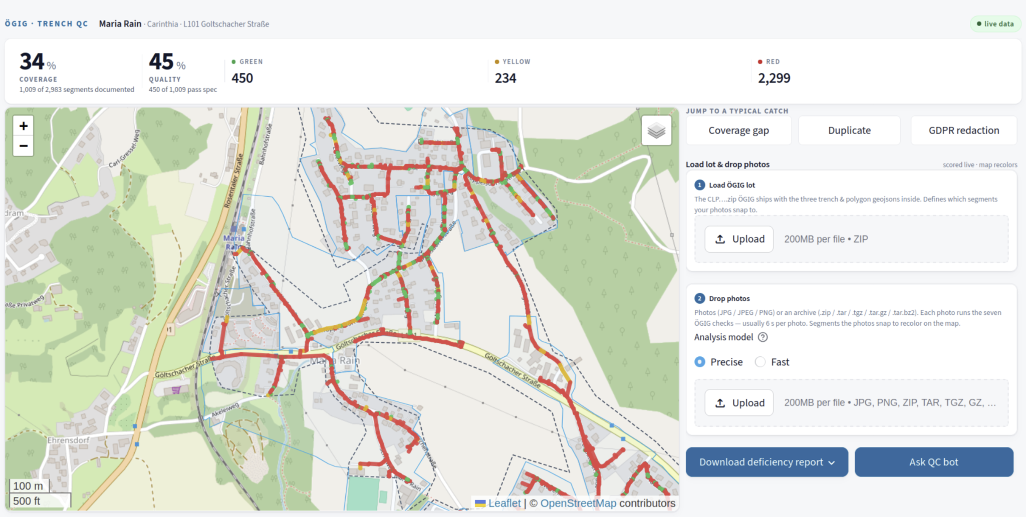
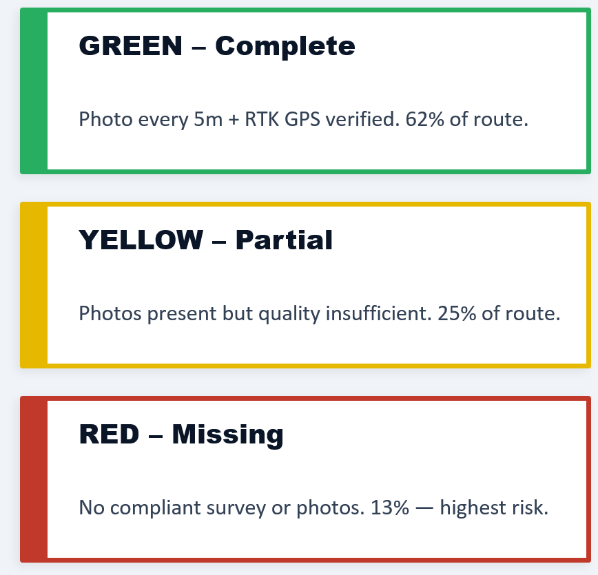
Technical Solution

Slide 8
COMPLIANCE & GDPR
Compliance Report: What ÖGIG Receives
GDPR / NIS2 Compliant
Zero Data Retention
Faces and license plates detected in every photo before any reviewer sees them. Flagged images are withheld from the display grid and routed to a "needs retake" list.
Photos are processed transiently — held in memory for the duration of the AI call, then released. Nothing is persisted on our servers. All results (scores, logs) are written exclusively to the customer's own database.
Full Audit Trail
Contractor Accountability
Every check result is logged with: photo ID · trench segment · GPS coordinates · timestamp · pass/fail per check. The export is a court-admissible evidence trail, not just a summary report.
Duplicate-photo detection fingerprints every image. If a contractor reuses the same photo across jobs, the system catches the original, the copy, and all job IDs it was submitted to. In our pilot: ~600 duplicates detected automatically.

Slide 9
Every Unreviewed Meter Is a Liability. We Close That Gap — Automatically.
01
02
03
Approve Pilot
Define KPIs
Scale
Authorise the TrenchVerify AI pilot for the current Klosterneuburg route build
Set acceptance thresholds: coverage %, photo compliance rate, time-to-report
Roll out across all future APG construction phases — protect the full network
Protect €42M+ in infrastructure. Secure the 50-year network lifespan. Act today.

Slide 10
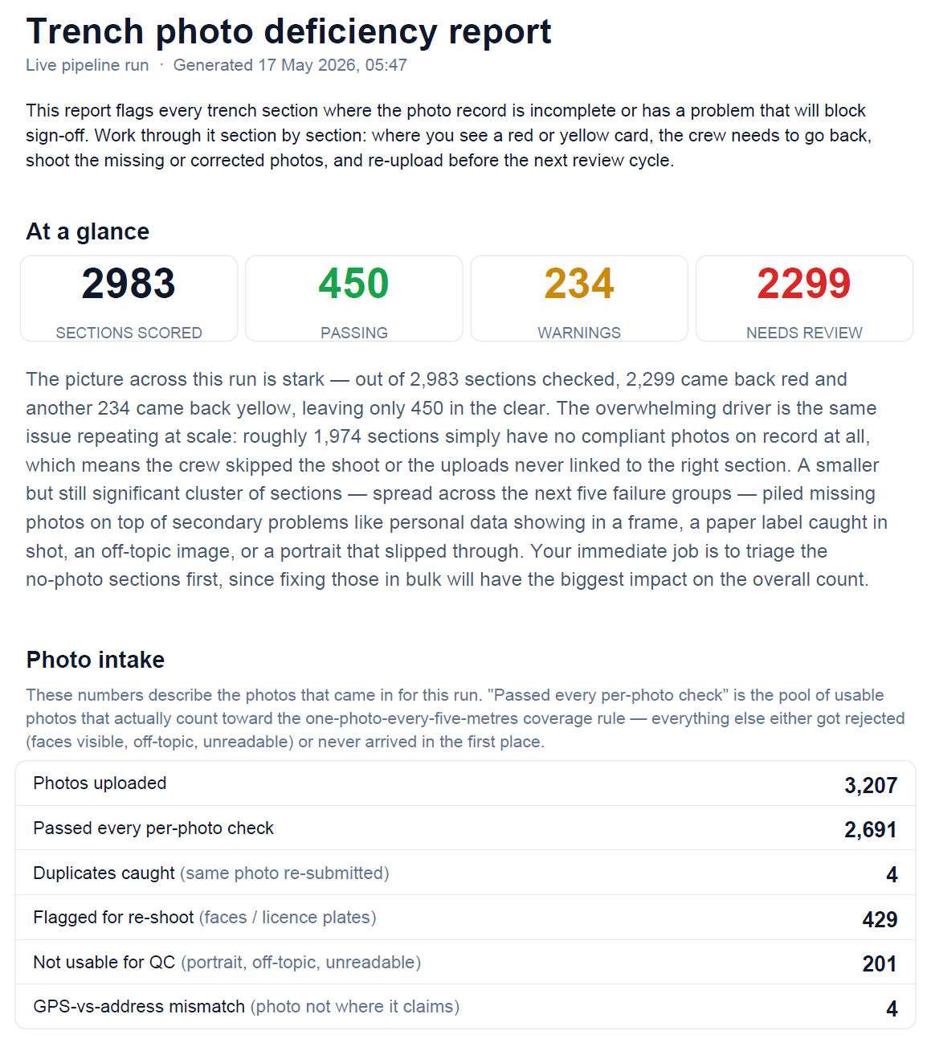
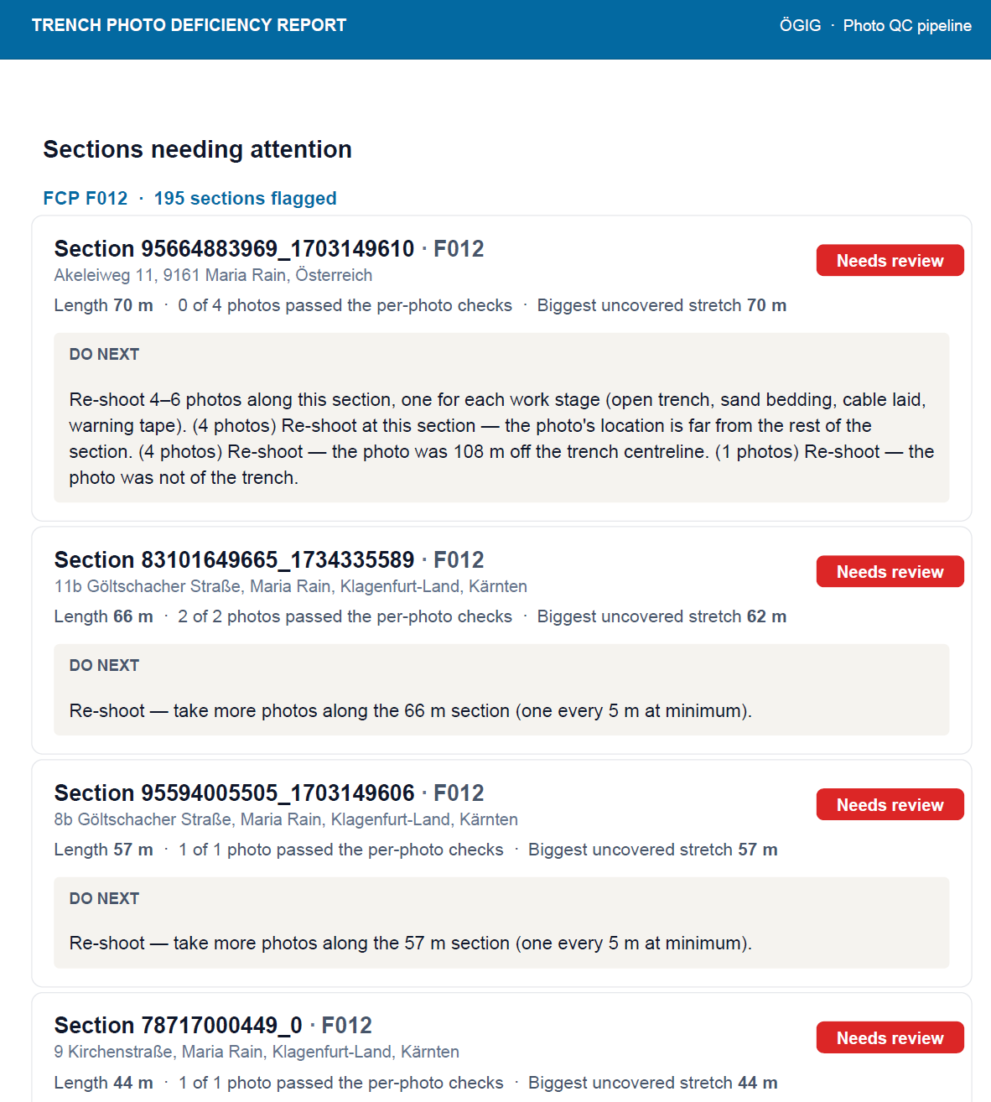
Report

Slide 11
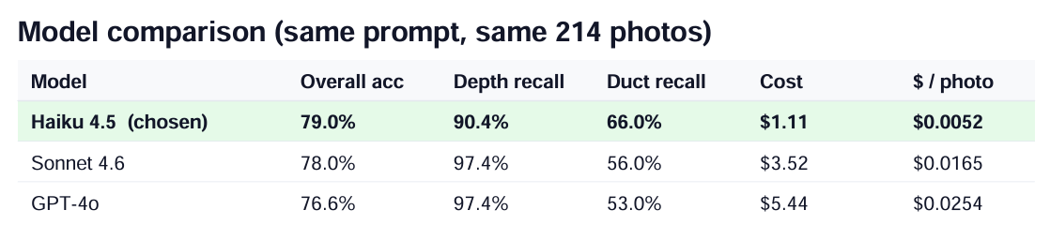
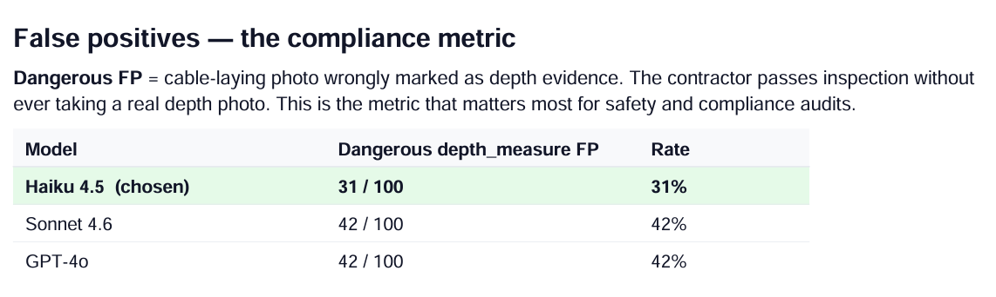
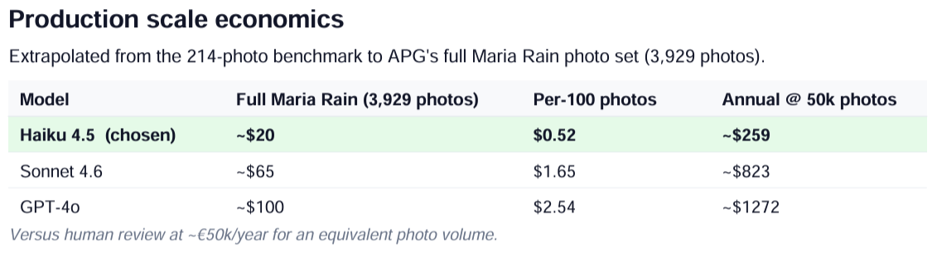
Analysis/Comparison

Slide 12
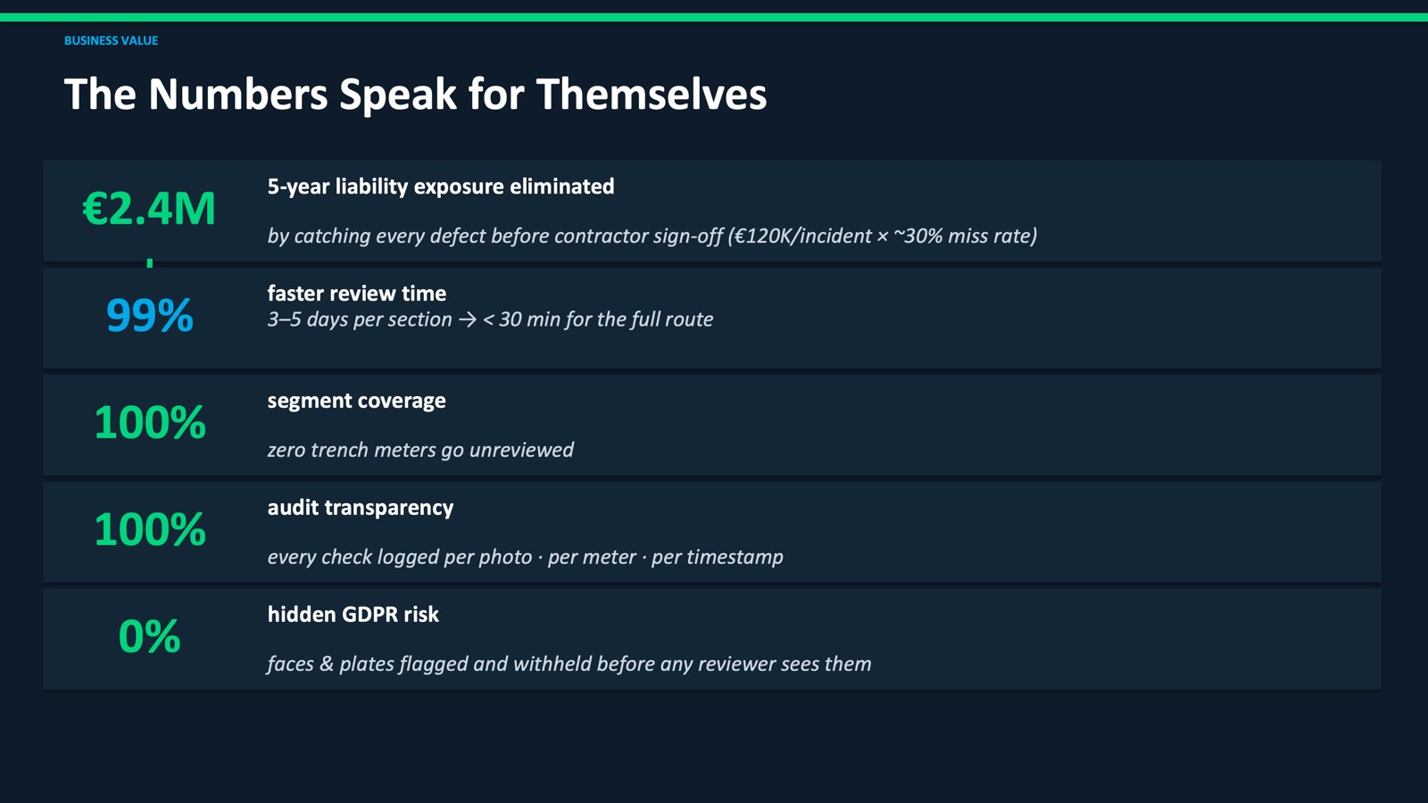
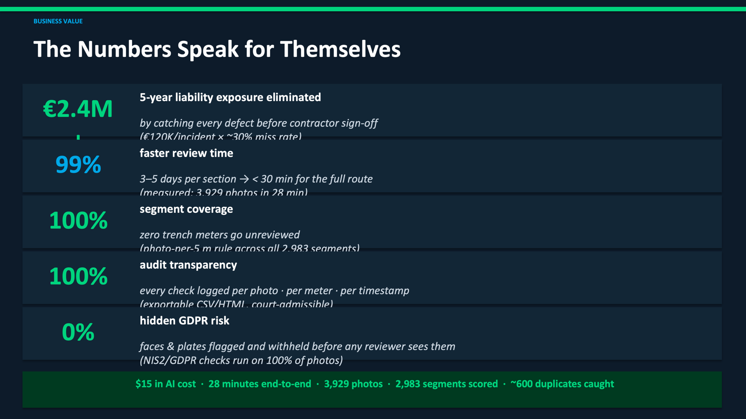

Slide 13
Thank You
Questions welcome
TrenchVerify — From Site Photo to Compliance Audit — Automatically
Team: 42 Claudettes : [Ahmad] · [Tino] · [Evgenii] · [Himani]
Built at Vienna UP 2026 · All pilot data from APG partner dataset

