Slide 1
A HIDDEN RISK IN EVERY METER
The Case for Automated Trench Documentation
Quality Control
€42M+
50 yrs
~500
Network Asset Value at Risk
Planned Network Lifespan
Trench Photos to Review
öGIG Fiber Infrastructure | Hackathon Solution Proposal | May 2026

Slide 2
THE PROBLEM: WHAT WE CAN'T SEE WILL COST US
📍
📷
📏
Wrong Survey Data
Missing Documentation
Incorrect Burial Depth
Inaccurate RTK GPS measurements and missing geo-referenced records lead to incorrect utility records.
No compliant photo evidence of open trench, duct positioning, or sand bedding at critical sections.
Undocumented depth deviations go undetected until road renewal projects expose improperly buried ducts.
Result: Fiber cuts during future excavations — each incident costs €15,000–€80,000 in emergency repairs plus liability.
Result: Cannot prove contractual compliance — warranty claims invalid, liability shifts to öGIG.
Result: Fiber damage during road works, network outages, and costly remediation across hundreds of meters.

Slide 3
THE COST OF INACTION
Poor documentation today = exponential costs tomorrow
€120K
3–5x
Average cost per
fiber cut incident
Cost multiplier
if undocumented
50 yrs
€2.4M+
Planned asset life
now jeopardized
Estimated 5-year
exposure if unresolved
*Figures based on industry benchmarks and internal estimates

Slide 4
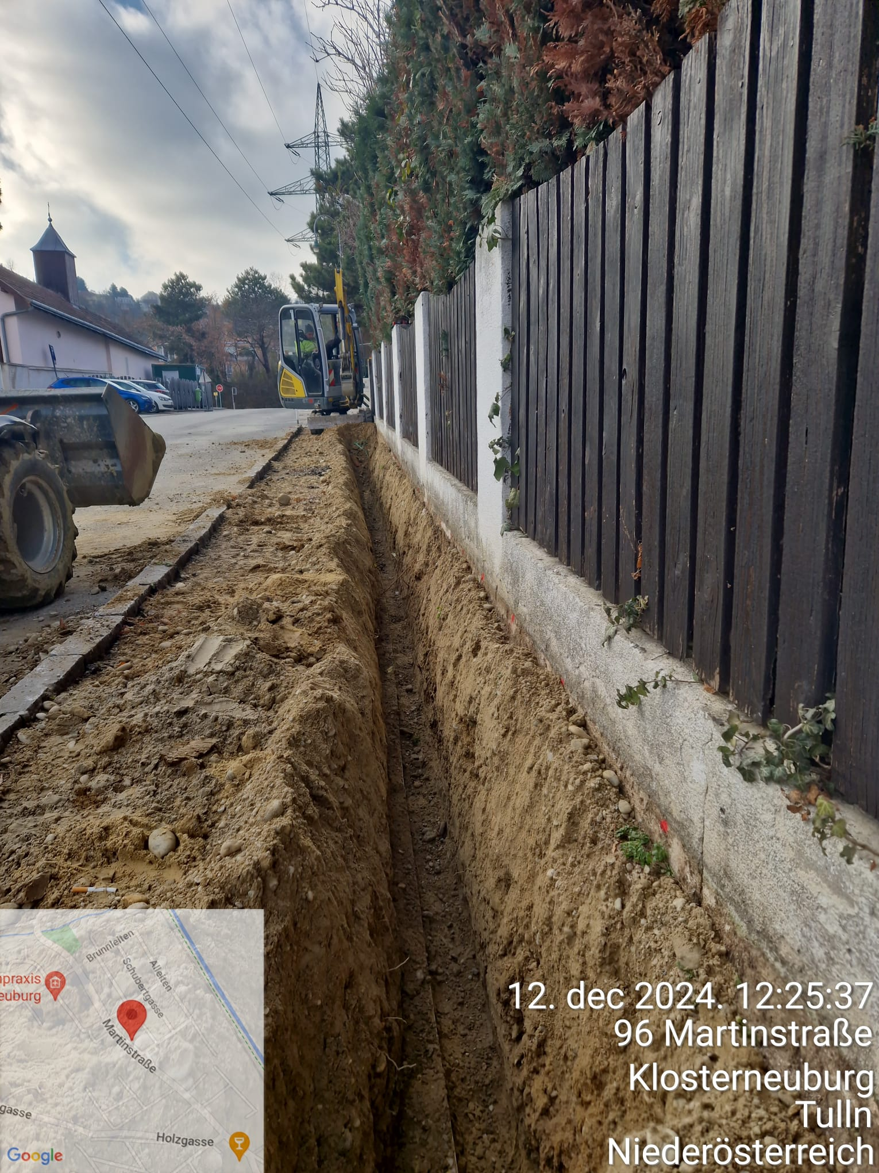
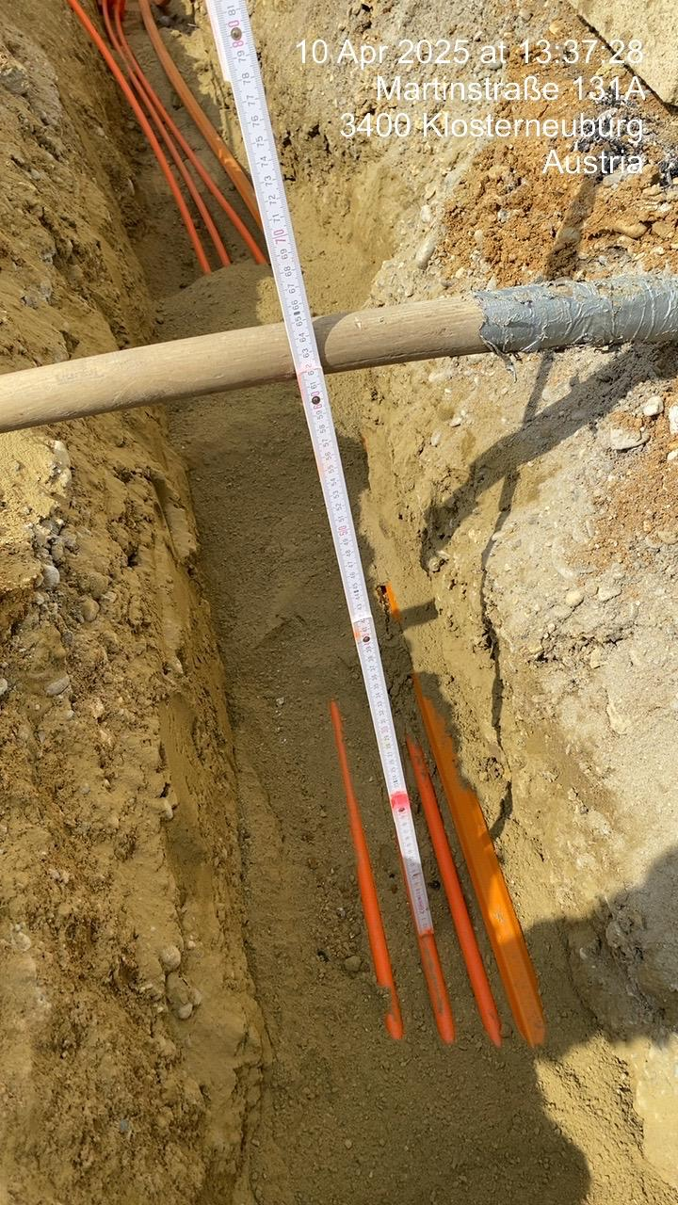
WHAT GOOD vs. BAD DOCUMENTATION LOOKS LIKE
✓ COMPLIANT — Open trench with visible context & GPS stamp
✗ NON-COMPLIANT — No duct bundle visible, no pipe end seals shown
✓ GPS/date/time metadata present
✗ Pipe ends sealed
✓ Duct bundle clearly visible
✗ Measurement ruler readable
✓ Sand bedding confirmed
✗ No persons/plates visible

Slide 5
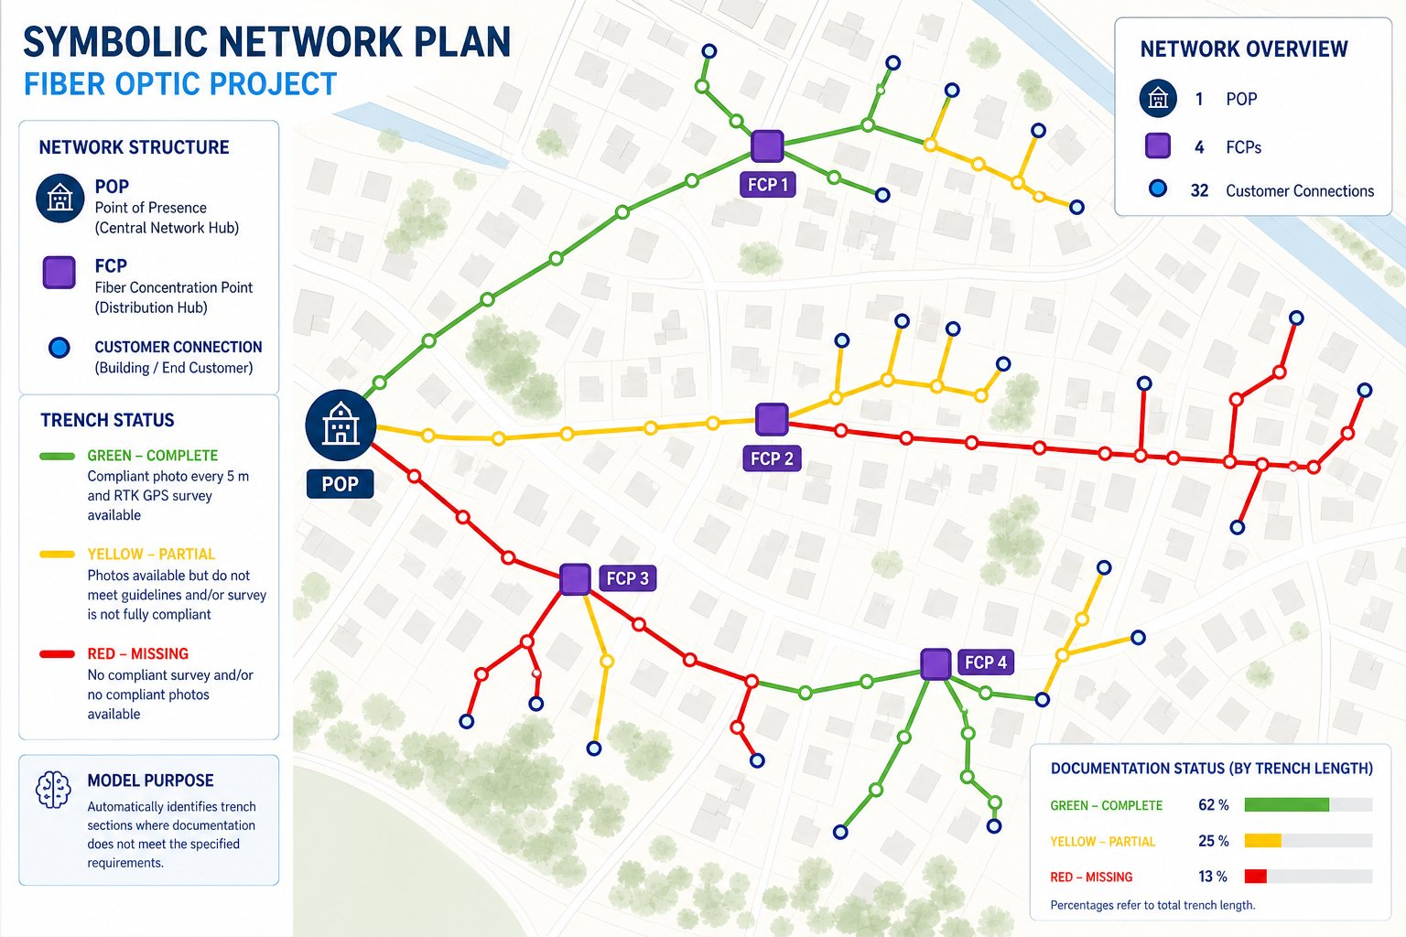
THE SOLUTION: AI-POWERED COVERAGE INTELLIGENCE
GREEN – Complete
Photo every 5m + RTK GPS verified. 62% of route.
YELLOW – Partial
Photos present but quality insufficient. 25% of route.
RED – Missing
No compliant survey or photos. 13% — highest risk.
AI auto-classifies every trench segment in seconds

Slide 6
HOW THE AI SYSTEM WORKS
📥
🗺️
🤖
🚦
📊
1
2
3
4
5
Ingest
Geo-Match
AI Review
Classify
Report
~500 trench photos + GeoJSON route file loaded into pipeline
GPS metadata matched to route segments at 5m resolution
Vision model scores each image: depth, ducts, coverage, compliance
Each segment flagged: OK / Poor Quality / Missing Evidence
Interactive map + PDF report delivered to reviewer in minutes
Manual review time: 3–5 days per section → AI review time: < 30 minutes for entire route

Slide 7
WHY ACT NOW: THE BUSINESS CASE
Without AI QC
With AI QC
✗ Manual reviews miss ~30% of defects
✓ 100% of segments reviewed automatically
✗ Fiber cuts cost €120K+ per incident
✓ Defects flagged before acceptance sign-off
✗ Network lifespan reduced below 50 years
✓ 50-year network lifespan protected
✗ Warranty claims invalid without evidence
✓ Contractor accountability enforced
✗ Liability risk shifts from contractors to öGIG
✓ Full audit trail for every trench meter
✗ Road renewal damage goes uncompensated
✓ Scalable across all future rollout phases

Slide 8
THE DECISION IS SIMPLE
Every unreviewed trench section is a liability waiting to be triggered.
01
02
03
Approve Project
Define KPIs
Scale
Authorize the AI-QC pilot for the current route build in Klosterneuburg
Set acceptance thresholds: coverage %, photo compliance rate, response time
Roll out across all future öGIG construction phases — protect the full network
Protect €42M+ in infrastructure. Secure the 50-year network lifespan. Act today.

