Slide 1


öGIG AI Quality Control
A HIDDEN RISK
IN EVERY METER
Automated quality control of trench documentation
Hackathon Solution Proposal · May 2026

Slide 2
THE SCALE OF THE CHALLENGE
öGIG Fiber Infrastructure
€42M+
50 yrs
~500
Network Asset
Value at Risk
Planned Network
Lifespan
Trench Photos to
Review per Section
2

Slide 3


THE PROBLEM
What we can't see will cost us
Missing Documentation
No compliant photo evidence of open trench, duct positioning, or sand bedding at critical sections.
→ Cannot prove contractual compliance — warranty claims invalid, liability shifts to öGIG.
Incorrect Burial Depth
Undocumented depth deviations go undetected until road renewal projects expose improperly buried ducts.
→ Fiber damage, network outages, and costly remediation across hundreds of meters.
Focus: photo evidence and burial-depth compliance
3

Slide 4
THE COST OF INACTION
Poor documentation today = exponential costs tomorrow
€120K
3–5×
50 yrs
€2.4M+
Average cost per
fiber cut incident
Cost multiplier if
undocumented
Planned asset life
now jeopardized
Estimated 5-year
exposure if unresolved
*Figures based on industry benchmarks and internal estimates
4

Slide 5
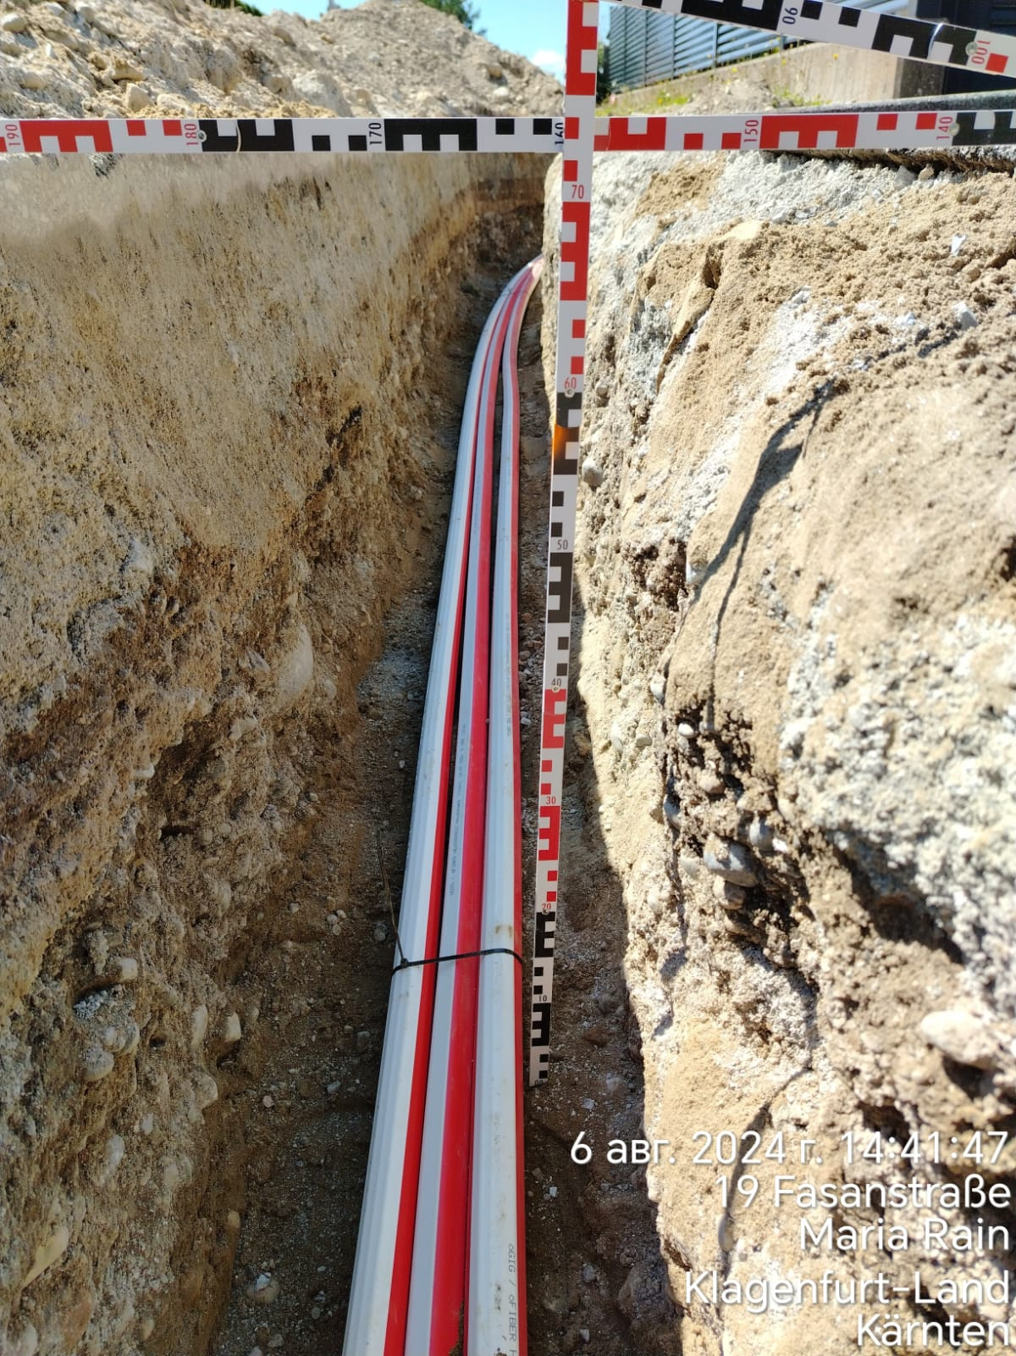
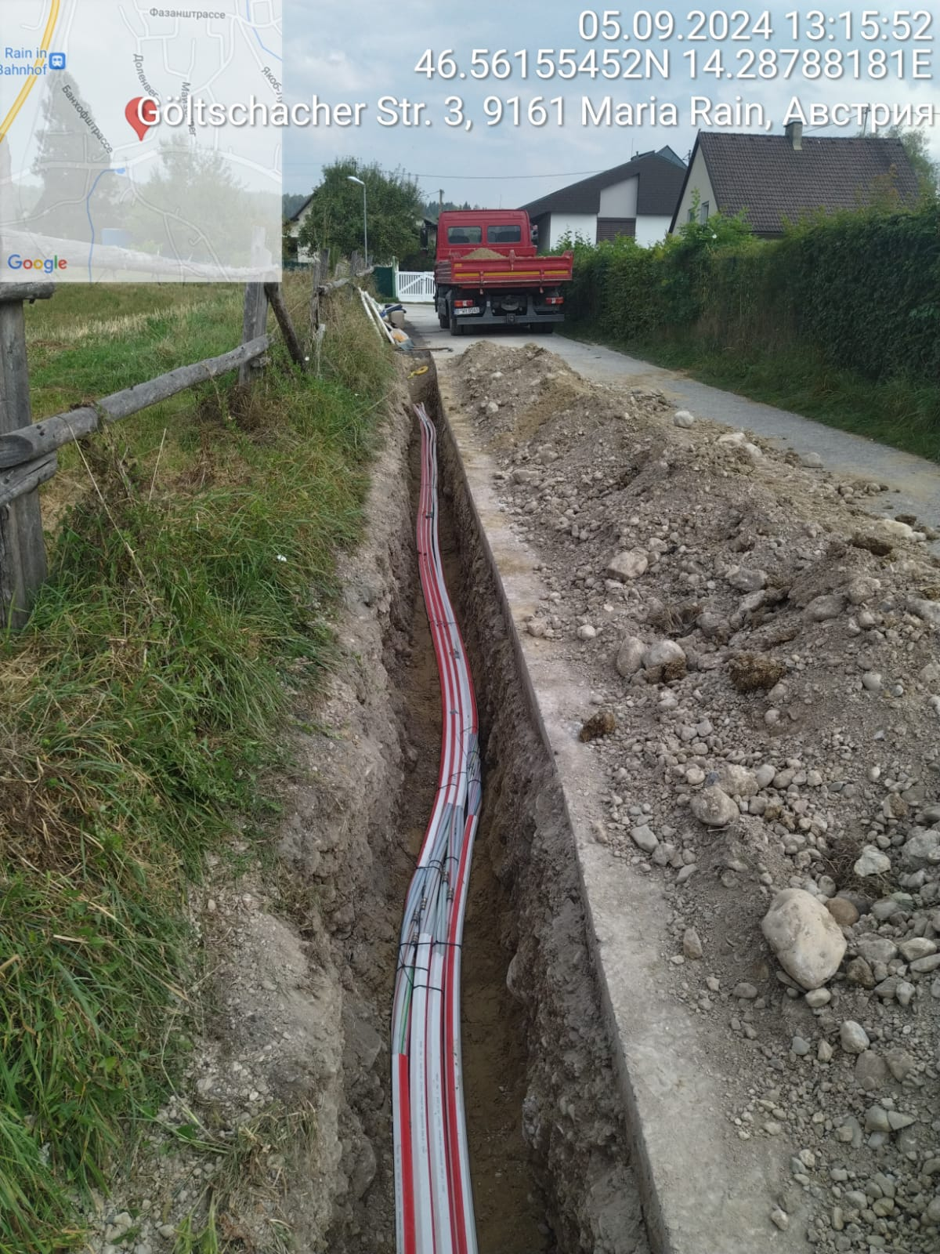
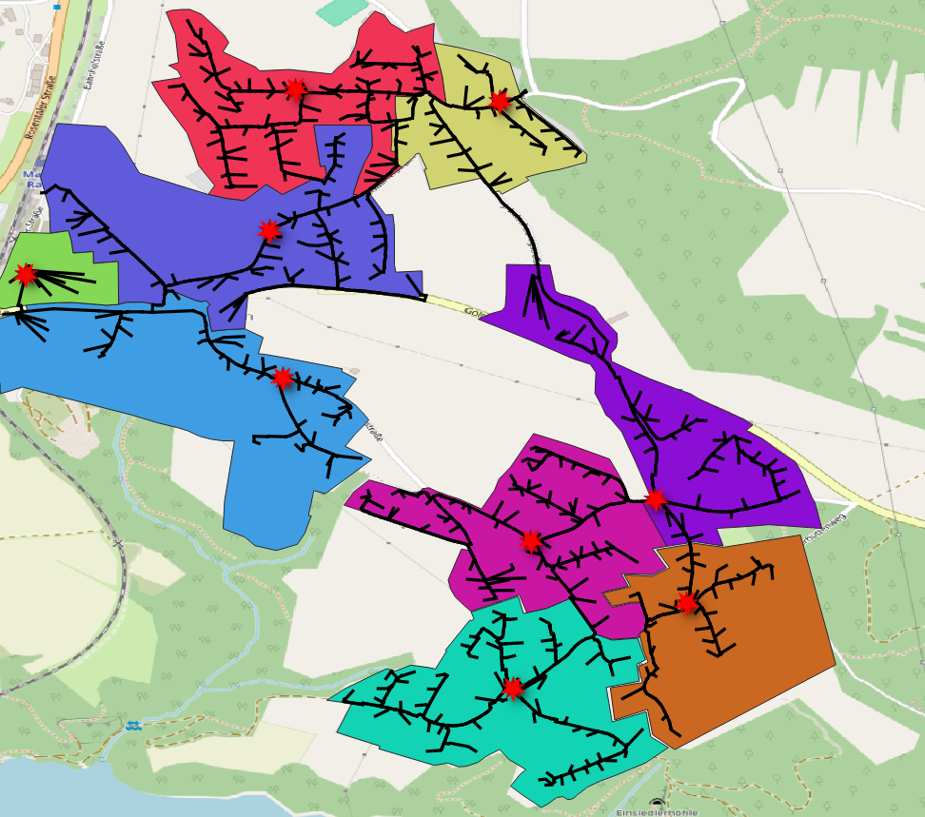
THE SOLUTION – Data base
AI-Powered Coverage Intelligence
Pictures – 3 929 pictures of the pilot region trenches
114 examples of visible depth measuring
105 examples of visible ducts in trenches
GeoData – Trenches, FCP-Areas, FCP, POP
5

Slide 6





HOW THE AI SYSTEM (could) WORK
1
2
3
4
5
Ingest
Geo-Match
AI Review
Classify
Report
~500 trench photos + GeoJSON route file
GPS metadata matched to route segments
Vision model scores depth, ducts, coverage
Segments flagged: OK / Poor / Missing
Map + PDF report in minutes
→
→
→
→
Manual review: 3–5 days per section → AI review: < 30 minutes for entire route
6

Slide 7
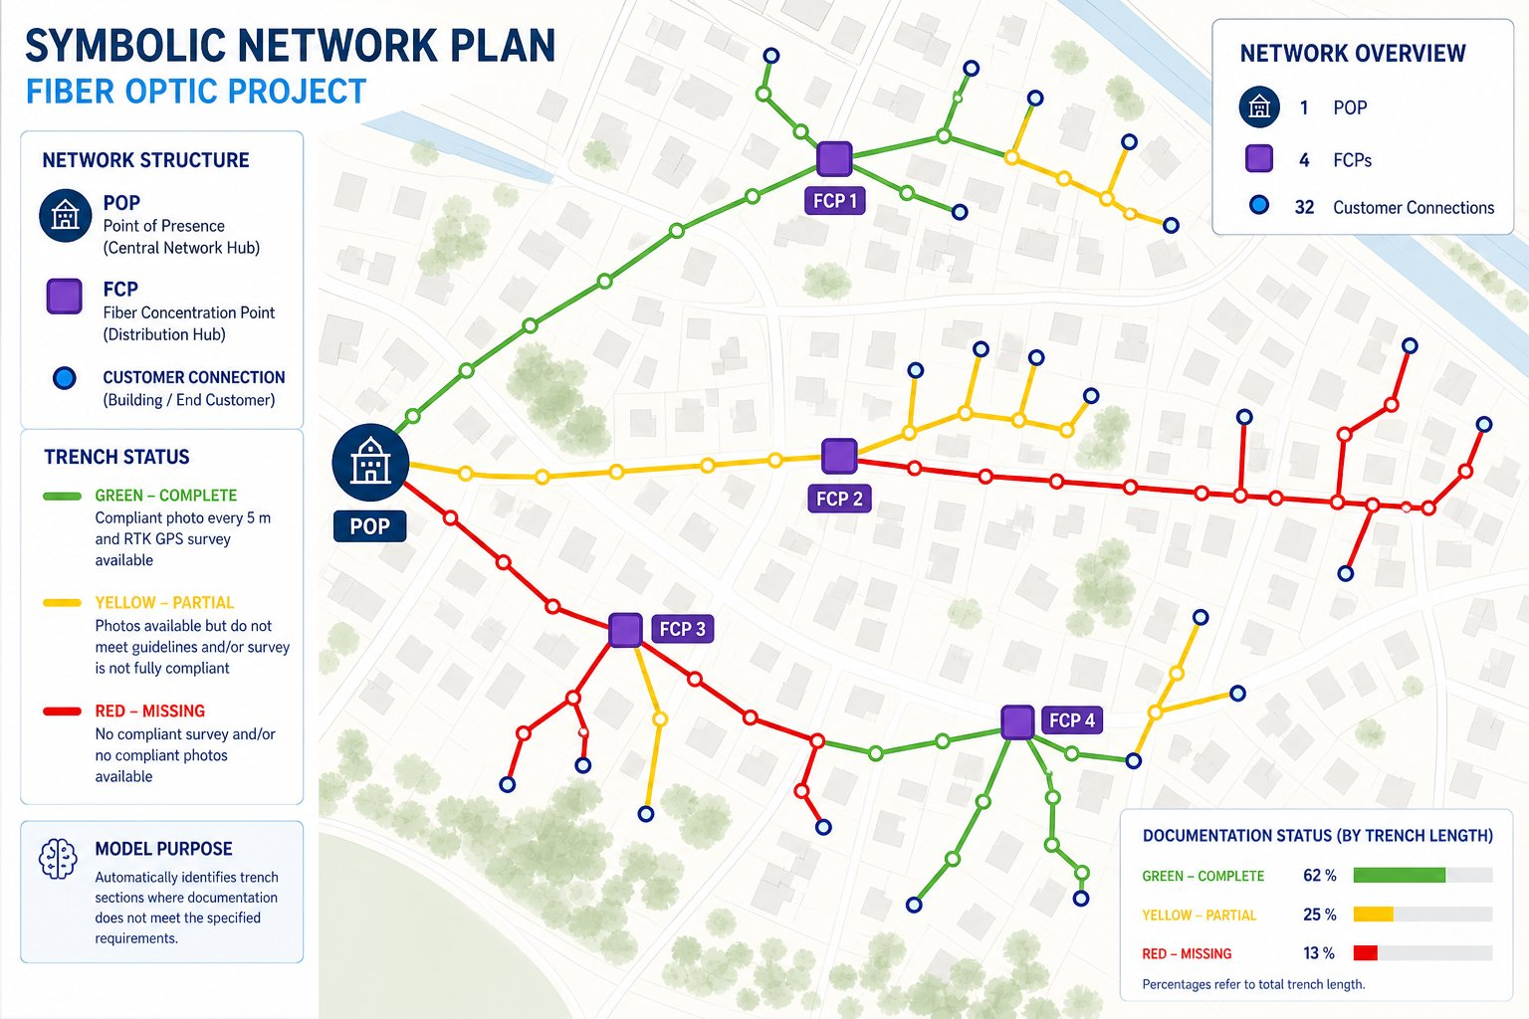
NETWORK MAP
Trench Documentation Status · Pilot Route
TRENCH STATUS
GREEN – Complete
Photo every 5m
62% of total route length
YELLOW – Partial
Photos present but
quality insufficient
25% of total route length
RED – Missing
No compliant
photos
1 POP · 4 FCPs · 32 Connections
13% of total route length
9
Network Overview

Slide 8
WHY ACT NOW: THE BUSINESS CASE
✗ WITHOUT AI QC
✓ WITH AI QC
✗ Manual reviews miss critical defects
✓ 100% of segments reviewed automatically
✗ Fiber cuts cost €120K+ per incident
✓ Defects flagged before acceptance sign-off
✗ Network lifespan reduced below 50 years
✓ 50-year network lifespan protected
✗ Warranty claims invalid without evidence
✓ Contractor accountability enforced
✗ Liability risk shifts from contractors to öGIG
✓ Full audit trail for every trench meter
✗ Road renewal damage goes uncompensated
✓ Scalable across all future rollout phases
7

