Slide 1
Chapter 3: CSS – Cascading Style Sheets (1)
SE262 Front-end and Web Development Foundation
02/2023
Web Development and Design Foundations with HTMLS by Terry Felke-Morris

Slide 2
Outline
CSS vs HTML
CSS
Using CSS
Lab2-Review
About CSS
What CSS?
Why CSS?
Inline
Embedded
External
CSS Formatting
Colour
Text
CSS Grouping
Identify element
Group elements

Slide 3
About CSS

Slide 4
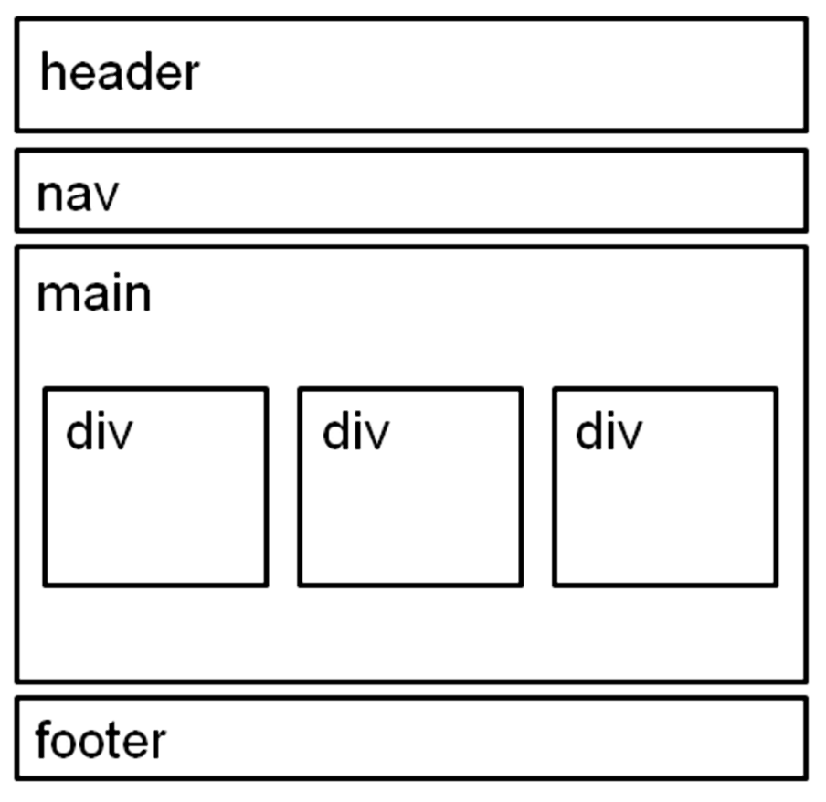
Difference between CSS and HTML?
HTML uses ‘tags’ to structure content
CSS is used to formatting the structured content
HTML tags(elements) such as <h1> and <p>
means that …
"this is a headline" or "this is a paragraph"
with default positioning and styling
https://www.w3schools.com/cssref/css_default_values.asp

Slide 5
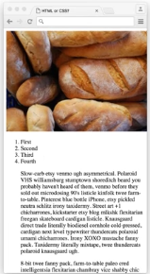


CSS or HTML?
See what is possible with CSS: Visit http://www.csszengarden.com
From the pictures below, which webpage is using CSS?
A
B
C

Slide 6
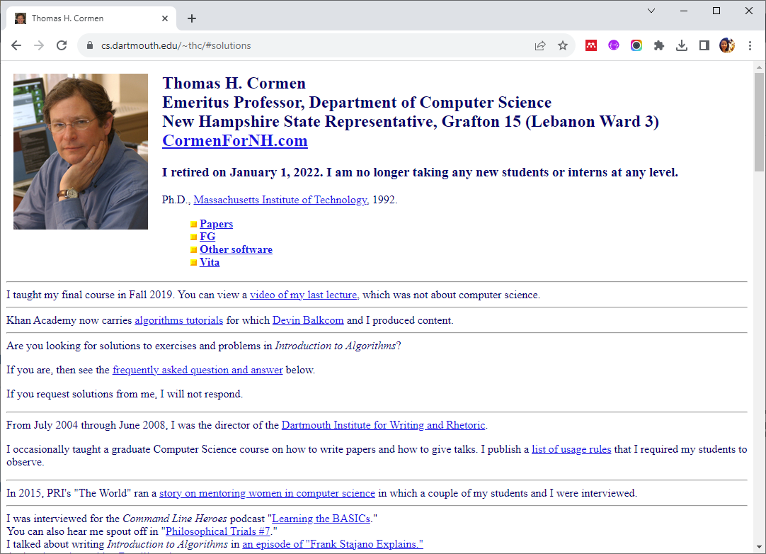
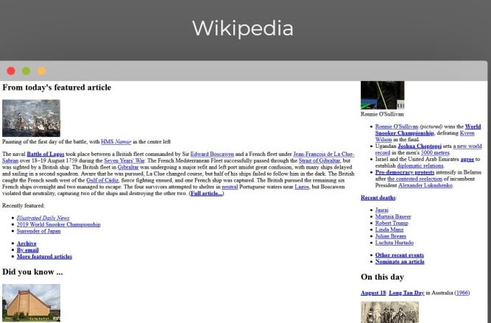
Why need both CSS and HTML?
As the Web gained popularity,
Designers started looking for possibilities to add layout to online documents.
HTML Limitation: can be misused to add layout to websites
CSS Offering: more styling options and is more accurate and sophisticated

Slide 7





What can be benefits of using layout on webpages?
ⓘ Start presenting to display the poll results on this slide.

Slide 8
Benefits of layout
Look & Feel
User Experience
Web Maintenance

Slide 9

Benefits of CSS – developer viewpoints
Control layout of many documents from one single style sheet
Page layout control – precise and flexible
Style can be stored in a separate document
Style can be separated from Structure
Easier site maintenance
Note: similar idea to OOP that we should not code everything in the main(), the configurable parts should be separated for flexible maintenance.
single style sheet

Slide 10
Using CSS

Slide 11
What is CSS?
Cascading Style Sheets = “Language” for styling
Positioning
HTML layout
Element position
Margins
Height
Width
Lines
Formatting
Background image
Fonts
Colors
Etc.

Slide 12

HTML document styling
Using HTML attribute we could have done it like this
With CSS the same result can be achieved like this
HTML file
<body bgcolor="#FF0000">
index
.html
CSS file
body {background-color: #FF0000;}
style
.css
CSS must be applied to a HTML element/tag!!!

Slide 13
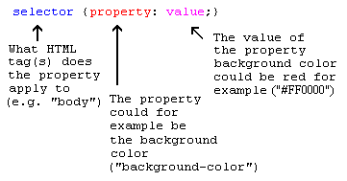
CSS syntax
CSS file
body {background-color: #FF0000;}
List of CSS properties: https://www.tutorialrepublic.com/css-reference/css3-properties.php

Slide 14
Applying CSS to an HTML document
There are three ways you can apply CSS to HTML document
Method 1: ‘Inline’ in HTML tag attribute
HTML file
<html>
<head>
<title>Example</title>
</head>
<body style="background-color: #FF0000;">
<p>This is a red page</p>
</body>
</html>

Slide 15
Applying ‘style’ to an HTML document
Method 2: ‘Embedded’ styling in HTML head
between the <head> and </head> tags
HTML file
<html>
<head><title>Example</title>
<style type="text/css">
body {background-color: #FF0000;}
</style>
</head>
<body>
<p>This is a red page</p>
</body>
</html>

Slide 16
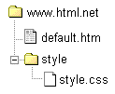
Applying ‘style’ to an HTML document
Method 3: ‘External’ styling in CSS file (link to a style sheet)
An external style sheet is simply a text file with the extension .css
between the <head> and </head> tags
HTML file
<html>
<head><title>Example</title>
<link rel="stylesheet" media="screen" href=“/style/style.css">
</head>
<body>
<p>This is a red page</p>
</body>
</html>
CSS file
body {background-color: #FF0000;}
This link tells the browser that it should use the layout from the CSS file when displaying the HTML file

Slide 17
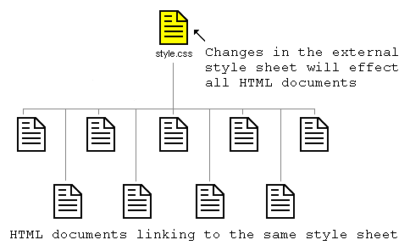
External styling CSS
CSS file can be used to control the layout of many HTML documents

Slide 18
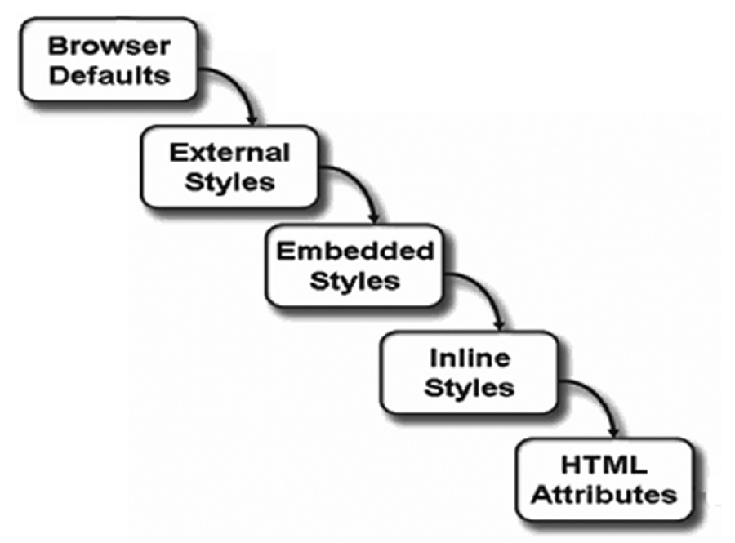
Execution of CSS styling
The inner styling replace the outer styling :
Method 1 – Inline Styles inside HTML attributes
Method 2 – Embedded Styles inside HTML head
Method 3 – External Style outside HTML file
3
HTML file
<body bgcolor="#FF0000">
2
HTML file
<head><title>Example</title>
<style type="text/css">
body{background-color: #00FF00;}
</style>
</head>
1
CSS file
body {background-color: #0000FF;}
**Among these 3 sample methods, body background will show in #FF0000(red) color.

Slide 19
CSS Formatting - Colour
https://developer.mozilla.org/en-US/docs/Web/CSS/color

Slide 20
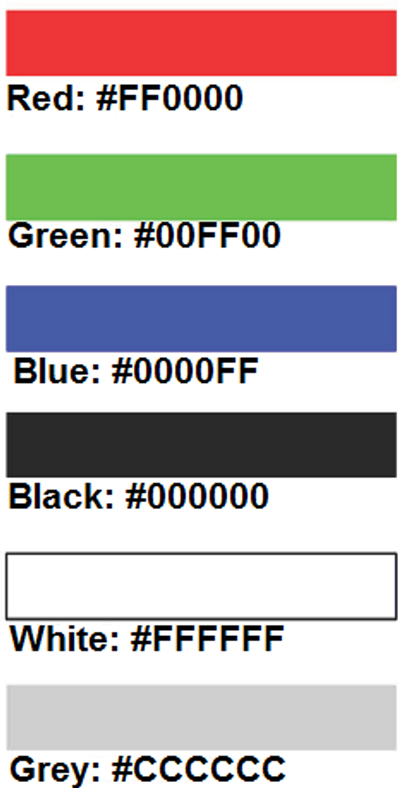
Using Color on Web Pages
Computer monitors display color as intensities of red, green, and blue light
RGB Light Color
The values of (red, green, blue) vary from 0 to 255.
(0,0,0) → white
(255,255,255) → black
Hexadecimal numbers (base 16) represent these color values.
https://developer.mozilla.org/en-US/docs/Web/CSS/background-color

Slide 21
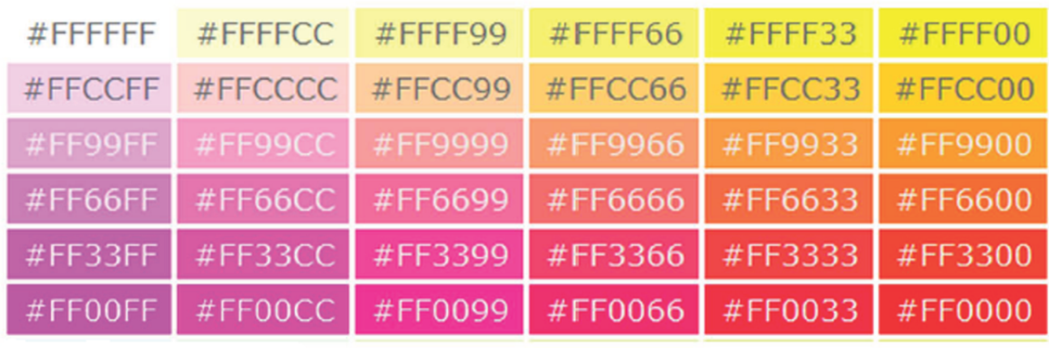
Hexadecimal Color Values
# is used to indicate a hexadecimal value
Hex value pairs range from 00 to FF
Three hex value pairs describe an RGB color
Color Chart
http://webdevfoundations.net/color
#000000 black #FFFFFF white
#FF0000 red #00FF00 green
#0000FF blue #CCCCCC grey

Slide 22
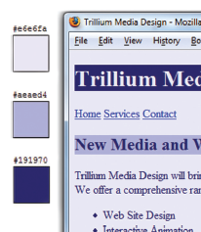
Making Color Choices
How to choose a color scheme?
Begin with a favorite color
Use one of the sites below to choose other colors
http://colorsontheweb.com/colorwizard.asp
http://kuler.Adobe.com
http://colorschemedesigner.com/
https://colorhunt.co/palette/94114

Slide 23
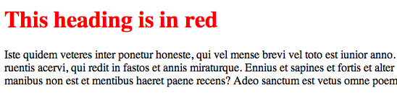
CSS : Example - color
Colors and backgrounds
The 'color' property
h1 {
color: #ff0000;
}

Slide 24
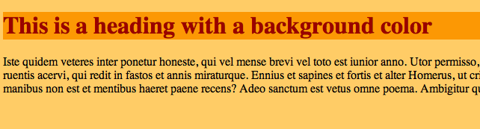
CSS : Example - background-color
The 'background-color' property
Body {
background-color: #FFCC66;
}
H1 {
color: #990000;
background-color: #FC9804;
}

Slide 25

CSS : Example - background-image
Background images [background-image]
Body {
background-color: #FFCC66;
background-image:url("butterfly.gif");
}
h1 {
color: #990000;
background-color: #FC9804;
}

Slide 26
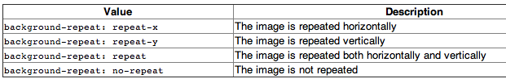
CSS : Example - background-repeat
Repeat background image [background-repeat]

Slide 27

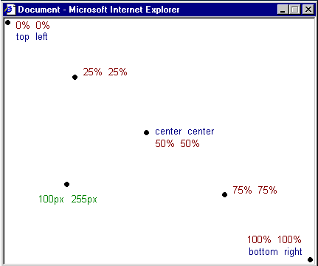
CSS : Example - background-position
Place background image [background-position]

Slide 28
CSS : Example - background
The property background is a shorthand for all the background properties
With background you can compress several properties and thereby write your style sheet in a shorter way which makes it easier to read.
background-color:#FFCC66;
background-image:url("butterfly.gif");
background-repeat:no-repeat;
background-attachment: fixed;
background-position: right bottom;
background: #FFCC66 url("butterfly.gif") no-repeat fixed right bottom;
achieved
The list of order is as follows:
[background-color] | [background-image] | [background-repeat] | [background-attachment] | [background-position]

Slide 29
CSS Formatting – Text Style

Slide 30
Configuring Text with CSS
CSS properties for configuring text:
font-family
Configures the font typeface of the text
font-weight
Configures the boldness of text
font-style
Configures text to an italic style
font-size
Configures the size of the text

Slide 31
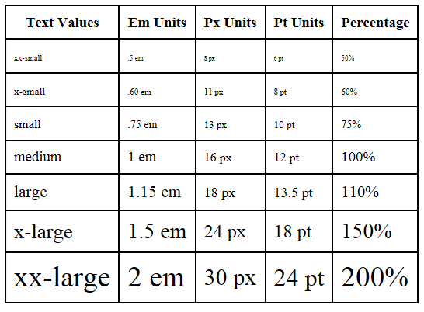
The font-size Property
Accessibility Recommendation: Use rem or em or percentage font sizes – these can be easily enlarged in all browsers by users
Em and % = Element; relative to the font-size of the parent element
Rem = Root Element; relative to the font-size of the root element
Px = Pixel
Pt = Point
When to use rem or em or px?
https://theodorusclarence.com/blog/btb-rem-em

Slide 32
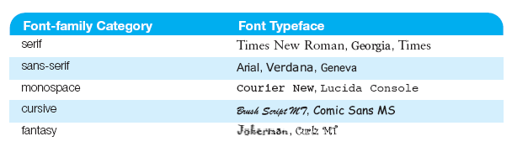
The font-family Property
Not everyone has the same fonts installed in their computer
Configure a list of fonts and include a generic family name
p {font-family: Arial, Verdana, sans-serif;}
https://developer.mozilla.org/en-US/docs/Web/CSS/font-family

Slide 33

Embedded Styles Example
<style>
body { background-color: #E6E6FA;
color: #191970;
font-family: Arial, Verdana, sans-serif; }
h1 { background-color: #191970;
color: #E6E6FA;
line-height: 200%;
font-family: Georgia, "Times New Roman", serif; }
h2 { background-color: #AEAED4;
color: #191970; text-align: center;
font-family: Georgia, "Times New Roman", serif; }
p {font-size: .90em; text-indent: 3em; }
ul {font-weight: bold; }
</style>

Slide 34
Grouping of styling elements
Class and id for identifying element(s) and to define style
Span and div for grouping elements and to apply style

Slide 35
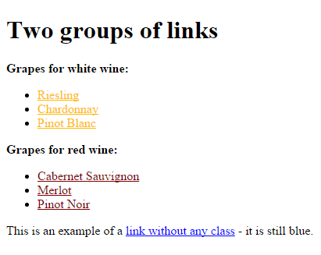
Grouping of styling elements
How many ‘hyperlink’ elements on this page?
How many ‘styling’ applied to hyperlinks?

Slide 36
CSS styling identification: class and id
Sometimes you want to apply a special style to
a particular element [using CSS ‘id’ attribute]
a particular group of elements [using CSS ‘class’ attribute]
class1
class2

Slide 37
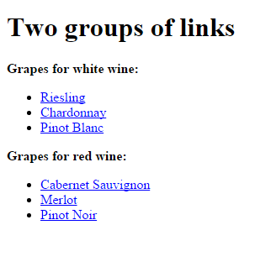
CSS identification: class and id
Let's say that we have two lists of links of different grapes used for white wine and red wine. The HTML code could look like this:
HTML code without CSS
<p>Grapes for white wine:</p>
<ul>
<li><a href="ri.htm">Riesling</a></li>
<li><a href="ch.htm">Chardonnay</a></li>
<li><a href="pb.htm">Pinot Blanc</a></li>
</ul>
<p>Grapes for red wine:</p>
<ul>
<li><a href="cs.htm">Cabernet Sauvignon</a></li>
<li><a href="me.htm">Merlot</a></li>
<li><a href="pn.htm">Pinot Noir</a></li>
</ul>

Slide 38
CSS identification: class and id
‘class’ attribute
Styling - white wine links to be yellow, the red wine links to be red and the rest of the existing links on the webpage to stay blue.
To achieve this, we divide the links into two categories. This is done by assigning a class to each link using the attribute class.
HTML code with ‘class’ styling
<p>Grapes for white wine:</p>
<ul>
<li><a href="ri.htm" class="whitewine">Riesling</a></li>
<li><a href="ch.htm" class="whitewine">Chardonnay</a></li>
<li><a href="pb.htm" class="whitewine">Pinot Blanc</a></li>
</ul>
<p>Grapes for red wine:</p>
<ul>
<li><a href="cs.htm" class="redwine">Cabernet Sauvignon</a></li>
<li><a href="me.htm" class="redwine">Merlot</a></li>
<li><a href="pn.htm" class="redwine">Pinot Noir</a></li>
</ul>
<p>This is an example of a <a href="pn.htm">Link without any class</a> - it is still blue</p>
CSS ‘class’ apply ‘ .’ (dot)
.whitewine {
color: #FFBB00;
}
.redwine {
color: #800000;
}
a {
color: blue;
}

Slide 39
CSS identification: class and id

Slide 40
CSS identification: class and id
‘id’ attribute
Identification of element
to identify one unique element
‘id’ special feature
Each id has to be unique.
cannot be two elements in the same document with the same id.
In other cases, you should use the ‘class’ attribute instead.

Slide 41
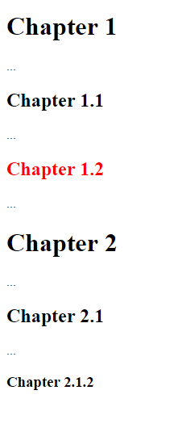
CSS identification: class and id
The example could be headings of any document split into chapters or paragraphs
HTML code without CSS
HTML code with ‘id’ styling
<h1>Chapter 1</h1>
...
<h2>Chapter 1.1</h2>
...
<h2>Chapter 1.2</h2>
...
<h1>Chapter 2</h1>
...
<h2>Chapter 2.1</h2>
...
<h3>Chapter 2.1.2</h3>
...
<h1 id="c1">Chapter 1</h1>
...
<h2 id="c1-1">Chapter 1.1</h2>
...
<h2 id="c1-2">Chapter 1.2</h2>
...
<h1 id="c2">Chapter 2</h1>
...
<h2 id="c2-1">Chapter 2.1</h2>
...
<h3 id="c2-1-2">Chapter 2.1.2</h3>
...
VS.
#c1-2 {
color: red;
}
CSS ‘id’ apply ‘#’(sharp)

Slide 42
CSS identification: class and id
Naming of ‘selector’
Selector for HTML tag
a {
color: blue;
}
Selector for ‘class’ attribute
.whitewine {
color: #FFBB00;
}
Selector for ‘id’ attribute
#c1-2 {
color: red;
}

Slide 43
CSS grouping of elements: span and div
The elements <span> and <div> are used
to group and structure a document
often be used together with the attributes ‘class’ and ‘id’.
Grouping with <span>
you could call a neutral element which does not add anything to the document itself.
<span> can be used to add visual features to specific parts of text in your documents.

Slide 44

CSS grouping of elements: span and div
<span> can be used to add visual features to specific parts of text in your documents.
<p>Early to bed and early to rise
makes a man healthy, wealthy and wise.</p>
Lets us say we want to display the benefits of not sleeping your day away emphasized in red. For that purpose, we can mark the benefits with <span>. Each span is then added a class, which we can define in our style sheet.
add <span> for styling text
<p>Early to bed and early to rise makes a man
<span class="benefit">healthy</span>,
<span class="benefit">wealthy</span>and
<span class="benefit">wise</span>.</p>
span.benefit {
color:red;
}
output

Slide 45
CSS grouping of elements: span and div
Grouping with <div>
Whereas <span> is used within a block-level element as seen in the previous example, <div> is used to group one or more block-level elements.
<div> covers others element(s) to group the style
<span> inside another element
<div id="democrats">
<ul>
<li>Franklin D. Roosevelt</li>
<li>Harry S. Truman</li>
<li>John F. Kennedy</li>
<li>Lyndon B. Johnson</li>
<li>Jimmy Carter</li>
<li>Bill Clinton</li>
</ul>
</div>
<p>Early to bed and early to rise makes a man
<span class="benefit">healthy</span>
</p>

Slide 46
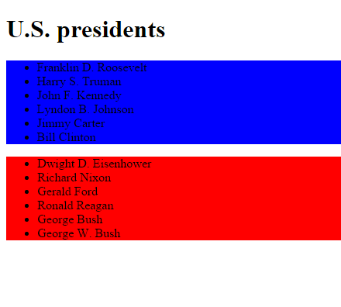
CSS grouping of elements: span and div
<div id="democrats">
<ul>
<li>Franklin D. Roosevelt</li>
<li>Harry S. Truman</li>
<li>John F. Kennedy</li>
<li>Lyndon B. Johnson</li>
<li>Jimmy Carter</li>
<li>Bill Clinton</li>
</ul>
</div>
<div id="republicans">
<ul>
<li>Dwight D. Eisenhower</li>
<li>Richard Nixon</li>
<li>Gerald Ford</li>
<li>Ronald Reagan</li>
<li>George Bush</li>
<li>George W. Bush</li>
</ul>
</div>
#democrats {
background:blue;
}
#republicans {
background:red;
}

Slide 47
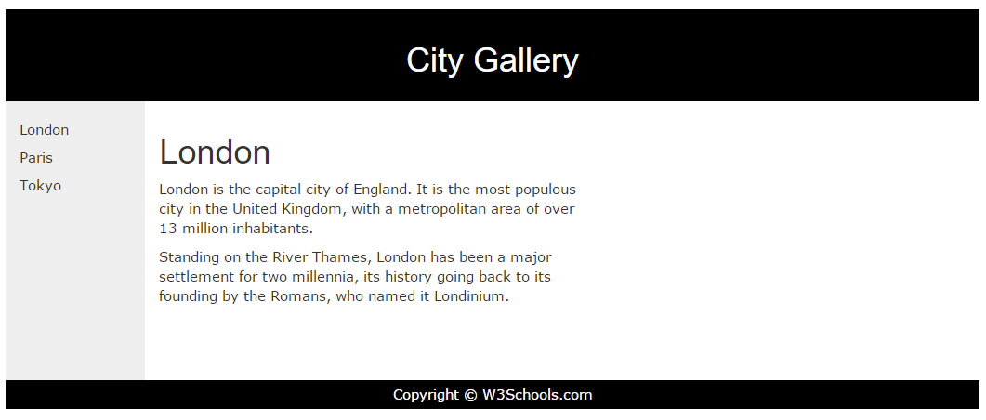
CSS Identification and grouping of elements W3Schools example

Slide 48
<body>
<div id="header">
<h1>City Gallery</h1>
</div>
<div id="nav">
London<br>
Paris<br>
Tokyo<br>
</div>
<div id="section">
<h1>London</h1>
<p>
London is the capital city of England. It is the most populous city in the United Kingdom,
with a metropolitan area of over 13 million inhabitants.
</p>
<p>
Standing on the River Thames, London has been a major settlement for two millennia,
its history going back to its founding by the Romans, who named it Londinium.
</p>
</div>
<div id="footer">
Copyright © W3Schools.com
</div>
</body>
<style>
#header {
background-color:black;
color:white;
text-align:center;
padding:5px;
}
#nav {
line-height:30px;
background-color:#eeeeee;
height:300px;
width:100px;
float:left;
padding:5px;
}
#section {
width:350px;
float:left;
padding:10px;
}
#footer {
background-color:black;
color:white;
clear:both;
text-align:center;
padding:5px;
}
</style>

Slide 49
Sum up!
CSS vs HTML
CSS
Using CSS
Lab2-Review
About CSS
What CSS?
Why CSS?
Inline
Embedded
External
CSS Formatting
Color
Text
CSS Grouping
Identify element
Group elements
CSS offers web designers to make the website be attractive
CSS syntax adjusts ‘style’ to HTML ‘structured content’
CSS offers developers to control web style precisely by applying CSS to inline HTML tag, embedded to HTML head and/or external CSS.
CSS colouring applies
in Hexadecimal RGB value e.g. #12EF1D
to value any custom colouring elements e.g. text, background, line, border, etc.
CSS group of styling
ID attribute: to manage a custom style to ONE element.
CLASS attribute: to manage a custom style to GROUP of elements (group).
<SPAN> tag: to apply custom styling to TEXT
<DIV> tag: to apply custom styling to ELEMENTS inside <div>
Read More http://www.html.net/tutorials/css
Reference http://www.html.net/tutorials/css

Slide 50
Q&A

