Slide 1
15.Dynamic Programming

Slide 2
Dynamic programming is typically applied to optimization problems. In such problem there can be many solutions. Each solution has a value, and we wish to find a solution with the optimal value.

Slide 3
The development of a dynamic programming algorithm can be broken into a sequence of four steps:
1. Characterize the structure of an optimal solution.
2. Recursively define the value of an optimal solution.
3. Compute the value of an optimal solution in a bottom up fashion.
4. Construct an optimal solution from computed information.

Slide 4
15.1 Assembly-line scheduling
An automobile chassis enters each assembly line, has parts added to it at a number of stations, and a finished auto exits at the end of the line.
Each assembly line has n stations, numbered j = 1, 2,...,n. We denote the jth station on line j ( where i is 1 or 2) by S_{i,j}. The jth station on line 1 (S_{1,j}) performs the same function as the jth station on line 2 (S_{2,j}).

Slide 5
The stations were built at different times and with different technologies, however, so that the time required at each station varies, even between stations at the same position on the two different lines. We denote the assembly time required at station S_{i,j} by a_{i,j}.
As the coming figure shows, a chassis enters station 1 of one of the assembly lines, and it progresses from each station to the next. There is also an entry time e_{i} for the chassis to enter assembly line i and an exit time x_{i} for the completed auto to exit assembly line i.

Slide 6
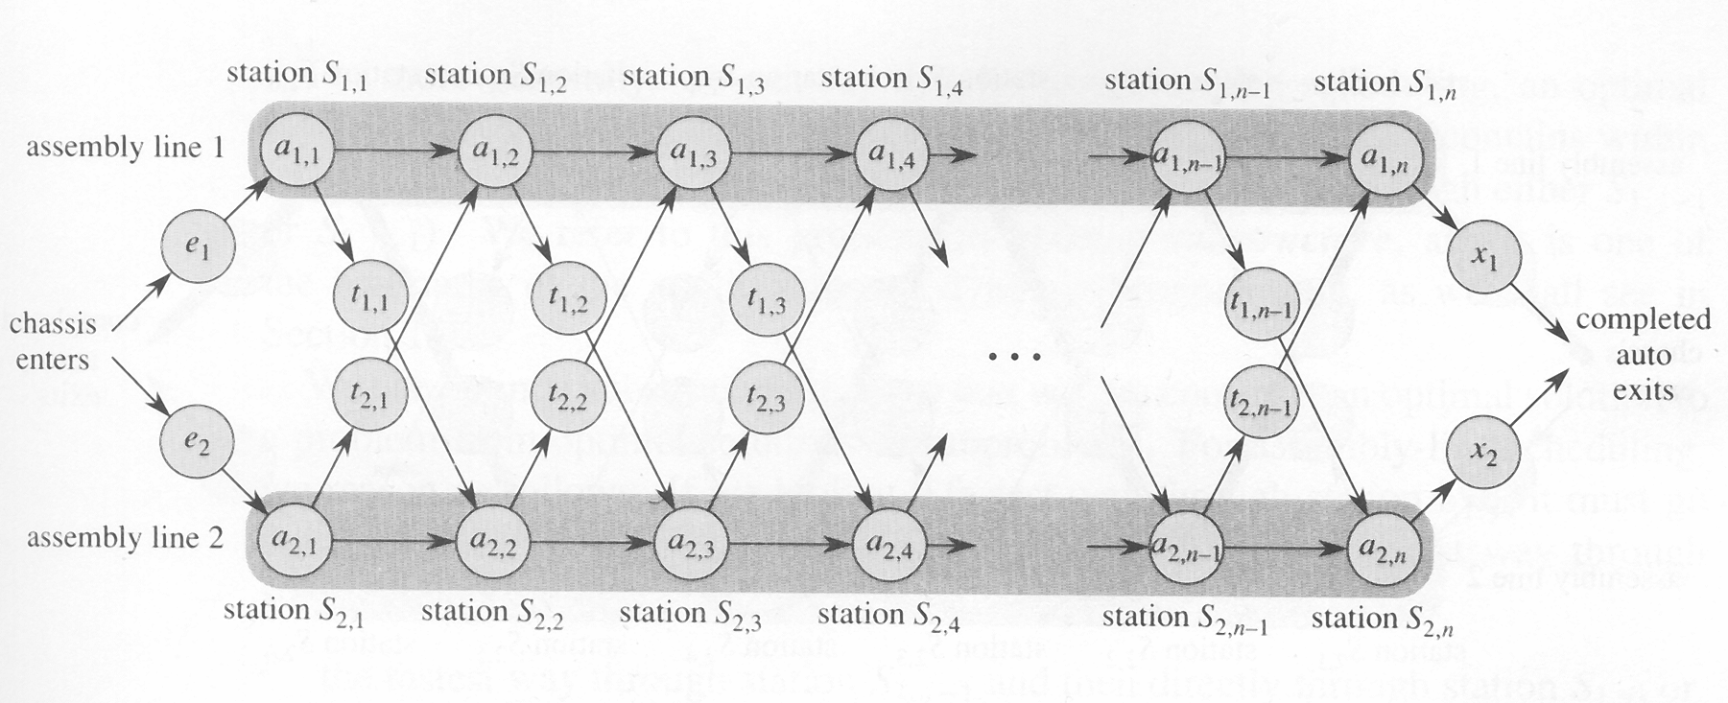
a manufacturing problem
to find the fast way through a factory

Slide 7
Normally, once a chassis enters an assembly line, it passes through that line only. The time to go from one station to the next within the same assembly line is negligible.
Occasionally a special rush order comes in, and the customer wants the automobile to be manufactured as quickly as possible.
For the rush orders, the chassis still passes through the n stations in order, but the factory manager may switch the partially-completed auto from one assembly line to the other after any station.

Slide 8
The time to transfer a chassis away from assembly line i after having gone through station S_{ij} is t_{i,j}, where i = 1, 2 and j = 1, 2, ..., n-1 (since after the nth station, assembly is complete). The problem is to determine which stations to choose from line 1 and which to choose from line 2 in order to minimize the total time through the factory for one auto.

Slide 9
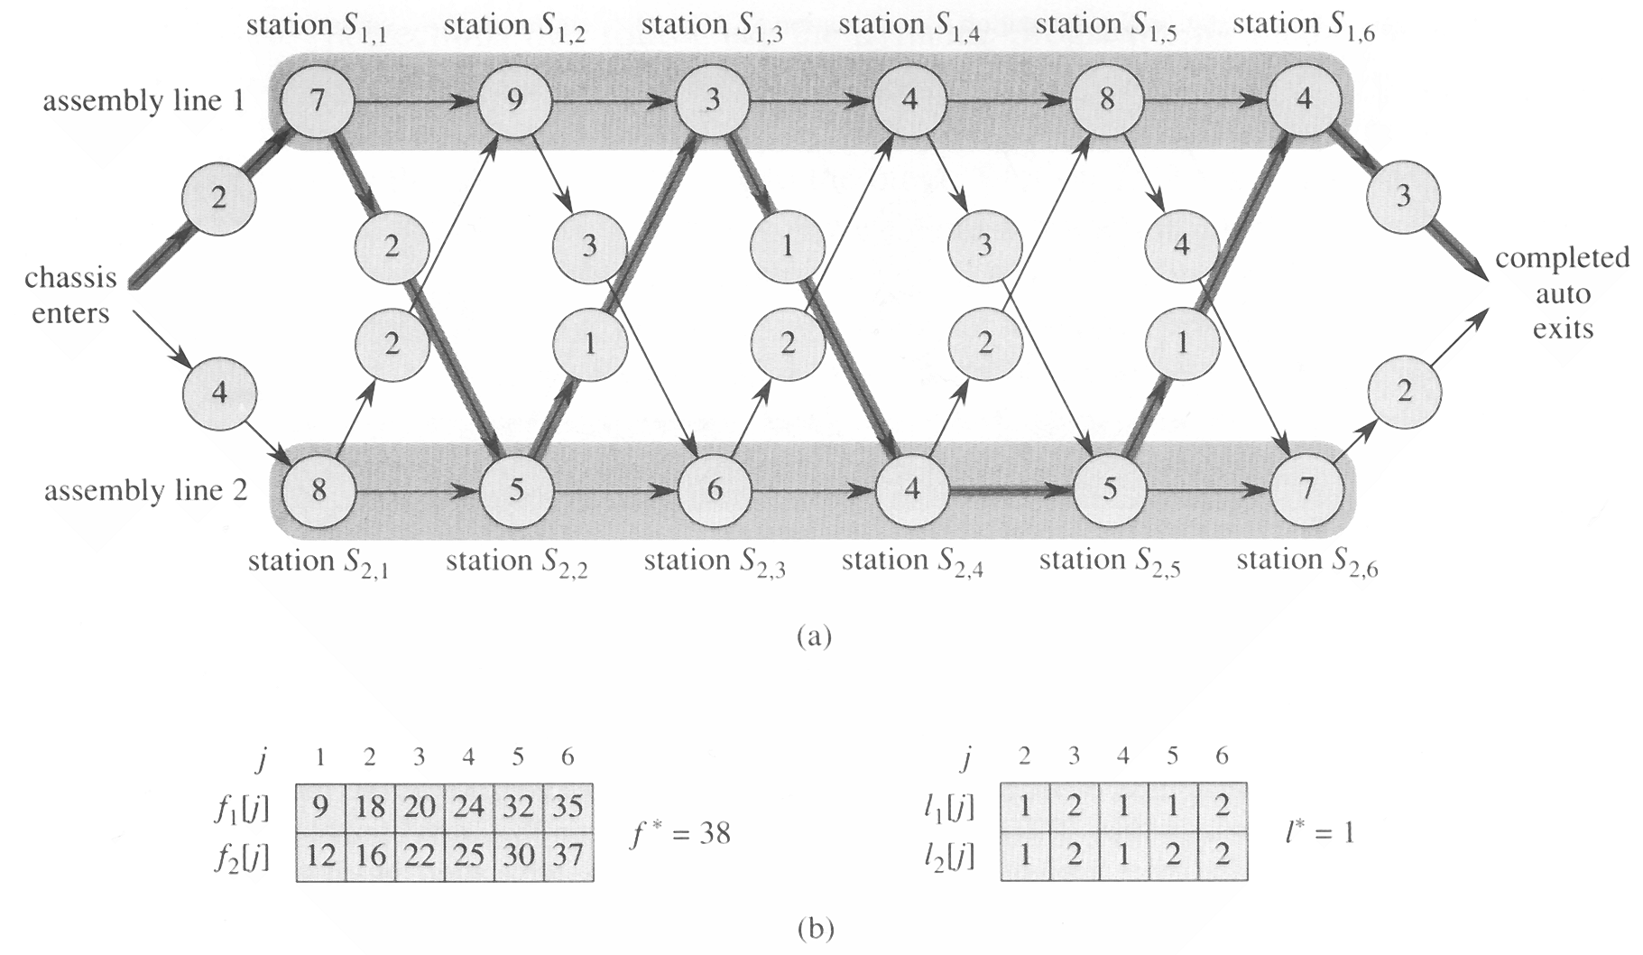
An instance of the assembly-line
problem with costs

Slide 10
Step1 The structure of the fastest way through the factory
  the fast way through station S_{1,j} is either
    the fastest way through Station S_{1,j-1} and then directly through station S_{1,j}, or
    the fastest way through station S_{2,j-1}, a transfer from line 2 to line 1, and then through station S_{1,j}.
  Using symmetric reasoning, the fastest way through station S_{2,j} is either
    the fastest way through station S_{2,j-1} and then directly through Station S_{2,j}, or
    the fastest way through station S_{1,j-1}, a transfer from line 1 to line 2, and then through Station S_{2,j}.

Slide 11
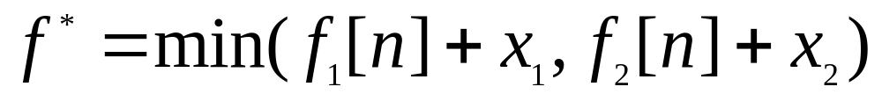
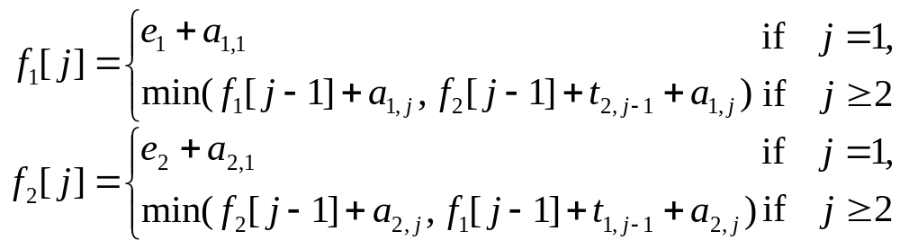
Step 2: A recursive solution

Slide 12
step 3: computing the fastest times
Let r_{i}(j)be the number of references made to f_{i}[j] in a recursive algorithm.
r₁(n)=r₂(n)=1
r₁(j) = r₂(j)=r₁(j+1)+r₂(j+1)
The total number of references to all f_{i}[j] values is Θ(2^{n}).
We can do much better if we compute the f_{i}[j] values in different order from the recursive way. Observe that for j ≥ 2, each value of f_{i}[j] depends only on the values of f₁[j-1] and f₂[j-1].

Slide 13
FASTEST-WAY procedure
FASTEST-WAY(a, t, e, x, n)
1 f₁[1] ← e₁ + a_{1,1}
2 f₂[1] ← e₂ + a_{2,1}
3 for j ← 2 to n
4 do if f₁[j-1] + a_{1,j} ≤ f₂[j-1] + t_{2,j-1} +a_{1,j}
5 then f₁[j] ← f₁[j-1] + a_{1,j}
6 l₁[j] ← 1
7 else f₁[j] ← f₂[j-1] + t_{2,j-1} +a_{1,j}
8 l₁[j] ← 2
9 if f₂[j-1] + a_{2, j} ≤ f₁[j-1] + t_{1,j-1} +a_{2,j}

Slide 14
10 then f₂[j] ← f₂[j – 1] + a_{2,j}
11 l2[j] ← 2
12 else f₂[j] ← f₁[j – 1] + t_{1,j-1} + a₂,j
13 l₂[j] ← 1
14 if f₁[n] + x₁ ≤ f₂[n] + x₂
15 then f* = f₁[n] + x₁
16 l* = 1
17 else f* = f₂[n] + x₂
18 l* = 2

Slide 15
step 4: constructing the fastest way through the factory
PRINT-STATIONS(l, n)
1 i ← l*
2 print “line” i “,station” n
3 for j ← n downto 2
4 do i ← l_{i}[j]
5 print “line” i “,station” j – 1
output
line 1, station 6
line 2, station 5
line 2, station 4
line 1, station 3
line 2, station 2
line 1, station 1

Slide 16
15.2 Matrix-chain multiplication
A product of matrices is fully parenthesized if it is either a single matrix, or a product of two fully parenthesized matrix product, surrounded by parentheses.

Slide 17
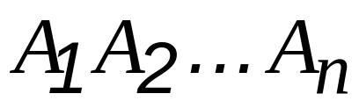


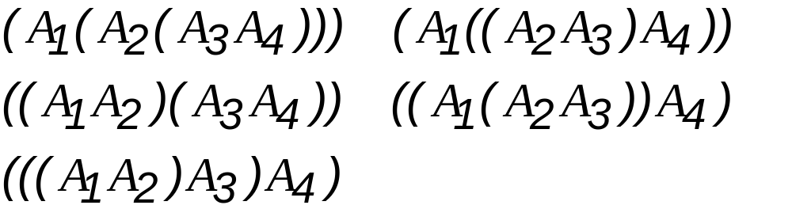
How to compute where is a matrix for every i.
Example:

Slide 18





MATRIX MULTIPLY
MATRIX MULTIPLY(A,B)
1 if columns[A] column[B]
2 then error “incompatible dimensions”
3 else for to rows[A]
4 do for to columns[B]
5 do
6 for to columns[A]
7 do
8 return C

Slide 19
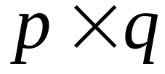
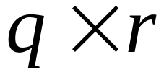
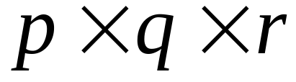
Complexity:
Let A be a matrix, and B be a
matrix. Then the complexity is
.

Slide 20








Example:
is a matrix, is a matrix, and is a matrix. Then
takes time. However takes
time.

Slide 21
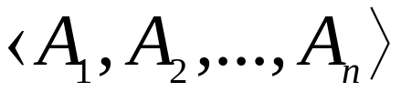
The matrix-chain multiplication problem:
Given a chain of n matrices, where for i=0,1,…,n, matrix Ai has dimension p_{i-1}×p_{i}, fully parenthesize the product in a way that minimizes the number of scalar multiplications.

Slide 22
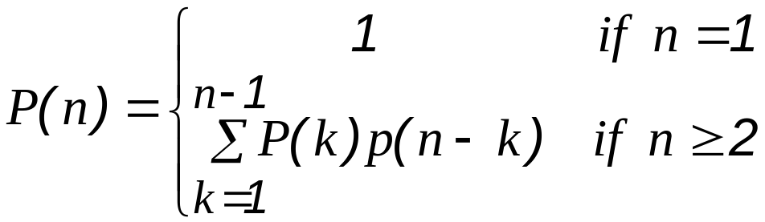
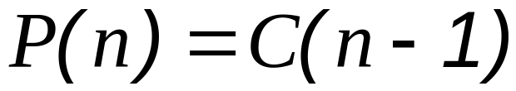
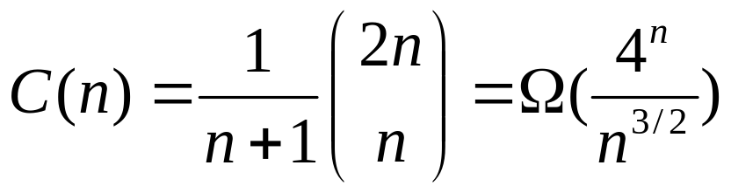
Counting the number of parenthesizations:
[Catalan number]

Slide 23
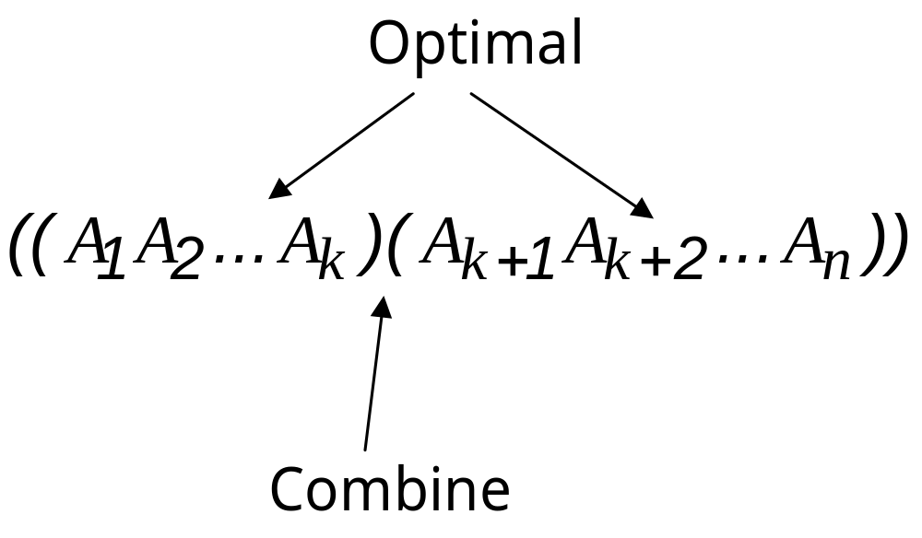
Step 1: The structure of an optimal parenthesization

Slide 24
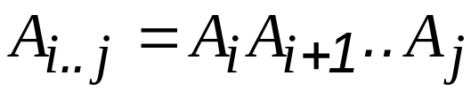
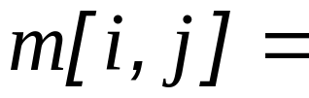
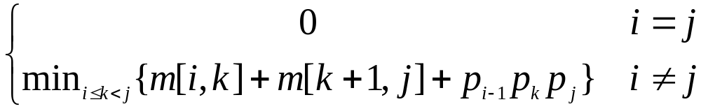
Step 2: A recursive solution
Define m[i, j]= minimum number of scalar multiplications needed to compute the matrix
goal m[1, n]

Slide 25
Step 3: Computing the optimal costs

Slide 26
RECURSIVE_MATRIX_CHAIN
RECURSIVE_MATRIX_CHAIN(p, i, j)
1 if i = j
2 then return 0
3 m[i, j] ← ∞
4 for k ← i to j – 1
5 do q ← RMC(p,i,k) + RMC(p,k+1,j) + p_{i-1}p_{k}p_{j}
6 if q < m[i, j]
7 then m[i, j] ← q
8 return m[i, j]

Slide 27
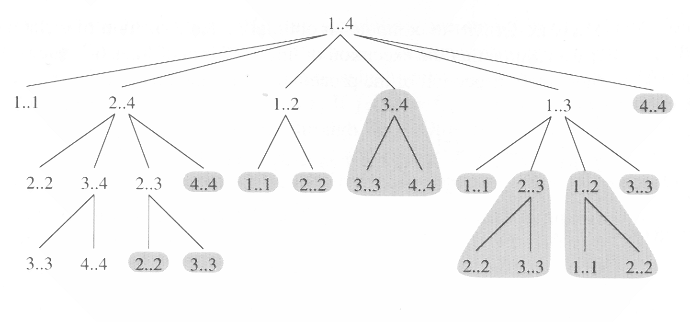
The recursion tree for the computation of RECURSUVE-MATRIX-CHAIN(P, 1, 4)

Slide 28
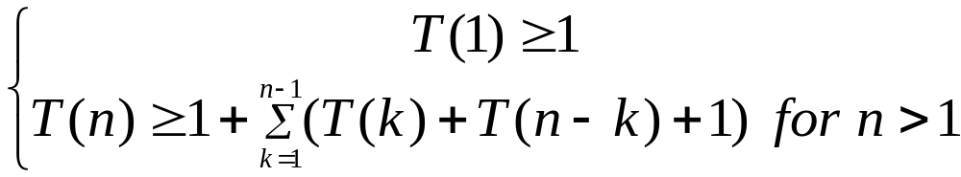
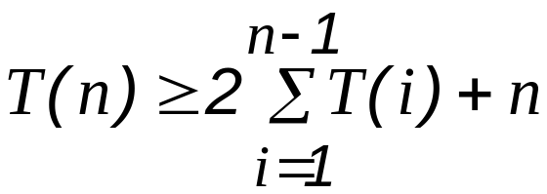
Complexity of Recursion
We can prove that T(n) =Ω(2^{n}) using substitution method.

Slide 29
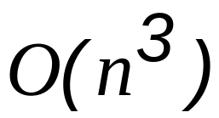
MATRIX_CHAIN_ORDER
MATRIX_CHAIN_ORDER(p)
1 n ← length[p] –1
2 for i ← 1 to n
3 do m[i, i] ← 0
4 for l ← 2 to n
5 do for i ← 1 to n – l + 1
6 do j ← i + l – 1
7 m[i, j] ← ∞
8 for k ← i to j – 1
9 do q ← m[i, k] + m[k+1, j]+ p_{i-1}p_{k}p_{j}
10 if q < m[i, j]
11 then m[i, j] ← q
12 s[i, j] ← k
13 return m and s
Complexity:

Slide 30
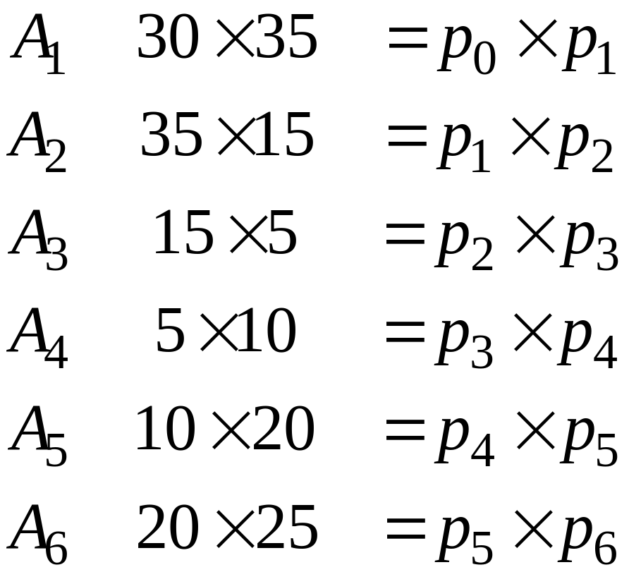
Example:

Slide 31
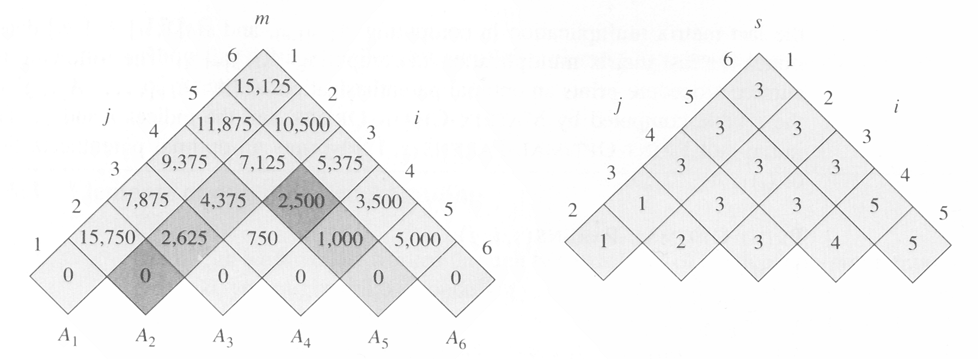
the m and s table computed by
MATRIX-CHAIN-ORDER for n=6

Slide 32
m[2,5]=
min{
m[2,2]+m[3,5]+p₁p₂p₅=0+2500+35×15×20=13000,
m[2,3]+m[4,5]+p₁p₃p₅=2625+1000+35×5×20=7125,
m[2,4]+m[5,5]+p₁p₄p₅=4375+0+35×10×20=11374
}
=7125

Slide 33
Step 4: Constructing an optimal solution

Slide 34


MATRIX_CHAIN_MULTIPLY
MATRIX_CHAIN_MULTIPLY(A, s, i, j)
1 if j > i
2 then
3
4 return MATRIX-MULTIPLY(X,Y)
5 else return A_{i}
example:

Slide 35
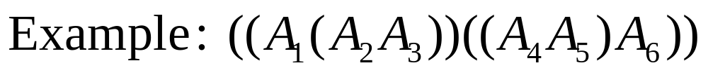
Print-Optimal-Parens(s, i, j)
Print-Optimal-Parens(s, i, j)
if i=j
then print “A”_{i}
else print “(”
Print-Optimal-Parens(s, i, s[i, j])
Print-Optimal-Parens(s, s[i, j]+1, j)
print “)”

Slide 36
16.3 Elements of dynamic programming

Slide 37
Optimal substructure:
We say that a problem exhibits optimal substructure if an optimal solution to the problem contains within its optimal solution to subproblems.
Example: Matrix-multiplication problem

Slide 38
1. You show that a solution to the problem consists of making a choice, Making this choice leaves one or more subproblems to be solved.
2. You suppose that for a given problem, you are given the choice that leads to an optimal solution.
3. Given this choice, you determine which subproblems ensue and how to best characterize the resulting space of subproblems.
4. You show that the solutions to the subproblems used within the optimal solution to the problem must themselves be optimal by using a “cut-and-paste” technique.

Slide 39
Optimal substructure varies across problem domains in two ways:
1. how many subproblems are used in an optimal solutiion to the original problem, and
2. how many choices we have in determining which subproblem(s) to use in an optimal solution.

Slide 40
Subtleties
One should be careful not to assume that optimal substructure applies when it does not. consider the following two problems in which we are given a directed graph G = (V, E) and vertices u, v ∈ V.
  Unweighted shortest path:
    Find a path from u to v consisting of the fewest edges. Good for Dynamic programming.
  Unweighted longest simple path:
    Find a simple path from u to v consisting of the most edges. Not good for Dynamic programming.

Slide 41
Overlapping subproblems:
example: MAXTRIX_CHAIN_ORDER

Slide 42
RECURSIVE_MATRIX_CHAIN
RECURSIVE_MATRIX_CHAIN(p, i, j)
1 if i = j
2 then return 0
3 m[i, j] ← ∞
4 for k ← i to j – 1
5 do q ← RMC(p,i,k) + RMC(p,k+1,j) + p_{i-1}p_{k}p_{j}
6 if q < m[i, j]
7 then m[i, j] ← q
8 return m[i, j]

Slide 43
The recursion tree for the computation
of RECURSUVE-MATRIX-CHAIN(P, 1, 4)

Slide 44
We can prove that T(n) =Ω(2^{n}) using substitution method.

Slide 45
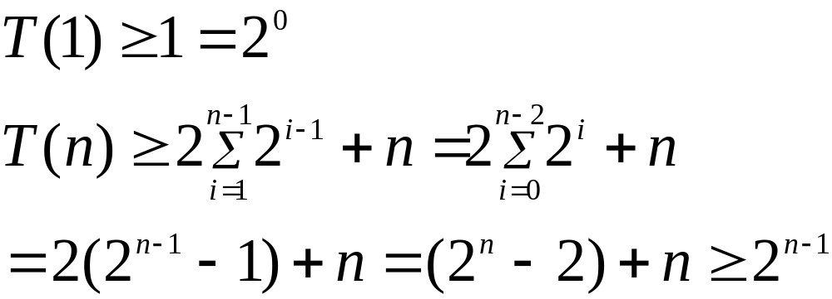
Solution:
1. bottom up
2. memorization (memorize the natural, but inefficient)

Slide 46
MEMORIZED_MATRIX_CHAIN
MEMORIZED_MATRIX_CHAIN(p)
1 n ← length[p] –1
2 for i ← 1 to n
3 do for j ← 1 to n
4 do m[i, j] ← ∞
5 return LC (p,1,n)

Slide 47

LOOKUP_CHAIN
LOOKUP_CHAIN(p, i, j)
1 if m[i, j] < ∞
2 then return m[i, j]
3 if i = j
4 then m[i, j] ← 0
5 else for k ← i to j – 1
6 do q ← LC(p, i, k) +LC(p, k+1, j)+p_{i-1}p_{k}p_{j}
7 if q < m[i, j]
8 then m[i, j] ← q
9 return m[i, j]
Time Complexity:

Slide 48
16.4 Longest Common Subsequence
X = < A, B, C, B, D, A, B >
Y = < B, D, C, A, B, A >
< B, C, A > is a common subsequence of both X and Y.
< B, C, B, A > or < B, C, A, B > is the longest common subsequence of X and Y.

Slide 49
Longest-common-subsequence problem:
We are given two sequences X = <x₁,x₂,...,x_{m}> and Y = <y₁,y₂,...,y_{n}> and wish to find a maximum length common subsequence of X and Y.
We Define X_{i} = < x₁,x₂,...,x_{i} >.

Slide 50
Theorem 16.1. (Optimal substructure of LCS)
Let X = <x₁,x₂,...,x_{m}> and Y = <y₁,y₂,...,y_{n}> be the sequences, and let Z = <z₁,z₂,...,z_{k}> be any LCS of X and Y.
1. If x_{m} = y_{n}
then z_{k} = x_{m} = y_{n} and Z_{k-1} is an LCS of X_{m-1} and Y_{n-1}.
2. If x_{m} ≠ y_{n}
then z_{k} ≠ x_{m} implies Z is an LCS of X_{m-1} and Y.
3. If x_{m} ≠ y_{n}
then z_{k} ≠ y_{n} implies Z is an LCS of X and Y_{n-1}.

Slide 51
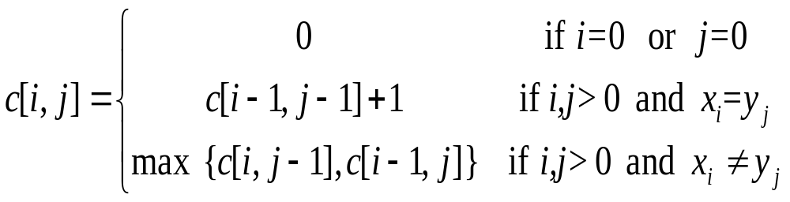
A recursive solution to subproblem
Define c [i, j] is the length of the LCS of X_{i} and Y_{j} .

Slide 52
Computing the length of an LCS
LCS_LENGTH(X,Y)
1 m ← length[X]
2 n ← length[Y]
3 for i ← 1 to m
4 do c[i, 0] ← 0
5 for j ← 1 to n
6 do c[0, j] ← 0
7 for i ← 1 to m
8 do for j ← 1 to n

Slide 53
9 do if x_{i} = y_{j}
10 then c[i, j] ← c[i-1, j-1]+1
11 b[i, j] ← “”
12 else if c[i–1, j] ≥ c[i, j-1]
13 then c[i, j] ← c[i-1, j]
14 b[i, j] ← “⬆”
15 else c[i, j] ← c[i, j-1]
16 b[i, j] ← “⬅”
17 return c and b

Slide 54
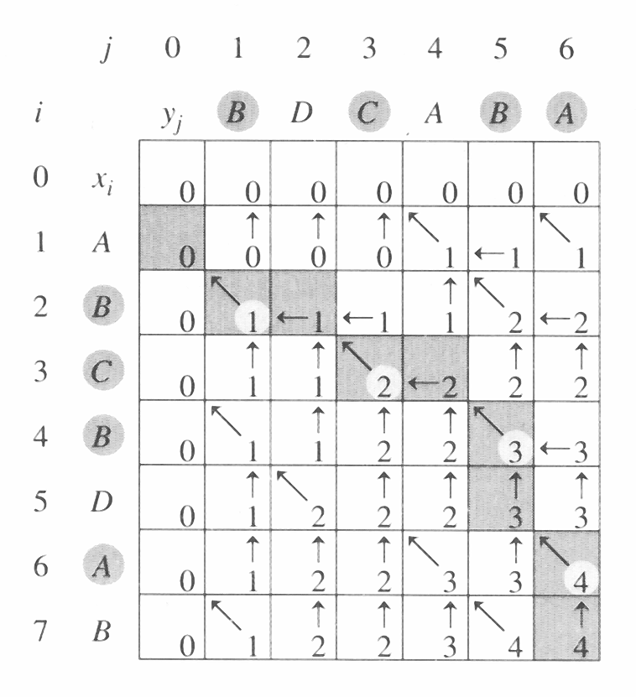
Complexity: O(mn)

Slide 55
PRINT_LCS
PRINT_LCS(b, X, c, j )
1 if i = 0 or j = 0
2 then return
3 if b[i, j] = “”
4 then PRINT_LCS(b, X, i-1, j-1)
5 print x_{i}
6 else if b[i, j] = “⬆”
7 then PRINT_LCS(b, X, i-1, j)
8 else PRINT_LCS(b, X, i, j-1)
Complexity: O(m+n)

Slide 56
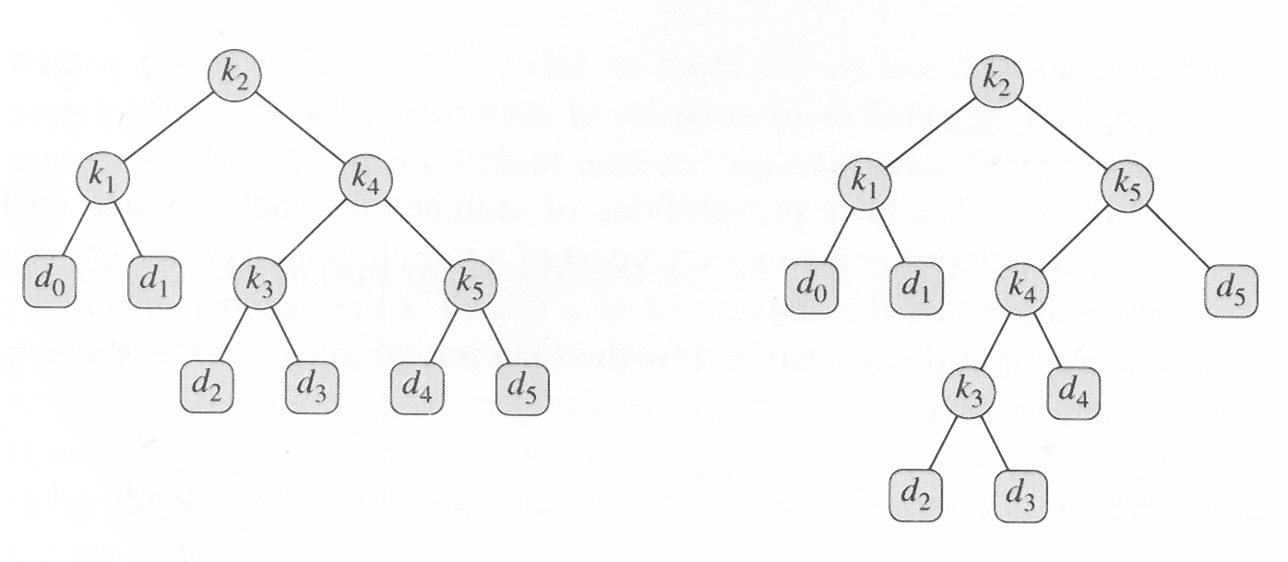
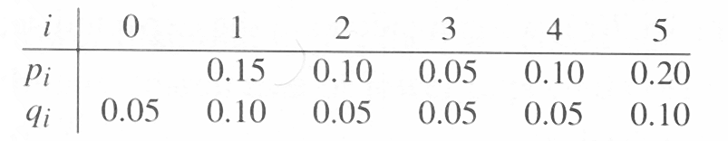
15.5 Optimal Binary search trees
cost:2.75
optimal!!
cost:2.80

Slide 57
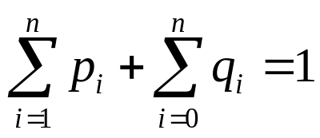
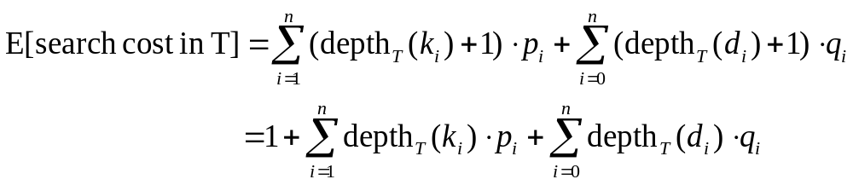
expected cost
the expected cost of a search in T is

Slide 58
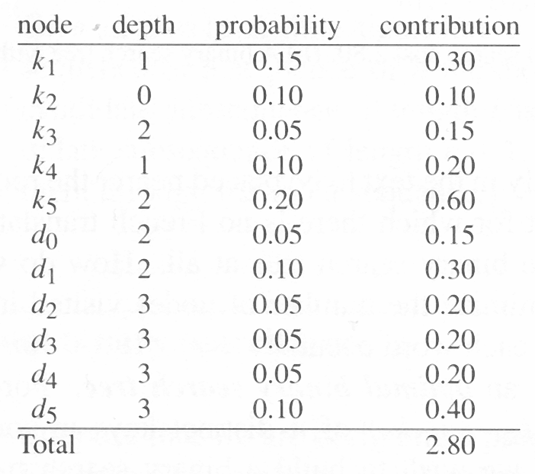
For a given set of probabilities, our goal is to construct a binary search tree whose expected search is smallest. We call such a tree an optimal binary search tree.

Slide 59
Step 1: The structure of an optimal binary search tree
Consider any subtree of a binary search tree. It must contain keys in a contiguous range k_{i}, ...,k_{j}, for some 1 ≤ i ≤ j ≤ n. In addition, a subtree that contains keys k_{i}, ..., k_{j} must also have as its leaves the dummy keys d_{i-1}, ..., d_{j}.
If an optimal binary search tree T has a subtree T' containing keys k_{i}, ..., k_{j}, then this subtree T' must be optimal as well for the subproblem with keys k_{i}, ..., k_{j} and dummy keys d_{i-1}, ..., d_{j}.

Slide 60
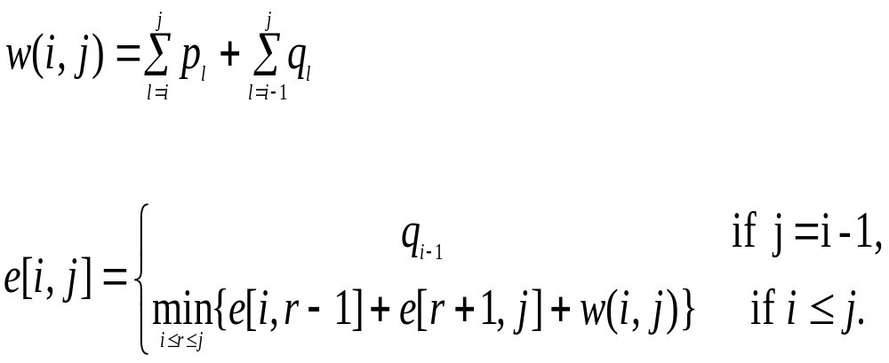
Step 2: A recursive solution

Slide 61
Step 3:computing the expected search cost of an optimal binary search tree
OPTIMAL-BST(p,q,n)
1 for i ← 1 to n + 1
2 do e[i, i – 1] ← q_{i-1}
3 w[i, i – 1] ← q_{i-1}
4 for l ← 1 to n
5 do for i ← 1 to n – l + 1
6 do j ← i + l – 1
7 e[i, j] ← ∞
8 w[i, j] ← w[i, j – 1] + p_{j}+q_{j}

Slide 62
9 for r ← i to j
10 do t ← e[i, r –1]+e[r +1, j]+w[i, j]
11 if t < e[i, j]
12 then e[i, j] ← t
13 root[i, j] ← r
14 return e and root
the OPTIMAL-BST procedure takes Θ(n³), just like MATRIX-CHAIN-ORDER

Slide 63
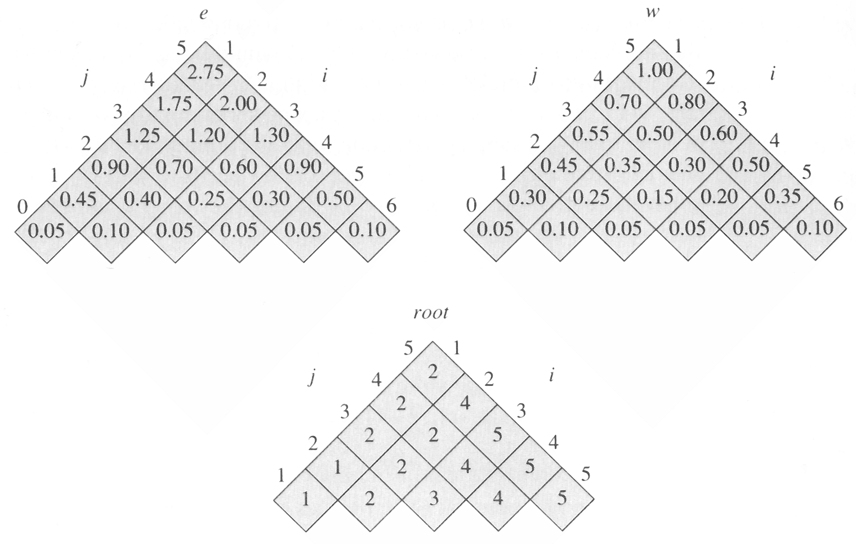
The table e[i,j], w[i,j], and root[i,j] computer by OPTIMAL-BST on the key distribution.

Slide 64
Knuth has shown that there are always roots of optimal subtrees such that root[i, j –1] ≤ root[i+1, j] for all 1 ≤ i ≤ j ≤ n. We can use this fact to modify Optimal-BST procedure to run in Θ(n²) time.

