Slide 1
16.Greedy algorithms

Slide 2
16.1 An activity-selection problem
Suppose we have a set S = {a₁, a₂, ..., a_{n}} of n proposed activities that with to use a resource. Each activity a_{i} has a start time s_{i} and a finish time f_{i}, where 0 ≤ s_{i} < f_{i} < ∞.
If selected, activity a_{i} take place during the half-open time interval [s_{i}, f_{i}). Activities a_{i} and a_{j} are compatible if the intervals [s_{i}, f_{i}) and [s_{j}, f_{j}) do not overlap (i.e., a_{i} and a_{j} are compatible if s_{i} ≥ f_{j} or s_{j} ≥ f_{i}).

Slide 3
The activity-selection problem is to select a maximum-size subset of mutually compatible activities.
Example:
i | 1 | 2 | 3 | 4 | 5 | 6 | 7 | 8 | 9 | 10 | 11
s_{i} | 1 | 3 | 0 | 5 | 3 | 5 | 6 | 8 | 8 | 2 | 12
f_{i} | 4 | 5 | 6 | 7 | 8 | 9 | 10 | 11 | 12 | 13 | 14

Slide 4
We shall solve this problem in several steps. We start by formulating a dynamic programming solution to this program in which we combine optimal solutions to two subproblems to form an optimal solution to the original problem.
We shall then observe that we need only consider one choice – the greedy choice – and that when we make the greedy choice, one of the subproblems is guaranteed to be empty, so that only one nonempty subproblem remains.

Slide 5
The optimal substructure of the activity-selection problem
S_{ij}={a_{k}∈S : f_{i} ≤ s_{k} < f_{k} ≤ s_{j}},
So that S_{ij} is the subset of activities in S that can start after activity a_{i} finishes and finish before activity a_{j} starts.
f₀=0 and s_{n+1} = ∞. Then S = S_{0,n+1}, and the ranges for i and j are given by 0 ≤ i, j ≤ n+1.
A_{ij} = A_{ik} ∪{a_{k}} ∪A_{kj}

Slide 6
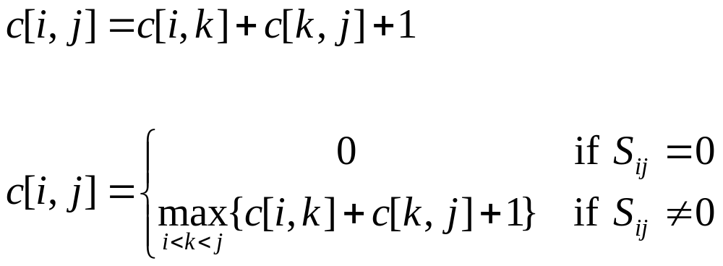
A recursive solution

Slide 7
Converting a dynamic-programming solution to a greedy solution
Theorem 16.1
  Consider any nonempty subproblem S_{ij}, and let a_{m} be the activity in S_{ij} with the earliest finish time:
  f_{m} = min { f_{k} : a_{k} ∈ S_{ij}}.
  then
  1. Activity a_{m} is used in some maximum-size subset of mutually compatible activities of S_{ij}.
  2. The subproblem S_{im} is empty, so that choosing a_{m} leaves the subproblem S_{mj} as the only one that may be nonempty.

Slide 8
A recursive greedy algorithm
RECURSIVE-ACTIVITY-SELECTOR(s, f, i, j)
1 m ← i +1
2 while m < j and s_{m} < f_{i} Find the first activity in S_{ij}
3 do m ← m + 1
4 if m < j
5 then return {a_{m}}∪RAS(s, f, m, j)
6 else return 0

Slide 9
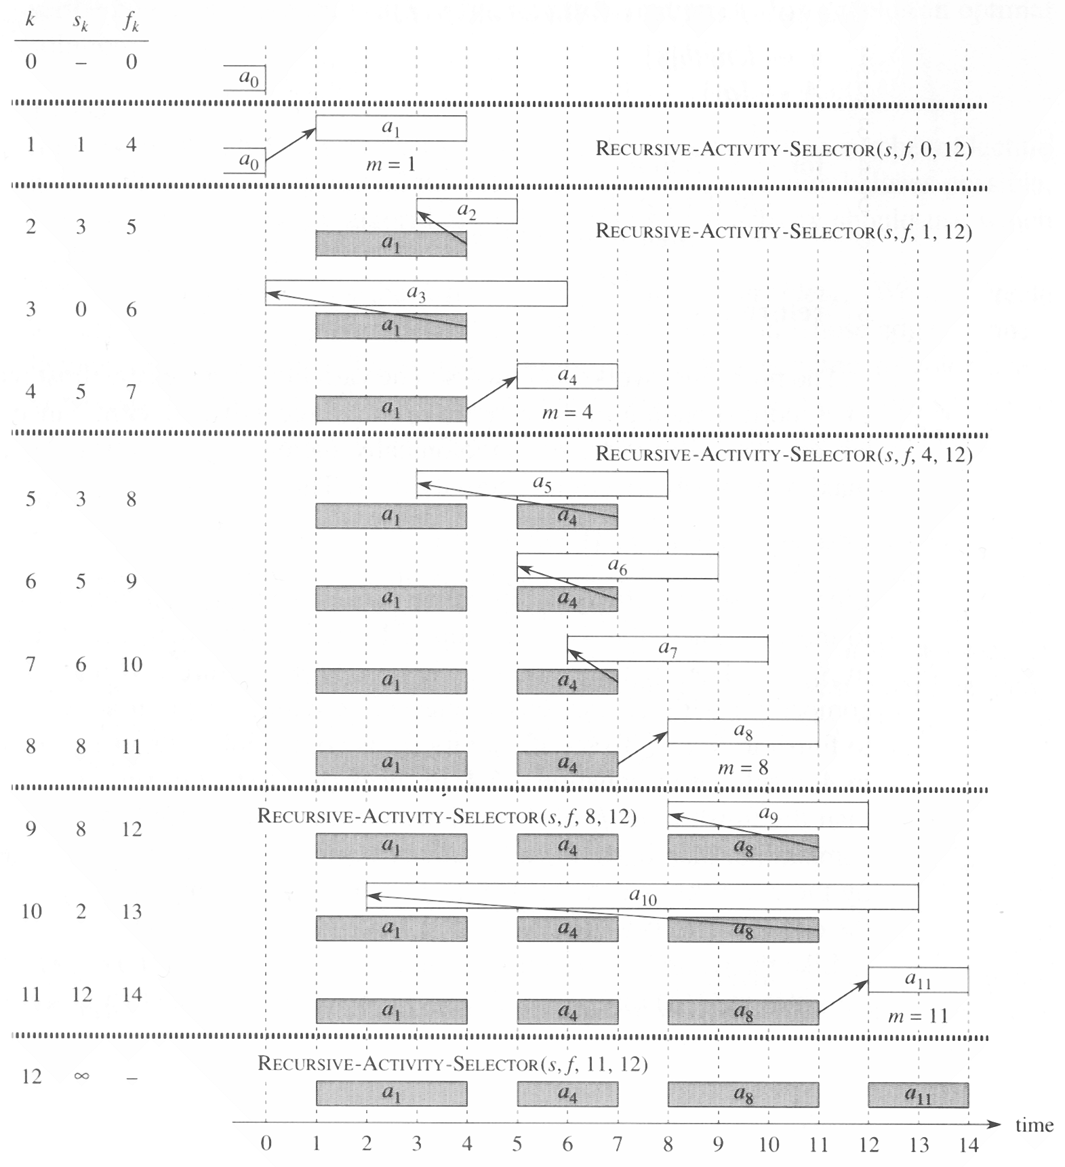
The operation of RECURSIVE-ACTIVITY-SELECTOR
on the 11 activities given earlier

Slide 11
An iterative greedy algorithm
GREEDY-ACTIVITY-SELECTOR(s, f)
1 n ← length[s]
2 a ← {a₁}
3 i ← 1
4 for m ← 2 to n
5 do if s_{m} ≥ f_{i}
6 then A ← A ∪ {a_{m}}
7 i ← m
8 return A

Slide 12
16.2 Elements of the greedy strategy
1. Determine the optimal substructure of the problem.
2. Develop a recursive solution.
3. Prove that at any stage of the recursion, one of the optimal choices is the greedy choice. Thus, it is always safe to make the greedy choice.

Slide 13
4. Show that all but one of the subproblems induced by having make the greedy choice are empty.
5. Develop a recursive algorithm that implements the greedy strategy.
6. Convert the recursive algorithm to an iterative algorithm.
Alternatively, we could have fashioned our optimal substructure with a greedy choice in mind.

Slide 14
Designing a greedy algorithm
1. Cast the optimization problem as one in which we make a choice and are left with one subproblem to solve.
2. Prove that there is always an optimal solution to the original problem that makes the greedy choice, so that the greedy choice is always safe.
3. Demonstrate that, having made the greedy choice , what remains is a subproblem with the property that if we combine an optimal solution to the subproblem with the greedy choice we have made, we arrive at an optimal solution to the original problem.

Slide 15
Greedy-choice property: A global optimal solution can be achieved by making a local optimal (optimal) choice.
Optimal substructure: An optimal solution to the problem within its optimal solution to subproblem.

Slide 16
Greedy versus dynamic programming
0-1 knapsack problem
fractional knapsack problem
(Exercise 16.2.2)

Slide 17
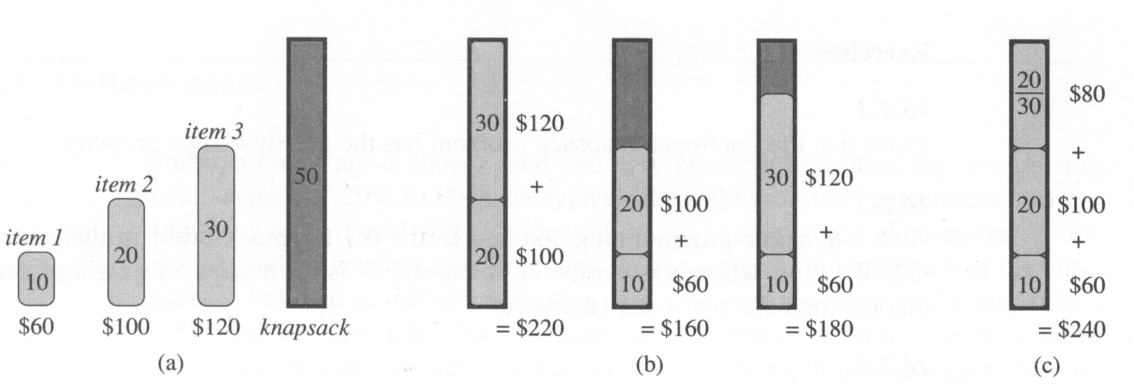
The greedy strategy does not work for the 0-1 knapsack

Slide 18
16.3 Huffman codes
 | a | b | c | d | e | f
Frequency (in hundred) | 45 | 13 | 12 | 16 | 9 | 5
Fixed length codeword | 000 | 001 | 010 | 011 | 100 | 101
Variable length codeword | 0 | 101 | 100 | 111 | 1101 | 1100
Prefix code: no codeword is also a prefix of some other codeword.

Slide 19
Can be shown that the optimal data compression achievable by a character code can always be achieved with prefix codes.
Simple encoding and decoding.
An optimal code for a file is always represented by a binary tree.

Slide 20
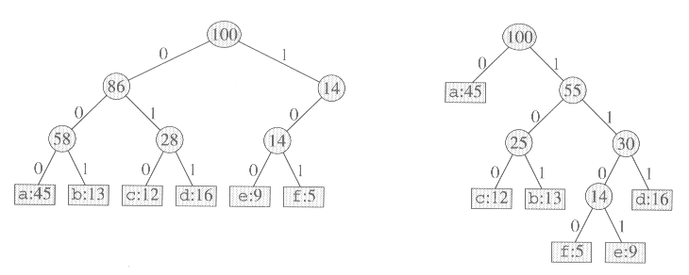
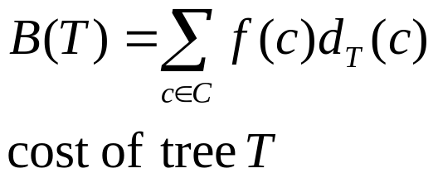
Tree correspond to the coding schemes

Slide 21
Constructing a Huffman code
HUFFMAN( C )
1 n ← |C|
2 Q ← C
3 for i ← 1 to n – 1
4 do allocate a new node z
5 left[z] ← x ← EXTRACT-MIN(Q)
6 right[z] ← y ← EXTRACT-MIN(Q)
7 f[z] ← f[x] + f[y]
8 INSERT(Q,Z)
9 return EXTRACT-MIN(Q)
Complexity: O(n log n)

Slide 22
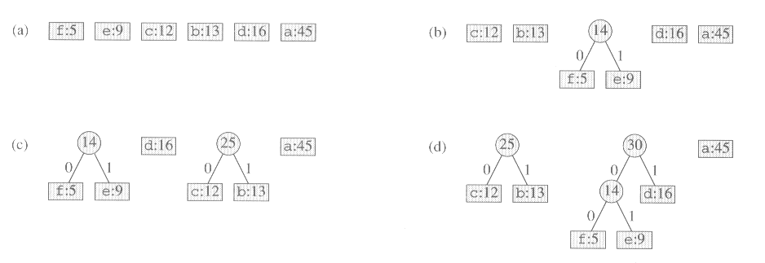
The steps of Huffman’s algorithm

Slide 23
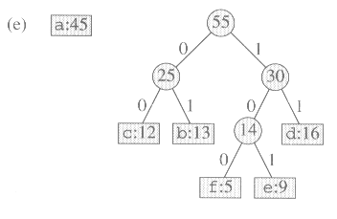
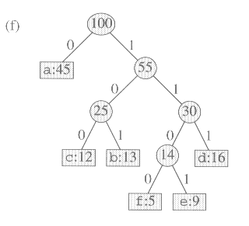

Slide 24
Correction of Huffman’s algorithm
Lemma 16.2.
  Let C be an alphabet in which c ∈ C has frequency f [c]. Let x and y be the two characters in C having the lowest frequencies. Then there exists an optimal prefix code in C in which the codeword for x and y having the same length and differ only in the last bit.

Slide 25
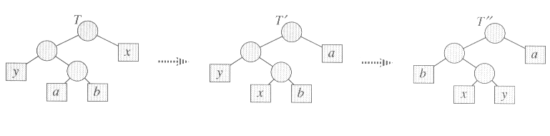
Proof.

Slide 26
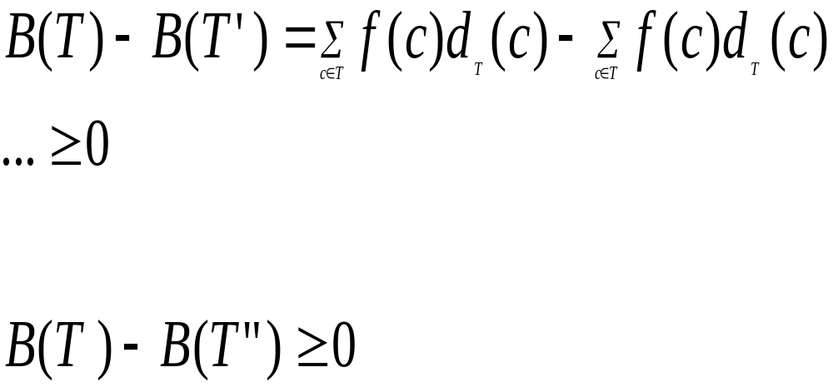

Slide 27
Lemma 16.3
Let C be a given alphabet with frequency f[c] defined for each character c ∈ C. Let x and y be two characters in C with minimum frequency. Let C’ be the alphabet C with characters x, y removed and character z added, so that C’ = C - {x, y}∪{z}; define f for C' as for C, except that f[z] = f[x] + f[y].

Slide 28
Lemma 16.3 (cont)
Let T' be any tree representing an optimal prefix code for the alphabet C'. Then the tree T, obtained from T' by replacing the leaf node for z with an internal node having x and y as children, represents an optimal prefix code for the alphabet C.
Proof
  B(T) = B(T') + f[x] + f[y]

Slide 29
Theorem 16.4
Procedure HUFFMAN produces an optimal prefix code.

