Slide 1
24.Single-Source Shortest Paths

Slide 2
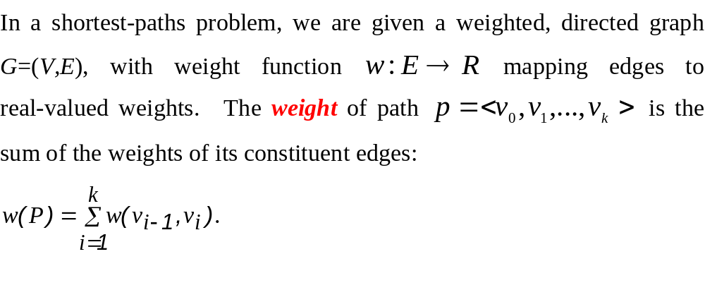

Slide 3
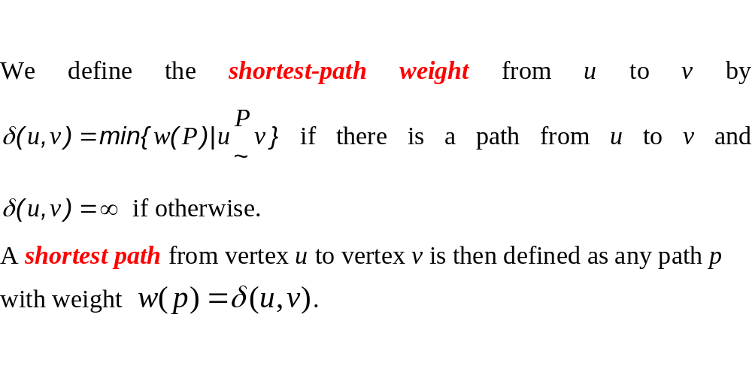

Slide 4
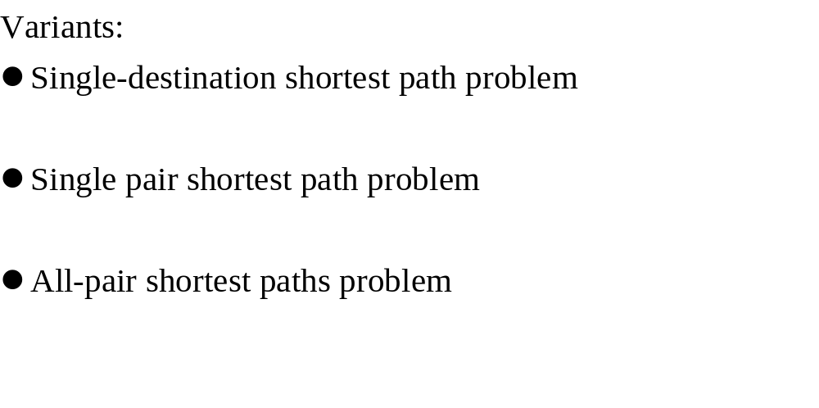

Slide 5
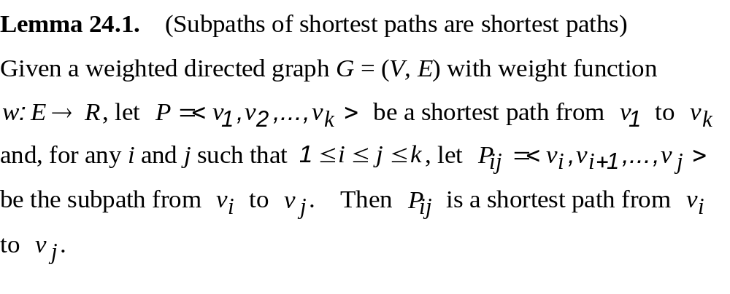
Optimal substructure of a shortest path

Slide 6
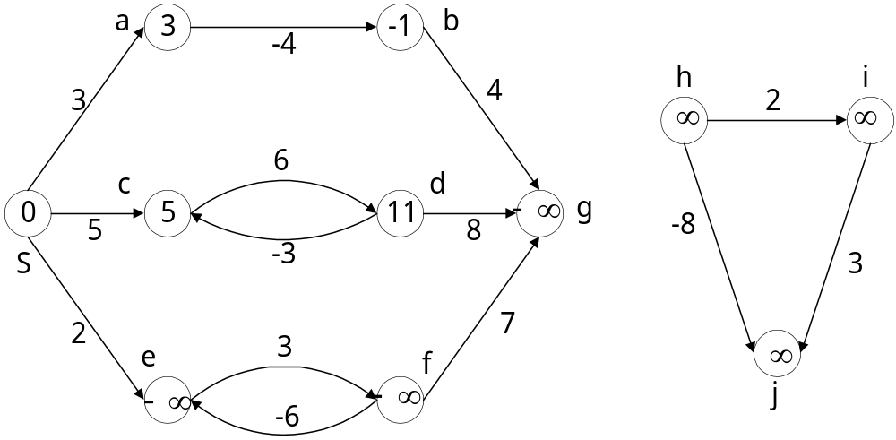
Negative-weight edge

Slide 7
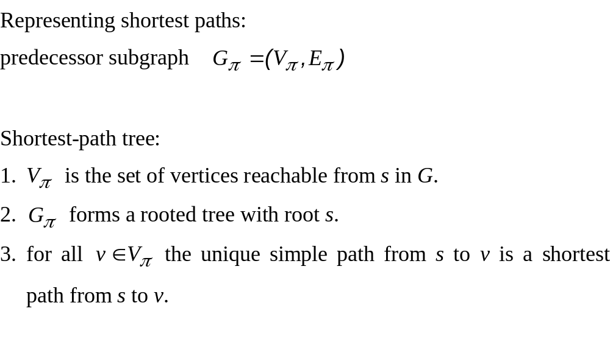

Slide 8
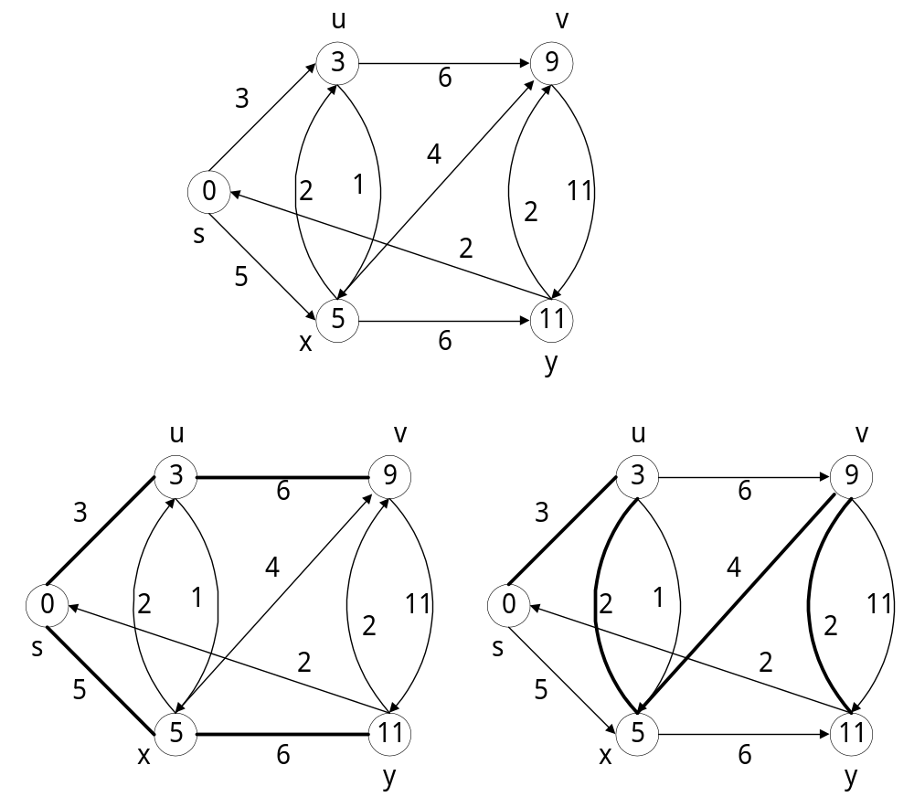
Shortest path tree is not unique

Slide 9
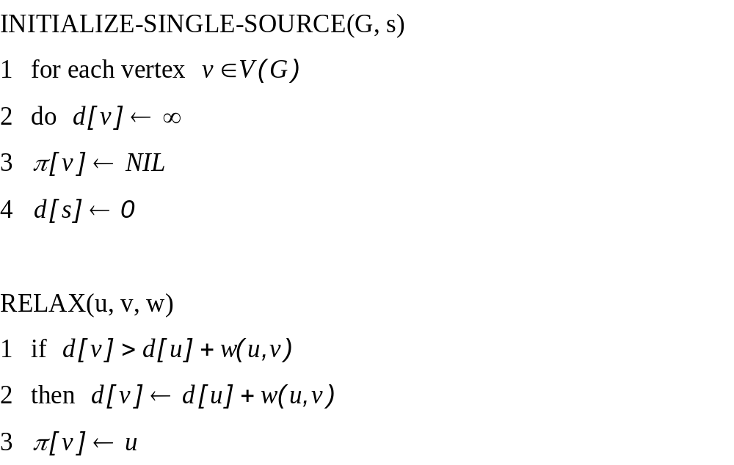
Relaxation

Slide 10
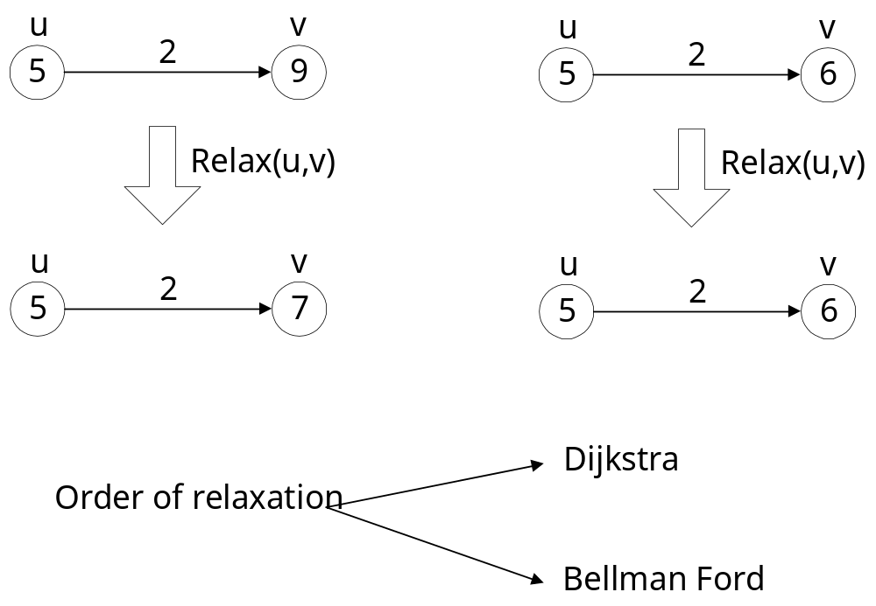

Slide 11
Properties of relaxation
Triangle inequality (Lemma 24.10)
  For any edge (u, v) ∈E, we have δ(s, v) ≤ δ(s, u) + ω(u, v)
Upper-bound property (Lemma24.11)
  We always have d[v] ≥ δ(s, v) for all vertices v ∈V, and once d[v] achieves the value δ(s, v), it never changes.
No-path property (Corollary 24.12)
  If there is no path from s to v, then we always have d[v] = δ(s, v) = ∞.
Convergence property (Lemma 24.14)
  If s ~> u → v is a shortest path in G for some u, v ∈ V, and if d[u] = δ(s, u) at any time prior to relaxing edge(u, v), then d[v] = δ(s, v) at all times afterward.

Slide 12
Properties of relaxation (cont)
Path-relaxation property (Lemma 24.15)
  If p = ⟨v₀, v₁, …, v_{k}⟩ is a shortest path from s = v₀ to v_{k}, and the edges of p are relaxed in the order (v₀, v₁), (v₁, v₂), …, (v_{k-1}, v_{k}), then d[v_{k}] = δ(s, v_{k}). This property holds regardless of any other relaxation steps that occur, even if they are intermixed with relaxations of the edges of p.
Predecessor-subgraph property (Lemma 24.17)
  once d[v] = δ(s, v) for all v ∈ V, the predecessor subgraph is a shortest-paths tree rooted at s.

Slide 13
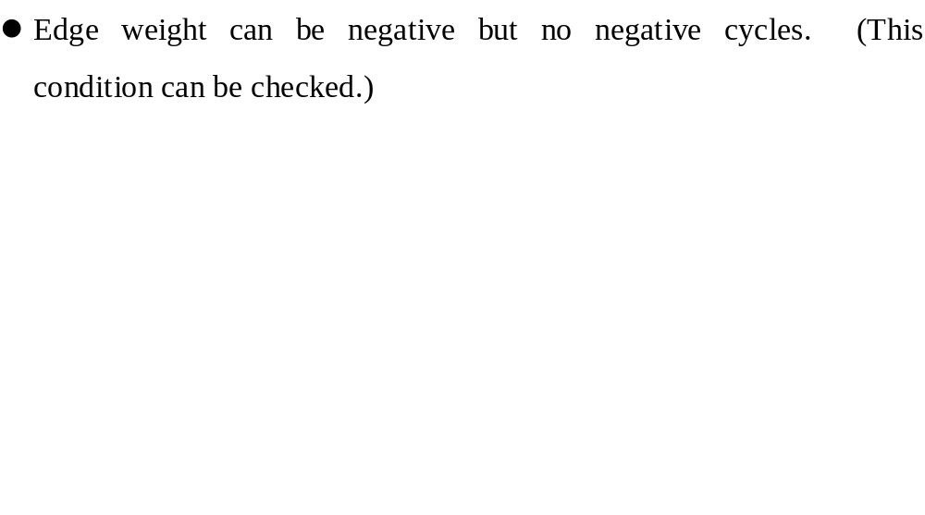
24.1 The Bellman-Ford Algorithm

Slide 14
BELLMAN-FORD(G, w, s)
1 INITIALIZE-SINGLE-SOURCE(G, s)
2 for i ← 1 to |V(G)| - 1
3 do for each edge (u, v) ∈ E[G]
4 do RELAX(u, v, w)
5 for each edge (u, v) ∈ E[G]
6 do if d[v] > d[u] + w(u, v)
7 then return FALSE
8 return TURE
Complexity: O (VE )

Slide 15
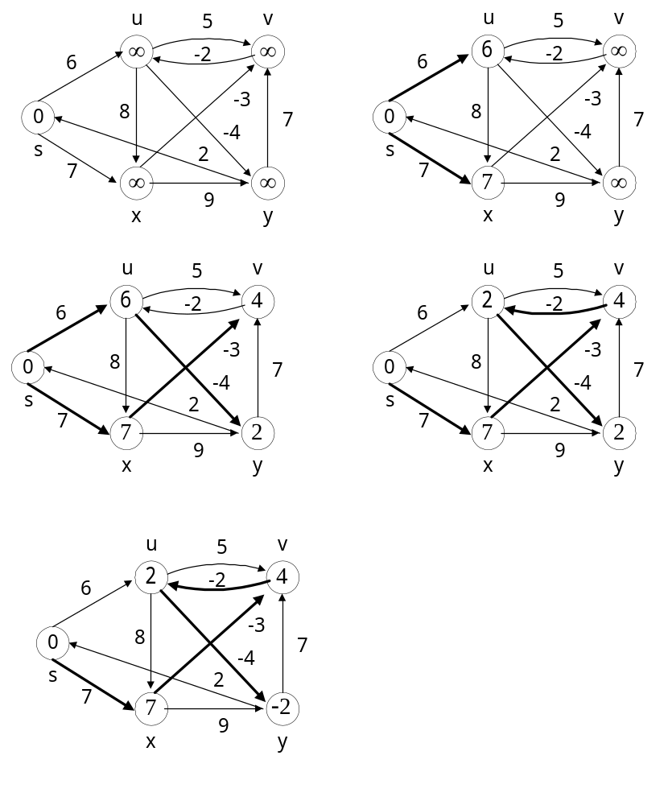

Slide 16
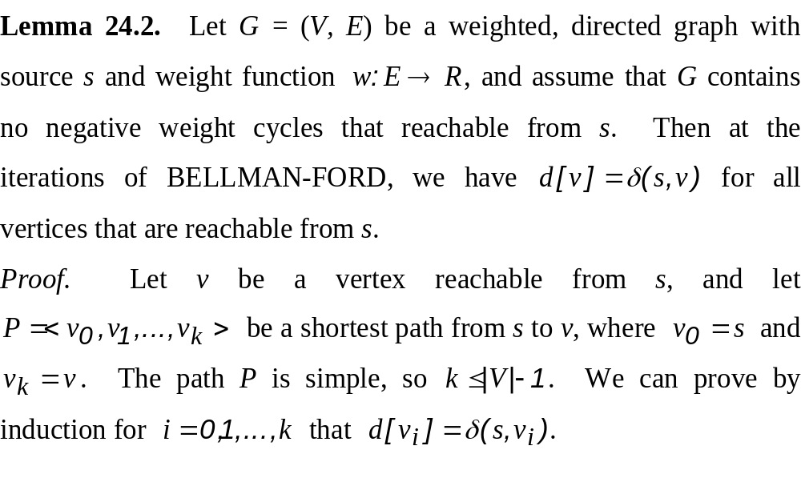

Slide 17
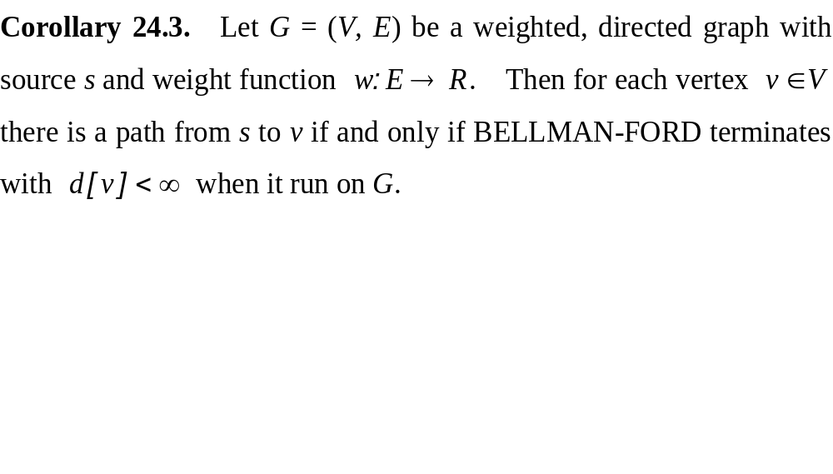

Slide 18
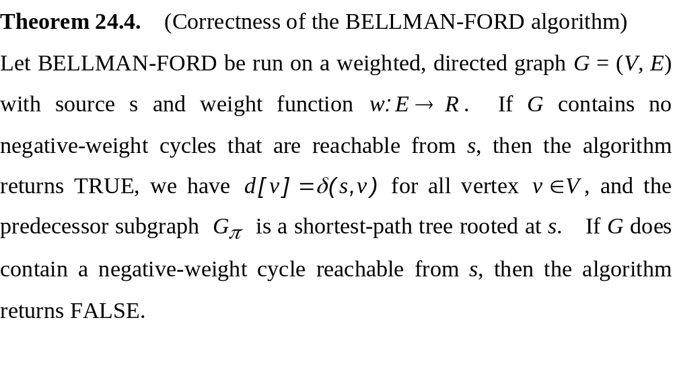

Slide 19
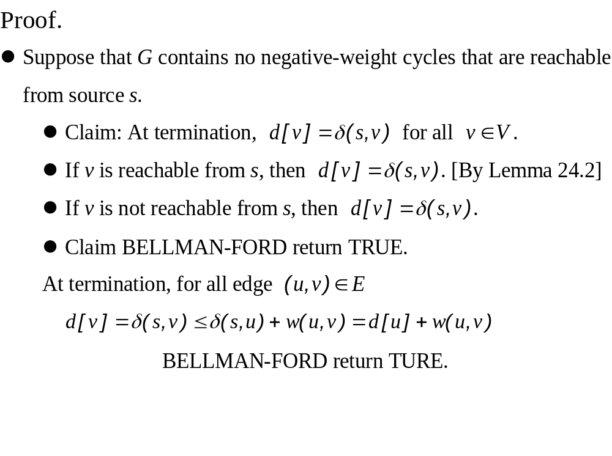

Slide 20
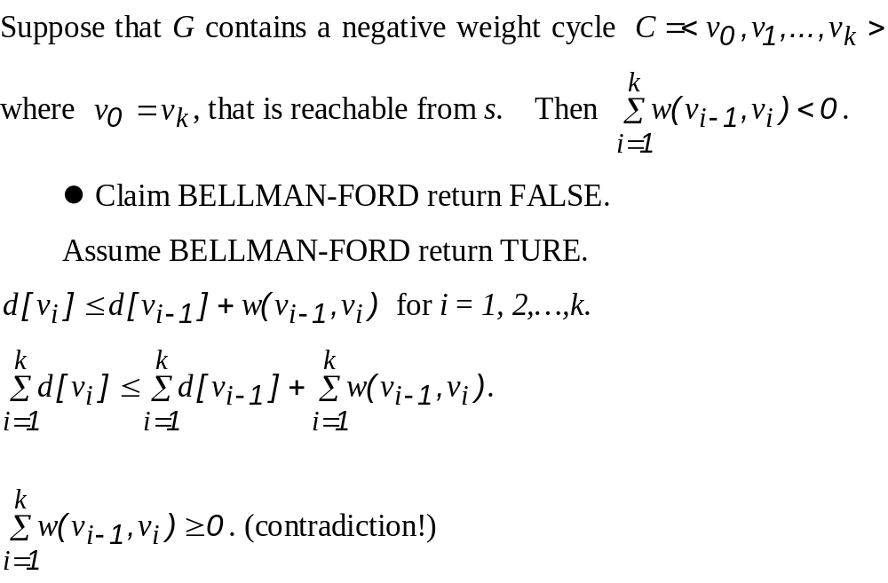

Slide 21
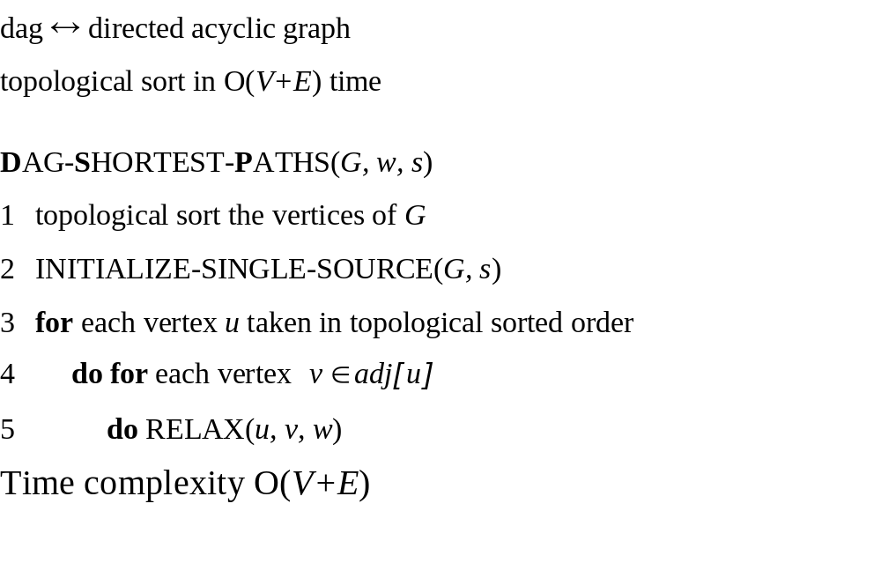
24.2 Single-source shortest paths in directed acyclic graphs

Slide 22
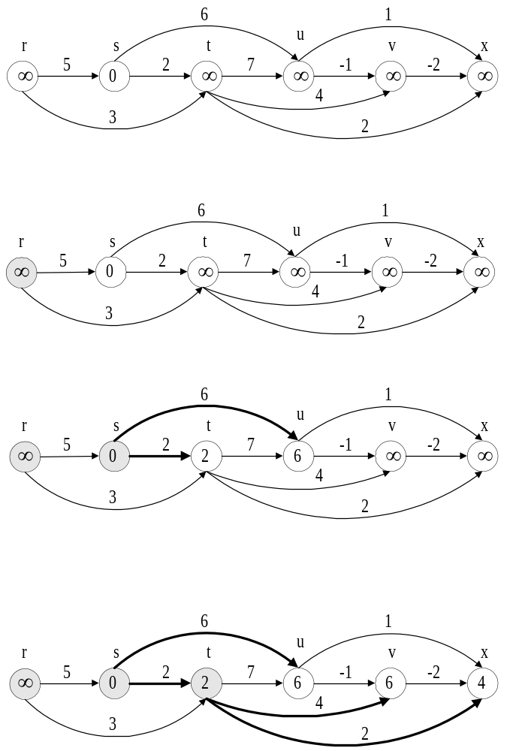
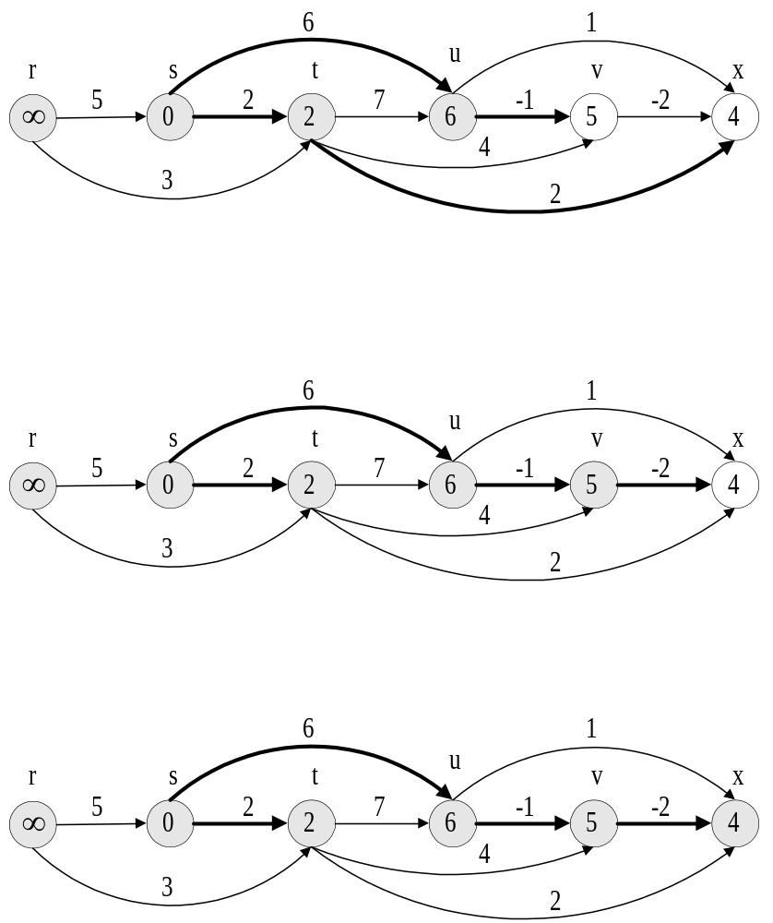

Slide 23
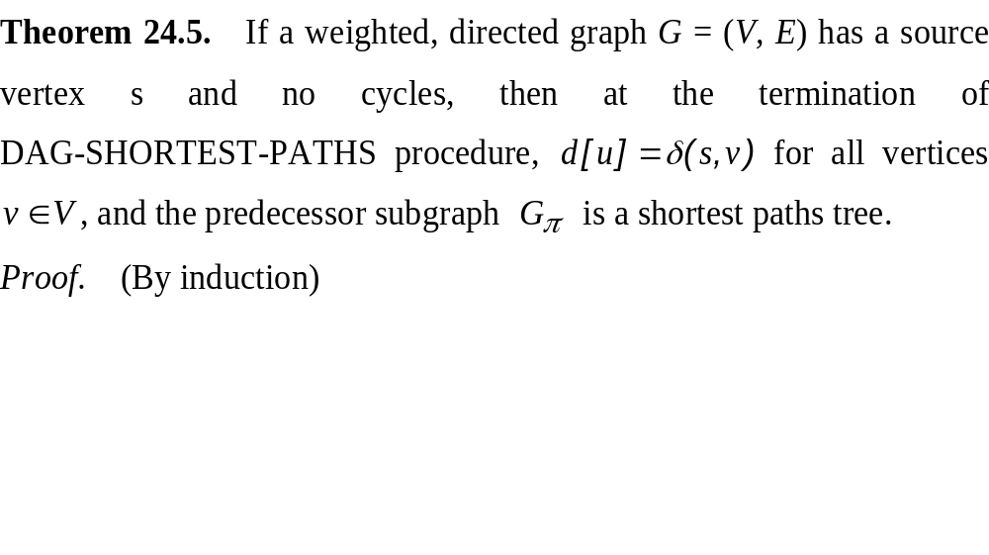

Slide 24
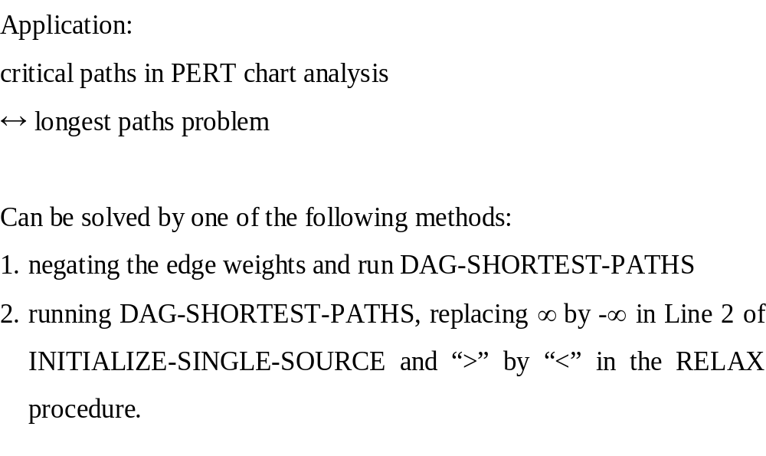

Slide 25
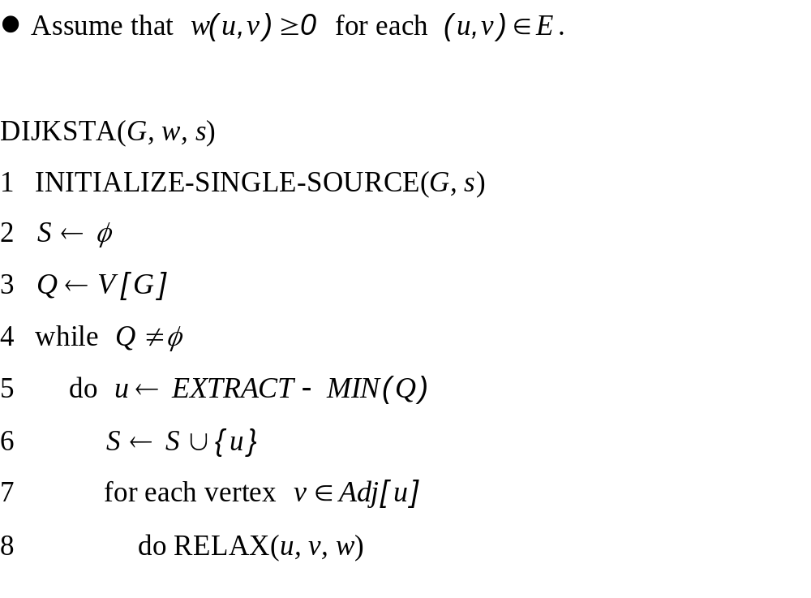
24.3 Dijkstra’s algorithm

Slide 26
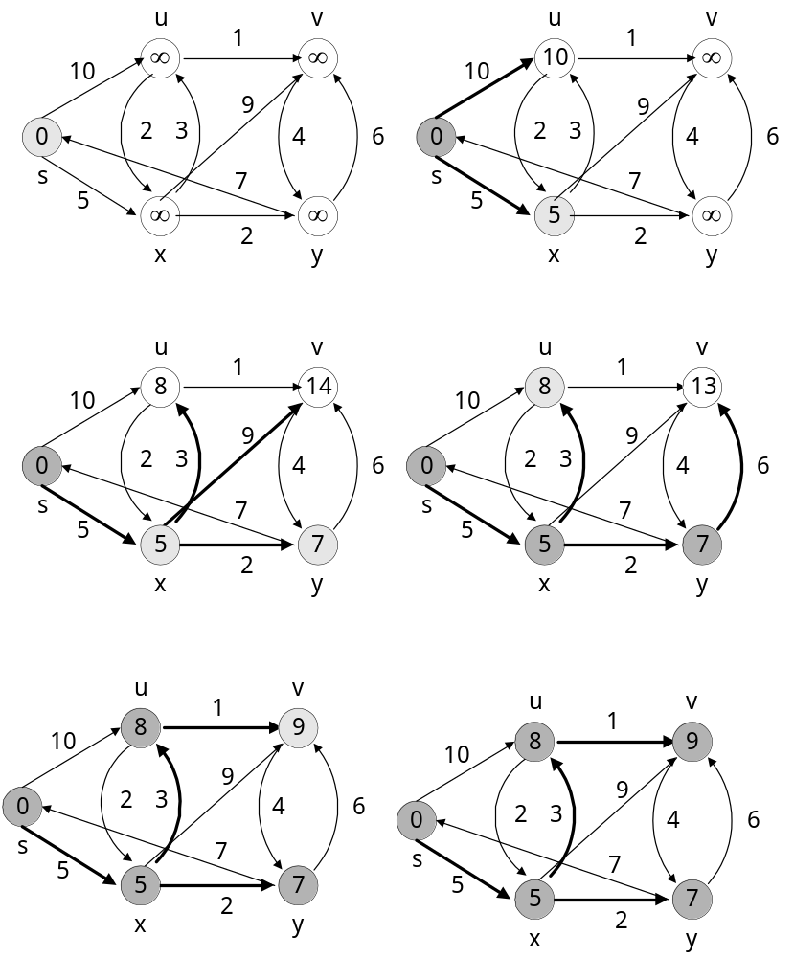

Slide 27
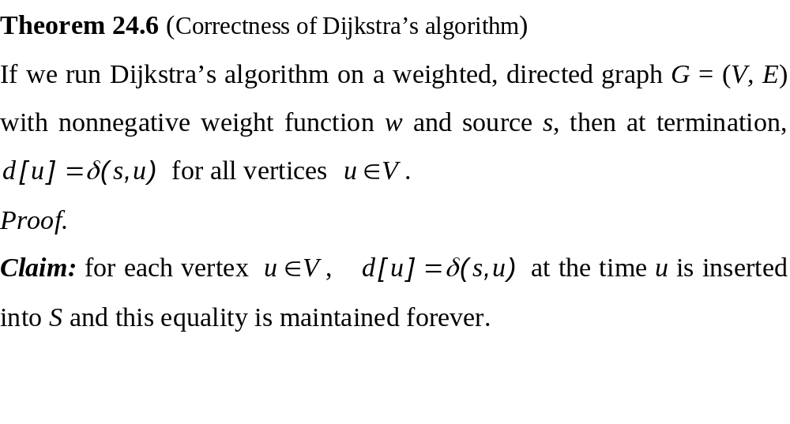
continue…

Slide 28
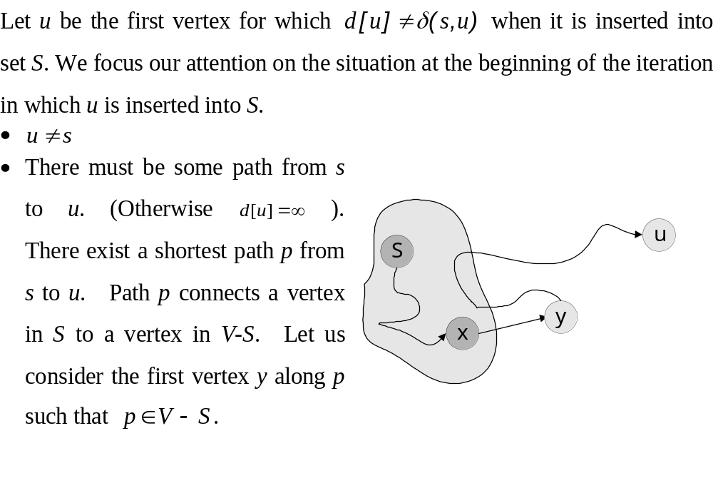

Slide 29
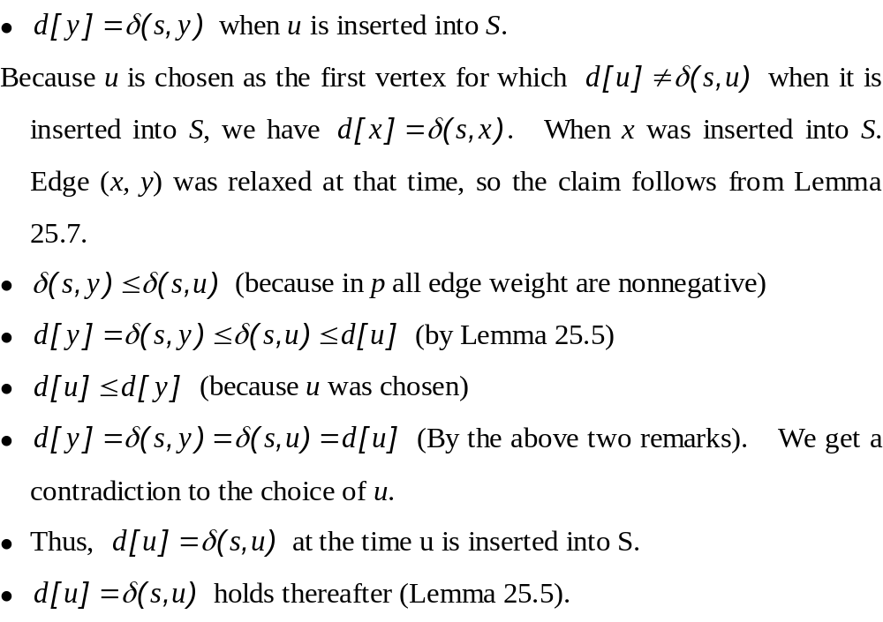

Slide 30
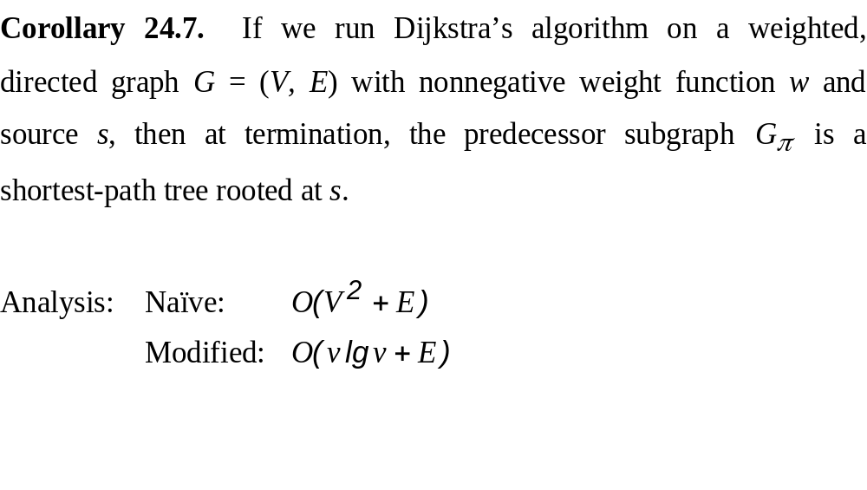

Slide 31
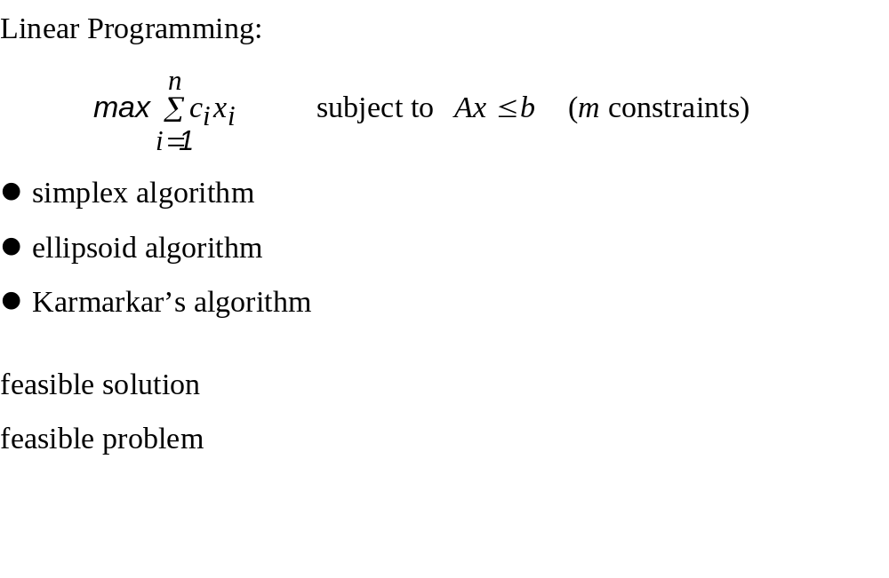
24.4 Difference constraints and shortest paths

Slide 32
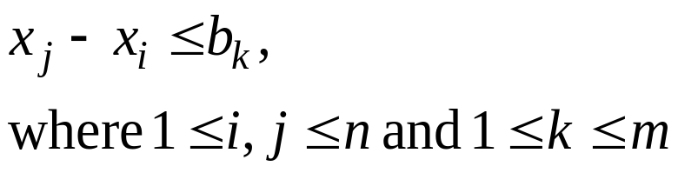
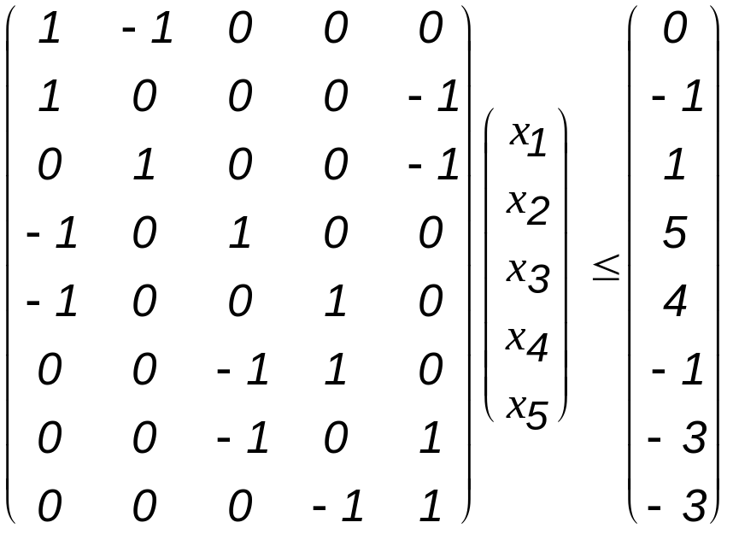
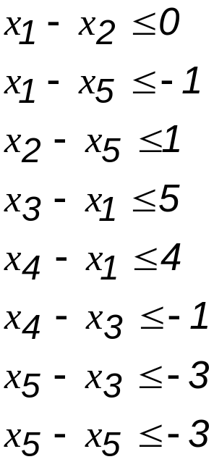
Systems of difference constraints

Slide 33
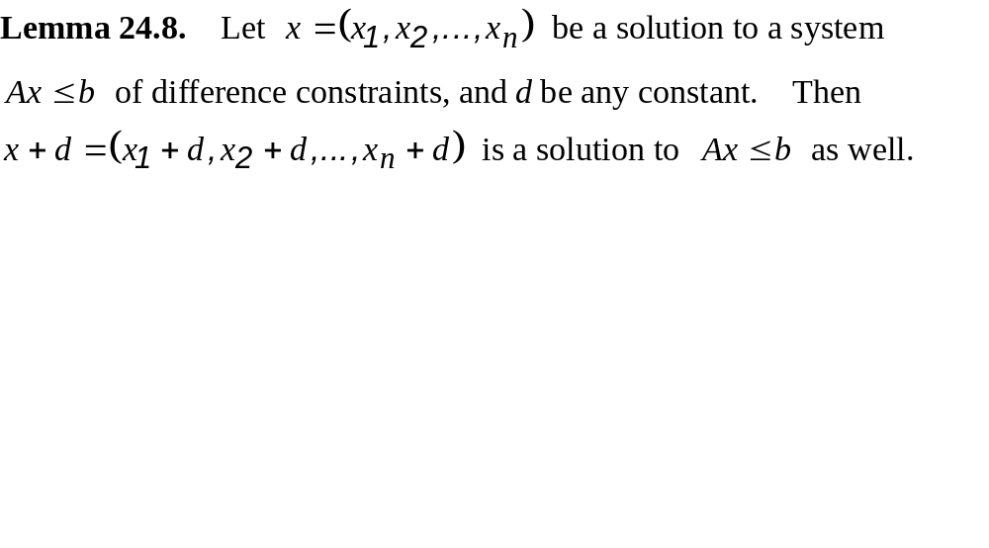
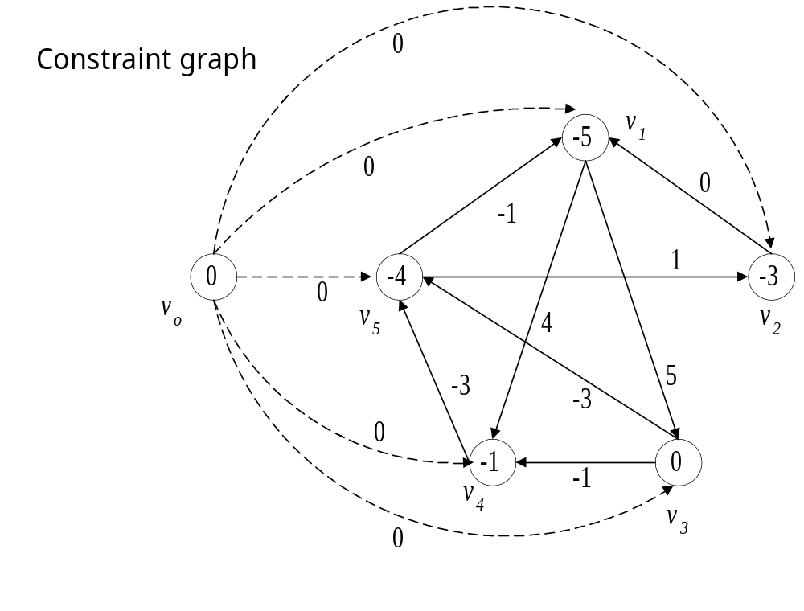

Slide 34
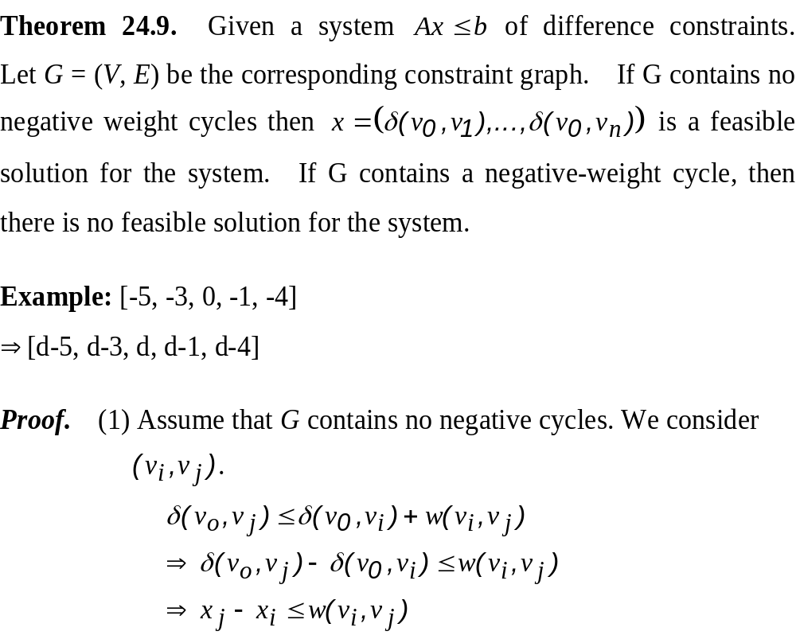

Slide 35
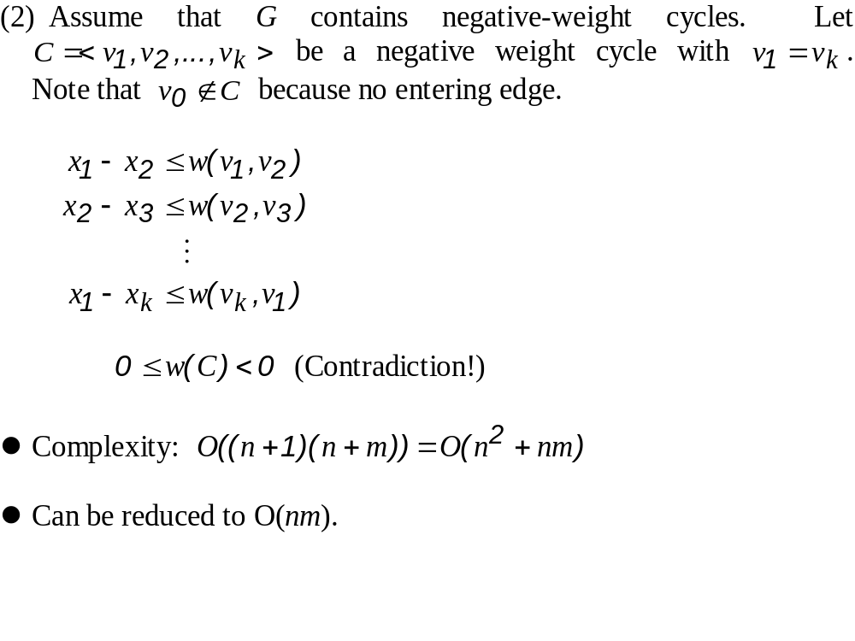

Slide 36
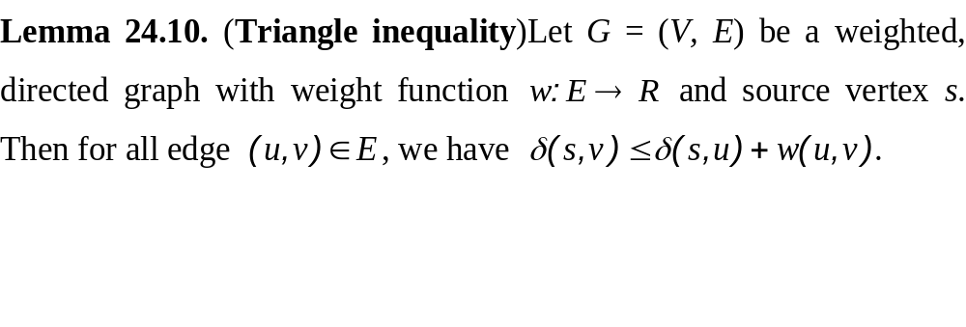
24.5 Proofs of shortest-paths properties

Slide 37
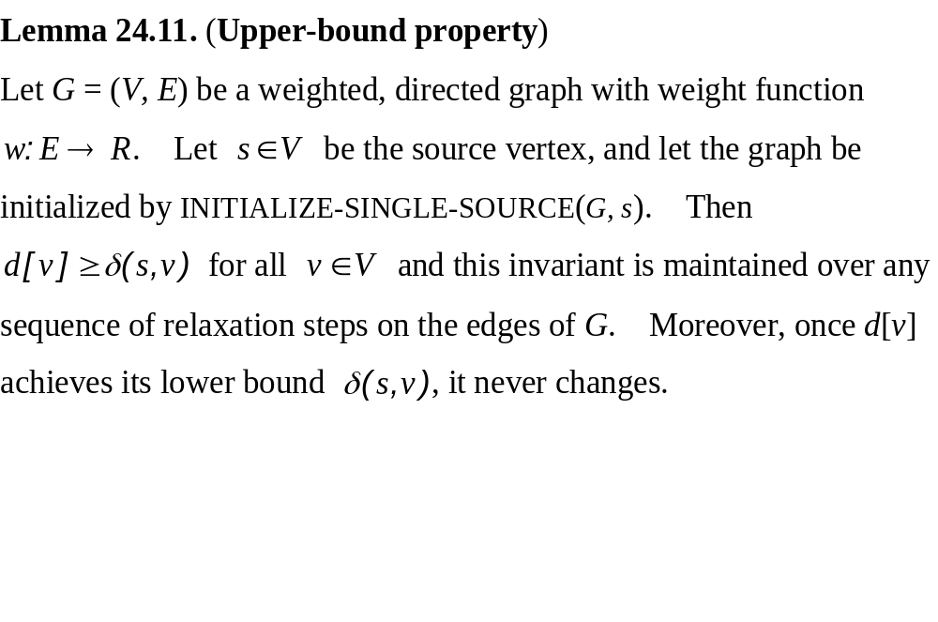
Effects of relaxation on shortest-path estimates

Slide 38
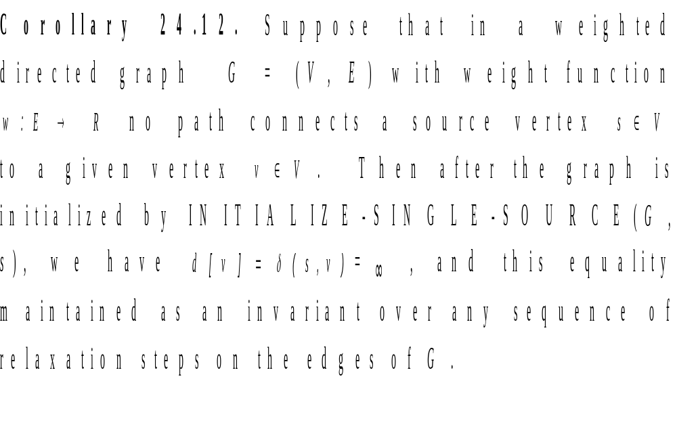
No-path property

Slide 39
Lemma 24.13. Let G = (V, E) be weighted, directed graph with weight function w : E → R, and let (u, v) ∈ E. Then, immediately after relaxing edge (u, v) by executing RELAX(u, v, w), we have d[v] ≤ d[u] + w(u, v).

Slide 40
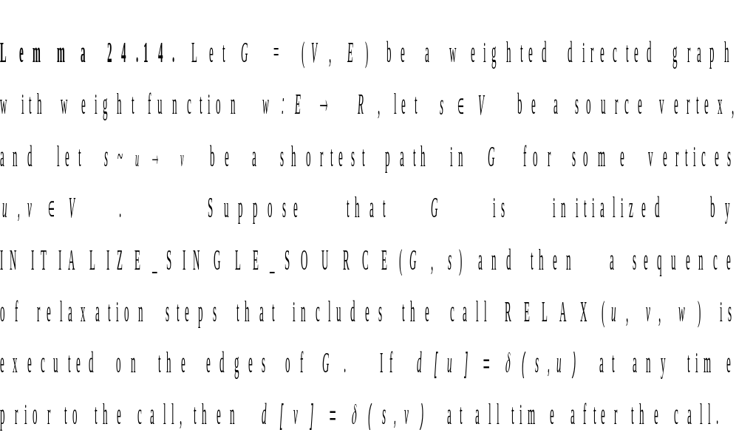
Convergence property

Slide 41
Path-relaxation property
Lemma 24.15. Let G = (V, E) be a weighted, directed graph with weighted function w: E → R, and s ∈ V be a source vertex. Consider any shortest path p = ⟨v₀, v₁, …, v_{k}⟩ from s = v₀ to v_{k}. If G is initialized by INITIALIZE-SINGLE-SOURCE(G, s) and then a sequence of relaxation steps occurs that includes, in order, relaxations of edges (v₀, v₁), (v₁, v₂), …, (v_{k-1}, v_{k}), then d[v_{k}] = δ(s, v_{k}) after these relaxations and at all times afterward. This property holds no matter what other edge relaxations occur, including relaxations that are intermixed with relaxations of the edges of p.

Slide 42
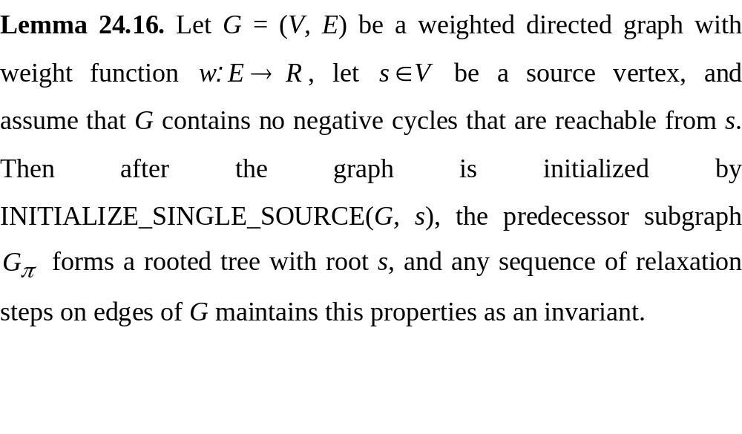
Relaxation and shortest-paths trees

Slide 43
Predecessor-subgraph property
Lemma 24.17. Let G = (V, E) be a weighted, directed graph with weight function w: E → R, let s ∈ V be a source vertex, and assume that G contains no negative-weight cycles that are reachable from s. Let us call INITIALIZE-SINGLE-SOURCE(G,s) and then execute any sequence of relaxation steps on edges of G that produces d[v_{i}] =δ(s, v) for all v ∈ V. Then the predecessor subgraph G_{π}is a shortest-paths tree rooted at s.

