Slide 1
4.Recurrences

Slide 2

Recurrences --
Substitution method
Recursion-tree method
Master method

Slide 3
Technicalities
We neglect certain technical details when we state and solve recurrences. A good example of a detail that is often glossed over is the assumption of integer arguments to functions. Boundary conditions is ignored. Omit floors, ceilings.

Slide 4
4.1 The substitution method
: Mathematical induction
The substitution method for solving recurrence entails two steps:
  1. Guess the form of the solution.
  2. Use mathematical induction to find the constants and show that the solution works.

Slide 5
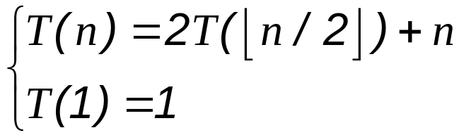


Example
(We may omit the initial condition later.)
Guess
Assume

Slide 6
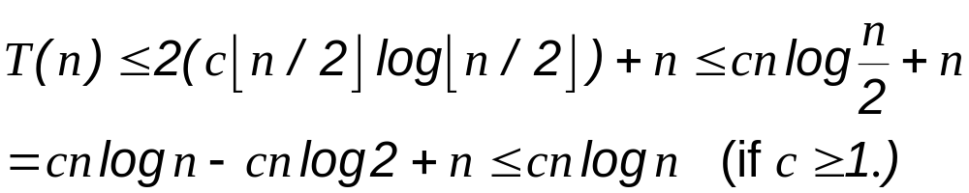


Initial condition
However,

Slide 7


Making a good guess
We guess
Making guess provides loose upper bound and lower bound. Then improve the gap.

Slide 8



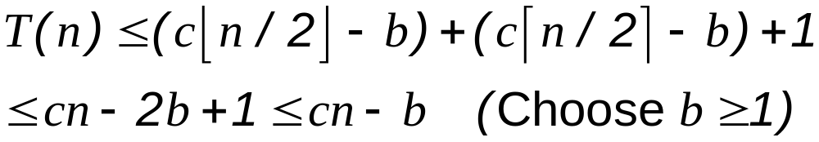
Subtleties
Guess
Assume
However, assume

Slide 9
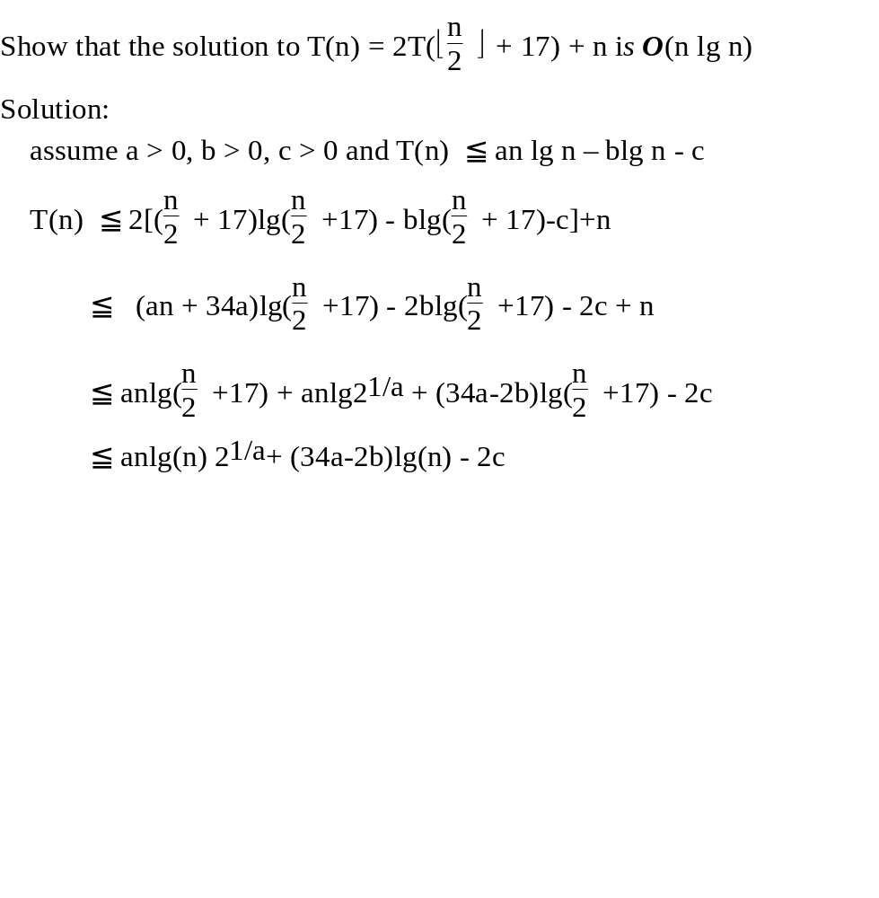

Slide 10
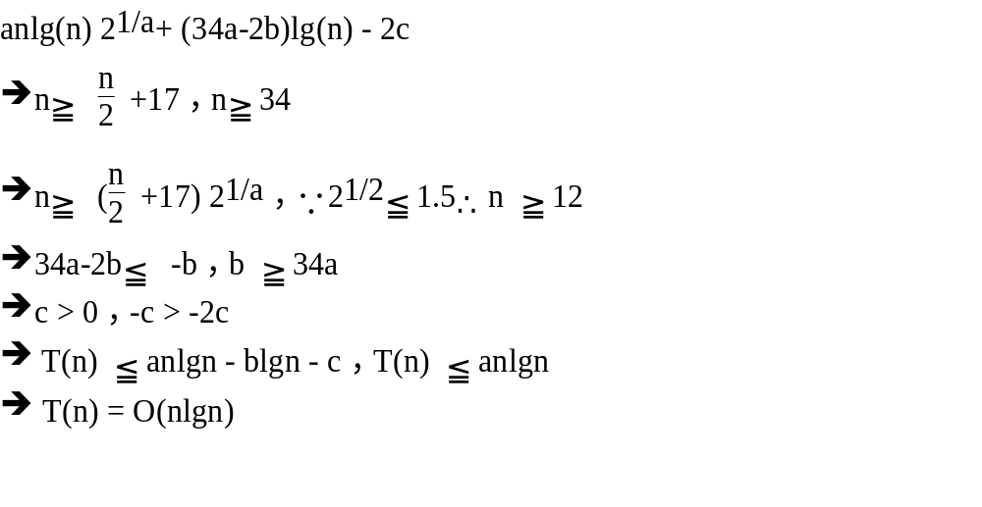

Slide 11

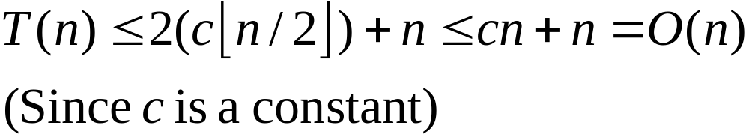
Avoiding pitfalls
Assume
Hence
(WRONG!) You cannot find such a c.

Slide 12
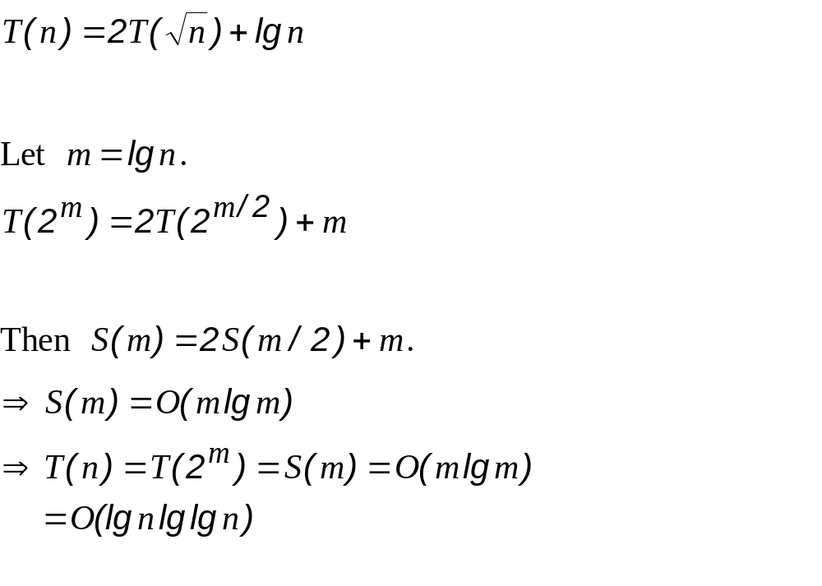
Changing variables

Slide 13
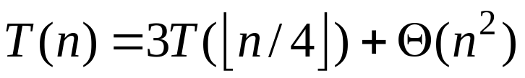
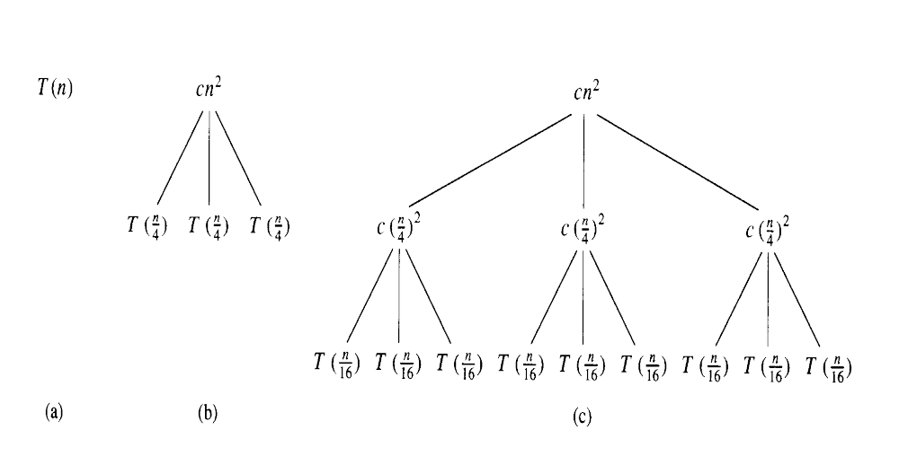
4.2 the Recursion-tree method

Slide 14
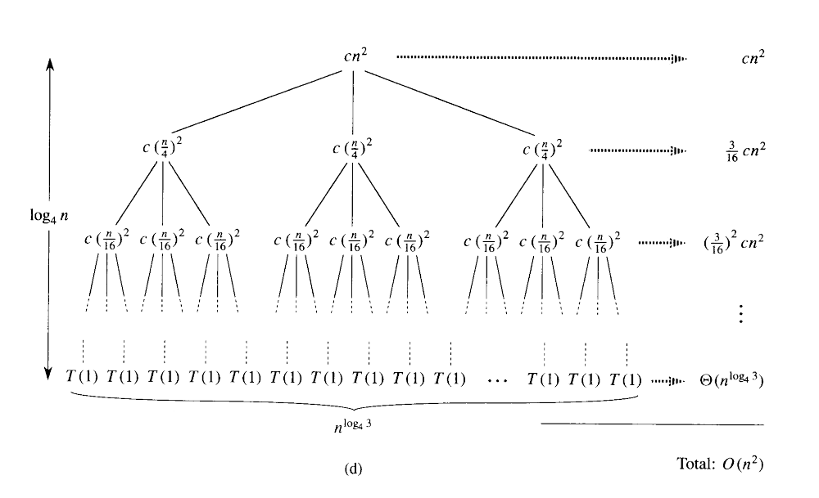

Slide 15
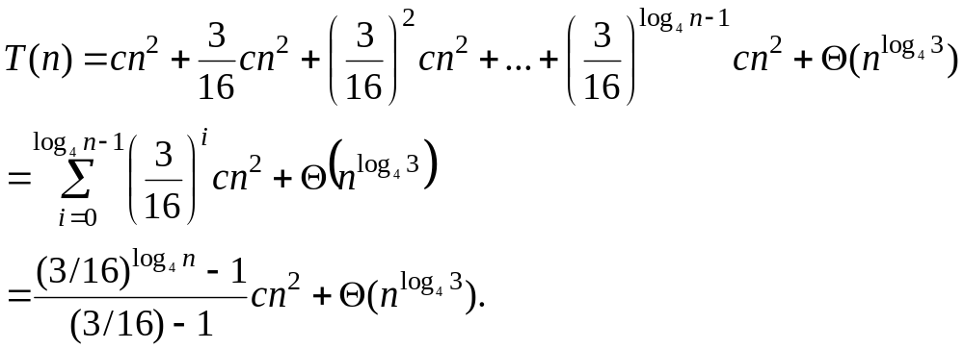
The cost of the entire tree

Slide 16
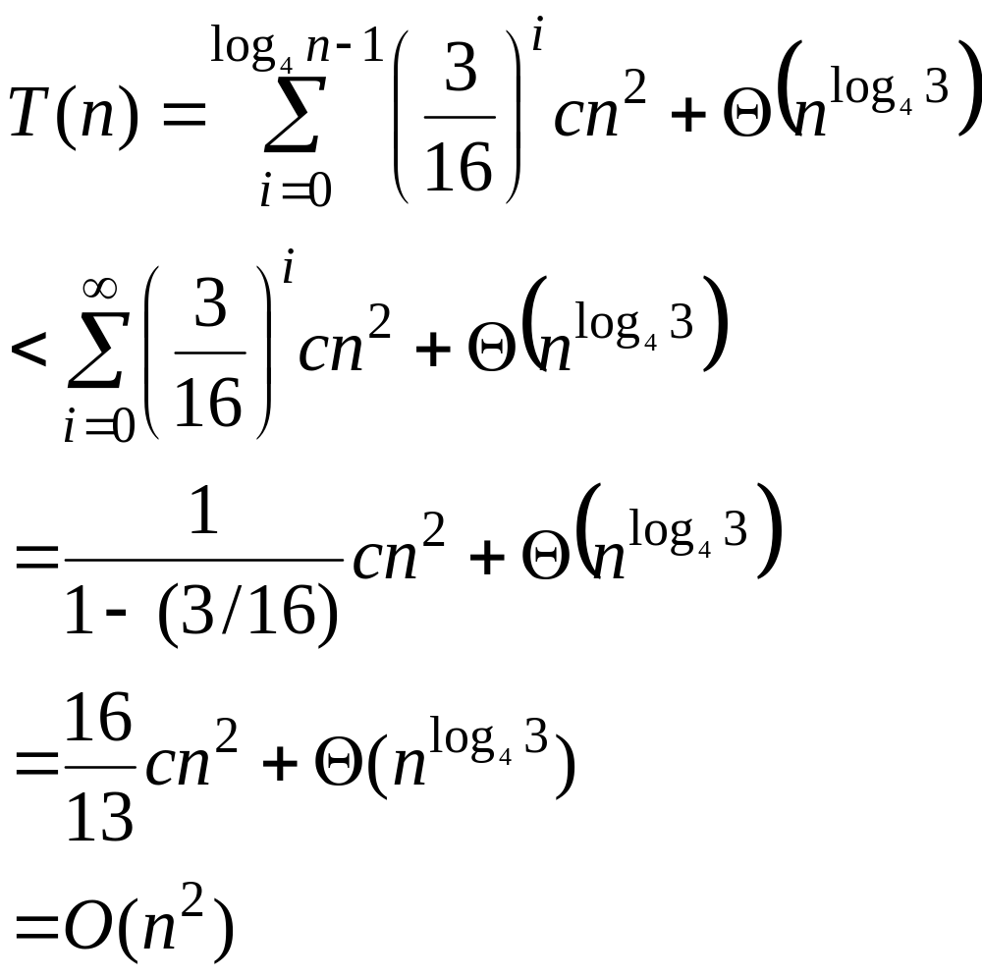

Slide 17
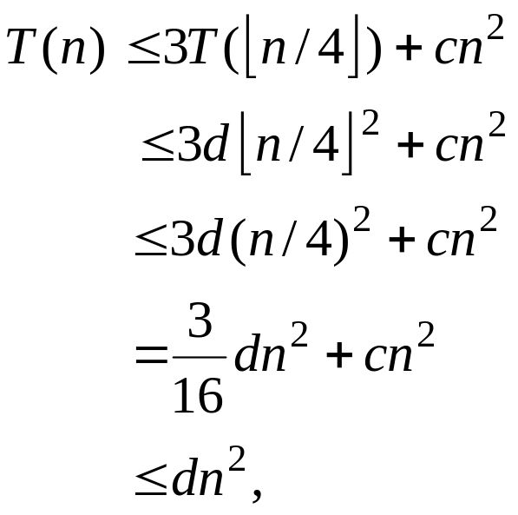
substitution method
  We want to Show that T(n) ≤ dn² for some constant d > 0. using the same constant c > 0 as before, we have
  Where the last step holds as long as d ≥(16/13)c.

Slide 18
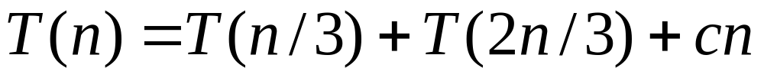
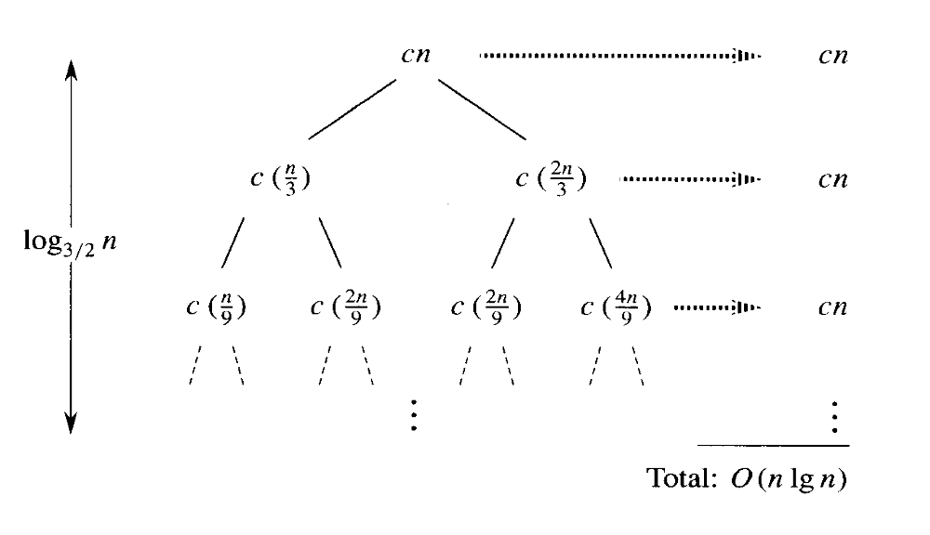

Slide 19
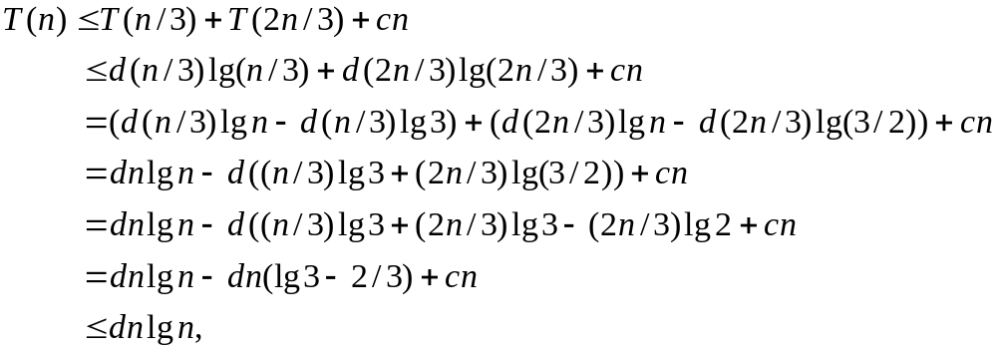
substitution method
As long as d ≥ c/lg3 – (2/3)).

Slide 20
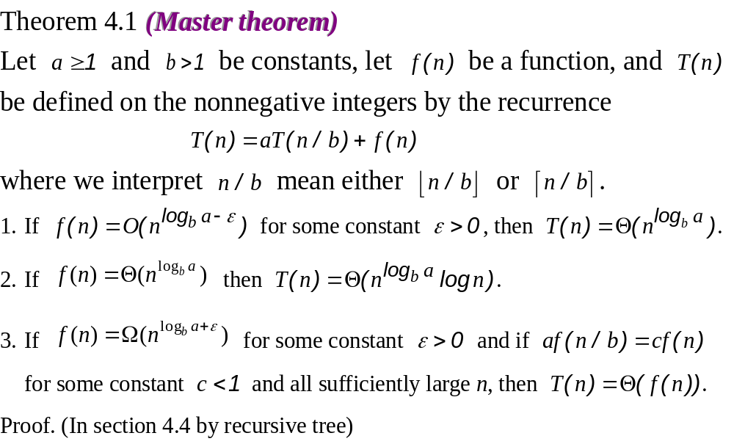
4.3 The master method

Slide 21
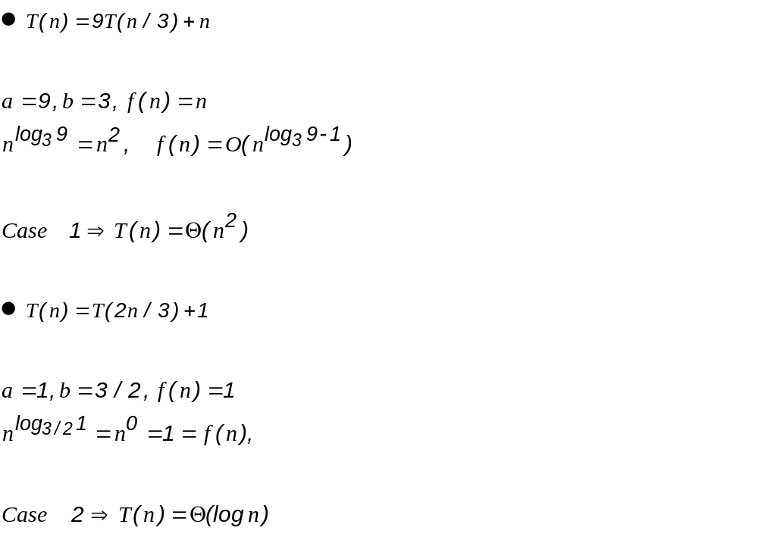

Slide 22
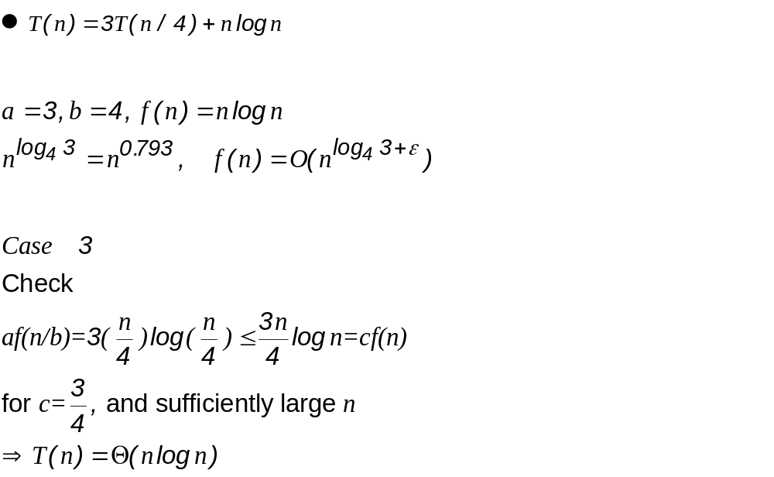

Slide 23
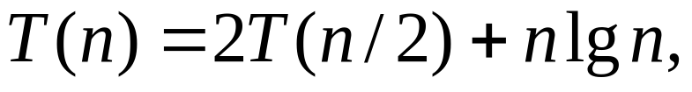
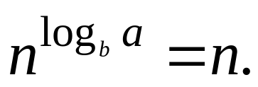
  The master method does not apply to the recurrence
  even though it has the proper form: a = 2, b=2, f(n)= n lgn, and It might seem that case 3 should apply, since f(n)= n lgn is asymptotically larger than
  The problem is that it is not polynomially larger.

