Slide 1
7.Quicksort

Slide 2
7.1 Description of quicksort
Divide
Conquer
Combine

Slide 3
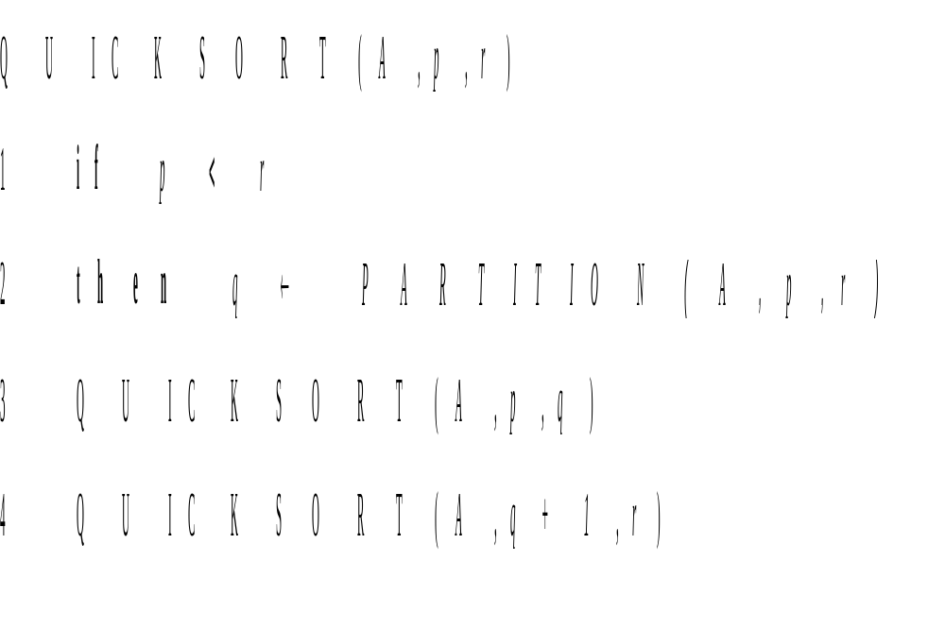

Slide 4
Partition(A, p, r)
1 x ← A[r]
2 i ← p – 1
3 for j ← p to r -1
4 do if A[j] ≤ x
5 then i ← i + 1
6 exchange A[i] ↔ A[j]
7 exchange A[i +1] ↔ A[r]
8 return i +1

Slide 5
At the beginning of each iteration of the loop of lines 3-6, for any array index k,
1. if p ≤ k ≤ i, then A[k] ≤ x.
2. if i + 1 ≤ k≤ j -1, then A[k] > x.
3. if k = r, then A[k] = x.

Slide 6
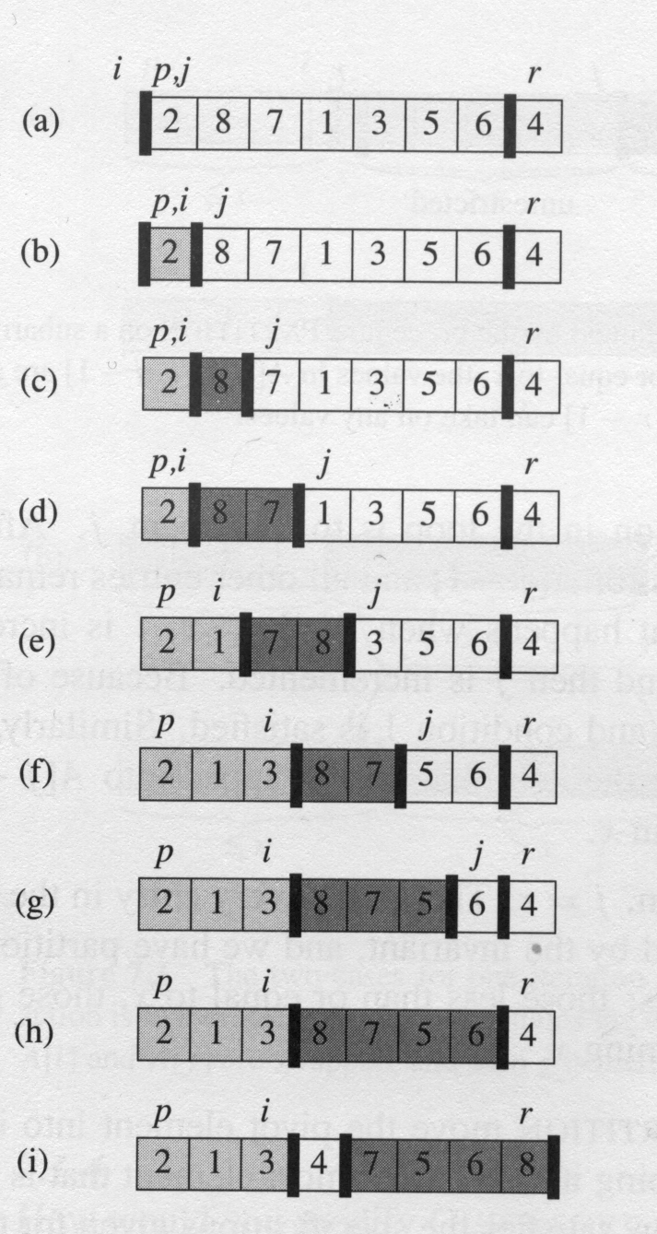
The operation of Partition on a sample array

Slide 7
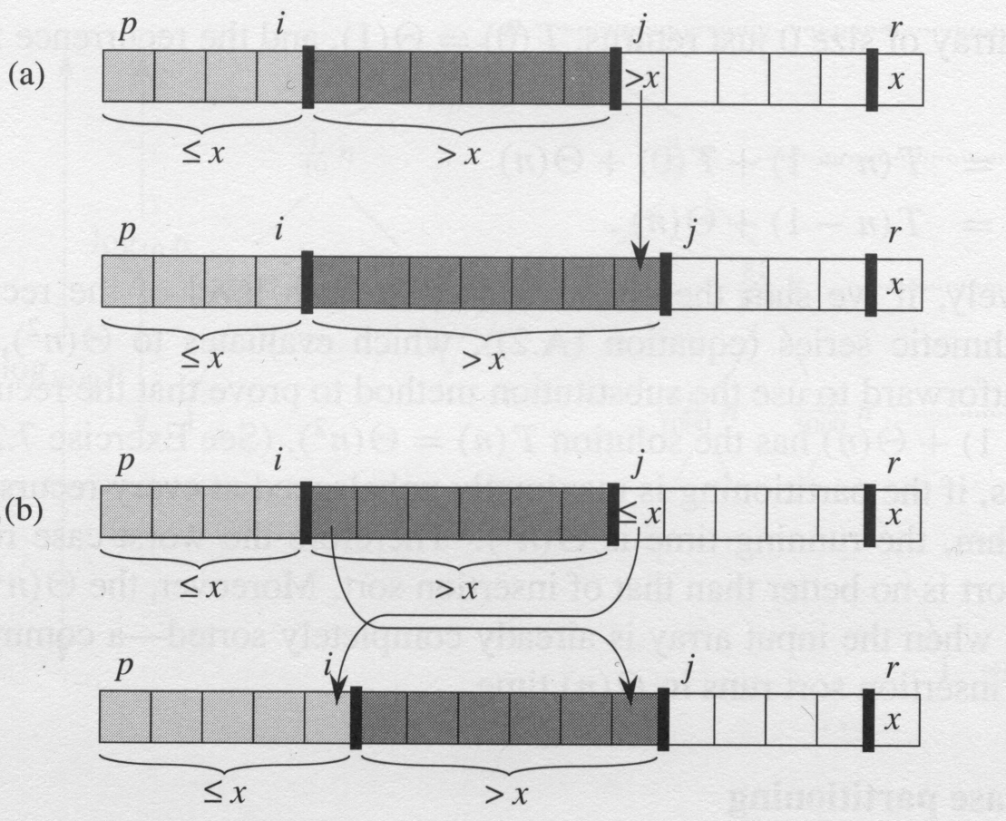
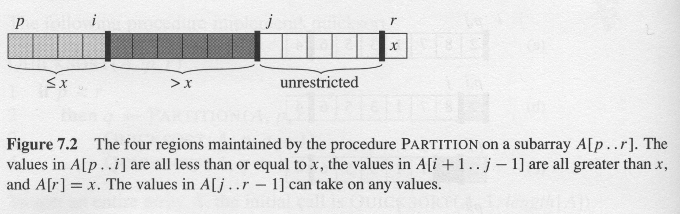
Two cases for one iteration of procedure Partition
Complexity:
Partition on A[p…r] is Θ(n)
where n = r –p +1

Slide 8
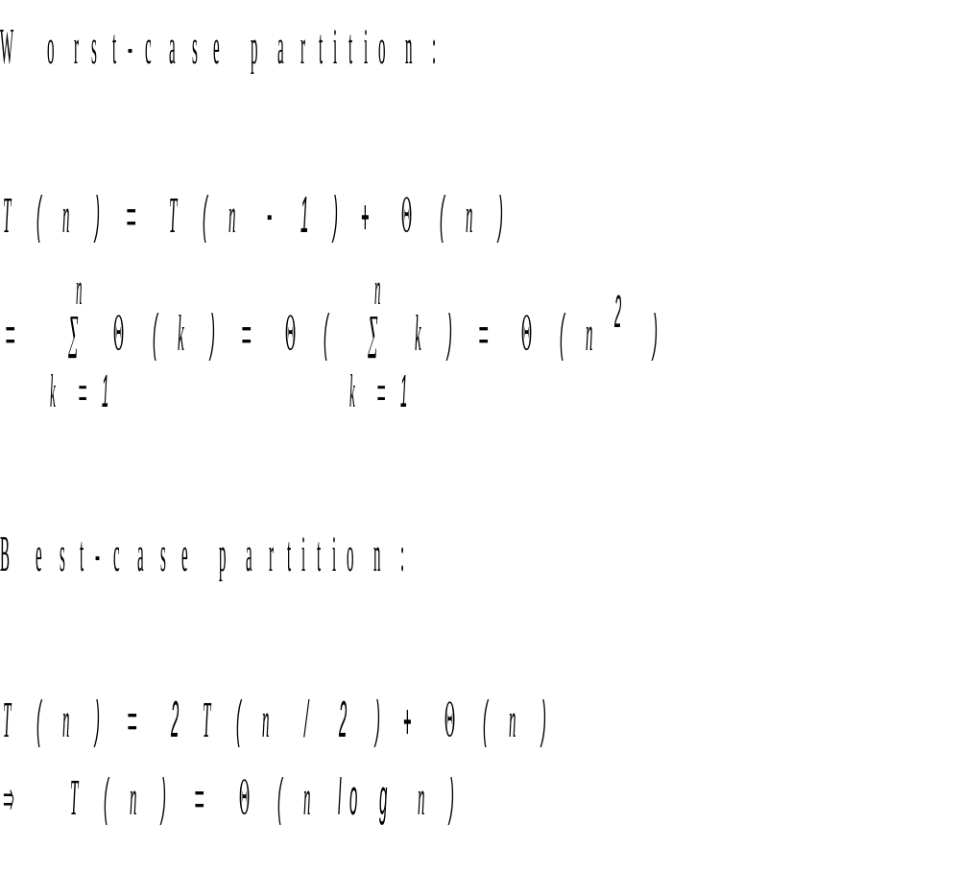
7.2 Performance of quicksort

Slide 9
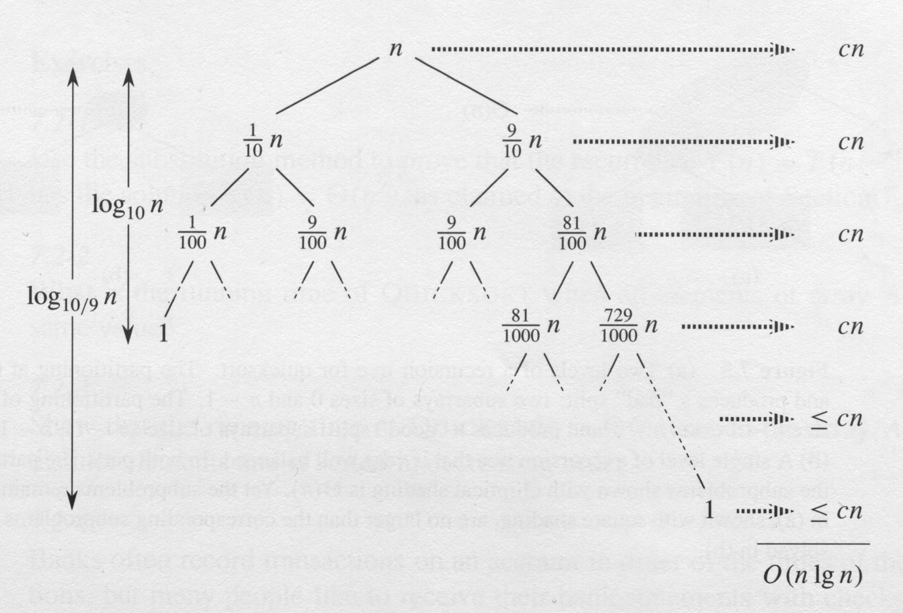
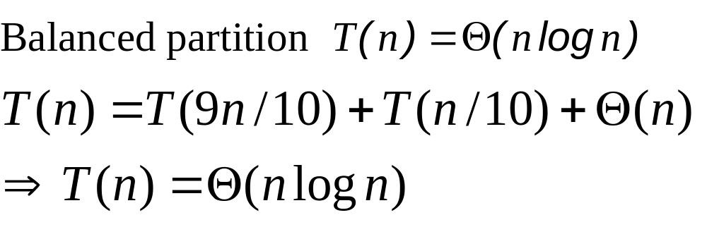

Slide 10
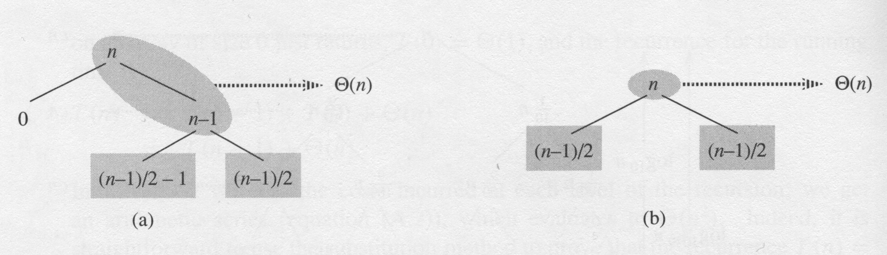
Intuition for the average case T(n) = Θ(n logn)

Slide 11
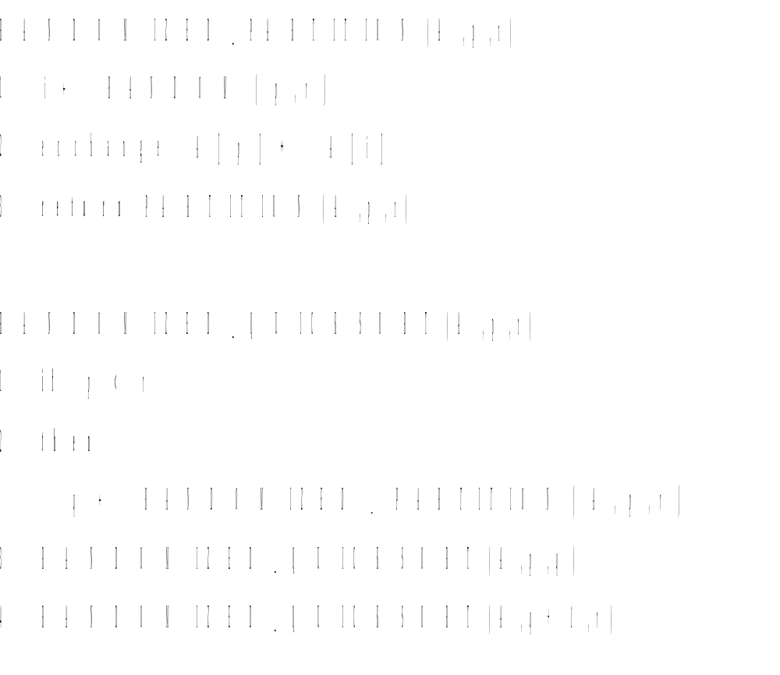
7.3 Randomized versions of partition

Slide 12
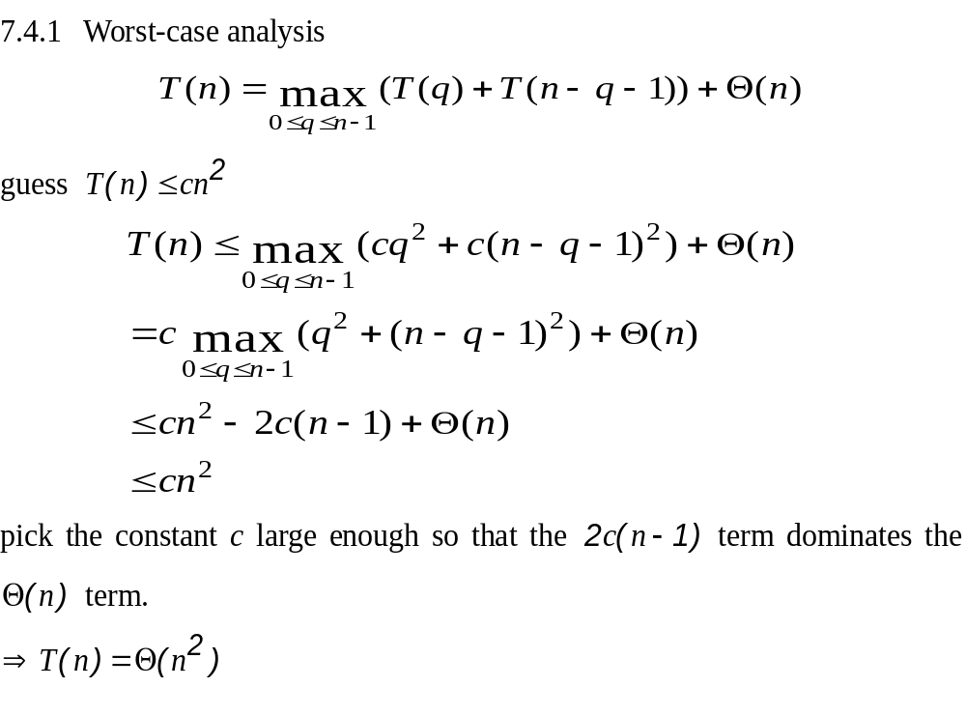
7.4 Analysis of quicksort

Slide 13
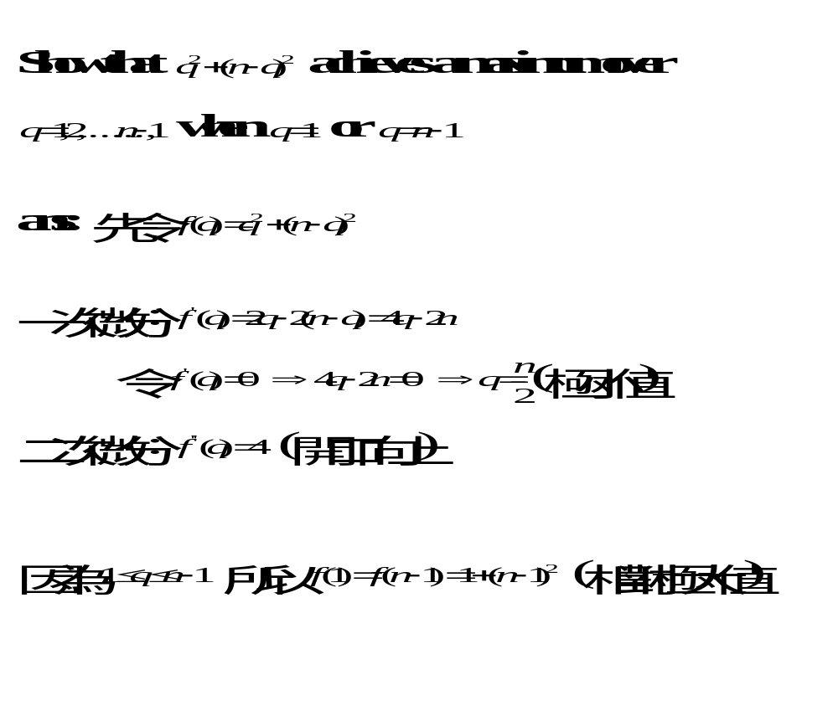
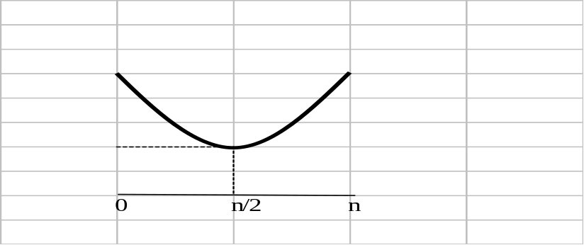
7.4-2

Slide 14
7.4.2 Expected running time
Running time and comparsions
Lemma 7.1
  Let X be the number of comparisons performed in line 4 of partition over the entire execution of Quicksort on an n-element array. Then the running rime of Quicksort is O(n+X)

Slide 15
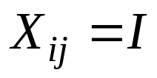
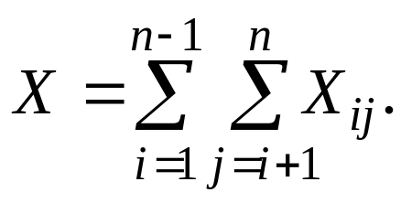
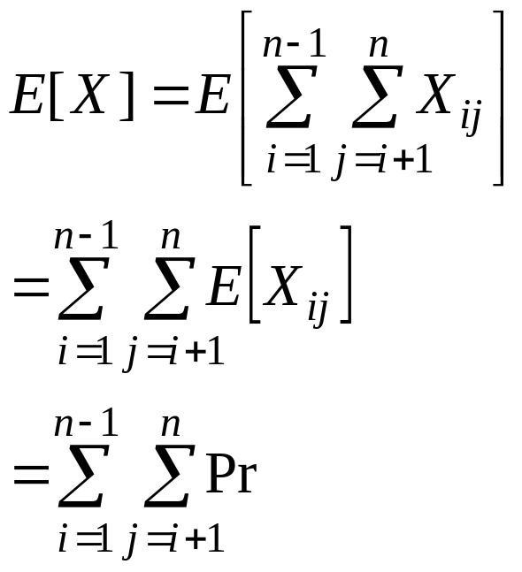
we define
{z_{i} is compared to z_{j}},
{z_{i} is compared to z_{j}}

Slide 16
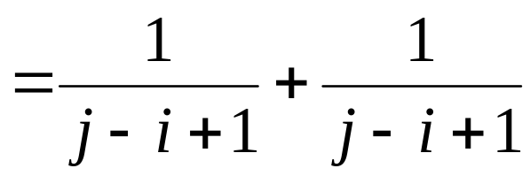
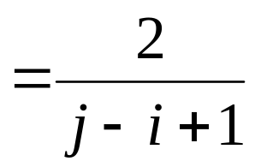
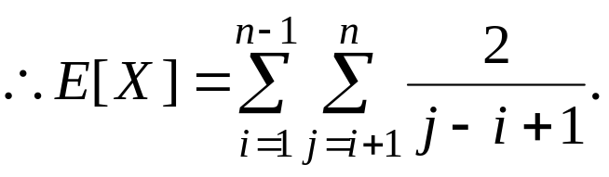
Pr{z_{i} is compared to z_{j}} = Pr{z_{i} or z_{j} is first pivot chosen from Z_{ij}}
= Pr{z_{i} is first pivot chosen from Z_{ij}}
+ Pr{z_{j} is first pivot chosen from Z_{ij}}

Slide 17
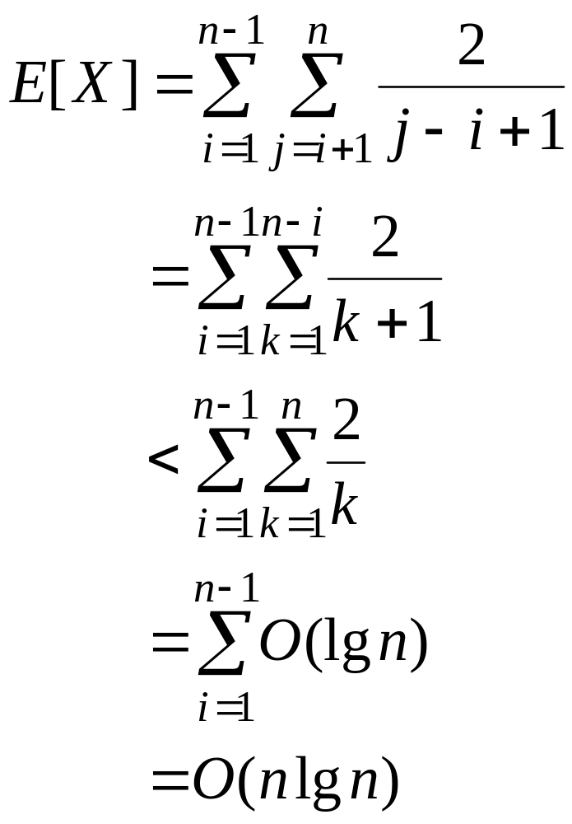

Slide 18
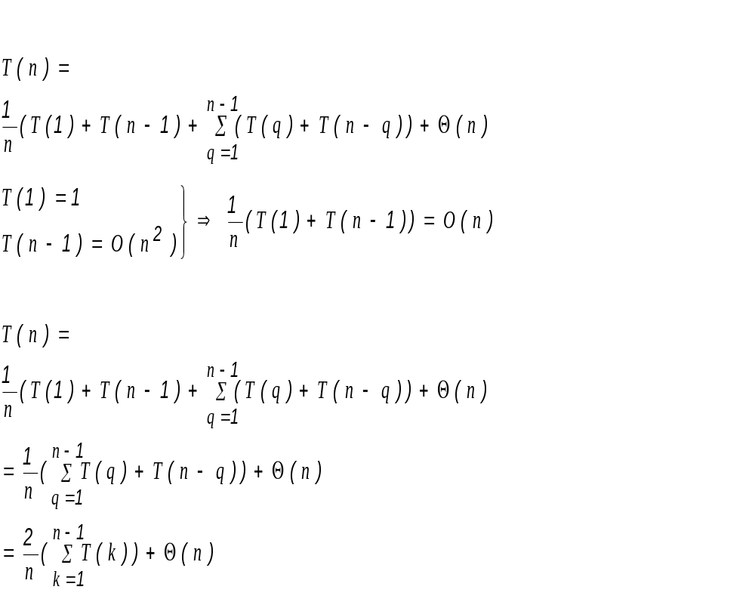
another analysis

Slide 19
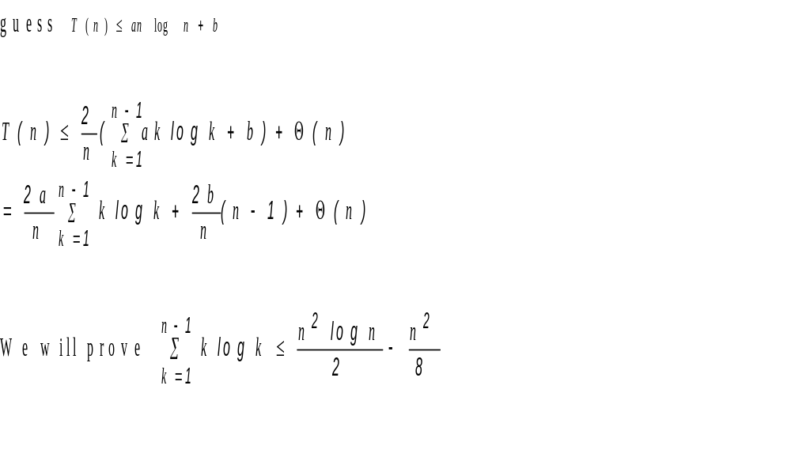

Slide 20
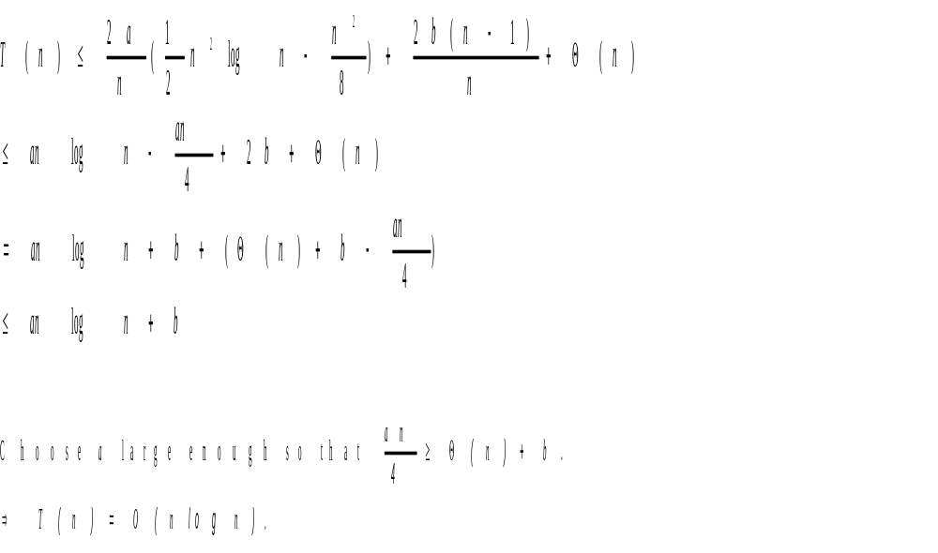

Slide 21
