Slide 1
11.Hash Tables

Slide 2
11.1 Directed-address tables
Direct addressing is a simple technique that works well when the universe U of keys is reasonable small. Suppose that an application needs a dynamic set in which an element has a key drawn from the universe U={0,1,…,m-1} where m is not too large. We shall assume that no two elements have the same key.

Slide 3
To represent the dynamic set, we use an array, or directed-address table, T[0..m-1], in which each position, or slot, corresponds to a key in the universe U.

Slide 4
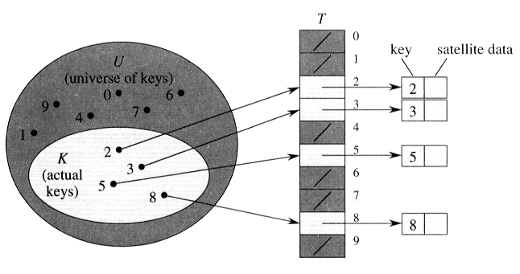

Slide 5
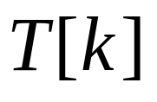
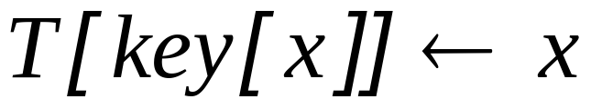
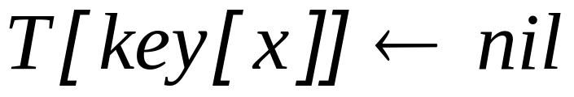
DIRECTED_ADDRESS_SEARCH(T,k)
return
DIRECTED_ADDRESS_INSERT(T,x)
DIRECTED-ADDRESS_DELETE(T,x)

Slide 6
11.2 Hash tables
The difficulty with direct address is obvious: if the universe U is large, storing a table T of size |U | may be impractical, or even impossible. Furthermore, the set K of keys actually stored may be so small relative to U. Specifically, the storage requirements can be reduced to O(|K |), even though searching for an element in in the hash table still requires only O(1) time.

Slide 7
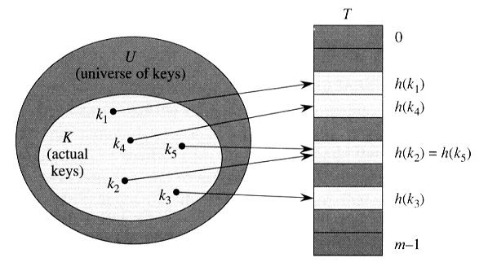

Slide 8
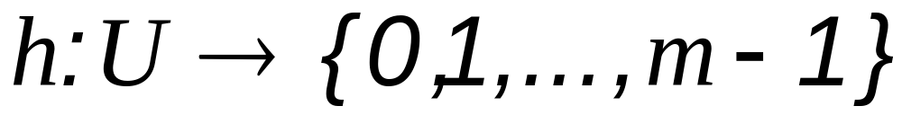
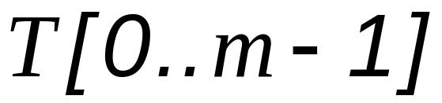
hash function:
hash table:
k hashs to slot: h (k) hash value
collision: two keys hash to the same slot

Slide 9
Collision resolution technique:
chaining
open addressing

Slide 10
Collision resolution by chaining:
In chaining, we put all the elements that hash to the same slot in a linked list.

Slide 11
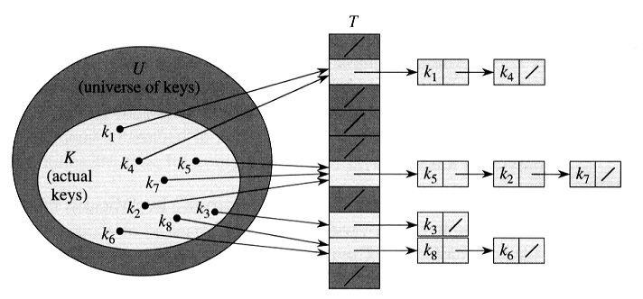

Slide 12
CHAINED_HASH_INSERT(T,x )
Insert x at the head of the list T[h[key[x]]]
CHAINED_HASH_SEARCH(T,k )
Search for the element with key k in the list T[h[k]]

Slide 13
CHAINED_HASH_DELETE(T,x )
delete x from the list T[h[key[x]]] Complexity:
INSERT O(1)
DELETE O(1) if the list
are doubly linked.

Slide 14
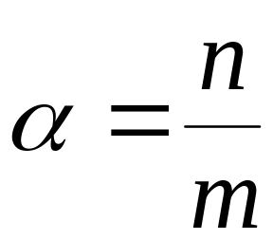
Analysis of hashing with chaining
Given a hash table T with m slots that stores n elements.
load factor: (the average number of elements stored in a chain.)

Slide 15
Assumption: simple uniform hashing
uniform distribution, hashing function takes O(1) time.
for j = 0, 1, …, m-1, let us denote the length of the list T[j] by n_{j}, so that
n = n₀ + n₁ + … + n_{m} – 1,
and the average value of n_{j} is
E[n_{j}] = α = n/m.

Slide 16
Theorem 11.1.
If a hash table in which collision are resolved by chaining, an unsuccessful search takes expected time Θ(1+α), under the assumption of simple uniform hashing.

Slide 17
Proof.
The average length of the list is .
The expected number of elements examined in an unsuccessful search is α .
The total time required (including the time for computing h(k) is O(1+ α).

Slide 18
Theorem 11.2
If a hash table in which collision are resolved by chaining, a successful search takes time , Θ(1+α) on the average, under the assumption of simple uniform hashing.

Slide 19
Proof.
Assume the key being searched is equally likely to be any of the n keys stored in the table.
Assume that CHAINED_HASH_INSERT procedure insert a new element at the end of the list instead of the front.

Slide 20
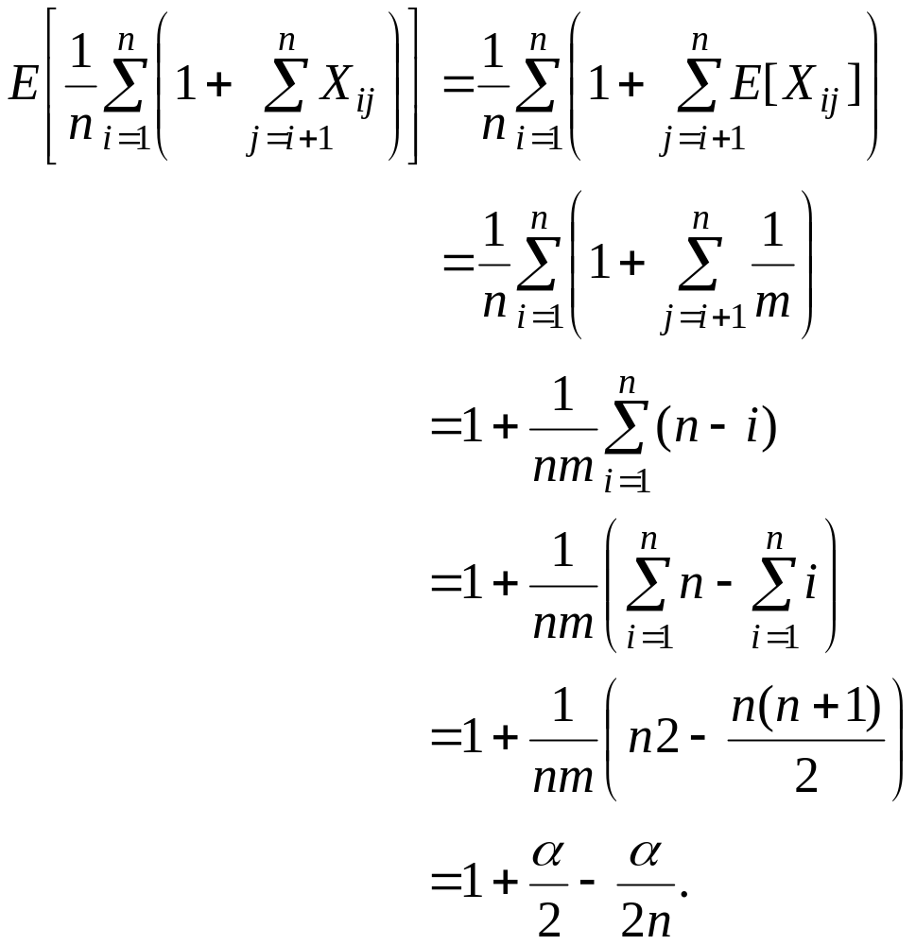
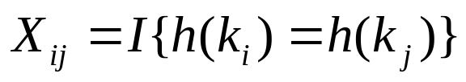
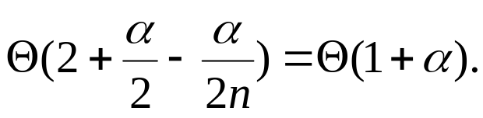
_{Total time required for}
_{a successful search}

Slide 21
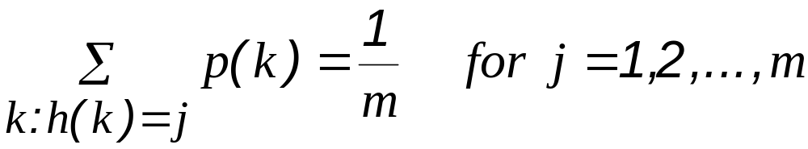
11.3 Hash functions
What makes a good hash function?

Slide 22

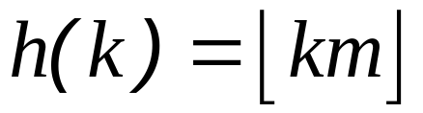
Example:
Assume .
Set .

Slide 23
Interpreting keys as natural number
ASCII code

Slide 24
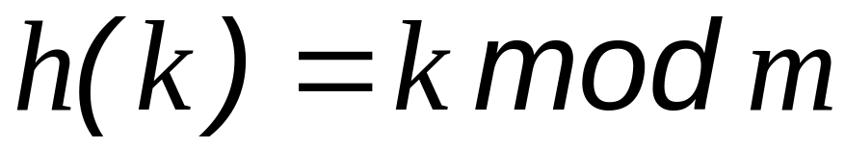
11.3.1 The division method
Suggestion: Choose m to be prime and not too close to exactly power of 2.

Slide 25
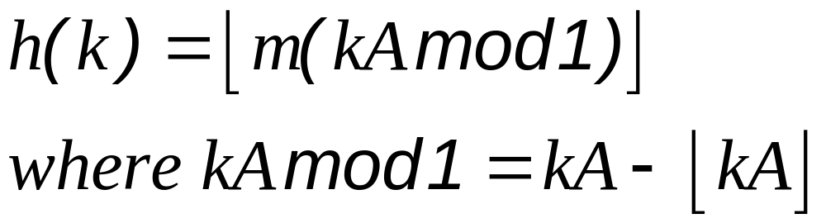
11.3.2 The multiplication method

Slide 26
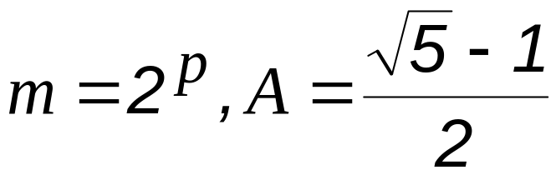
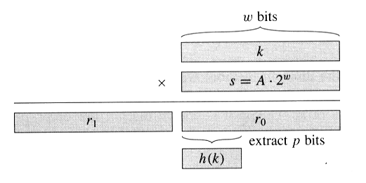
Suggestion: choose

Slide 27
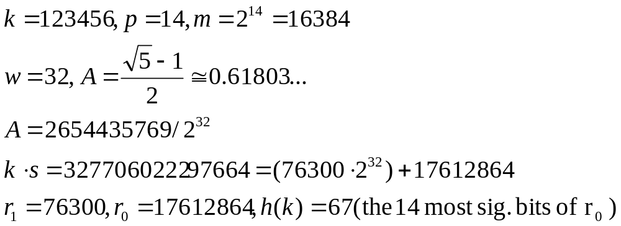
Example:

Slide 28
11.3.3 Universal hashing
Choose the hash function randomly in a way that is independent of the keys that actually going to be stored.

Slide 29
Let H be a finite collection of hashing functions that maps a give universe U of keys into the range {0, 1, 2, …, m-1}. Such a collection is said to be universal if each pair of distinct keys k,l ∈ U, the number of hash functions h ∈ H for which h(k) = h(l) is at most |H |/m.

Slide 30
In other words, with a hash function randomly chosen from H, the chance of collision between distinct keys k and l is no more then the chance 1/m of a collision if h(k) and h(l) were randomly and independently chosen from the set {0, 1, …, m – 1}.

Slide 31
Theorem 11.3
Suppose that a hash function h is choose from a universal collection of hash function and is used to hash n keys into a table T of size m, using chaining to resolve collisions. If key k is not in the table, then the expected length E[n_{h(k)}] of the list that key k hashes to is at most α. If key k is in the table, then the expected length E[n_{h(k)}] of the lest containing key k is at most 1 + α.

Slide 32
Proof.
For each pair k and l of distinct keys, define the indicator random variable
X_{kl} = I{h(k) = h(l)}.
Pr{h(k)=h(l)} ≤ 1/m
E[X_{kl}] ≤ 1/m

Slide 33
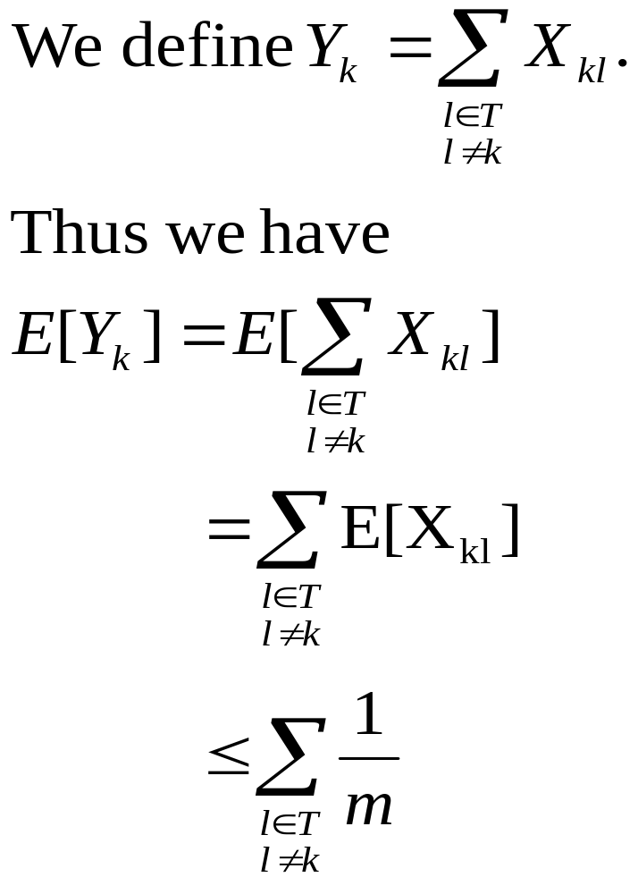

Slide 34
If k ∉ T, then n_{h(k)} = Y_{k} and |{l: l ∈ T and l ≠ k}| = n. Thus E[n_{h(k)}] = E[Y_{k}] ≤ n/m = α.
If k ∈ T, then because key k appears in list T[h(k)] and the count Y_{k} does not include key k, we have n_{h(k)} = Y_{k} + 1 and |{l: l ∈ T and l ≠ k}| = n - 1. Thus E[n_{h(k)}]= E[Y_{k}] + 1 ≤ (n - 1) / m + 1 = 1+α - 1/m < 1 + α.

Slide 35
Corollary 11.4
Using universal hashing and collision resolution by chaining in a table with m slots, it takes expected time Θ(n) to handle any sequence if n INSERT, SEARCH and DELETE operations containing O(m) INSERT operations.

Slide 36
Proof.
Since the number of insertions is O(m), we have n = O(m) and so α = O(1). The INSERT and DELETE operations take constant time and, by Theorem 11.3, the expected time for each SEARCH operation is O(1). BY linearity of expectation, therefore, the expected time for the entire sequence of operations is O(n)

Slide 37
Design a universal class of hash functions
We begin by choosing a prime number p large enough so that every possible key k is in the range 0 to p – 1, inclusive. Let Z_{p} denote the set {0,1,…, p – 1}, and let Z_{p}* denote the set {1, 2, …, p – 1}.
Since p is prime, we can solve equations modulo p with the methods given in Chapter 31. Because we assume that the size of the universe of keys is greater than the number of slots in the hash table we have p > m.

Slide 38
We now define the hash function h_{a,b} for any a ∈ Z_{p}* and any b ∈ Z_{p} using a linear transformation followed by reductions modulo p and then modulo m :
h_{a,b}(k)=((ak + b) mod p) mod m.
For example, with p = 17 and m = 6, we have h_{3,4}(8) = 5. The family of all such hash functions is
H_{p,m} = {h_{a,b} : a ∈ Z_{p}* and b ∈ Z_{p}}.

Slide 39
Each hash function h_{a,b} maps Z_{p} to Z_{m}. This class of hash functions has the nice property that the size m of the output range is arbitrary –not necessarily prime– a feature which we shall use in Section 11.5. Since there are p – 1 choices for a and there are p choices for b, there are p(p – 1)hash functions in H_{p,m}.

Slide 40
Theorem 11.5
The class H_{p,m} defined above is a universal hash functions.

Slide 41
Proof.
Consider two distinct keys k, l from Z_{p}, so k ≠ l. For a given hash function h_{a,b} we let
r = (ak + b) mod p,
s = (al + b) mod p.
r ≠ s
a = ((r – s)((k – l)⁻¹ mod p)) mod p,
b = (r – ak) mod p,
For any given pair of input k and l, if we pick (a, b) uniformly at random form Z_{p}* × Z_{p}, the resulting pair (r, s) is equally likely to be any pair of distinct values modulo p.

Slide 42
It then follows that the probability that distinct keys k ad l collide is equal to the probability that r ≡ s(mod m) when r and s are randomly chosen as distinct values modulo p. For a given value of r, of the p – 1 possible remaining values for s, the number of values s such that s ≠ r and s ≡ r (mod m) is at most
⎡p/m⎤ - 1 ≤ (( p + m – 1)/m – 1
= (p – 1)/m.
The probability that s collides with r when reduced modulo m is at most
((p – 1)/m)/(p – 1) = 1/m.

Slide 43
11.4 Open addressing
(All elements are stored in the hash tables itself.)
h : U × {0,1,…,m-1}→{0,1,…,m-1}.
With open addressing, we require that for every key k, the probe sequence ⟨h(k,0),h(k,1),…,h(k,m-1)⟩
be a permutation of {0,1, …,m}.

Slide 44
HASH_INSERT(T,k)
1 i ← 0
2 repeat j ← h(k, i)
3 if T[j]= NIL
4 then T[j] ← k
5 return j
6 else i ← i + 1
7 until i = m
8 error “hash table overflow”

Slide 45
HASH_SEARCH(T,k)
1 i ← 0
2 repeat j ← h(k, i)
3 if T[j] = k
4 then return j
5 i ← i + 1
6 until T[j] = NIL or i = m
7 return NIL

Slide 46
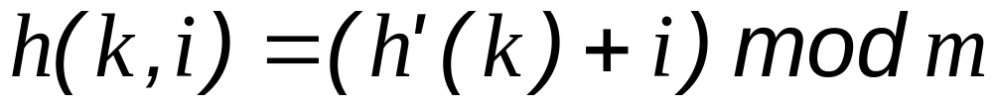
Linear probing:
It suffers the primary clustering problem.

Slide 47
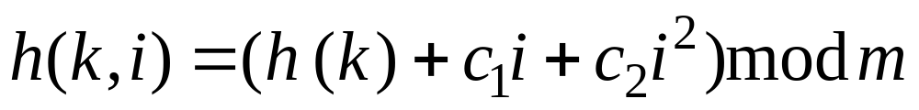
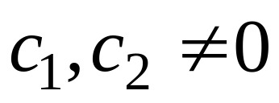
Quadratic probing:
It suffers the secondary clustering problem.

Slide 48
Double hashing:

Slide 49
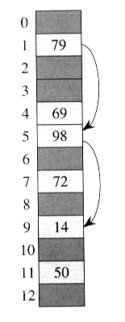
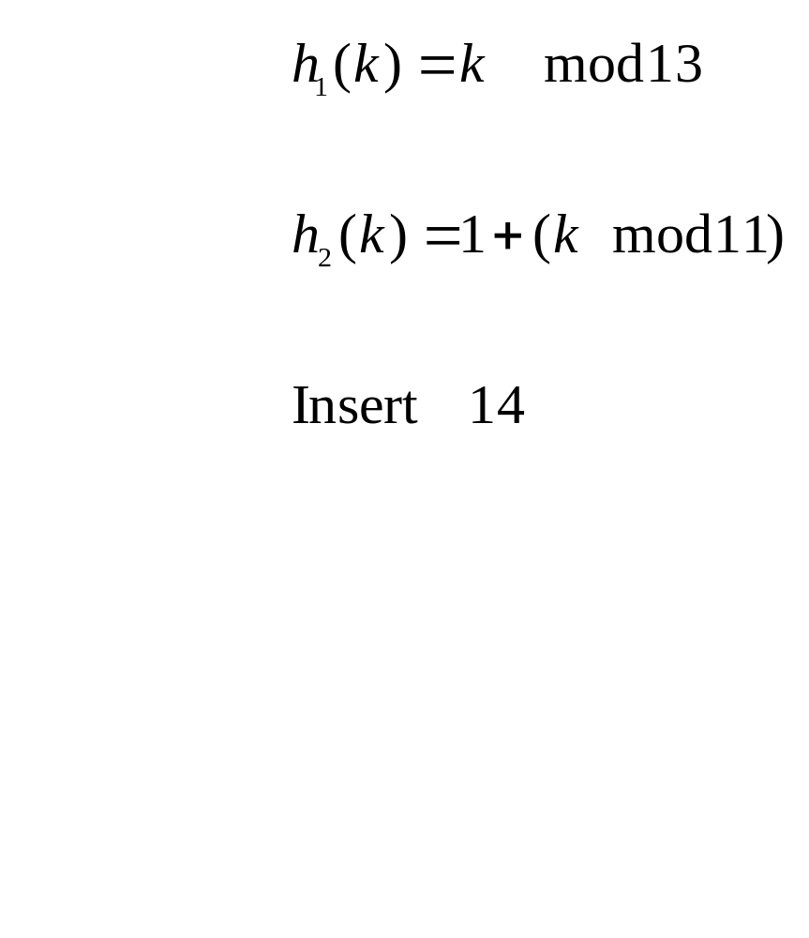

Slide 50
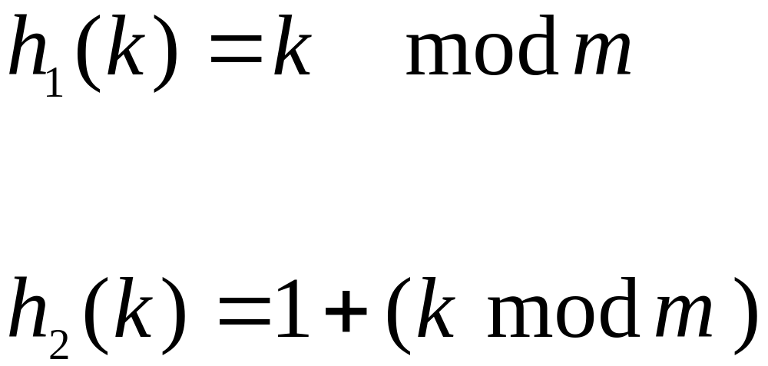
Example:

Slide 51
Double hashing represents an improvement over linear and quadratic probing in that probe sequence are used. Its performance is more closed to uniform hashing.

Slide 52
Analysis of open-address hash

Slide 53
Theorem 11.6
Given an open-address hash-table with load factor α = n/m < 1, the expected number of probes in an unsuccessful search is at most 1/(1-α) assuming uniform hashing.

Slide 54
Proof. – 1/4
Define the random variable X to be the number of probes made in an unsuccessful search
Define event A_{i} to be the event that there is an ith probe and it is to an occupied slot

Slide 55
Proof – 2/4
Event {X≥i}=A₁∩A₂ ∩A₃ ∩… ∩A_{i-1}
Pr{A₁∩A₂ ∩A₃ ∩… ∩A_{i-1}}
=Pr{A₁}.Pr{A₂|A₁}.Pr{A₃|A₁ ∩A₂}…
Pr{A_{i-1}|A₁∩A₂ ∩A₃ ∩… ∩A_{i-2}}
Pr{A₁}=n/m
Pr{A_{j}|A₁∩A₂ ∩A₃ ∩… ∩A_{j-1}}=
(n-j+1)/(m-j+1)

Slide 56
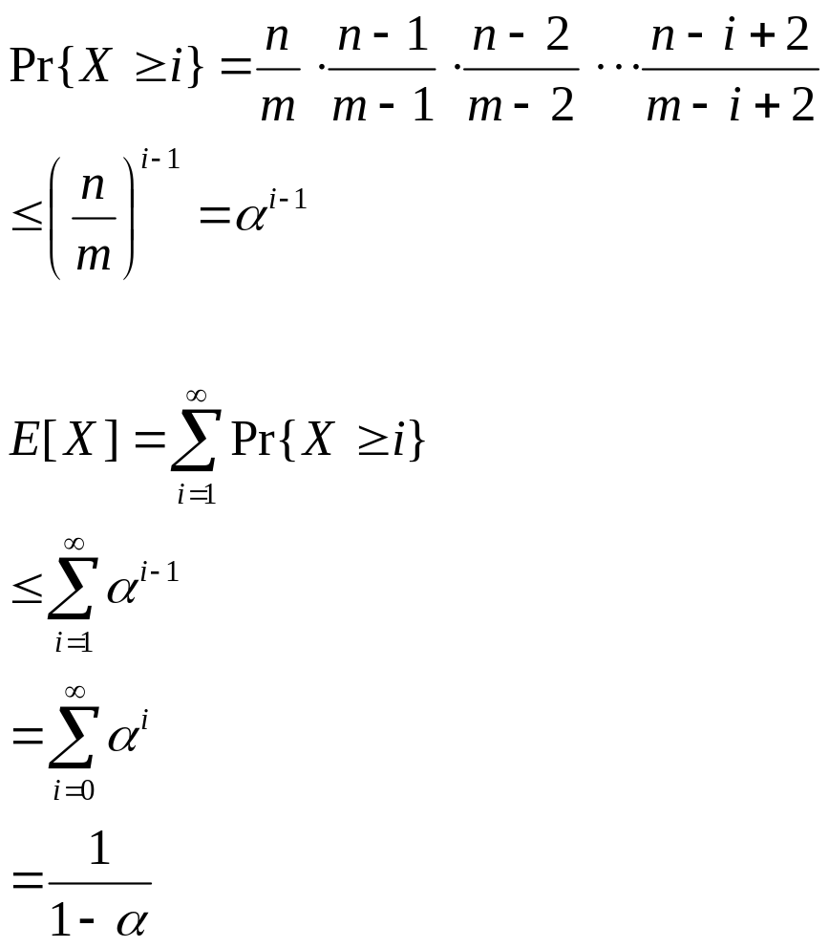
Proof – 3/4

Slide 57
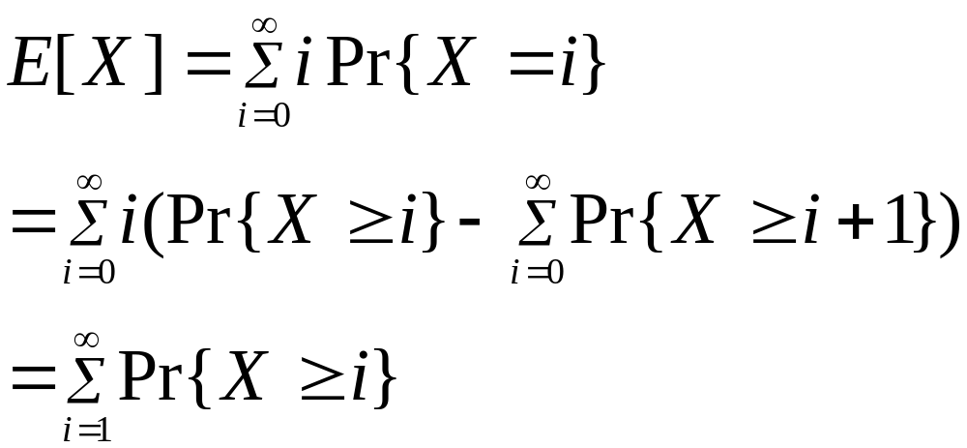
Proof – 4/4
Pr{X≥i} is added i times, but subtracted out i-1 times
Pr{X≥0} is added 0 times and not subtracted at all

Slide 58
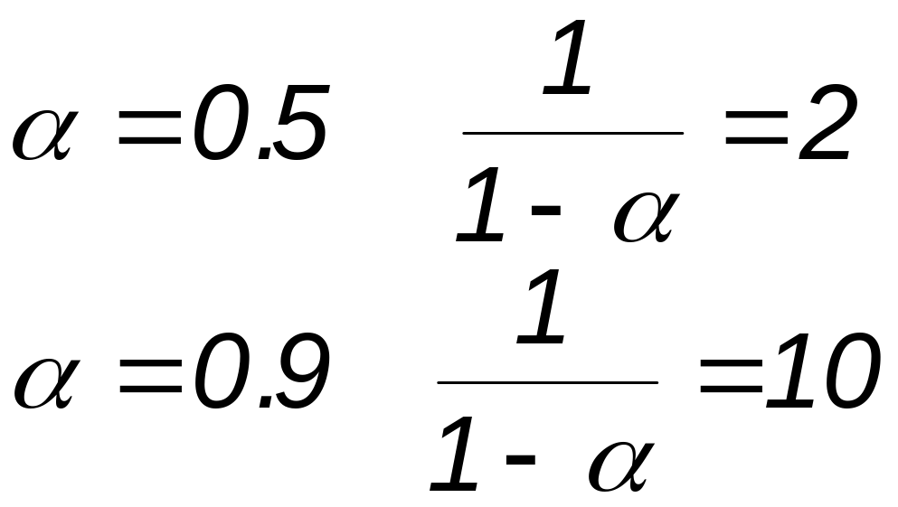
Example:

Slide 59
Corollary 11.7
Inserting an element into an open-address hash table with load factor
α requires at most 1/(1 - α) probes on average, assuming uniform hashing.

Slide 60
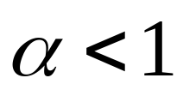
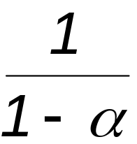
Proof.
An element is inserted only if there is room in the table, and thus . Inserting a key requires an unsuccessful search followed by placement of the key in the first empty slot found. Thus, the expected number of probes is .

Slide 61
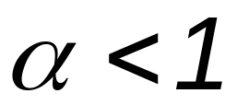
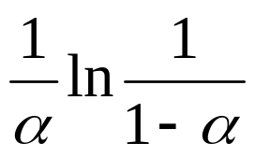
Theorem 11.8
Given an open-address hash table with load factor , the expected number of probes in a successful search is at most assuming uniform hashing and assuming that each key in the table is equally likely to be searched for.

Slide 62
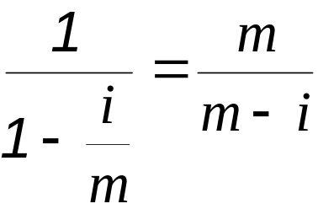
Proof.
A search for k follows the same probe sequence as followed when k was inserted.
If k is the (i+1)st key inserted in the hash table, the expected number of probes made in a search for k is at most .

Slide 63
Averaging over all n key in the hash table gives us the average number of probes in a successful search:

Slide 64
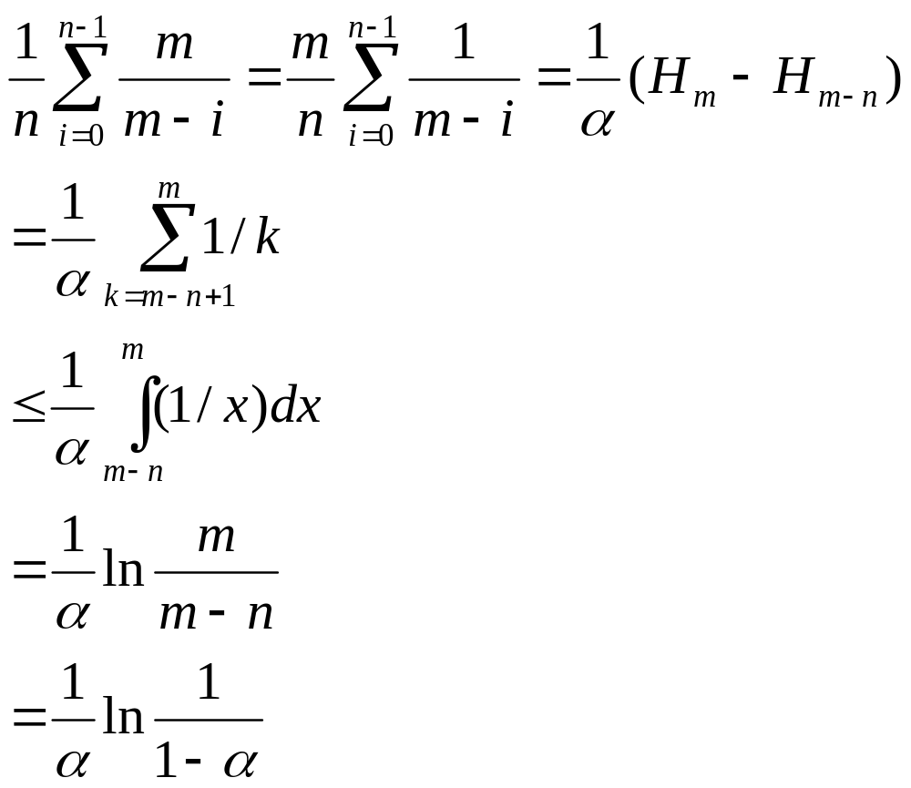

Slide 65
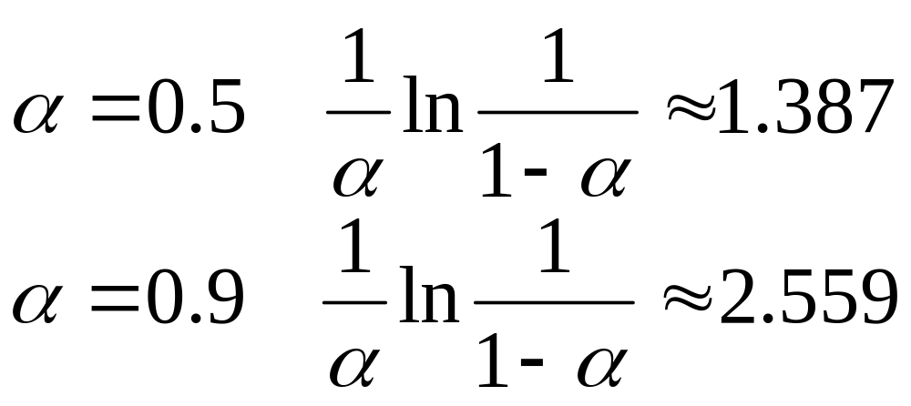
Example:

