Slide 1
23.Minimum spanning tree

Slide 2
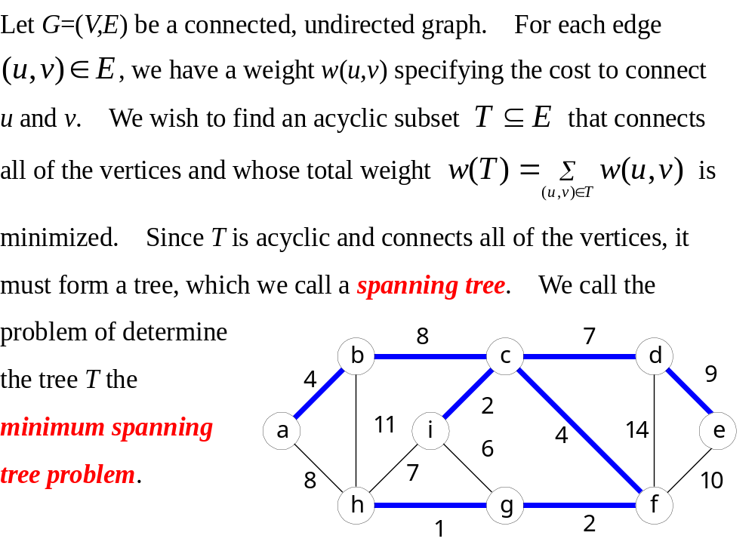

Slide 3
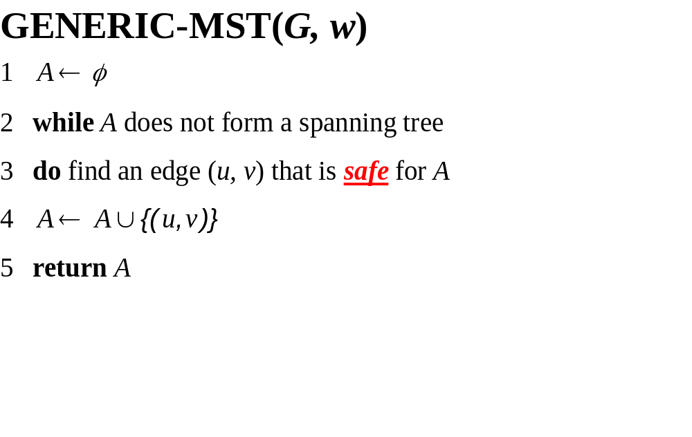
23.1 Growing a minimum spanning tree

Slide 4
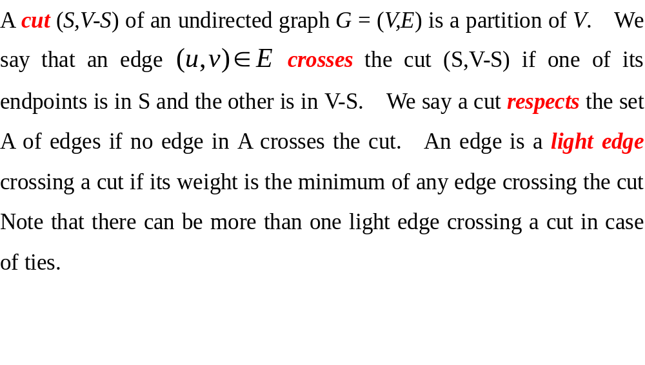

Slide 5
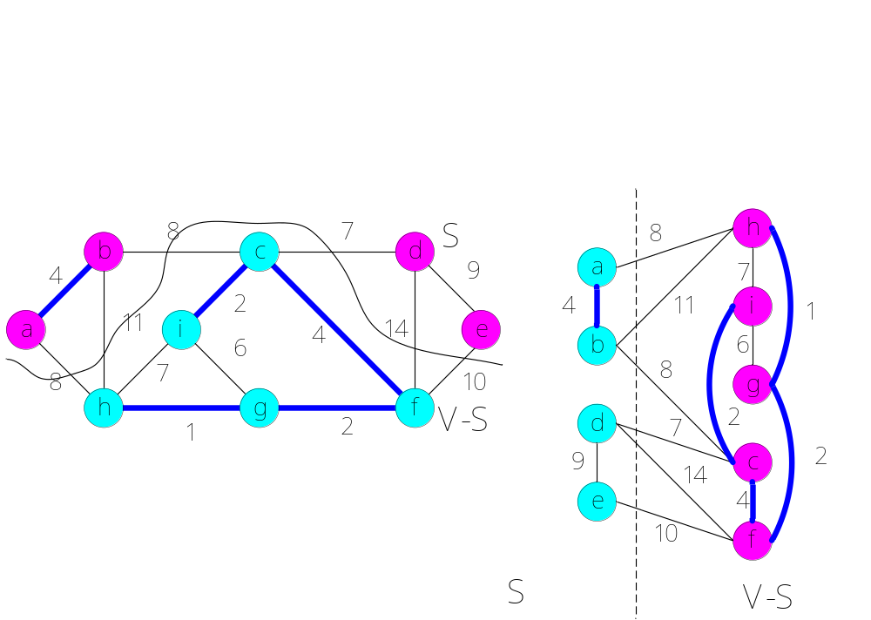

Slide 6
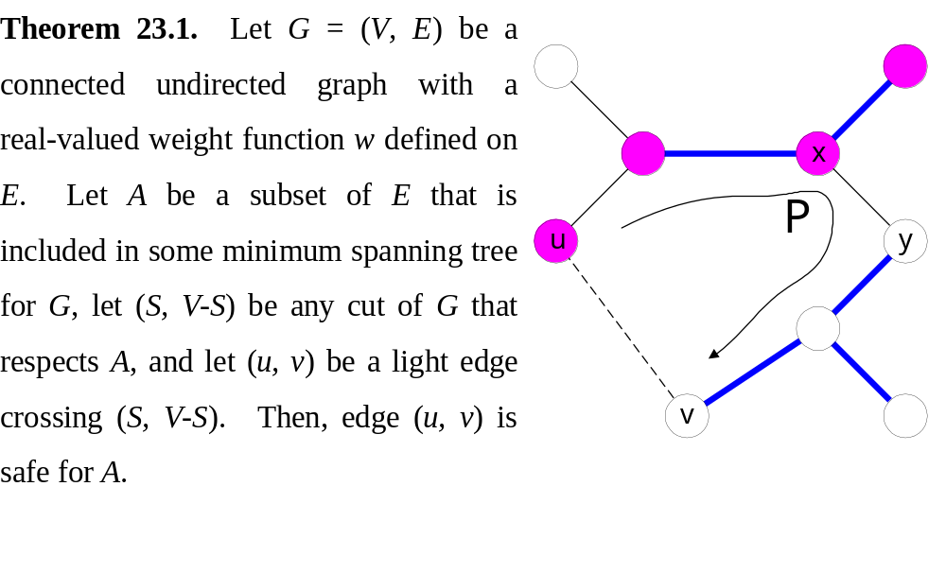

Slide 7
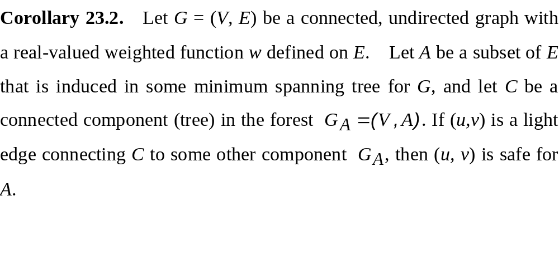

Slide 8
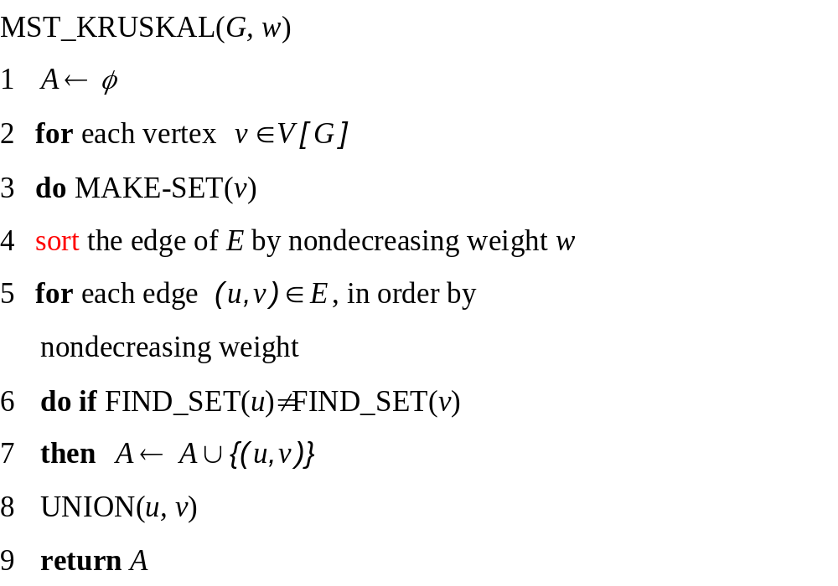
23.2 The algorithms of Kruskal and Prim
Complexity O(E log E)

Slide 9
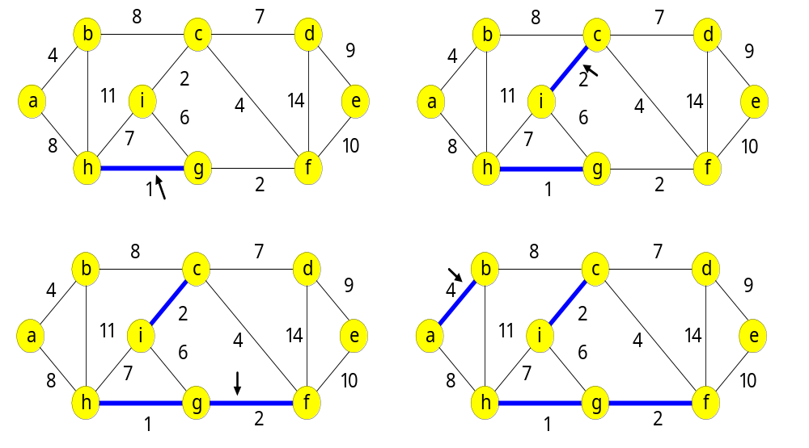

Slide 10
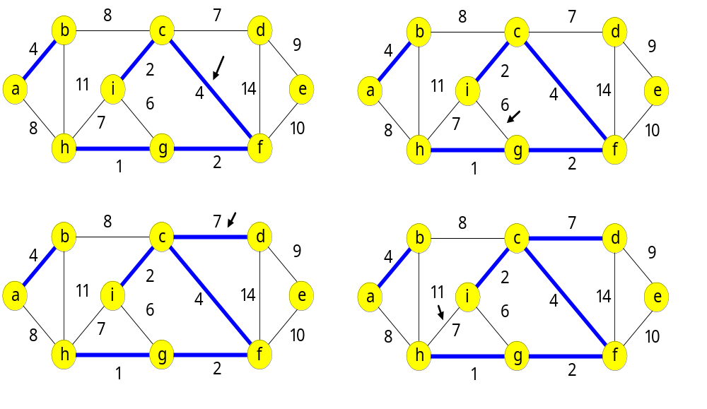
Continue ……

Slide 11
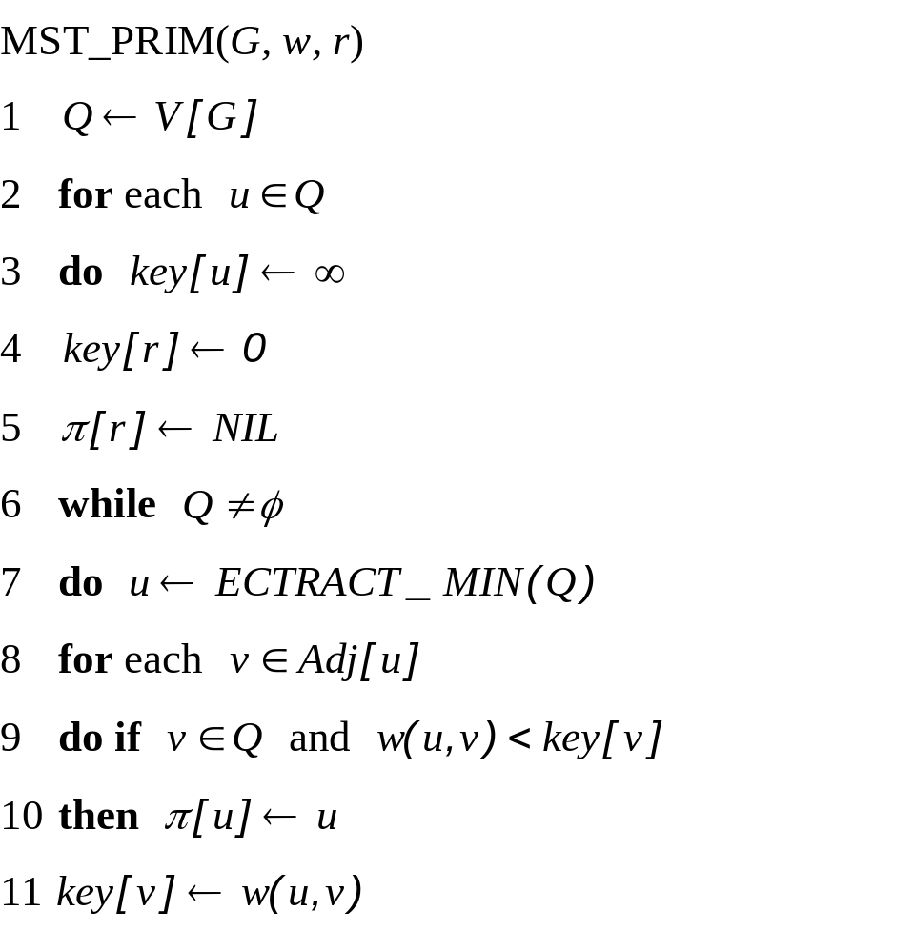
Prim’s algorithm
Complexity:
O(V log V + E log V), or
O(E + V log V)

Slide 12
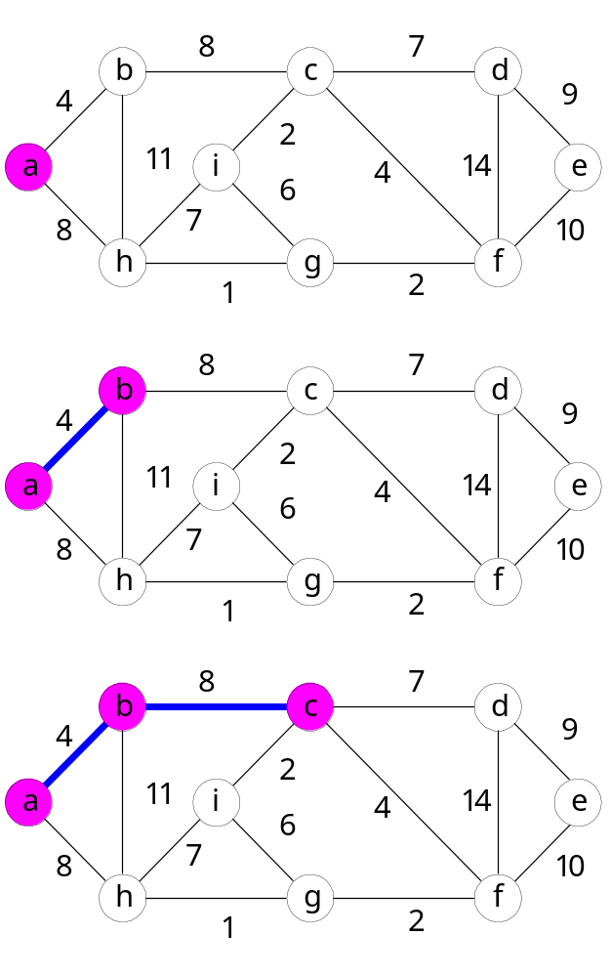
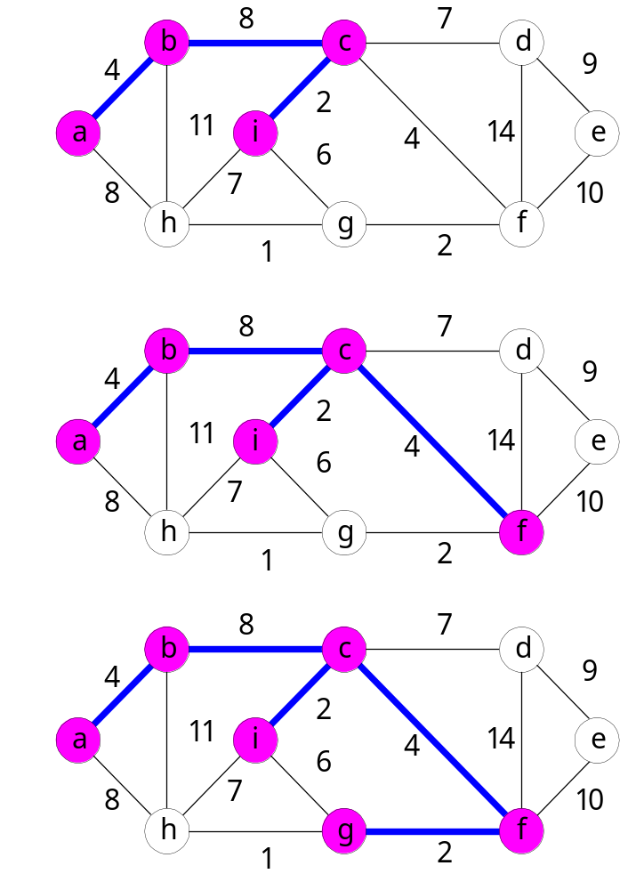

Slide 13
