Slide 1
3.Growth of Functions

Slide 2
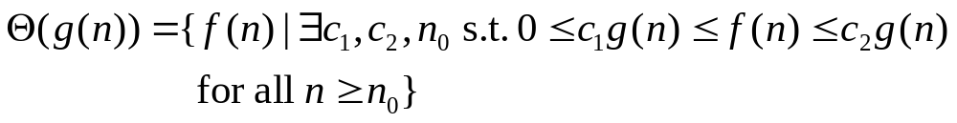

3.1 Asymptotic notation
⇒ g(n) is an asymptotic tight bound for f(n).
``=’’ abuse

Slide 3
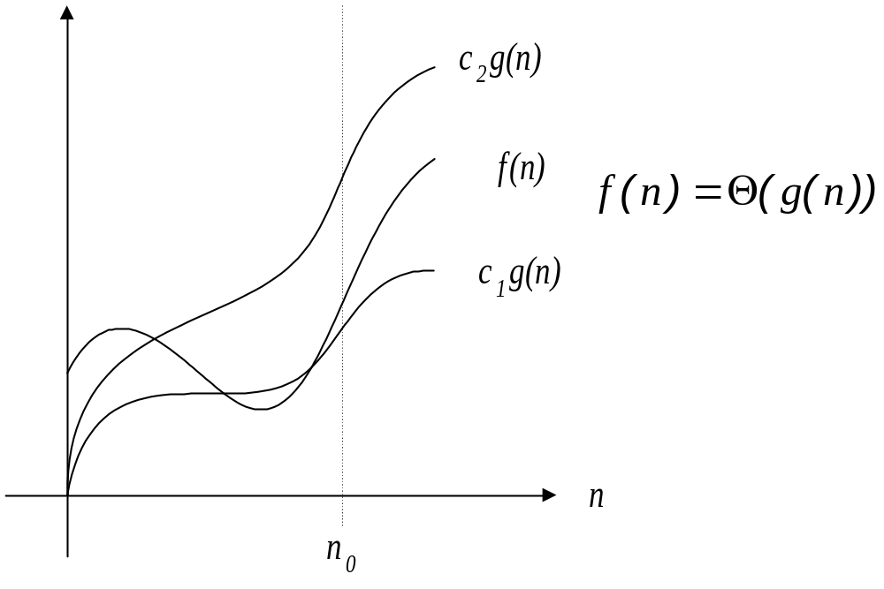
The definition of required every member of be asymptotically nonnegative.

Slide 4
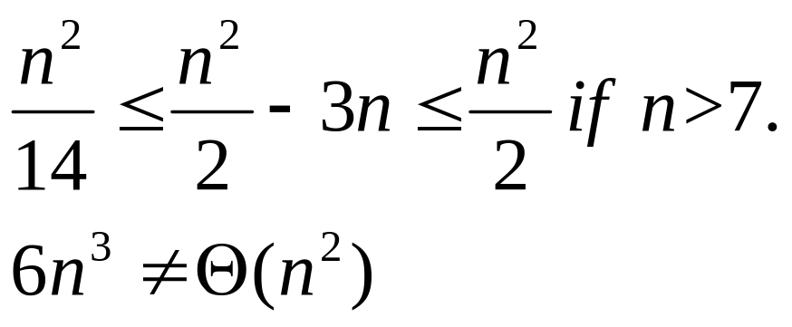
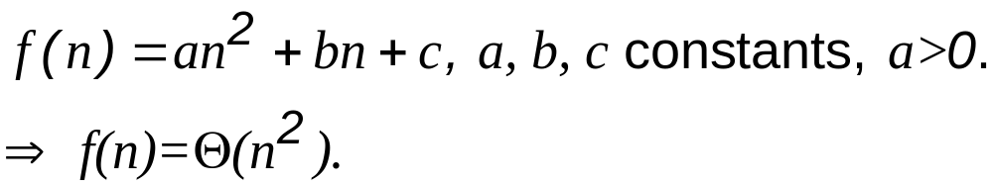
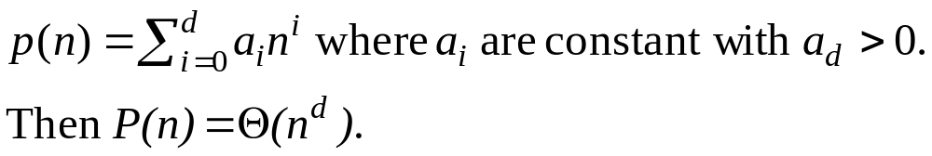
Example:
In general,

Slide 5
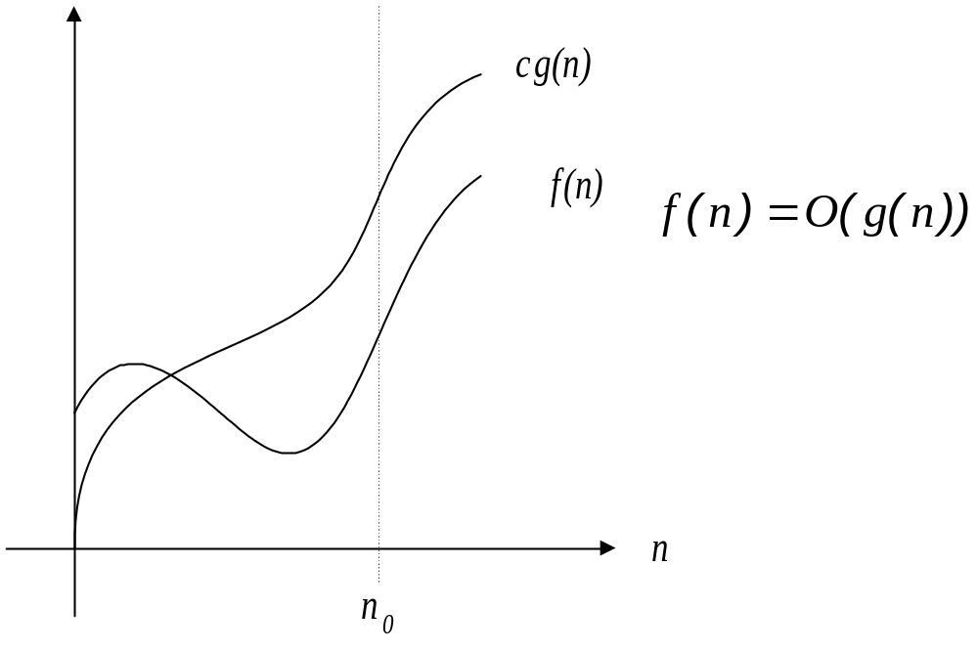
asymptotic upper bound

Slide 6
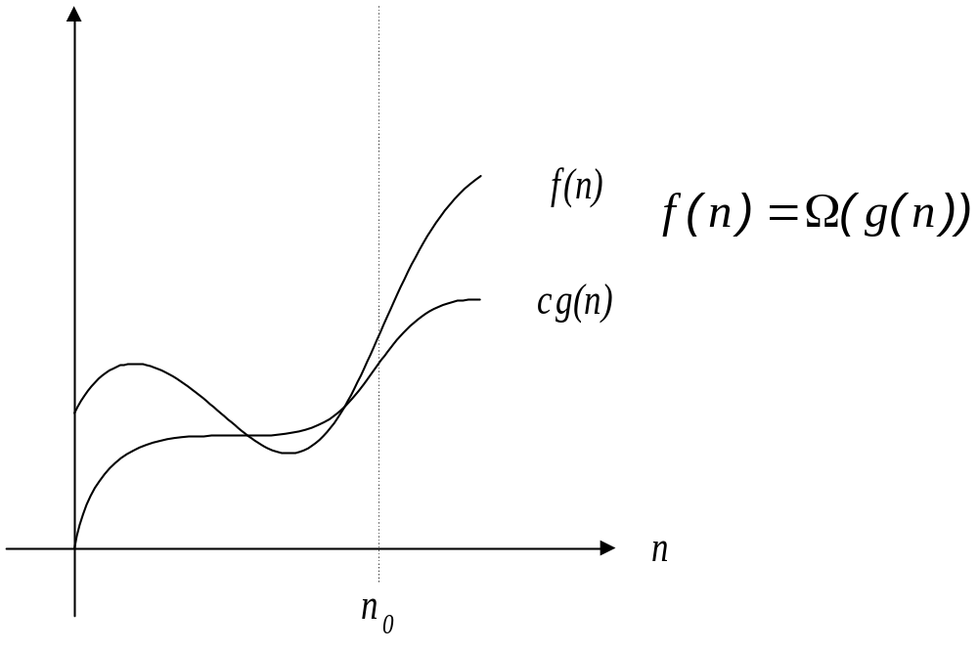
asymptotic lower bound

Slide 7



Theorem 3.1.
For any two functions f(n) and g(n),
if and only if
and

Slide 8
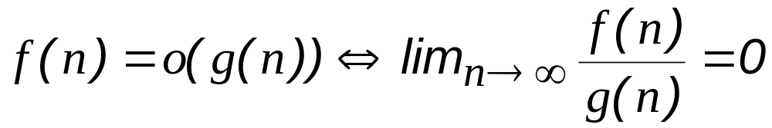
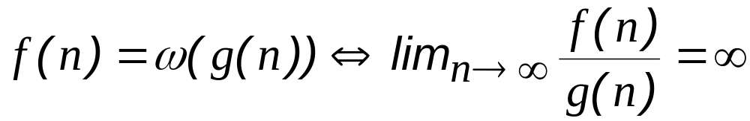

Slide 9



Transitivity
Reflexivity
Symmetry

Slide 10





Transpose symmetry

Slide 11
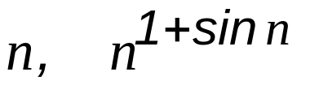
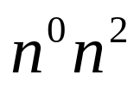
Trichotomy
a < b, a = b, or a > b.
e.g., does not always hold
because the latter oscillates between

Slide 12
2.2 Standard notations and common functions
Monotonicity:
  A function f is monotonically increasing if m ≤ n implies f(m) ≤ f(n).
  A function f is monotonically decreasing if m ≤ n implies f(m) ≥ f(n).
  A function f is strictly increasing if m < n implies f(m) < f(n).
  A function f is strictly decreasing if m > n implies f(m) > f(n).

Slide 13


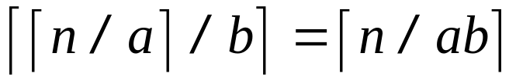
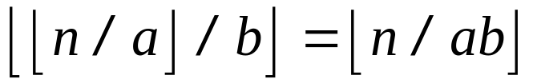
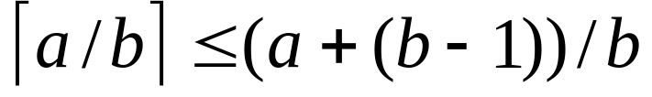
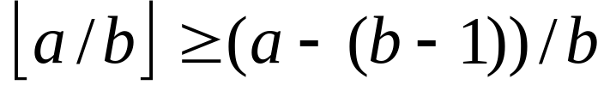
Floor and ceiling
For any real x
For any integer n
For any real n>=0, and
integers a, b >0

Slide 14
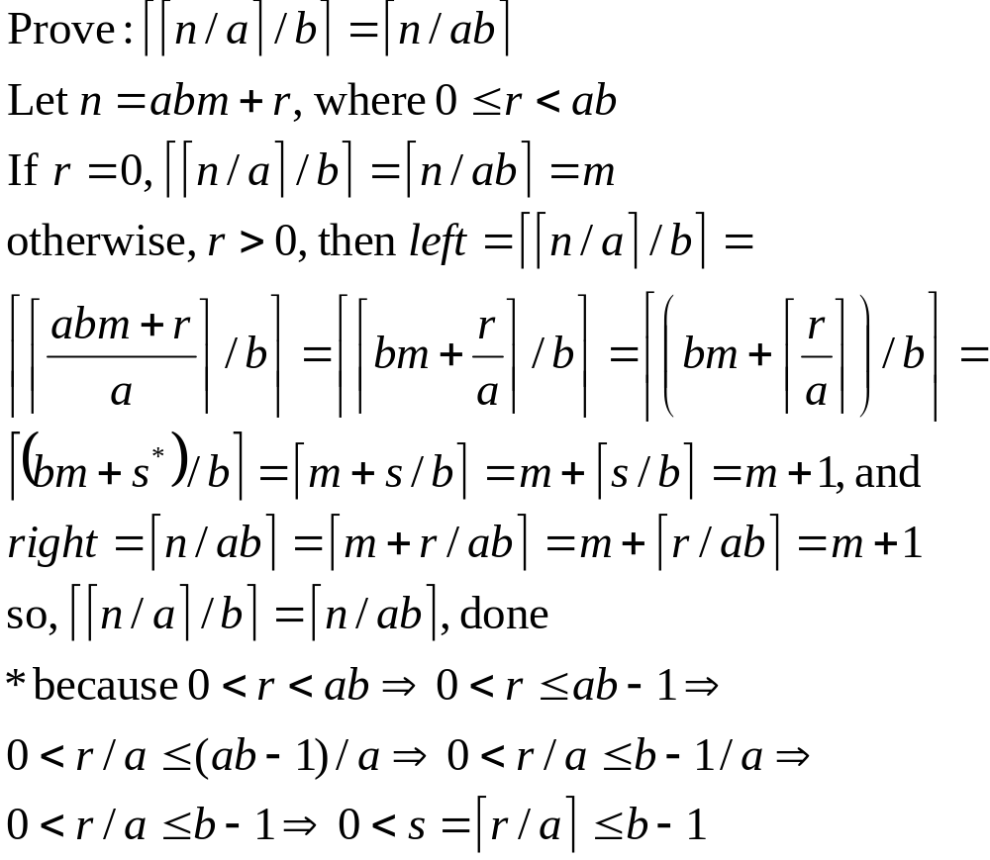
Proof of Ceiling

Slide 15
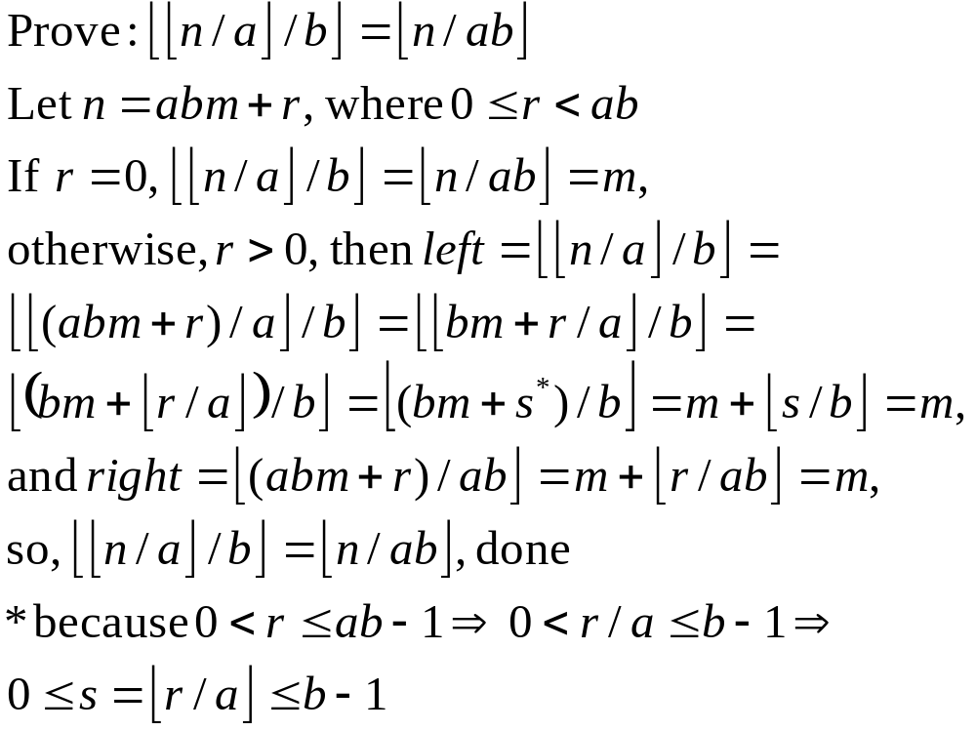
Proof of Floor

Slide 16
Modular arithmetic
  For any integer a and any positive integer n, the value a mod n is the remainder (or residue) of the quotient a/n :
a mod n =a - ⎣a/n⎦ n.
  If(a mod n) = (b mod n). We write a ≡ b (mod n) and say that a is equivalent to b, modulo n.
  We write a ≢ b (mod n) if a is not equivalent to b modulo n.

Slide 17
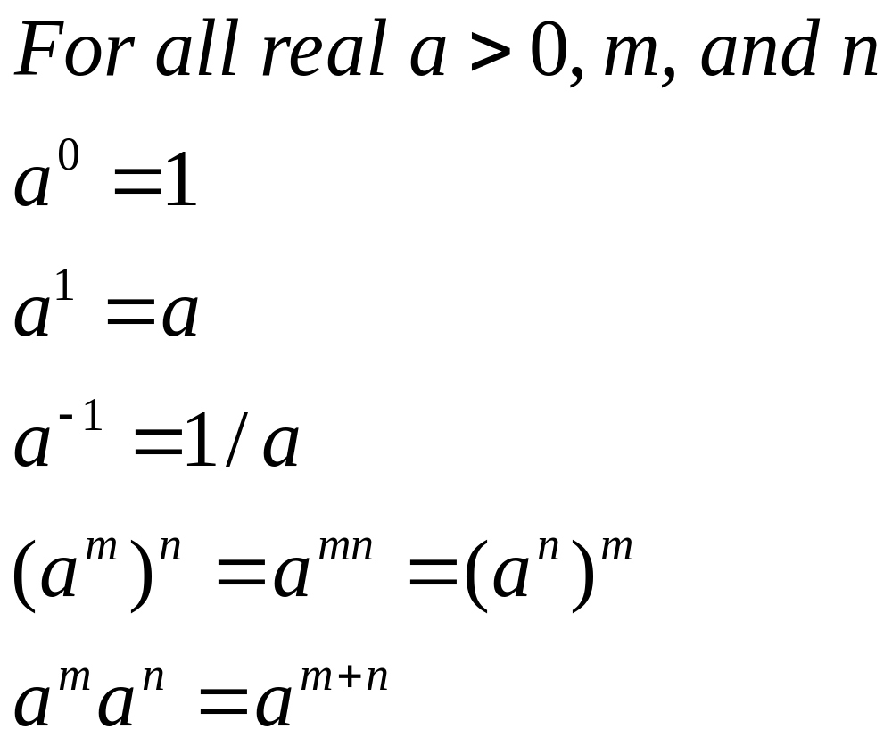
Exponential Basics

Slide 18
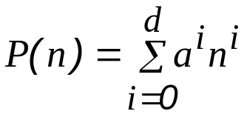
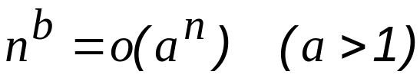
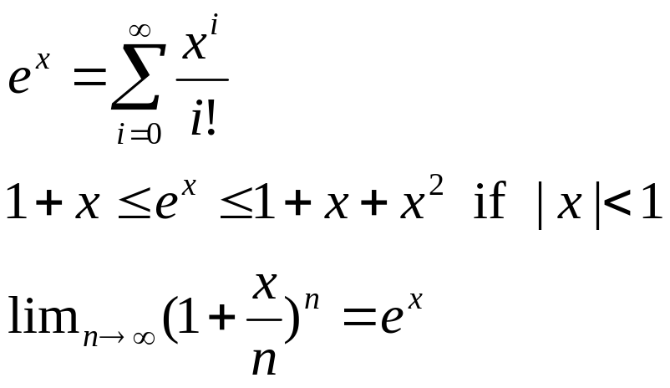
Polynomials v.s. Exponentials
Polynomials:
  A function is polynomial bounded if f(n)=O(n^{k})
Exponentials:
  Any positive exponential function grows faster than any polynomial.

Slide 19
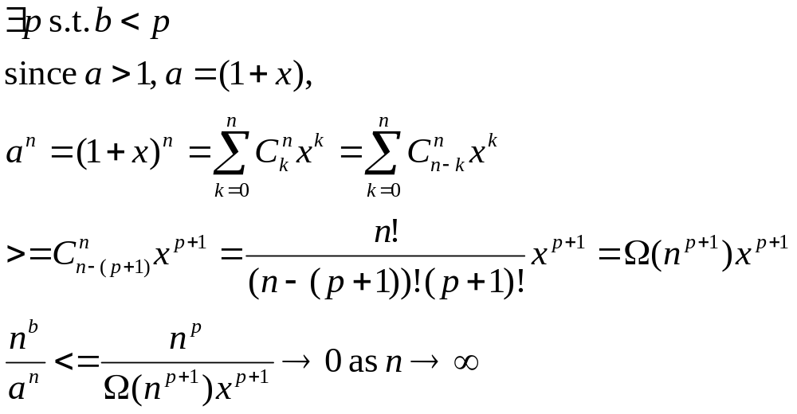
Prove: n^{b}=o(a^{n})

Slide 20
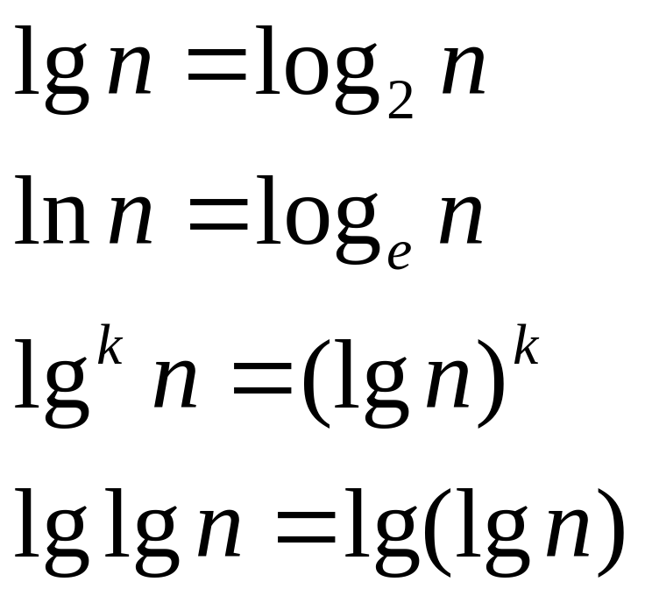
Logarithm Notations

Slide 21
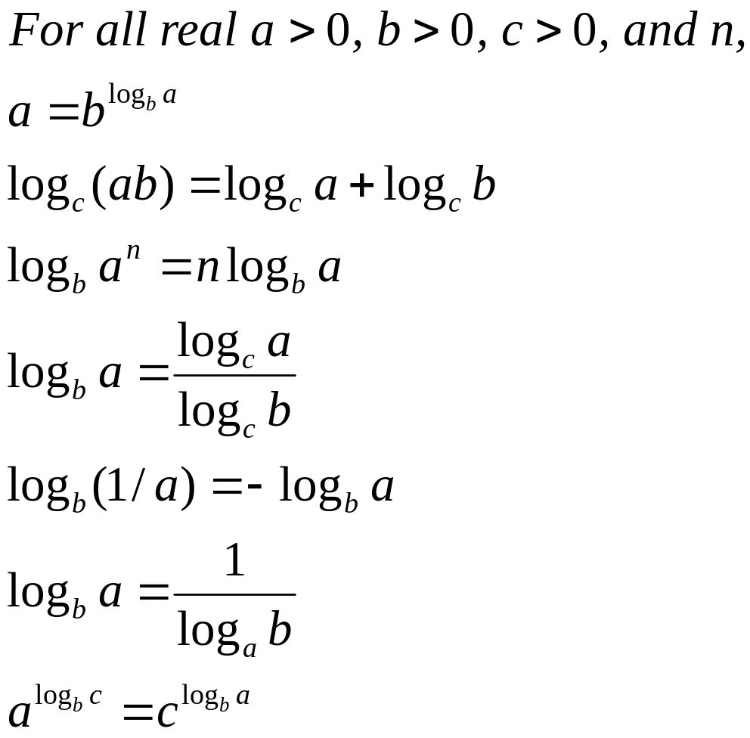
Logarithm Basics

Slide 22
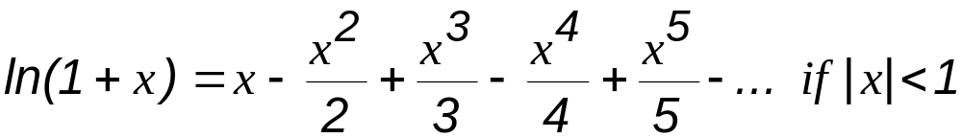
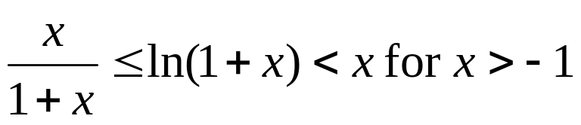
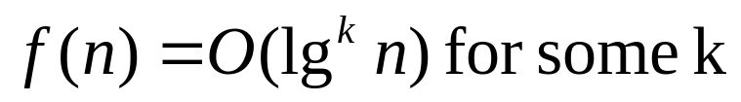
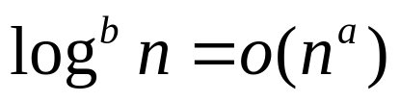
Logarithms
A function f(n) is polylogarithmically bounded if
for any constant a > 0.
Any positive polynomial function grows faster than any polylogarithmic function.

Slide 23
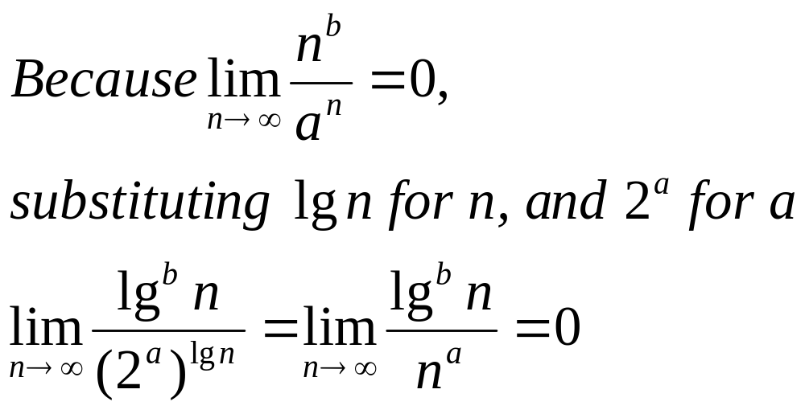
Prove: lg^{b}n=o(nª)

Slide 24
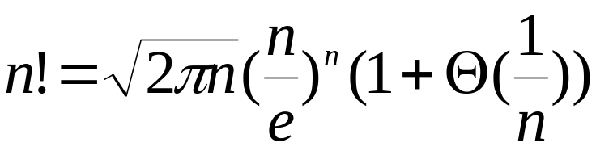



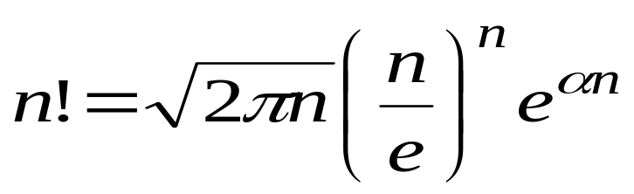
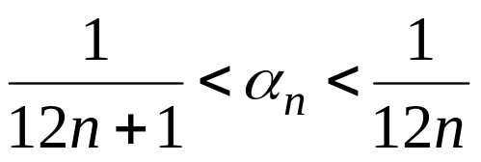
Factorials
Stirling’s approximation
where

Slide 25
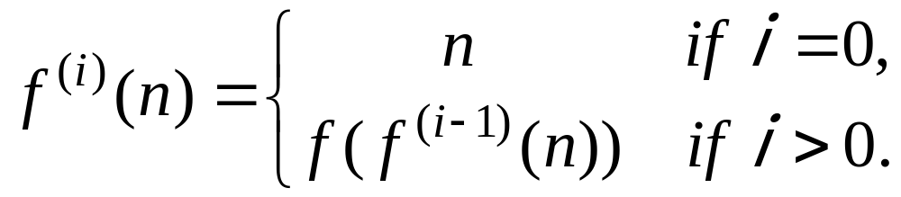

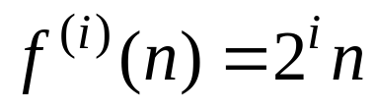
Function iteration
For example, if , then

Slide 26
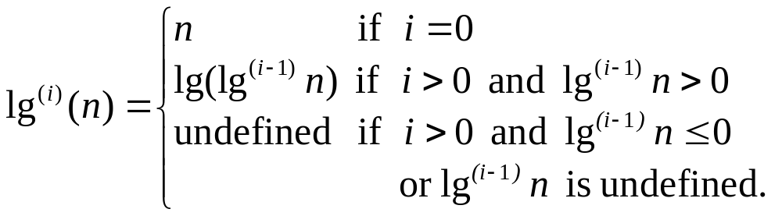
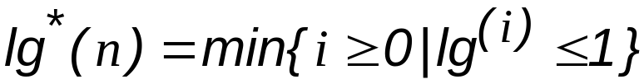


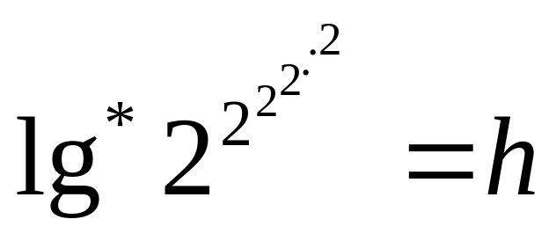



The iterative logarithm function
h

Slide 27



Since the number of atoms in the observable universe is estimated to be about , which is much less than , we rarely encounter a value of n such that .

Slide 28
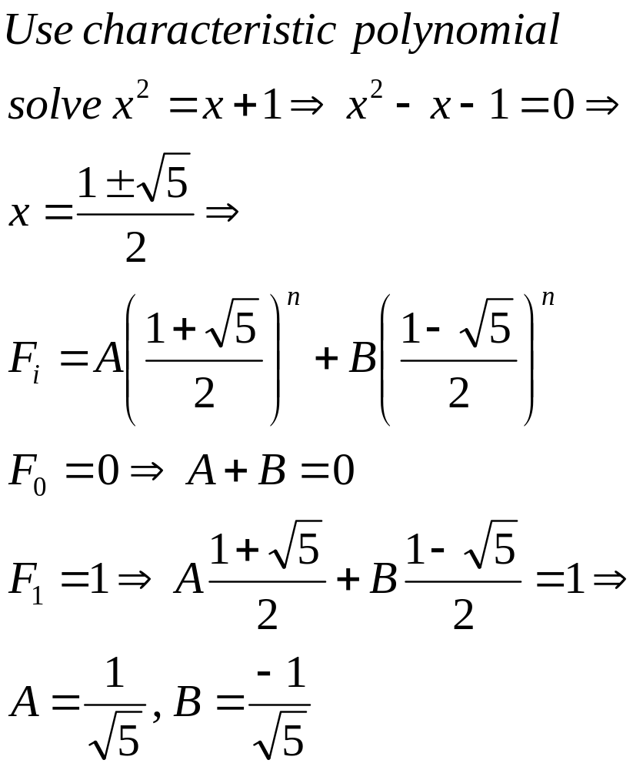
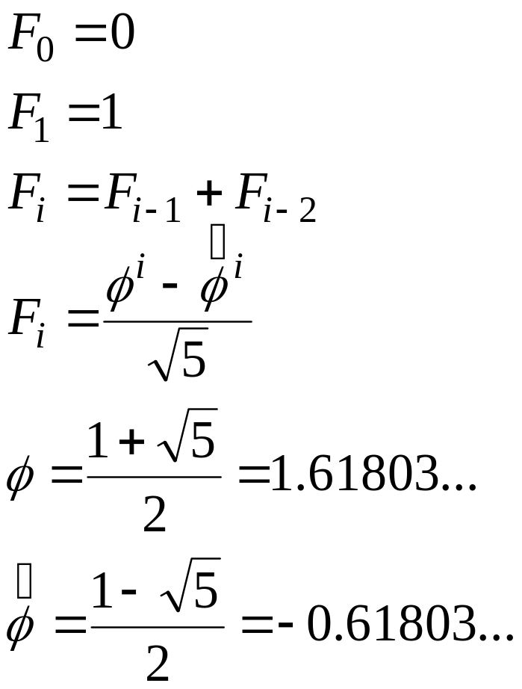
Fibonacci numbers

