Slide 1
8.Sorting in linear time

Slide 2
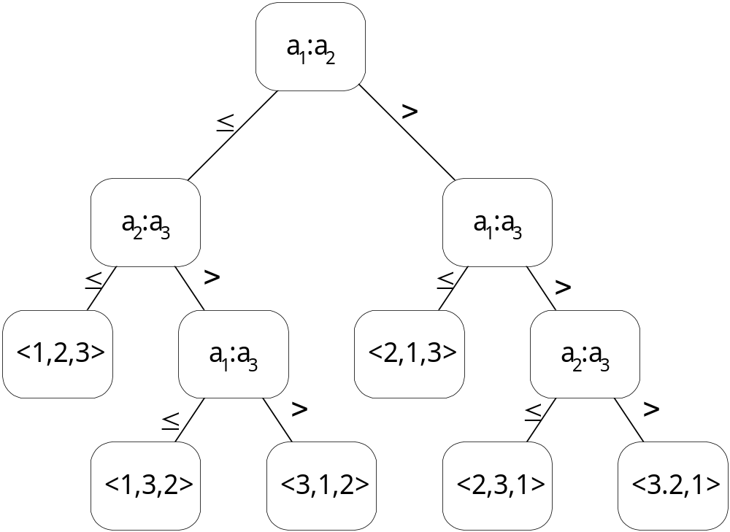
8.1 Lower bound for sorting
The decision tree model

Slide 3
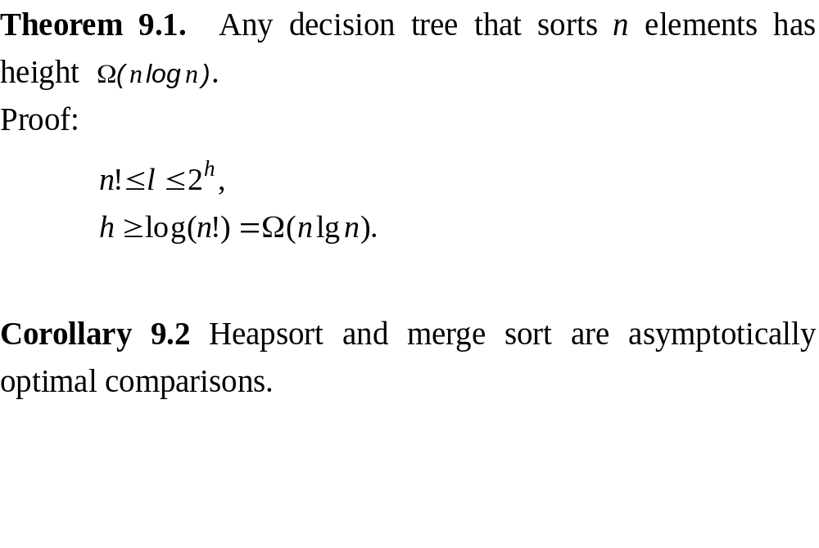

Slide 4
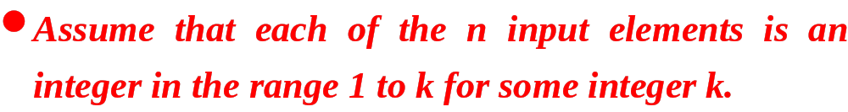
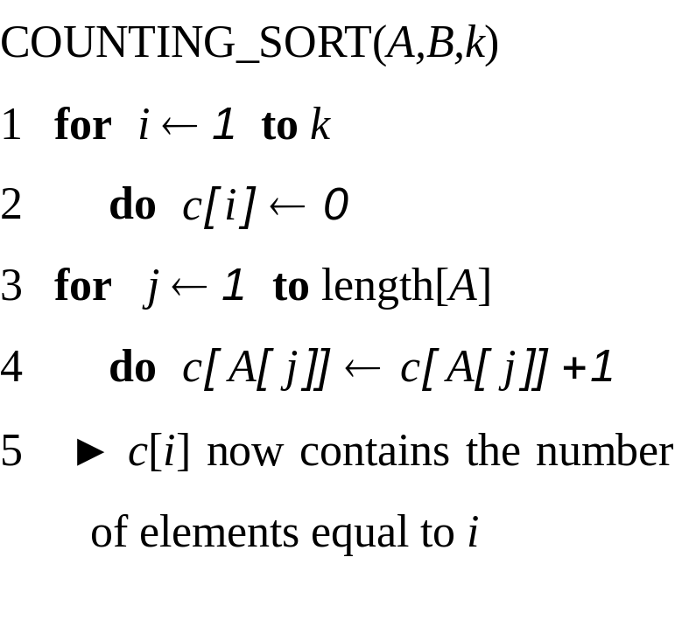
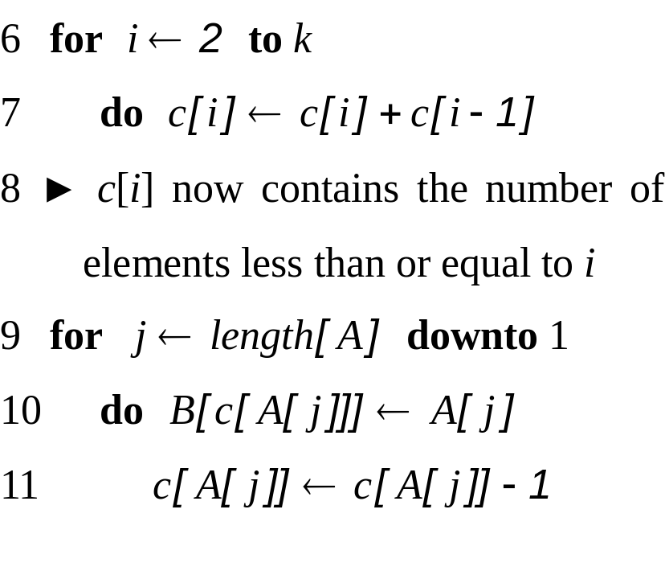
8.2 Counting sort

Slide 5
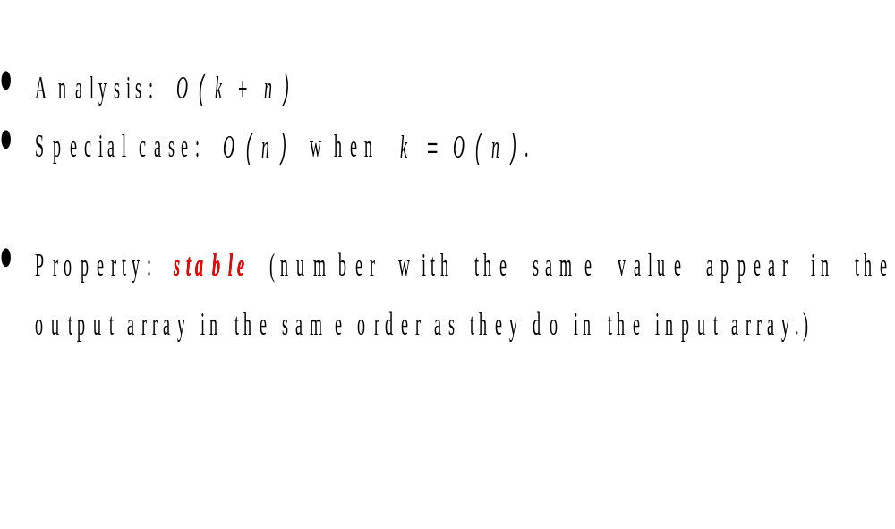

Slide 6
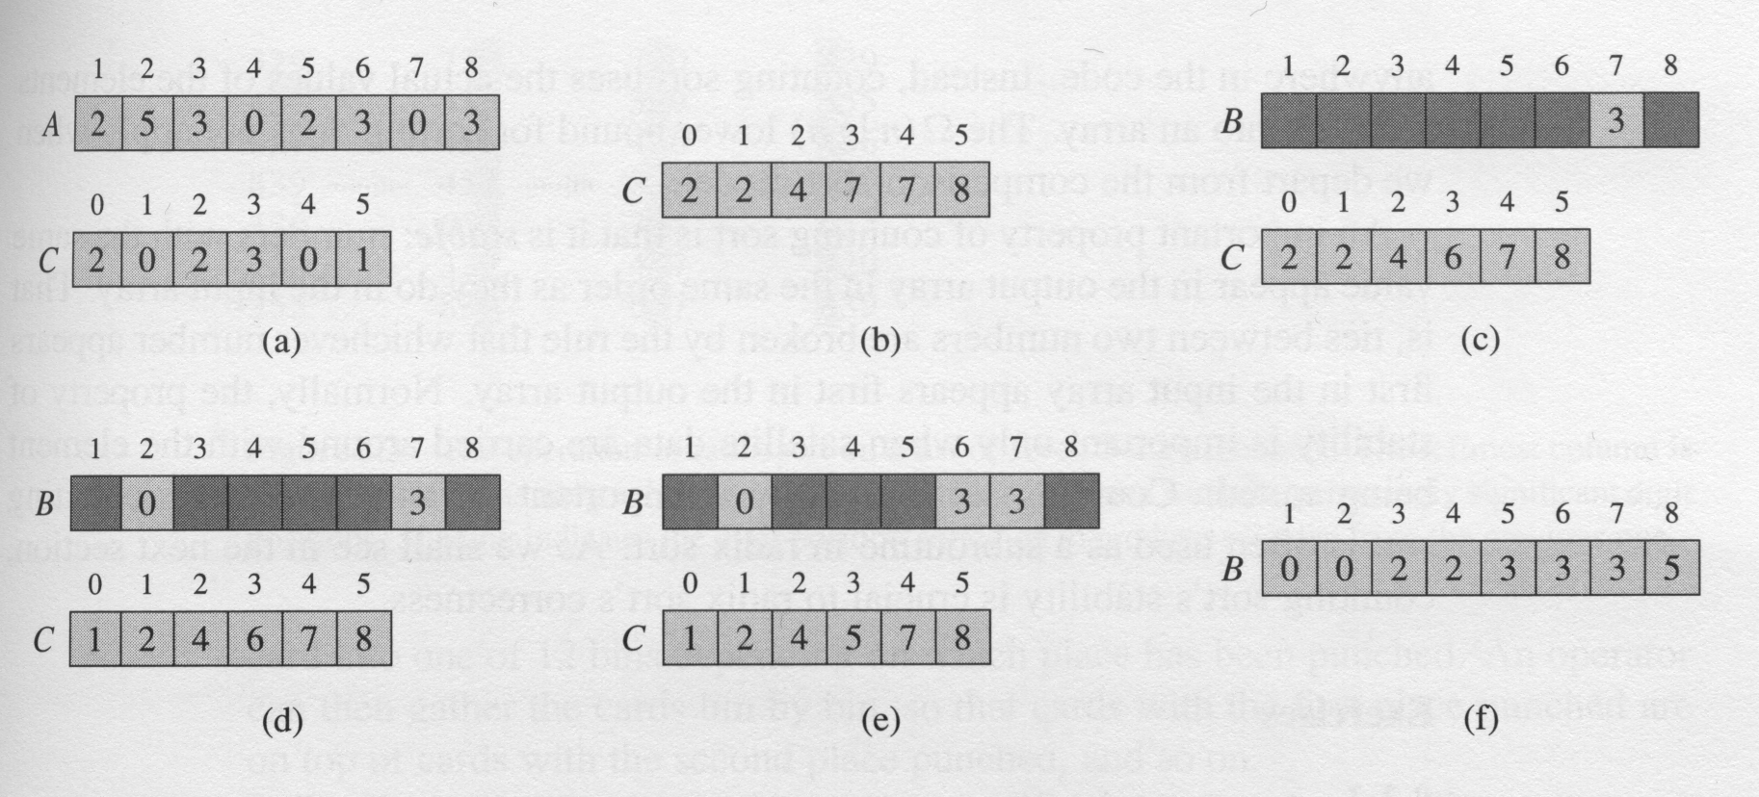
The operation of Counting-sort on an input array A[1..8]

Slide 7
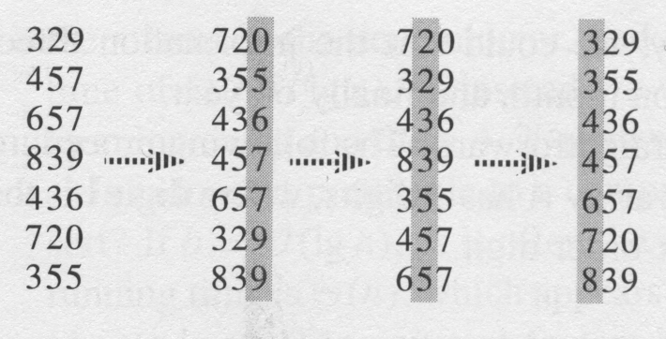
8.3 Radix sort
Used by the card-sorting machines you can now find only in computer museum.
RADIX_SORT(A,d)
1 for i ← 1 to d
2 do use a stable sort to sort array A on digit i

Slide 8
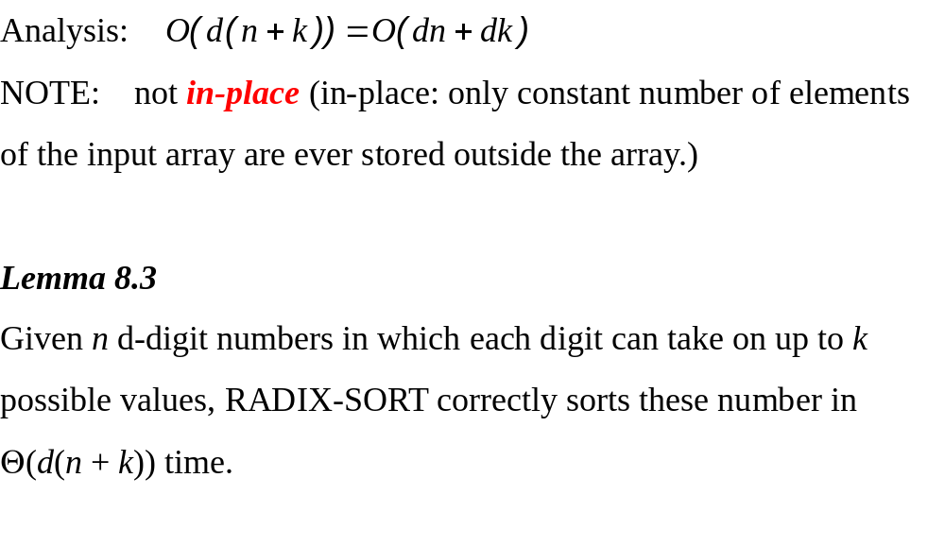

Slide 9
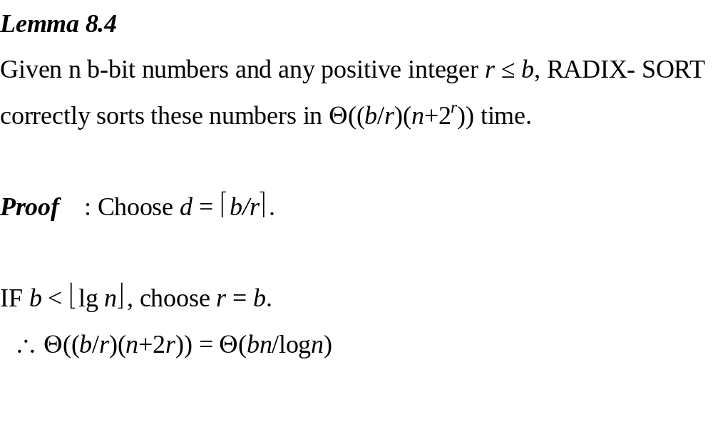

Slide 10
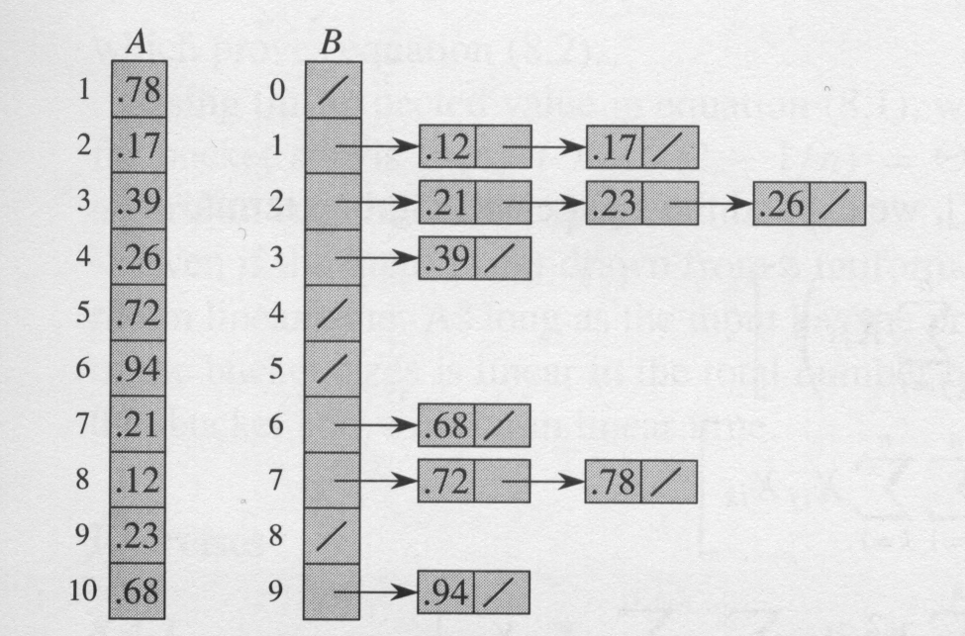
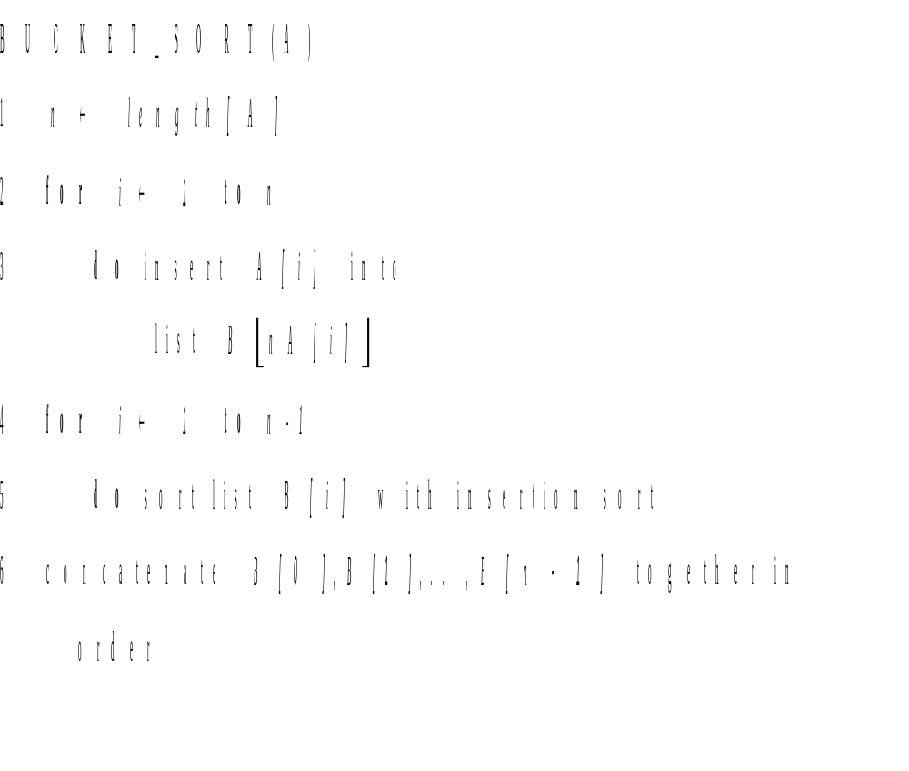
8.4 Bucket sort

Slide 11
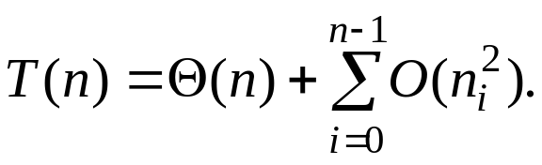
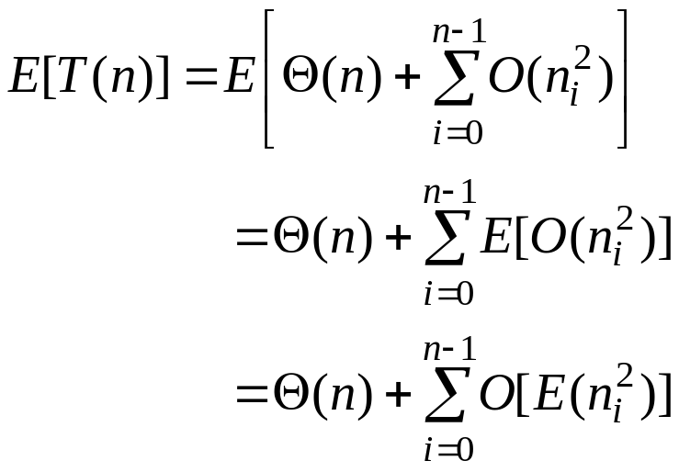
Analysis
The running time of bucket sort is
taking expectations of both sides and using linearity of expectation, we have

Slide 12
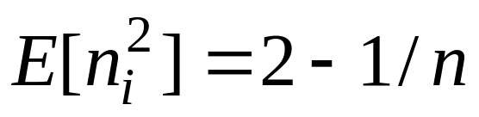
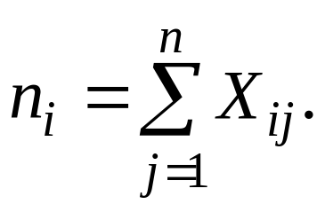
We claim that
We define indicator random variables
X_{ij} = I {A[j] falls in bucket i}
for i = 0, 1, …, n-1 and j = 1, 2,…,n. thus,

Slide 13
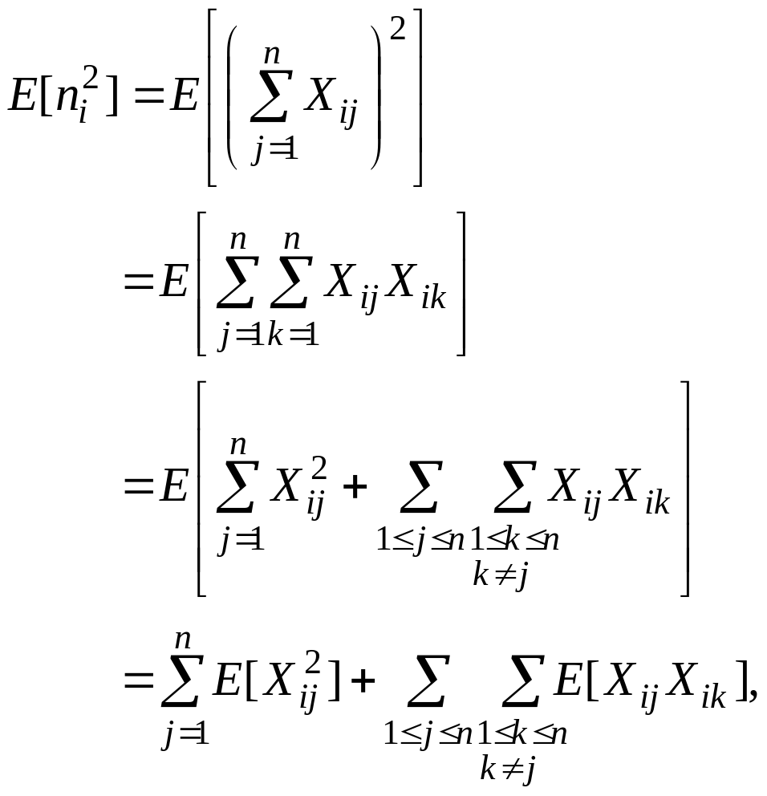

Slide 14
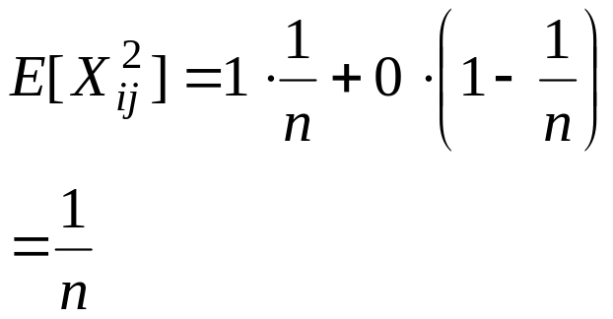
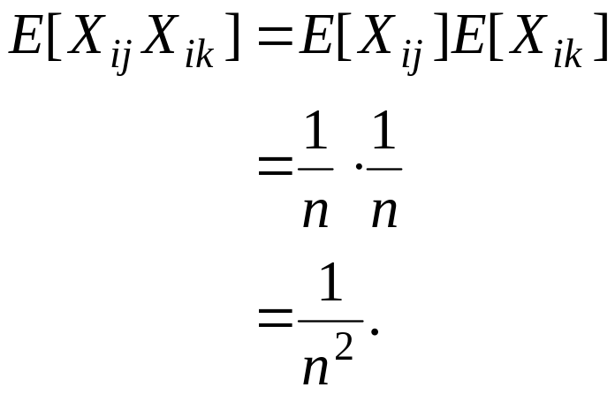
Indicator random variable X_{ij} is 1 with probability 1/n and 0
otherwise, and therefore
When k ≠ j, the variables X_{ij} and X_{ik} are independent, and hence

Slide 15
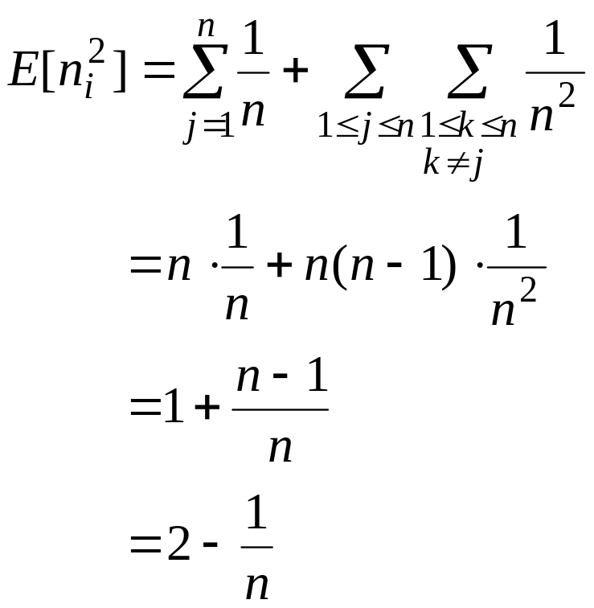
We can conclude that the expected time for bucket sort is
Θ(n)+n·O(2-1/n)= Θ(n).

Slide 16
