Slide 1
9.Medians and order statistics

Slide 2
The ith order statistic of a set of n element is the ith smallest.
The selection problem can be specified formally as follows:
  Input: A set of n (distinct) numbers and a number i, with 1 ≤ i ≤ n.
  Output: the element x ∈ A that is larger than exactly i - 1 other elements of A.

Slide 3
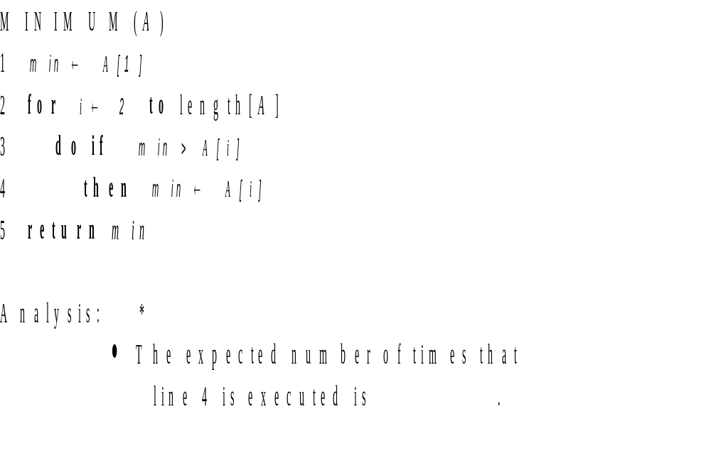


9.1 Minimum and Maximum

Slide 4
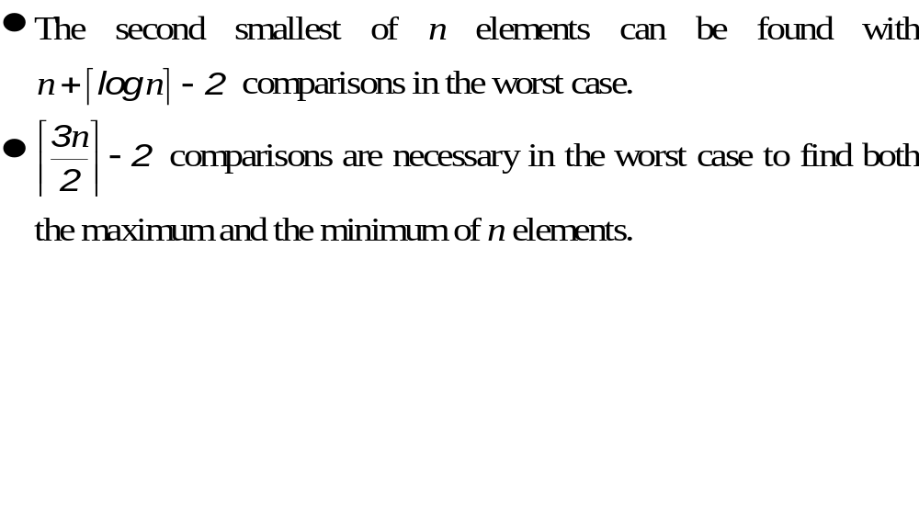

Slide 5
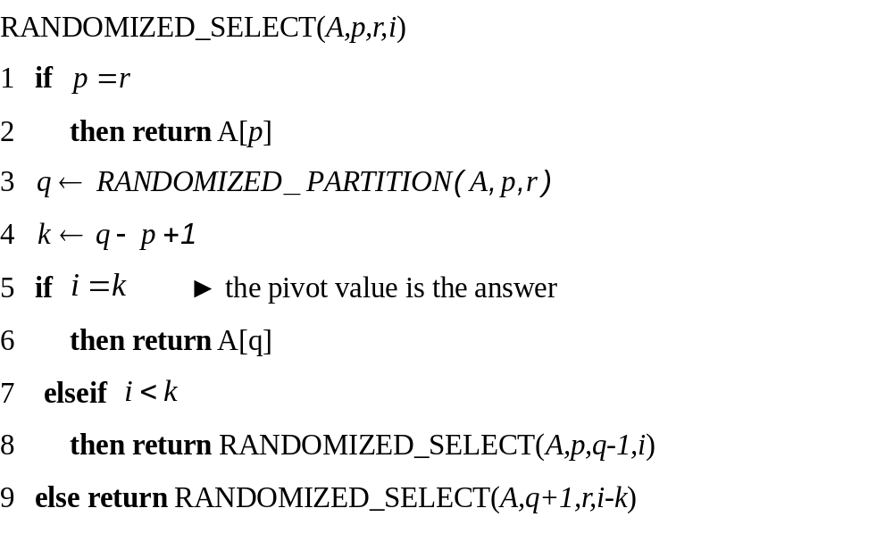
9.2 Selection in expected linear time

Slide 6
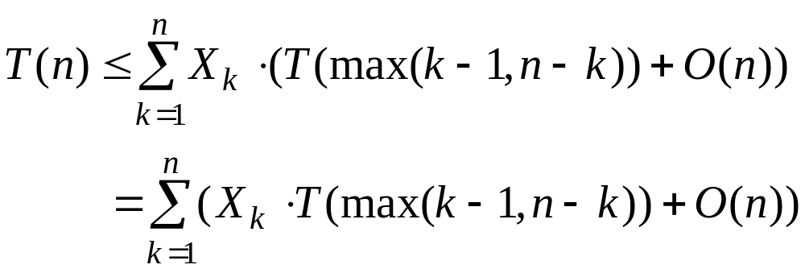
Analysis
For k = 1, 2, …, n, we define indicator random variables X_{k} where
X_{k} = I {the subarray A[p..q] has exactly k elements} ,
and so we have
E[X_{k}] = 1/n .

Slide 7
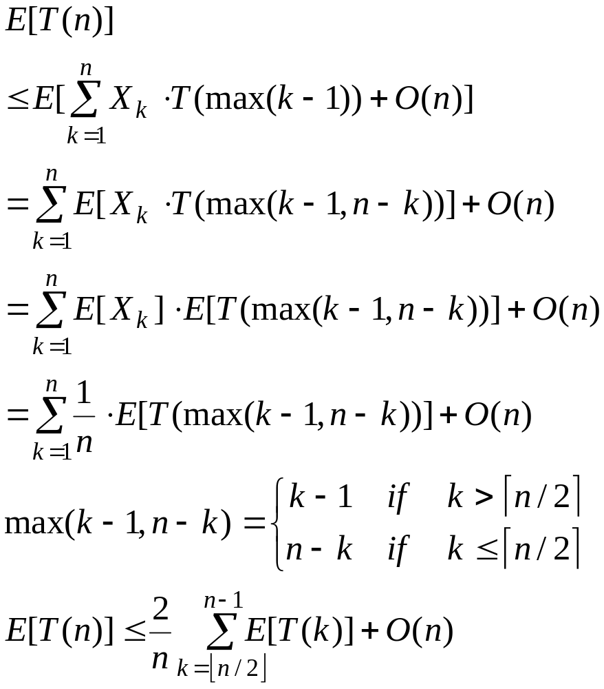
Taking expected values, we have

Slide 8
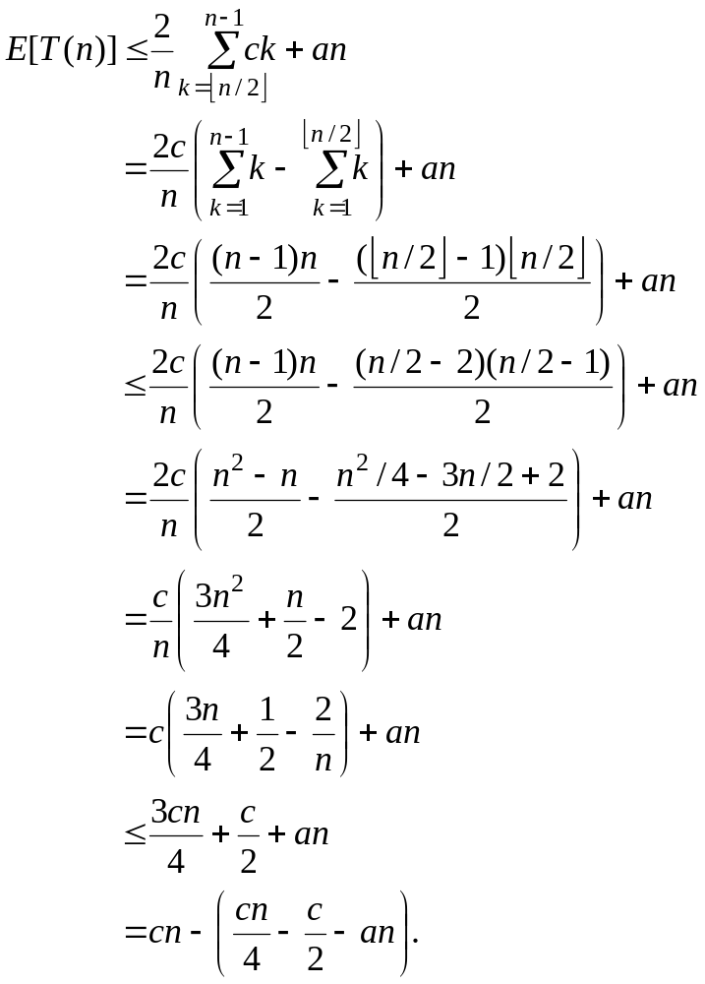

Slide 9
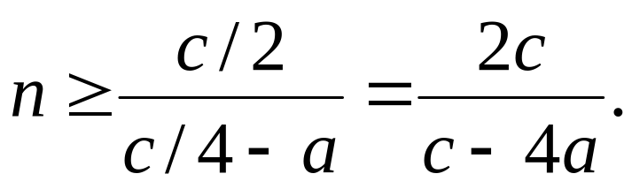
We choose the constant c so that c/4 - a > 0, i.d., c>4a, we can
Divide both sides by c/4 – a, giving
Thus, if we assume that T(n)=O(1) for n < 2c/(c-4a), we have
T(n) = O(n).

Slide 10
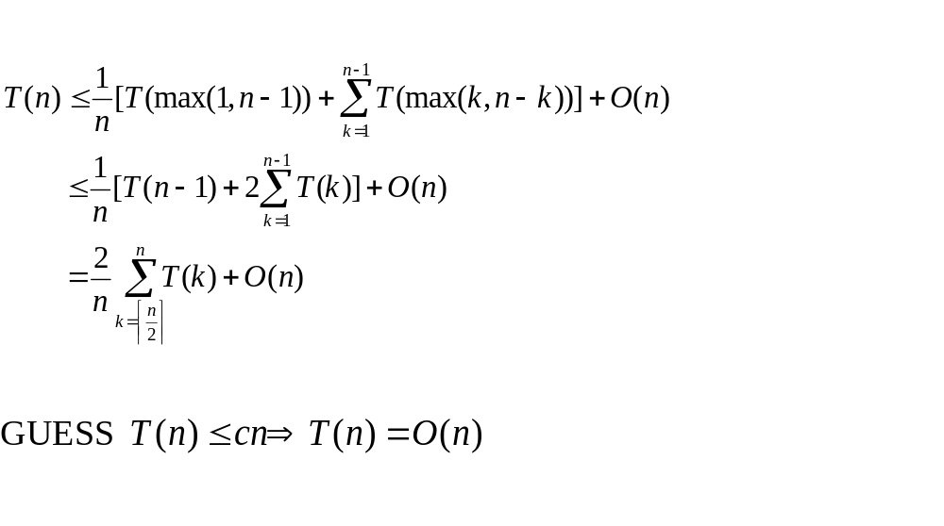
Another analysis

Slide 11
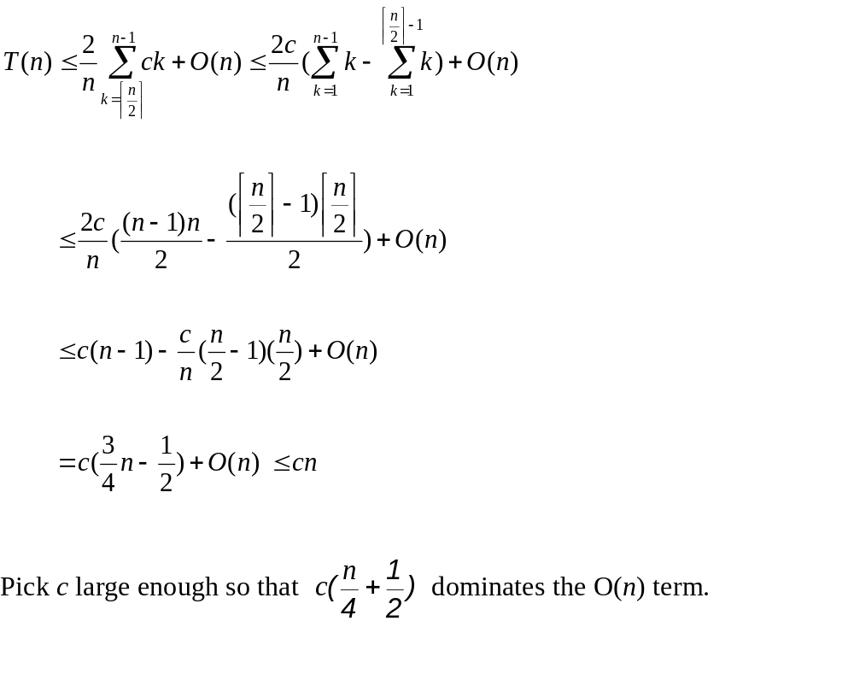

Slide 12
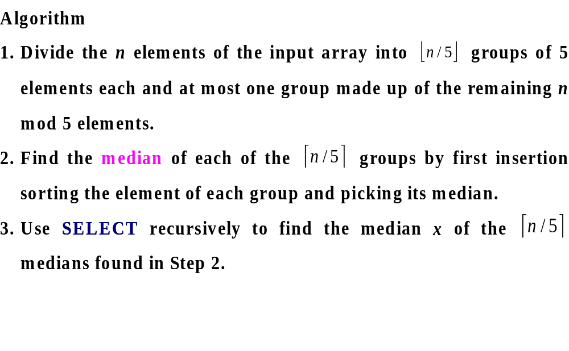
9.3 Selection in worst-case linear time

Slide 13
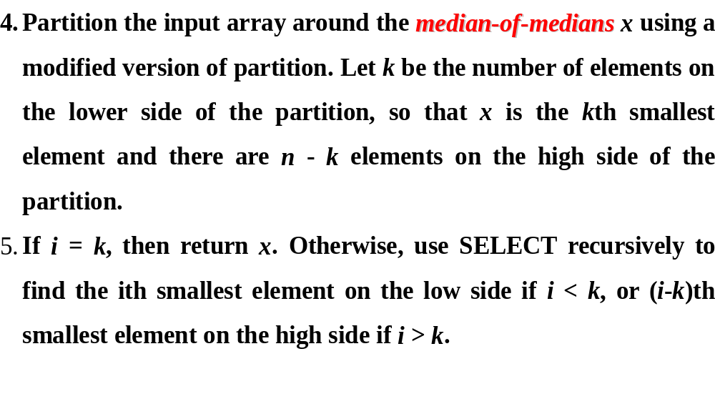

Slide 14
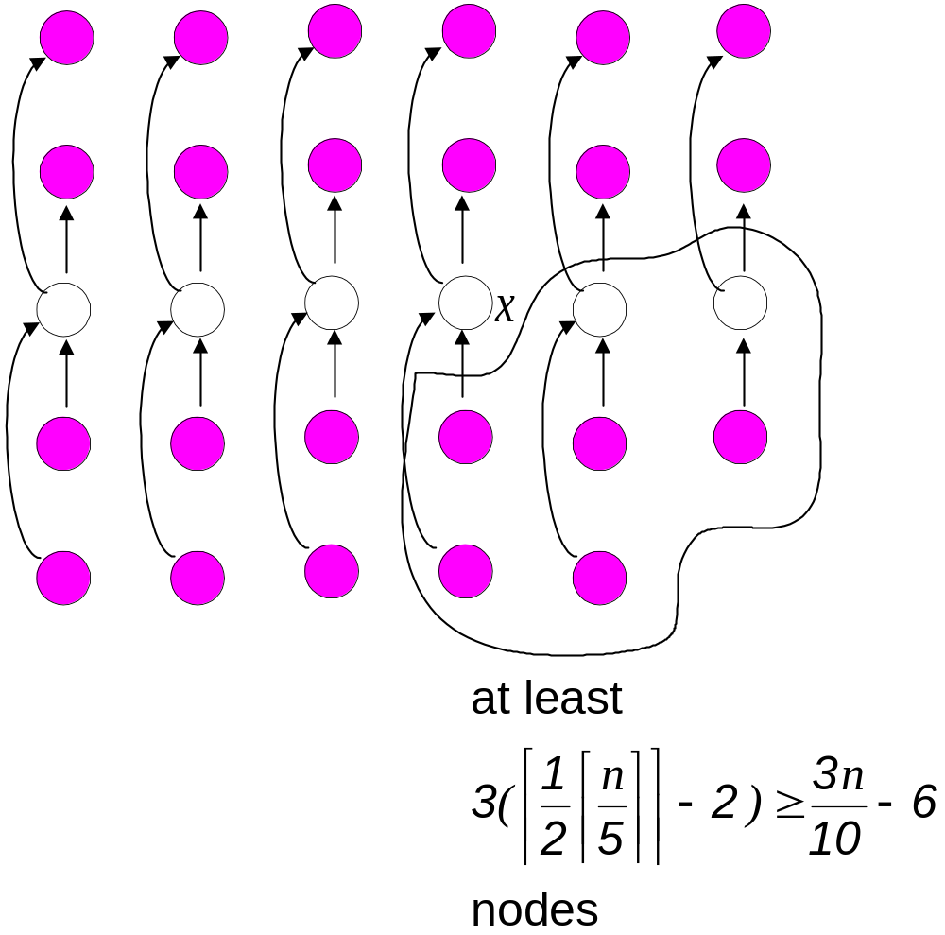
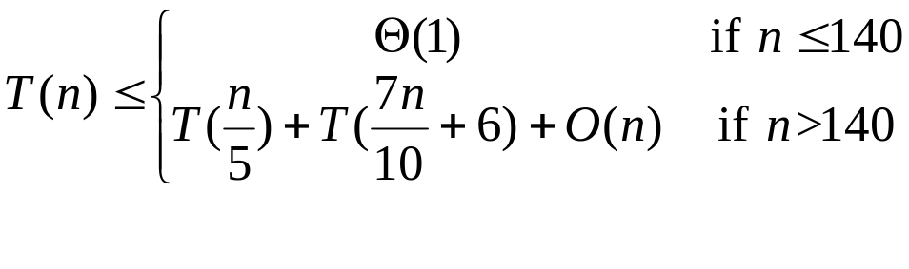

Slide 15
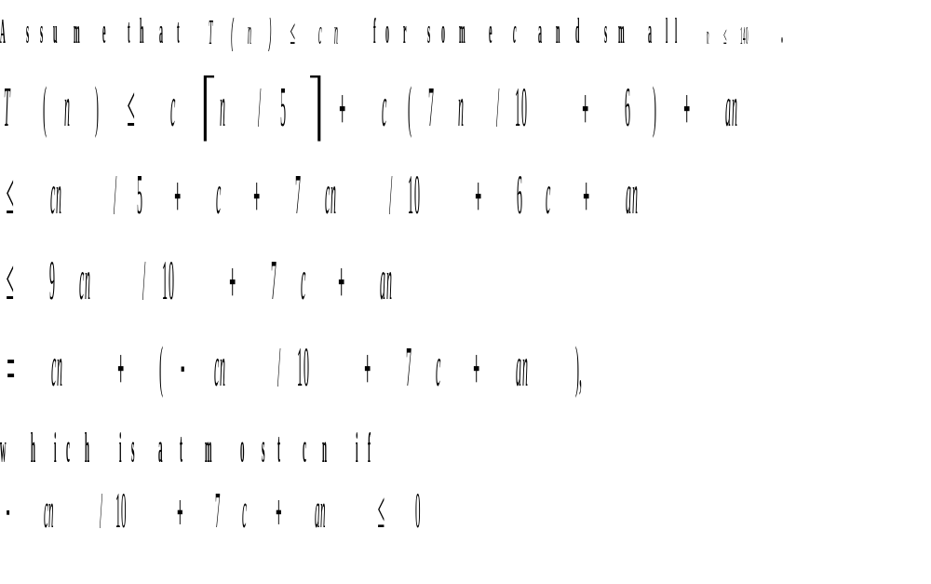

Slide 16
