Slide 1
Image similarity Estimation using Siamese Neural Networks
Lakshmipathirao Devalla , Shihao Zhang
WS 21/22

Slide 2
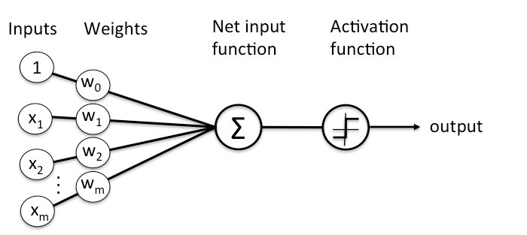
Neural Networks
Neural networks are a set of algorithms modeled loosely after the human brain
Universal approximators as they can learn to approximate an unknown function f(x) = y between any input x and output y
Image Similarity Estimation using Siamese Neural Networks
Notes:
point 1 and 2- Give a short intro on what neural networks are
picture is a perceptron - A perceptron is a single layer neural network and a multi-layer perceptron is called Neural Network
Source: https://wiki.pathmind.com/neural-network

Slide 3

Introduction to Convolutional Neural Networks
CNN
X or O
Source: https://e2eml.school/how_convolutional_neural_networks_work.html
Image Similarity Estimation using Siamese Neural Networks

Slide 4
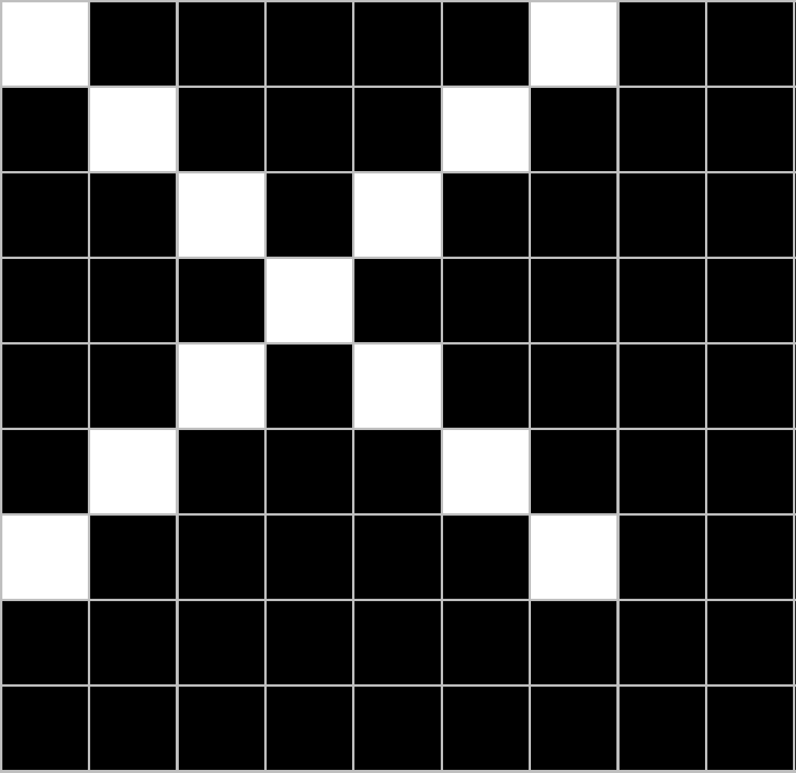
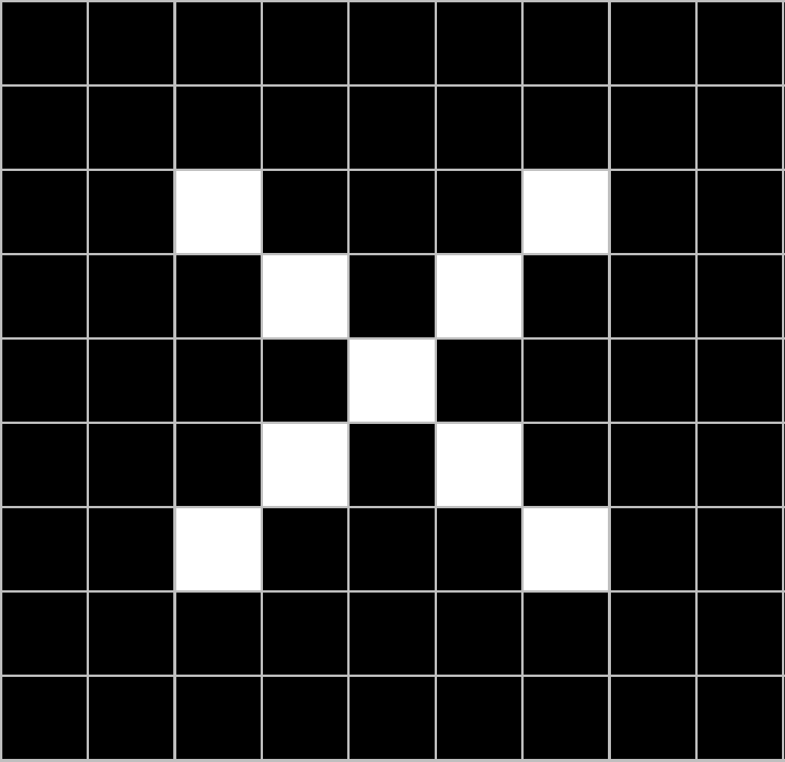
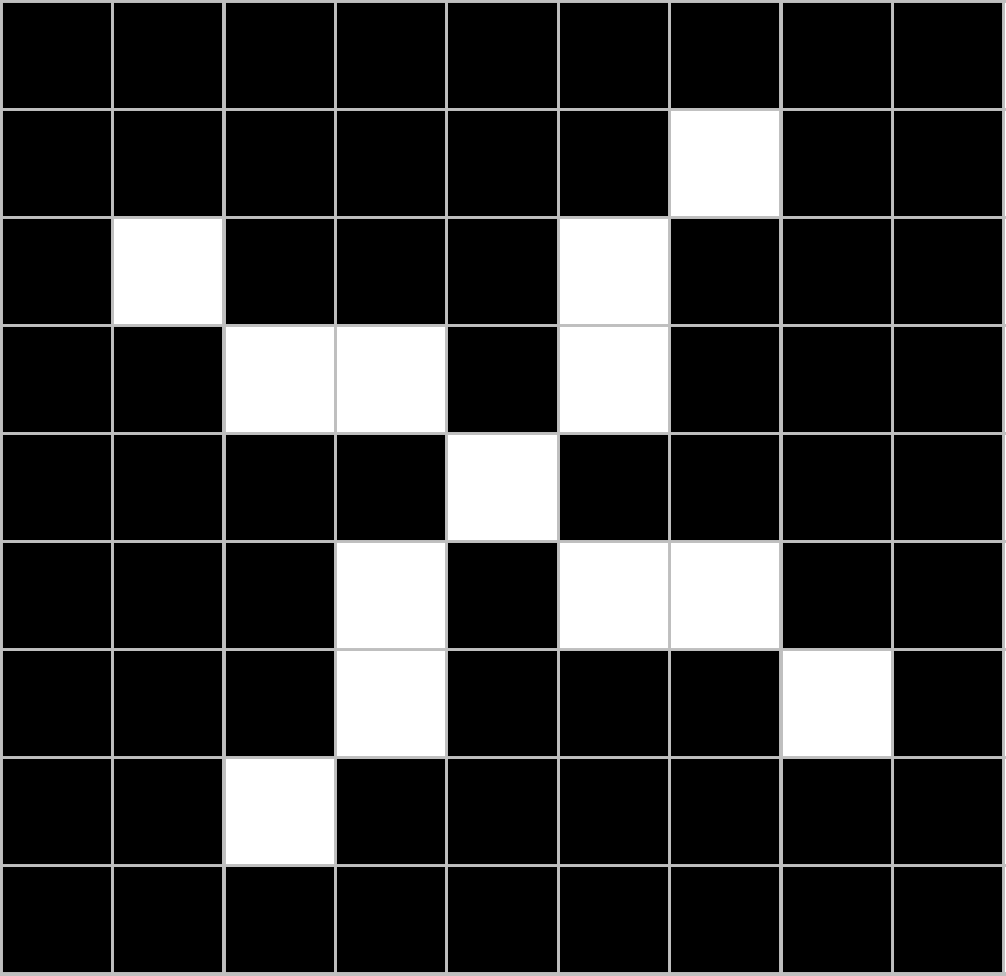
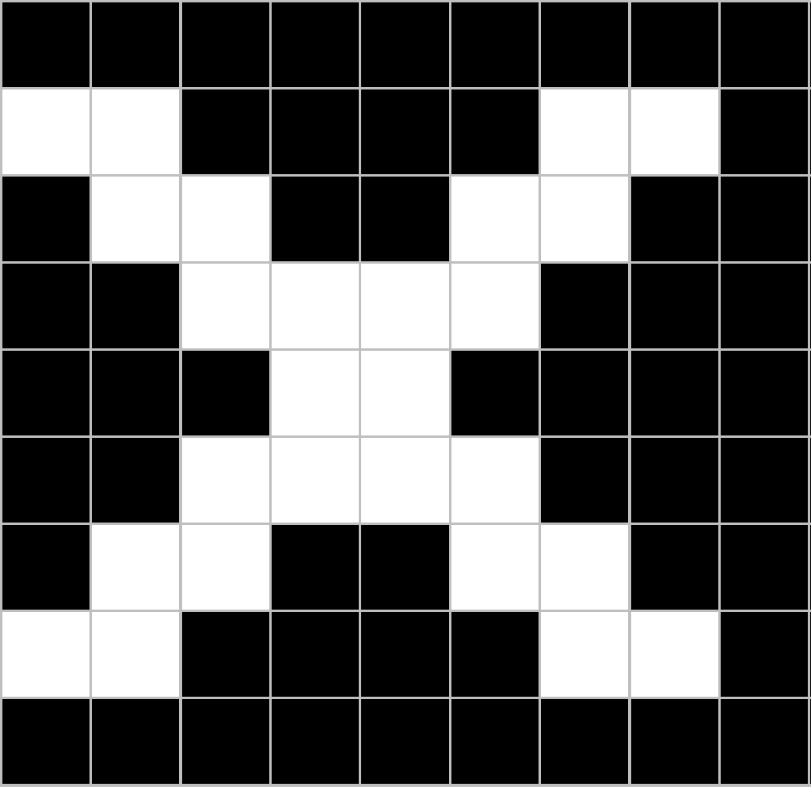
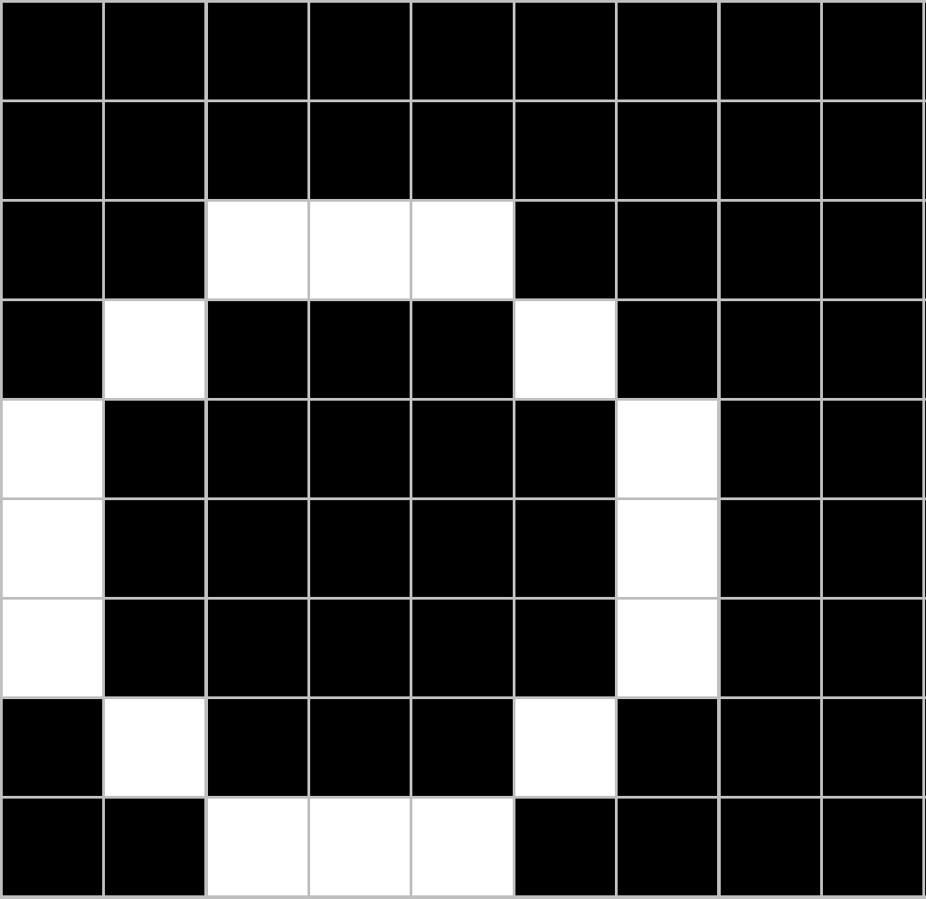
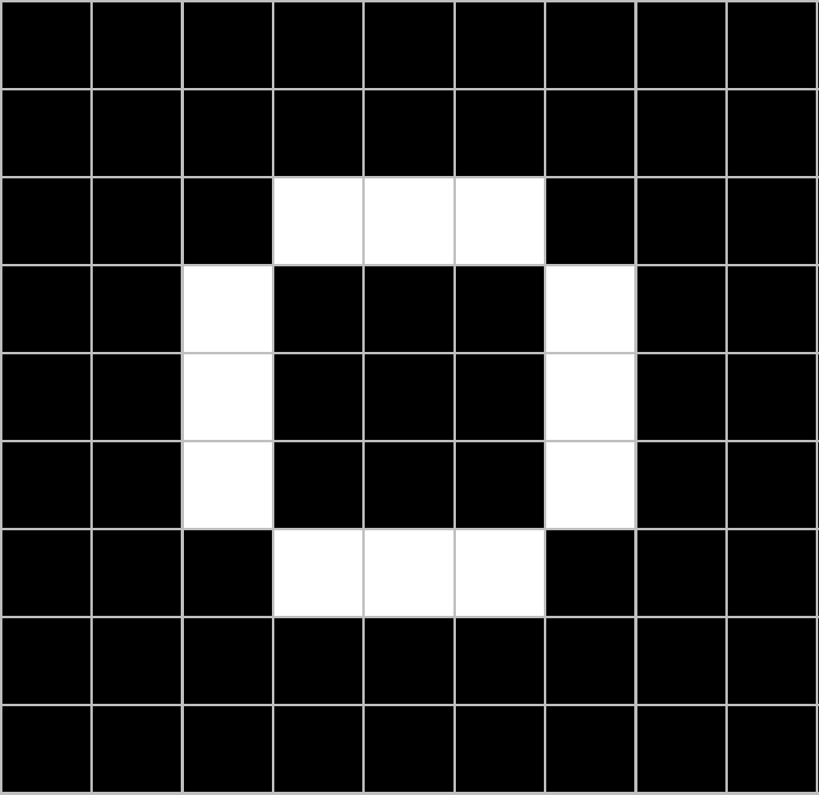
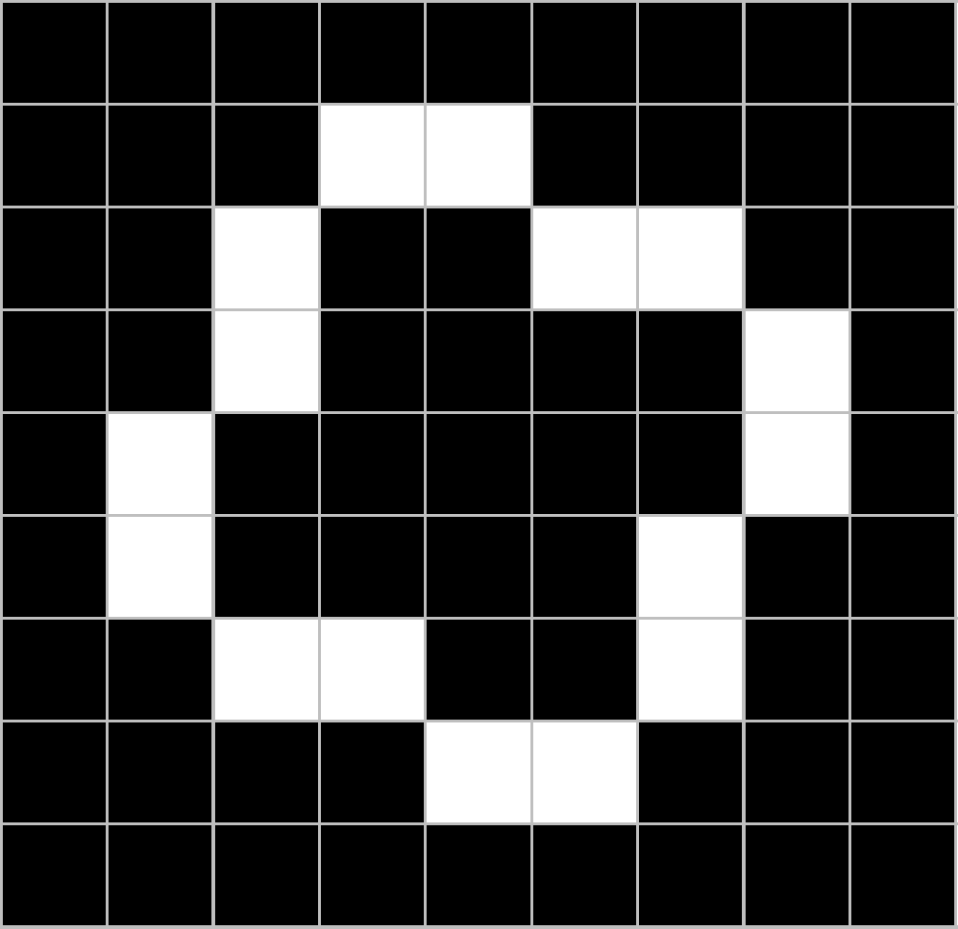
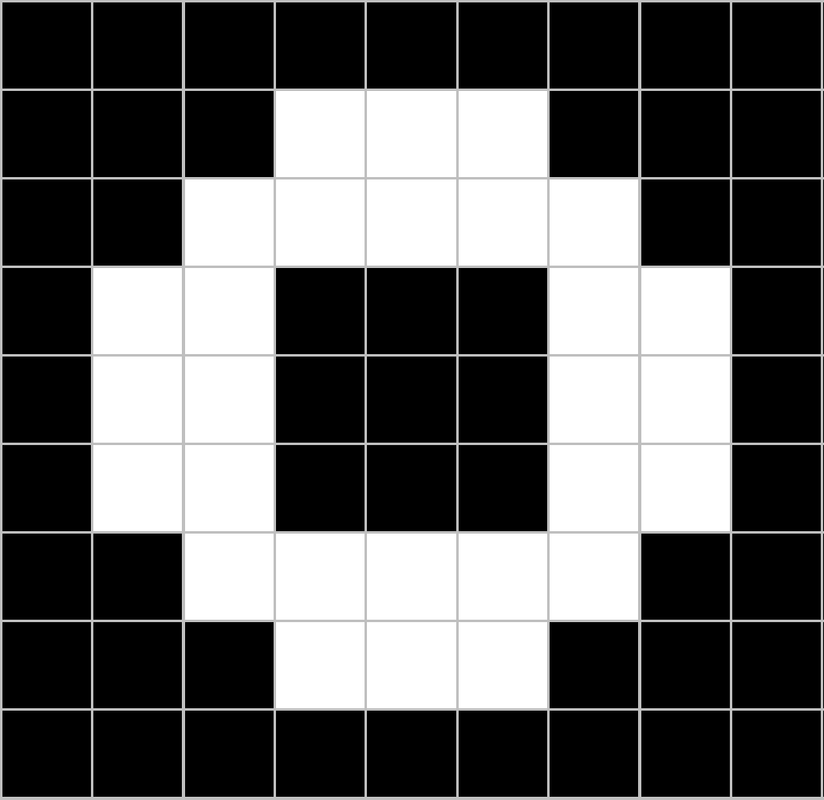
Introduction to Convolutional Neural Networks
CNN
X
translation
scaling
rotation
weight
CNN
O
Image Similarity Estimation using Siamese Neural Networks

Slide 5
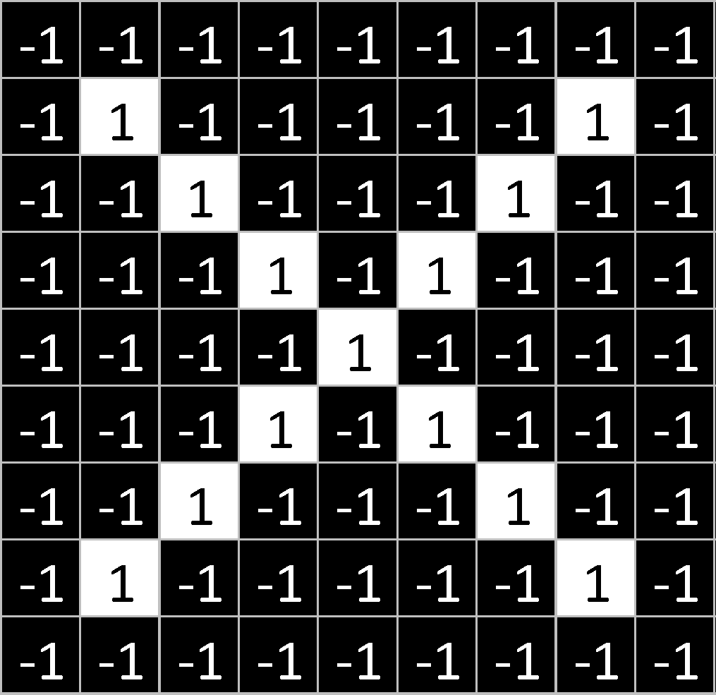
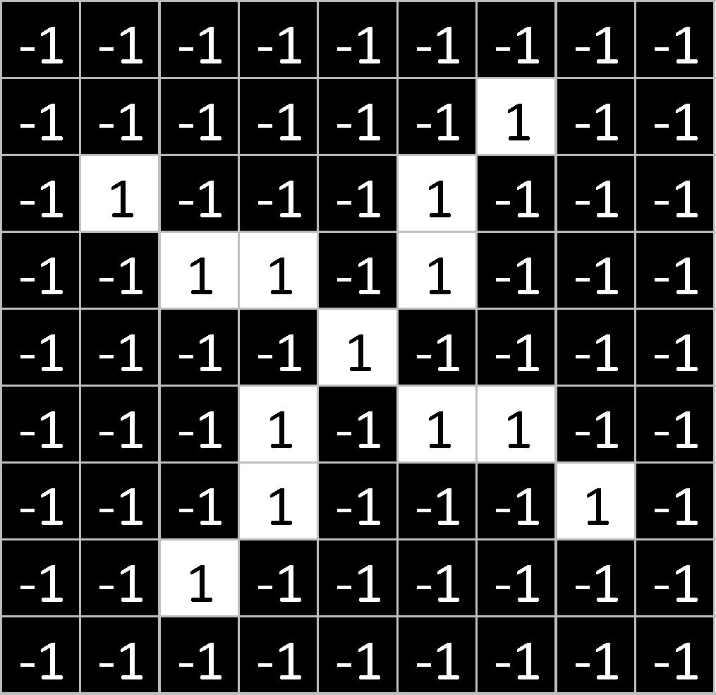
Introduction to Convolutional Neural Networks
Image Similarity Estimation using Siamese Neural Networks

Slide 6
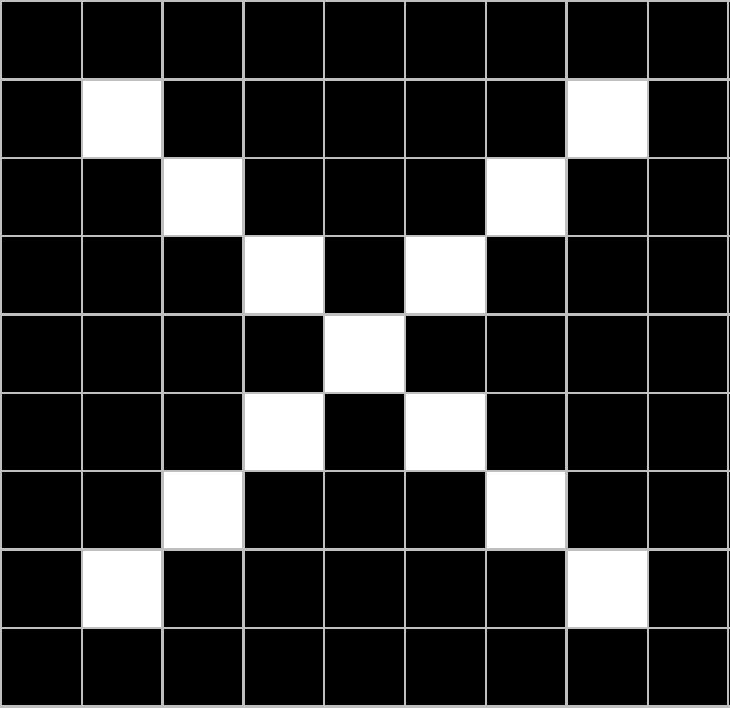
Introduction to Convolutional Neural Networks
=
=
=
=
Image Similarity Estimation using Siamese Neural Networks

Slide 7
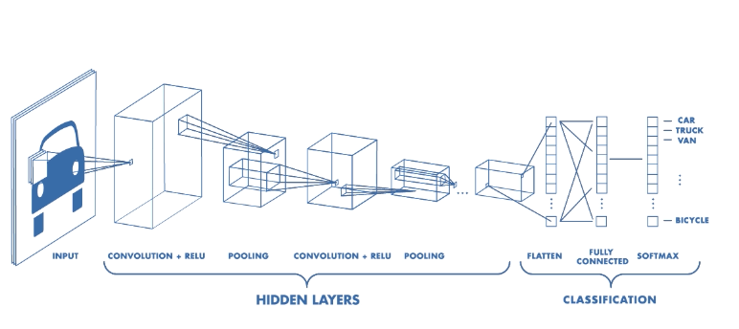
Typical structure of a CNN
Convolutional layer, pooling layer, fully-connected layer
First stack CONV-ReLU layers, followed by POOL
Repeat this pattern until image has been merged spatially to a small size
Source: Introduction to deep learning
Image Similarity Estimation using Siamese Neural Networks

Slide 8
Introduction to Convolutional neural networks
The structure of CNN
convolutional layer, pooling layer, fully-connected layer
first stack CONV-ReLU layers, followed by POOL
then Repeat this pattern until image has been merged spatially to a small size
Similarity Learning using Artificial Neural Networks

Slide 9
Convolutional layer
Source: https://www.freecodecamp.org/news/an-intuitive-guide-to-convolutional-neural-networks-260c2de0a050/
Image Similarity Estimation using Siamese Neural Networks

Slide 10
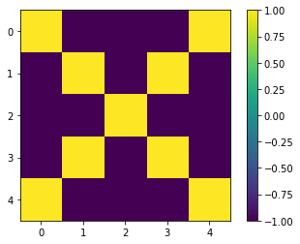
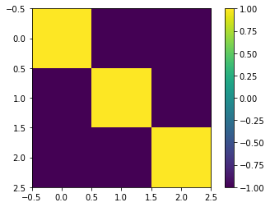
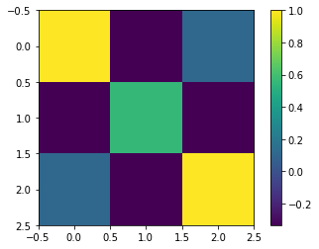
Image Similarity Estimation using Siamese Neural Networks

Slide 11
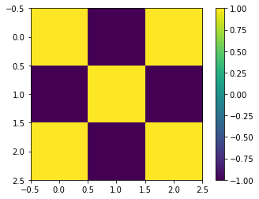
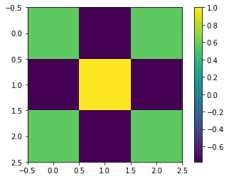
Image Similarity Estimation using Siamese Neural Networks

Slide 12
Image Similarity Estimation using Siamese Neural Networks

Slide 13
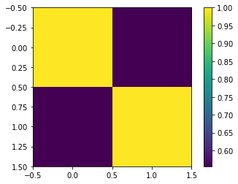
Pooling layer
Max or Avg
Image Similarity Estimation using Siamese Neural Networks

Slide 14
Activation function
ReLU
Negative value = 0
This helps the CNN stay mathematically healthy by keeping learned values from getting stuck near 0 or blowing up toward infinity
Image Similarity Estimation using Siamese Neural Networks

Slide 15
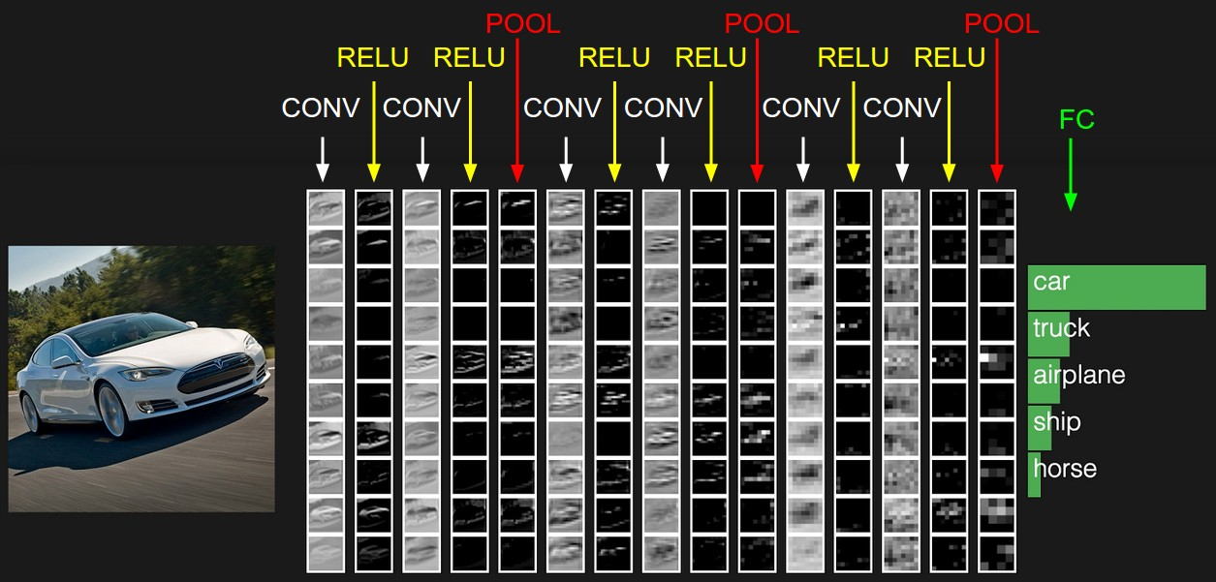
Fully-connected layer
Source: https://cs231n.github.io/convolutional-networks/#fc
Image Similarity Estimation using Siamese Neural Networks

Slide 16
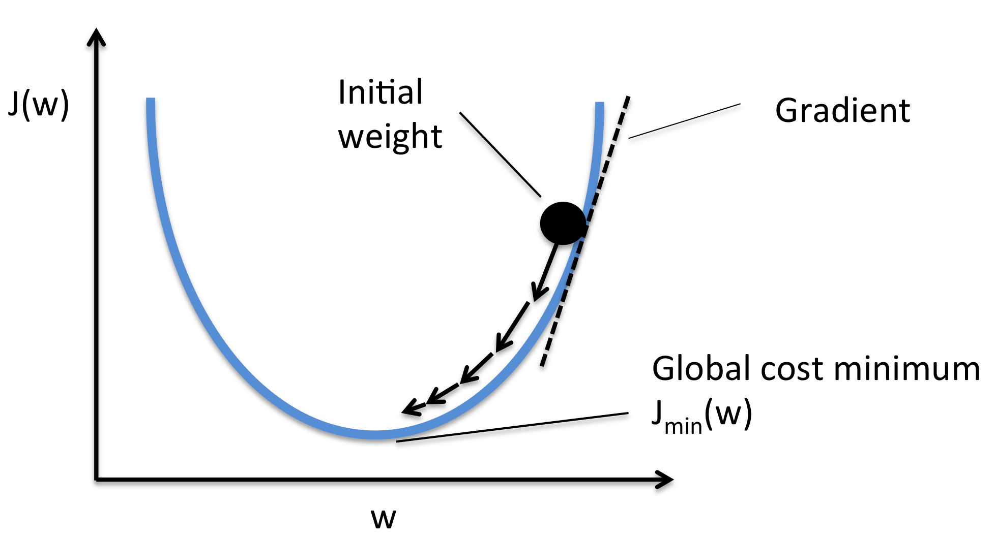
Backpropagation
Source: https://wiki.tum.de/display/lfdv/Adaptive+Learning+Rate+Method
Image Similarity Estimation using Siamese Neural Networks

Slide 17
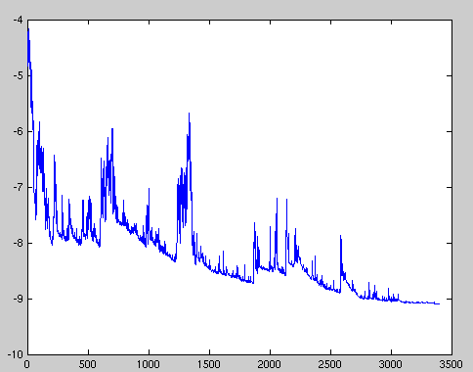
Stochastic gradient descent
Image Similarity Estimation using Siamese Neural Networks

Slide 18
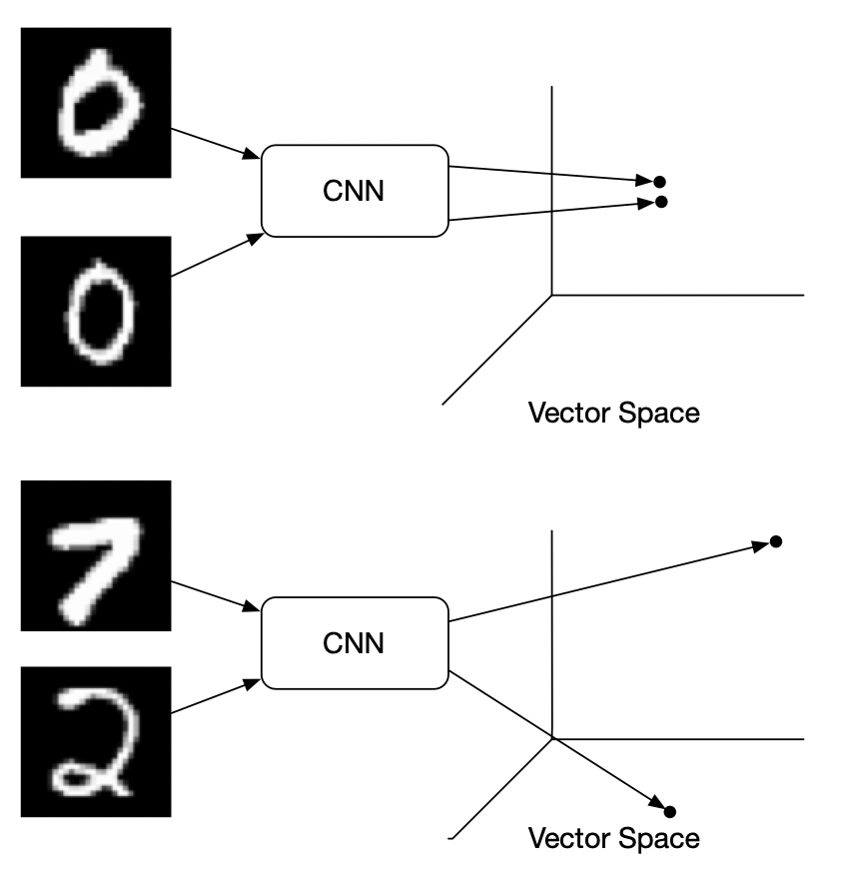
Introduction to Siamese Neural Networks
same convolutional neural network to extract features
Image Similarity Estimation using Siamese Neural Networks

Slide 19
Introduction to Siamese Neural Networks
Procedure
First design a convolutional neural network, mainly used to extract image features
We can get a feature vector for each image by applying this neural network
Subtract these two eigenvectors to get a new vector
Input the subtraction to a fully connected layer to obtain a scalar
Finally, use the sigmoid function to compare the results. If the two pictures are of the same category, the output should be close to 1. On the contrary, the output should be close to 0.
Image Similarity Estimation using Siamese Neural Networks

Slide 20
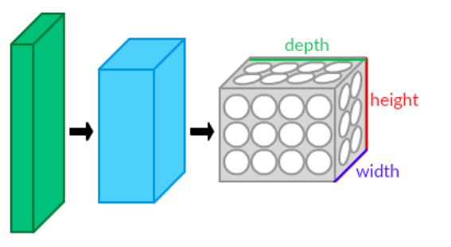
Introduction to Convolutional Neural Networks - CNN’s
CNN - A network architecture which learns directly from images
Before: pre-defined kernels extract a given feature from the image
Now: neural network learns the kernels to extract meaningful features from the image
Image Similarity Estimation using Siamese Neural Networks

Slide 21
Advantages of CNN
Image and video recognition
Image classification and segmentation
Object detection
Visual question answering
Image captioning
Image Similarity Estimation using Siamese Neural Networks

Slide 22
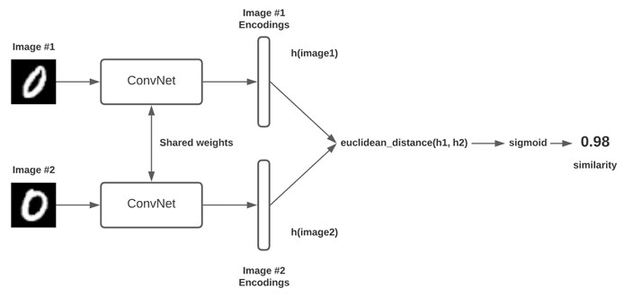
Siamese Neural Networks - General Architecture
Consists of twin networks which accept distinct inputs
These two subnetworks have the same architecture, parameters and mirror each other
Compute the Euclidean distance between the latent representations and fed through a sigmoid activation to obtain a similarity score
Source: Siamese Neural Networks
Image Similarity Estimation using Siamese Neural Networks

Slide 23
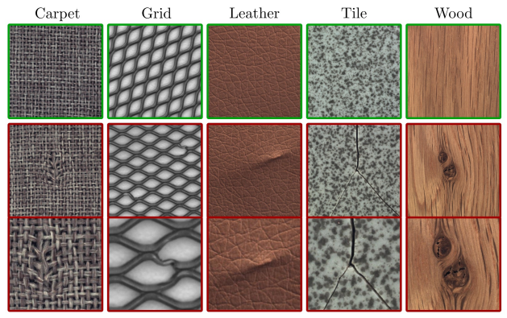
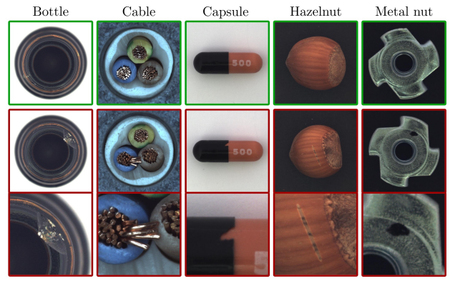
Dataset and Pre-processing
MVTEC AD - Contains over 5000 images from 15 different Objects and Textures
Textures
objects
Source: MVTEC AD Dataset
Image Similarity Estimation using Siamese Neural Networks

Slide 24
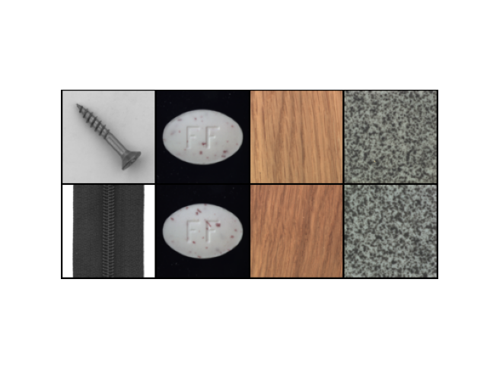
Dataset and Pre-processing
Images are resized to 105 * 105 *1(Grayscale)
80:20 split for training and validation sets
Images are paired as similar and dissimilar and
fed to the network
Similar pairs are labelled as 0,
Dissimilar pairs are labelled as 1
The goal is to find a similarity metric between any two
given images
1 1 1 0
Dataloader sample
Image Similarity Estimation using Siamese Neural Networks

Slide 25
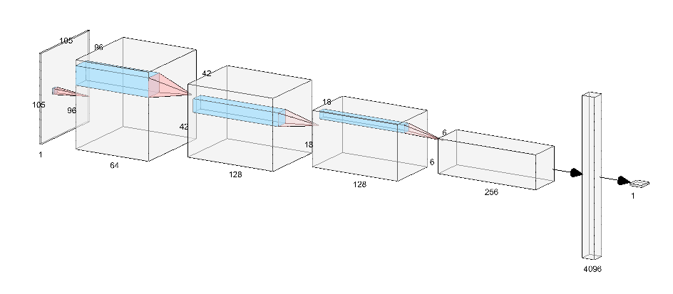
Convnet Architecture
Source: NN SVG
Image Similarity Estimation using Siamese Neural Networks

Slide 26
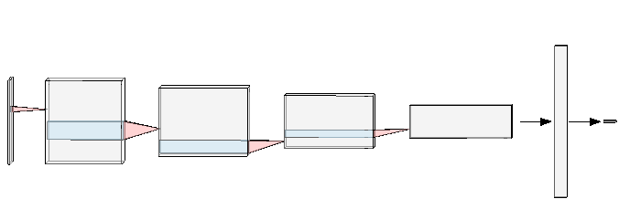
Siamese Network
Convnet
Encoding
Shared weights
Contrastive loss
Similarity Score
Encoding
Convnet
Image Similarity Estimation using Siamese Neural Networks

Slide 27
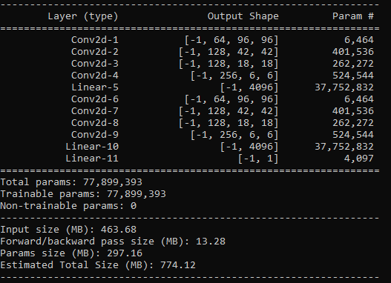
Design choices
Architecture
4 conv layers followed by a linear
Image Similarity Estimation using Siamese Neural Networks

Slide 28
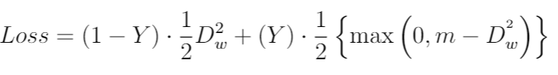



Contrastive loss
Objective is to have a small distance for positive pairs and a large distance for negative pairs
margin defines the radius to indicate that dissimilar pairs beyond this margin will not contribute to the loss
Image Similarity Estimation using Siamese Neural Networks

Slide 29
Training parameters
Epochs - 200
learning_rate - 0.0005
training_batch_size - 4
valid_batch_size - 4
Validated for every 2 epochs and saves the model
Model saved after every 2 epochs
Took around 8+ hours to train on NVIDIA 3060 TI 8GB GPU
Image Similarity Estimation using Siamese Neural Networks

Slide 30
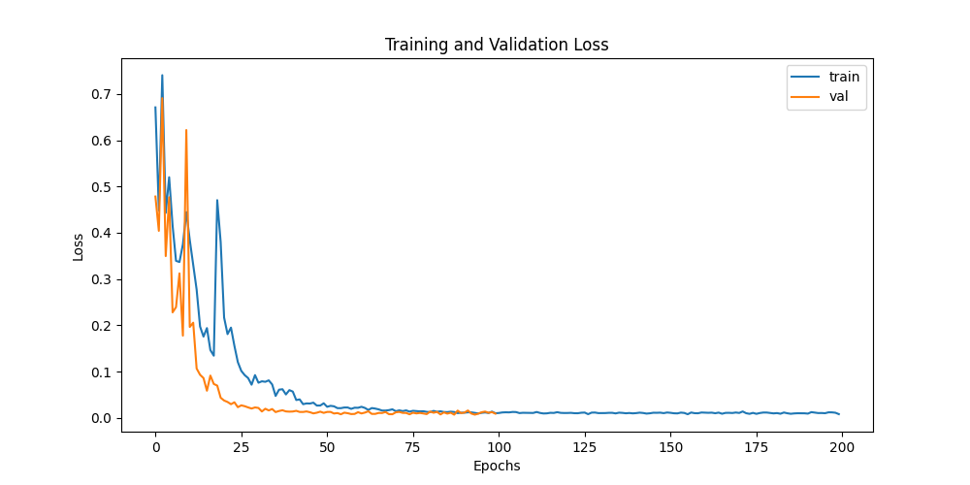
Training and validation loss
Image Similarity Estimation using Siamese Neural Networks

Slide 31
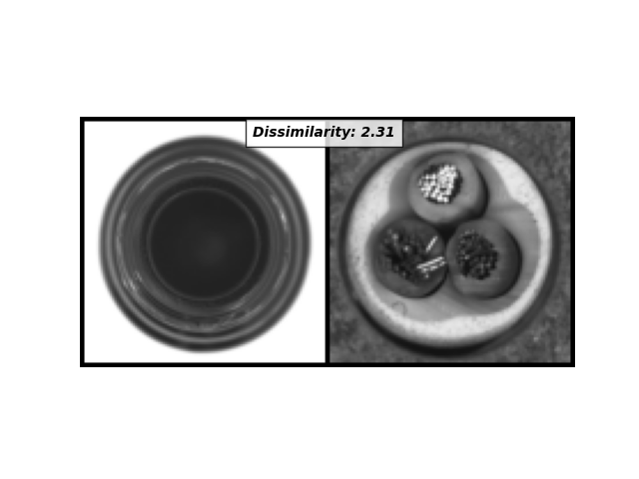
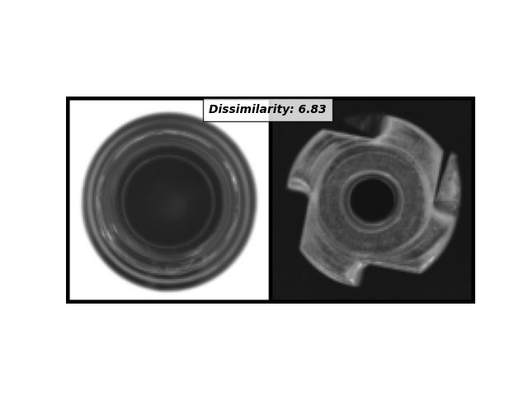
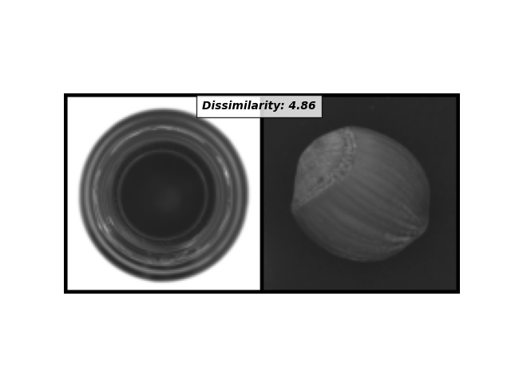
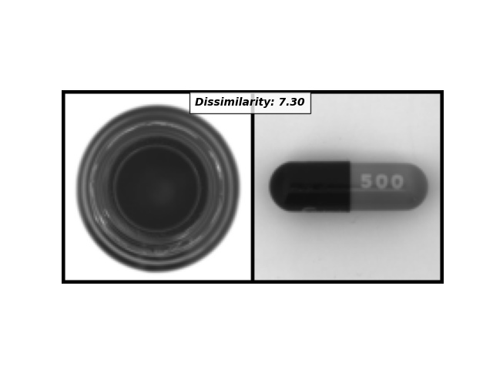
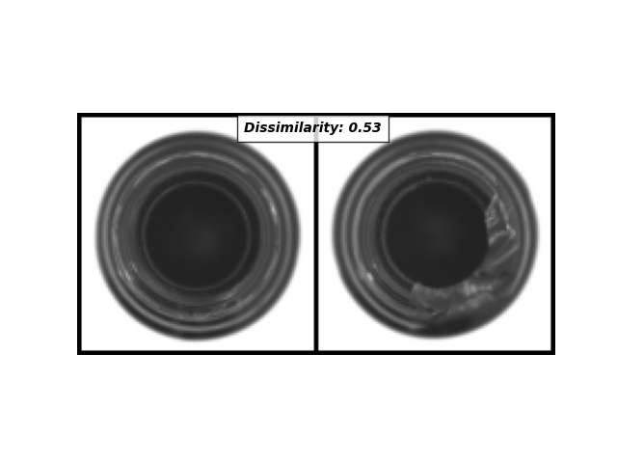
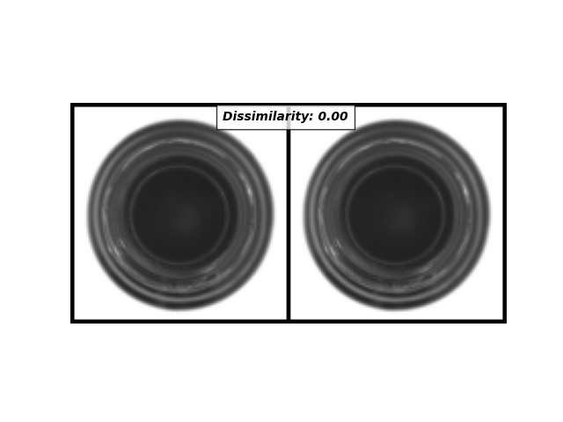
Evaluation
Image Similarity Estimation using Siamese Neural Networks

Slide 32
Pros and Cons
Pros:
More robust to class imbalance
One-shot classification model
Generates embeddings that are used for unseen classes
Cons:
Longer training time
Does not output probabilities but rather similarity metric
Image Similarity Estimation using Siamese Neural Networks

Slide 33
Questions ?
Image Similarity Estimation using Siamese Neural Networks

Slide 34
Thank you
Image Similarity Estimation using Siamese Neural Networks

