Slide 1
Image similarity Estimation using Siamese Neural Networks
Lakshmipathirao Devalla , Shihao Zhang
WS 21/22

Slide 2
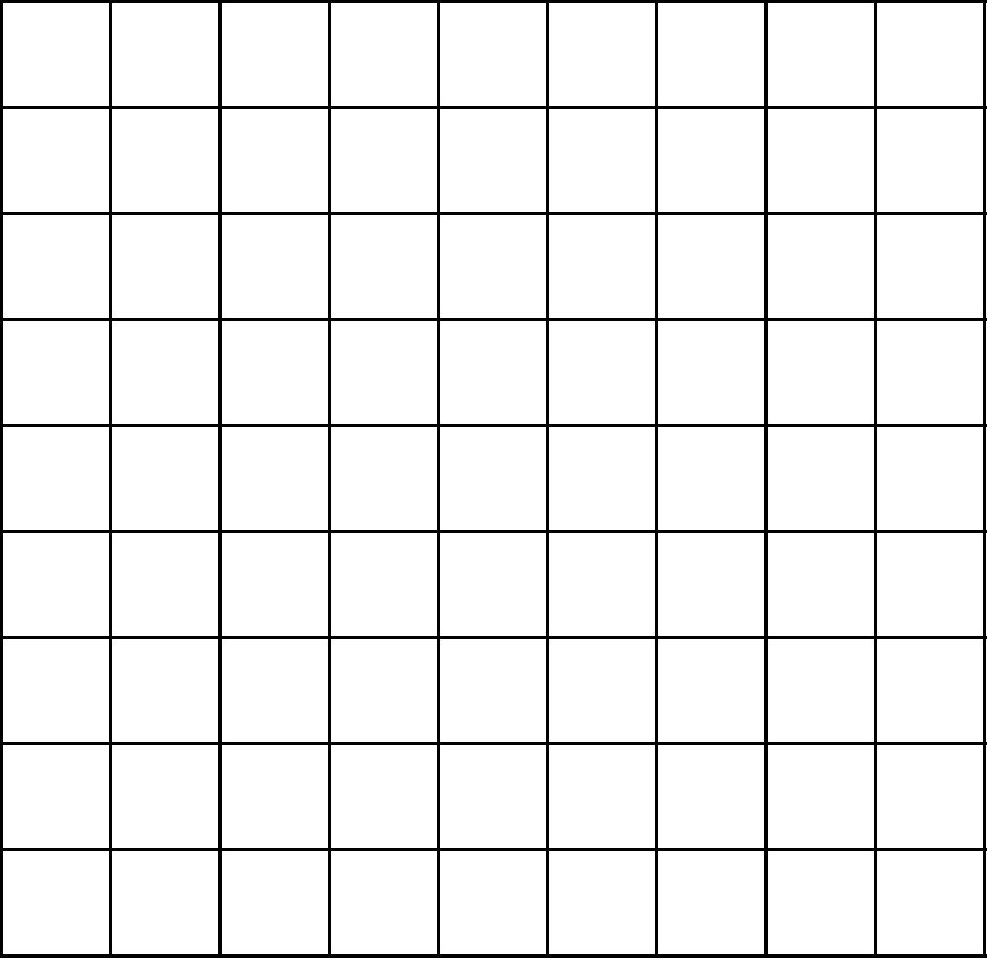
Introduction to Convolutional neural networks
CNN
X or O
https://e2eml.school/how_convolutional_neural_networks_work.html

Slide 3
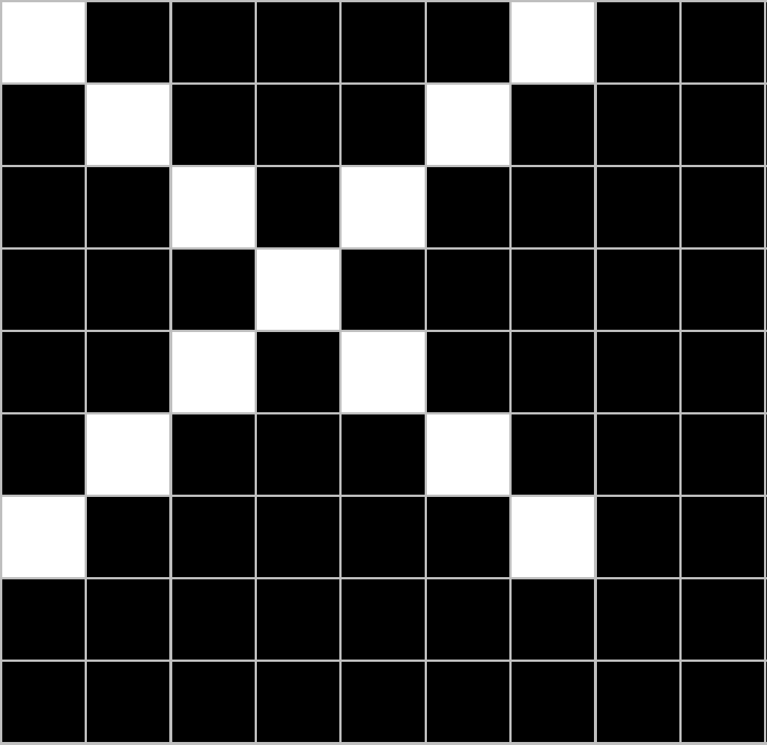
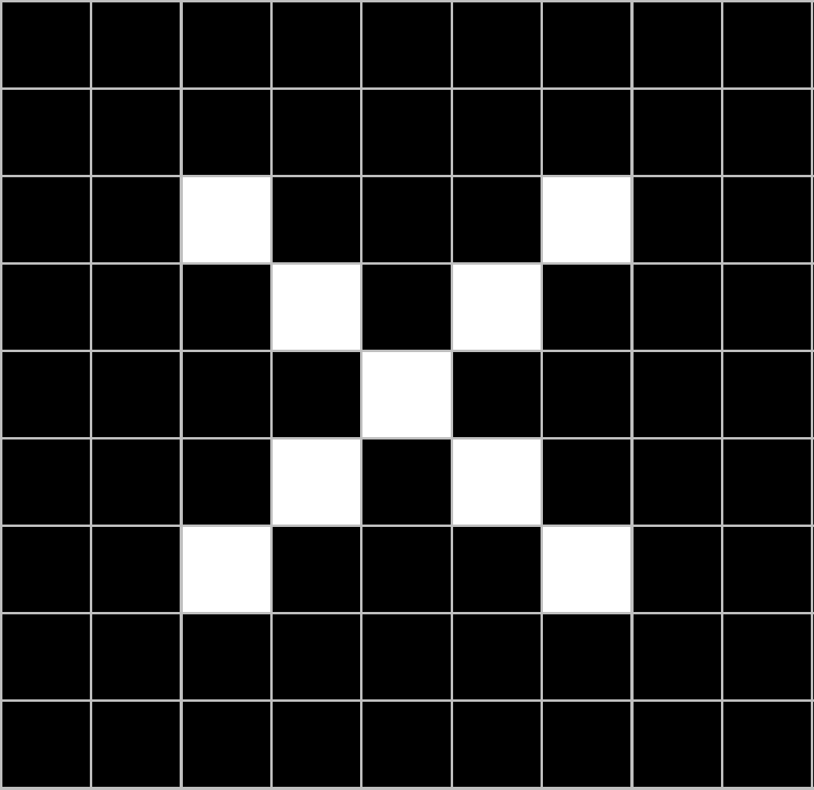
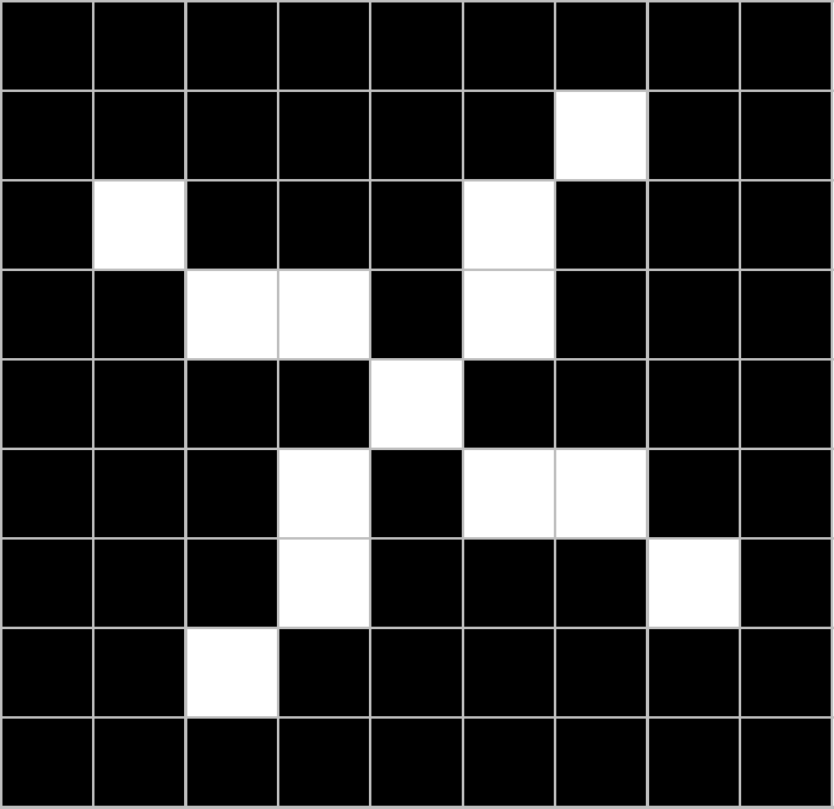
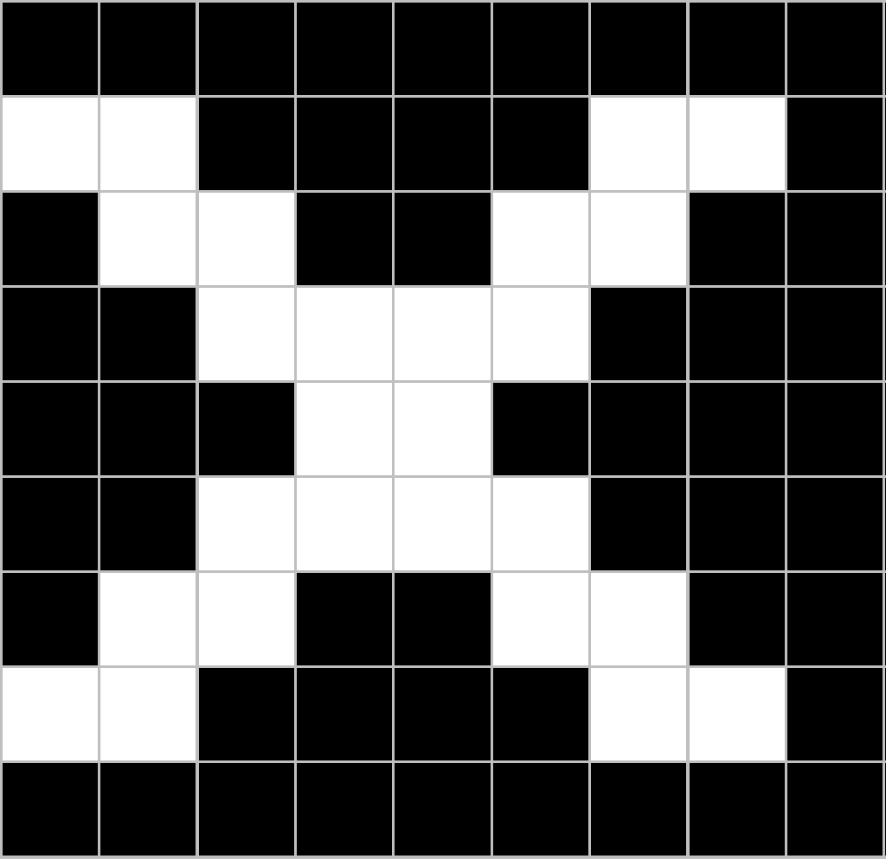
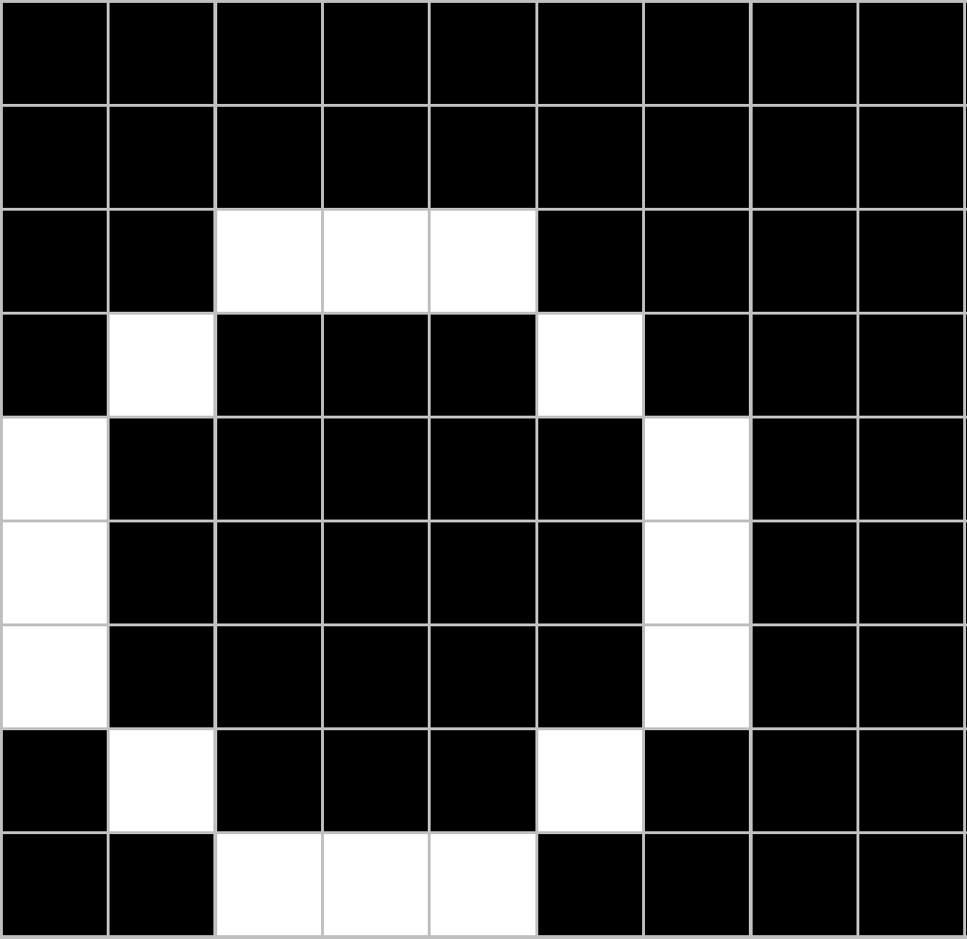
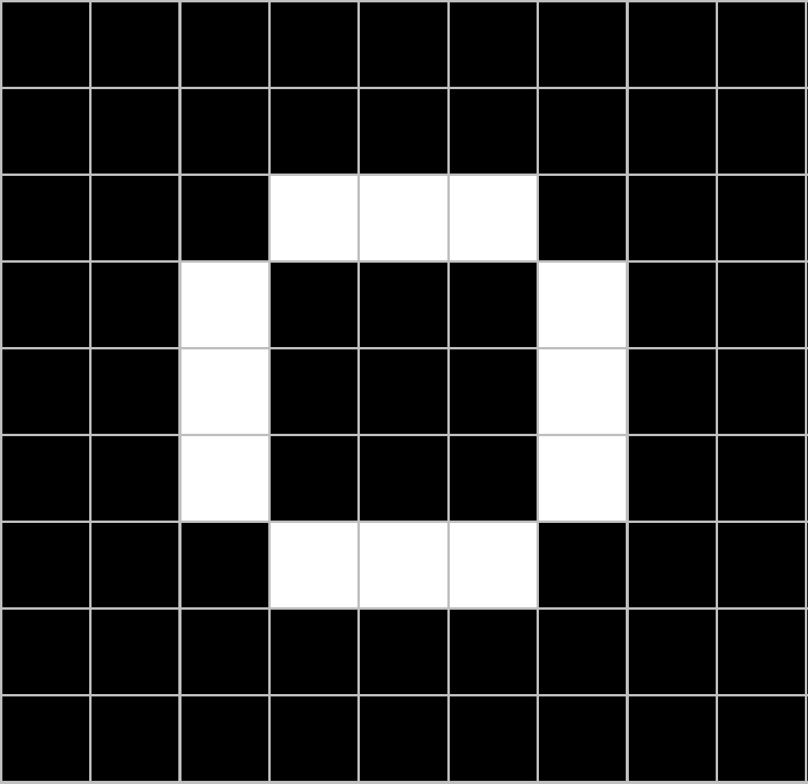
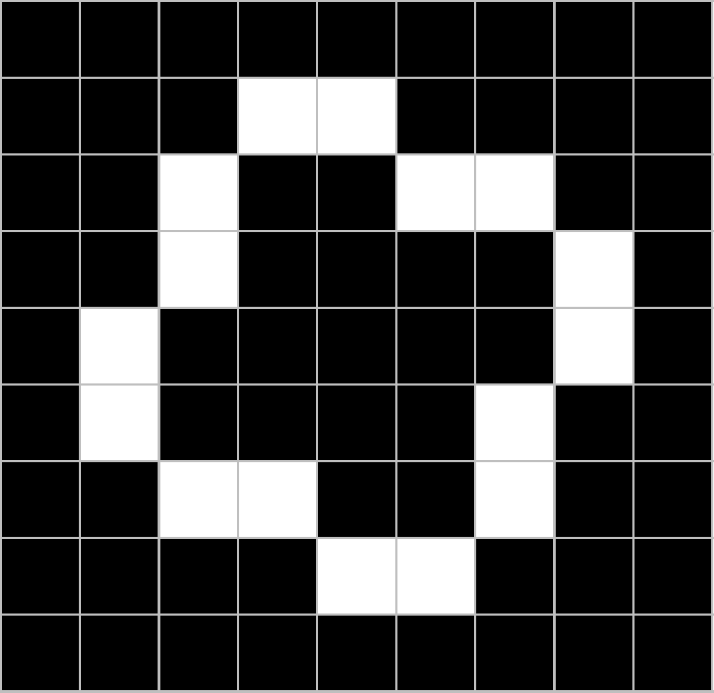
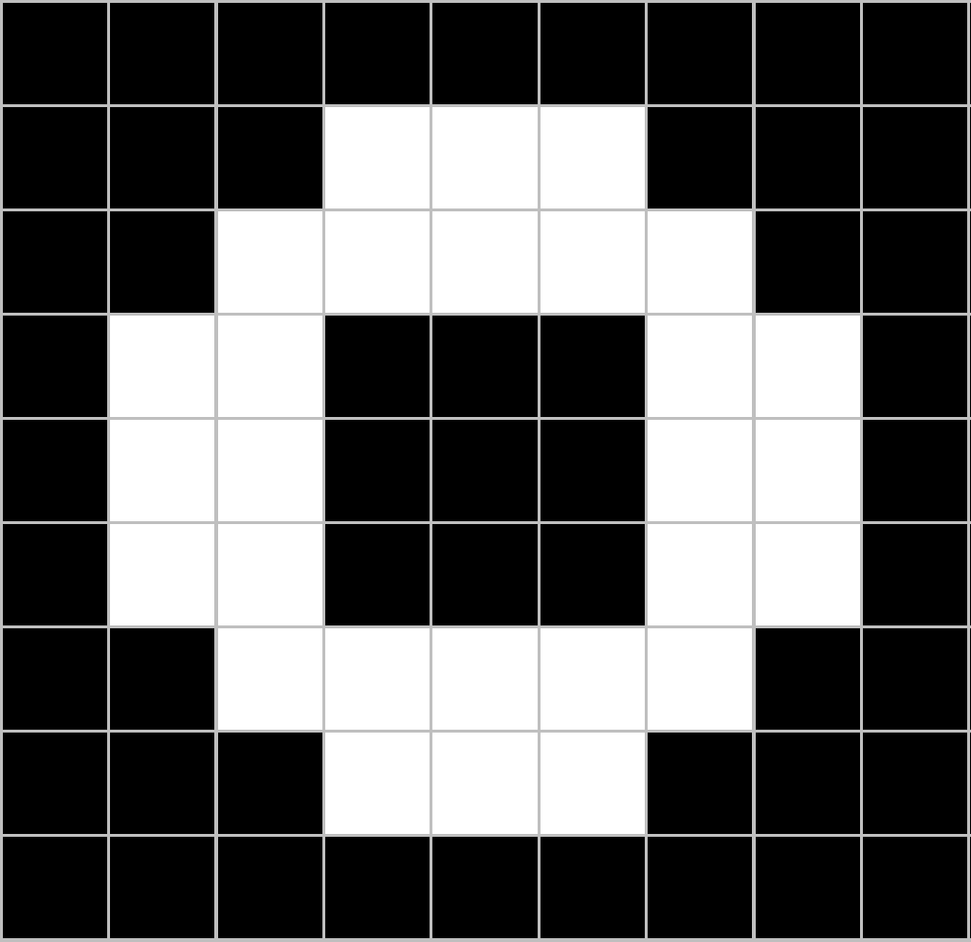
CNN
X
translation
scaling
rotation
weight
CNN
O

Slide 4
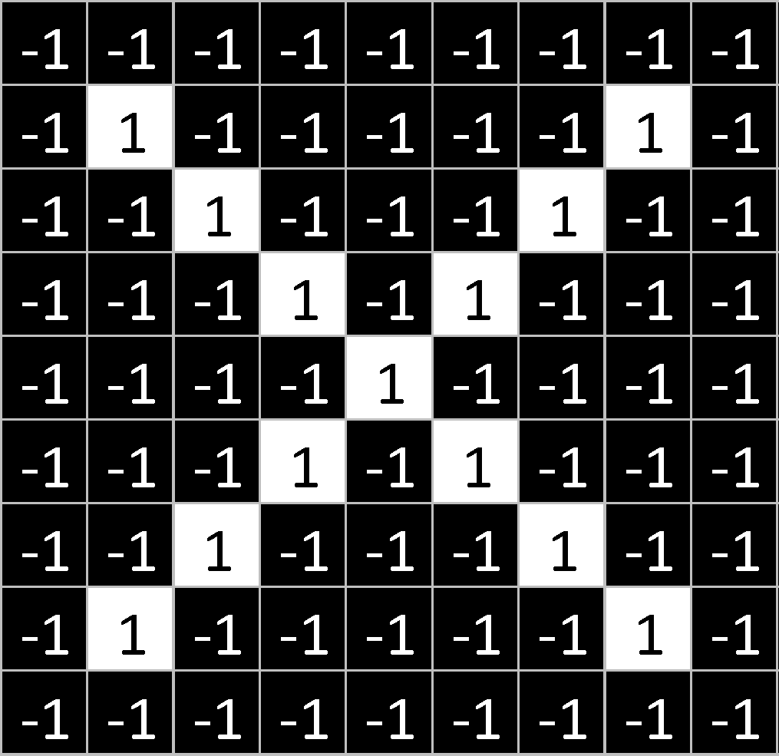
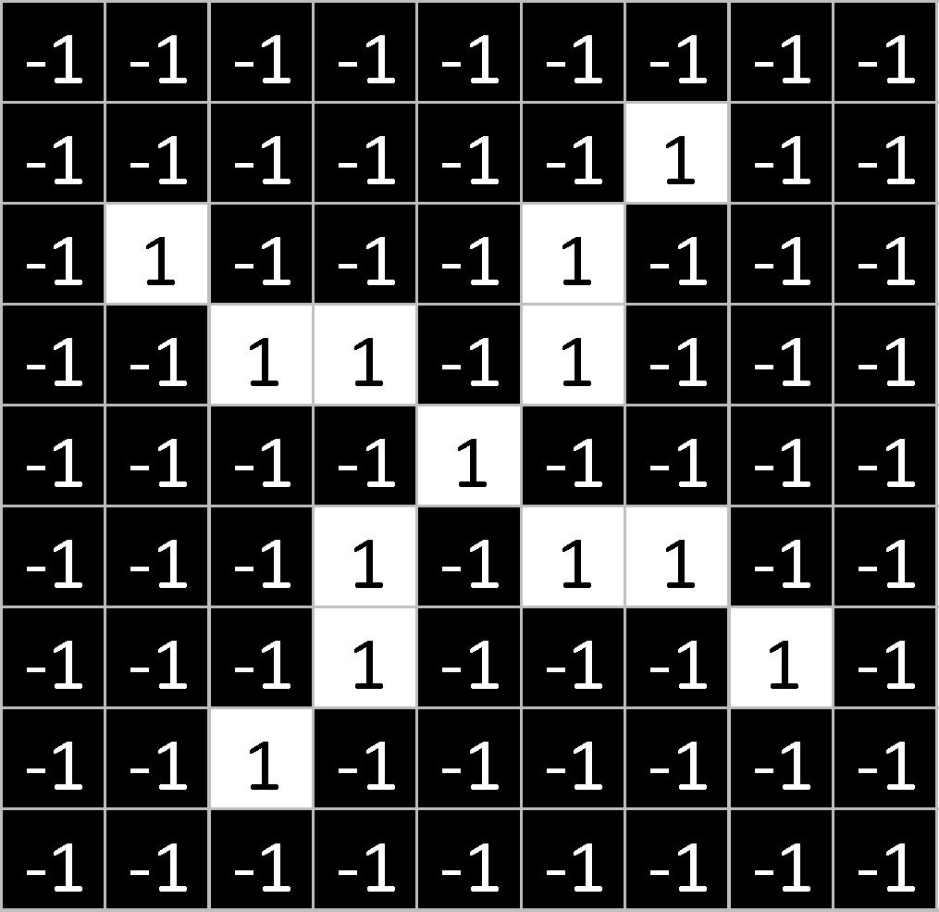

Slide 5
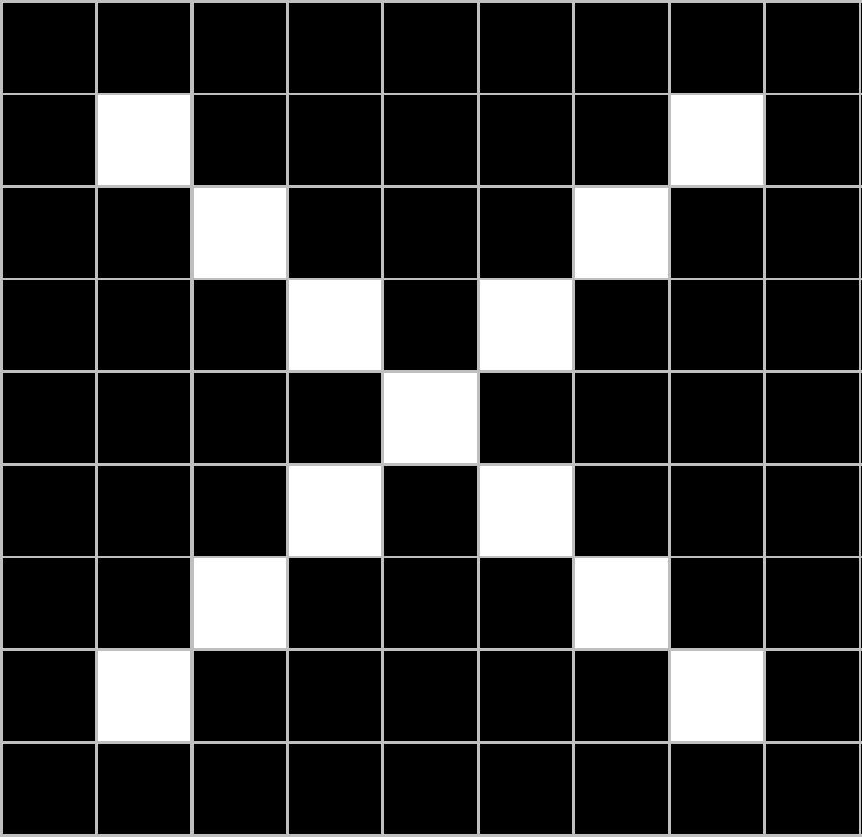
=
=
=
=

Slide 6
Introduction to Convolutional neural networks
The structure of CNN
convolutional layer, pooling layer, fully-connected layer
first stack CONV-ReLU layers, followed by POOL
then Repeat this pattern until image has been merged spatially to a small size

Slide 7
convolutional layer
https://www.freecodecamp.org/news/an-intuitive-guide-to-convolutional-neural-networks-260c2de0a050/

Slide 8
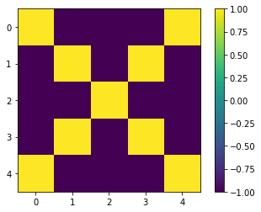
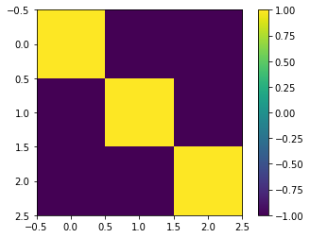
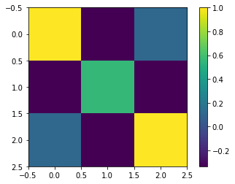

Slide 9
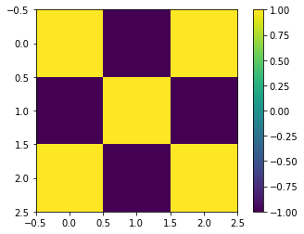
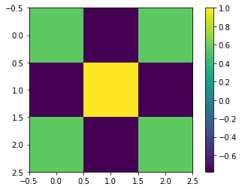

Slide 11
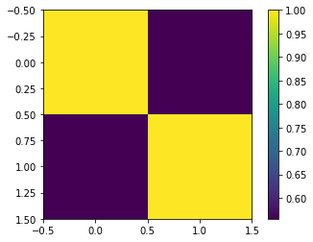
Pooling layer
Max or Avg

Slide 12
Rectified Linear Units
Negative value = 0
This helps the CNN stay mathematically healthy by keeping learned values from getting stuck near 0 or blowing up toward infinity

Slide 13
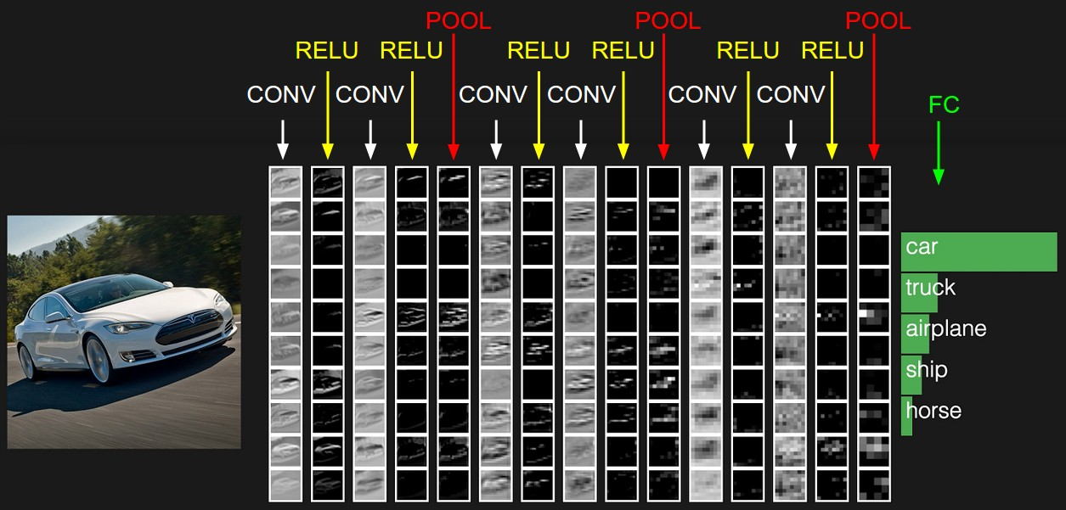
Fully-connected layer
https://cs231n.github.io/convolutional-networks/#fc

Slide 14
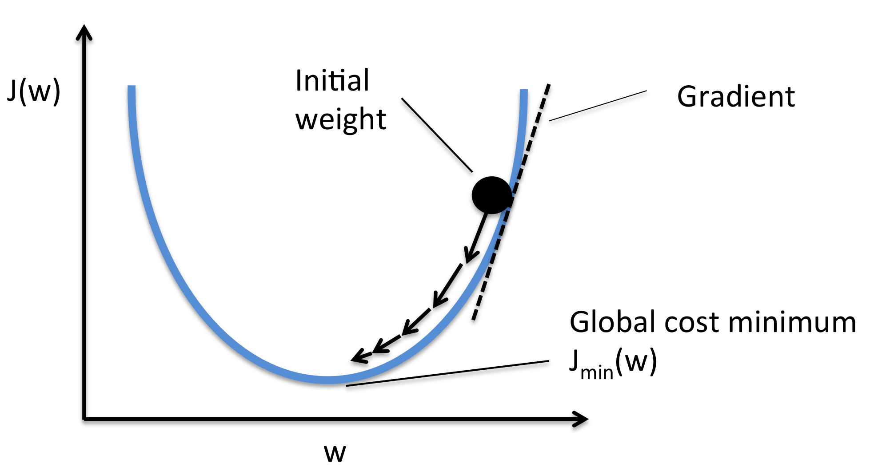
Backpropagation
https://wiki.tum.de/display/lfdv/Adaptive+Learning+Rate+Method

Slide 15
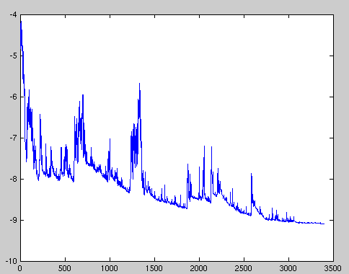
Stochastic gradient descent

Slide 16
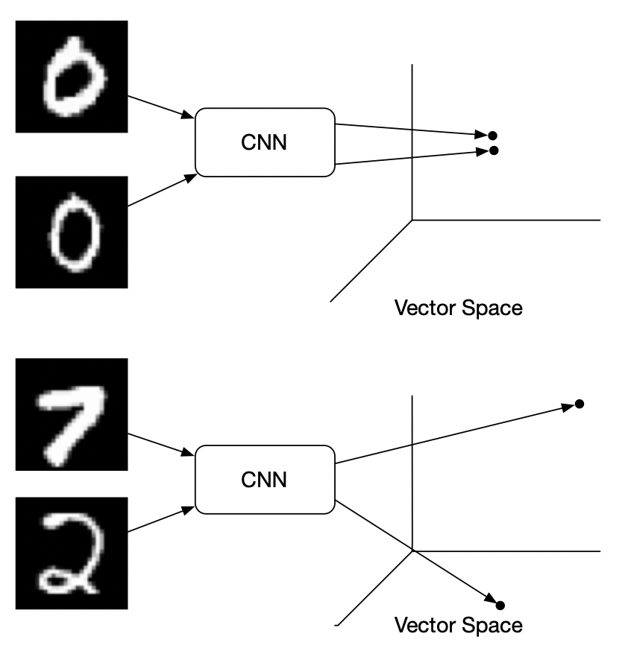
Introduction to Siamese Neural Networks
same convolutional neural network to extract features

Slide 17
Introduction to Siamese Neural Networks
Procedure
First design a convolutional neural network, mainly used to extract image features
We can get a feature vector for each image by applying this neural network
Subtract these two eigenvectors to get a new vector
Input the subtraction to a fully connected layer to obtain a scalar
Finally, use the sigmoid function to compare the results. If the two pictures are of the same category, the output should be close to 1. On the contrary, the output should be close to 0.

