Slide 1
Image similarity Estimation using Siamese Neural Networks
Lakshmipathirao Devalla , Shihao Zhang
WS 21/22

Slide 2
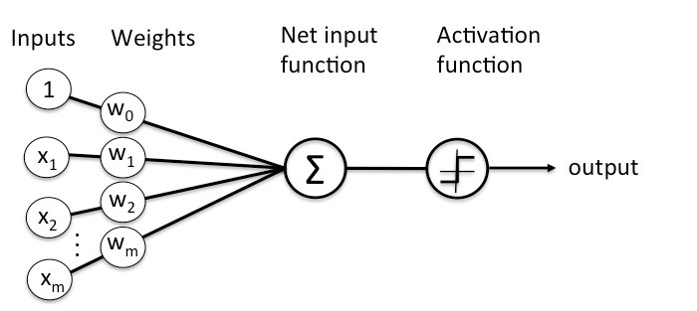
Neural Networks
Neural networks are a set of algorithms modeled loosely after the human brain
Universal approximators as they can learn to approximate an unknown function f(x) = y between any input x and output y
Similarity Learning using Artificial Neural Networks
Notes:
point 1 and 2- Give a short intro on what neural networks are
picture is a perceptron - A perceptron is a single layer neural network and a multi-layer perceptron is called Neural Network
Source: https://wiki.pathmind.com/neural-network

Slide 3
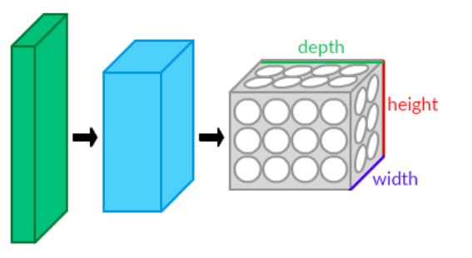
Introduction to Convolutional Neural Networks - CNN’s
CNN - A network architecture which learns directly from images
Before: pre-defined kernels extract a given feature from the image
Now: neural network learns the kernels to extract meaningful features from the image

Slide 4
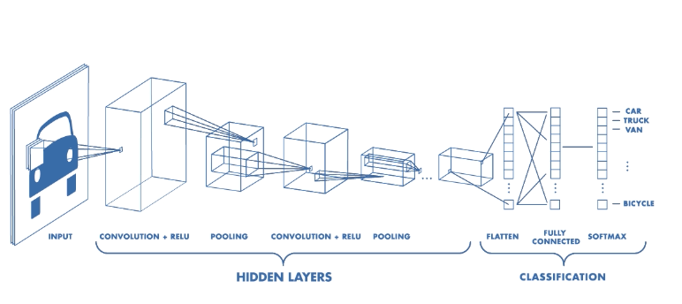
Typical structure of a CNN
Convolutional layer, pooling layer, fully-connected layer
First stack CONV-ReLU layers, followed by POOL
Repeat this pattern until image has been merged spatially to a small size
Source: Introduction to deep learning

Slide 5
Advantages of CNN
Image and video recognition
Image classification and segmentation
Object detection
Visual question answering
Image captioning

Slide 6
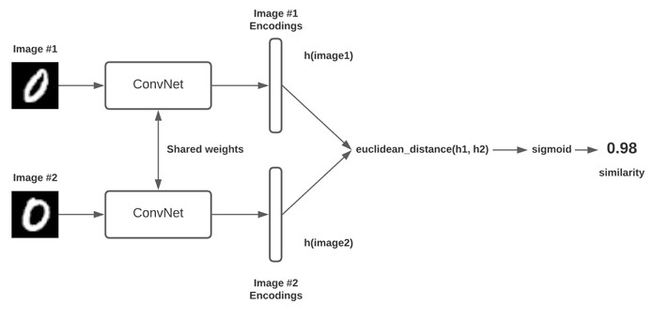
Siamese Neural Networks - General Architecture
Consists of twin networks which accept distinct inputs
These two subnetworks have the same architecture, parameters and mirror each other
Compute the Euclidean distance between the latent representations and fed through a sigmoid activation to obtain a similarity score
Source: Siamese Neural Networks

Slide 7
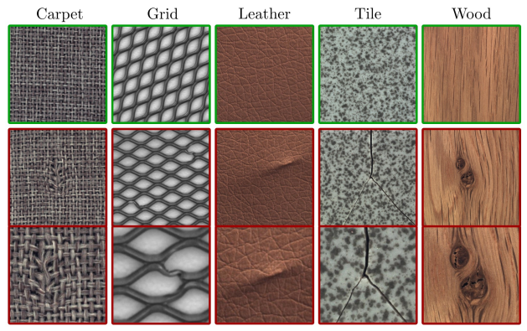
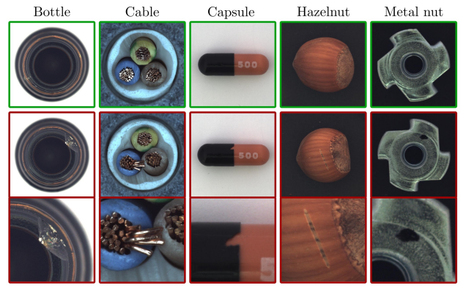
Dataset and Pre-processing
MVTEC AD - Contains over 5000 images from 15 different Objects and Textures
Textures
objects
Source: MVTEC AD Dataset

Slide 8
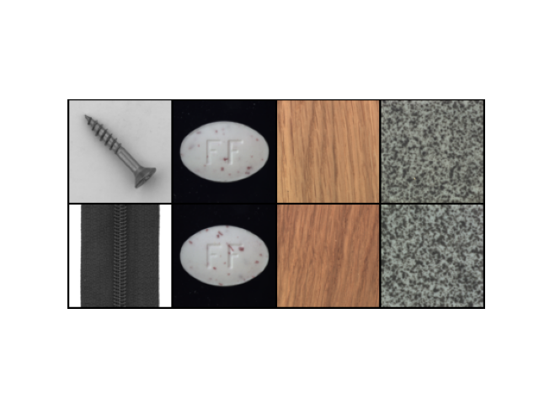
Dataset and Pre-processing
Images are resized to 105 * 105 *1(Grayscale)
80:20 split for training and validation sets
Images are paired as similar and dissimilar and
fed to the network
Similar pairs are labelled as 0,
Dissimilar pairs are labelled as 1
The goal is to find a similarity metric between any two
given images
1 1 1 0
Dataloader sample

Slide 9
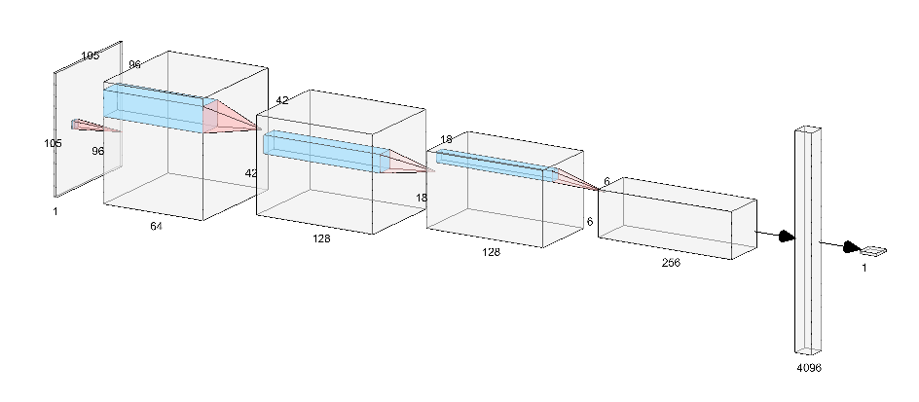
Convnet Architecture
Source: Software used

Slide 10
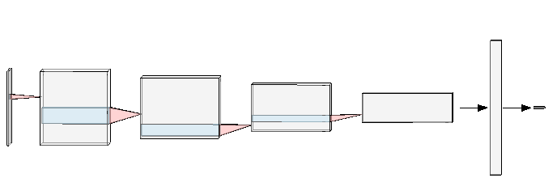
Siamese Network
Convnet
Encoding
Shared weights
Contrastive loss
Similarity Score
Encoding
Convnet

Slide 11
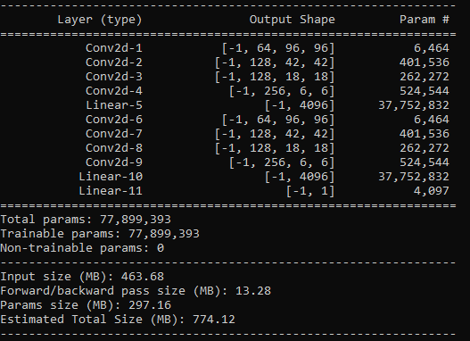
Design choices
Architecture
4 conv layers followed by a linear

Slide 12
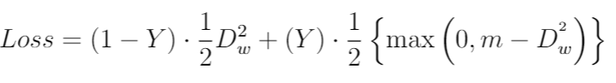



Contrastive loss
Objective is to have a small distance for positive pairs and a large distance for negative pairs
Source: Contrastive Loss figure

Slide 13
Training parameters
Epochs - 200
learning_rate - 0.0005
training_batch_size - 4
valid_batch_size - 4
Validated for every 2 epochs and saves the model
Model saved after every 2 epochs
Took around 8+ hours to train on NVIDIA 3060 TI 8GB GPU

Slide 14
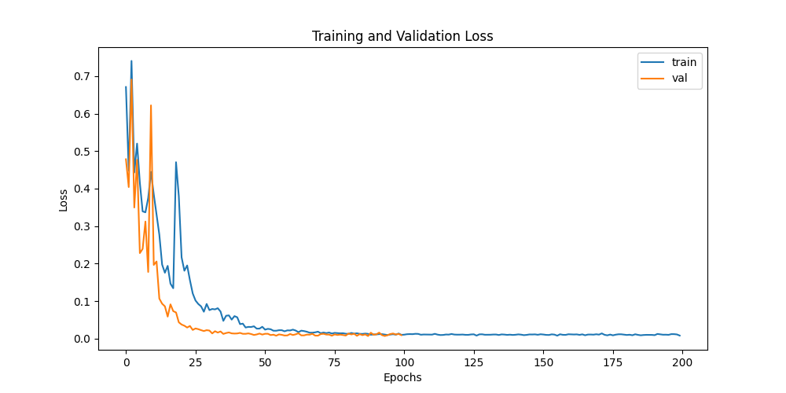
Training and validation loss

Slide 15
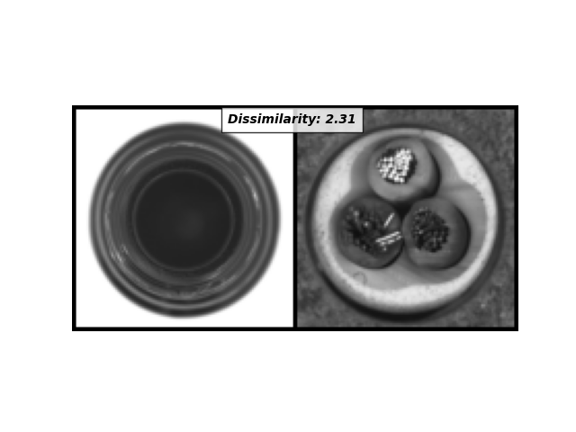
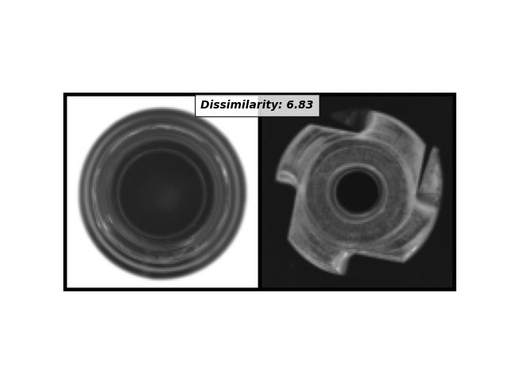
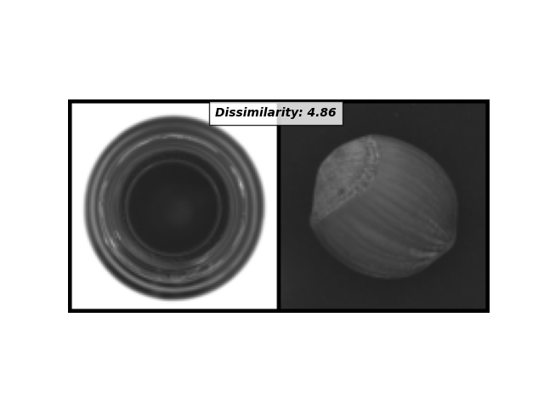
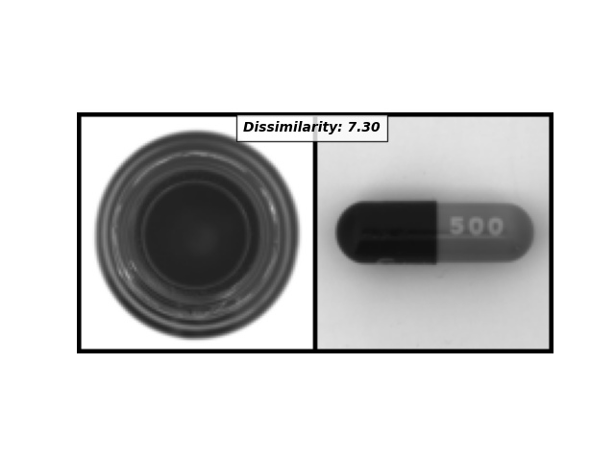
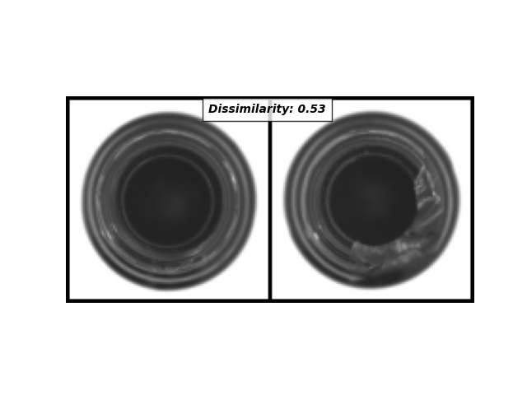
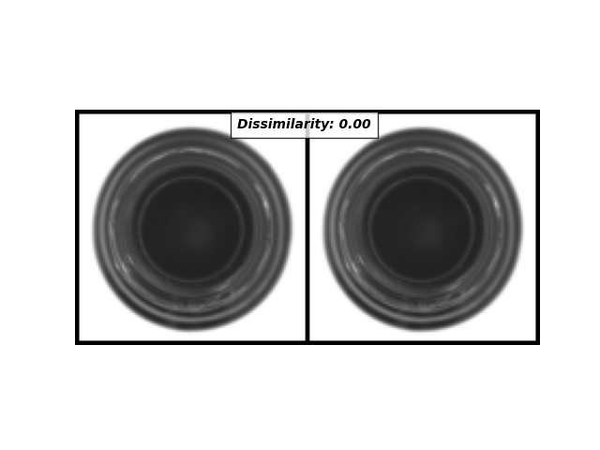
Evaluation

Slide 16
Pros and Cons
Pros:
More robust to class imbalance
One-shot classification model
Generates embeddings that are used for unseen classes
Cons:
Longer training time
Does not output probabilities but rather similarity metric

Slide 17
Questions ?

Slide 18
Thank you

