Slide 1
Image similarity Estimation using Siamese Neural Networks
Lakshmipathirao Devalla , Shihao Zhang
WS 21/22

Slide 2
Neural Networks
The advantage of CNN
before: pre-defined kernels extract a given feature from the image
now: neural network learns the kernels to extract meaningful features from the image
convolutional networks = neural networks that use convolution instead of normal matrix multiplication in at least one of their layers

Slide 3
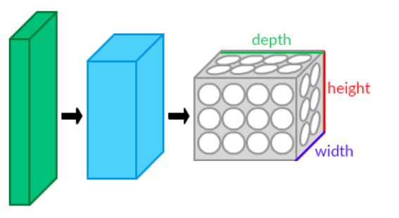
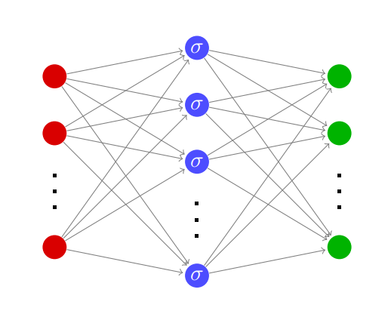
Introduction to Convolutional neural networks
The advantage of CNN
before: pre-defined kernels extract a given feature from the image
now: neural network learns the kernels to extract meaningful features from the image
convolutional networks = neural networks that use convolution instead of normal matrix multiplication in at least one of their layers

Slide 4
Introduction to Convolutional neural networks
The structure of CNN
convolutional layer, pooling layer, fully-connected layer
first stack CONV-ReLU layers, followed by POOL
then Repeat this pattern until image has been merged spatially to a small size

Slide 5
Introduction to Convolutional neural networks
The function of layers
convolutional layer : the network will learn filters that activate when they see some type of visual feature such as an edge of some orientation or a blotch of some color on the first layer
pooling layer :it reduces the spatial size of the representation to reduce the amount of parameters and computation in the network, and hence to also control overfitting.

Slide 6
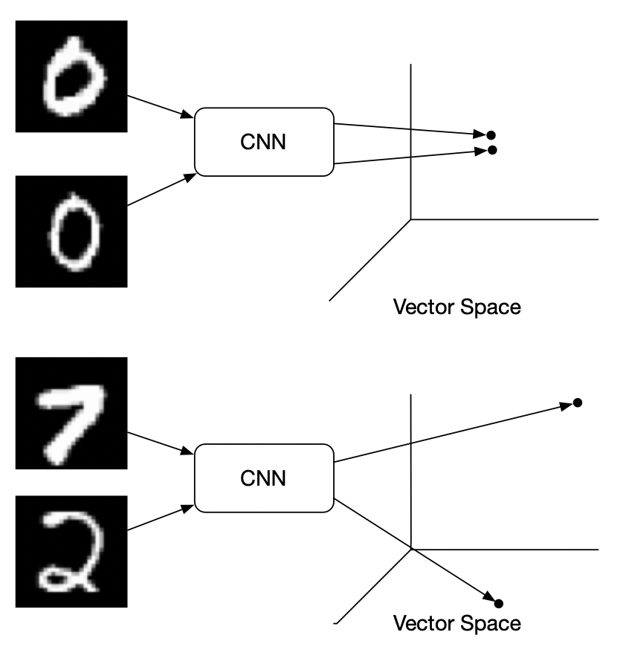
Introduction to Siamese Neural Networks
The core idea of Siamese Neural Networks is applying the same convolutional neural network to extract features from the input two pictures and then distinguishing whether they belong to the same category by comparing the distance between their feature vectors.

Slide 7
Introduction to Siamese Neural Networks
Procedure
First design a convolutional neural network, mainly used to extract image features
We can get a feature vector for each image by applying this neural network
Subtract these two eigenvectors to get a new vector
Input the subtraction to a fully connected layer to obtain a scalar
Finally, use the sigmoid function to compare the results. If the two pictures are of the same category, the output should be close to 1. On the contrary, the output should be close to 0.

Slide 8
Introduction to Siamese Neural Networks
How to train a Siamese neural network
The distance between the predicted value and the actual value of the sigmoid output is calculated as the loss function. The loss function is the cross entropy between the output and the actual value which reflects the difference between the predicted and the actual value. This allows the parameters to be updated by backpropagation via gradient descent. The model mainly consists of two parts: convolutional neural network and fully connected neural network. The training process is to update the parameters of these two parts of the network.

Slide 9
Design decisions
Functions for each code
dataLoader : transform the image to data
datahandler : use Siamese neural network to extract the feature vector

Slide 10
Training

Slide 11
Results

