Slide 1

Sales Meeting - GAM Region
Puttalam | Kegalle | Gampaha
6-Jul-2026
Cluster Owner: Damindu Dissanayake

Slide 2
Content
Objective
Data and Voice Traffic Behavior of Puttalam, Kegalle, and Gampaha
Puttalam, Chilaw, Negombo, and Gampaha Improvement plan based on sales visits
Complaints escalation summery
Q & A

Slide 3

Objective: Regional Network and Sales Collaboration
Regional Issues speed escalation and rectification
Solve maximum issues at the regional level
Improve communication on:
  Technical issues to Sales
  New improvements
  Issues and requirements from sale steam
  Improve customer experience as a one team
  Special sales requirement accommodation
  One team with one goal
  “Better Network with good customer experience.”
RF
Team
Field
NOP
Sales
Team

Slide 4
GAM Region Traffic Trends
Puttalam | Kegalle | Gampaha

Slide 5
3G + 4G Data Traffic (GAM) (TB) - GAM
Network
30.639%
25.65%
Gampaha
Jun 2025 → Jun 2026

Slide 6
VoLTE Traffic (Erlang) - GAM
Network
58.98%
Gampaha
73.23%
Jun 2025 → Jun 2026

Slide 7
2G Voice Traffic (Erlang) - GAM
Network
-8.31%
Gampaha
-13.15%
Jun 2025 → Jun 2026

Slide 8
3G Voice Traffic (Erlang) - GAM
Network
-42.57%
Gampaha
-100%
Network
Jun 2025 → Jun 2026

Slide 9
3G + 4G Data Traffic (TB) – KEG/PUT
Network
25.47%
Kegalle
27.88%
Puttalam
26.74%
Jun 2025 → Jun 2026

Slide 10
VoLTE Traffic (Erlang) – KEG/PUT
Network
58.98%
Kegalle
61.31%
Puttalam
53.3%
Jun 2025 → Jun 2026

Slide 11
2G+3G Voice Traffic (Erlang) - KEG/PUT
Network
-8.31%
Kegalle
-6.99%
Puttalam
-1.43%
Jun 2025 → Jun 2026

Slide 12
3G Voice Traffic (Erlang) – KEG/PUT
Network
-42.57%
Kegalle
-8.92%
Puttalam
-6.43%
Jun 2025 → Jun 2026

Slide 13
Completed Upgrades (April-2025 to Jun-2026)
Upgrade | GAM | KEG | PUT
2T2R UBR Addition | 1
4T4R 1800 Addition(share between 2 sectors) |  | 4
4T4R UBR Addition | 11
4T4R UBR Addition (share between 2 sectors)
L1800 Addition | 2 |  | 2
L2100 SISO Addition
ZTE to Huawei Swap | 60
ZTE to ZTE Swap_4T4R UBR Addition | 9
ZTE to ZTE Swap_4T4R UBR share between two sectors | 18
Grand Total | 101 | 4 | 2

Slide 14
Upcoming Upgrades (New August Batch 285)
Upgrade | GAM | KEG | PUT | Grand Total
2T2R UBR Addition | 46 | 9 | 4 | 59
4T4R UBR Addition | 97 | 5 | 6 | 108
4T4R UBR Addition and BBU Swap | 3 | 1 | 1 | 5
L1800 Addition | 41 | 22 | 11 | 74
L900 4T4R share between 2 sectors | 10 |  |  | 10
L900 4T4R share between 2 sectors and 2T2R UBR Addition | 2 |  |  | 2
L900 4T4R share between 2 sectors and 4T4R UBR Addition | 6 |  |  | 6
L900 4T4R share between 2 sectors and 4T4R UBR Addition lamp pole | 2 |  |  | 2
L900 Addition | 3 |  |  | 3
L900 Addition and 2T2R UBR Addition | 5 |  |  | 5
L900 Addition and 4T4R UBR Addition | 3 |  |  | 3
L900 Addition and 4T4R UBR Addition lamp pole | 1 |  |  | 1
L900 SISO-->MIMO and L1800 Addition | 1 |  |  | 1
Sector Addition | 4 |  |  | 4
Grand Total | 224 | 37 | 22 | 283

Slide 15
Sales complaint track
Row Labels | Gampaha | Kegalle | Puttalam
Capacity addition completed | 1
Capacity Addition Pending | 18 | 4 | 5
Duplicated Complain | 4 | 1
Insufficient Details | 12 | 1 | 2
New Site Require | 19 |  | 6
Package Issues | 1
Pending
Pending with Power Team | 1
Resolved | 67 | 4 | 7
Temporary Issue | 1
Unable to resolve | 1 | 2
Wrong Details | 1 |  | 1
Grand Total | 126 | 12 | 21

Slide 16
Optimization-ongoing New site update Jun-2026
Site Name | Site ID | Project | Categorization | On Air Date | SSV Actual Date | June Revenue
Makola-2 | GAM419 | New Site | New site - Cluster Improvement | 4/6/2026 | 6/17/2026 | 492,541
Mudalappali-1 | PUT151 | New Site | New site - Cluster Improvement | 5/17/2026 | Pending | 412,018

Slide 17
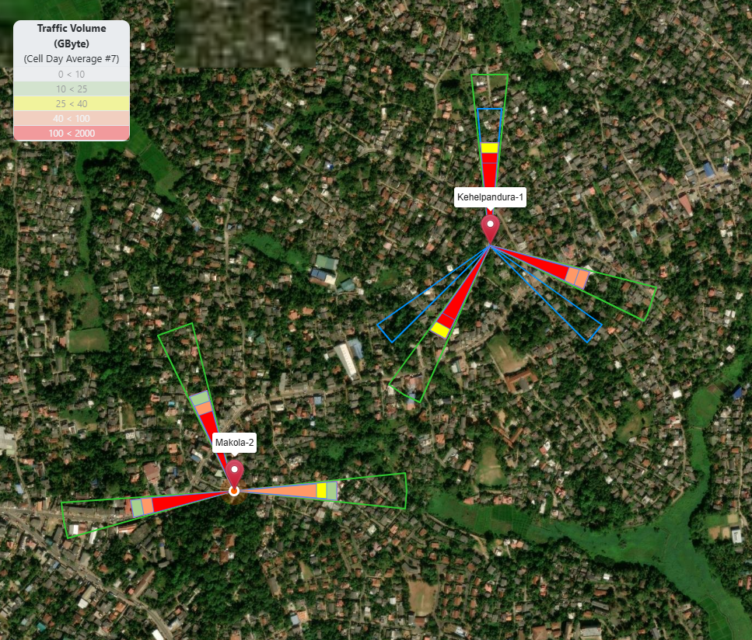
Makola-2
Site Name | Site ID | Project | Categorization | On Air Date | SSV Actual Date | June Revenue
Makola-2 | GAM419 | New Site | New site - Cluster Improvement | 4/6/2026 | 6/17/2026 | 492,541

Slide 18
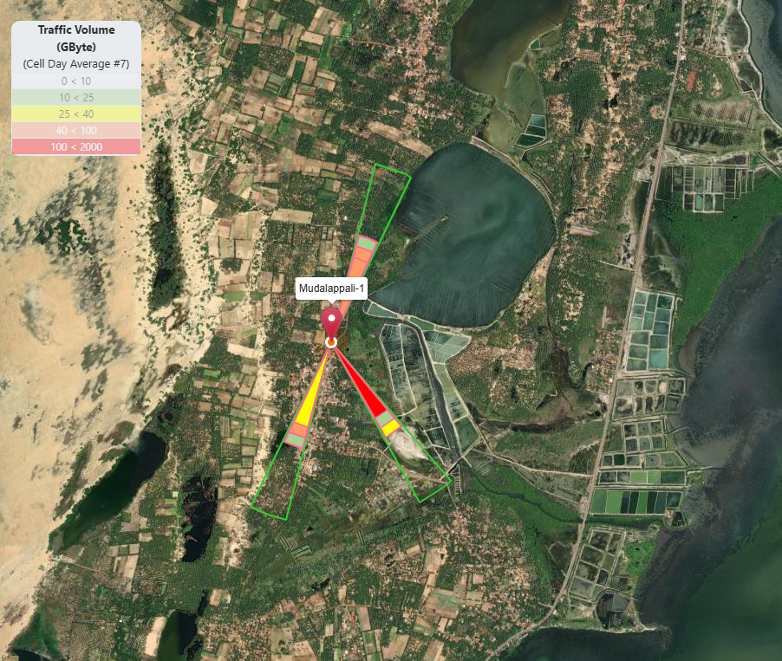
Mudalappali-1
Site Name | Site ID | Project | Categorization | On Air Date | SSV Actual Date | June Revenue
Mudalappali-1 | PUT151 | New Site | New site - Cluster Improvement | 5/17/2026 | Pending | 412,018

Slide 19
Low Revenue Sites In Kegalle District

Slide 20
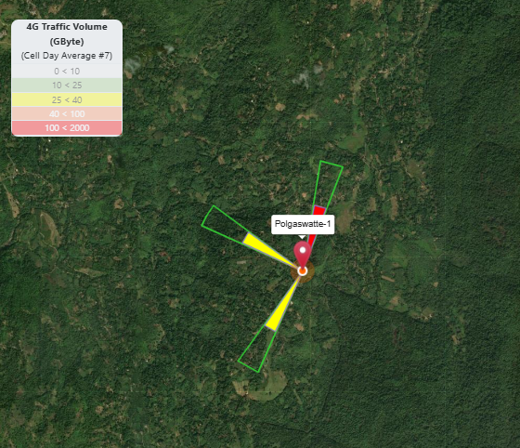
Polgaswatte-1
Pre Avg Daily Traffic (14-15 Jun) (GB/day) | Post Avg Daily Traffic (17-18 Jun) (GB/day) | Traffic Variation (%)
173.50 | 156.54 | -9.78%

Slide 21
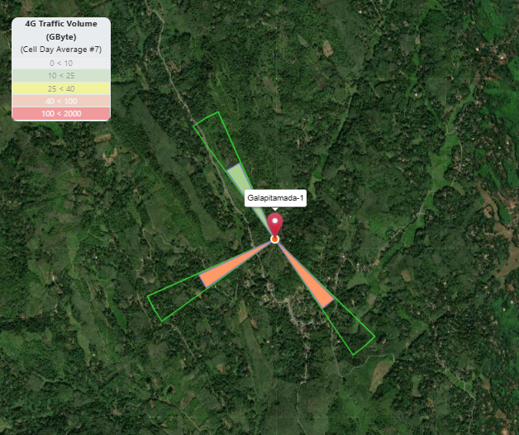
Galapitamada-1
Pre Avg Daily Traffic (14-15 Jun) (GB/day) | Post Avg Daily Traffic (17-18 Jun) (GB/day) | Traffic Variation (%)
195.79 | 189.77 | -3.07%

Slide 22
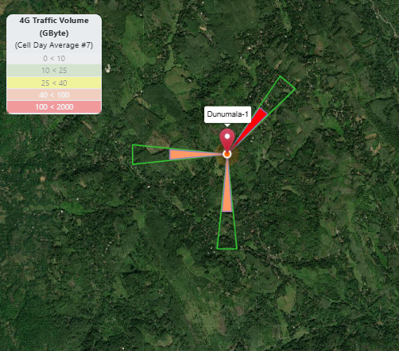
Dunumala-1
Pre Avg Daily Traffic (14-15 Jun) (GB/day) | Post Avg Daily Traffic (17-18 Jun) (GB/day) | Traffic Variation (%)
347.41 | 267.94 | -22.87%

Slide 23
Thihaliyadda-1
Pre Avg Daily Traffic (14-15 Jun) (GB/day) | Post Avg Daily Traffic (17-18 Jun) (GB/day) | Traffic Variation (%)
179.05 | 166.84 | -6.82%

Slide 24
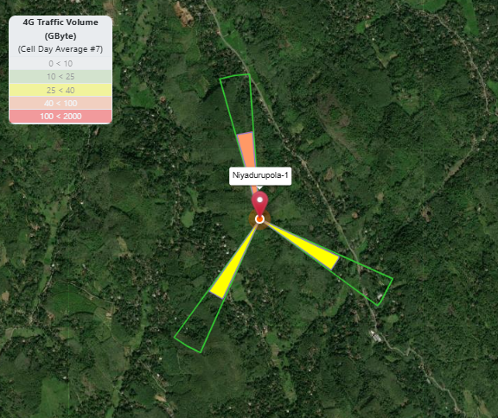
Niyadurupola-1
Pre Avg Daily Traffic (14-15 Jun) (GB/day) | Post Avg Daily Traffic (17-18 Jun) (GB/day) | Traffic Variation (%)
140.09 | 147.64 | 5.39%

Slide 25
Low Revenue Sites In Puttalam District

Slide 26
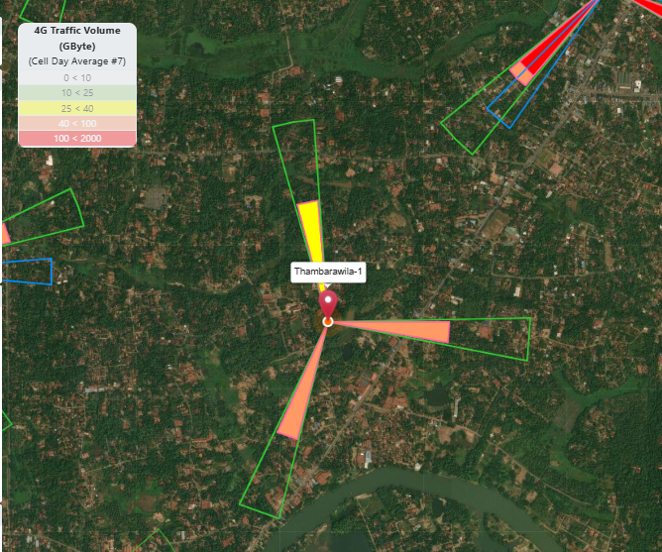
Thambarawila-1
Pre Avg Daily Traffic (14-15 Jun) (GB/day) | Post Avg Daily Traffic (17-18 Jun) (GB/day) | Traffic Variation (%)
123.53 | 113.50 | -8.12%
Urban population

Slide 27
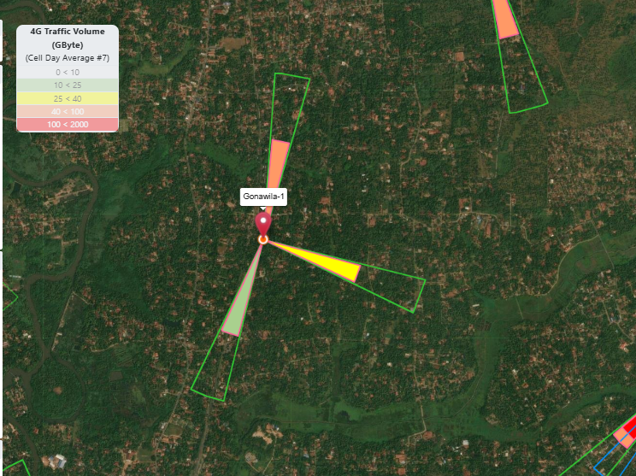
Gonawila-1
Pre Avg Daily Traffic (14-15 Jun) (GB/day) | Post Avg Daily Traffic (17-18 Jun) (GB/day) | Traffic Variation (%)
146.85 | 140.37 | -4.41%
sub Urban population

Slide 28
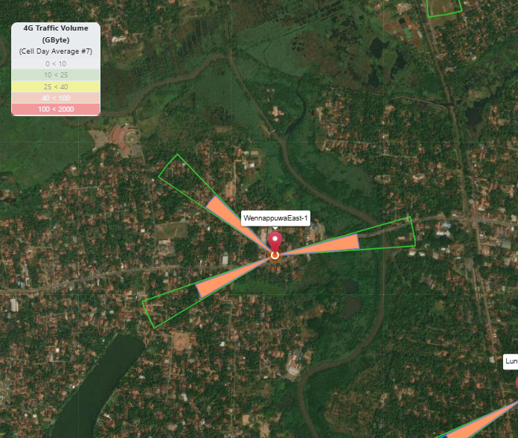
Wennappuwaeast-1
Pre Avg Daily Traffic (14-15 Jun) (GB/day) | Post Avg Daily Traffic (17-18 Jun) (GB/day) | Traffic Variation (%)
175.27 | 178.08 | 1.60%
Urban population

Slide 29
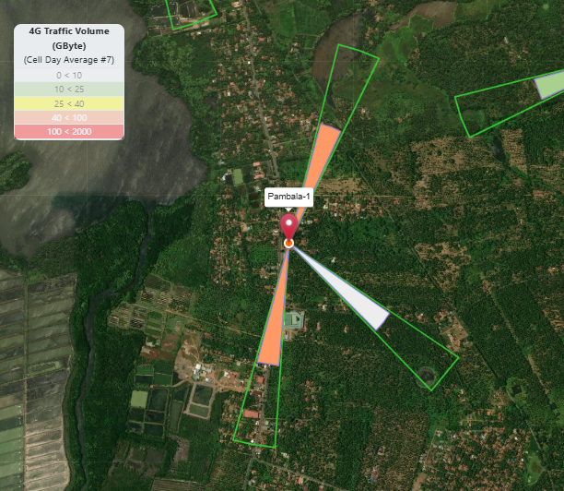
Pambala-1
Pre Avg Daily Traffic (14-15 Jun) (GB/day) | Post Avg Daily Traffic (17-18 Jun) (GB/day) | Traffic Variation (%)
123.18 | 149.22 | 21.14%
Urban population

Slide 30
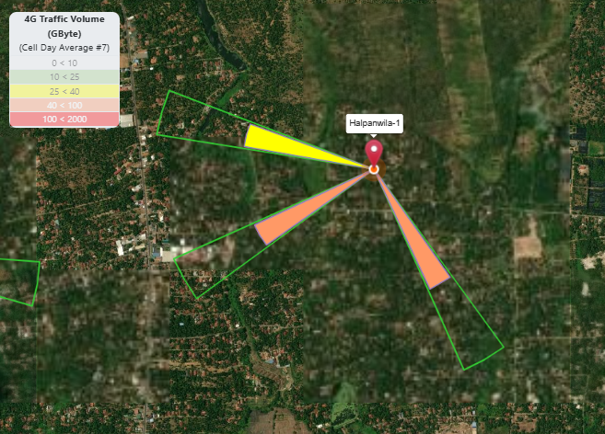
Halpanwila-1
Pre Avg Daily Traffic (14-15 Jun) (GB/day) | Post Avg Daily Traffic (17-18 Jun) (GB/day) | Traffic Variation (%)
188.79 | 157.57 | -16.54%
sub Urban population

Slide 31
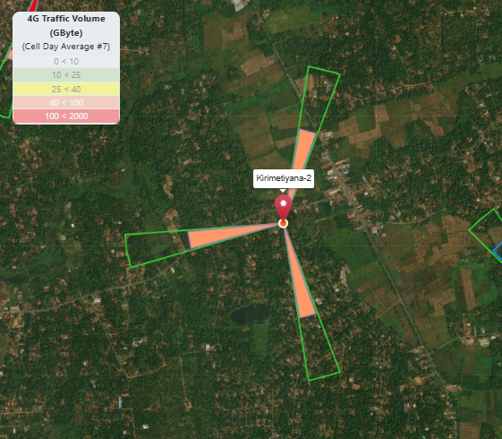
Kirimetiyana-2
Pre Avg Daily Traffic (14-15 Jun) (GB/day) | Post Avg Daily Traffic (17-18 Jun) (GB/day) | Traffic Variation (%)
179.21 | 163.19 | -8.94%
Urban population

Slide 32
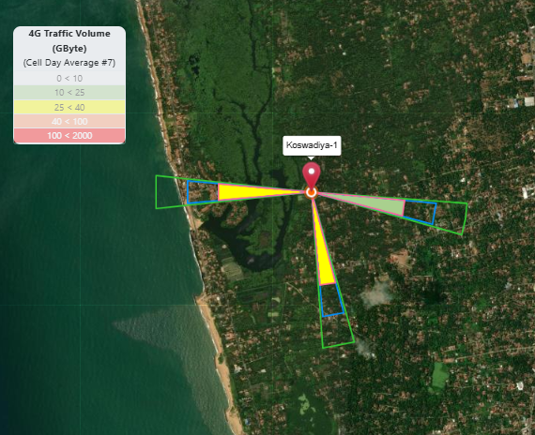
Koswadiya-1
sub Urban population

Slide 33
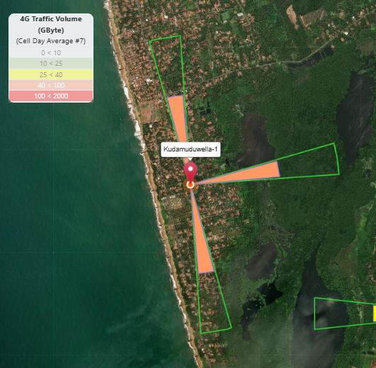
Kudamuduwella-1
Pre Avg Daily Traffic (14-15 Jun) (GB/day) | Post Avg Daily Traffic (17-18 Jun) (GB/day) | Traffic Variation (%)
198.01 | 168.69 | -14.81%
Urban population

Slide 34
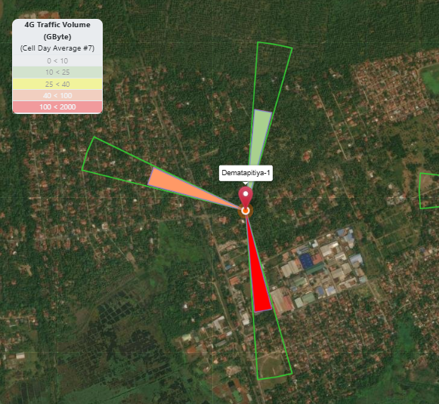
Dematapitiya-1
Pre Avg Daily Traffic (14-15 Jun) (GB/day) | Post Avg Daily Traffic (17-18 Jun) (GB/day) | Traffic Variation (%)
235.68 | 200.26 | -15.03%
Urban population

Slide 35
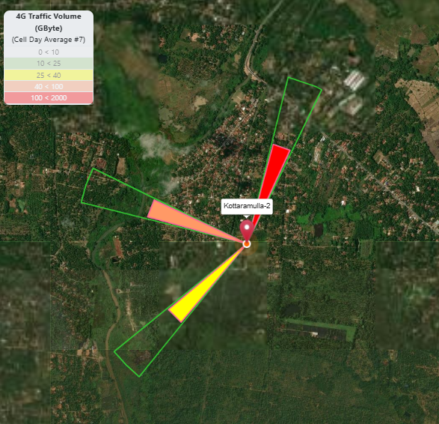
Kottaramulla-2
Pre Avg Daily Traffic (14-15 Jun) (GB/day) | Post Avg Daily Traffic (17-18 Jun) (GB/day) | Traffic Variation (%)
229.28 | 211.45 | -7.78%
Sector addition ongoing

Slide 36
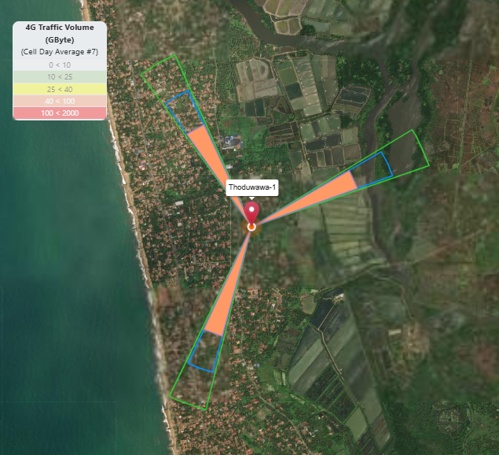
Thoduwawa-1
Pre Avg Daily Traffic (14-15 Jun) (GB/day) | Post Avg Daily Traffic (17-18 Jun) (GB/day) | Traffic Variation (%)
185.2 | 207.4 | 10.70%
Urban population

Slide 37
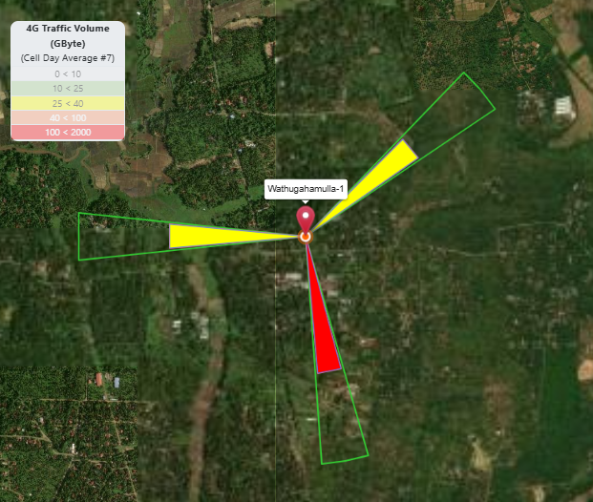
Wathugahamulla-1
Pre Avg Daily Traffic (14-15 Jun) (GB/day) | Post Avg Daily Traffic (17-18 Jun) (GB/day) | Traffic Variation (%)
184.26 | 186.17 | 1.04%

Slide 38
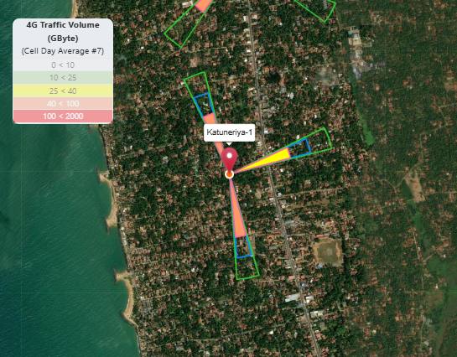
Katuneriya-1
Urban population

Slide 39
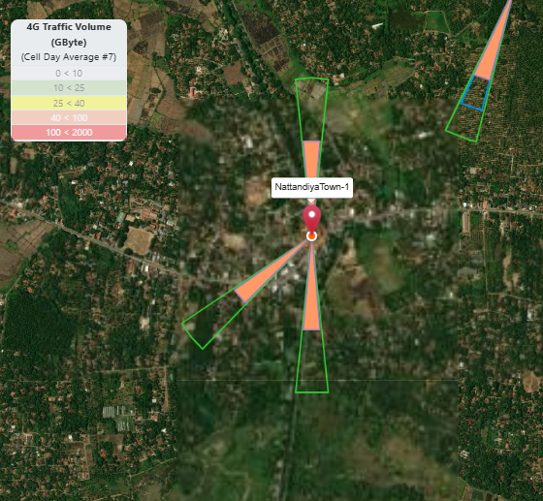
Nattandiyatown-1
Pre Avg Daily Traffic (14-15 Jun) (GB/day) | Post Avg Daily Traffic (17-18 Jun) (GB/day) | Traffic Variation (%)
213.26 | 216.32 | 1.43%
Urban population

Slide 40
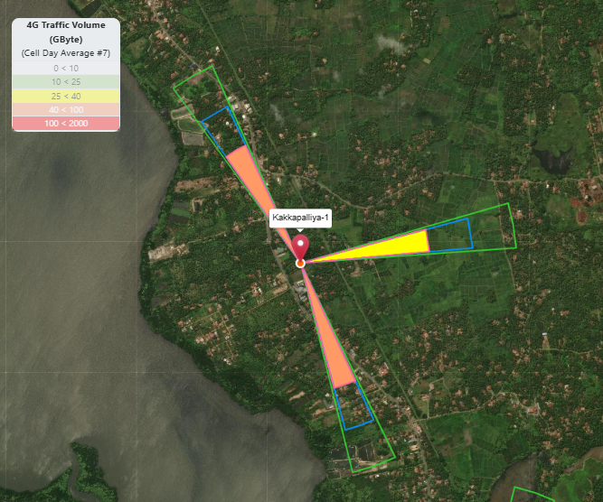
Kakkapalliya-1
Pre Avg Daily Traffic (14-15 Jun) (GB/day) | Post Avg Daily Traffic (17-18 Jun) (GB/day) | Traffic Variation (%)
127.2 | 132.4 | 3.93%
Sub urban population

Slide 41
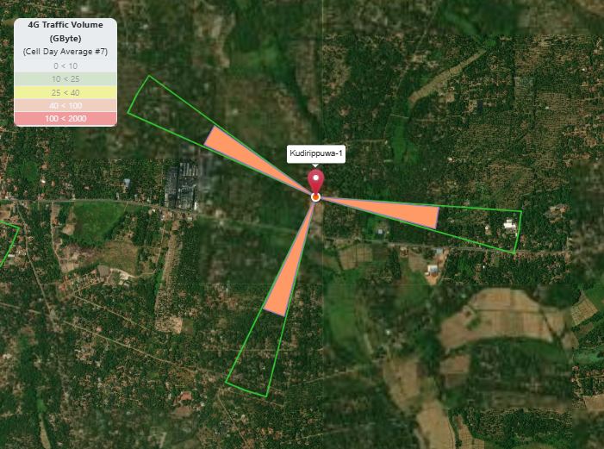
Kudirippuwa-1
Pre Avg Daily Traffic (14-15 Jun) (GB/day) | Post Avg Daily Traffic (17-18 Jun) (GB/day) | Traffic Variation (%)
219.00 | 200.37 | -8.51%
Sub urban population

Slide 42
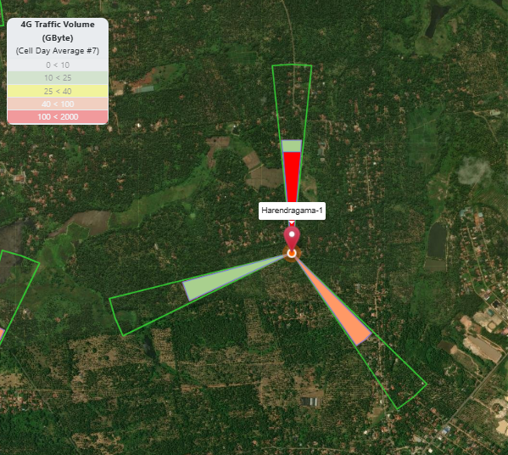
Harendragama-1
Pre Avg Daily Traffic (14-15 Jun) (GB/day) | Post Avg Daily Traffic (17-18 Jun) (GB/day) | Traffic Variation (%)
254.69 | 247.20 | -2.94%

Slide 43

Q & A

Slide 44
Thank You

