Slide 1
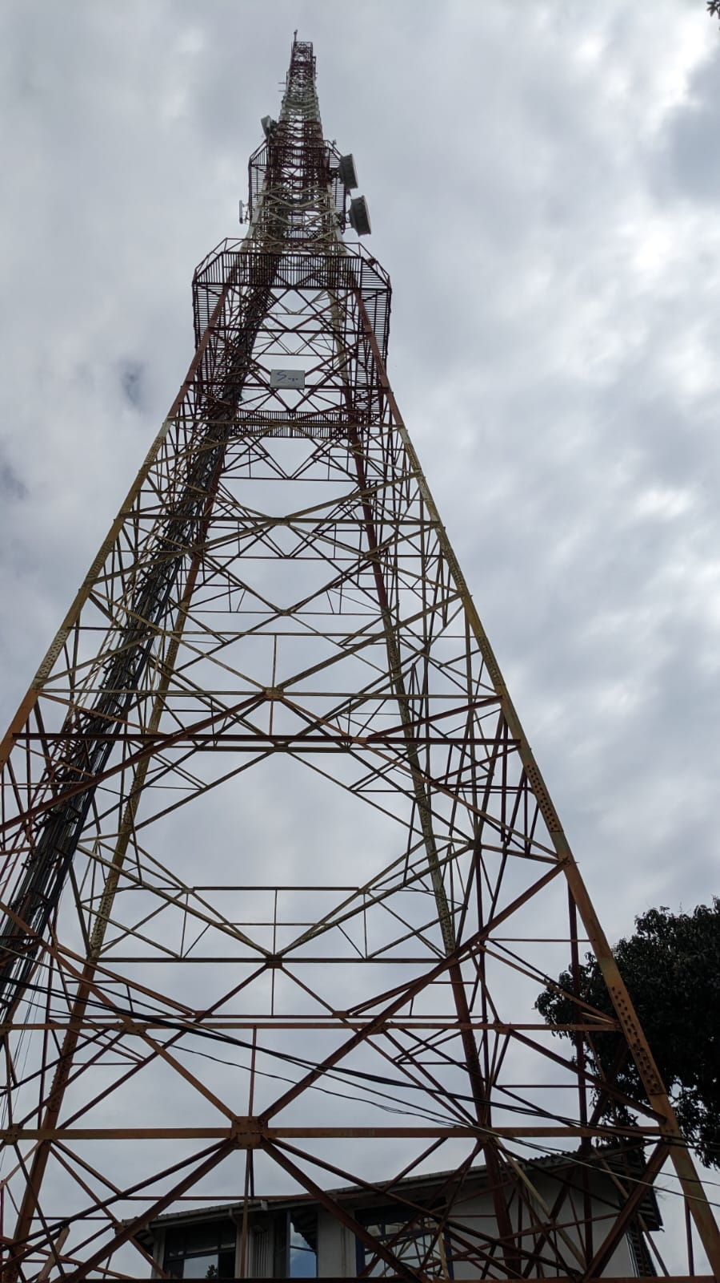

Southern Region
Network-Sales Meeting
June 2026

Slide 2
Content
Distribution of Sites
Data and Voice Traffic Behavior of Southern Cluster
Capacity Addition Summary
Southern Cluster Improvement Initiatives
Q and A

Slide 3
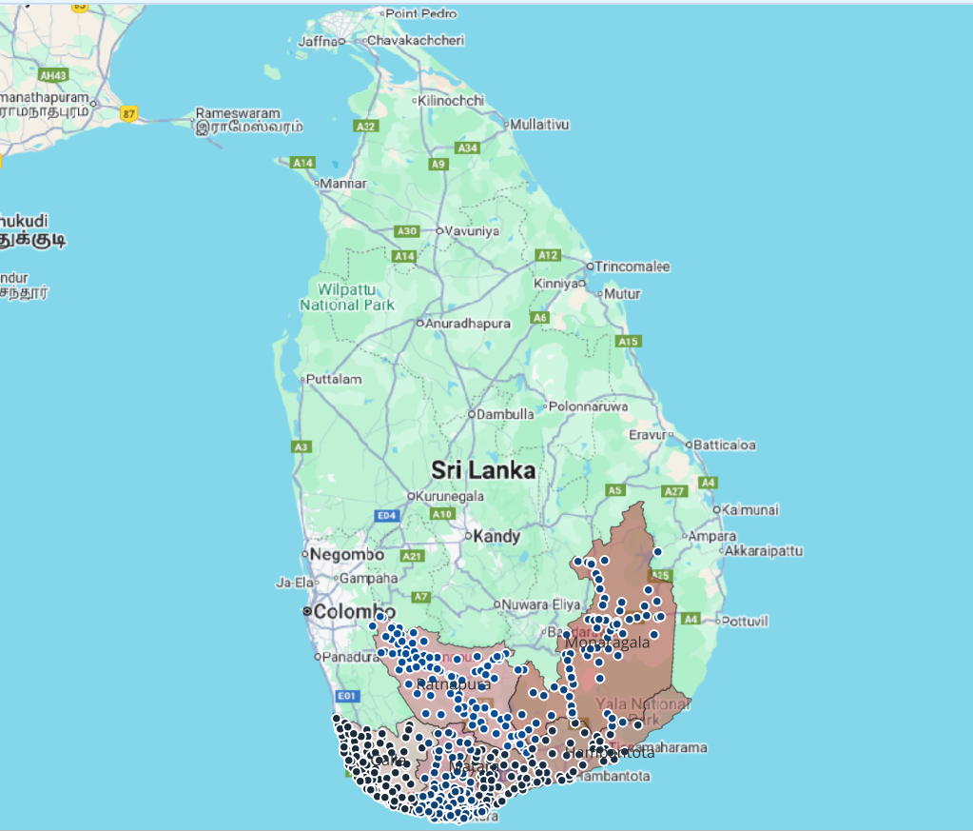
Distribution of Sites
District | Count of Sites
Moneragala | 69->71
Galle | 115->118
Hambantota | 86
Matara | 106->109
Ratnapura | 105->106
Grand Total | 481->490

Slide 4
Data and Voice Traffic Behavior of Southern Cluster – 2G Voice Traffic

Slide 5
Data and Voice Traffic Behavior of Southern Cluster – 3G Voice Traffic

Slide 6
Data and Voice Traffic Behavior of Southern Cluster – Total Voice Traffic

Slide 7
Data and Voice Traffic Behavior of Southern Cluster – 4G Data Traffic

Slide 8
Data and Voice Traffic Behavior of Southern Cluster – 3G Data Traffic

Slide 9
Data and Voice Traffic Behavior of Southern Cluster – Total Data Traffic

Slide 10
VoLTE traffic Behavior of Southern Cluster

Slide 11
VoLTE traffic - Network

Slide 12
Traffic Improvement 2026 January 2nd Week vs 2026 June 2nd Week
Data
Voice
VoLTE

Slide 13
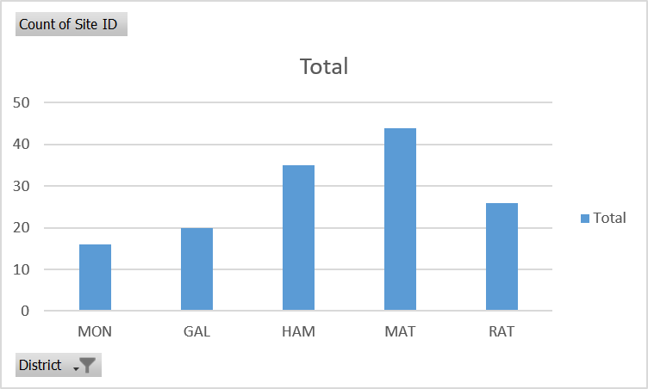
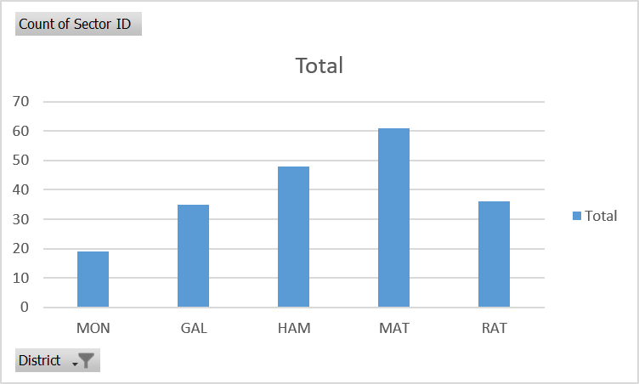
Capacity Upgrades 2026 – Current status
Row Labels | Count of Site ID
Moneragala | 16
Galle | 20
Hambantota | 35
Matara | 44
Ratnapura | 26
Grand Total | 141
District | Count of Sectors
Moneragala | 19
Galle | 35
Hambantota | 48
Matara | 61
Ratnapura | 36
Grand Total | 199

Slide 14
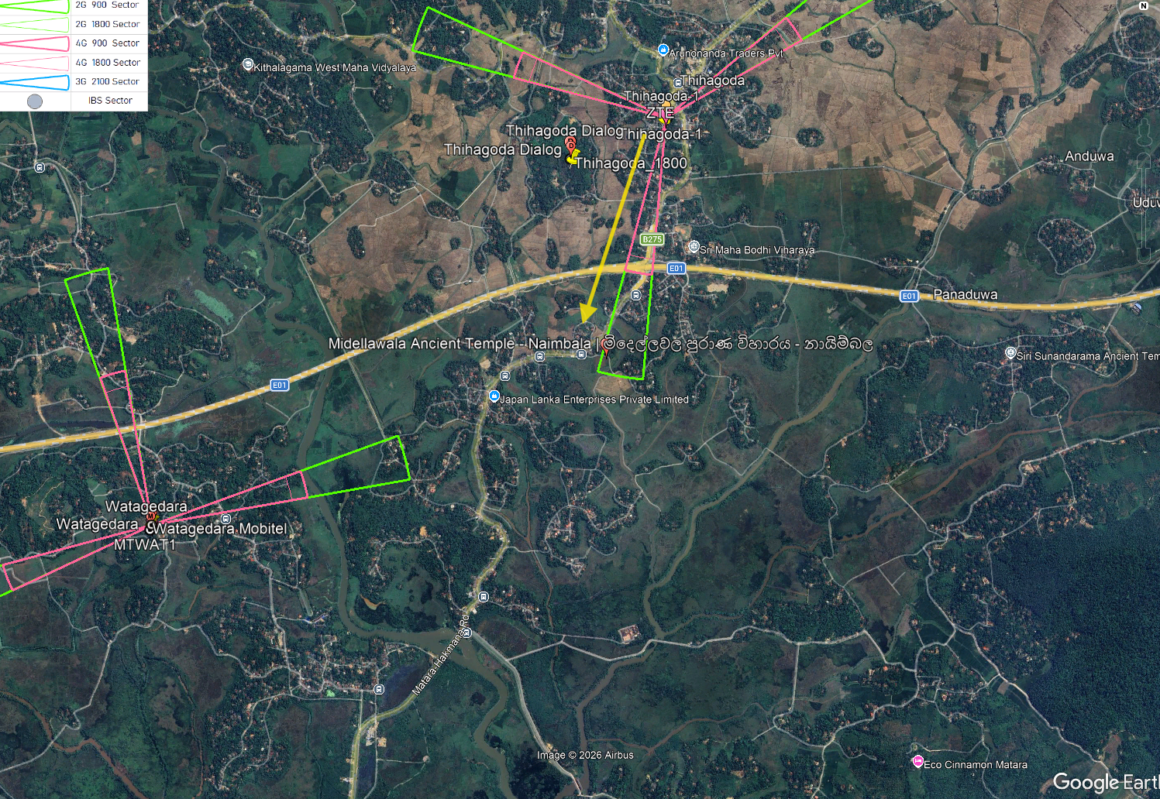
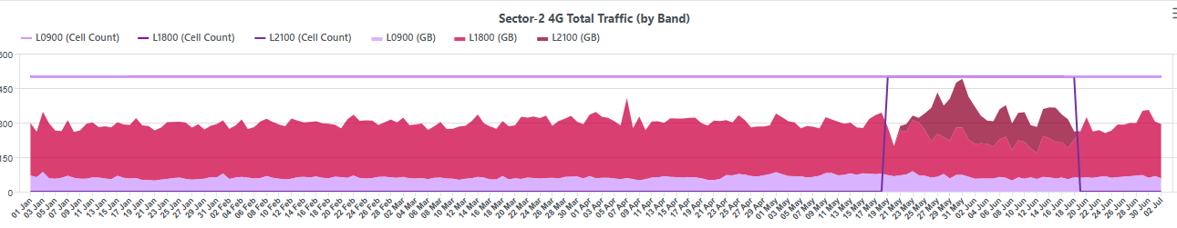
Vesak Festival - Matara
4G Traffic gain
Thihagoda-1_2

Slide 15
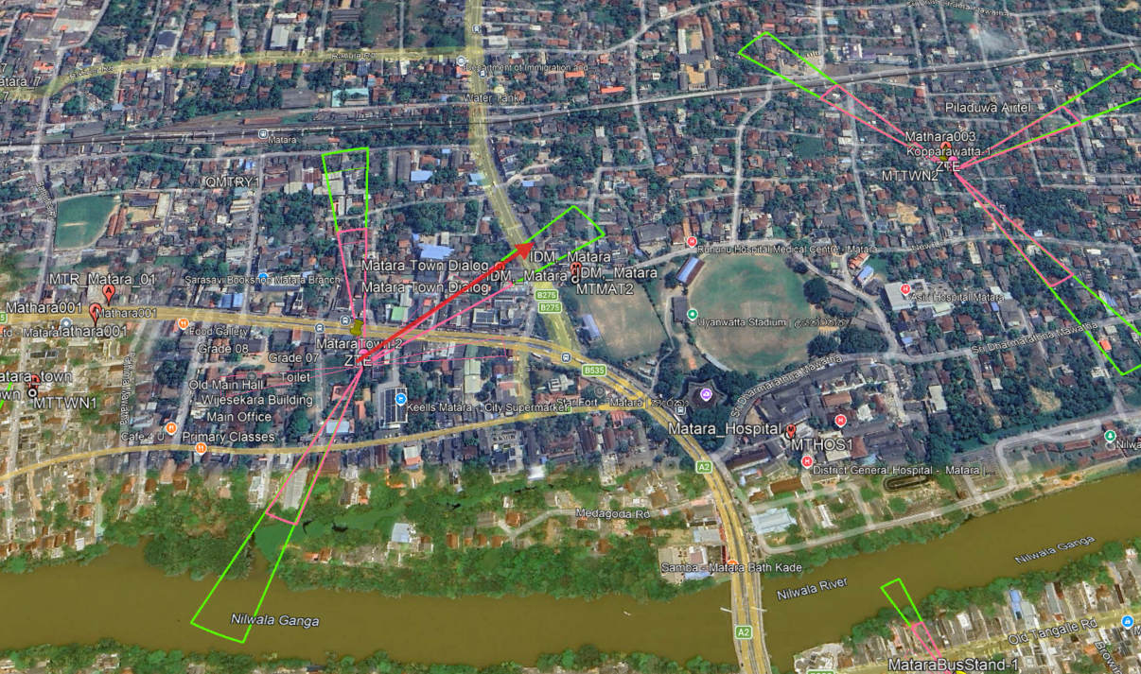
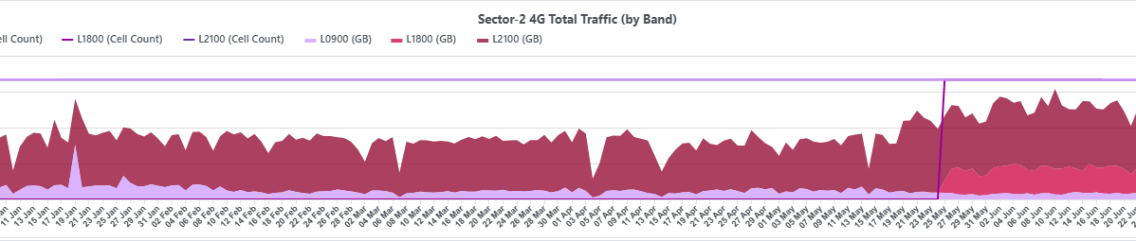
Improvement Initiatives
Upcoming
Kopparawatta-1_1
Kopparawatta-1_2
Kopparawatta-1_3
MataraTown-2_2

Slide 16
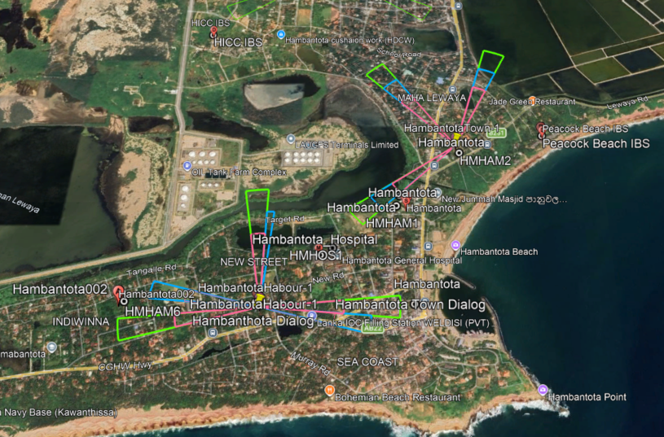
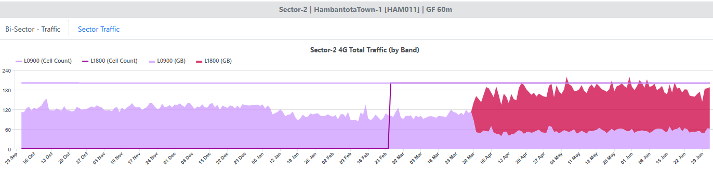
Hambantota Town area improvement
Capacity upgrade
HambantotaTown-1_2 planned -> completed

Slide 17
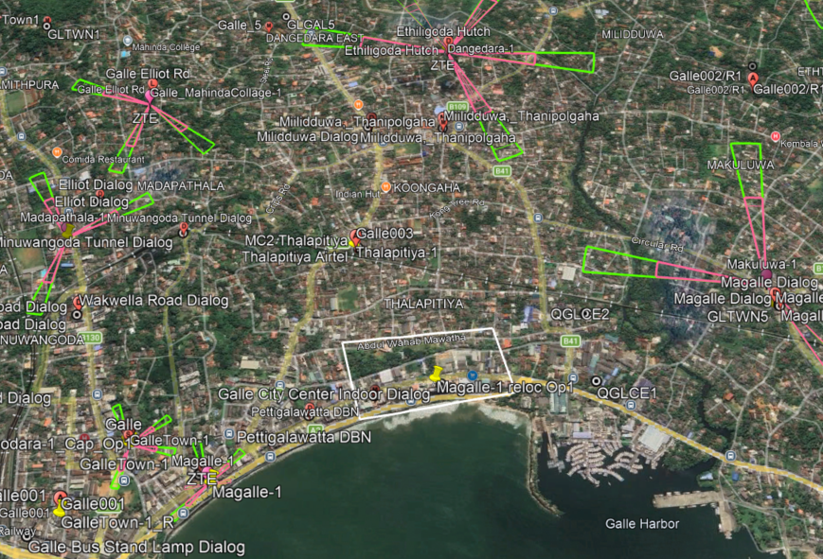
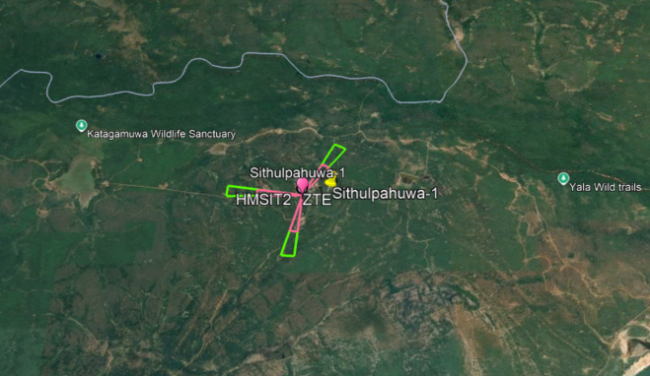
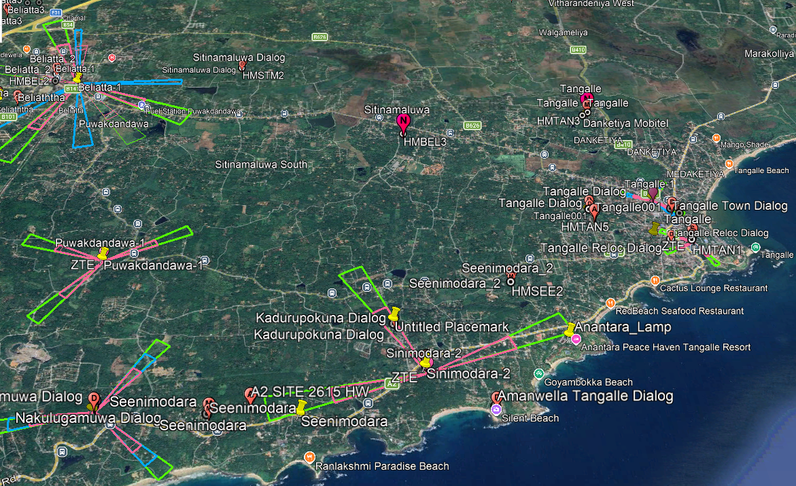
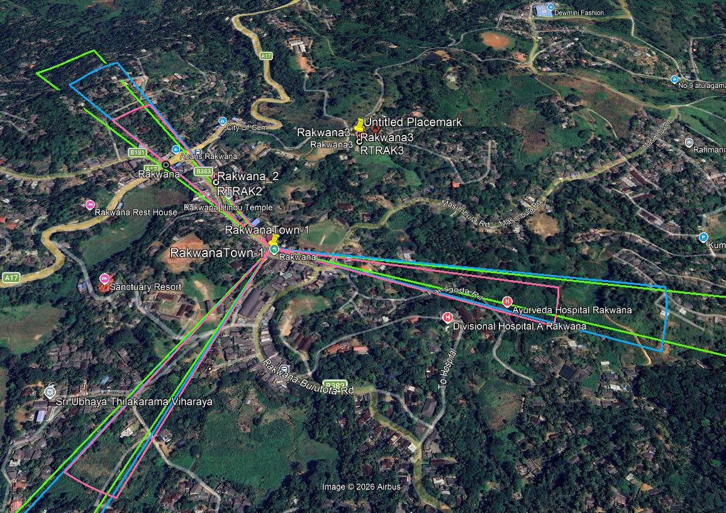
Relocations proceeding
Magalle-1 Relocation
Sithulpahuwa-1 Relocation
Sinimodara-2 Relocation
RakwanaTown-1 Relocation

Slide 18
New sites
District | Site Name | Category
Moneragala | Ulkanda _Handapanagala-1 | Coverage
 | Horabokka-1 | Coverage
Galle | Dorala-1 | Capacity
 | Kathaluwa1 | Capacity
 | KurundugahaHethekma-1 | Coverage
Matara | Denipitiya-3 | Capacity
 | Ellewela-1, | Coverage
 | Ranchagoda-1 | Coverage
Ratnapura | Balangoda-2 (ATP pending) | Coverage
District | Count of Sites
Moneragala | 69->71
Galle | 115->118
Matara | 106->109
Ratnapura | 105->106
Grand Total | 481->490

Slide 19
New sites
Site Name/ Sector name | Site ID | Project | Categorization | Configuration | On Air Date | June Revenue
Horabokka-1 | MON084 | New Site | New site - Coverage | 900 | 5/7/2026 | 187,201
Dorala-1 | GAL143 | New Site | New site - Cluster Improvement | 900/1800/2100 | 5/10/2026 | 137,762
Kathaluwa-1 | GAL144 | New Site | New site - Cluster Improvement | 900/1800/2100 | 3/14/2026 | 138,900
Denipitiya-3 | MAT142 | New Site | New site - Cluster Improvement | 900/1800/2100 | 5/24/2026 | 473,320
Ranchagoda-1 | MAT138 | New Site | New site - Coverage | 900 | 5/27/2026 | 107,624
KurundugahaHethekma-1 | GAL149 | New Site | New site - Coverage | 900 | 5/12/2026 | 311,880

Slide 20

Q & A

Slide 21
Thank You

