Slide 1

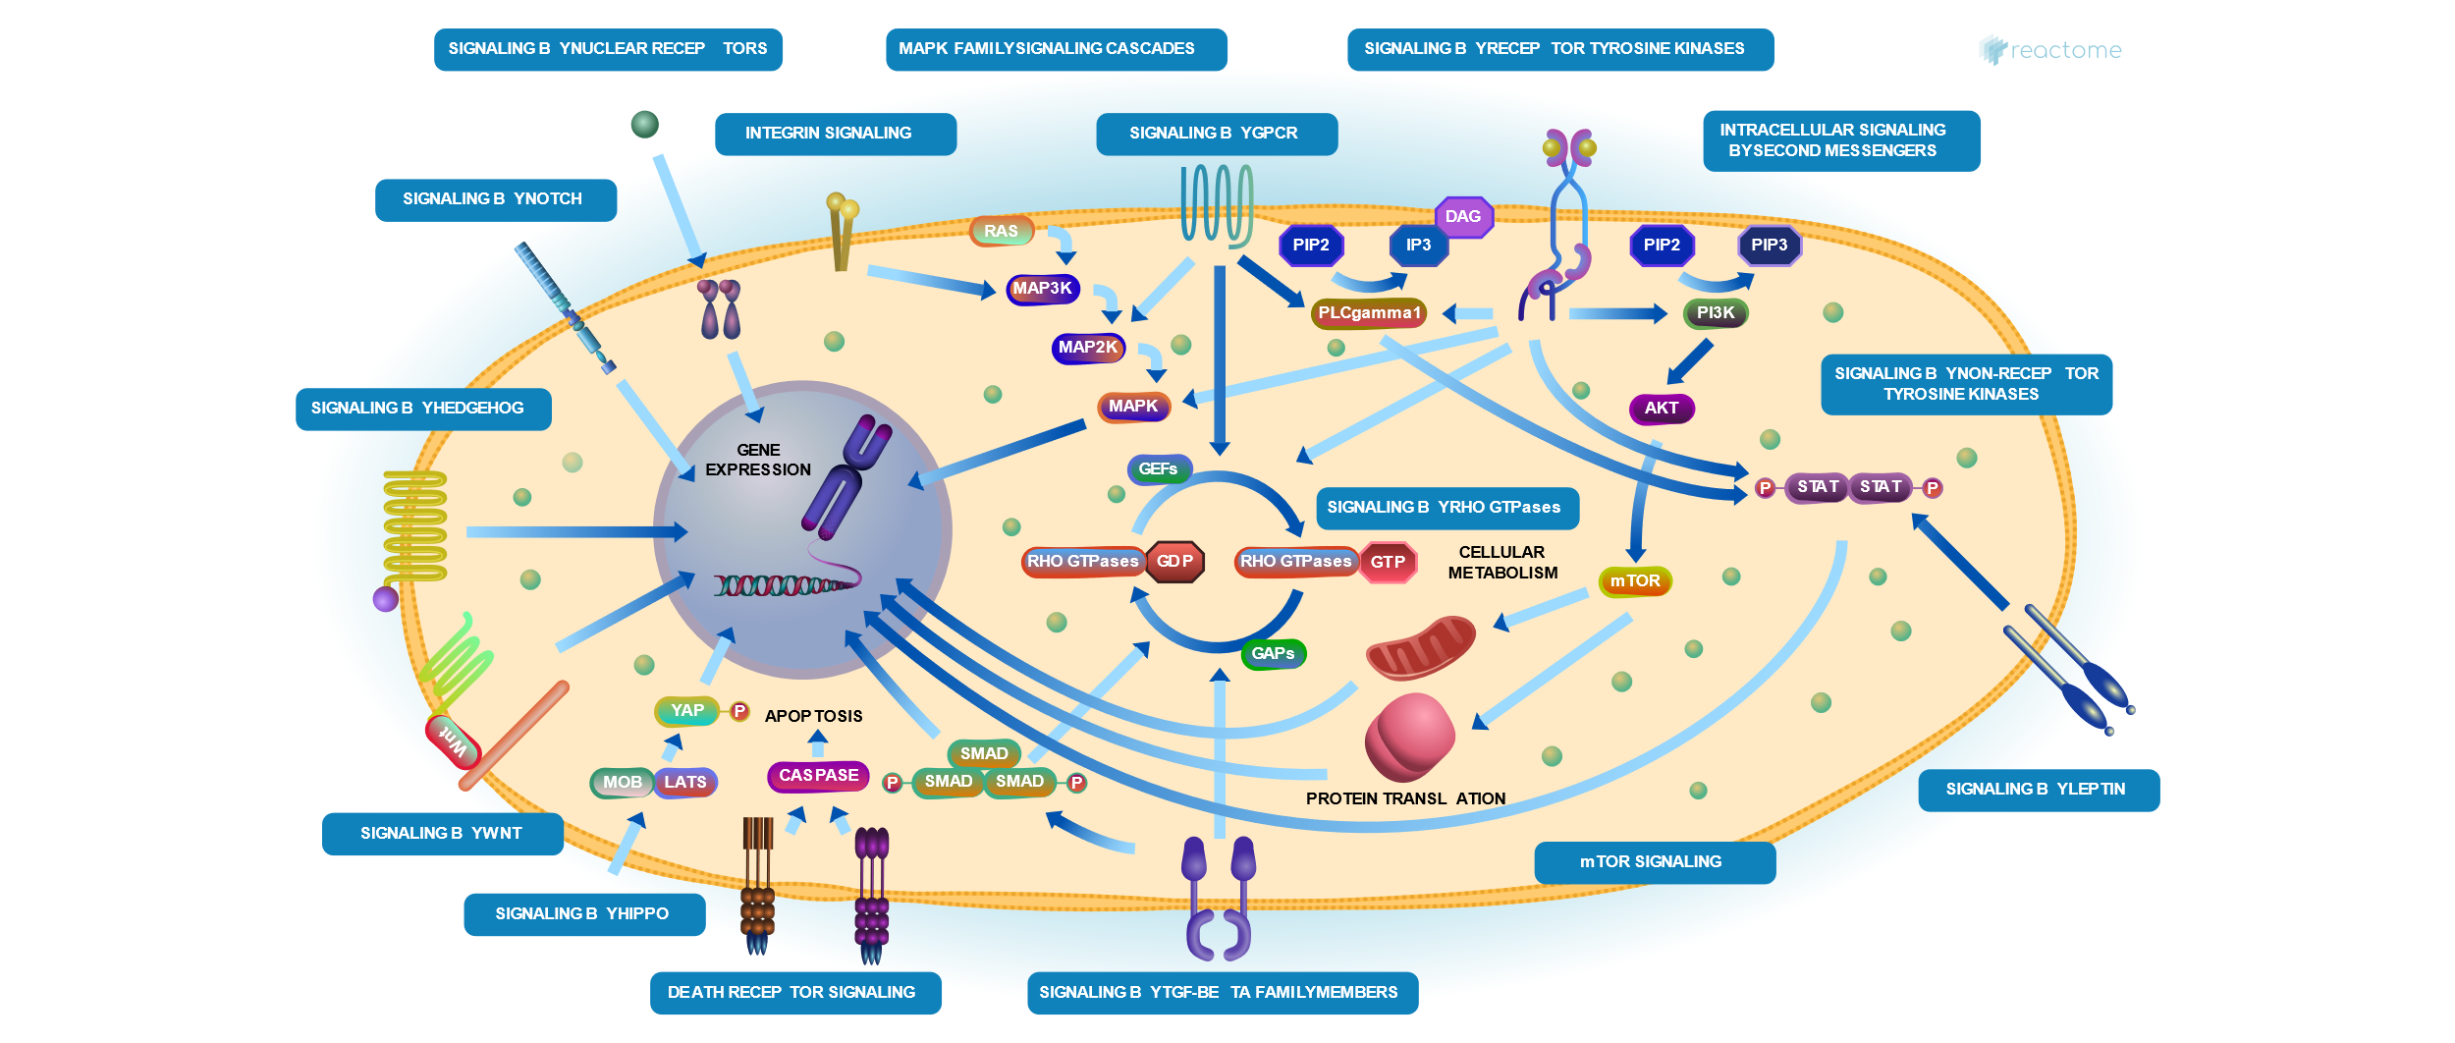
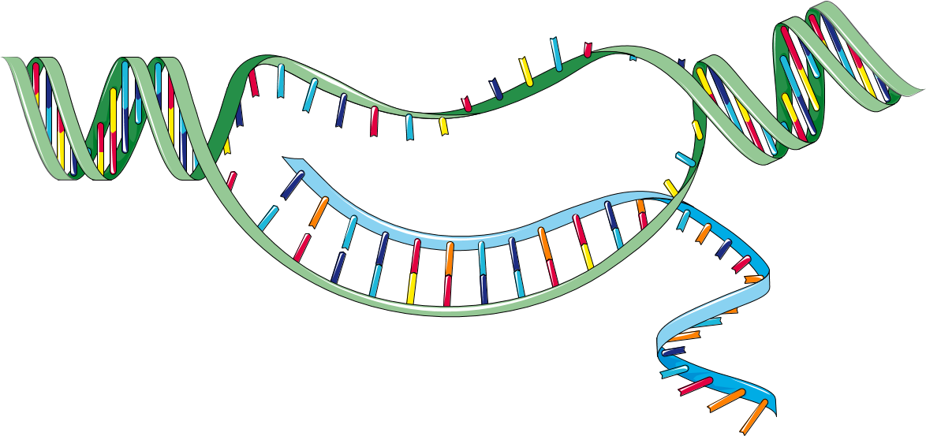
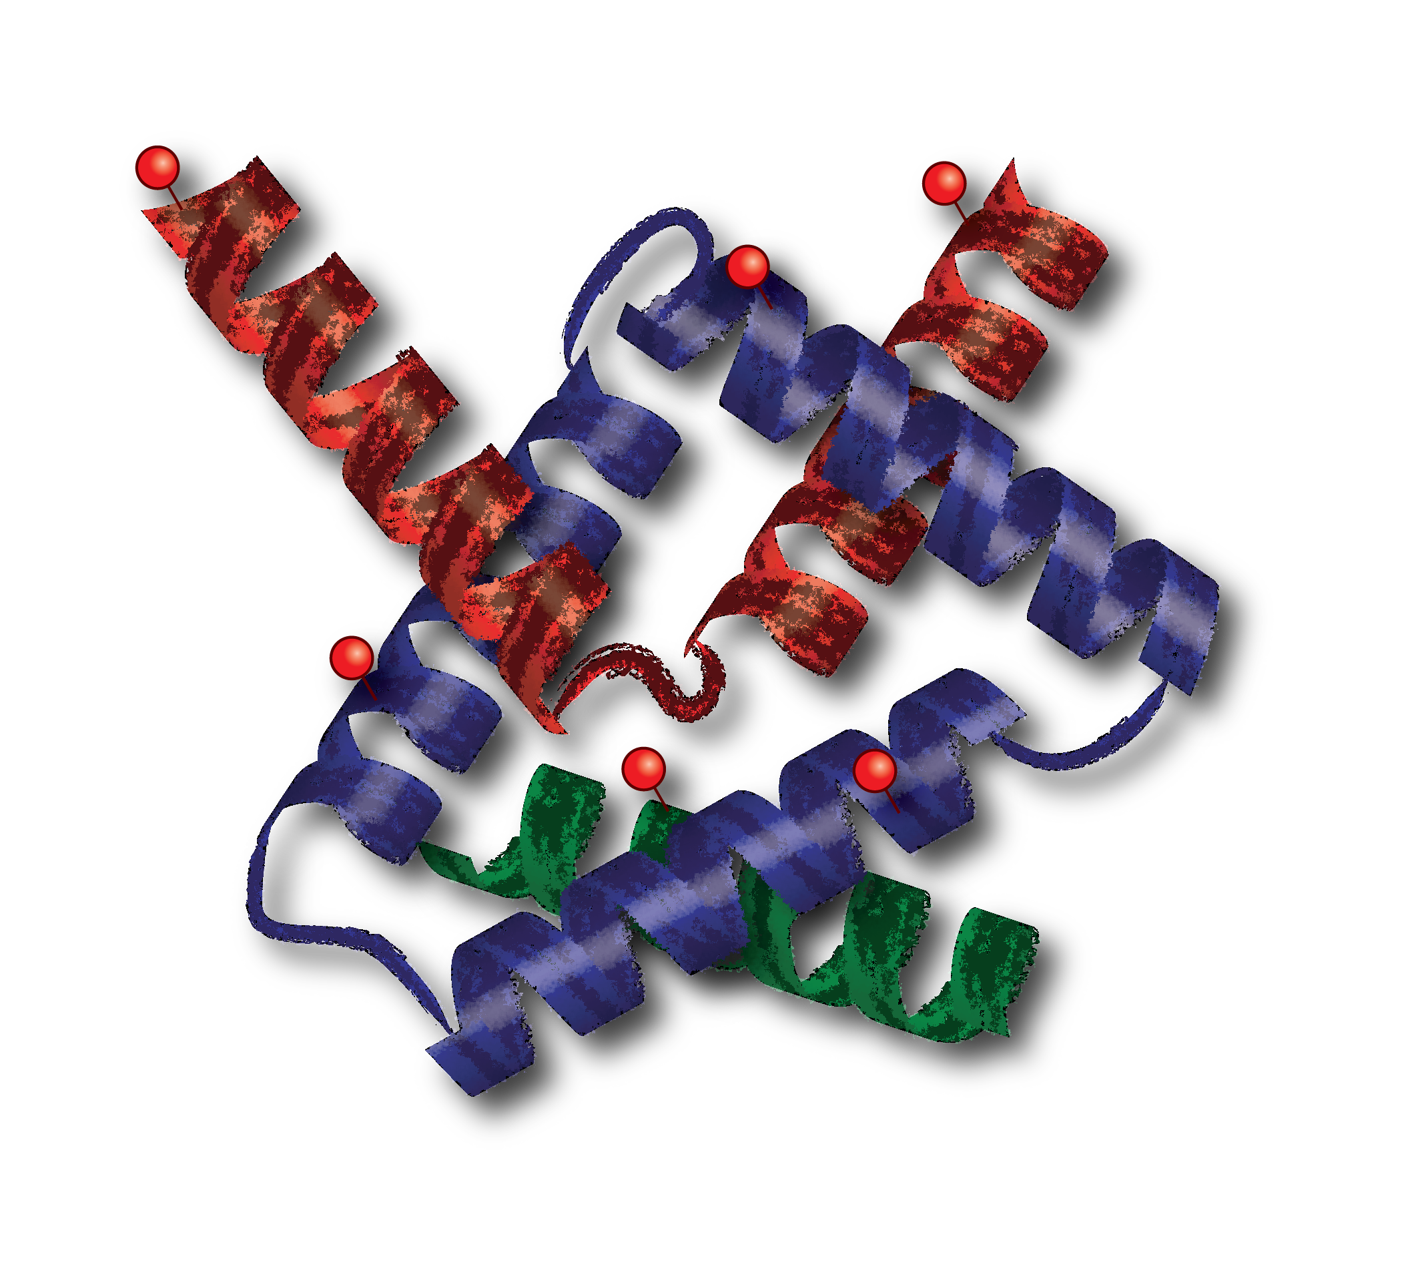
Categories
Pathways
Reactions
Variants
Genes
Proteins
Peptides
PTMs
Proteoforms

