Slide 1

Universidad de Guadalajara Centro Universitario de los Valles BASELINE Subject: Software Configuration Management Teacher: Dr. Omar Ali Zatarain Gurán Author: Patricia Guadalupe Gutiérrez Constantino

Slide 2
PROJECT DESCRIPTION
This project involves creating an app to manage access to a gym. Customers will be able to check in using a fingerprint reader, and the app will show them how many days they have left on their membership. Managers will be able to add, modify or delete customers and their memberships, renew them when necessary, and generate access reports, which can be filtered by customer or by day. It's a handy solution to keep everything organized and automated.

Slide 3
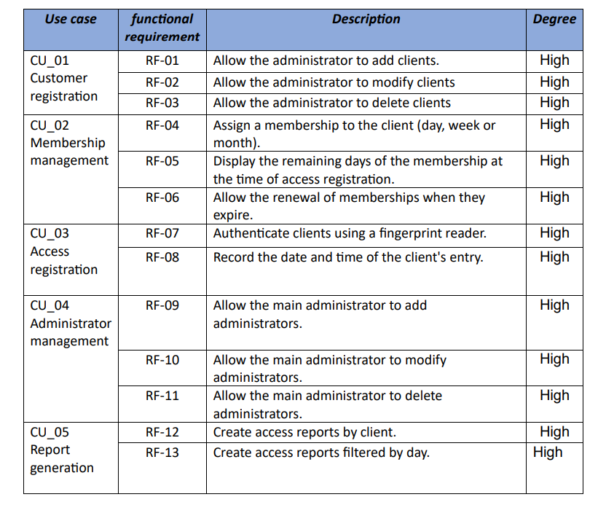
FUNCTIONAL REQUIREMENTS

Slide 4
FUNCTIONAL REQUIREMENTS
RNF_01 Usability:
The interface must be simple and easy to use for both clients and administrators.
RNF_02 Compatibility:
The application must be compatible with fingerprint reading devices.
RNF_03 Security:
The application has different types of users.
Customers' personal and access data must be protected.

Slide 5
limitation
Fingerprint Reader Dependency: Access log functionality depends on proper integration with the fingerprint reader hardware. If the fingerprint reader fails, functionality will be limited.
Initial Scalability: The application is designed for a specific gym, so its ability to handle multiple branches may be limited in its initial release.
Internet Access: If a cloud database or online services is chosen, the system will depend on a stable internet connection for some functionality.
Device Compatibility: The application may not be compatible with all fingerprint reader models.
Hardware Restrictions: System performance may depend on hardware specifications (such as the fingerprint reader or the server where the database is hosted).

Slide 6
limitation
Fingerprint Reader Dependency: Access log functionality depends on proper integration with the fingerprint reader hardware. If the fingerprint reader fails, functionality will be limited.
Initial Scalability: The application is designed for a specific gym, so its ability to handle multiple branches may be limited in its initial release.
Internet Access: If a cloud database or online services is chosen, the system will depend on a stable internet connection for some functionality.
Device Compatibility: The application may not be compatible with all fingerprint reader models.
Hardware Restrictions: System performance may depend on hardware specifications (such as the fingerprint reader or the server where the database is hosted).

Slide 7
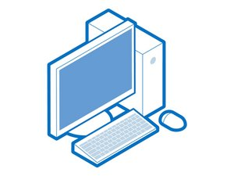




Hardware and software Requirements
Hardware
Pc device
Fingerprint reader
Network connection
Software
Mysql
Java

Slide 8
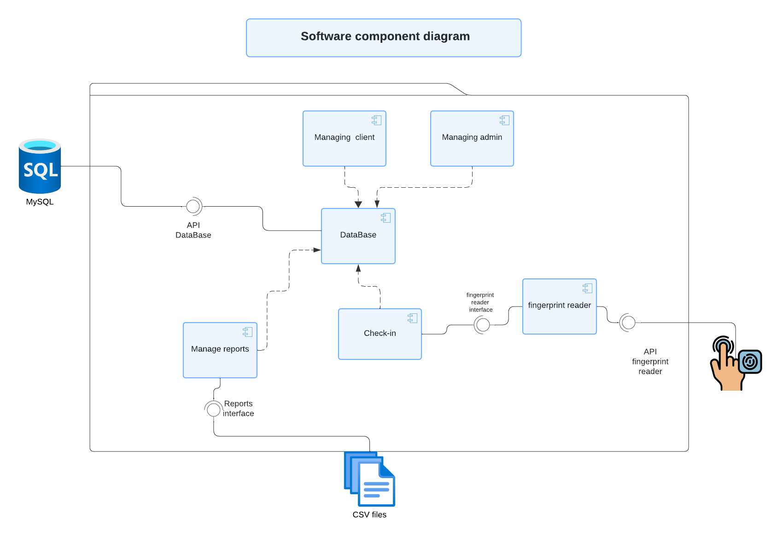
Design

Slide 9
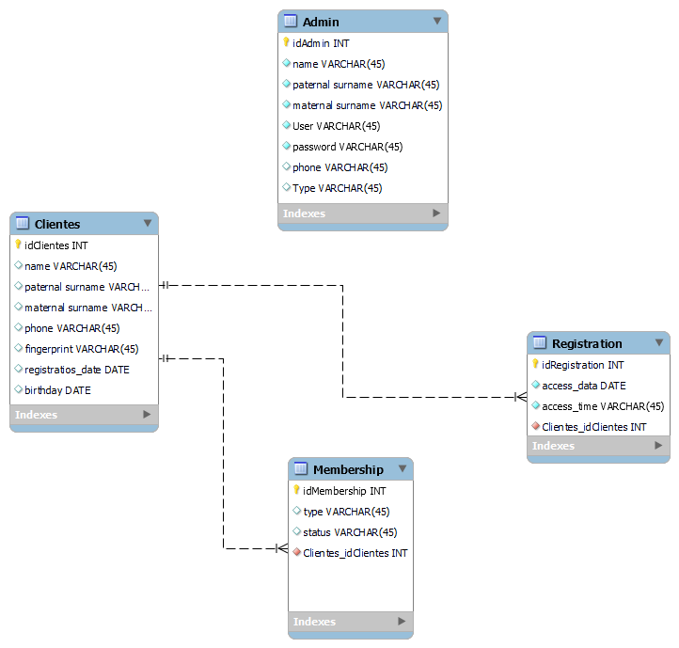
Database diagram

Slide 10
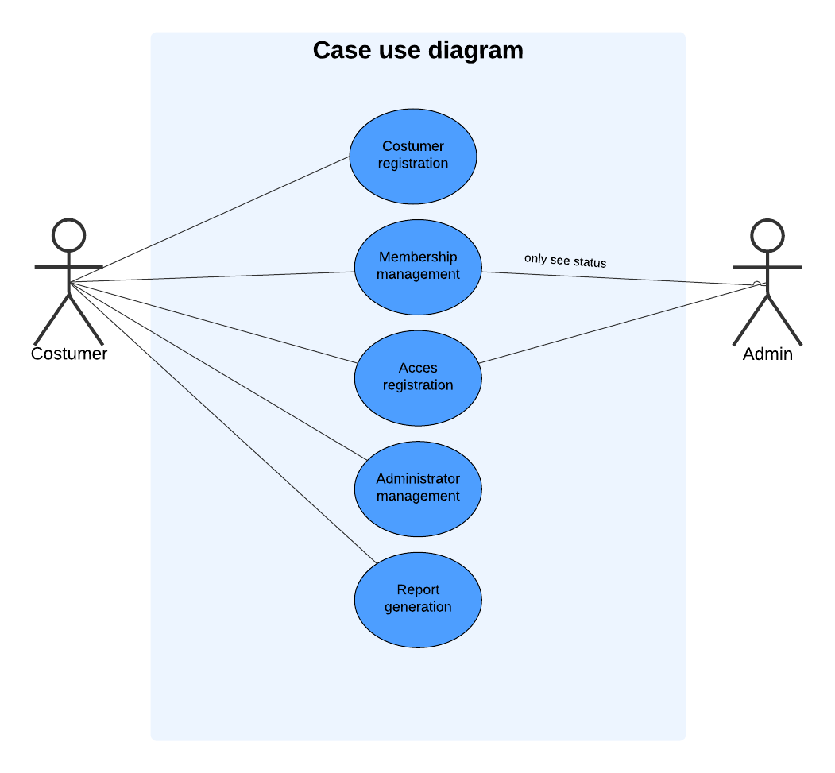
Design

Slide 11
thank you

