Slide 1


P
Y
P
Y
P
$$p_{y}$$
O
X
O
X
$$p_{x}$$
(a)
(b)
(c)

Slide 2
P
P
P
D
D
D
Q
Q
(a)
(b)
(c)

Slide 3








$$u<0$$
P
P
$$p−q=\left[\begin{matrix}p_{x}−q_{x} \\ p_{y}−q_{y}\end{matrix}\right]$$
$$u=0.2$$
$$u=0.5$$
Q
$${\left(p−q\right)}^{⊥}=\left[\begin{matrix}q_{y}−p_{y} \\ p_{x}−q_{x}\end{matrix}\right]$$
Q
X
$$u=0.9$$
$${\left(p−q\right)}^{⊥}⋅x=0$$
$$u>1$$
(a)
(b)

Slide 4












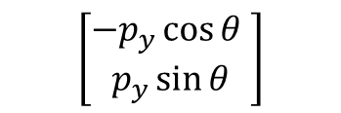
P’
X’
P’
X’
Y
Y
Y’
P
$$θ$$
Y’
P
$${p′}_{y}$$
$$p_{y}$$
$$p_{x}$$
X
X
$${p′}_{x}$$
(a)
(b)
$$x′=\left[\begin{matrix}\sin{θ} \\ \cos{θ}\end{matrix}\right]$$
$$\sin{θ}$$
$$y′=\left[\begin{matrix}−\cos{θ} \\ \sin{θ}\end{matrix}\right]$$
$$\cos{θ}$$
$$\sin{θ}$$
$$−\cos{θ}$$
$$\left[\begin{matrix}p_{x}\sin{θ} \\ p_{x}\cos{θ}\end{matrix}\right]$$
$$\left[\begin{matrix}−p_{y}\cos{θ} \\ p_{y}\sin{θ}\end{matrix}\right]$$
(c)
(d)

Slide 5
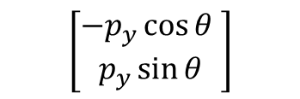

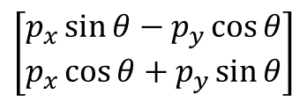
$$\left[\begin{matrix}p_{x}\sin{θ}−p_{y}\cos{θ} \\ p_{x}\cos{θ}+p_{y}\sin{θ}\end{matrix}\right]$$
$$\left[\begin{matrix}p_{x}\sin{θ} \\ p_{x}\cos{θ}\end{matrix}\right]$$
$$\left[\begin{matrix}−p_{y}\cos{θ} \\ p_{y}\sin{θ}\end{matrix}\right]$$
(e)

Slide 6


$$p_{x′}$$
O’
Y
P
$$p_{y′}$$
Y’
X’
O
X

Slide 7


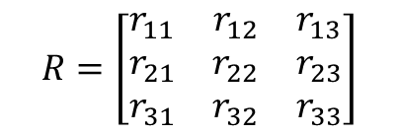

$$R=\left[\begin{matrix}r_{11} & r_{12} & r_{13} \\ r_{21} & r_{22} & r_{23} \\ r_{31} & r_{32} & r_{33}\end{matrix}\right]$$
(0,1,0)
$$(r_{11},r_{21},r_{31})$$
$$(r_{13},r_{23},r_{33})$$
(1,0,0)
$$(r_{12},r_{22},r_{32})$$
(0,0,1)

Slide 8

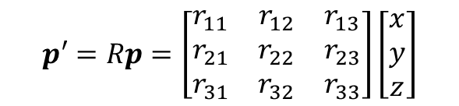
P
P’
$$p′=Rp=\left[\begin{matrix}r_{11} & r_{12} & r_{13} \\ r_{21} & r_{22} & r_{23} \\ r_{31} & r_{32} & r_{33}\end{matrix}\right]\left[\begin{matrix}x \\ y \\ z\end{matrix}\right]$$
$$p=(x,y,z)$$

Slide 9





$$θ$$
$$0$$
$$2π$$
$$0$$
$$2π$$

Slide 10



$$θ_{x}$$
$$θ_{z}$$
$$θ_{y}$$

Slide 11





$$R_{1}$$
$$R_{2}$$
$$R_{1}R_{2}$$
$$∘$$
$$=$$
(about Z)
(about X)
(rotate about X, then
about the original Z)

Slide 12






$$R_{X}(ψ)$$
$$R_{Y}(θ)$$
$$R_{Z}(φ)$$
Z’
X’’
X’’’
X’’’
Z’’’
Z’’’
Extrinsic view
Y’
Z’’
Y’’
Y’’’
Y’’’
X’
Z
Y
$$R_{Z}(φ)$$
$$R_{Y}(θ)$$
$$R_{X}(ψ)$$
Z’
X’’
X’’’
Z’’’
X
Intrinsic view
Z’’
Y’’’
Y’
Y’’
X’

Slide 13


$$θ$$
$$a$$

